Slide 1
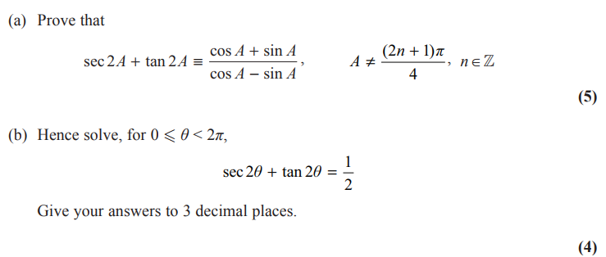
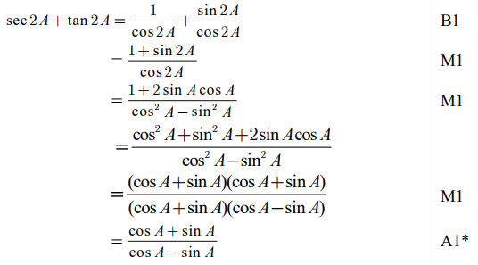
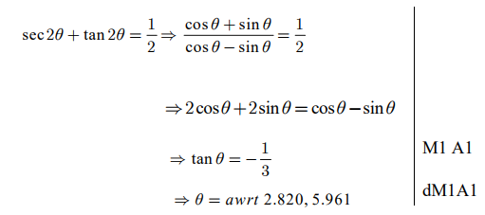
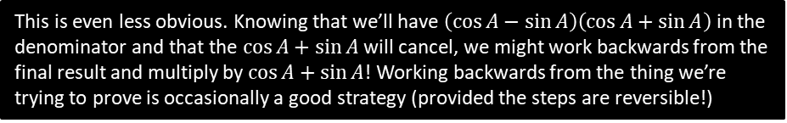
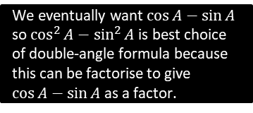
Very Challenging Exam Example
Edexcel C3 June 2015 Q8
We eventually want $\cos{A}−\sin{A}$ so $\cos^{2}{A}−\sin^{2}{A}$ is best choice of double-angle formula because this can be factorise to give $\cos{A}−\sin{A}$ as a factor.
? a
? b
This is even less obvious. Knowing that we’ll have $\left(\cos{A}−\sin{A}\right)\left(\cos{A}+\sin{A}\right)$ in the denominator and that the $\cos{A}+\sin{A}$ will cancel, we might work backwards from the final result and multiply by $\cos{A}+\sin{A}$! Working backwards from the thing we’re trying to prove is occasionally a good strategy (provided the steps are reversible!)

Slide 2
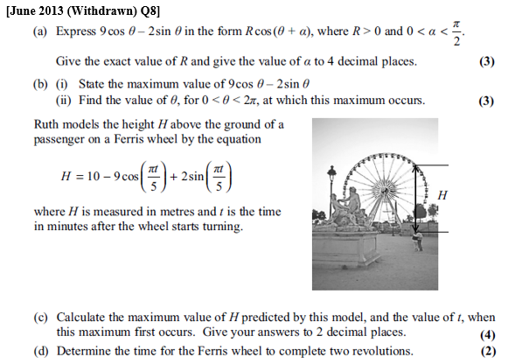
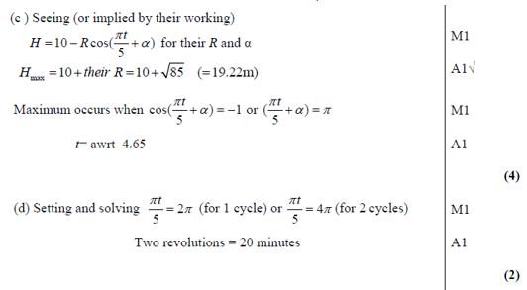
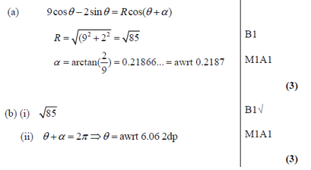
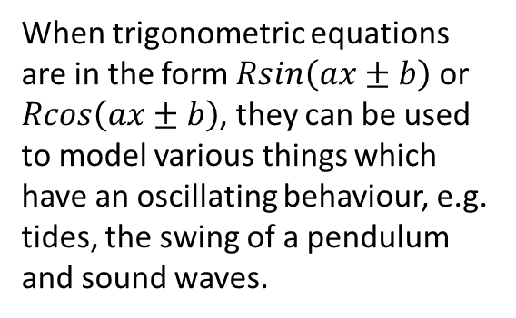
Modelling
When trigonometric equations are in the form $Rsin\left(ax±b\right)$ or $Rcos\left(ax±b\right)$, they can be used to model various things which have an oscillating behaviour, e.g. tides, the swing of a pendulum and sound waves.
? c
? a
? b
? d

Slide 3
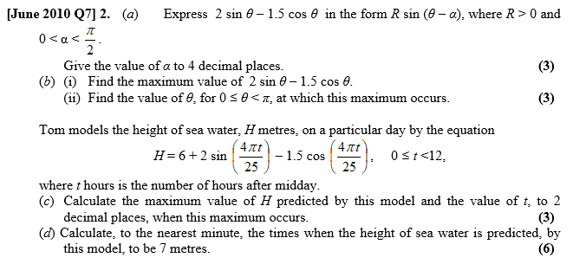
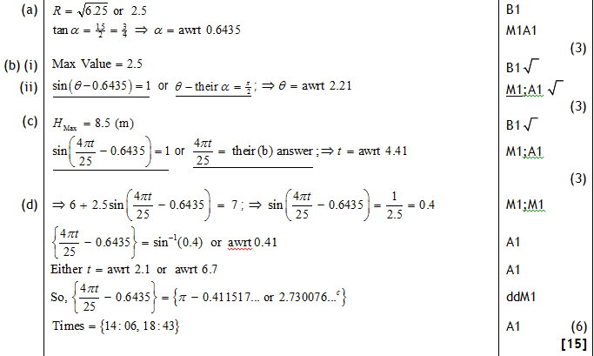
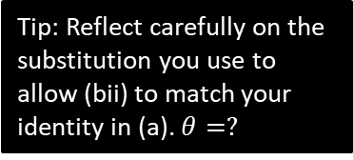
Test Your Understanding
Tip: Reflect carefully on the substitution you use to allow (bii) to match your identity in (a). $θ=?$
? a
? bi
? bii
? c
? d

Slide 4
Exercise 7G
Pearson Pure Mathematics Year 2/AS
Pages 190-191
Complete before the lesson Q1-2
In Class:
Amber Q3-5
Red Q6-7 & Challenge

