Slide 1
Year 2 Applied Mathematics
Normal Distribution
- Normal Cumulative Distribution
Chapter 3 (Part 2)

Slide 2
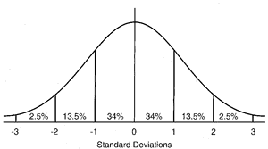

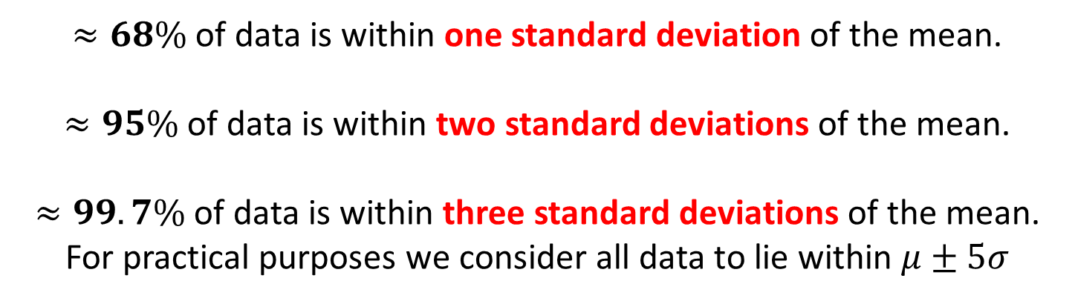
Normal Distribution – 68, 95, 99.7 rule
99.7%
95%
68%
$≈68\%$ of data is within one standard deviation of the mean.
$≈95\%$ of data is within two standard deviations of the mean.
$≈99.7\%$ of data is within three standard deviations of the mean.
For practical purposes we consider all data to lie within $μ±5σ$

Slide 3
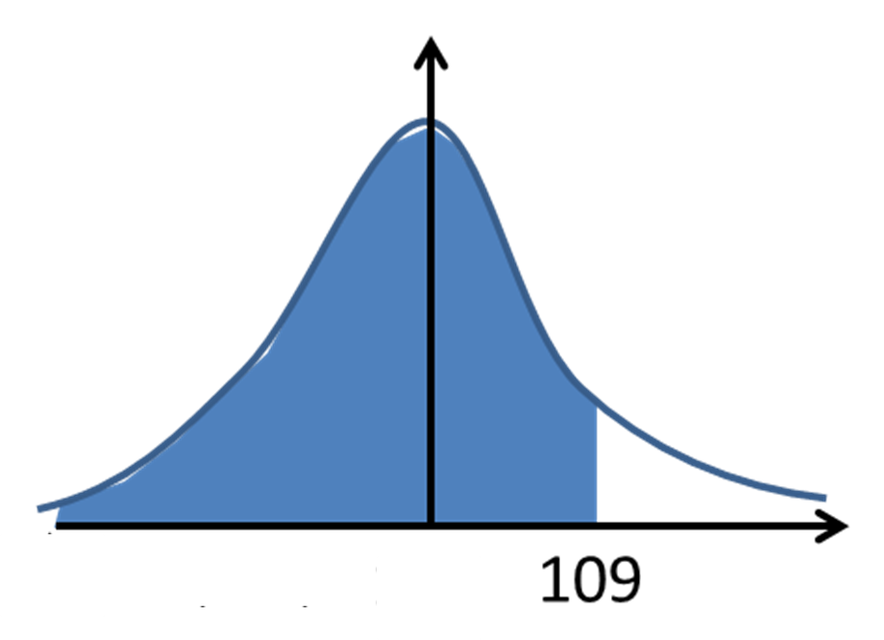
Normal Distribution – Using a Calculator
A cumulative distribution gives the
running total of the probability up to a given value.
P (X < 109) = Blue Area

Slide 4
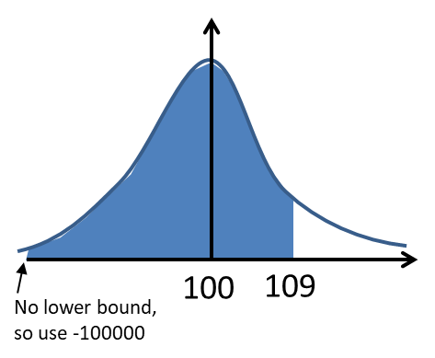

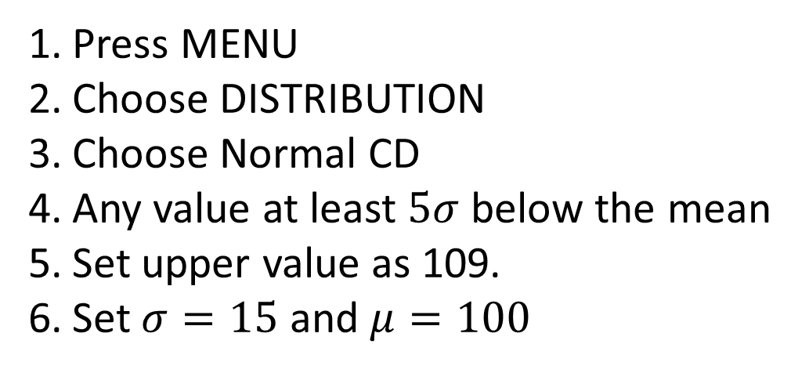
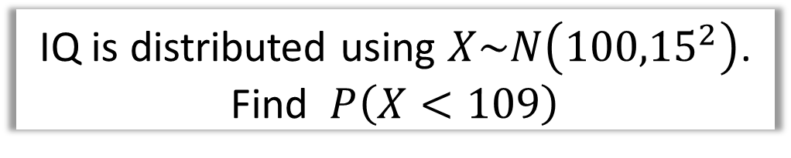

Normal Distribution – Using a Calculator
IQ is distributed using $X\sim N\left({100,15}^{2}\right)$.
Find $P\left(X<109\right)$
Press MENU
Choose DISTRIBUTION
Choose Normal CD
Any value at least $5σ$ below the mean
Set upper value as 109.
Set $σ=15$ and $μ=100$
$$P\left(X<109\right)=0.7257 (4dp)$$

Slide 5
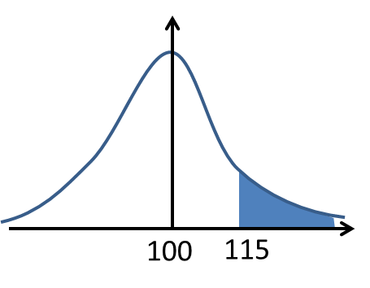
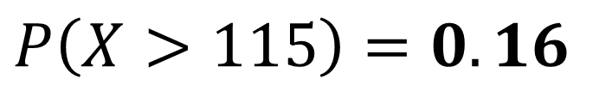
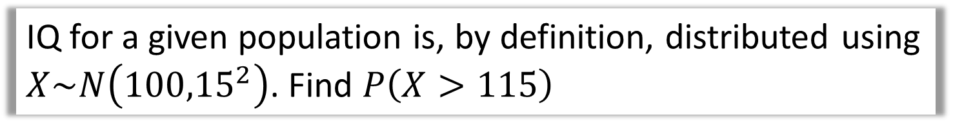
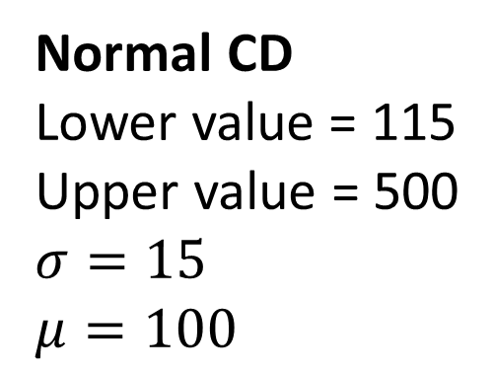
Normal Distribution – Easy Calculations
IQ for a given population is, by definition, distributed using $X\sim N\left({100,15}^{2}\right)$. Find $P\left(X>115\right)$
Normal CD
Lower value = 115
Upper value = 500
$σ=15$
$$μ=100$$
$$P\left(X>115\right)=0.16$$

Slide 6
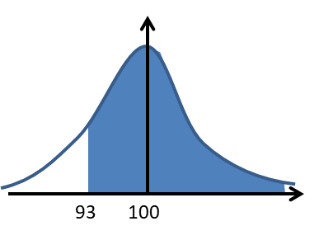
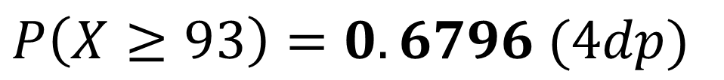
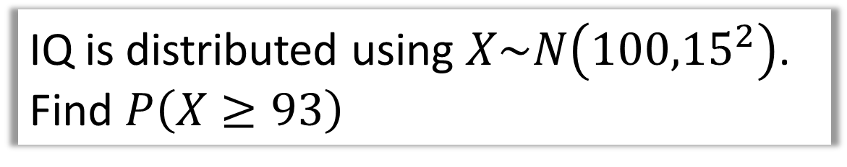
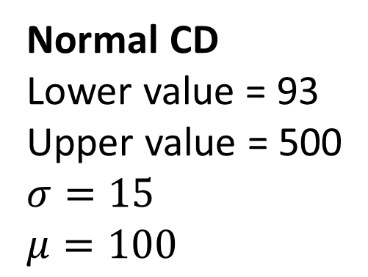
Normal Distribution – Using a Calculator
IQ is distributed using $X\sim N\left({100,15}^{2}\right)$.
Find $P\left(X≥93\right)$
Normal CD
Lower value = 93
Upper value = 500
$σ=15$
$$μ=100$$
$$P\left(X≥93\right)=0.6796 (4dp)$$

Slide 7
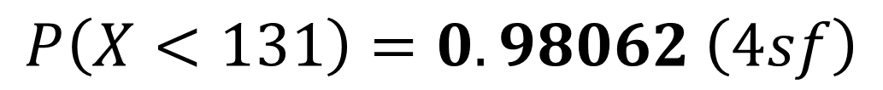
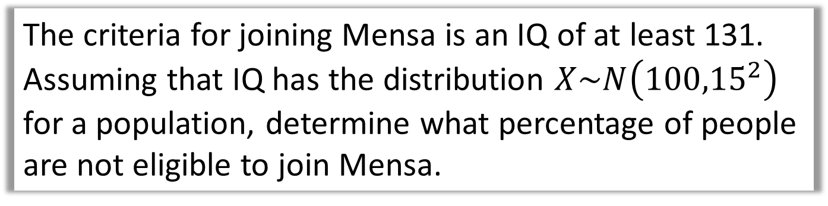
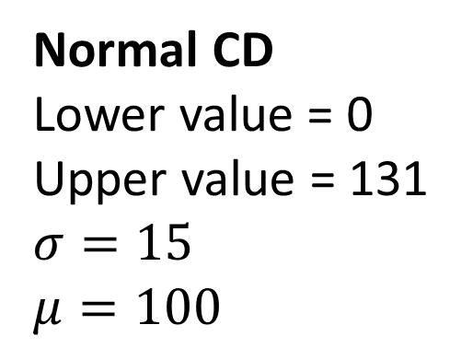
Normal Distribution – Further Questions
The criteria for joining Mensa is an IQ of at least 131.
Assuming that IQ has the distribution $X\sim N\left({100,15}^{2}\right)$
for a population, determine what percentage of people
are not eligible to join Mensa.
Normal CD
Lower value = 0
Upper value = 131
$σ=15$
$$μ=100$$
$$P\left(X<131\right)=0. 98062 \left(4sf\right)$$

Slide 8
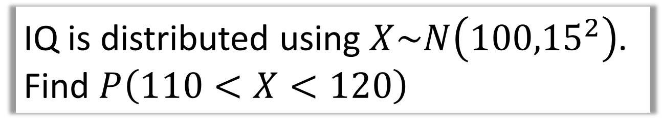
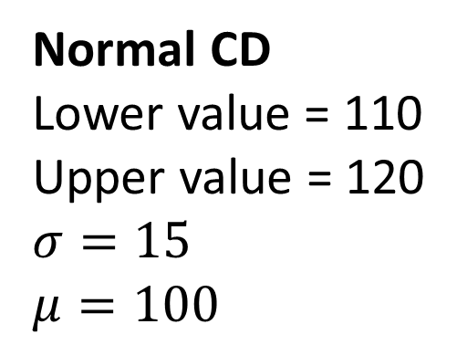
Normal Distribution – Using a Calculator
IQ is distributed using $X\sim N\left({100,15}^{2}\right)$.
Find $P\left(110<X<120\right)$
Normal CD
Lower value = 110
Upper value = 120
$σ=15$
$$μ=100$$
$$P\left(110<X<120\right)=0.1613 (4dp)$$

Slide 9

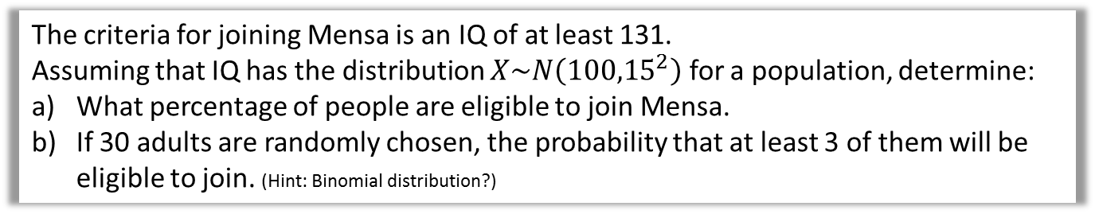
Test Your Understanding
The criteria for joining Mensa is an IQ of at least 131.
Assuming that IQ has the distribution $X\sim N\left({100,15}^{2}\right)$ for a population, determine:
What percentage of people are eligible to join Mensa.
If 30 adults are randomly chosen, the probability that at least 3 of them will be eligible to join. (Hint: Binomial distribution?)
$$P\left(X≥131\right)=0.01938 \left(4sf\right)$$
Let $Y$ be the number of adults among 30 who are eligible to join.
$$Y\sim B(30, 0.0193827)$$
$$P\left(Y≥3\right)=1−P\left(Y≤2\right) \\ =1−0.979986 \\ =0.02001 (4sf)$$
a
?
b
?
Froculator Note: You absolutely can’t use tables in a formula booklet here. You’ll need to use a calculator.

Slide 10
Exercise 3B
Pearson Stats/Mechanics Year 2
Pages 40-41
Complete before the lesson Q1&5
In Class:
Green Q6-7
Amber Q8-9
Red Q10-12

