Slide 1
Year 2 Applied Mathematics
Further Kinematics
- Vectors and Projectiles
Chapter 8
(Part 2 of 4)

Slide 2
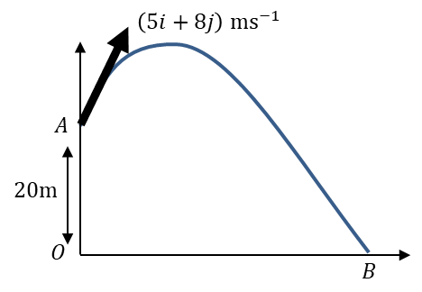
Vectors and projectiles
Using a velocity vector to represent the initial projection (vectors have both direction and magnitude).
Vertical Initial Velocity = 5 ms⁻¹
Horizontal Initial Velocity = 8 ms⁻¹

Slide 3
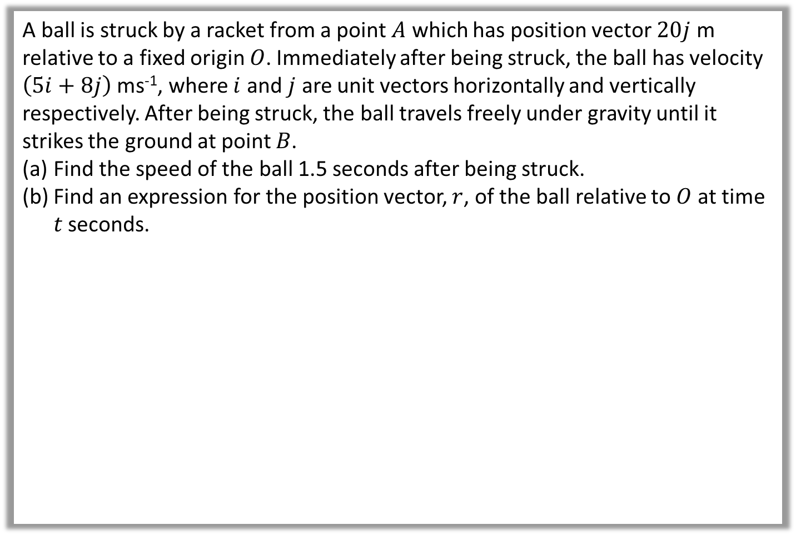
Vectors and projectiles – Example A
A ball is struck by a racket from a point $A$ which has position vector $20j$ m relative to a fixed origin $O$. Immediately after being struck, the ball has velocity $\left(5i+8j\right)$ ms⁻¹, where $i$ and $j$ are unit vectors horizontally and vertically respectively. After being struck, the ball travels freely under gravity until it strikes the ground at point $B$.
Find the speed of the ball 1.5 seconds after being struck.
Find an expression for the position vector, $r$, of the ball relative to $O$ at time $t$ seconds.

Slide 4

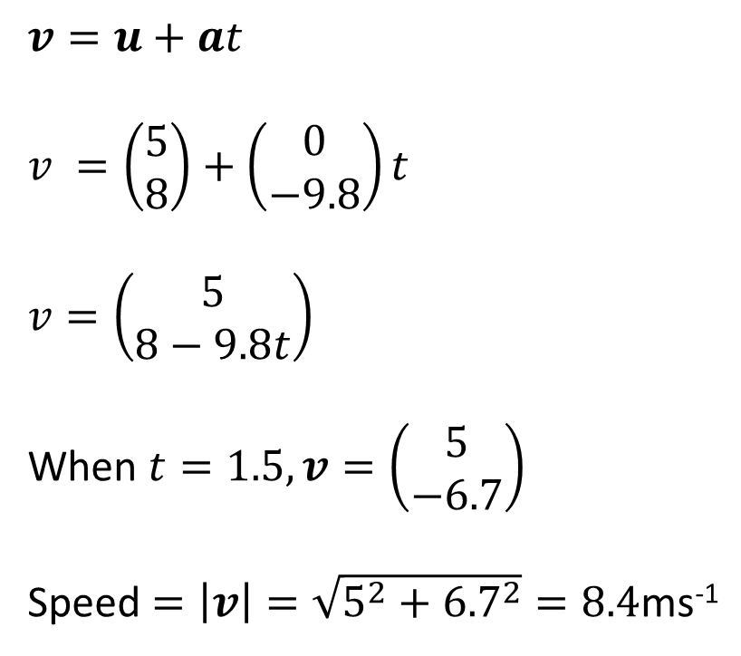
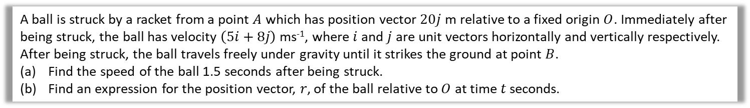
Vectors and projectiles – Example A
A ball is struck by a racket from a point $A$ which has position vector $20j$ m relative to a fixed origin $O$. Immediately after being struck, the ball has velocity $\left(5i+8j\right)$ ms⁻¹, where $i$ and $j$ are unit vectors horizontally and vertically respectively. After being struck, the ball travels freely under gravity until it strikes the ground at point $B$.
Find the speed of the ball 1.5 seconds after being struck.
Find an expression for the position vector, $r$, of the ball relative to $O$ at time $t$ seconds.
a
$$v=u+at$$
$$v =\left(\begin{matrix}5 \\ 8\end{matrix}\right)+\left(\begin{matrix}0 \\ −9.8\end{matrix}\right)t$$
$$v=\left(\begin{matrix}5 \\ 8−9.8t\end{matrix}\right)$$
When $t=1.5, v=\left(\begin{matrix}5 \\ −6.7\end{matrix}\right)$
Speed $=\left|v\right|=\sqrt{5^{2}+{6.7}^{2}}=8.4$ms⁻¹

Slide 5
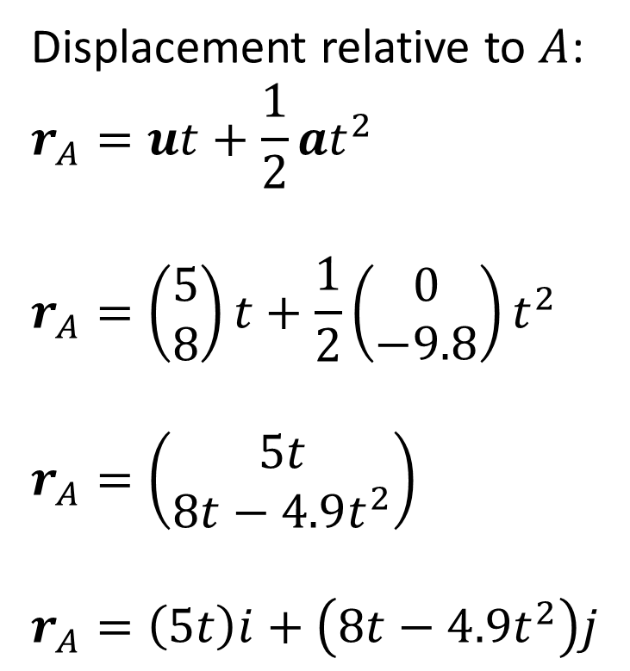
Vectors and projectiles – Example A
A ball is struck by a racket from a point $A$ which has position vector $20j$ m relative to a fixed origin $O$. Immediately after being struck, the ball has velocity $\left(5i+8j\right)$ ms⁻¹, where $i$ and $j$ are unit vectors horizontally and vertically respectively. After being struck, the ball travels freely under gravity until it strikes the ground at point $B$.
Find the speed of the ball 1.5 seconds after being struck.
Find an expression for the position vector, $r$, of the ball relative to $O$ at time $t$ seconds.
Displacement relative to $A$:
$$r_{A}=ut+\frac{1}{2}at^{2}$$
$$r_{A}=\left(\begin{matrix}5 \\ 8\end{matrix}\right)t+\frac{1}{2}\left(\begin{matrix}0 \\ −9.8\end{matrix}\right)t^{2}$$
$$r_{A}=\left(\begin{matrix}5t \\ 8t−4.9t^{2}\end{matrix}\right)$$
$$r_{A}=\left(5t\right)i+\left(8t−4.9t^{2}\right)j$$
b

Slide 6
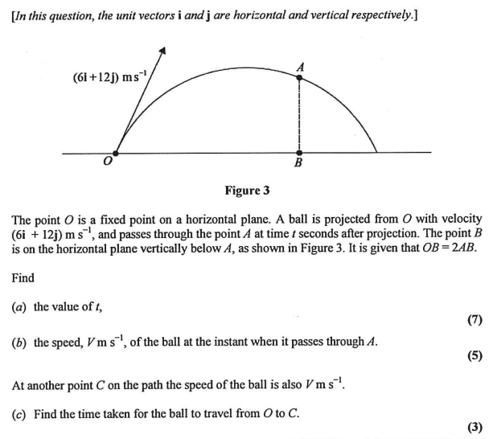
Vectors and projectiles – Exam Questions

Slide 7
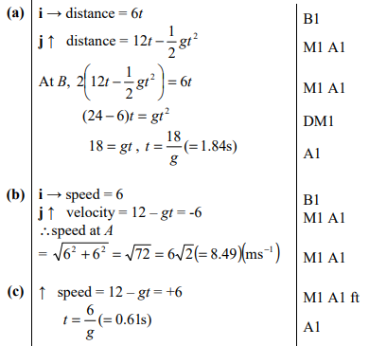
Vectors and projectiles – Exam Questions

Slide 8
Exercise 8B
Pearson Stats/Mechanics Year 2
Pages 166-167
Complete before the lesson Q1-2
In Class:
Amber Q3-4
Red Q5-6

