Slide 1

P2 Chapter 12 :: Vectors
jfrost@tiffin.kingston.sch.uk
www.drfrostmaths.com
@DrFrostMaths
Last modified: 6th September 2018

Slide 2








www.drfrostmaths.com
Everything is completely free.
Why not register?
Register now to interactively practise questions on this topic, including past paper questions and extension questions (including MAT + UKMT).
Teachers: you can create student accounts (or students can register themselves), to set work, monitor progress and even create worksheets.
With questions by:
Dashboard with points, trophies, notifications and student progress.
Questions organised by topic, difficulty and past paper.
Teaching videos with topic tests to check understanding.

Slide 3


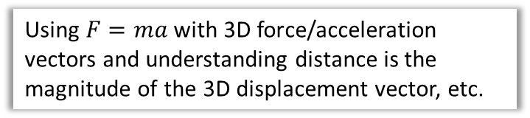

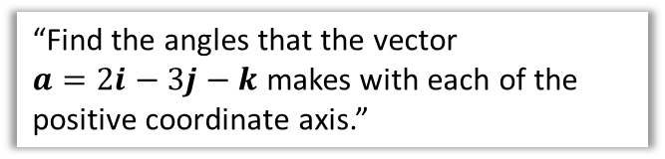
Chapter Overview
This chapter is not hugely long, nor intended to be demanding (relatively speaking!). It’s a reminder of how 3D coordinates work (which you may have encountered at GCSE), and extends some of the results you learned in Year 1 vectors from 2D to 3D.
1:: Distance between two points.
2:: $i,j,k$ notation for vectors
What’s the distance between $(1,0,4)$ and $(−3,5,9)$?
$$\left(\begin{matrix}1 \\ −2 \\ 5\end{matrix}\right) → i−2j+5k$$
3:: Magnitude of a 3D vector and using it to find angle between vector and a coordinate axis.
4:: Solving Geometric Problems
Same as Year 1 but with 3D vectors.
“Find the angles that the vector
$a=2i−3j−k$ makes with each of the positive coordinate axis.”
5:: Application to Mechanics
Using $F=ma$ with 3D force/acceleration vectors and understanding distance is the magnitude of the 3D displacement vector, etc.
Note for teachers: All the harder vectors content from C4 has been moved to Further Maths, i.e. no vector equations of straight lines nor dot product nor angles between vectors (except with a coordinate axis).

Slide 4



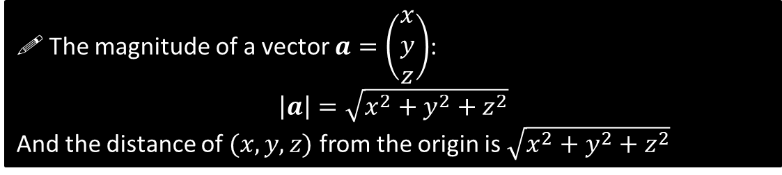


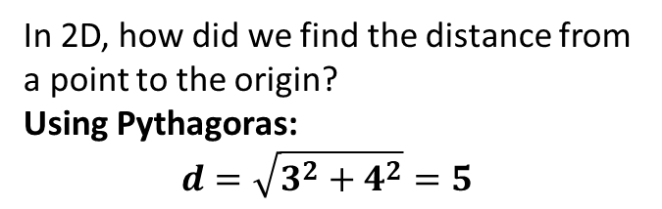



Distance from the origin and magnitude of a vector
$$y$$
In 2D, how did we find the distance from a point to the origin?
Using Pythagoras:
$$d=\sqrt{3^{2}+4^{2}}=5$$
$$\left(3,4\right)$$
?
$$d$$
4
$$x$$
How about in 3D then?
You may be familiar with this method from GCSE. Using Pythagoras on the base of the cuboid:
$$\sqrt{3^{2}+4^{2}}=5$$
Then using the highlighted triangle:
$$\sqrt{5^{2}+12^{2}}=13$$
We could have similarly done this is one go using:
$$\sqrt{3^{2}+4^{2}+12^{2}}=13$$
$$z$$
3
?
$$y$$
$$\left(3,4,12\right)$$
$$x$$
From Year 1 you will be familiar with the magnitude $|a|$ of a vector $a$ being its length. We can see from above that this nicely extends to 3D:
! The magnitude of a vector $a=\left(\begin{matrix}x \\ y \\ z\end{matrix}\right)$:
$$\left|a\right|=\sqrt{x^{2}+y^{2}+z^{2}}$$
And the distance of $(x,y,z)$ from the origin is $\sqrt{x^{2}+y^{2}+z^{2}}$

Slide 5
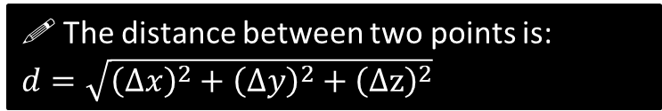







Distance between two 3D points
$$z$$
How do we find the distance between $P$ and $Q$?
It’s just the magnitude/length of the vector between them.
i.e.
$$\left|\vec{PQ}\right|=\left|\left(\begin{matrix}1 \\ −5 \\ −5\end{matrix}\right)\right| \\ =\sqrt{1^{2}+{\left(−5\right)}^{2}+{\left(−5\right)}^{2}}=\sqrt{51}$$
?
$$y$$
$$P\left(3,4,12\right)$$
$$x$$
$$Q\left(4,−1,7\right)$$
! The distance between two points is:
$d=\sqrt{{\left(Δx\right)}^{2}+{\left(Δy\right)}^{2}+{\left(Δz\right)}^{2}}$
$Δx$ means “change in $x$”
Quickfire Questions:
Distance between $(0,4,3)$ and $\left(5,2,3\right).$
$$d=\sqrt{5^{2}+{\left(−2\right)}^{2}+0^{2}}=\sqrt{29}$$
Distance between $(1,1,1)$ and $\left(2,1,0\right).$
$$d=\sqrt{1^{2}+0^{2}+1^{2}}=\sqrt{2}$$
Distance between $(−5,2,0)$ and $\left(−2,−3,−3\right).$
$$d=\sqrt{3^{2}+5^{2}+3^{2}}=\sqrt{43}$$
Fro Tip: Because we’re squaring, it doesn’t matter whether the change is negative or positive.
Distance of $(4,0,−2)$ from the origin:
$$\sqrt{4^{2}+0^{2}+{\left(−2\right)}^{2}}=\sqrt{20}$$
$$\left|\left(\begin{matrix}5 \\ 4 \\ −1\end{matrix}\right)\right|=\sqrt{5^{2}+4^{2}+{\left(−1\right)}^{2}}=\sqrt{42}$$
?
?
?
?
?

Slide 6


Test Your Understanding So Far…
[Textbook] Find the distance from the origin to the point $P(7,7,7)$.
?
$$\sqrt{7^{2}+7^{2}+7^{2}}=7\sqrt{3}$$
[Textbook] The coordinates of $A$ and $B$ are $(5,3,−8)$ and $\left(1,k,−3\right)$ respectively. Given that the distance from $A$ to $B$ is $3\sqrt{10}$ units, find the possible values of $k$.
?
$$\sqrt{4^{2}+{\left(k−3\right)}^{2}+5^{2}}=3\sqrt{10} \\ \sqrt{k^{2}−6k+50}=3\sqrt{10} \\ k^{2}−6k+50=90 \\ k^{2}−6k−40=0 \\ \left(k+4\right)\left(k−10\right)=0 \\ k=−4 or k=10$$

Slide 7

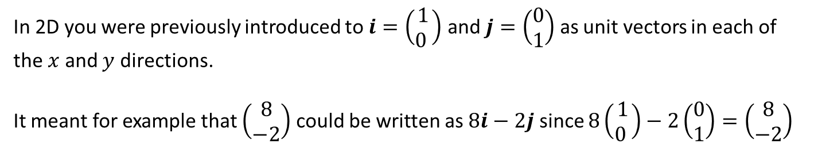

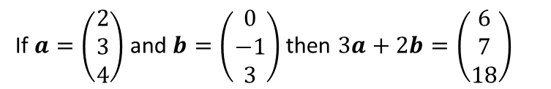

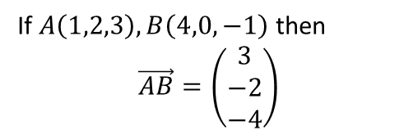




$i$, $j$ and $k$ notation
In 2D you were previously introduced to $i=\left(\begin{matrix}1 \\ 0 \end{matrix}\right)$ and $j=\left(\begin{matrix}0 \\ 1\end{matrix}\right)$ as unit vectors in each of the $x$ and $y$ directions.
It meant for example that $\left(\begin{matrix}8 \\ −2\end{matrix}\right)$ could be written as $8i−2j$ since $8\left(\begin{matrix}1 \\ 0 \end{matrix}\right)−2\left(\begin{matrix}0 \\ 1\end{matrix}\right)=\left(\begin{matrix}8 \\ −2\end{matrix}\right)$
Unsurprisingly, in 3D:
$$i=\left(\begin{matrix}1 \\ 0 \\ 0\end{matrix}\right), j=\left(\begin{matrix}0 \\ 1 \\ 0\end{matrix}\right), k=\left(\begin{matrix}0 \\ 0 \\ 1\end{matrix}\right)$$
Quickfire Questions
2
Write as a column vector:
?
$$i−j=\left(\begin{matrix}1 \\ −1 \\ 0\end{matrix}\right)$$
$$4j+k=\left(\begin{matrix}0 \\ 4 \\ 1\end{matrix}\right)$$
?
1
Put in $i,j,k$ notation:
$$\left(\begin{matrix}1 \\ 2 \\ 3\end{matrix}\right)=i+2j+3k$$
?
3
If $A\left(1,2,3\right), B\left(4,0,−1\right)$ then
$$\vec{AB}=\left(\begin{matrix}3 \\ −2 \\ −4\end{matrix}\right)$$
$$\left(\begin{matrix}−7 \\ 3 \\ 0\end{matrix}\right)=−7i+3j$$
?
?
$$\left(\begin{matrix}3 \\ 0 \\ −1\end{matrix}\right)=3i−k$$
?
If $a=\left(\begin{matrix}2 \\ 3 \\ 4\end{matrix}\right)$ and $b=\left(\begin{matrix}0 \\ −1 \\ 3\end{matrix}\right)$ then $3a+2b=\left(\begin{matrix}6 \\ 7 \\ 18\end{matrix}\right)$
?
4

Slide 8
Exercise 12A
Pearson Pure Mathematics Year 2/AS
Pages 338-340
Complete before the lesson Q1-3
In Class:
Green Q4
Amber Q5
Red Challenge

Slide 9
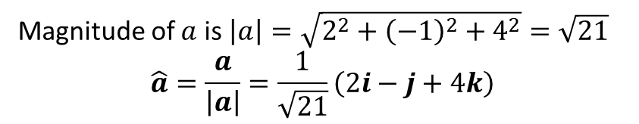
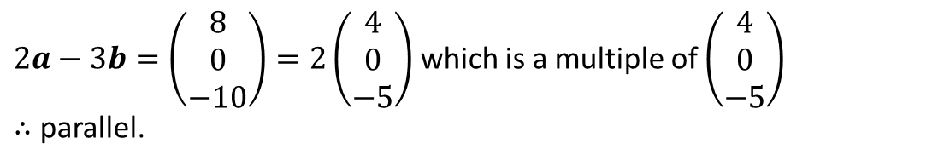
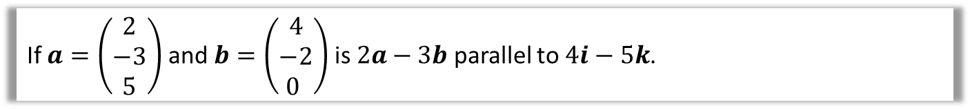
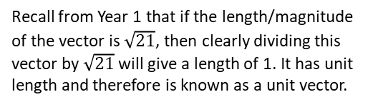
Examples
Find the magnitude of $a=2i−j+4k$ and hence find $\hat{a}$, the unit vector in the direction of $a$.
?
Magnitude of $a$ is $\left|a\right|=\sqrt{2^{2}+{\left(−1\right)}^{2}+4^{2}}=\sqrt{21}$
$$\hat{a}=\frac{a}{\left|a\right|}=\frac{1}{\sqrt{21}}\left(2i−j+4k\right)$$
Recall from Year 1 that if the length/magnitude of the vector is $\sqrt{21}$, then clearly dividing this vector by $\sqrt{21}$ will give a length of 1. It has unit length and therefore is known as a unit vector.
If $a=\left(\begin{matrix}2 \\ −3 \\ 5\end{matrix}\right)$ and $b=\left(\begin{matrix}4 \\ −2 \\ 0 \end{matrix}\right)$ is $2a−3b$ parallel to $4i−5k$.
?
$2a−3b=\left(\begin{matrix}8 \\ 0 \\ −10\end{matrix}\right)=2\left(\begin{matrix}4 \\ 0 \\ −5\end{matrix}\right)$ which is a multiple of $\left(\begin{matrix}4 \\ 0 \\ −5\end{matrix}\right)$
$∴$ parallel.

Slide 10






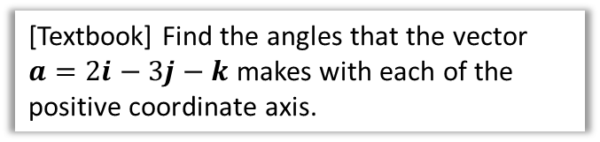
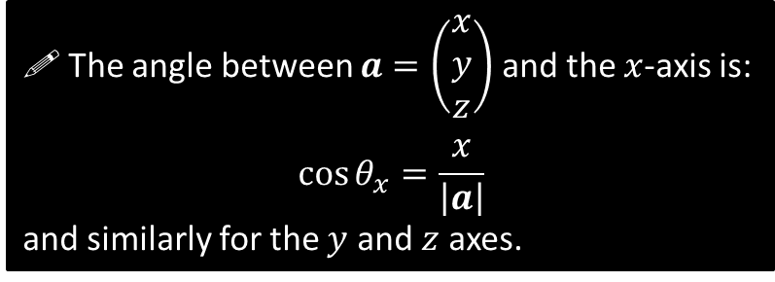
Angles between vectors and an axis
$$z$$
How could you work out the angle between a vector and the $x$-axis?
Just form a right-angle triangle!
$$y$$
?
$$a$$
The angle between $a=\left(\begin{matrix}x \\ y \\ z\end{matrix}\right)$ and the $x$-axis is:
$$\cos{θ_{x}}=\frac{x}{\left|a\right|}$$
and similarly for the $y$ and $z$ axes.
$$θ_{x}$$
$$x$$
$$x$$
[Textbook] Find the angles that the vector $a=2i−3j−k$ makes with each of the positive coordinate axis.
?
$$\left|a\right|=\sqrt{2^{2}+{\left(−3\right)}^{2}+{\left(−1\right)}^{2}}=\sqrt{14} \\ \cos{θ_{x}}=\frac{2}{\sqrt{14}} → θ_{x}=57.7° \\ \cos{θ_{y}}=\frac{−3}{\sqrt{14}} → θ_{y}=143.3° \\ \cos{θ_{z}}=\frac{−1}{\sqrt{14}} → θ_{z}=105.5°$$

Slide 11

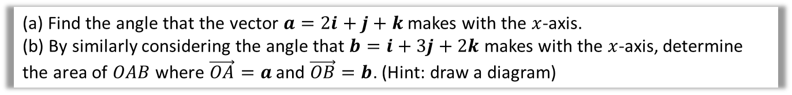




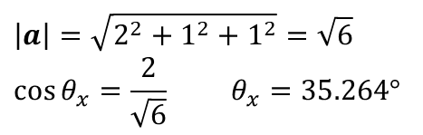


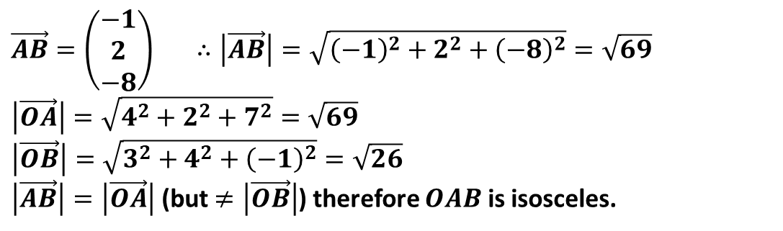


Test Your Understanding
[Textbook] The points $A$ and $B$ have position vectors $4i+2j+7k$ and $3i+4j−k$ relative to a fixed origin, $O$. Find $\vec{AB}$ and show that $ΔOAB$ is isosceles.
?
We can find $\vec{AB}$ by simply looking at the change from 4 to 3, and so on. The textbook has a longwinded way of writing $\vec{OA} =\left(\begin{matrix}4 \\ 2 \\ 7\end{matrix}\right)$ and $\vec{OB} =\left(\begin{matrix}3 \\ 4 \\ −1\end{matrix}\right)$, then finding $\vec{AB}=\vec{OB}−\vec{OA}$. Overkill!
$$\vec{AB}=\left(\begin{matrix}−1 \\ 2 \\ −8\end{matrix}\right) ∴\left|\vec{AB}\right|=\sqrt{{\left(−1\right)}^{2}+2^{2}+{\left(−8\right)}^{2}}=\sqrt{69} \\ \left|\vec{OA}\right|=\sqrt{4^{2}+2^{2}+7^{2}}=\sqrt{69} \\ \left|\vec{OB}\right|=\sqrt{3^{2}+4^{2}+{\left(−1\right)}^{2}}=\sqrt{26}$$
$\left|\vec{AB}\right|=\left|\vec{OA}\right|$ (but $≠\left|\vec{OB}\right|$) therefore $OAB$ is isosceles.
(a) Find the angle that the vector $a=2i+j+k$ makes with the $x$-axis.
(b) By similarly considering the angle that $b=i+3j+2k$ makes with the $x$-axis, determine the area of $OAB$ where $\vec{OA}=a$ and $\vec{OB}=b$. (Hint: draw a diagram)
$$\left|a\right|=\sqrt{2^{2}+1^{2}+1^{2}}=\sqrt{6} \\ \cos{θ_{x}}=\frac{2}{\sqrt{6}} θ_{x}=35.264°$$
$$\left|b\right|=\sqrt{1^{2}+3^{2}+2^{2}}=\sqrt{14} \\ \cos{θ_{x}}=\frac{1}{\sqrt{14}} θ_{x}=74.499°$$
Using diagram, $∠BOA=75.499−35.264=39.235°$.
$$∴Area=\frac{1}{2}×\sqrt{6}×\sqrt{14}×\sin\left(39.235\right)=2.90$$
$$B$$
a
?
b
?
$$\sqrt{14}$$
$$\sqrt{6}$$
$$A$$
$$74.499°$$
$$35.264°$$
$$x$$
$$O$$

Slide 12
Exercise 12B
Pearson Pure Mathematics Year 2/AS
Pages 341-343
In Class:
Green Q7-9
Amber Q10-12
Red Q13-17 Challenge

Slide 13



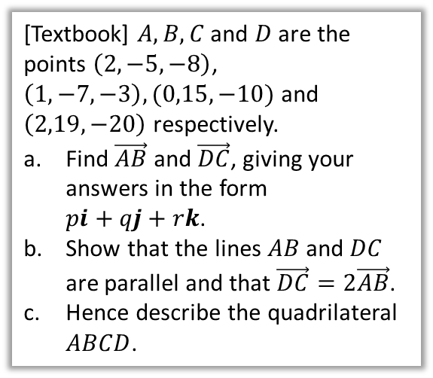


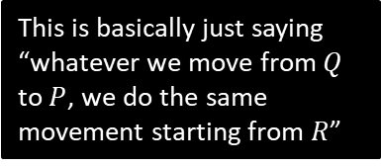
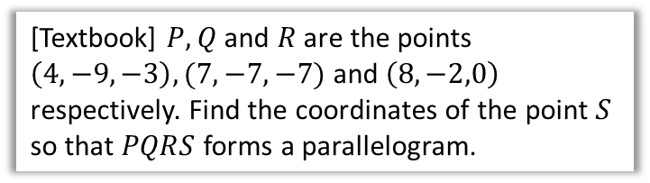

Geometric Problems
For more general problems involving vectors, often drawing a diagram helps!
[Textbook] $A, B, C$ and $D$ are the points $\left(2,−5,−8\right)$, $\left(1,−7,−3\right), (0,15,−10)$ and $\left(2,19,−20\right)$ respectively.
Find $\vec{AB}$ and $\vec{DC}$, giving your answers in the form
$pi+qj+rk$.
Show that the lines $AB$ and $DC$ are parallel and that $\vec{DC}=2\vec{AB}$.
Hence describe the quadrilateral $ABCD$.
[Textbook] $P, Q$ and $R$ are the points $\left(4,−9,−3\right),(7,−7,−7)$ and $\left(8,−2,0\right)$ respectively. Find the coordinates of the point $S$ so that $PQRS$ forms a parallelogram.
?
$$S$$
$$P(4,−9,−3)$$
(Draw a diagram, recalling that the letters go in a clockwise or anticlockwise order)
$$R(8,−2,0)$$
$$\vec{AB}=−i−2j+5k \\ \vec{DC}=−2i−4j+10k$$
$$\vec{DC}=2\left(−i+2j+5k\right)=2\vec{AB}$$
They are multiples $∴$ parallel.
$AB$ and $DC$ are parallel but different in length. Therefore $ABCD$ is a trapezium.
$$Q(7,−7,−7)$$
a
?
This is basically just saying “whatever we move from $Q$ to $P$, we do the same movement starting from $R$”
$$\vec{QP}=\left(\begin{matrix}−3 \\ −2 \\ 4\end{matrix}\right) \\ ∴\vec{OS}=\vec{OR}+\vec{RS} \\ =\vec{OR}+\vec{QP} \\ =\left(\begin{matrix}8 \\ −2 \\ 0\end{matrix}\right)+\left(\begin{matrix}−3 \\ −2 \\ 4\end{matrix}\right)=\left(\begin{matrix}5 \\ −4 \\ 4\end{matrix}\right)$$
$$S\left(5,−4,4\right)$$
b
?
c
?

Slide 14



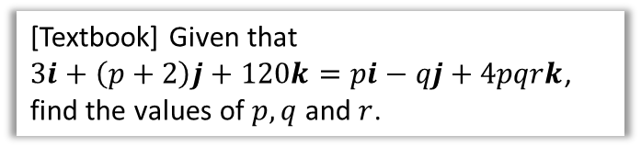



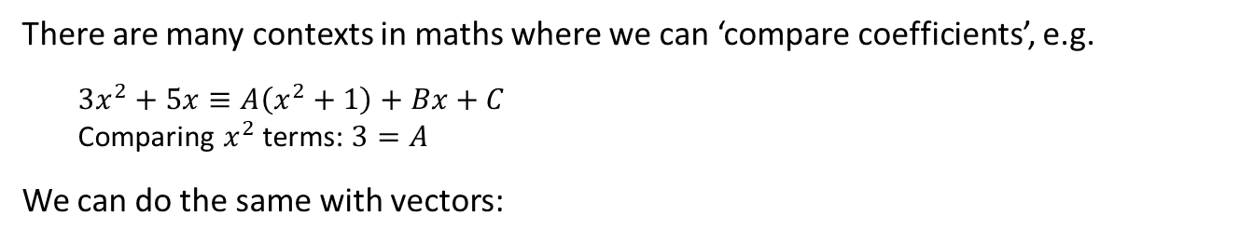






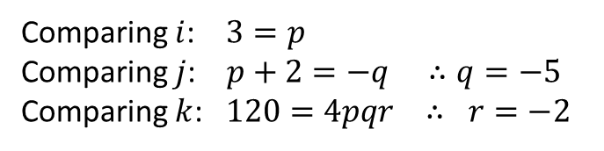


Comparing Coefficients
There are many contexts in maths where we can ‘compare coefficients’, e.g.
$3x^{2}+5x≡A\left(x^{2}+1\right)+Bx+C$
Comparing $x^{2}$ terms: $3=A$
We can do the same with vectors:
[Textbook] The diagram shows a cuboid whose vertices are $O,A,B,C,D,E,F$ and $G$. Vectors $a, b$ and $c$ are the position vectors of the vertices $A, B$ and $C$ respectively. Prove that the diagonals $OE$ and $BG$ bisect each other.
[Textbook] Given that
$3i+\left(p+2\right)j+120k=pi−qj+4pqrk$, find the values of $p, q$ and $r$.
$$F$$
$$E$$
$$C$$
$$G$$
The strategy behind this type of question is to find the point of intersection in 2 ways, and compare coefficients.
$$c$$
$$H$$
$$B$$
$$D$$
?
$$b$$
$$a$$
$$A$$
Comparing $i$: $3=p$
Comparing $j$: $p+2=−q ∴q=−5$
Comparing $k$: $120=4pqr ∴ r=−2$
$$O$$
?
Suppose there is a point of intersection $H$ of $OE$ and $BG$.
We can get to $H$ in two ways:
$\vec{OH}=r \vec{OE}$ for some scalar $r$.
$\vec{OH}=\vec{OB}+\vec{BH}=\vec{OB}+s \vec{BG}$ for some scalar $s$.
$$\vec{OH}=r\left(a+b+c\right)=b+s\left(a−b+c\right) \\ ra+rb+rc=sa+\left(1−s\right)b+sc$$
Comparing coefficients, $r=s$ and $r=1−s$
Adding: $2r=1 ∴r=s=\frac{1}{2}$
Therefore lines bisect each other.

Slide 15
Exercise 12C
Pearson Pure Mathematics Year 2/AS
Pages 346-347
Complete before the lesson Q1-3
In Class:
Green Q4
Amber Q5-6
Red Q7-8 & Challenge

Slide 16
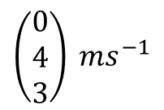
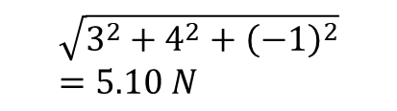

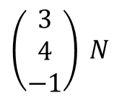
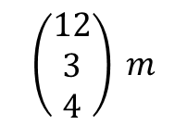

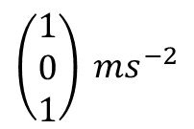

Application to Mechanics
Out of displacement, speed, acceleration, force, mass and time, all but mass and time are vectors. Clearly these can act in 3D space.
Vector
Scalar
$$\left(\begin{matrix}3 \\ 4 \\ −1\end{matrix}\right) N$$
?
Force
$$\sqrt{3^{2}+4^{2}+{\left(−1\right)}^{2}} \\ =5.10 N$$
$$\left(\begin{matrix}1 \\ 0 \\ 1\end{matrix}\right) ms^{−2}$$
?
Acceleration
$$1.41 ms^{−2}$$
$$\left(\begin{matrix}12 \\ 3 \\ 4\end{matrix}\right) m$$
?
Displacement
$$13 m$$
Distance
$$\left(\begin{matrix}0 \\ 4 \\ 3\end{matrix}\right) ms^{−1}$$
?
Velocity
$$5 m$$
Speed

Slide 17

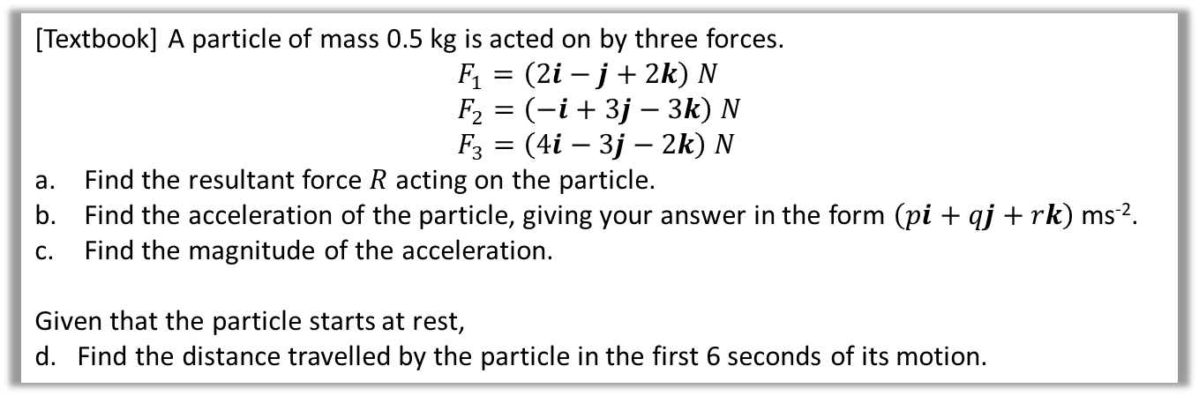
Example
[Textbook] A particle of mass 0.5 kg is acted on by three forces.
$$F_{1}=\left(2i−j+2k\right) N \\ F_{2}=\left(−i+3j−3k\right) N \\ F_{3}=\left(4i−3j−2k\right) N$$
Find the resultant force $R$ acting on the particle.
Find the acceleration of the particle, giving your answer in the form $\left(pi+qj+rk\right)$ ms⁻².
Find the magnitude of the acceleration.
Given that the particle starts at rest,
d. Find the distance travelled by the particle in the first 6 seconds of its motion.
?
$\left(\begin{matrix}2 \\ −1 \\ 2\end{matrix}\right)+\left(\begin{matrix}−1 \\ 3 \\ −3\end{matrix}\right)+\left(\begin{matrix}4 \\ −3 \\ −2\end{matrix}\right)=\left(\begin{matrix}5 \\ −1 \\ −3\end{matrix}\right) N$
$F=ma$
$\left(\begin{matrix}5 \\ −1 \\ −3\end{matrix}\right)=0.5a ∴a=\left(\begin{matrix}10 \\ −2 \\ −6\end{matrix}\right) ms^{−2}$
$\left|a\right|=\sqrt{{10}^{2}+{\left(−2\right)}^{2}+{\left(−6\right)}^{2}}=\sqrt{140}$ ms⁻²
$u=0, a=\sqrt{140} ms^{−2}, t=6 s, s=?$
$s=ut+\frac{1}{2}at^{2}=\frac{1}{2}×\sqrt{140}×6^{2}=36\sqrt{35} m$
?
?
?

Slide 18
Exercise 12D
Pearson Pure Mathematics Year 2/AS
Pages 348-349
Complete before the lesson Q1-3
In Class:
Green Q4
Red Q5-6

Slide 19

The End

