Slide 1
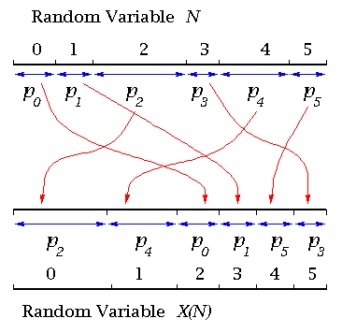
Discrete Random Variables
x | 1 | 2 | 3 | 4
x² | 1 | 4 | 9 | 16
P(X=x) | ¹/₃ | ¹/₃ | ¹/₆ | ¹/₆
The Variance of X
The Variance of a set of data, X, is given by;
‘The expected value of X² subtract the expected value of X, squared’
a) Calculate E(X) and E(X²) for the following set of data…
→ E(X) = 2 ¹/₆
8D

Slide 2
Discrete Random Variables
x | 1 | 2 | 3 | 4
x² | 1 | 4 | 9 | 16
P(X=x) | ¹/₃ | ¹/₃ | ¹/₆ | ¹/₆
The Variance of X
The Variance of a set of data, X, is given by;
‘The expected value of X² subtract the expected value of X, squared’
a) Calculate E(X) and E(X²) for the following set of data…
→ E(X) = 2 ¹/₆
→ E(X²) = 5 ⁵/₆
8D

Slide 3
Discrete Random Variables
x | 1 | 2 | 3 | 4
x² | 1 | 4 | 9 | 16
P(X=x) | ¹/₃ | ¹/₃ | ¹/₆ | ¹/₆
The Variance of X
The Variance of a set of data, X, is given by;
‘The expected value of X² subtract the expected value of X, squared’
a) Calculate E(X) and E(X²) for the following set of data…
→ E(X) = 2 ¹/₆
→ E(X²) = 5 ⁵/₆
b) Calculate the Variance of X
→ 1.14 (2dp)
8D

Slide 4
Exercise 1B
Pearson Pure Mathematics Year 1/AS
Pages 6-7
Complete before the lesson Q2
In Class:
Green Q3
Amber Q4-5
Red Q6-7

