Slide 1
Year 2 Pure Mathematics
Integration
- (ax + b)
Chapter 11
(Part 2 of 11)

Slide 2
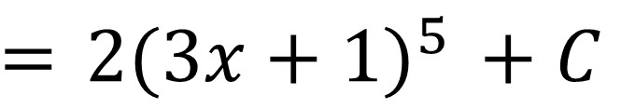
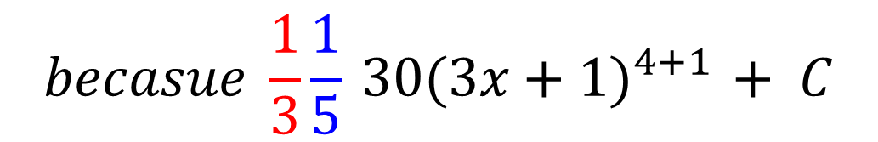
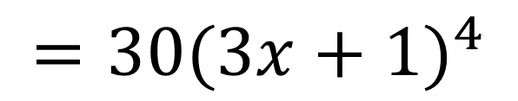
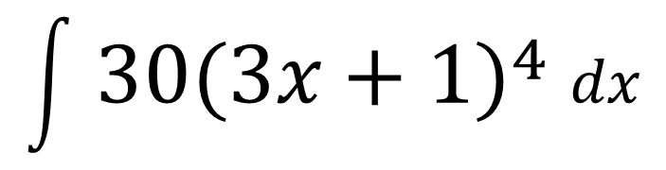
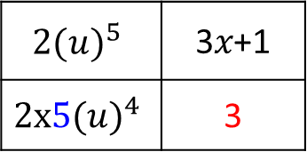
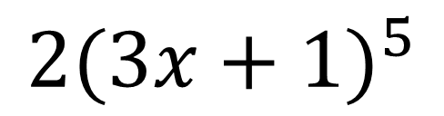
Integrating $f\left(ax+b\right)$
Differentiate
$${2(u)}^{5}$$ | 3𝑥+1
$${2x5(u)}^{4}$$ | 3
$${2(3x+1)}^{5}$$
$${=30(3x+1)}^{4}$$
Integrate
$$\int{{ 30(3x+1)}^{4} dx}$$
$$={ 2(3x+1)}^{5} + C$$
$$becasue \frac{1}{3}\frac{1}{5}{ 30(3x+1)}^{4+1} + C$$

Slide 3
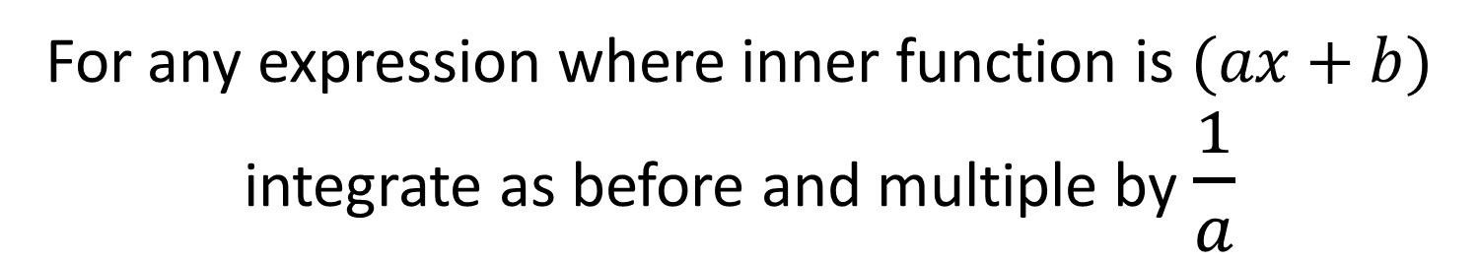
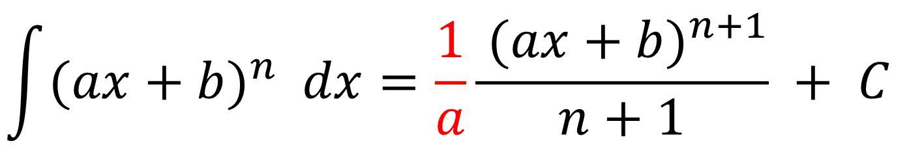
Integrating $f\left(ax+b\right)$
For any expression where inner function is $(ax+b)$ integrate as before and multiple by $\frac{1}{a}$
$$\int{{(ax+b)}^{n} dx}=\frac{1}{a}\frac{{ (ax+b)}^{n+1}}{n+1} + C$$

Slide 4
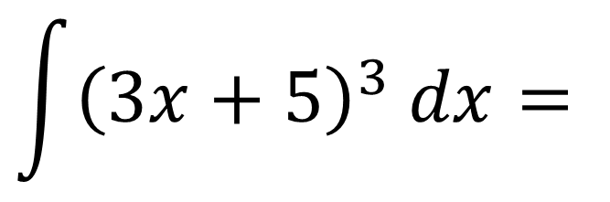
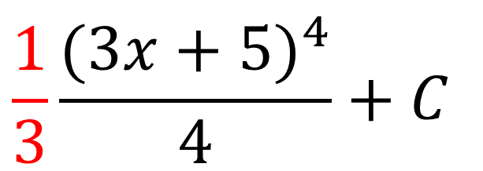
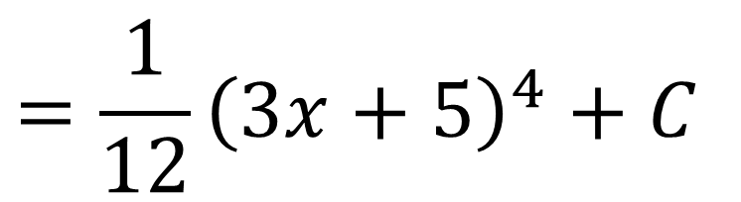
Integrating $f\left(ax+b\right)$
$$\int{{\left(3x+5\right)}^{3} dx}=$$
$$\frac{1}{3}\frac{{(3x+5)}^{4}}{4}+C$$
$$=\frac{1}{12}{\left(3x+5\right)}^{4}+C$$

Slide 5
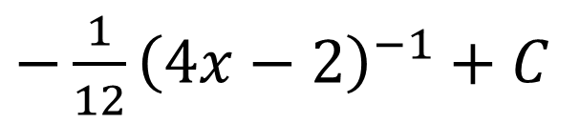
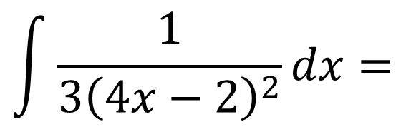
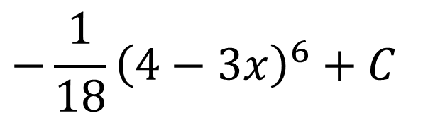
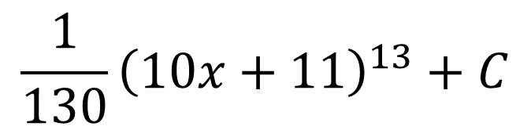
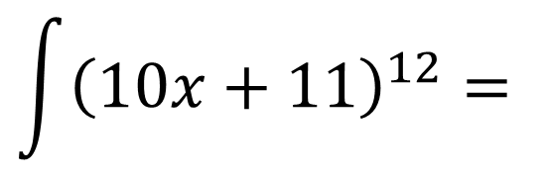
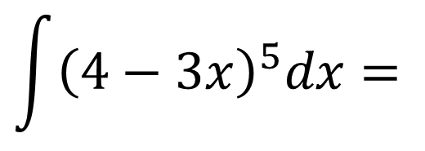
Integrating $f\left(ax+b\right)$
$$\int{{\left(10x+11\right)}^{12}=}$$
$$\frac{1}{130}{\left(10x+11\right)}^{13}+C$$
$$\int{{\left(4−3x\right)}^{5}dx}=$$
$$−\frac{1}{18}{\left(4−3x\right)}^{6}+C$$
$$\int{\frac{1}{3{\left(4x−2\right)}^{2}}dx= }$$
$−\frac{1}{12}{\left(4x−2\right)}^{−1}+C$

Slide 6
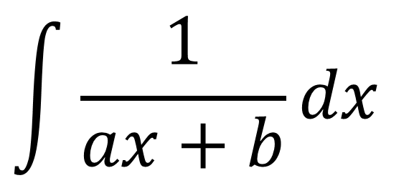
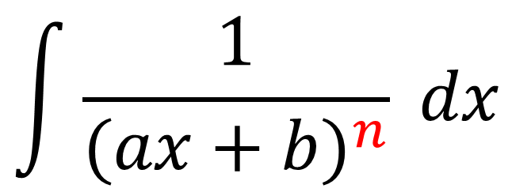
Integrating a reciprocal of $f\left(ax+b\right)$
Integrating a reciprocals.
Two types of questions.
TYPE 1
TYPE 2
$$\int{\frac{1}{ax+b}dx}$$
$$\int{\frac{1}{{(ax+b)}^{n}} dx}$$
when n ≠ 1

Slide 7
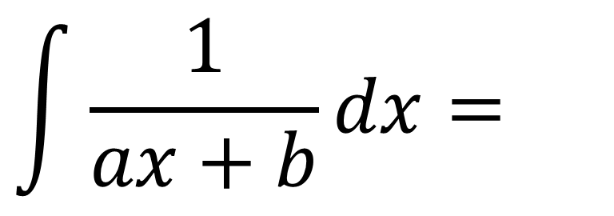
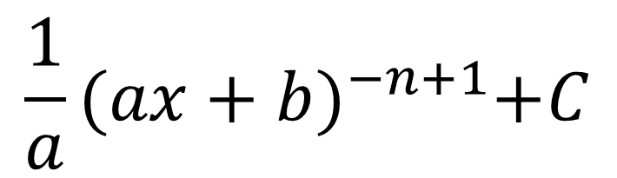
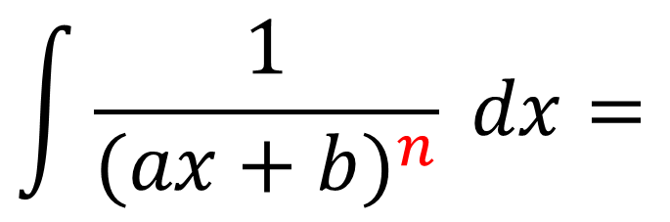
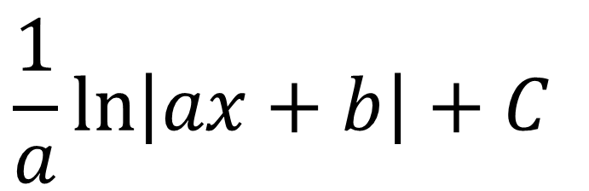
Integrating a reciprocal of $f\left(ax+b\right)$
$$\int{\frac{1}{ax+b}dx}=$$
$$\frac{1}{a}\ln\left|ax+b\right|+C$$
watch for when n ≠ 1
$$\int{\frac{1}{{(ax+b)}^{n}} dx}=$$
$$\frac{1}{a}{(ax+b)}^{−n+1}+C$$

Slide 8

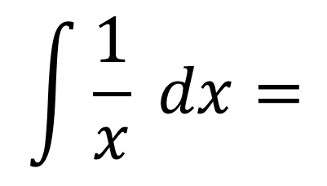
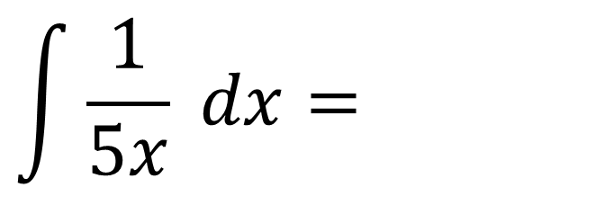
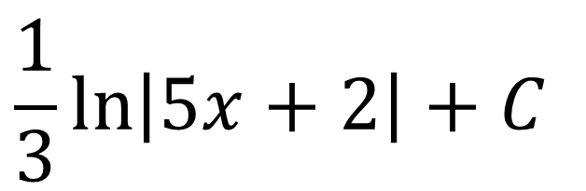
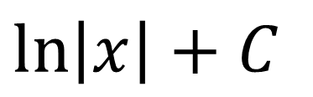
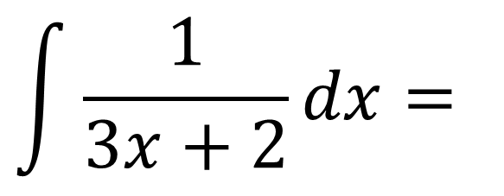
Integrating a reciprocal of $f\left(ax+b\right)$
$$\int{\frac{1}{x} dx}=$$
$$\ln\left|x\right|+C$$
$$\int{\frac{1}{5x} dx}=$$
$$\frac{1}{5}\ln\left|5x\right|+C$$
$$\int{\frac{1}{3x+2}dx}=$$
$$\frac{1}{3}\ln\left|5x+2\right|+C$$

Slide 9
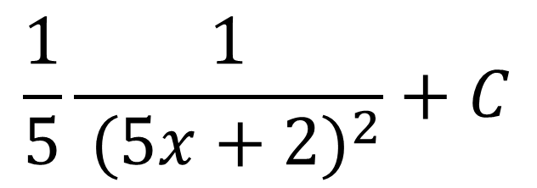
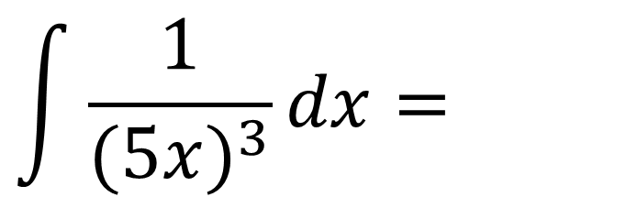
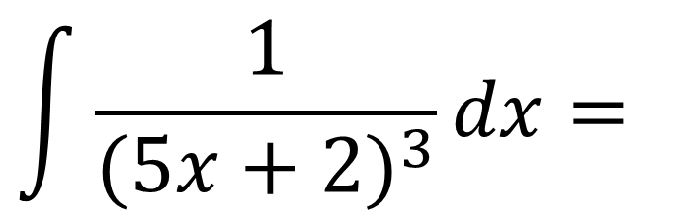
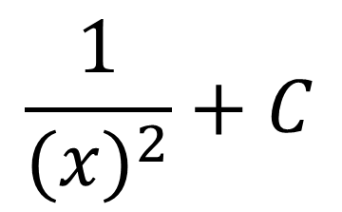
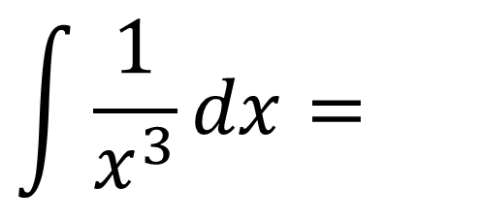
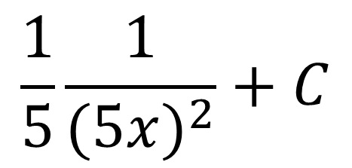
Integrating a reciprocal of $f\left(ax+b\right)$
$$\int{\frac{1}{x^{3}}dx}=$$
$$\frac{1}{{(x)}^{2}}+C$$
$$\int{\frac{1}{{(5x)}^{3}}dx}=$$
$$\frac{1}{5}\frac{1}{{(5x)}^{2}}+C$$
$$\int{\frac{1}{{(5x+2)}^{3}}dx}=$$
$$\frac{1}{5}\frac{1}{{ (5x+2)}^{2}}+C$$

Slide 10
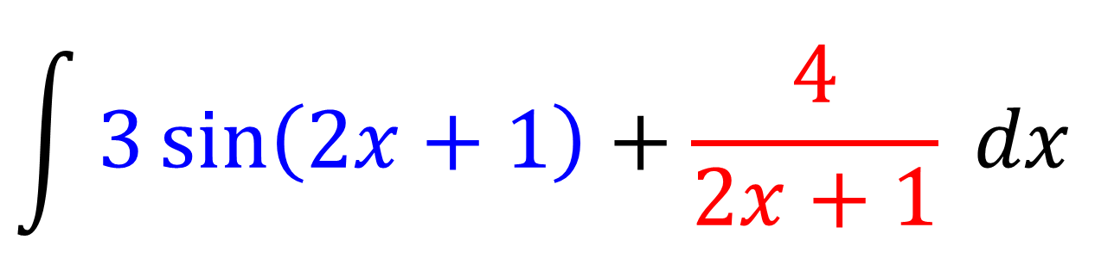
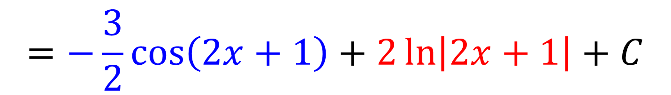
Integrating $f\left(ax+b\right)$ and the reciprocal of $f\left(ax+b\right)$
$$\int{3\sin\left(2x+1\right)+\frac{4}{2x+1} dx}$$
$$=−\frac{3}{2}\cos\left(2x+1\right)+2\ln\left|2x+1\right|+C$$

Slide 11
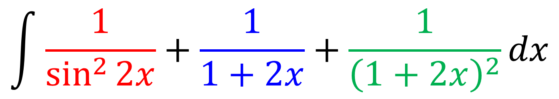
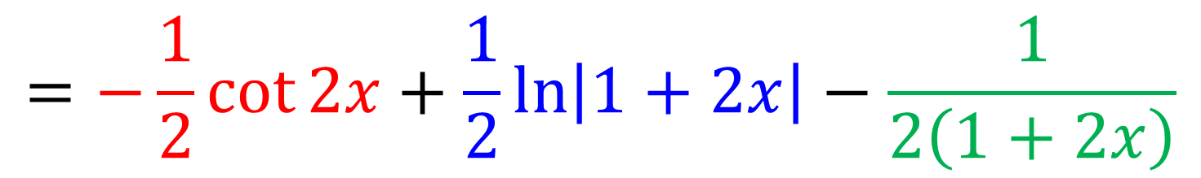
Integrating $f\left(ax+b\right)$ and the reciprocal of $f\left(ax+b\right)$
$$\int{\frac{1}{\sin^{2}{2x}}+\frac{1}{1+2x}+\frac{1}{{\left(1+2x\right)}^{2}}dx}$$
$$=−\frac{1}{2}\cot{2x}+\frac{1}{2}\ln\left|1+2x\right|−\frac{1}{2\left(1+2x\right)}$$

Slide 12
Exercise 11B
Pages 297-298
Complete before the lesson Q1-4
In Class:
Green Q5
Amber Q6
Red Q7-8 & Challenge

