Slide 1

Further Mechanics 1 :
Elastic Collisions in Two Dimensions
Mr Ingall
(the boss of www.DrFrostMaths.com)
Last modified: 29th March 2019

Slide 2
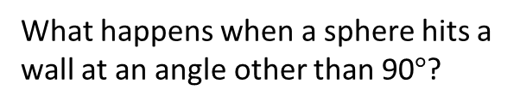
Oblique Collision with a fixed smooth surface
In this chapter we will consider:
u
or
What happens when a sphere hits a wall at an angle other than 90$°$?
What happens when two spheres that are not travelling along the same straight line collide?
The key to all the questions in this chapter is that all the spheres and all the surfaces are ALWAYS SMOOTH.

Slide 3

The consequence of Smoothness
A smooth surface cannot apply a frictional force.
The only force it can apply is a NORMAL reaction force.
The impulse (force x time) exerted by the surface is also NORMAL to the surface
The change in momentum (impulse) is normal to the surface
The component of momentum (and velocity) parallel to the surface is UNCHANGED
R
Fr=0
The component of velocity parallel to the surfaces in contact is unchanged
The component of velocity perpendicular to the surfaces in contact depends on the coefficient of restitution (e).

Slide 4

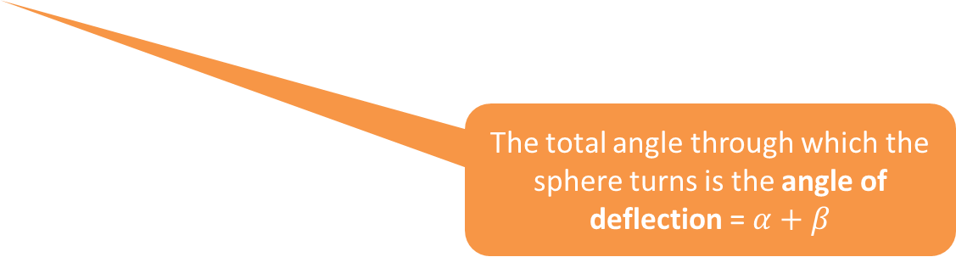



The Theory
Parallel velocity component unchanged => $u cosα=v cosβ$
Perpendicular velocity component => $e u sinα=v sinβ$
1
2
u
$$e$$
v
$$α$$
$$β$$
The total angle through which the sphere turns is the angle of deflection = $α+β$
$$÷$$
2
1
=> $e tanα=tanβ$

Slide 5


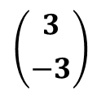

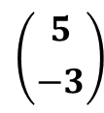
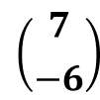




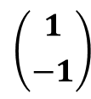

Quickfire Questions
j
i
$$\left({3 \atop −3}\right)$$
$$\left({1 \atop −1}\right)$$
?
?
$e$= $\frac{1}{3}$
v = $\left({3 \atop 1}\right)$
$e$= 1
v = $\left({1 \atop 1}\right)$
$$\left({7 \atop −6}\right)$$
$$\left({5 \atop −3}\right)$$
?
?
$e$= $\frac{1}{2}$
v = $\left({7 \atop 3}\right)$
$e$= 0
v = $\left({5 \atop 0}\right)$

Slide 6



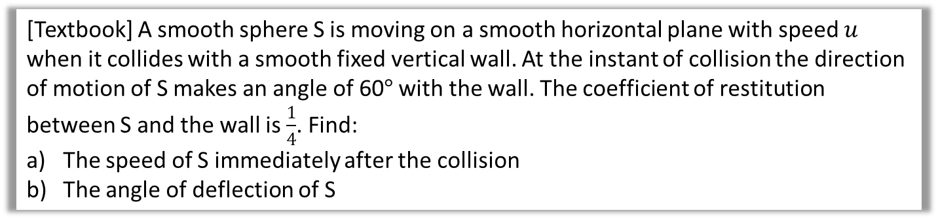


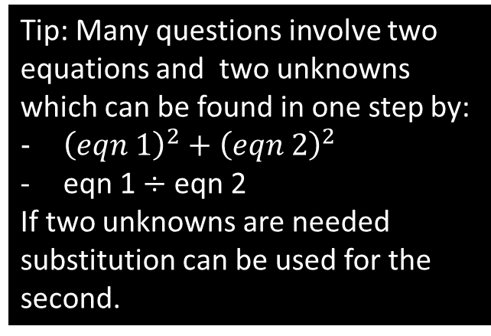


An Example
[Textbook] A smooth sphere S is moving on a smooth horizontal plane with speed $u$ when it collides with a smooth fixed vertical wall. At the instant of collision the direction of motion of S makes an angle of 60$°$ with the wall. The coefficient of restitution between S and the wall is $\frac{1}{4}$. Find:
The speed of S immediately after the collision
The angle of deflection of S
$$→ ucos60=vcosβ$$
$$↑ \frac{1}{4}usin60=vsinβ$$
$$\frac{1}{4}tan60=tanβ$$
$u^{2}\cos^{2}{60+\frac{1}{16}u^{2}\sin^{2}{60=v^{2}}}$
$$v^{2}=\frac{u^{2}}{4}+\frac{{3u}^{2}}{64}=\frac{19u^{2}}{64}$$
$$v=\frac{\sqrt{19}}{8}u,$$
$$β=\tan^{−1}\left(\frac{1}{4}tan60\right)=23.4° (1dp)$$
=> Angle of deflection = 60+23.4 = 83.4$°$ (1dp)
a?
1
$$e=\frac{1}{4}$$
Diagram
u
v
2
$$60°$$
$$β$$
2
$$÷$$
1
Tip: Many questions involve two equations and two unknowns which can be found in one step by:
${\left(eqn 1\right)}^{2}+{\left(eqn 2\right)}^{2}$
eqn 1 $÷$ eqn 2
If two unknowns are needed substitution can be used for the second.
$${}^{2}+$$
$${}^{2}$$
2
1

Slide 7
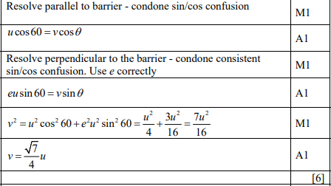
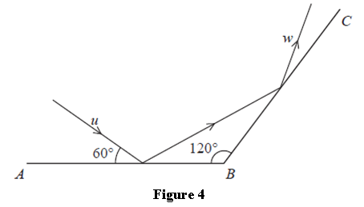
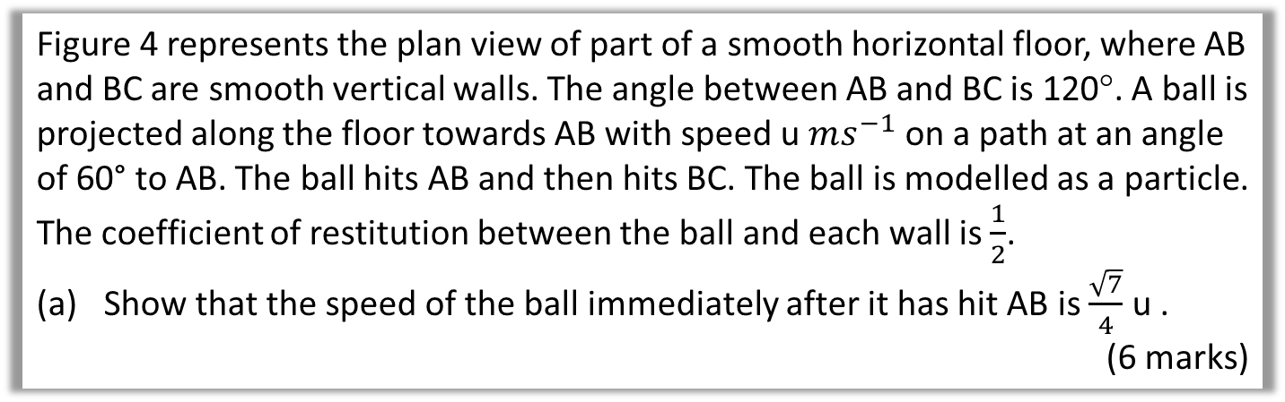
Test Your Understanding
Edexcel M4 June 2015 Q7a
Figure 4 represents the plan view of part of a smooth horizontal floor, where AB and BC are smooth vertical walls. The angle between AB and BC is 120°. A ball is projected along the floor towards AB with speed u $ms^{−1}$ on a path at an angle of 60° to AB. The ball hits AB and then hits BC. The ball is modelled as a particle. The coefficient of restitution between the ball and each wall is $\frac{1}{2}$.
Show that the speed of the ball immediately after it has hit AB is $\frac{\sqrt{7}}{4}$ u .
(6 marks)
?

Slide 8
Exercise 5A
Pearson Further Mechanics 1
Pages 99-101 questions 1 - 14
Complete before the lesson Q1-3
In Class:
Green Q4-8
Amber Q9-14
Red Q15-18 & challenge

Slide 9

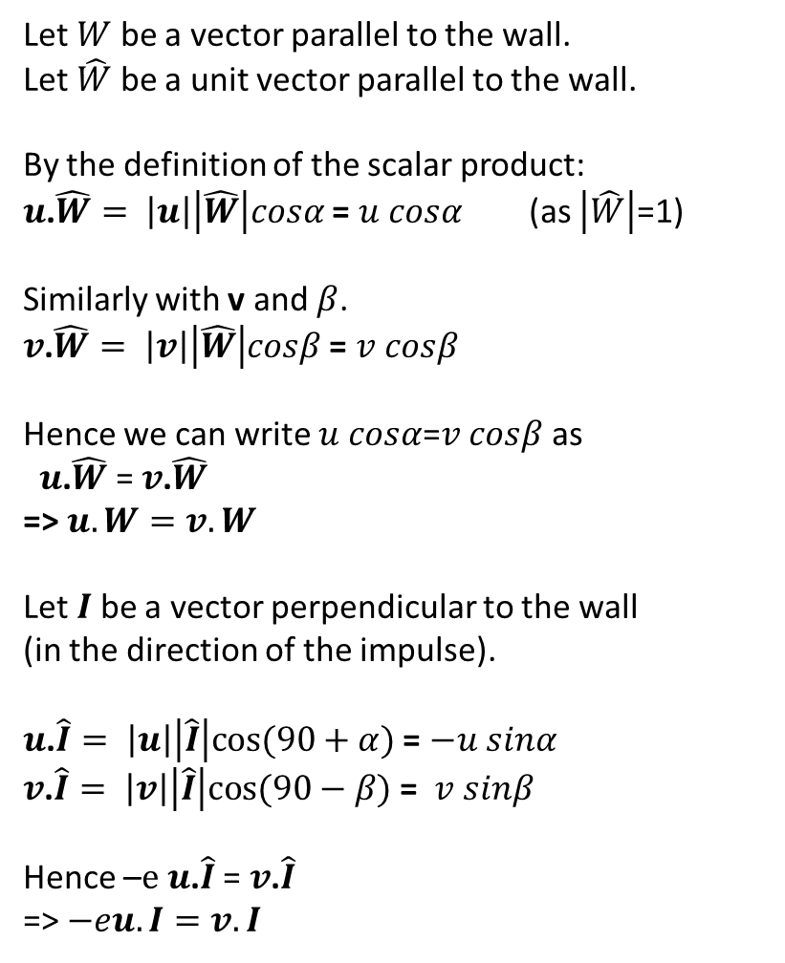
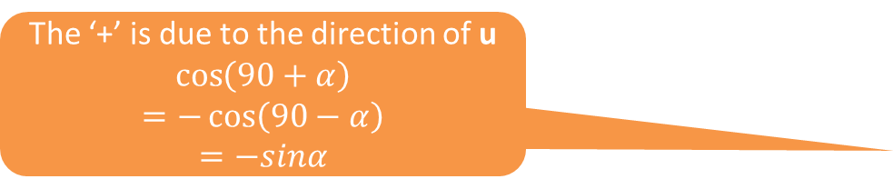






Using the Scalar Product
Let $W$ be a vector parallel to the wall.
Let $\hat{W}$ be a unit vector parallel to the wall.
By the definition of the scalar product:
$u$.$\hat{W}= \left|u\right|\left|\hat{W}\right|cosα$ = $u cosα$ (as $\left|\hat{W}\right|$=1)
Similarly with v and $β$.
$v$.$\hat{W}= \left|v\right|\left|\hat{W}\right|cosβ$ = $v cosβ$
Hence we can write $u cosα$=$v cosβ$ as
$u$.$\hat{W}$ = $v$.$\hat{W}$
=> $u.W=v.W$
Let $I$ be a vector perpendicular to the wall
(in the direction of the impulse).
$u$.$\hat{I}= \left|u\right|\left|\hat{I}\right|cos⁡(90+α)$ = $−u sinα$
$v$.$\hat{I}= \left|v\right|\left|\hat{I}\right|cos⁡(90−β)$ = $v sinβ$
Hence –$e u$.$\hat{I}$ = $v$.$\hat{I}$
=> $−eu.I=v.I$
I
u
$$e$$
v
$$α$$
$$β$$
W
Note: This method is not explicitly covered in the text book but is implied by hints and solutions to some questions where it saves a lot of time.
Multiplying both sides by $\left|W\right|$
The ‘+’ is due to the direction of u
$$\cos\left(90+α\right)$$
$$=−\cos\left(90−α\right)$$
$$=−sinα$$
Multiplying both sides by $\left|I\right|$
Tip: $−eu.I=v.I$
is useful for finding $e$ if $u$ and $v$ are known
A valid starting point.
$−eu.I=v.I$

Slide 10

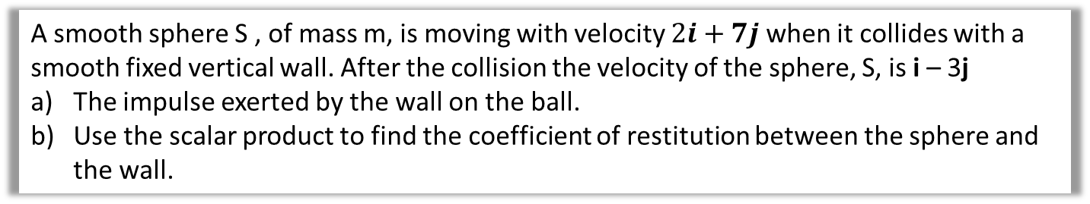
An Example
A smooth sphere S , of mass m, is moving with velocity $2i+7j$when it collides with a smooth fixed vertical wall. After the collision the velocity of the sphere, S, is i – 3j
The impulse exerted by the wall on the ball.
Use the scalar product to find the coefficient of restitution between the sphere and the wall.
a?
a) $impusle= ∆momentum$
$$=m\left(\left(i−3j\right)−\left(2i+7j\right)\right)=m\left(−i−10j\right)$$
b) $− e u. I=v.I$
where $I$ can be any convenient vector parallel to Impulse
let: $I=\left({1 \atop 10}\right)$
$−e\left({1 \atop 10}\right)$. $\left({2 \atop 7}\right)$=$\left({1 \atop 10}\right)$. $\left({1 \atop −3}\right)$
$−72e=−29$
$e=\frac{29}{72}$
b?
Derived on the previous slide

Slide 11
Exercise 5A
Pearson Further Mechanics 1
Pages 99-101 questions 1 - 14
Complete before the lesson Q1-3
In Class:
Green Q4-8
Amber Q9-14
Red Q15-18 & challenge

Slide 12
Successive Oblique Impacts
Sometimes you may be asked to consider two successive impact.
Find the speed and direction of motion after the first impact.
Use angle properties to calculate the angle of approach for the second collision using the direction of motion after the first impact.
Look at the second impact starting by drawing a new diagram.
There are no new concepts needed to address this type of question.

Slide 13




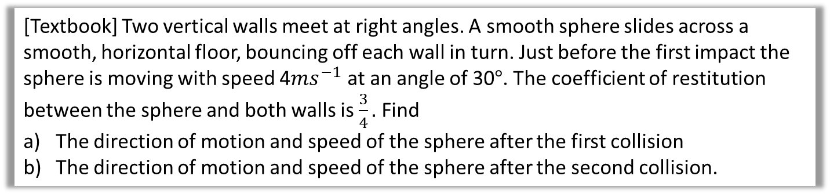



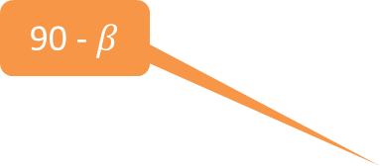

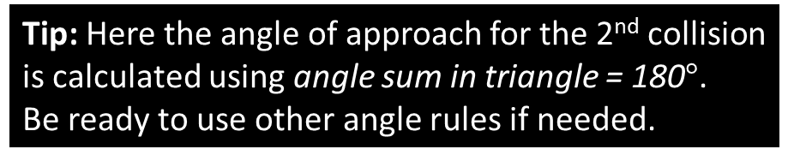
An Example
[Textbook] Two vertical walls meet at right angles. A smooth sphere slides across a smooth, horizontal floor, bouncing off each wall in turn. Just before the first impact the sphere is moving with speed 4$ms^{−1}$ at an angle of 30$°$. The coefficient of restitution between the sphere and both walls is $\frac{3}{4}.$ Find
The direction of motion and speed of the sphere after the first collision
The direction of motion and speed of the sphere after the second collision.
?
Diagram?
For 1st collision:
$$→4\cos{30=vcosβ}$$
$$↑\frac{3}{4}×4sin30=vsinβ$$
… combining as usual gives …
$$v=3.77…ms^{−1}, β=23.4…°$$
For 2nd Collision:
$$↑vcos\left(90−β\right)=wcosγ$$
$$←\frac{3}{4}\sin\left(90−β\right)=wsinγ$$
… combining as usual gives …
$$w=3ms^{−1}, γ=60°$$
90 - $β$
$$w$$
$$γ$$
$$e=\frac{3}{4}$$
4
$$e=\frac{3}{4}$$
$$v$$
30$°$
$$β$$
Tip: Here the angle of approach for the 2nd collision is calculated using angle sum in triangle = 180$°$.
Be ready to use other angle rules if needed.

Slide 14
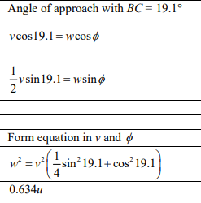
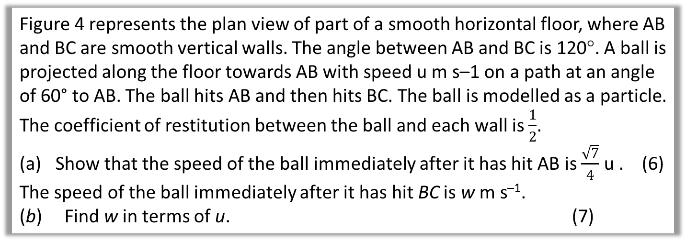
Test Your Understanding
Edexcel M4 June 2015 Q7a
Figure 4 represents the plan view of part of a smooth horizontal floor, where AB and BC are smooth vertical walls. The angle between AB and BC is 120°. A ball is projected along the floor towards AB with speed u m s–1 on a path at an angle of 60° to AB. The ball hits AB and then hits BC. The ball is modelled as a particle. The coefficient of restitution between the ball and each wall is $\frac{1}{2}$.
Show that the speed of the ball immediately after it has hit AB is $\frac{\sqrt{7}}{4}$ u . (6)
The speed of the ball immediately after it has hit BC is w m s^{–1}.
(b) Find w in terms of u. (7)
YOU DID PART a) ON A PREVIOUS SLIDE!
this is the mark scheme for b

Slide 15


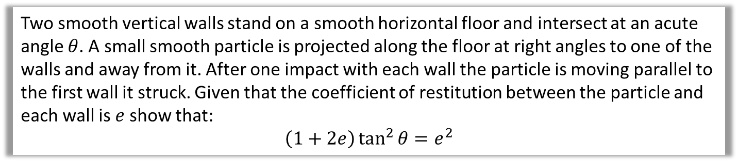





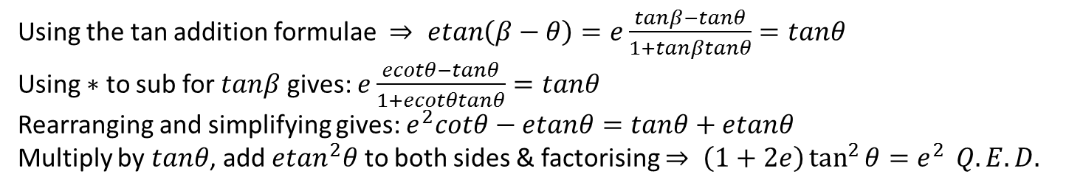




Tough Question
Old M4 Edexcel Textbook (2000 spec)
Two smooth vertical walls stand on a smooth horizontal floor and intersect at an acute angle $θ$. A small smooth particle is projected along the floor at right angles to one of the walls and away from it. After one impact with each wall the particle is moving parallel to the first wall it struck. Given that the coefficient of restitution between the particle and each wall is $e$ show that:
$$\left(1+2e\right)\tan^{2}{θ=e^{2}}$$
P
At X: $ucos\left(90−θ\right)=vcosβ$
    $$⇒usinθ=vcosβ$$
$eusin\left(90−θ\right)=vsinβ$
$⇒eucosθ=vsinβ$
$ecotθ=tanβ$ $∗$ $÷$
At Y: $vcos\left(β−θ\right)=wcosθ$
$evsin\left(β−θ\right)=wsinθ$
$etan\left(β−θ\right)=tanθ ÷$
Diagram?
Standard steps?
(most marks awarded here)
$$θ$$
Y
S
1
Q
$$w$$
$$θ$$
$∠$SYX =$β$ (alternate)
$∠$OSY = $θ$ (alternate) => $∠OYX=β−θ$
$β$-$θ$
2
2
1
$$v$$
$$u$$
3
$$β$$
90-$θ$
$$θ$$
O
4
R
X
4
3
Using the tan addition formulae $⇒ \operatorname{etan}\left(β−θ\right)=e\frac{tanβ−tanθ}{1+tanβtanθ}=tanθ$
Using $∗$ to sub for $tanβ$ gives: $e\frac{ecotθ−tanθ}{1+ecotθtanθ}=tanθ$
Rearranging and simplifying gives: $e^{2}cotθ−etanθ=tanθ+etanθ$
Multiply by $tanθ$, add $etan^{2}θ$ to both sides & factorising $⇒ \left(1+2e\right)\tan^{2}{θ=e^{2}} Q.E.D.$
The tricky algebra to finish it off?

Slide 16
Exercise 5B
Pearson Further Mechanics 1
Pages 99-101 questions 15 - 18
Complete before the lesson Q1-2
In Class:
Green Q3-4
Amber Q5-7
Red Q8-10 & challenge

Slide 17
Oblique Impact of Smooth Spheres
Line of Centres
B
A
Common Tangent
Key idea 1:
As with the smooth wall, the component of velocity parallel to the common tangent doesn’t change.
A
Key idea 2:
The components of velocities parallel to the line of centres
are treated exactly like they were in chapter 4 :
Use conservation of momentum
Consider Newton’s law of restitution
Elastic colisions in one dimension

Slide 18
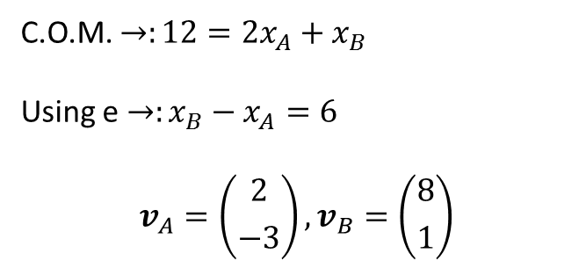

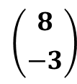




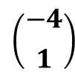



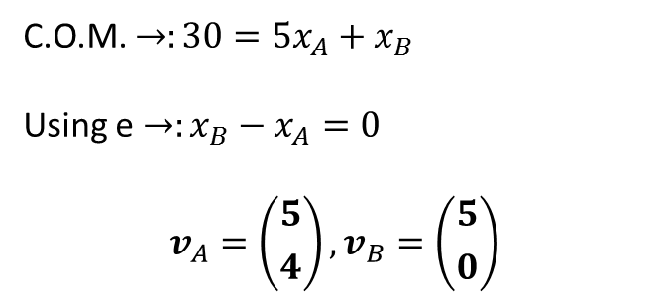
Quickfire Questions
j
i
$$\left({8 \atop −3}\right)$$
$$\left({x_{A} \atop 4}\right)$$
$$\left({x_{B} \atop 1}\right)$$
?
$e$= $\frac{1}{2}$
?
$e$= $0$
$$\left({x_{B} \atop 0}\right)$$
2
1
5
1
?
$$\left({−4 \atop 1}\right)$$
$$\left({6 \atop 4}\right)$$
$$\left({x_{A} \atop −3}\right)$$
$$\left({0 \atop 0}\right)$$
?
C.O.M. $→:12={2x}_{A}+x_{B}$
Using e $→:x_{B}−x_{A}=6$
$$v_{A}=\left({2 \atop −3}\right), v_{B}=\left({8 \atop 1}\right)$$
C.O.M. $→:30={5x}_{A}+x_{B}$
Using e $→:x_{B}−x_{A}=0$
$$v_{A}=\left({5 \atop 4}\right), v_{B}=\left({5 \atop 0}\right)$$
?
?
?
?
?
?
?
?

Slide 19
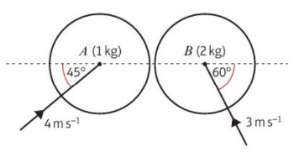
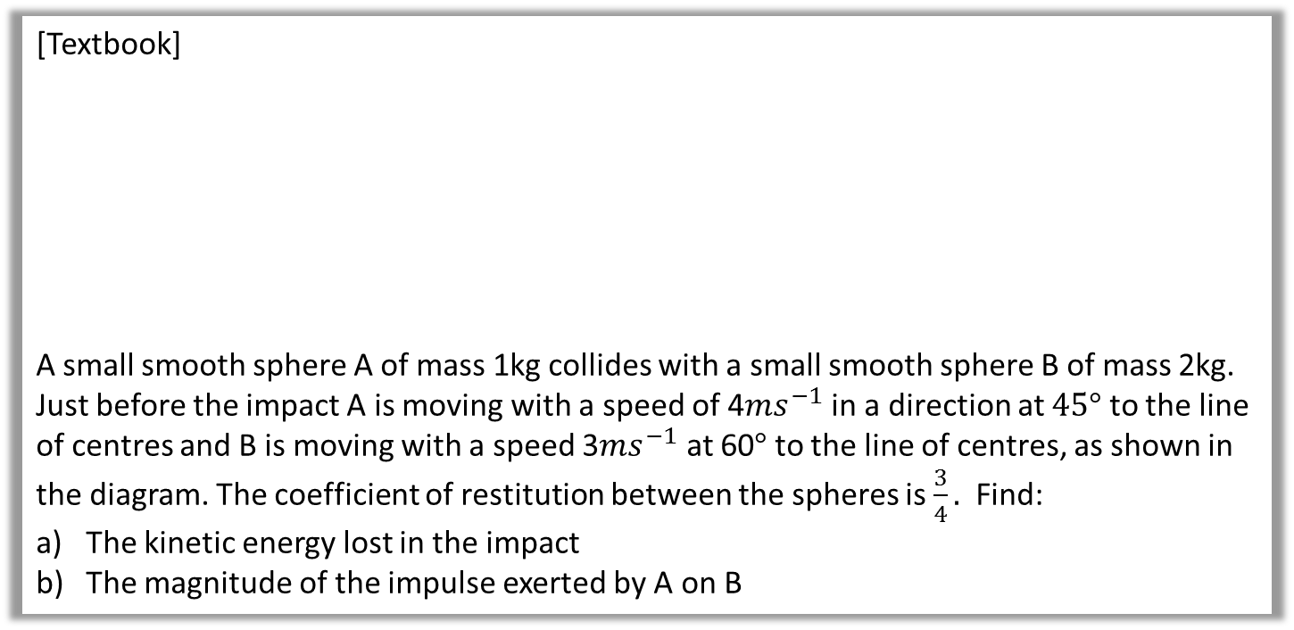
An Example
[Textbook]
A small smooth sphere A of mass 1kg collides with a small smooth sphere B of mass 2kg. Just before the impact A is moving with a speed of 4$ms^{−1}$ in a direction at $45°$ to the line of centres and B is moving with a speed 3$ms^{−1}$ at 60$°$ to the line of centres, as shown in the diagram. The coefficient of restitution between the spheres is $\frac{3}{4}.$ Find:
The kinetic energy lost in the impact
The magnitude of the impulse exerted by A on B
Solution on next page

Slide 20

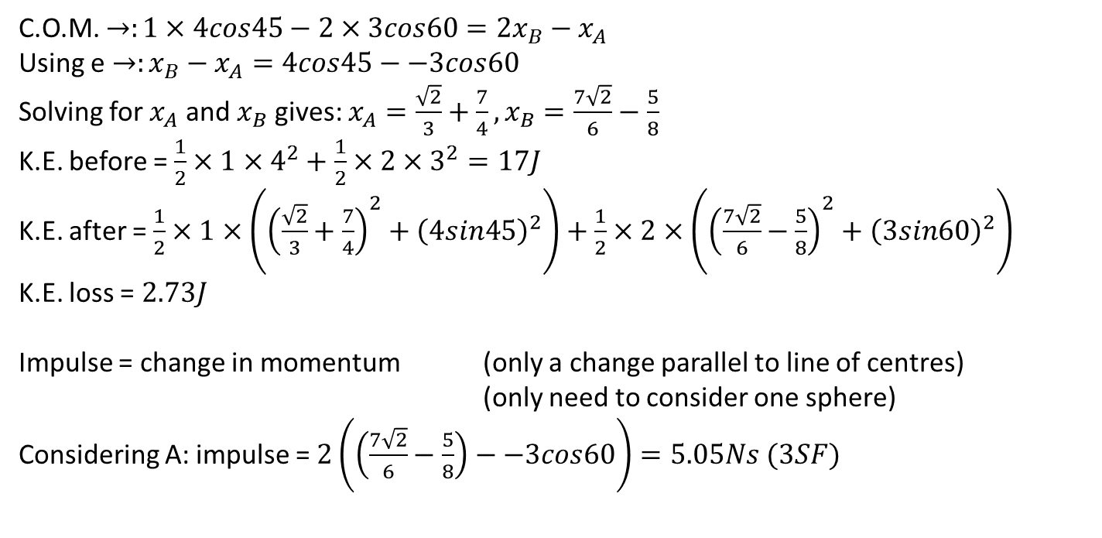



An Example
$4sin$45
$$3sin60$$
$$x_{A}$$
1
2
$$x_{B}$$
a)
C.O.M. $→:1×4cos45−2×3cos60={2x}_{B}−x_{A}$
Using e $→:x_{B}−x_{A}=4cos45−−3cos60$
Solving for $x_{A}$ and $x_{B}$ gives: $x_{A}=\frac{\sqrt{2}}{3}+\frac{7}{4},x_{B}=\frac{7\sqrt{2}}{6}−\frac{5}{8}$
K.E. before = $\frac{1}{2}×1×4^{2}+\frac{1}{2}×2×3^{2}=17J$
K.E. after = $\frac{1}{2}×1×\left({\left(\frac{\sqrt{2}}{3}+\frac{7}{4}\right)}^{2}+{\left(4sin45\right)}^{2}\right)+\frac{1}{2}×2×\left({\left(\frac{7\sqrt{2}}{6}−\frac{5}{8}\right)}^{2}+{\left(3sin60\right)}^{2}\right)$
K.E. loss = $2.73J$
Impulse = change in momentum (only a change parallel to line of centres)
(only need to consider one sphere)
Considering A: impulse = $2\left(\left(\frac{7\sqrt{2}}{6}−\frac{5}{8}\right)−−3cos60\right)=5.05Ns (3SF)$
b)

Slide 21
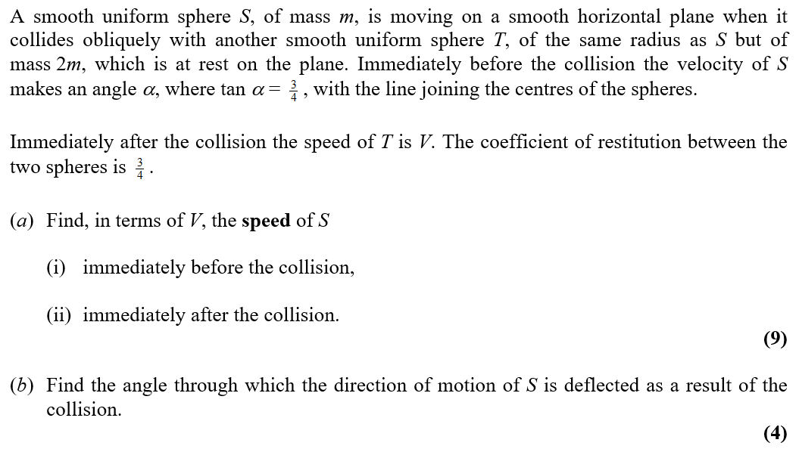
Test Your Understanding
Edexcel M4 June 2012 Q1
Mark Scheme on next page

Slide 22
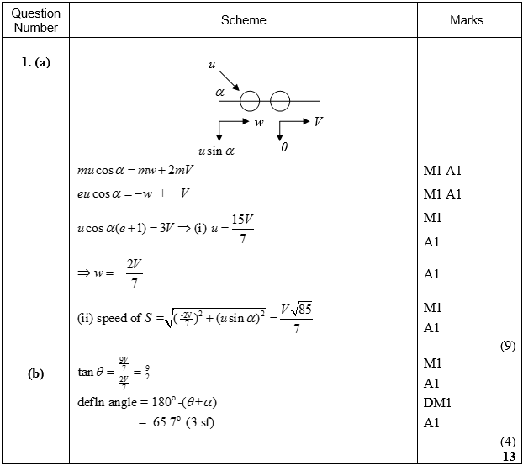
Test Your Understanding
Edexcel M4 June 2012 Q1 MARK SCHEME

Slide 23



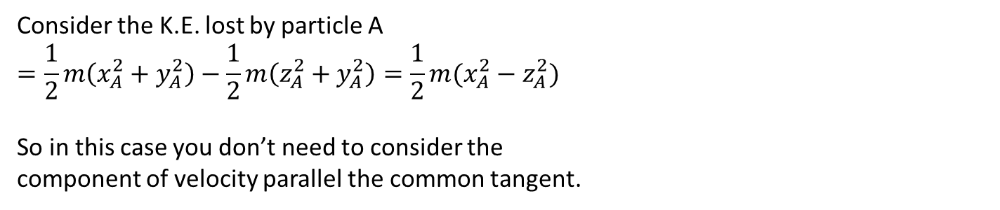
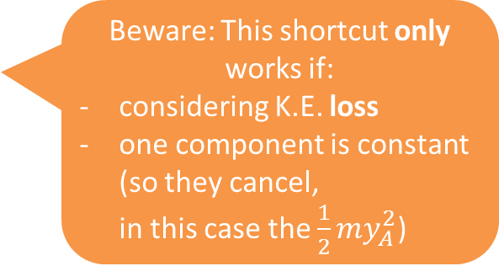




K.E. Loss – a potential shortcut?
Before
A
B
After
A
B
$$y_{A}$$
$$y_{B}$$
$$y_{A}$$
$$y_{B}$$
$$x_{A}$$
m
m
$$x_{B}$$
$$z_{A}$$
m
m
$$z_{B}$$
Consider the K.E. lost by particle A
$$=\frac{1}{2}m\left(x_{A}^{2}+y_{A}^{2}\right)−\frac{1}{2}m\left(z_{A}^{2}+y_{A}^{2}\right)=\frac{1}{2}m(x_{A}^{2}−z_{A}^{2})$$
So in this case you don’t need to consider the
component of velocity parallel the common tangent.
Beware: This shortcut only works if:
considering K.E. loss
one component is constant (so they cancel,
in this case the $\frac{1}{2}my_{A}^{2}$)

Slide 24










Angle of deflection – a common source of errors
$$u$$
$$α$$
$$β$$
$$v$$
The angle of deflection is NOT $α+β$.
90-$α$
$$u$$
?
$$α$$
$$β$$
90-$β$
$$v$$
?
The angle of deflection IS $\left(90−α\right)+\left(90−β\right)=180−α−β$.
?

Slide 25
Exercise 5C
Pearson Further Mechanics 1
Pages 112-114 questions 1 - 13
Complete before the lesson Q1-3
In Class:
Green Q4-7
Amber Q8-13
Red Q14- 16 & challenge

Slide 26


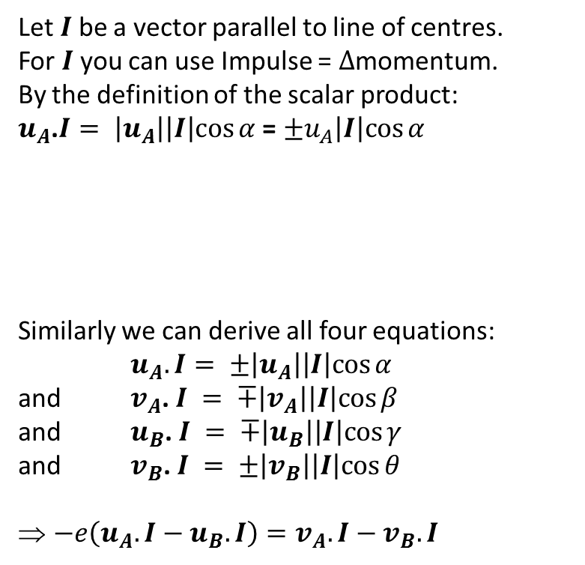


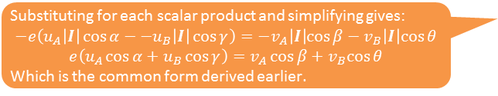



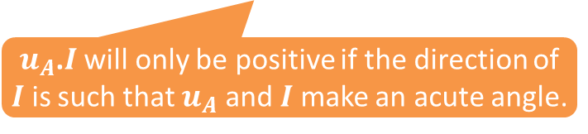
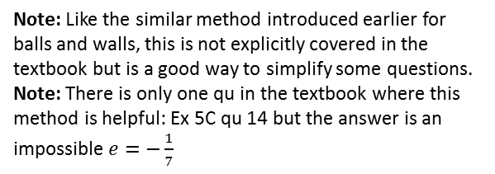
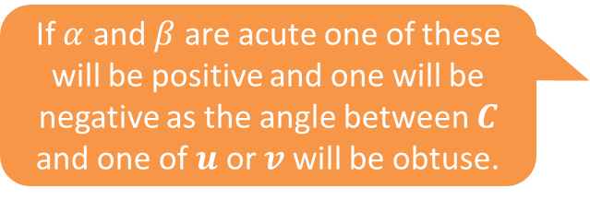


Using the Scalar Product
Let $I$ be a vector parallel to line of centres.
For $I$ you can use Impulse = $∆$momentum.
By the definition of the scalar product:
$u_{A}$.$I= \left|u_{A}\right|\left|I\right|cos⁡α$ = $±u_{A}\left|I\right|cos⁡α$
Similarly we can derive all four equations:
$u_{A}.I= ±\left|u_{A}\right|\left|I\right|cos⁡α$
and $v_{A}$. $I = ∓\left|v_{A}\right|\left|I\right|cos⁡β$
and $u_{B}$. $I = ∓\left|u_{B}\right|\left|I\right|cos⁡γ$
and $v_{B}$. $I = ±\left|v_{B}\right|\left|I\right|cos⁡θ$
$−e\left(u_{A}.I−u_{B}.I\right)=v_{A}.I−v_{B}.I$
$$u_{A}$$
$$α$$
$$u_{B}$$
$$β$$
$$γ$$
$u_{A}$.$I$ will only be positive if the direction of $I$ is such that $u_{A}$ and $I$ make an acute angle.
$$v_{A}$$
$$θ$$
$$v_{B}$$
If $α$ and $β$ are acute one of these will be positive and one will be negative as the angle between $C$ and one of $u$ or $v$ will be obtuse.
Substituting for each scalar product and simplifying gives:
$$−e\left(u_{A}\left|I\right|\cos{α}−−u_{B}\left|I\right|\cos{γ}\right)=−v_{A}\left|I\right|cos⁡β−v_{B}\left|I\right|cos⁡θ$$
$$e\left(u_{A}\cos{α}+u_{B}\cos{γ}\right)=v_{A}\cos{β}+v_{B}cos⁡θ$$
Which is the common form derived earlier.
Note: Like the similar method introduced earlier for balls and walls, this is not explicitly covered in the textbook but is a good way to simplify some questions.
Note: There is only one qu in the textbook where this method is helpful: Ex 5C qu 14 but the answer is an impossible $e=−\frac{1}{7}$
$e\left(u_{A}.I−u_{B}.I\right)=v_{B}.I−v_{A}.I$
Very like the original definition of e in one dimension!

Slide 27

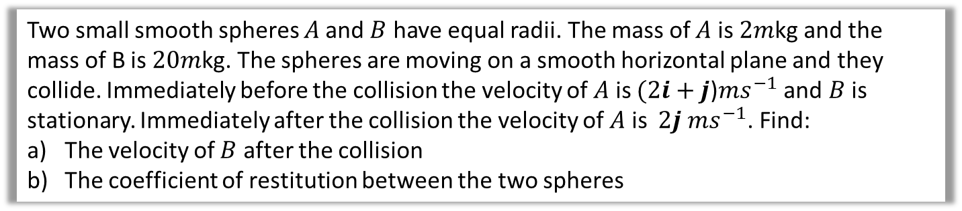
An Example
Two small smooth spheres $A$and $B$ have equal radii. The mass of $A$ is $2m$kg and the mass of B is $20m$kg. The spheres are moving on a smooth horizontal plane and they collide. Immediately before the collision the velocity of $A$ is $(2i+j$)$ms^{−1}$ and $B$ is stationary. Immediately after the collision the velocity of $A$ is $2j ms^{−1}$. Find:
The velocity of $B$ after the collision
The coefficient of restitution between the two spheres
a?
a) $impusle on A= ∆momentum$
$$=2m\left(2j−(2i+j)\right)=2m\left(−2i+j\right)$$
$⇒impulse on B= 2m\left(2i−j\right)$
$⇒2m\left(2i−j\right)=20mv_{B}$
$⇒v_{B}=0.2i−0.1j$
b) Let a vector parallel to the line of Centres = $C$ = $\left({2 \atop −1}\right)$
$$e\left(u_{A}.C−u_{B}.C\right)=v_{B}.C−v_{A}.C$$
$⇒ e(\left({2 \atop 1}\right).$ $\left({2 \atop −1}\right)$ $−$ $\left({0 \atop 0}\right).$ $\left({2 \atop −1}\right)$)=$\left({0.2 \atop −0.1}\right).$ $\left({2 \atop −1}\right)$ $−$ $\left({0 \atop 2}\right).$ $\left({2 \atop −1}\right)$
$⇒e\left(3−0\right)=$ 0.5$−−2$
$⇒e=\frac{2.5}{3}=\frac{5}{6}$
b?
Derived on the previous slide

Slide 28

Exercise 5C
Pearson Further Mechanics 1
Pages 114-115 questions 14 – 16 (note: qu 14 is impossible as e = $−\frac{1}{7}$)
Pages 115-118 Mixed Exercise 5 questions 1 – 13
Challenging Questions:
Review Exercise 2 qu 31, 36, 38
(Review Exercise 2 qu 19 – 39 are all good questions but these three combine several skills in an unusual way)
Complete before the lesson Q1-3
In Class:
Green Q4-7
Amber Q8-13
Red Q14- 16 & challenge

