Slide 1
Year 2 Pure Mathematics
Differentiation
- Rates of Change
Chapter 9
(Part 10 of 10)

Slide 2
Year 2 Pure Mathematics
Differentiation is used to calculate
the rate at which one quantity varies with another.
Examples of rates of change:
Gradient
– the change of y with respect to x
Acceleration
– the change of speed with respect to time
Volume
– the change of volume with respect to time

Slide 3
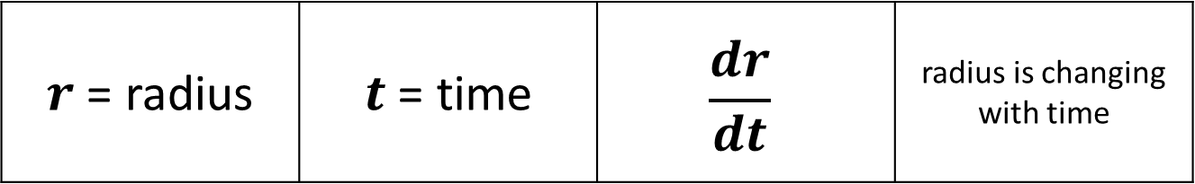
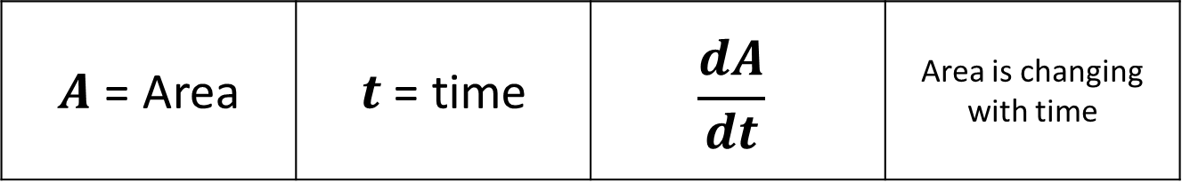
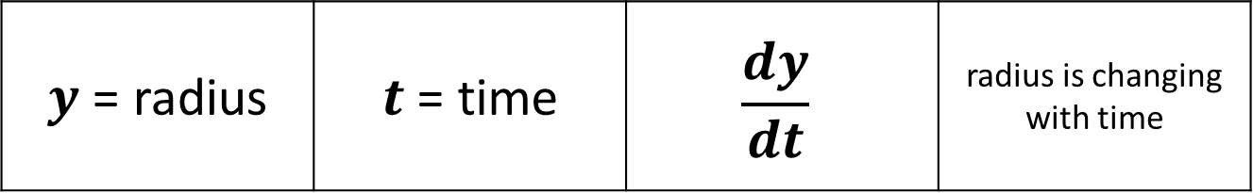
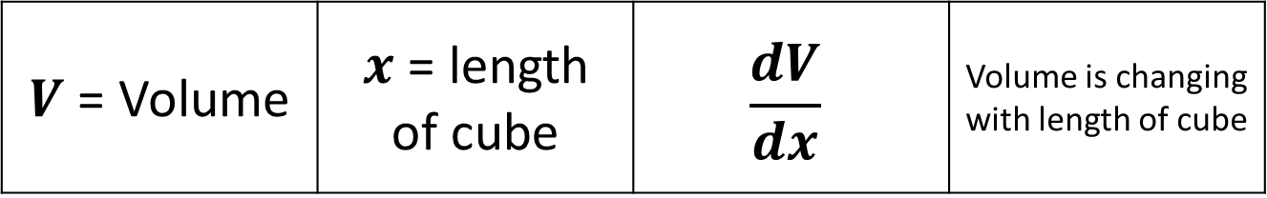
Rates of Change
$A$ = Area | $t$ = time | $$\frac{dA}{dt}$$ | Area is changing with time
$r$ = radius | $t$ = time | $$\frac{dr}{dt}$$ | radius is changing with time
$V$ = Volume | $x$ = length of cube | $$\frac{dV}{dx}$$ | Volume is changing with length of cube
$y$ = radius | $t$ = time | $$\frac{dy}{dt}$$ | radius is changing with time

Slide 4
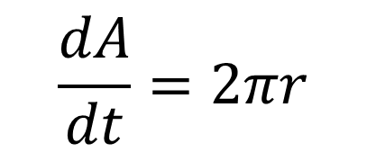
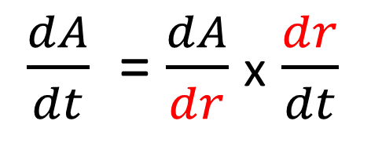
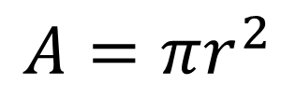
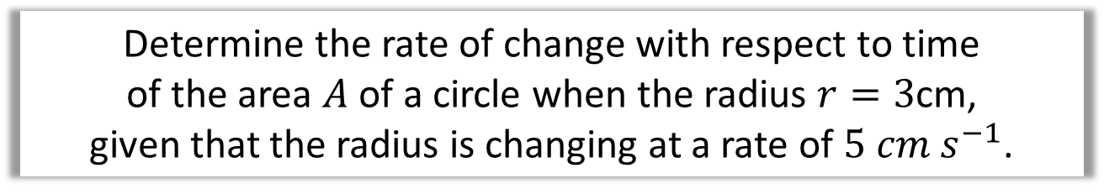
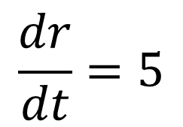
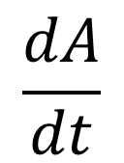
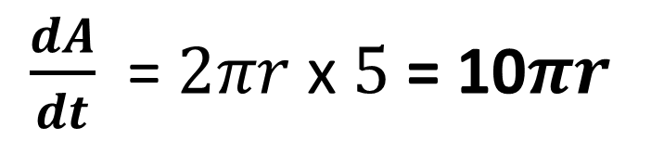

Rates of Change
Determine the rate of change with respect to time
of the area $A$ of a circle when the radius $r=3$cm,
given that the radius is changing at a rate of $5 cm s^{−1}$.
i) Ask yourself what do I need to work out.
iv) Therefore you can work $\frac{dA}{dt}$.
$$\frac{dA}{dt}$$
$$\frac{dA}{dt}=2πr$$
ii) Ask yourself what do you know.
v) Use the chain rule.
$$\frac{dr}{dt}=5$$
$\frac{dA}{dt}$ = $\frac{dA}{dr}$ x $\frac{dr}{dt}$
iii) What formula can you write out.
$\frac{dA}{dt}$ = $2πr$ x $5$ = 10$πr$
$$A=πr^{2}$$

Slide 5
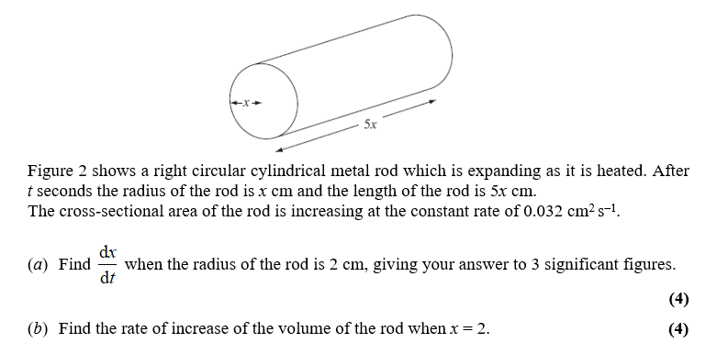
Rates of Change – Exam Question

Slide 6
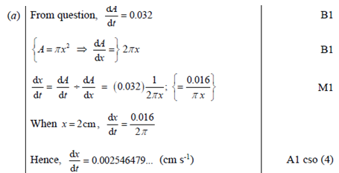
Rates of Change – Exam Question

Slide 7
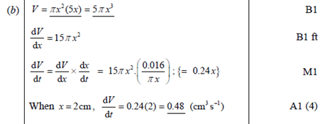
Rates of Change – Exam Question

Slide 8
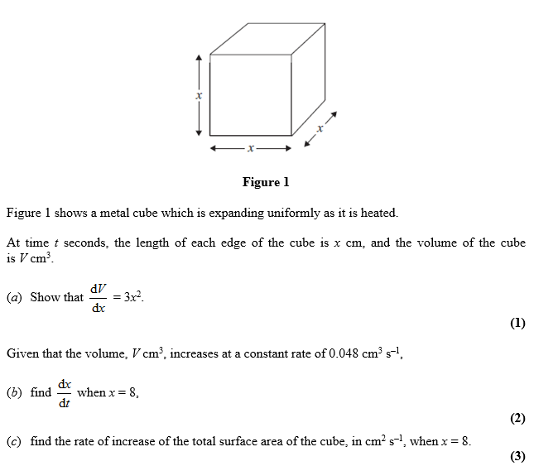
Rates of Change – Exam Question

Slide 9
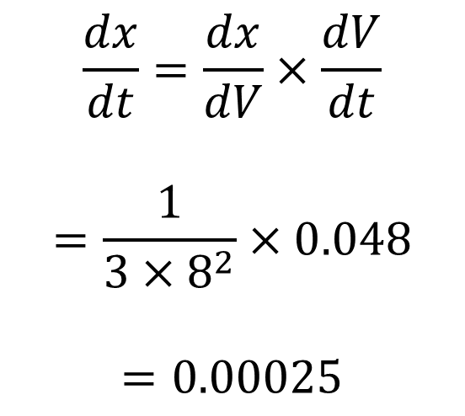
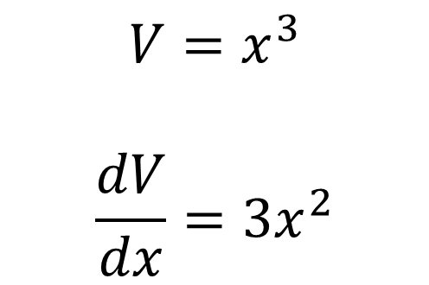
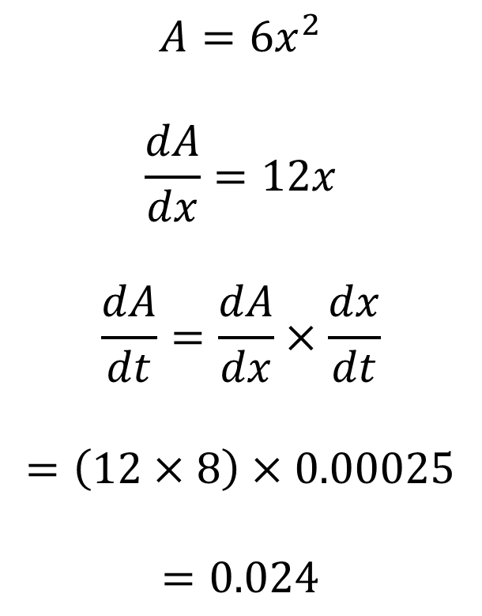
Rates of Change – Exam Question
$$V=x^{3}$$
$$\frac{dV}{dx}=3x^{2}$$
a)
c)
$$A=6x^{2}$$
$$\frac{dA}{dx}=12x$$
$$\frac{dA}{dt}=\frac{dA}{dx}×\frac{dx}{dt}$$
$$=\left(12×8\right)×0.00025$$
$$=0.024$$
$$\frac{dx}{dt}=\frac{dx}{dV}×\frac{dV}{dt}$$
$$=\frac{1}{3×8^{2}}×0.048$$
$$=0.00025$$
b)

Slide 10
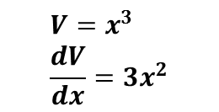
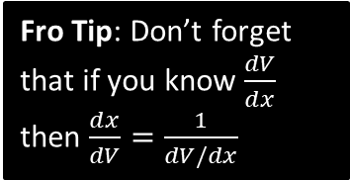

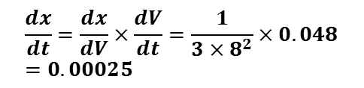
Test Your Understanding
June 2012 Q2
Fro Tip: Don’t forget that if you know $\frac{dV}{dx}$ then $\frac{dx}{dV}=\frac{1}{dV/dx}$
$$V=x^{3} \\ \frac{dV}{dx}=3x^{2}$$
?
?
$$\frac{dx}{dt}=\frac{dx}{dV}×\frac{dV}{dt}=\frac{1}{3×8^{2}}×0.048=0.00025$$
?
$$A=6x^{2} \\ \frac{dA}{dx}=12x \\ \frac{dA}{dt}=\frac{dA}{dx}×\frac{dx}{dt}=\left(12×8\right)×0.00025=0.024$$

Slide 11
Exercise 9J
Pearson Pure Mathematics Year 2/AS
Pages 263-264
Complete before the lesson Q1-4
In Class:
Amber Q5-9
Red Q10-14

