Slide 1

Further Mechanics 1 :
Momentum and Impulse
Mr Ingall
(the boss of www.drfrostmaths.com)
Last modified: 13th December

Slide 2
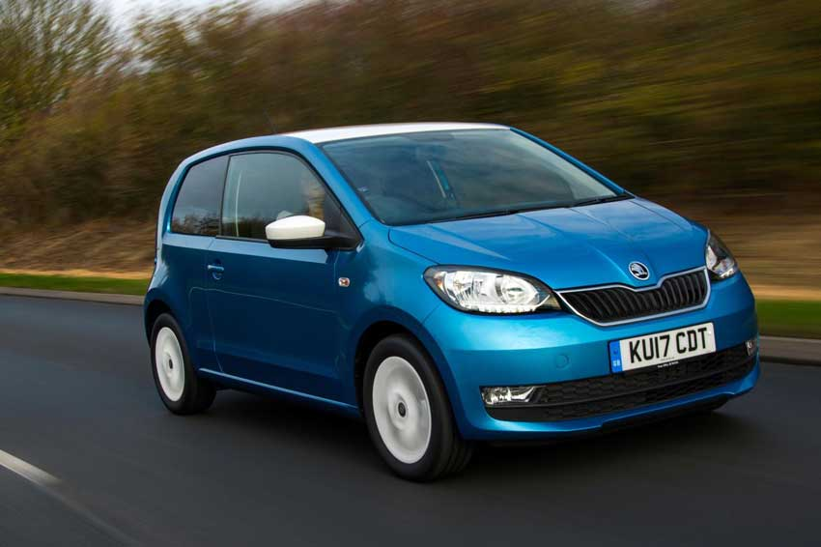
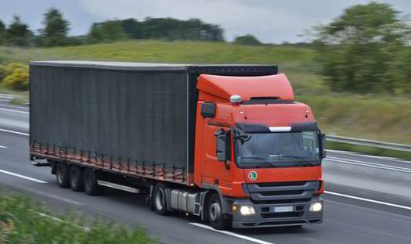
What do we understand by Momentum?
Two identical cars are driving – one at 100 km/h and the other at 30 km/h.
Which has greater momentum?
100km/h
30km/h
The 100 km/h car – higher speeds are associated with higher momentum
?
Both the car and the lorry are driving at 50 km/h. Which has greater momentum?
50km/h
50km/h
The lorry – greater mass is associated with greater momentum
?

Slide 3
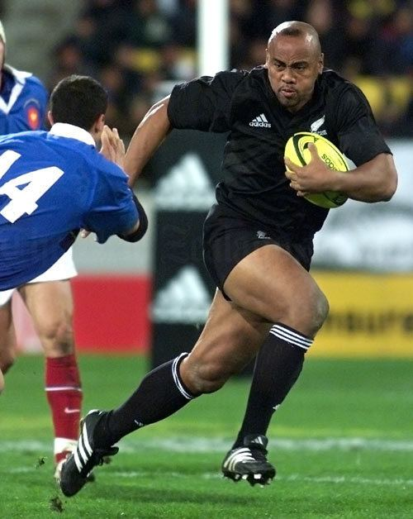

Defining Momentum
Jonah Lomu the famous All Black winger was the personification of momentum:
He was lightening quick¹ AND massive² !
Definition of Momentum:
?
Momentum = mass $×$ velocity
P = mv
Although never used in A Level Maths
P can be used to represent momentum.
Momentum is a vector quantity:
the direction will be the same as the velocity.
Momentum is measured in kgms⁻¹ or Ns
These units are equivalent as N = kgms⁻² (F = ma)
1. His PB for 100m 10.7s 2. He was 6 foot 5inches tall and weighted 19 stone

Slide 4
Quickfire Momentum
Fill in the gaps in the table below
(if possible give momentum as a vector, otherwise find the magnitude of momentum.
Mass | Velocity | Momentum
6 kg | 5 m/s | 30 Ns
1.2 tonnes | 0.8 ms⁻¹ | 960 Ns
5kg | 13 ms⁻¹ | 65 kgms⁻¹
523 kg | 0 m/s | 0 Ns
3kg | 4i + 7j ms⁻¹ | 12i + 21j ms⁻¹
600g | 36 km/h | 6 Ns
2kg | 3i + 9j ms⁻¹ | 6i + 18j Ns
20kg | 7i + 7j ms⁻¹ | 140i + 140j kgms⁻¹
?
?
?
?
?
?
?
?

Slide 5
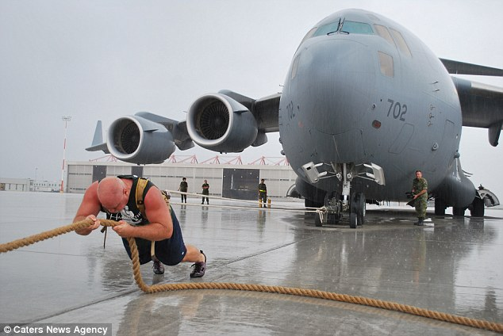

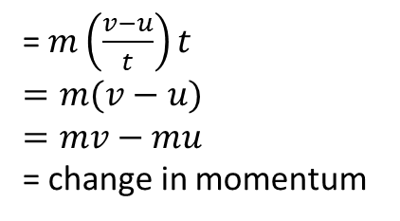

Defining Impulse
If a constant force is exerted on an object for a given time the impulse exerted is defined as:
Impulse = Force $×$ time
I = Ft
Impulse has the same units as momentum
= change in momentum
= $m\left(\frac{v−u}{t}\right)t$
$$=m(v−u)$$
$$=mv−mu$$
= change in momentum
by substituting $a= \frac{v−u}{t}$ into $F=ma$
Tip: Beware of signs! Define one direction as positive and all velocities in the other direction are negative.
Impulse
Known as the
impulse-momentum principle
To understand that:
Impulse = Ft = change in momentum
Picture a strong man pulling an aeroplane!
The momentum gained by the aeroplane depends on:
How hard the man pulls (Force)
How long he pulls for (Time)
Often a reasonable impulse is the result of a very large force acting for very short time (e.g. a bat hitting a ball) in these cases it is easier to calculate the change in momentum.

Slide 6
Quickfire Impulse
Calculated the impulse exerted on the object in the following cases:
A force of 30N is exerted on an object for 0.5s
A ball of mass 3kg was travelling at 10m/s is hit and slows to 6m/s without changing direction.
A ball of mass 3kg was travelling at 10m/s is hit so that it returns in the opposite direction at a speed of 6m/s
A rocket of mass 100kg travelling at 2000m/s hits the ground and stops.
The momentum before impact is 6i + 3j Ns and the momentum after impact is 10i + 5j Ns
The momentum before impact is 6i - 5j Ns and the momentum after impact is 10i + 5j Ns
15Ns
12Ns
48Ns
200000Ns
4i + 2j Ns
4i + 10j Ns
?
?
?
?
?
?
Tip: In situations where the direction changes the magnitude of the impulse should be larger

Slide 7

An Example
[Textbook] A ball of mass 0.2 kg hits a vertical wall at right angles with a speed of 3.5 ms⁻¹. The ball rebounds with speed 2.5 ms⁻¹. Find the magnitude of the impulse exerted on the wall by the ball.
The thinking behind the problem
The wall doesn’t move => the force applied to the wall by the ball is matched by another force (probably from the floor) that keeps it in place => can’t use change of momentum of the wall
We have no information about the force exerted or the time the ball is in contact with the wall:
so we can’t use I = Ft
So:
- Calculate change of momentum of the ball
- (by Newton’s 3rd law) the impulse exerted by the wall on the ball is equal (in magnitude) and opposite (in direction) to the force exerted by the ball on the wall.
Taking away from the wall as positive:
I = m(v - u)
= 0.2($2.5−−3.5$)
= 0.2 $×$ 6 = 1.2 Ns
Alternatively taking towards the wall as positive:
I = 0.2($−2.5−3.5)$ = $−$1.2Ns (so 1.2Ns away from the wall)
In both cases we deduce that the ball experienced an impulse of 1.2 Ns away from the wall => the wall experienced an impulse of 1.2 Ns in the opposite direction.
The solution
3.5
Tip: A quick diagram can help visualise the problem
2.5

Slide 8
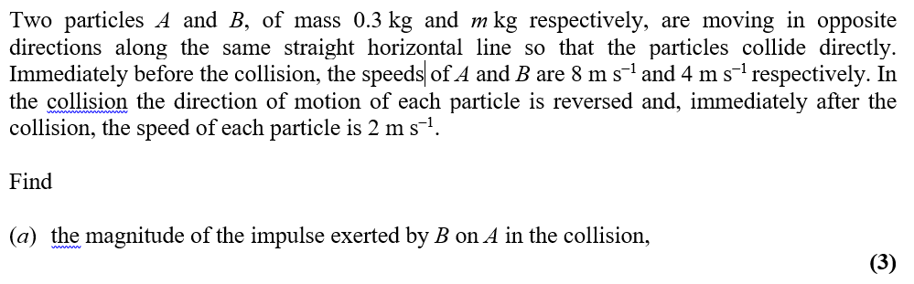
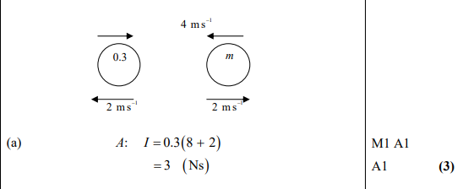
Test Your Understanding
Edexcel M1 Jun 2007 Q2a
?

Slide 9
Exercise 1A
Pearson Further Mechanics 1
Pages 3-4
Complete before the lesson Q1
In Class:
Green Q2-3
Amber Q4-5

Slide 10











The law of Conservation of Momentum
The law of Conservation of Momentum
In an isolated system:
Total momentum before impact = Total momentum after impact
100km/h
30km/h
Proof:
$$u_{1}$$
$$u_{2}$$
Diagram?
Tip: Start by drawing a diagram
do it quickly free hand
make it a decent size
Velocities: use single arrows detached from bodies
Impulses: use arrows attached to bodies (like forces)
Before
$$I$$
$$m_{1}$$
$$m_{2}$$
$$I$$
After
$$v_{1}$$
$$v_{2}$$
By Newton’s 3rd law the magnitude of $I$is equal on both bodies (equal and opposite forces acting for equal time).
$\underset{→}{Body 1}$: $I=m_{1}v_{1}−m_{1}u_{1}$
$\underset{→}{Body 2}$: $−I=m_{2}v_{2}−m_{2}u_{2}$
$0=m_{1}v_{1}−m_{1}u_{1}+m_{2}v_{2}−m_{2}u_{2}$
$⇒ m_{1}u_{1}+m_{2}u_{2}=m_{1}v_{1}+m_{2}v_{2}$
?
1
?
2
$$+$$
?
1
2
$⇒$Total momentum before impact = Total momentum after impact (as required)
1. An isolated system is a collection of bodies which only experience unbalanced forces from other bodies in the system.

Slide 11









Quickfire Conservation of Momentum
Calculated the value of the unknown in the following isolated systems.
All velocities marked are in m/s and all masses in kg.
3
1
$$v_{2}=5{ms}^{−1}$$
2
1
?
1
$$v_{2}$$
3
1
2
1
$$v_{2}=9{ms}^{−1}$$
?
1
$$v_{2}$$
3
1
2
1
$$v_{2}=7{ms}^{−1}$$
?
1
$$v_{2}$$
3
1
?
$$v=\frac{5}{3}{ms}^{−1}$$
2
1
$$v$$
$$v$$

Slide 12
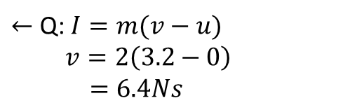


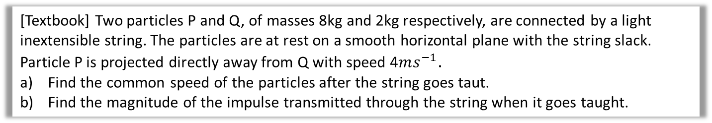

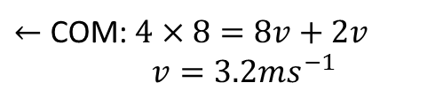

An Example
[Textbook] Two particles P and Q, of masses 8kg and 2kg respectively, are connected by a light inextensible string. The particles are at rest on a smooth horizontal plane with the string slack. Particle P is projected directly away from Q with speed 4$ms^{−1}$.
Find the common speed of the particles after the string goes taut.
Find the magnitude of the impulse transmitted through the string when it goes taught.
4
0
Solution to a)
Diagram for a?
8
2
$←$ COM: $4×8=8v+2v$
$v=3.2ms^{−1}$
$$v$$
$$v$$
0
Diagram for b?
Solution to b)
$$I$$
$←$ Q: $I=m(v−u)$
$v=2\left(3.2−0\right)$
$=6.4Ns$
2
$$v$$

Slide 13
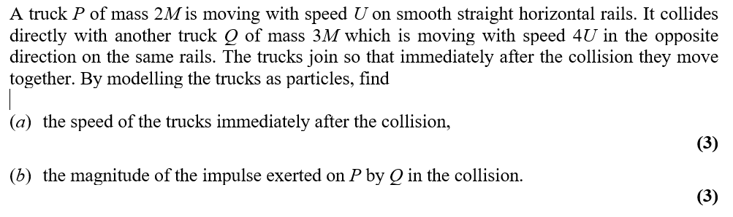
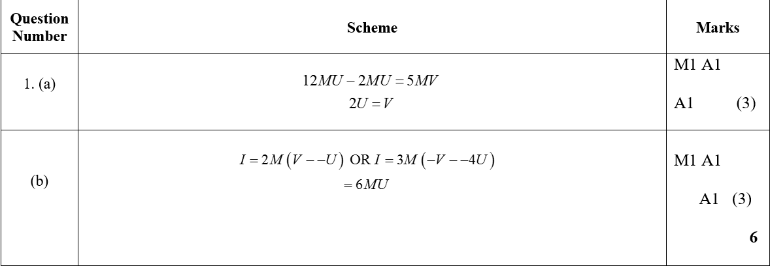
Test Your Understanding
Edexcel M1 Jan 2014 (I) Q1
?

Slide 14
Exercise 1B
Pearson Further Mechanics 1
Pages 7-9
Complete before the lesson Q1-4
In Class:
Green Q5-7
Amber Q8-10
Red Q11-12 & challenge

Slide 15
Momentum as a Vector
Mass and time are scalar quantities.
Momentum, Force, Velocity and Impulse are all vector quantities.
For one dimensional questions all direction is simply + or -.
For two dimensional questions, all the equations from this chapter can be used with vectors.
You can work separately with i, j (and k) components.
[Textbook] A particle of mass 0.2kg is moving with velocity (10i – 5j) ${ms}^{−1}$ when it receives an impulse (3i – 2j)Ns. Find the new velocity of the particle.
?
Impulse = change in momentum
I = m(v – u)
3i – 2j = 0.2(v – (10i – 5j)) dividing both sides by 0.2
15i – 10j = v – (10i – 5j) adding 10i – 5j to both sides
15i – 10j + 10i – 5j = v collecting i and j terms separately
v = 25i – 15j

Slide 16
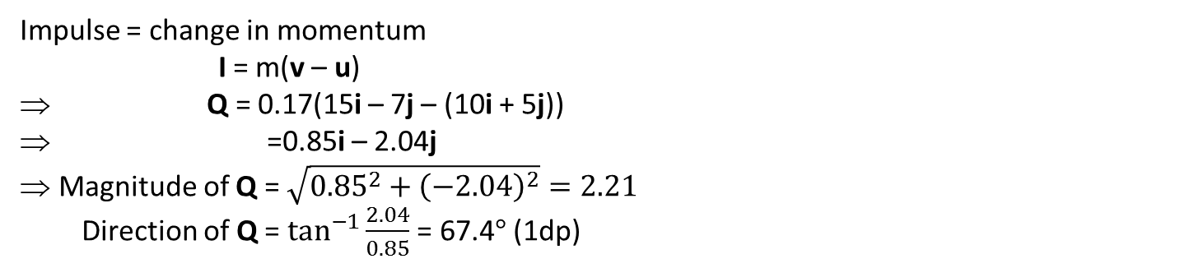
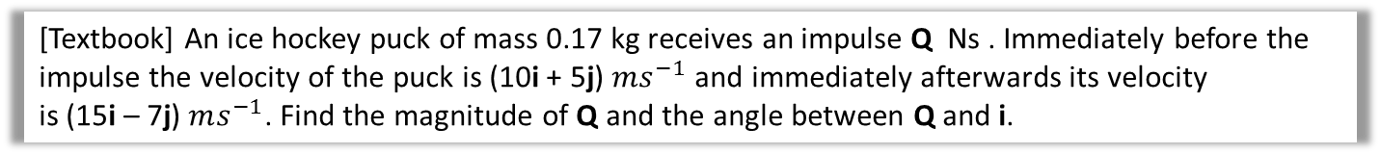


Momentum as a Vector
To find the magnitude of a vector (e.g. Impulse Momentum) use Pythagoras
To find the direction of a vector use trigonometry
Tip: Remember if the question asks for speed, this is the magnitude of velocity, if it asks for distance this is the magnitude of displacement.
[Textbook] An ice hockey puck of mass 0.17 kg receives an impulse Q Ns . Immediately before the impulse the velocity of the puck is (10i + 5j) $ms^{−1}$ and immediately afterwards its velocity
is (15i – 7j) $ms^{−1}$. Find the magnitude of Q and the angle between Q and i.
Impulse = change in momentum
I = m(v – u)
Q = 0.17(15i – 7j – (10i + 5j))
=0.85i – 2.04j
Magnitude of Q = $\sqrt{{0.85}^{2}+{\left(−2.04\right)}^{2}}=2.21$
  Direction of Q = $\tan^{−1}{\frac{2.04}{0.85}}$ = 67.4$°$ (1dp)
?
0.85
$$i$$
Tip: Diagrams help when finding directions
67.4$°$
Q
2.04

Slide 17
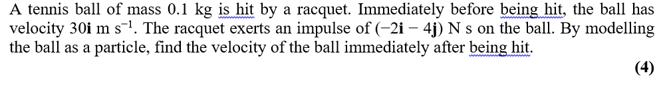
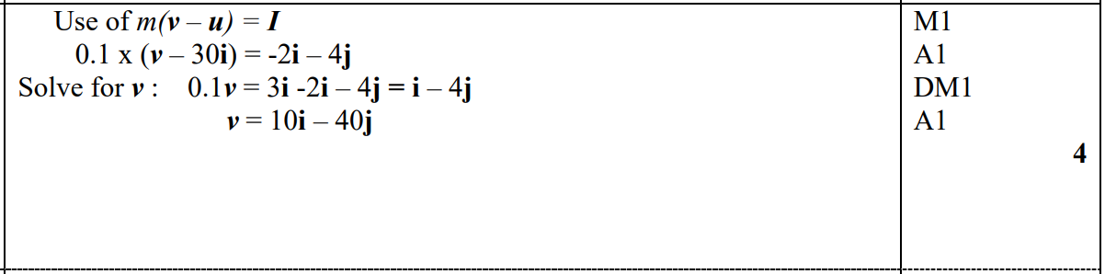


Test Your Understanding
Edexcel M2 Jan 2012 Q1
?
Riddle: (VIM + VI) + 0 + +

Slide 18
Exercise 1C
Pearson Further Mechanics 1
Pages 11-12
Complete before the lesson Q1-3
In Class:
Green Q4-6
Amber Q7-10
Red Q11-16 & challenge

