Slide 1
Year 1 Pure Mathematics
Binomial Expansion
- Expanding Brackets
Chapter 8
(Part 1 of 3)

Slide 2
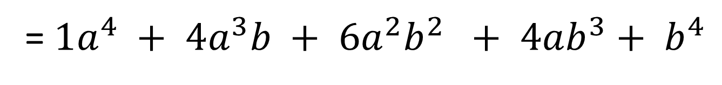


Binomial Expansion
Expand and Simplify
$${\left(a+b\right)}^{4}$$
= $1a^{4} + 4a^{3}b + 6a^{2}b^{2} + 4ab^{3}+ b^{4}$
Imagine Expanding
${\left(a+b\right)}^{8}$
Binomial Expansion is a method that makes expanding brackets a much friendlier process.

Slide 3
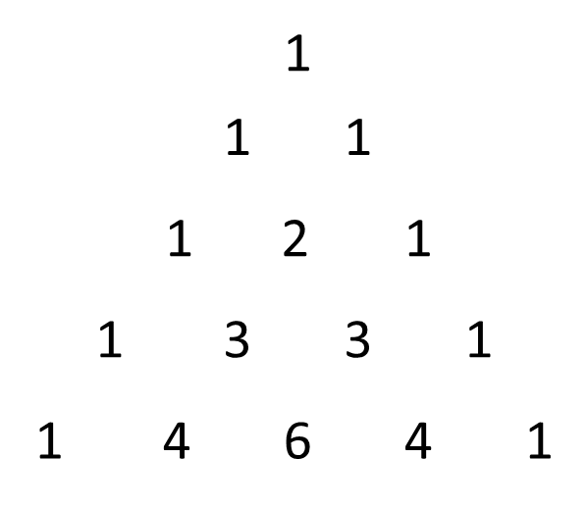
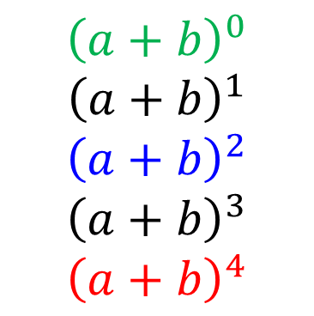
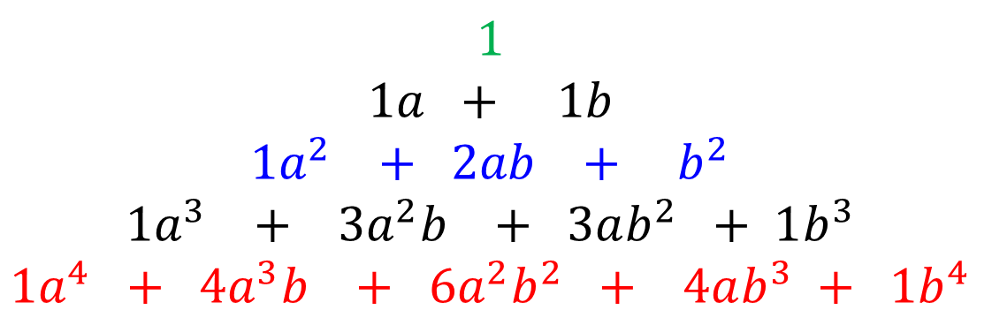
Binomial Expansion
What do you notice about
the following expansions?
$${\left(a+b\right)}^{0}$$
$${\left(a+b\right)}^{1}$$
$${\left(a+b\right)}^{2}$$
$${\left(a+b\right)}^{3}$$
$${\left(a+b\right)}^{4}$$
$$1$$
$$1a + 1b$$
$$1a^{2} + 2ab + b^{2}$$
$$1a^{3} + 3a^{2}b + 3ab^{2} + 1b^{3}$$
$$1a^{4} + 4a^{3}b + 6a^{2}b^{2} + 4ab^{3} + {1b}^{4}$$
=
=
=
=
=
Its Pascal’s Triangle!

Slide 4
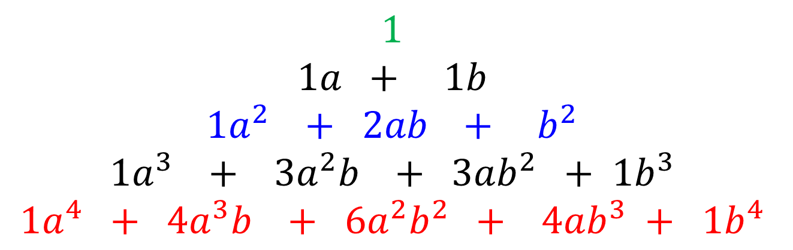

Binomial Expansion
$$1$$
$$1a + 1b$$
$$1a^{2} + 2ab + b^{2}$$
$$1a^{3} + 3a^{2}b + 3ab^{2} + 1b^{3}$$
$$1a^{4} + 4a^{3}b + 6a^{2}b^{2} + 4ab^{3} + 1b^{4}$$
Expansion of ${\left(a+b\right)}^{5}$
$$1a^{5} + 5a^{4}b + 10b^{2} +10a^{2}b^{3 }+5ab^{4} + {1b}^{5}$$

Slide 5

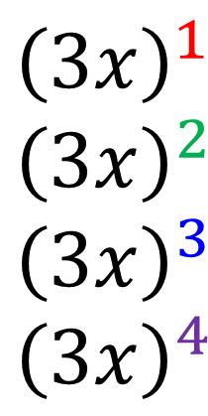
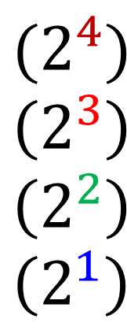
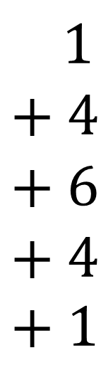
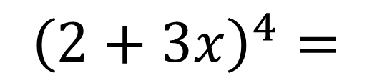
Binomial Expansion
Find the expansion of ${\left(2+3x\right)}^{4}$
$${\left(2+3x\right)}^{4}=$$
$$1 \\ + 4 \\ + 6 \\ + 4 \\ + 1$$
$$(2^{4}) \\ \left(2^{3}\right) \\ \left(2^{2}\right) \\ \left(2^{1}\right)$$
$${\left(3x\right)}^{1} \\ {\left(3x\right)}^{2} \\ {\left(3x\right)}^{3} \\ {\left(3x\right)}^{4}$$
$$=16+96x+216x^{2}+216x^{3}+81x^{4}$$

Slide 6
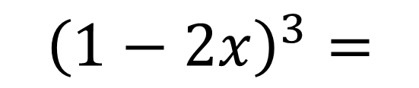
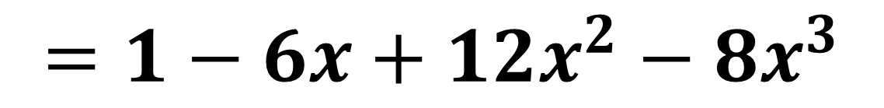
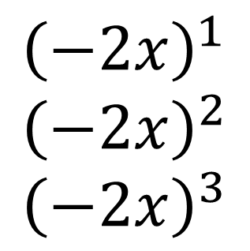
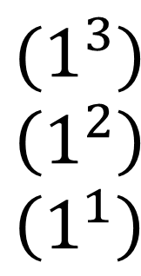
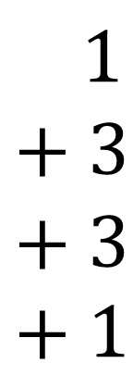
Binomial Expansion
Find the expansion of ${\left(2+3x\right)}^{4}$
$${\left(1−2x\right)}^{3}=$$
$$1 \\ + 3 \\ + 3 \\ + 1$$
$$(1^{3}) \\ \left(1^{2}\right) \\ \left(1^{1}\right)$$
$${\left(−2x\right)}^{1} \\ {\left(−2x\right)}^{2} \\ {\left(−2x\right)}^{3}$$
$$=1−6x+12x^{2}−8x^{3}$$

Slide 7



Using Binomial Coefficients to Expand
There is an easy way to find out the coefficients
so you don’t need to remember Pascal’s Triangle.
The ‘choose’ button on you calculator
will work out the values of you
Use the $nCr$ button on your calculator
⁵C₀
⁵C₁
⁵C₂
⁵C₃
⁵C₄
⁵C₅
1 5 10 10 5 1
$\left(\begin{matrix}5 \\ 4\end{matrix}\right)$ notation is preferable to $5C4$
$\left(\begin{matrix}5 \\ 0 \end{matrix}\right)\left(\begin{matrix}5 \\ 1 \end{matrix}\right)$ $\left(\begin{matrix}5 \\ 2 \end{matrix}\right)$ $\left(\begin{matrix}5 \\ 3 \end{matrix}\right)$ $\left(\begin{matrix}5 \\ 4 \end{matrix}\right)$ $\left(\begin{matrix}5 \\ 5 \end{matrix}\right)$

Slide 8
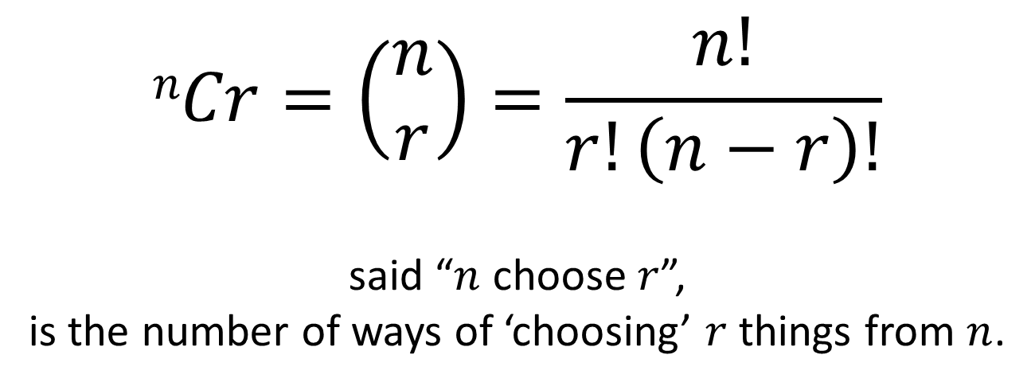
Factorial and Choose Function
$$nCr=\left(\begin{matrix}n \\ r\end{matrix}\right)=\frac{n!}{r!\left(n−r\right)!}$$
said “$n$ choose $r$”,
is the number of ways of ‘choosing’ $r$ things from $n$.
For example, if your a football team captain
and need to choose 2 people from amongst 5 in your class.
YYNNN
YNYNN
YNNYN
YNNNY
NYYNN
NYNYN
NYNNY
NNYYN
NNYNY
NNNYY

Slide 9
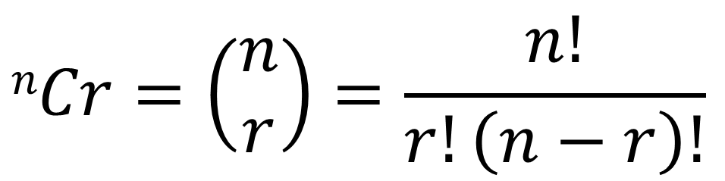
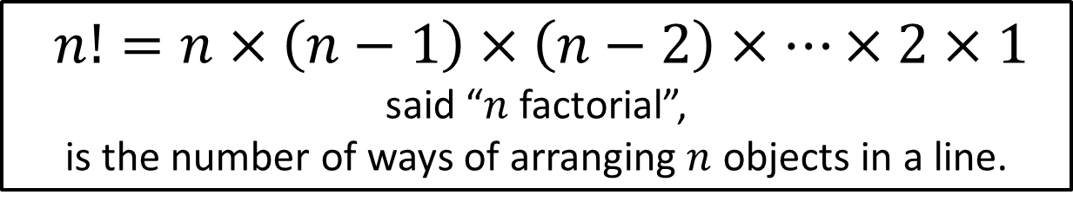
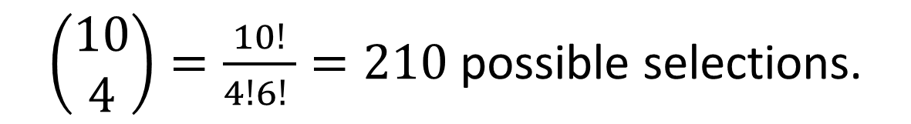
Factorial and Choose Function
$$nCr=\left(\begin{matrix}n \\ r\end{matrix}\right)=\frac{n!}{r!\left(n−r\right)!}$$
For example, if your a football team captain
and need to choose 4 people from amongst 10 in your class.
$\left(\begin{matrix}10 \\ 4\end{matrix}\right)=\frac{10!}{4!6! }=210$ possible selections.
$n!=n×\left(n−1\right)×\left(n−2\right)×…×2×1$
said “$n$ factorial”,
is the number of ways of arranging $n$ objects in a line.

Slide 10
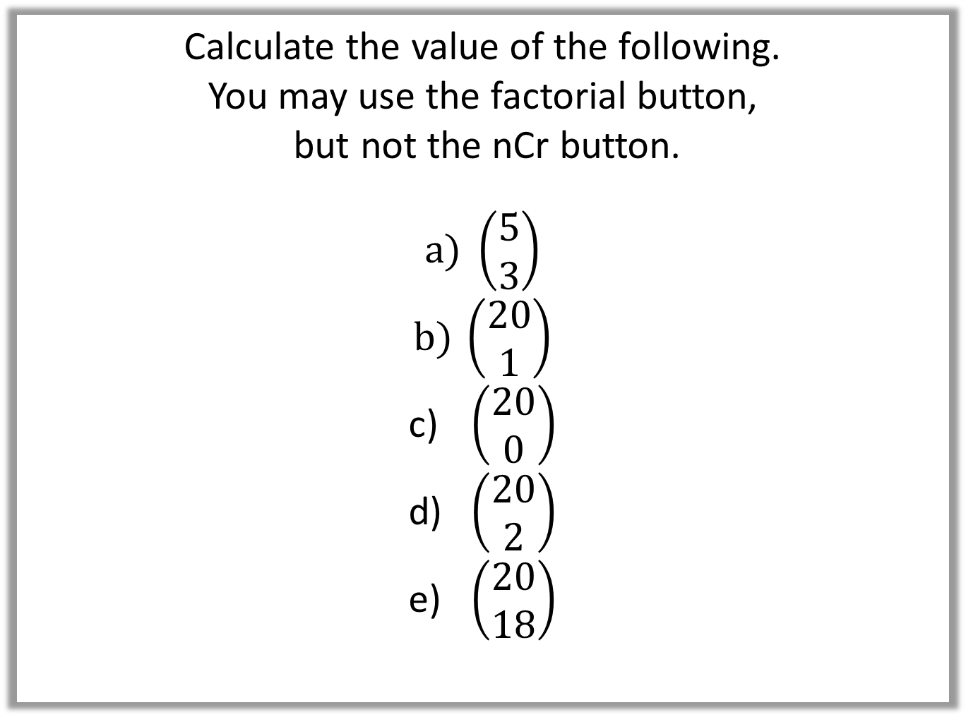
Factorial and Choose Function
Calculate the value of the following.
You may use the factorial button,
but not the nCr button.
$\left(\begin{matrix}5 \\ 3\end{matrix}\right)$
$\left(\begin{matrix}20 \\ 1\end{matrix}\right)$
$\left(\begin{matrix}20 \\ 0\end{matrix}\right)$
$\left(\begin{matrix}20 \\ 2\end{matrix}\right)$
$\left(\begin{matrix}20 \\ 18\end{matrix}\right)$

Slide 11
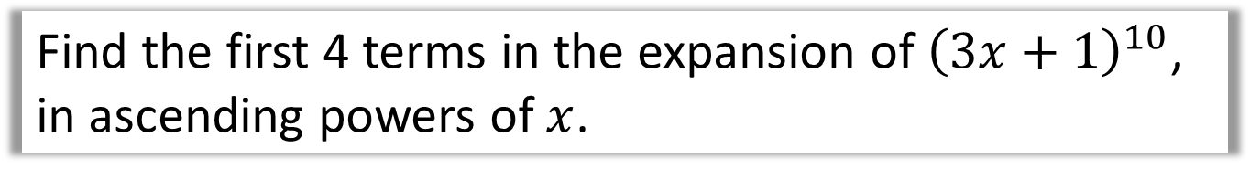

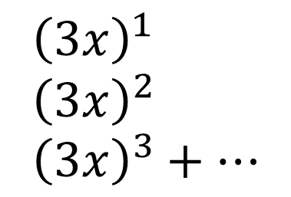
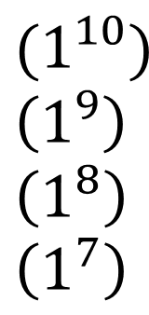

Using Binomial Coefficients to Expand
Find the first 4 terms in the expansion of ${\left(3x+1\right)}^{10}$,
in ascending powers of $x$.
$${\left(a+b\right)}^{n}=a^{n}+\left(\begin{matrix}n \\ 1\end{matrix}\right)a^{n−1}b+\left(\begin{matrix}n \\ 2\end{matrix}\right)a^{n−2}b^{2}+…+\left(\begin{matrix}n \\ r\end{matrix}\right)a^{n−r}b^{r}+…+b^{n}$$
$$\left(\begin{matrix}10 \\ 0\end{matrix}\right) \\ +\left(\begin{matrix}10 \\ 1\end{matrix}\right) \\ +\left(\begin{matrix}10 \\ 2\end{matrix}\right) \\ +\left(\begin{matrix}10 \\ 3\end{matrix}\right)$$
$${\left(3x+1\right)}^{10}=$$
$$(1^{10}) \\ \left(1^{9}\right) \\ \left(1^{8}\right) \\ \left(1^{7}\right)$$
$${\left(3x\right)}^{1} \\ {\left(3x\right)}^{2} \\ {\left(3x\right)}^{3}+…$$
$$=1+30x+405x^{2}+3240x^{3}+…$$

Slide 12
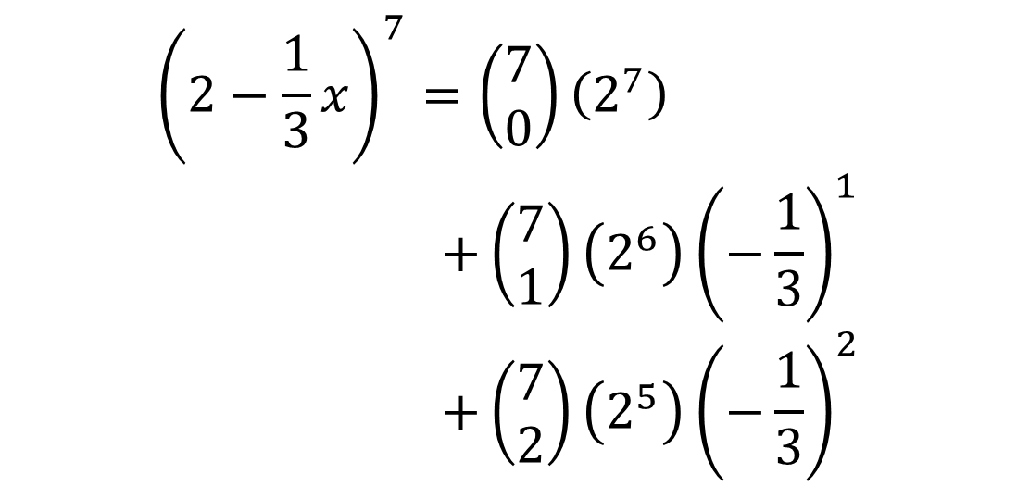
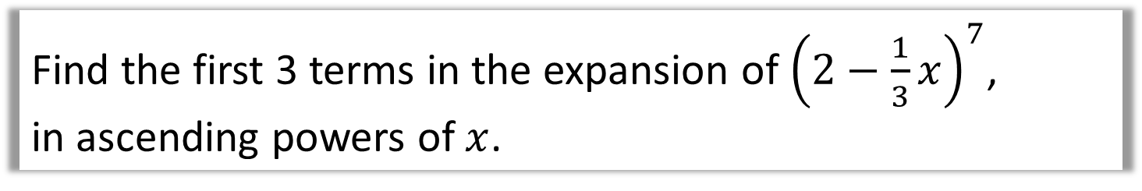
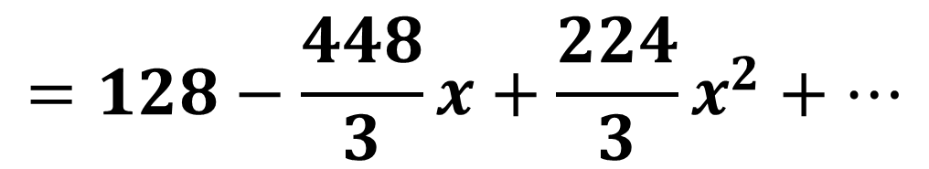
Using Binomial Coefficients to Expand
Find the first 3 terms in the expansion of ${\left(2−\frac{1}{3}x\right)}^{7}$,
in ascending powers of $x$.
$${\left(2−\frac{1}{3}x\right)}^{7}=\left(\begin{matrix}7 \\ 0\end{matrix}\right)\left(2^{7}\right) \\ +\left(\begin{matrix}7 \\ 1\end{matrix}\right)\left(2^{6}\right){\left(−\frac{1}{3}\right)}^{1} \\ +\left(\begin{matrix}7 \\ 2\end{matrix}\right)\left(2^{5}\right){\left(−\frac{1}{3}\right)}^{2}$$
$$=128−\frac{448}{3}x+\frac{224}{3}x^{2}+…$$

Slide 13

Exercise 8A
Pearson Pure Mathematics Year 1/AS
Pages 160-161
Extension
[MAT 2009 1J]
The number of pairs of positive integers $x,y$ which solve the equation:
$$x^{3}+6x^{2}y+12xy^{2}+8y^{3}=2^{30}$$
is:
0
$2^{6}$
$2^{9}−1$
$2^{10}+2$
The LHS is the binomial expansion of ${\left(x+2y\right)}^{3}$, therefore:
$${\left(x+2y\right)}^{3}=2^{30} \\ x+2y=2^{10} \\ x=2\left(2^{9}−y\right)$$
In order for $x$ to be a positive integer, $y$ can be between 1 and $2^{9}−1$. The answer is C.
1
Complete before the lesson Q1-3
Green Q4
Amber Q5-6
Red Q7-9 & Challenge
?

Slide 14
Exercise 8B
Pearson Pure Mathematics Year 1/AS
Pages 162
Complete before the lesson Q1-5
Green Q6-7
Amber Q8-9
Red 10-11 & Challenge

