Slide 1
Year 1 Pure Mathematics
Sketching Graphs
- Quartic Graphs
Chapter 4
(Part 1 of 5)

Slide 2
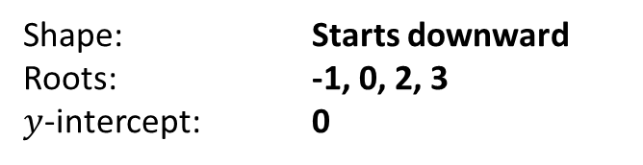
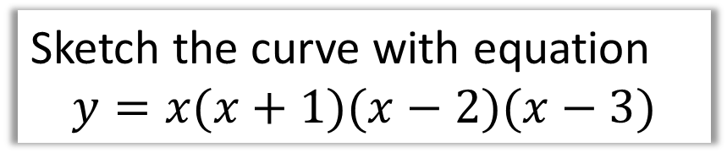


Quartic Graphs – No Equal Roots
Sketch the curve with equation
$$y=x(x+1)(x−2)(x−3)$$
Shape: Starts downward
Roots: -1, 0, 2, 3
$y$-intercept: 0
$$y$$
2
$$x$$
-1
3

Slide 3
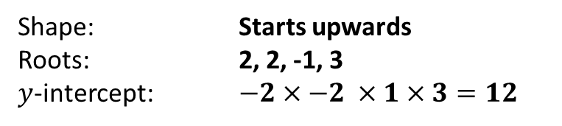
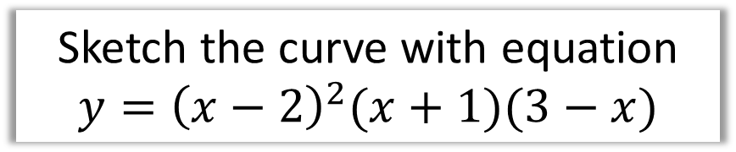


Quartic Graphs – 2 Equal Roots
Sketch the curve with equation
$$y={\left(x−2\right)}^{2}(x+1)(3−x)$$
Shape: Starts upwards
Roots: 2, 2, -1, 3
$y$-intercept: $−2×−2 ×1×3=12$
$$y$$
2
3
$$x$$
-1

Slide 4

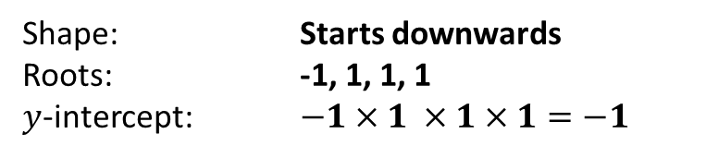
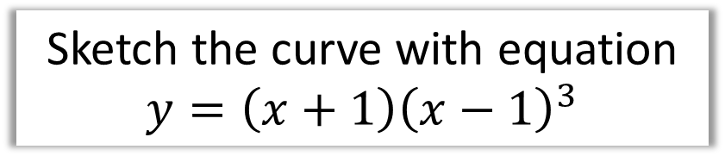
Quartic Graphs – 3 Equal Roots
Sketch the curve with equation
$$y=\left(x+1\right){\left(x−1\right)}^{3}$$
Shape: Starts downwards
Roots: -1, 1, 1, 1
$y$-intercept: $−1×1 ×1×1=−1$
$$y$$
1
$$x$$
-1
-1

Slide 5


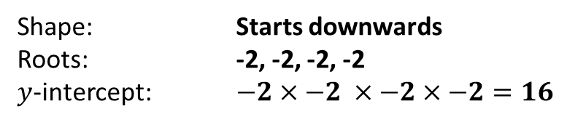

Quartic Graphs – 4 Equal Roots
Sketch the curve with equation
$$y={\left(x−2\right)}^{4}$$
Shape: Starts downwards
Roots: -2, -2, -2, -2
$y$-intercept: $−2×−2 ×−2×−2=16$
$$y$$
16
$$x$$
2

Slide 6
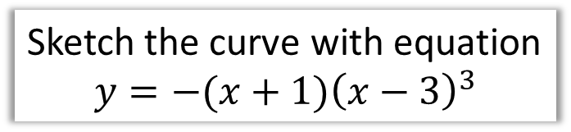

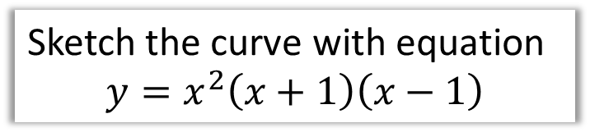



Quartic Graphs - Test Your Understanding
Sketch the curve with equation
$$y=x^{2}\left(x+1\right)\left(x−1\right)$$
Sketch the curve with equation
$$y=−(x+1){\left(x−3\right)}^{3}$$
$$y$$
$$y$$
27
$$x$$
-1
3
$$x$$
-1
1

Slide 7
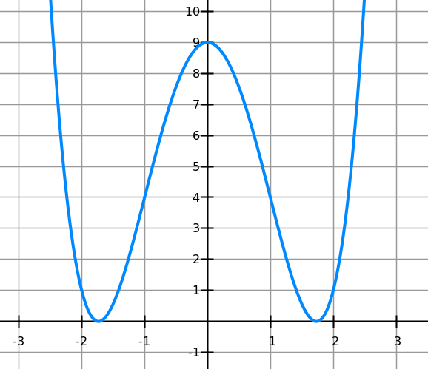
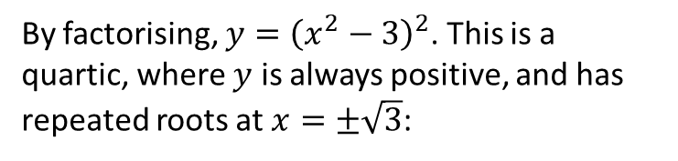
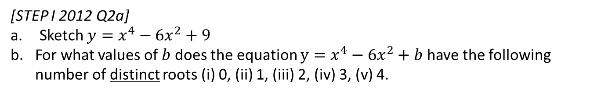

Exercise 4B
Complete before the lesson Q1 a-d only
Green Complete Q1
Amber Q2-3
Red Q4 & Challenge
Pearson Pure Mathematics Year 1/AS
Pages 65-66
Extension
[STEP I 2012 Q2a]
Sketch $y=x^{4}−6x^{2}+9$
For what values of $b$ does the equation $y=x^{4}−6x^{2}+b$ have the following number of distinct roots (i) 0, (ii) 1, (iii) 2, (iv) 3, (v) 4.
1
a)
By factorising, $y={\left(x^{2}−3\right)}^{2}$. This is a quartic, where $y$ is always positive, and has repeated roots at $x=±\sqrt{3}$:
b)
By changing $b$, we shift the graph up and down. Then we can see that:
0 roots: When $b>9$
1 root: Not possible.
2 roots: When $b=9 or b<0$
3 roots: $b=0$
4 roots: $0<b<9$
?
?
?
?
?
?

