Slide 1
Year 1 Applied Mathematics
Hypothesis Testing
- Accept or Reject
Chapter 7
(Part 4 of 5)

Slide 2

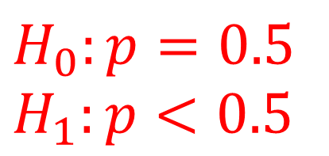
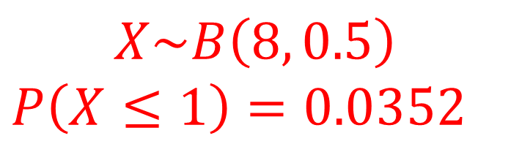
Hypothesis Test – One Tailed
John tosses a coin 8 times and it comes up heads 1 times.
He claims the coin is biased towards tails.
With a significance level of 5%, test his claim.
Step 1: Write you hypothesis
$$H_{0}:p=0.5 \\ H_{1}:p<0.5$$
Step 2: Calculate the probability of getting 1 or less
$$X\sim B\left(8, 0.5\right)$$
$$P\left(X≤1\right)=0.0352$$
Step 3: Accept or Reject Hypothesis
3.52% < 5%,
so sufficient evidence to reject $H_{0}$.
Coin is biased.

Slide 3

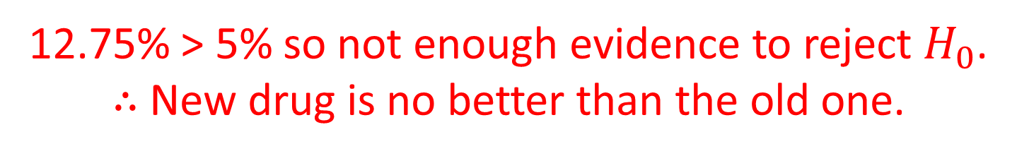
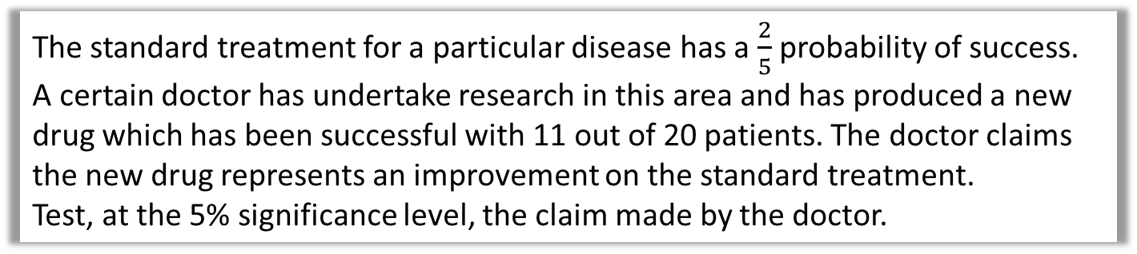
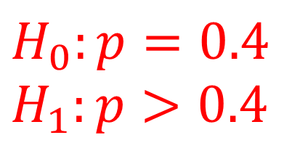
Hypothesis Test – One Tailed
The standard treatment for a particular disease has a $\frac{2}{5}$ probability of success. A certain doctor has undertake research in this area and has produced a new drug which has been successful with 11 out of 20 patients. The doctor claims the new drug represents an improvement on the standard treatment.
Test, at the 5% significance level, the claim made by the doctor.
Step 1: Write you hypothesis
$$H_{0}:p=0.4 \\ H_{1}:p>0.4$$
Step 2: Calculate the probability of getting 11 or more
$$P\left(X≥11\right)=1−P\left(X≤10\right)=0.1275$$
Step 3: Accept or Reject Hypothesis
12.75% > 5% so not enough evidence to reject $H_{0}$.
$∴$ New drug is no better than the old one.

Slide 4
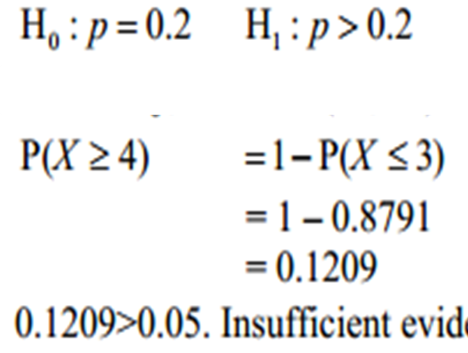
Hypothesis Test – One Tailed
A student takes a multiple choice test.
The test is made up of 10 questions each with 5 possible answers.
The student gets 4 questions correct.
Her teacher claims she was guessing the answers.
Using a one tailed test, at the 5% level of significance,
test whether or not there is evidence to reject the teacher’s claim.
State your hypotheses clearly. (6)
H_{o} is accepted. The teacher’s claim is supported.

Slide 5
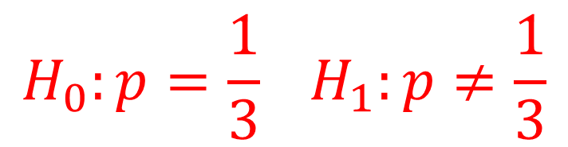

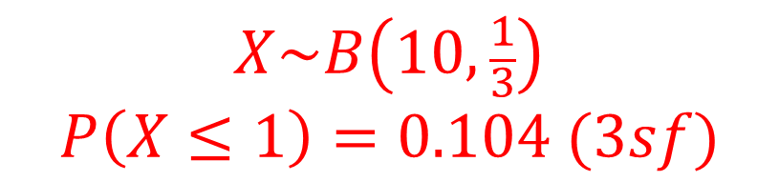
Hypothesis Test – Two Tailed
Over a long period of time it has been found that in Enrico’s restaurant the ratio of non-veg to veg meals is 2 to 1. In Manuel’s restaurant in a random sample of 10 people ordering meals, 1 ordered a vegetarian meal.
Using a 5% level of significance, test whether or not the proportion of people eating veg meals in Manuel’s restaurant is different to that in Enrico’s restaurant.
Step 1: Write you hypothesis
$$H_{0}:p=\frac{1}{3} H_{1}:p≠\frac{1}{3}$$
Step 2: Calculate the probability of getting 1 or less
$$X\sim B\left(10, \frac{1}{3}\right)$$
$$P\left(X≤1\right)=0.104 (3sf)$$
Step 3: Accept or Reject Hypothesis
$0.104>0.025$ accept $H_{0}$.
Not enough evidence to support that the proportion of veg meals
at Manuel’s restaurant is different to Enrico’s.

Slide 6
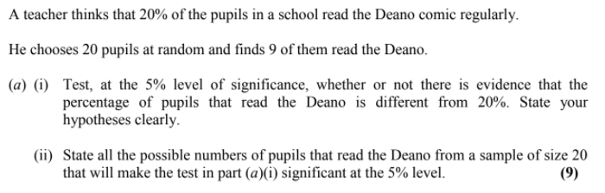
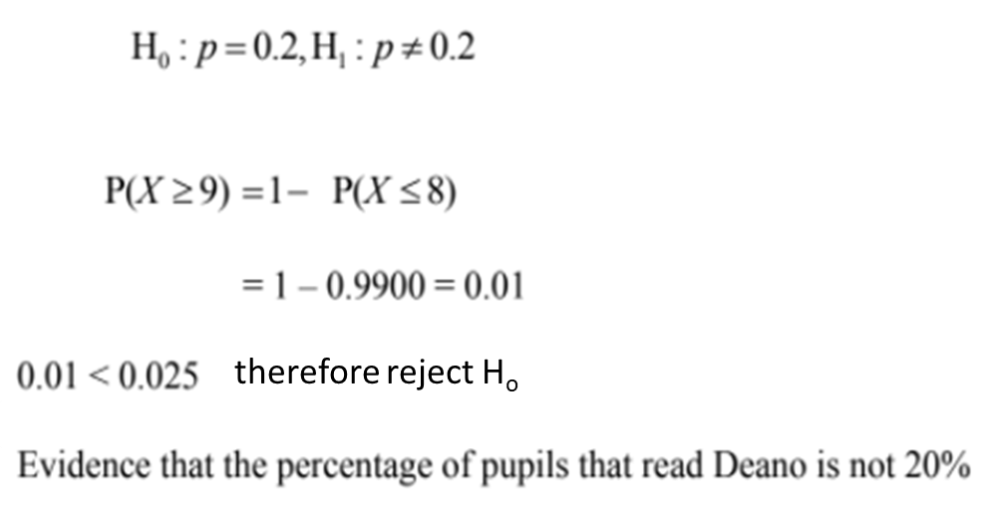
Hypothesis Test – Two Tailed

Slide 7
Exercise 7C
Pearson Pure Mathematics Year 1/AS
Pages 106-107
Complete before the lesson Q1-3
In Class:
Green Q4-6
Amber Q7-8
Red Q9-10

Slide 8
Exercise 7D
Pearson Pure Mathematics Year 1/AS
Pages 108-109
Complete before the lesson Q1-2
In Class:
Green Q3-4
Amber Q5-6
Red Q7-10

