Slide 1

P1 Chapter 11 :: Vectors
jfrost@tiffin.kingston.sch.uk
www.drfrostmaths.com
@DrFrostMaths
Last modified: 23rd July 2018

Slide 2








www.drfrostmaths.com
Everything is completely free.
Why not register?
Register now to interactively practise questions on this topic, including past paper questions and extension questions (including MAT + UKMT).
Teachers: you can create student accounts (or students can register themselves), to set work, monitor progress and even create worksheets.
With questions by:
Dashboard with points, trophies, notifications and student progress.
Questions organised by topic, difficulty and past paper.
Teaching videos with topic tests to check understanding.

Slide 3

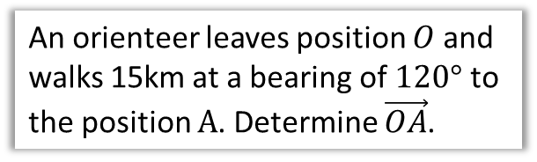
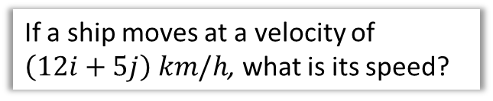
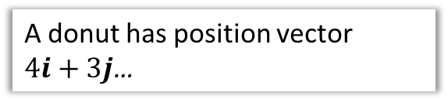
Chapter Overview
Vectors used to be a Year 2 A Level topic. However, the more difficult content has been moved to Further Maths. This chapter is now more intended as providing the ‘fundamentals’ of vectors (most of which you learned at GCSE), supporting Mechanics and FM.
1:: Add/scale factors and show vectors are parallel.
2:: Calculate magnitude and direction of a vector.
If $a=3i+4j$, determine $|a|$.
3:: Understand and use position vectors.
4:: Solve both geometric problems.
An orienteer leaves position $O$ and walks 15km at a bearing of $120°$ to the position $A$. Determine $\vec{OA}$.
A donut has position vector
$4i+3j$…
5:: Understand speed vs velocity
If a ship moves at a velocity of $\left(12i+5j\right) km/h$, what is its speed?

Slide 4







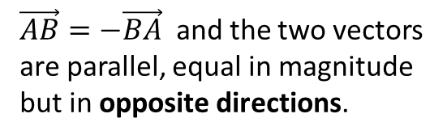
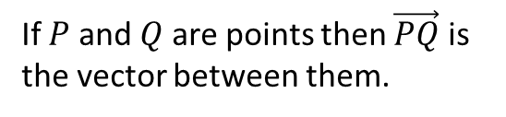




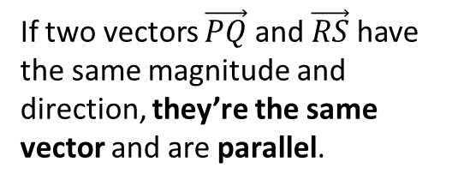


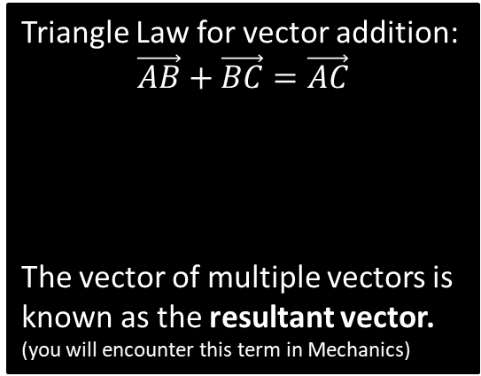





Vector Basics
Whereas a coordinate represents a position in space, a vector represents a displacement in space.
C
$\vec{AB}=−\vec{BA}$ and the two vectors are parallel, equal in magnitude but in opposite directions.
A
$$a$$
$$B$$
A vector has 2 properties:
Direction
Magnitude (i.e. length)
$$B$$
$$A$$
$$−a$$
$$A$$
D
Triangle Law for vector addition:
$$\vec{AB}+\vec{BC}=\vec{AC}$$
The vector of multiple vectors is known as the resultant vector. (you will encounter this term in Mechanics)
If $P$ and $Q$ are points then $\vec{PQ}$ is the vector between them.
$$B$$
$$b$$
$$a$$
$$Q$$
$$C$$
$$P$$
$$A$$
$$a+b$$
B
If two vectors $\vec{PQ}$ and $\vec{RS}$ have the same magnitude and direction, they’re the same vector and are parallel.
This might seem obvious, but students sometimes think the vector is different because the movement occurred at a different point in space. Nope!
$$Q$$
$$P$$
$$S$$
$$R$$

Slide 5



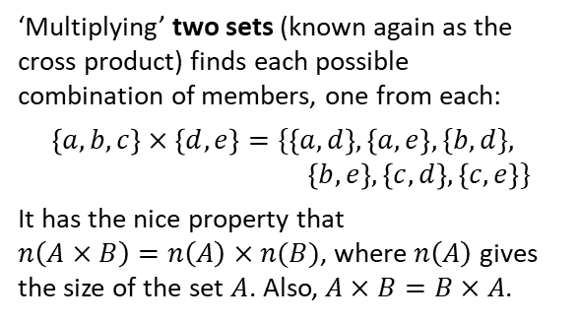
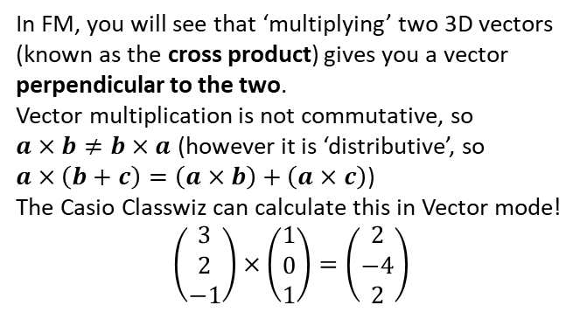
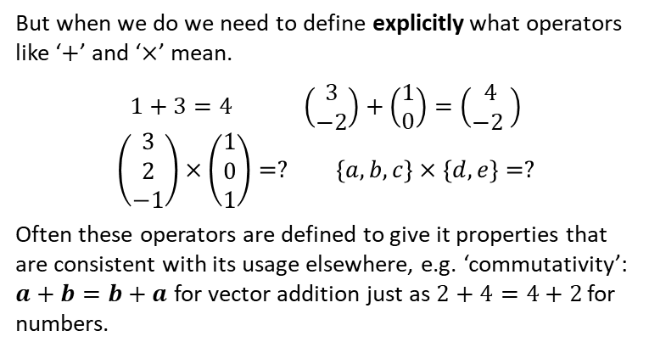
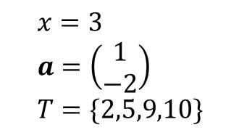


Just for your interest…
Have you ever wondered what happens if you ‘multiply’ two vectors or two sets?
Erm…
In KS2/3 you probably only experienced variables holding numerical values. You since saw that variables can represent other mathematical types, such as sets or vectors:
But when we do we need to define explicitly what operators like ‘$+$’ and ‘$×$’ mean.
$$1+3=4 \left(\begin{matrix}3 \\ −2\end{matrix}\right)+\left(\begin{matrix}1 \\ 0\end{matrix}\right)=\left(\begin{matrix}4 \\ −2 \end{matrix}\right)$$
$$\left(\begin{matrix}3 \\ 2 \\ −1\end{matrix}\right)×\left(\begin{matrix}1 \\ 0 \\ 1\end{matrix}\right)=? \left\{a,b,c\right\}×\left\{d,e\right\}=?$$
Often these operators are defined to give it properties that are consistent with its usage elsewhere, e.g. ‘commutativity’: $a+b=b+a$ for vector addition just as $2+4=4+2$ for numbers.
$$x=3 \\ a=\left(\begin{matrix}1 \\ −2\end{matrix}\right) \\ T=\{2,5,9,10\}$$
‘Multiplying’ two sets (known again as the cross product) finds each possible combination of members, one from each:
$$\left\{a,b,c\right\}×\left\{d,e\right\}=\{\left\{a,d\right\},\left\{a,e\right\},\{b,d\}, \\ \left\{b,e\right\},\left\{c,d\right\},\left\{c,e\right\}\}$$
It has the nice property that
$n\left(A×B\right)=n\left(A\right)×n(B)$, where $n\left(A\right)$ gives the size of the set $A$. Also, $A×B=B×A$.
In FM, you will see that ‘multiplying’ two 3D vectors (known as the cross product) gives you a vector perpendicular to the two.
Vector multiplication is not commutative, so
$a×b≠b×a$ (however it is ‘distributive’, so
$a×\left(b+c\right)=\left(a×b\right)+\left(a×c\right)$)
The Casio Classwiz can calculate this in Vector mode!
$$\left(\begin{matrix}3 \\ 2 \\ −1\end{matrix}\right)×\left(\begin{matrix}1 \\ 0 \\ 1\end{matrix}\right)=\left(\begin{matrix}2 \\ −4 \\ 2\end{matrix}\right)$$
$$a×b$$
$$b$$
ME-WOW!
$$a$$

Slide 6
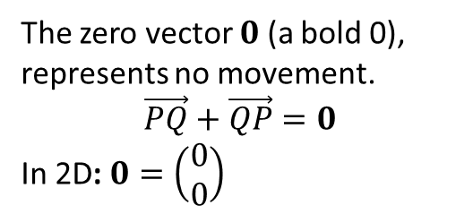



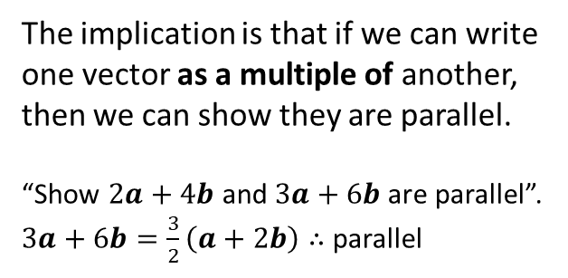
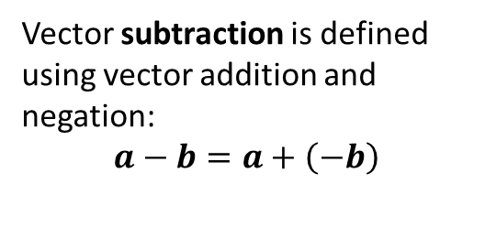






Vector Basics
E
Vector subtraction is defined using vector addition and negation:
$$a−b=a+\left(−b\right)$$
G
A scalar is a normal number, which can be used to ‘scale’ a vector.
The direction will be the same.
But the magnitude will be different (unless the scalar is 1).
$$a$$
$$a$$
$$b$$
$$−b$$
$$a$$
$$a−b$$
$$2a$$
If scalar is negative, opposite direction.
F
The zero vector $0$ (a bold 0), represents no movement.
$$\vec{PQ}+\vec{QP}=0$$
In 2D: $0=\left(\begin{matrix}0 \\ 0\end{matrix}\right)$
$$−\frac{1}{2}a$$
H
Any vector parallel to the vector $a$ can be written as $λa$, where $λ$ is a scalar.
The implication is that if we can write one vector as a multiple of another, then we can show they are parallel.
“Show $2a+4b$ and $3a+6b$ are parallel”.
$3a+6b=\frac{3}{2}\left(a+2b\right)∴$parallel

Slide 7
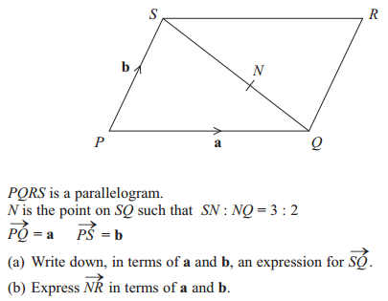

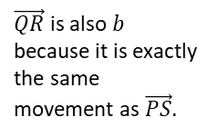


Example
Edexcel GCSE June 2013 1H Q27
Fro Tip: This ratio wasn’t in the original diagram. I like to add the ratio as a visual aid.
$$\vec{SQ}=−b+a$$
a
?
For (b), there’s two possible paths to get from $N$ to $R$: via $S$ or via $Q$. But which is best?
In (a) we found $S$ to $Q$ rather than $Q$ to $S$, so it makes sense to go in this direction so that we can use our result in (a).
3 : 2
?
$$\vec{NR}=\frac{2}{5}\vec{SQ}+b \\ =\frac{2}{5}\left(−b+a\right)+b \\ =\frac{2}{5}a+\frac{3}{5}b$$
$\vec{QR}$ is also $b$ because it is exactly the same movement as $\vec{PS}$.
b
?
Fro Workings Tip: While you’re welcome to start your working with the second line, I recommend the first line so that your chosen route is clearer.

Slide 8
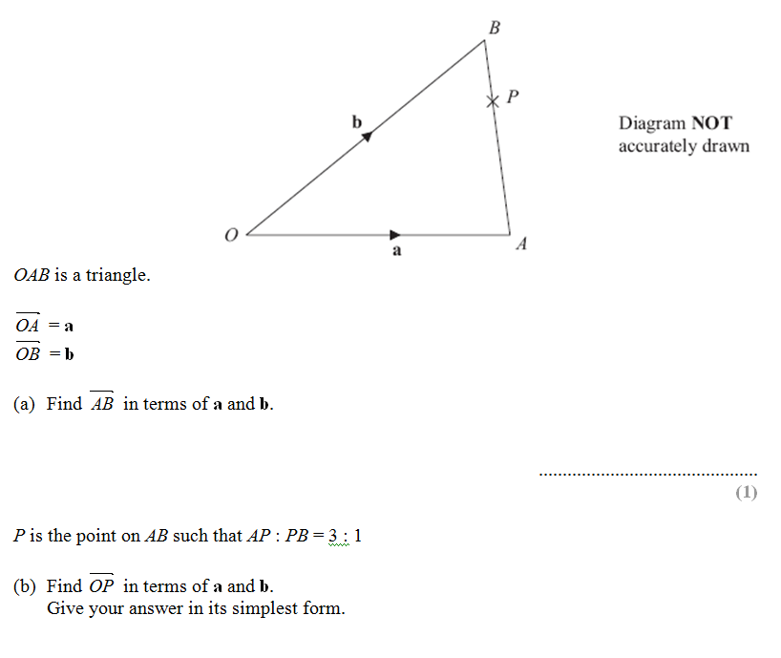
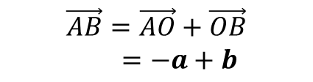

Test Your Understanding
Edexcel GCSE June 2012
$$\vec{AB}=\vec{AO}+\vec{OB}$$
$=−a+b$
?
$$\vec{OP}=a+\frac{3}{4}\vec{AB}$$
$=a+\frac{3}{4}\left(−a+b\right)$
$=\frac{1}{4}a+\frac{3}{4}b$
?

Slide 9
Exercise 11A
Pearson Pure Mathematics Year 1/AS
Pages 234-235
Complete before the lesson Q1-4
Green Q5-6
Amber Q7-8
Red Q9-11

Slide 10


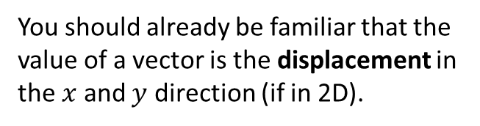

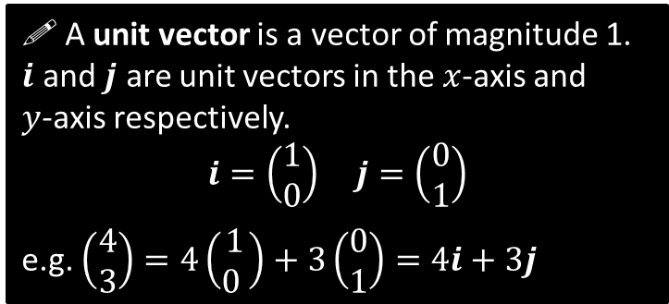
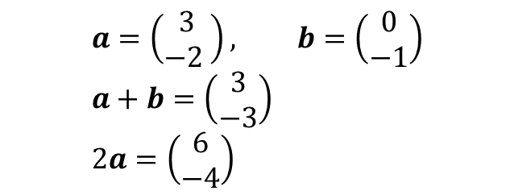

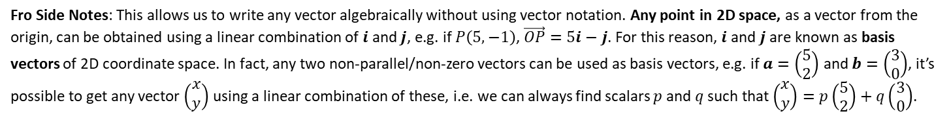
Representing Vectors
You should already be familiar that the value of a vector is the displacement in the $x$ and $y$ direction (if in 2D).
$$\left(\begin{matrix}3 \\ −2 \end{matrix}\right)$$
$$a=\left(\begin{matrix}3 \\ −2 \end{matrix}\right), b=\left(\begin{matrix}0 \\ −1\end{matrix}\right) \\ a+b=\left(\begin{matrix}3 \\ −3\end{matrix}\right) \\ 2a=\left(\begin{matrix}6 \\ −4\end{matrix}\right)$$
?
?
! A unit vector is a vector of magnitude 1.
$i$ and $j$ are unit vectors in the $x$-axis and
$y$-axis respectively.
$$i=\left(\begin{matrix}1 \\ 0\end{matrix}\right) j=\left(\begin{matrix}0 \\ 1\end{matrix}\right)$$
e.g. $\left(\begin{matrix}4 \\ 3\end{matrix}\right)=4\left(\begin{matrix}1 \\ 0 \end{matrix}\right)+3\left(\begin{matrix}0 \\ 1\end{matrix}\right)=4i+3j$
$$j$$
$$i$$
Fro Side Notes: This allows us to write any vector algebraically without using vector notation. Any point in 2D space, as a vector from the origin, can be obtained using a linear combination of $i$ and $j$, e.g. if $P\left(5,−1\right)$, $\vec{OP}=5i−j$. For this reason, $i$ and $j$ are known as basis vectors of 2D coordinate space. In fact, any two non-parallel/non-zero vectors can be used as basis vectors, e.g. if $a=\left(\begin{matrix}5 \\ 2\end{matrix}\right)$ and $b=\left(\begin{matrix}3 \\ 0\end{matrix}\right)$, it’s possible to get any vector $\left(\begin{matrix}x \\ y\end{matrix}\right)$ using a linear combination of these, i.e. we can always find scalars $p$ and $q$ such that $\left(\begin{matrix}x \\ y\end{matrix}\right)=p\left(\begin{matrix}5 \\ 2\end{matrix}\right)+q\left(\begin{matrix}3 \\ 0\end{matrix}\right)$.

Slide 11

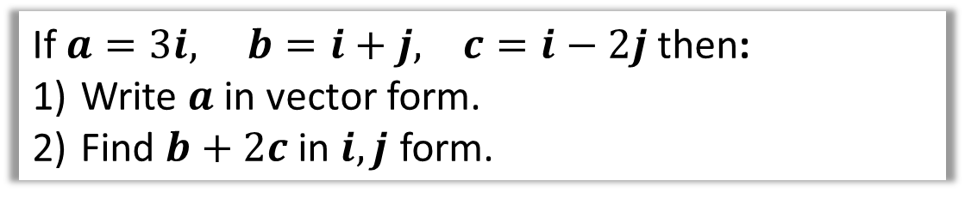
Examples
If $a=3i, b=i+j, c=i−2j$ then:
Write $a$ in vector form.
Find $b+2c$ in $i,j$ form.
$$a=\left(\begin{matrix}3 \\ 0\end{matrix}\right)$$
$$b+2c=i+j+2\left(i−2j\right) \\ =i+j+2i−4j \\ =3i−3j$$
1
?
2
?

Slide 12
Exercise 11B
Pearson Pure Mathematics Year 1/AS
Pages 237-238
Complete before the lesson Q1-3
Green Q4-5
Amber Q6-7
Red Q8-10

Slide 13
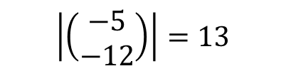


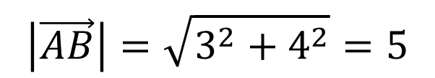





Magnitude of a Vector
! The magnitude $|a|$ of a vector $a$ is its length.
If $a=\left(\begin{matrix}x \\ y\end{matrix}\right) \left|a\right|=\sqrt{x^{2}+y^{2}}$
$$\left(\begin{matrix}3 \\ 4\end{matrix}\right)$$
$$B$$
?
4
$$\left|\vec{AB}\right|=\sqrt{3^{2}+4^{2}}=5$$
$$A$$
3
?
?
$$\left|\left(\begin{matrix}1 \\ −1\end{matrix}\right)\right|=\sqrt{2}$$
$$\left|\left(\begin{matrix}−5 \\ −12\end{matrix}\right)\right|=13$$
$$a=\left(\begin{matrix}4 \\ −1\end{matrix}\right) \left|a\right|=\sqrt{4^{2}+1^{2}}=\sqrt{17}$$
?
?
$$b=\left(\begin{matrix}2 \\ 0\end{matrix}\right) \left|b\right|=\sqrt{2^{2}+0^{2}}=2$$

Slide 14



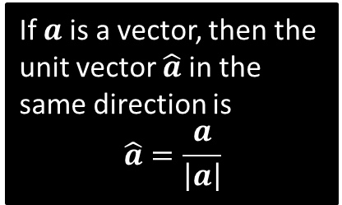
Unit Vectors
! A unit vector is a vector whose magnitude is 1
There’s certain operations on vectors that require the vectors to be ‘unit’ vectors. We just scale the vector so that its magnitude is now 1.
$$a=\left(\begin{matrix}3 \\ 4\end{matrix}\right) \\ \left|a\right|=\sqrt{3^{2}+4^{2}}=5 \\ \hat{a}=\left(\begin{matrix}3/5 \\ 4/5\end{matrix}\right)$$
If $a$ is a vector, then the unit vector $\hat{a}$in the same direction is
$$\hat{a}=\frac{a}{\left|a\right|}$$
?
Test Your Understanding: Convert the following vectors to unit vectors.
$$a=\left(\begin{matrix}12 \\ −5\end{matrix}\right)$$
$$\left|a\right|=\sqrt{{12}^{2}+5^{2}}=13 \\ ∴\hat{a}=\left(\begin{matrix}\frac{12}{13} \\ −\frac{5}{13}\end{matrix}\right)$$
$$b=\left(\begin{matrix}1 \\ 1\end{matrix}\right)$$
$$\left|b\right|=\sqrt{1^{2}+1^{2}}=\sqrt{2} \\ ∴\hat{b}=\left(\begin{matrix}\frac{1}{\sqrt{2}} \\ \frac{1}{\sqrt{2}}\end{matrix}\right)$$
?
?

Slide 15
Exercise 11C
Pearson Pure Mathematics Year 1/AS
Pages 240-242
Complete before the lesson Q1-5
Green Q6-7
Amber Q8-10
Red Q11 & Challenge

Slide 16




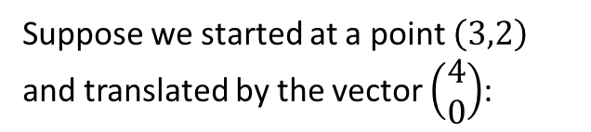


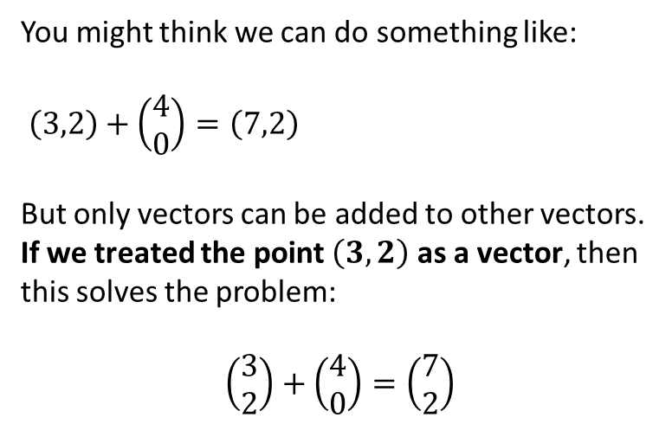
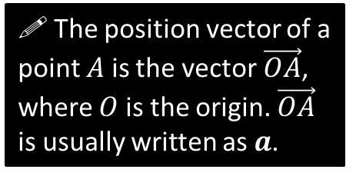


Position Vectors
$$y$$
Suppose we started at a point $\left(3,2\right)$ and translated by the vector $\left(\begin{matrix}4 \\ 0\end{matrix}\right)$:
$$a=\left(\begin{matrix}3 \\ 2\end{matrix}\right)$$
$$A\left(3,2\right)$$
$$\left(\begin{matrix}4 \\ 0\end{matrix}\right)$$
$$O$$
$$x$$
$$A\left(3,2\right)$$
$$?$$
A vector used to represent a position is unsurprisingly known as a position vector.
A position can be thought of as a translation from the origin, as per above. It enables us to use positions in all sorts of vector (and matrix!) calculations.
You might think we can do something like:
$\left(3,2\right)+\left(\begin{matrix}4 \\ 0\end{matrix}\right)=\left(7,2\right)$
But only vectors can be added to other vectors.
If we treated the point $\left(3,2\right)$ as a vector, then this solves the problem:
$$\left(\begin{matrix}3 \\ 2\end{matrix}\right)+\left(\begin{matrix}4 \\ 0\end{matrix}\right)=\left(\begin{matrix}7 \\ 2\end{matrix}\right)$$
! The position vector of a point $A$ is the vector$\vec{OA}$, where $O$ is the origin. $\vec{OA}$ is usually written as $a$.

Slide 17

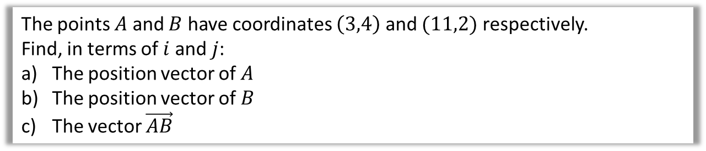


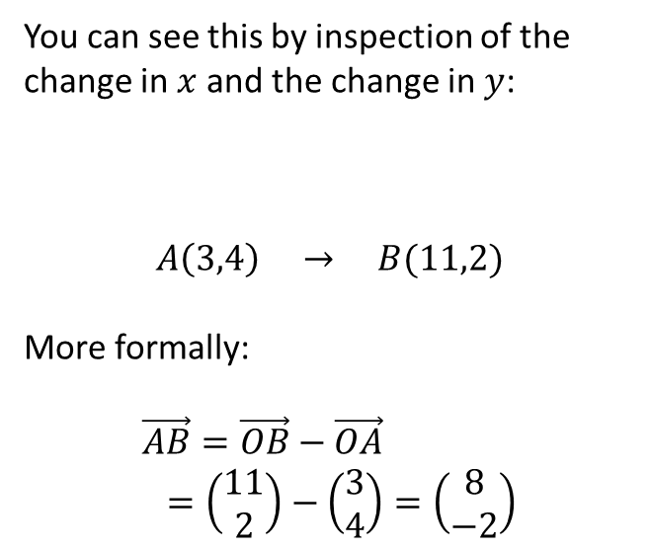
Example
The points $A$ and $B$ have coordinates $\left(3,4\right)$ and $(11,2)$ respectively.
Find, in terms of $i$ and $j$:
The position vector of $A$
The position vector of $B$
The vector $\vec{AB}$
?
You can see this by inspection of the change in $x$ and the change in $y$:
$$A\left(3,4\right) → B(11,2)$$
More formally:
$$\vec{AB}=\vec{OB}−\vec{OA} \\ =\left(\begin{matrix}11 \\ 2\end{matrix}\right)−\left(\begin{matrix}3 \\ 4\end{matrix}\right)=\left(\begin{matrix}8 \\ −2\end{matrix}\right)$$
a
$$\vec{OA}=3i+4j$$
$$\vec{OB}=11i+2j$$
$$\vec{AB}=8i−2j$$
b
?
$$+8$$
$$−2$$
c
?

Slide 18
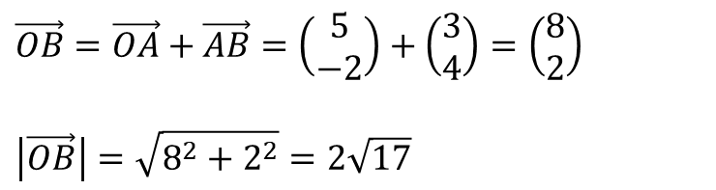
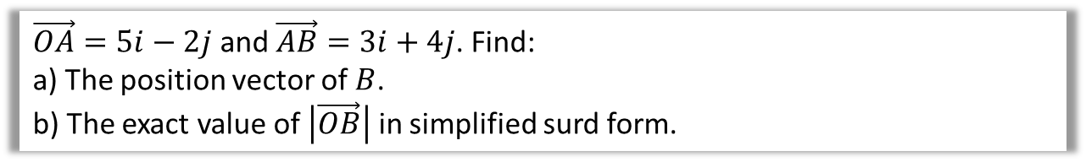
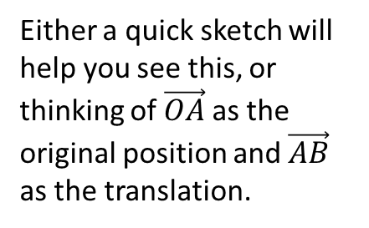
Further Example
$\vec{OA}=5i−2j$ and $\vec{AB}=3i+4j$. Find:
a) The position vector of $B$.
b) The exact value of $\left|\vec{OB}\right|$ in simplified surd form.
Either a quick sketch will help you see this, or thinking of $\vec{OA}$ as the original position and $\vec{AB}$ as the translation.
?
a
$$\vec{OB}=\vec{OA}+\vec{AB}=\left(\begin{matrix}5 \\ −2\end{matrix}\right)+\left(\begin{matrix}3 \\ 4\end{matrix}\right)=\left(\begin{matrix}8 \\ 2\end{matrix}\right)$$
$$\left|\vec{OB}\right|=\sqrt{8^{2}+2^{2}}=2\sqrt{17}$$
?
b

Slide 19
Exercise 11D
Pearson Pure Mathematics Year 1/AS
Pages 243-244
Complete before the lesson Q1-3
Green Q4-5
Amber Q6
Red Q7 & Challenge

Slide 20








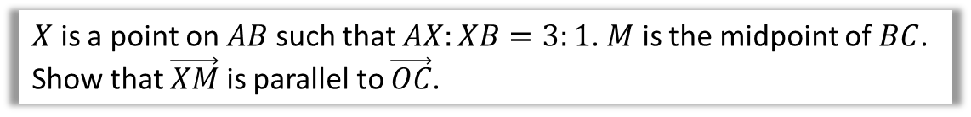


Solving Geometric Problems
$$A$$
$$C$$
$$a$$
$$X$$
$$M$$
$$O$$
$$b$$
$$B$$
$X$ is a point on $AB$ such that $AX:XB=3:1$. $M$ is the midpoint of $BC$.
Show that $\vec{XM}$ is parallel to $\vec{OC}$.
?
For any proof question always find the vectors involved first, in this case $\vec{XM}$ and $\vec{OC}$.
$$\vec{OC}=a+b \\ \vec{XM}=\frac{1}{4}\left(−a+b\right)+\frac{1}{2}a=\frac{1}{4}a+\frac{1}{4}b \\ =\frac{1}{4}\left(a+b\right)$$
$\vec{XM}$ is a multiple of $\vec{OC}$ $∴$ parallel.
The key is to factor out a scalar such that we see the same vector.
The magic words here are “is a multiple of”.

Slide 21




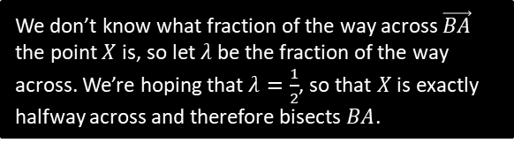




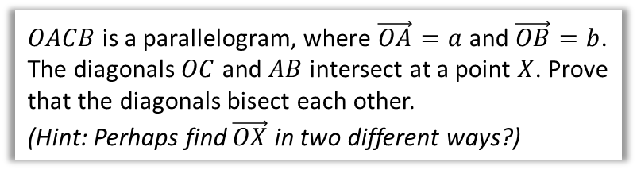

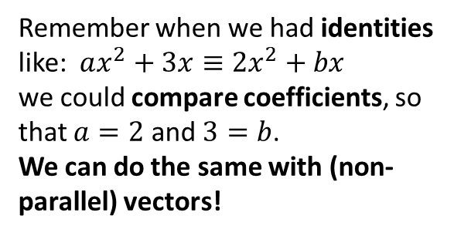
Introducing Scalars and Comparing Coefficients
Remember when we had identities like: $ax^{2}+3x≡2x^{2}+bx$
we could compare coefficients, so that $a=2$ and $3=b$.
We can do the same with (non-parallel) vectors!
$$O$$
$$a$$
$$A$$
$$X$$
$$b$$
$OACB$ is a parallelogram, where $\vec{OA}=a$ and $\vec{OB}=b$. The diagonals $OC$ and $AB$ intersect at a point $X$. Prove that the diagonals bisect each other.
(Hint: Perhaps find $\vec{OX}$ in two different ways?)
$$B$$
$$C$$
By considering the route $O→B→X$:
$$\vec{OX}=b+λ \vec{BA} \\ =b+λ\left(−b+a\right)=b−λb+λa \\ =λa+\left(1−λ\right)b$$
Similarly, considering the line $OC$:
$$\vec{OX}=μ \vec{OC}=μ\left(a+b\right)=μa+μb$$
$$∴μa+μb=λa+\left(1−λ\right)b$$
Comparing coefficients of $a$: $μ=λ$
Comparing coefficients of $b$: $μ=1−λ$
$$∴μ=λ=\frac{1}{2}$$
$∴X$ is the midpoint of each of the diagonals.
?
We don’t know what fraction of the way across $\vec{BA}$ the point $X$ is, so let $λ$ be the fraction of the way across. We’re hoping that $λ=\frac{1}{2}$, so that $X$ is exactly halfway across and therefore bisects $BA$.
We need to use a different scalar constant, this time $μ$.
It is common to use the letters $λ$ and $μ$ for scalars.

Slide 22



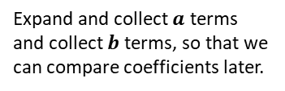







Test Your Understanding
$$a$$
$$O$$
$$Q$$
$$A$$
$$X$$
$$b$$
$$B$$
$$C$$
In the above diagram, $\vec{OA}=a, \vec{OB}=b$ and $\vec{OQ}=\frac{1}{3}a$. We wish to find the ratio $OX:XC$.
If $\vec{OX}=λ \vec{OC}$, find an expression for $\vec{OX}$ in terms of $a,b$ and $λ$.
If $\vec{BX}=μ \vec{BQ}$, find an expression for $\vec{OX}$ in terms of $a,b$ and $μ$.
By comparing coefficients or otherwise, determine the value of $λ$, and hence the ratio $OX:XC$.
$$\vec{OX}=λ \vec{OC}=λ\left(a+b\right)=λa+λb \\ \vec{OX}=b+μ \vec{BQ}=b+μ\left(−b+\frac{1}{3}a\right)=\frac{1}{3}μa+\left(1−μ\right)b$$
Comparing coefficients: $λ=\frac{1}{3}μ$ and $λ=1−μ$, $∴λ=\frac{1}{4}$
If $\vec{OX}=\frac{1}{4} \vec{OC}$, then $OX:XC=1:3$.
a
?
Expand and collect $a$ terms and collect $b$ terms, so that we can compare coefficients later.
b
?
c
?

Slide 23











Area of a Triangle
$\vec{AB}=3i−2j$ and $\vec{AC}=i−5j$. Determine $∠BAC$.
?
Strategy: Find 3 lengths of triangle then use cosine rule to find angle.
$$A$$
$$\left(\begin{matrix}3 \\ −2\end{matrix}\right)$$
?
$$\left|\vec{AB}\right|=\sqrt{13}$$
$$B$$
$$\left(\begin{matrix}1 \\ −5\end{matrix}\right)$$
$$\left(\begin{matrix}2 \\ 3\end{matrix}\right)$$
?
?
$$\left|\vec{CB}\right|=\sqrt{13}$$
?
$$\left|\vec{AC}\right|=\sqrt{26}$$
$$C$$
A clever student might at this point realise that we can divide all the lengths by $\sqrt{13}$ without changing $∠BAC$, giving a $1:1:\sqrt{2}$ triangle (one of our ‘special’ triangles!), and thus instantly getting $∠BAC=45°$.
But let’s use a more general method of using the cosine rule:
$$a=\sqrt{13}, b=\sqrt{13}, c=\sqrt{26} \\ 13=13+26−2×\sqrt{13}×\sqrt{26}×\cos\left(A\right) \\ \cos\left(A\right)=\frac{1}{\sqrt{2}} → A=45°$$
?

Slide 24

Exercise 11E
Complete before the lesson Q1
Green Q2
Amber Q3-4
Red Q5-6 & Challenge
Pearson Pure Mathematics
Pages 246-247
Extension
1
[STEP 2010 Q7]
Relative to a fixed origin $O$, the points $A$ and $B$ have position vectors $a$ and $b$, respectively. (The points $O, A$ and $B$ are not collinear.) The point $C$ has position vector $c$ given by
$$c=αa+βb,$$
where $α$ and $β$ are positive constants with $α+β<1$. The lines $OA$ and $BC$ meet at the point $P$ with position vector $p$ and the lines $OB$ and $AC$ meet at the point $Q$ with position vector $q$. Show that
$$p=\frac{αa}{1−β}$$
and write down $q$ in terms of $α, β$ and $b$.
Show further that the point $R$ with position vector $r$ given by
$$r=\frac{αa+βb}{α+β},$$
lies on the lines $OC$ and $AB$.
The lines $OB$ and $PR$ intersect at the point $S$. Prove that $\frac{OQ}{BQ}=\frac{OS}{BS}$.
Click here for the solution:
http://www.mathshelper.co.uk/STEP%202010%20Solutions.pdf
(go to Q7)

Slide 25








Modelling
In Mechanics, you will see certain things can be represented as a simple number (without direction), or as a vector (with direction):
Remember a ‘scalar’ just means a normal number (in the context of vectors). It can be obtained using the magnitude of the vector.
Vector Quantity
Equivalent Scalar Quantity
Velocity
e.g. $\left(\begin{matrix}3 \\ 4\end{matrix}\right) km/h$
?
Speed
$= 5 km/h$
This means the position vector of the object changes by $\left(\begin{matrix}3 \\ 4\end{matrix}\right)$ each hour.
…which is equivalent to moving 5km each hour.
$$5$$
$$4$$
$$3$$
Displacement
e.g. $\left(\begin{matrix}−5 \\ 12\end{matrix}\right) km$
?
Distance
$$=13 km$$

Slide 26








Example
[Textbook] A girl walks 2 km due east from a fixed point $O$ to $A$, and then 3 km due south from $A$ to $B$. Find
the total distance travelled
the position vector of $B$ relative to $O$
$\left|\vec{OB}\right|$
The bearing of $B$ from $O$.
N
$$2+3=5km \\ \vec{OB}=\left(\begin{matrix}2 \\ 3\end{matrix}\right) km$$
$\left|\vec{OB}\right|=\sqrt{2^{2}+3^{2}}=\sqrt{13}=3.61km$ (3sf)
$$90°+\tan^{−1}\left(\frac{3}{2}\right)=56.3°$$
$$2$$
$$A$$
a
?
$$O$$
b
?
$$θ$$
$$3$$
c
?
d
?
$$B$$

Slide 27























Further Example
[Textbook] In an orienteering exercise, a cadet leaves the starting point $O$ and walks 15 km on a bearing of $120°$ to reach $A$, the first checkpoint. From $A$ he walks 9 km on a bearing of $240°$ to the second checkpoint, at $B$. From $B$ he returns directly to $O$.
Find:
the position vector of $A$ relative to $O$
$\left|\vec{OB}\right|$
the bearing of $B$ from $O$
the position vector of $B$ relative $O$.
I have no specific advice to offer except:
Draw a BIG diagram.
Remember bearings are measured clockwise from North.
Don’t forget units (on vectors!)
N
?
N
b
Using cosine rule on $ΔOAB$, $\left|\vec{OB}\right|=13.1km$ (3sf)
?
a
$$120°$$
$$O$$
N
$$O$$
N
$$30°$$
$$30°$$
$$θ$$
$$60°$$
$$θ$$
$$15 km$$
$$A$$
$$15 km$$
$$A$$
$$60°$$
$$240°$$
$$240°$$
$$9 km$$
$$9 km$$
$$B$$
$$B$$
?
$$\vec{OA}=\left(\begin{matrix}15\cos{30°} \\ 15\sin{30°}\end{matrix}\right)=\left(\begin{matrix}13.0 \\ 7.5\end{matrix}\right) km$$
c
Using sine rule on $ΔOAB$:
$$θ=36.6…°$$
$∴$Bearing $=120+36.6°=157°$ (3sf)

Slide 28







Further Example
[Textbook] In an orienteering exercise, a cadet leaves the starting point $O$ and walks 15 km on a bearing of $120°$ to reach $A$, the first checkpoint. From $A$ he walks 9 km on a bearing of $240°$ to the second checkpoint, at $B$. From $B$ he returns directly to $O$.
Find:
the position vector of $A$ relative to $O$
$\left|\vec{OB}\right|$
the bearing of $B$ from $O$
the position vector of $B$ relative $O$.
N
d
?
$$120°$$
$$O$$
N
$$30°$$
$$\vec{OB}=\left(\begin{matrix}13.07\sin{23.41°} \\ −13.07\cos{23.41°}\end{matrix}\right)=\left(\begin{matrix}5.19 \\ −12.0\end{matrix}\right) km$$
$$36.59°$$
$$15 km$$
$$23.41°$$
$$A$$
$$13.07 km$$
$$9 km$$
(I think the textbook made a rounding error due to use of rounded values. They put $\left(\begin{matrix}5.1 \\ −12.1\end{matrix}\right)$)
$$B$$

Slide 29
Exercise 11F
Pearson Pure Mathematics Year 1/AS
Pages 250-251
Complete before the lesson Q1-3
Green Q4-5
Amber Q6
Red Q7-8

