Slide 1
Year 2 Applied Mathematics
Projectiles
- Formulae
Chapter 6
(Part 3 of 3)

Slide 2
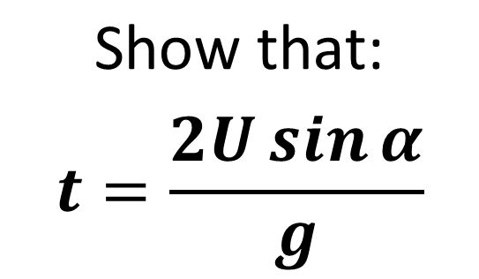
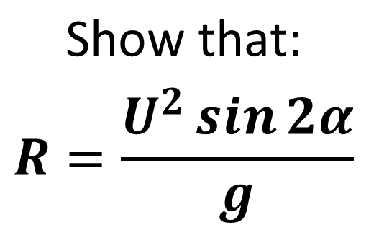
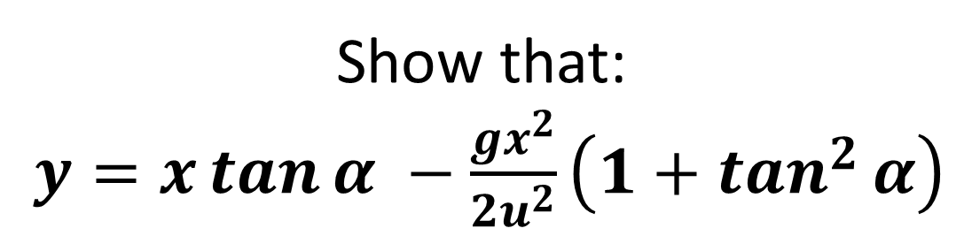
Projectile Formulae
There’s nothing new here, but you may be asked to prove more general results regarding projectile motion.
$$\text{Show} \text{that}\text{:}$$
$$t=\frac{2U\sin{α}}{g}$$
$$\text{Show} \text{that}\text{:}$$
$$R=\frac{U^{2}\sin{2α}}{g}$$
Show that:
$y=x\tan{α −\frac{gx^{2}}{2u^{2}}\left(1+\tan^{2}{α}\right)}$

Slide 3
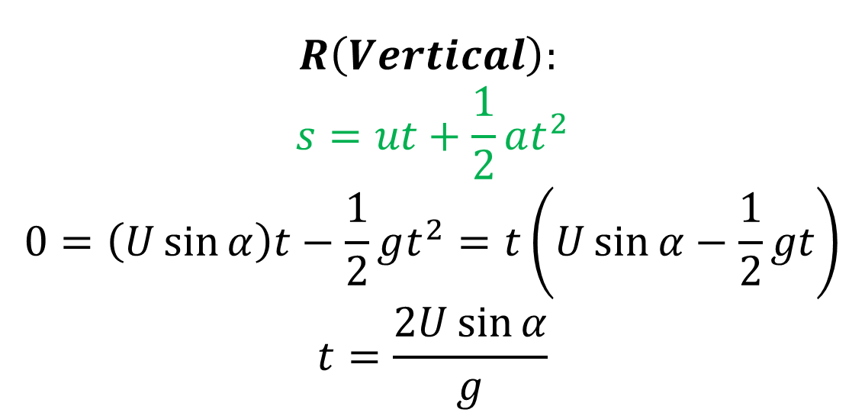
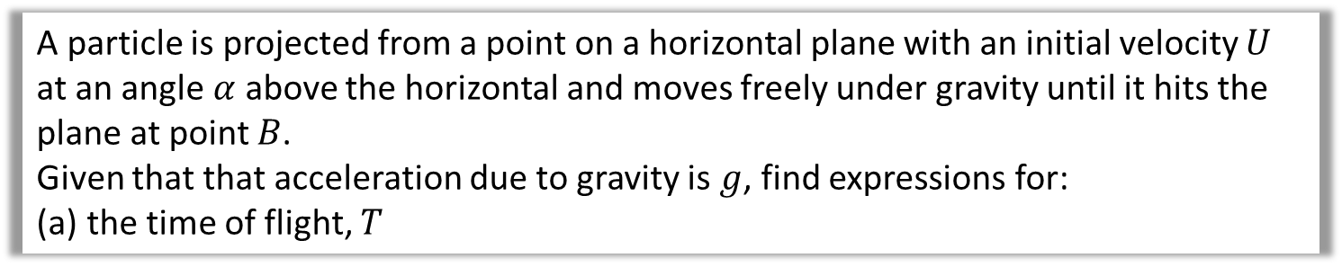
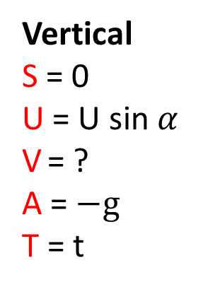
Projectile Formulae
A particle is projected from a point on a horizontal plane with an initial velocity $U$ at an angle $α$ above the horizontal and moves freely under gravity until it hits the plane at point $B$.
Given that that acceleration due to gravity is $g$, find expressions for:
the time of flight, $T$
Vertical
S = 0
U = U sin $α$
V = ?
A = $−g$
T = t
$$R\left(Vertical\right):$$
$$s=ut+\frac{1}{2}at^{2} \\ 0=\left(U\sin{α}\right)t−\frac{1}{2}gt^{2}=t\left(U\sin{α}−\frac{1}{2}gt\right) \\ t=\frac{2U\sin{α}}{g}$$

Slide 4
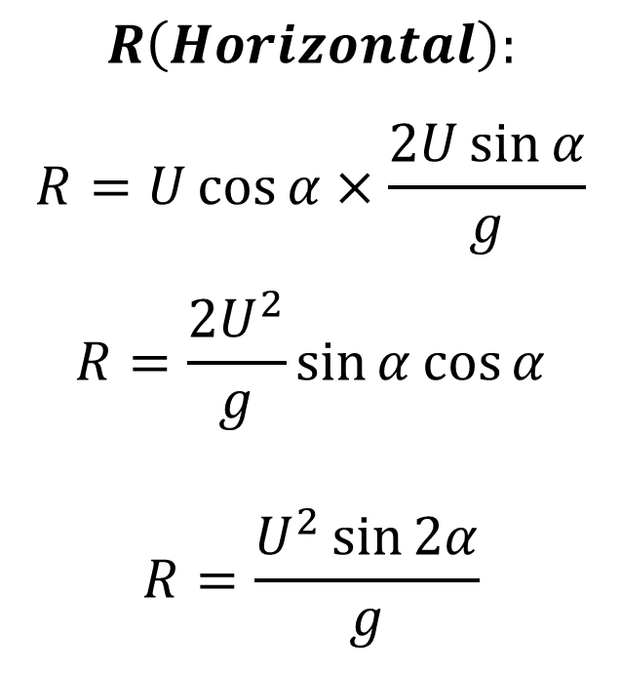
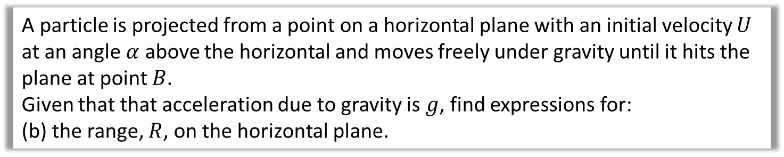
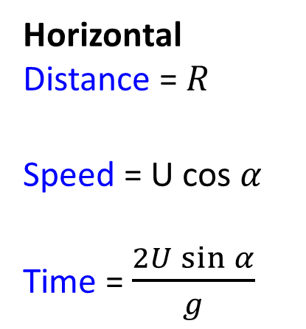

Projectile Formulae
A particle is projected from a point on a horizontal plane with an initial velocity $U$ at an angle $α$ above the horizontal and moves freely under gravity until it hits the plane at point $B$.
Given that that acceleration due to gravity is $g$, find expressions for:
(b) the range, $R$, on the horizontal plane.
Horizontal
Distance = $R$
Speed = U cos $α$
Time = $\frac{2U\sin{α}}{g}$
$$R\left(Horizontal\right):$$
$$R=U\cos{α}×\frac{2U\sin{α}}{g}$$
$$R=\frac{2U^{2}}{g}\sin{α}cos{α}$$
$$R=\frac{U^{2}\sin{2α}}{g}$$
Using double-angle formula to get $sin$ $2α$

Slide 5
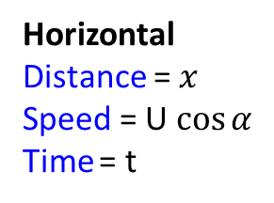
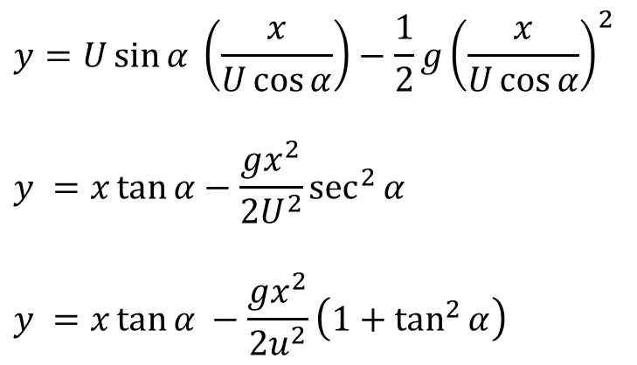
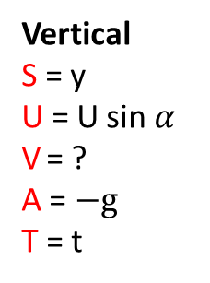
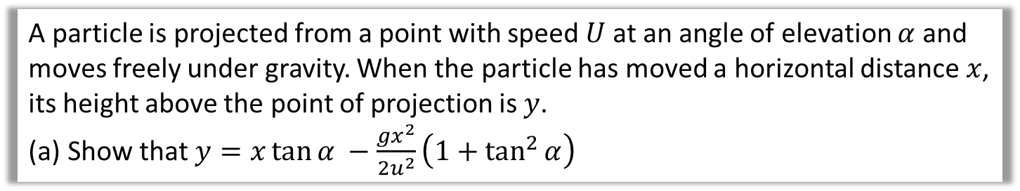

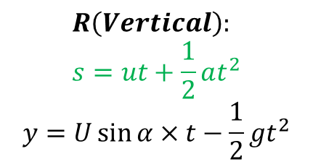
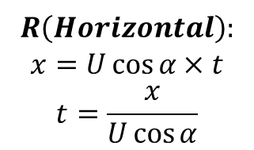
Projectile Formulae
A particle is projected from a point with speed $U$ at an angle of elevation $α$ and moves freely under gravity. When the particle has moved a horizontal distance $x$, its height above the point of projection is $y$.
Show that $y=x\tan{α −\frac{gx^{2}}{2u^{2}}\left(1+\tan^{2}{α}\right)}$
Horizontal
Distance = $x$
Speed = U $\cos{α}$
Time = t
$R\left(Horizontal\right):$
$$x=U\cos{α}×t$$
$$t=\frac{x}{U\cos{α}}$$
The target equation doesn’t contain $t$,
so make $t$ the subject of $(1)$ and substitute into $(2)$:
$$y=U\sin{α} \left(\frac{x}{U\cos{α}}\right)−\frac{1}{2}g{\left(\frac{x}{U\cos{α}}\right)}^{2}$$
$$y =x\tan{α}−\frac{gx^{2}}{2U^{2}}\sec^{2}{α}$$
$$y =x\tan{α −\frac{gx^{2}}{2u^{2}}\left(1+\tan^{2}{α}\right)}$$
Vertical
S = y
U = U sin $α$
V = ?
A = $−g$
T = t
$$R\left(Vertical\right):$$
$$s=ut+\frac{1}{2}at^{2} \\ y=U\sin{α}×t−\frac{1}{2}gt^{2}$$

Slide 6
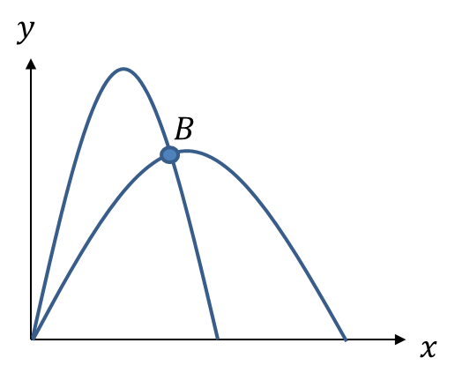
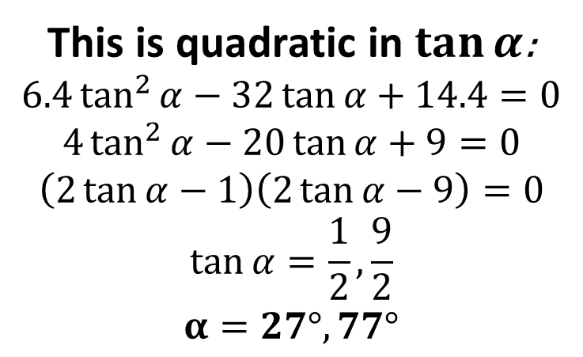
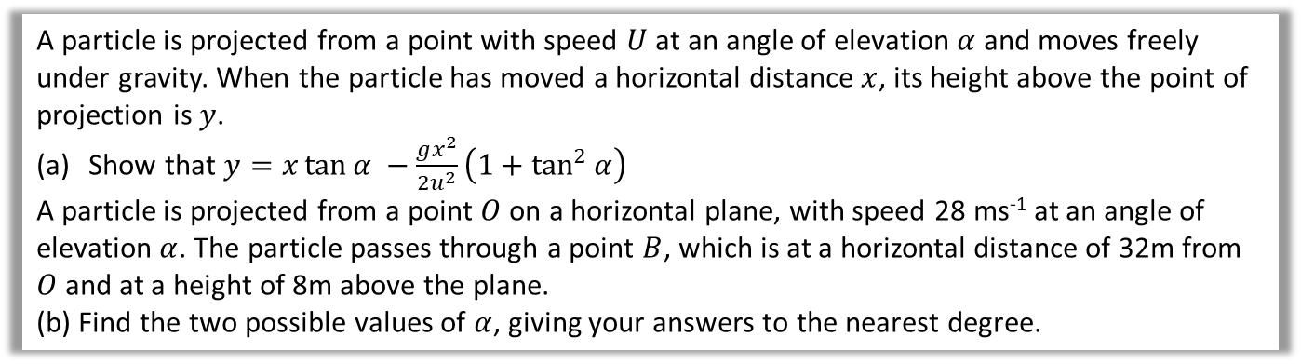
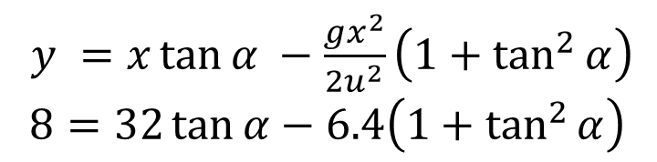
Projectile Formulae
A particle is projected from a point with speed $U$ at an angle of elevation $α$ and moves freely under gravity. When the particle has moved a horizontal distance $x$, its height above the point of projection is $y$.
Show that $y=x\tan{α −\frac{gx^{2}}{2u^{2}}\left(1+\tan^{2}{α}\right)}$
A particle is projected from a point $O$ on a horizontal plane, with speed 28 ms⁻¹ at an angle of elevation $α$. The particle passes through a point $B$, which is at a horizontal distance of 32m from $O$ and at a height of 8m above the plane.
(b) Find the two possible values of $α$, giving your answers to the nearest degree.
$y =x\tan{α −\frac{gx^{2}}{2u^{2}}\left(1+\tan^{2}{α}\right)}$
$$8=32\tan{α}−6.4\left(1+\tan^{2}{α}\right)$$
This is quadratic in $\tan{α}$:
$$6.4\tan^{2}{α}−32\tan{α+14.4=0} \\ 4\tan^{2}{α}−20\tan{α}+9=0 \\ \left(2\tan{α}−1\right)\left(2\tan{α}−9\right)=0 \\ \tan{α=\frac{1}{2},\frac{9}{2}} \\ α=27°, 77°$$

Slide 7
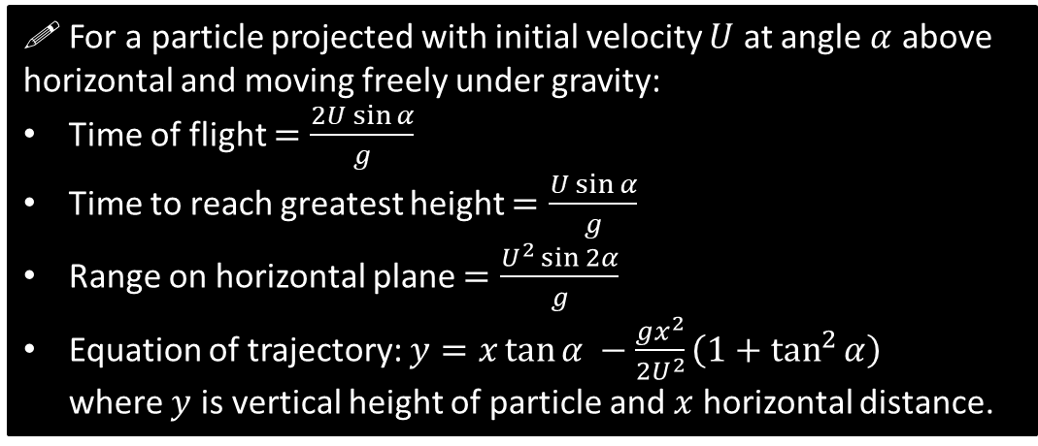
General Results
Exam Note: You may be asked to derive these. But don’t attempt to memorise them or actually use them to solve exam problems – instead use the techniques used earlier in the chapter.
! For a particle projected with initial velocity $U$ at angle $α$ above horizontal and moving freely under gravity:
Time of flight $=\frac{2U\sin{α}}{g}$
Time to reach greatest height $=\frac{U\sin{α}}{g}$
Range on horizontal plane $=\frac{U^{2}\sin{2α}}{g}$
Equation of trajectory: $y=x\tan{α −\frac{gx^{2}}{2U^{2}}\left(1+\tan^{2}{α}\right)}$
where $y$ is vertical height of particle and $x$ horizontal distance.

Slide 8
Exercise 6D
Pearson Stats/Mechanics Year 2
Pages 123-125
Complete before the lesson Q1
In Class:
Green Q2-4
Amber Q4-5
Red Q6-8 & Challenge

