Slide 1

P1 Chapter 7 :: Algebraic Methods
jfrost@tiffin.kingston.sch.uk
www.drfrostmaths.com
@DrFrostMaths
Last modified: 23rd July 2018

Slide 2








www.drfrostmaths.com
Everything is completely free.
Why not register?
Register now to interactively practise questions on this topic, including past paper questions and extension questions (including MAT + UKMT).
Teachers: you can create student accounts (or students can register themselves), to set work, monitor progress and even create worksheets.
With questions by:
Dashboard with points, trophies, notifications and student progress.
Questions organised by topic, difficulty and past paper.
Teaching videos with topic tests to check understanding.

Slide 3
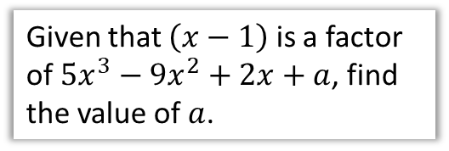


Chapter Overview
This chapter covers a number of algebraic techniques, but also algebraic ‘proofs’.
1:: Algebraic Fractions
2:: Dividing Polynomials
Simplify $\frac{2x^{2}−5x−3}{2x^{2}−9x+9}$
Divide $x^{3}+2x^{2}−17x+6$
3:: The Factor Theorem
Given that $\left(x−1\right)$ is a factor of $5x^{3}−9x^{2}+2x+a$, find the value of $a$.
4:: Proof
Prove that all square numbers are either a multiple of 4 or 1 more than a multiple of 4.
A Level 2017 specification note: The ‘Remainder Theorem’ has been removed (it was included in C2). Sad times…

Slide 4
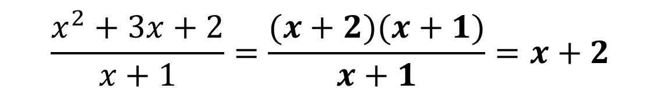
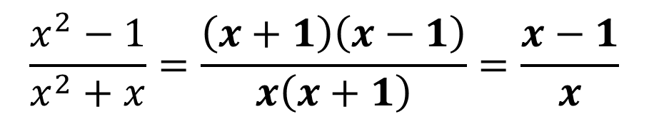

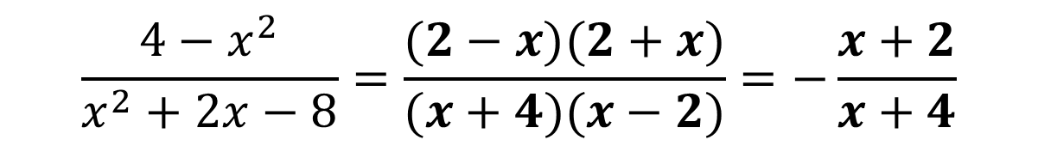
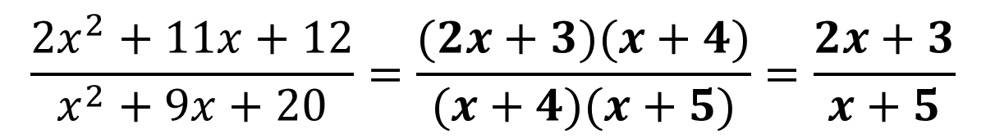
1 :: Simplifying Algebraic Fractions
Recall that you can simplify fractions by dividing the numerator and denominator by a common factor.
Fro Hint: To identify common factors we need to factorise first.
$$\frac{x^{2}−1}{x^{2}+x}=\frac{\left(x+1\right)\left(x−1\right)}{x\left(x+1\right)}=\frac{x−1}{x}$$
?
$$\frac{x^{2}+3x+2}{x+1}=\frac{(x+2)(x+1)}{x+1}=x+2$$
Fro Note: Do not leave 1 in the denominator!
?
Fro Tip: Factorise the easier one first because it provides clues to the factorisation of the other.
$$\frac{2x^{2}+11x+12}{x^{2}+9x+20}=\frac{(2x+3)(x+4)}{(x+4)(x+5)}=\frac{2x+3}{x+5}$$
?
$$\frac{4−x^{2}}{x^{2}+2x−8}=\frac{(2−x)(2+x)}{(x+4)(x−2)}=−\frac{x+2}{x+4}$$
?
Fro Tip: $\frac{a−b}{b−a}=−1$

Slide 5
Exercise 7A
Pearson Pure Mathematics Year 1/AS
Pages 138-139
Complete before the lesson Q1
Green Q2
Amber Q3

Slide 6
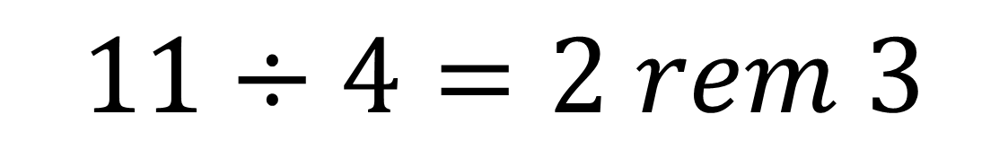
Terminology
$$11÷4=2 rem 3$$
?
dividend
(the thing we’re dividing)
quotient
?
divisor
(the thing we’re dividing by)
?
remainder
?

Slide 7
Normal Long Division
3
8 .
11
4 2 3 . 0 0 0 0
3 3
1. We found how many whole number of times (i.e. the quotient) the divisor went into the dividend.
9 3
8 8
5 0
2. We multiplied the quotient by the dividend.
3. …in order to find the remainder.
4. Find we ‘brought down’ the next number.

Slide 8
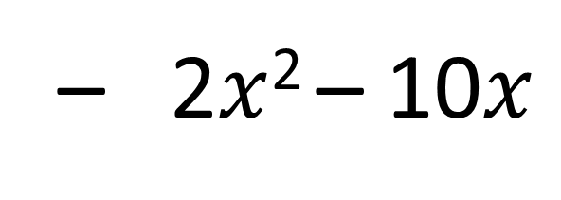
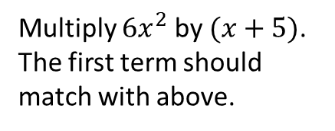
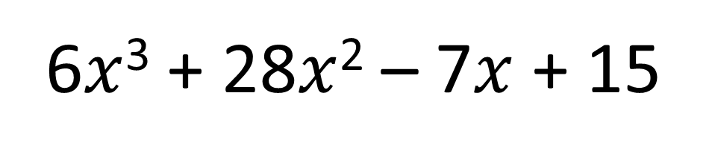
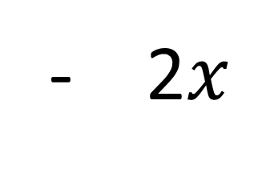

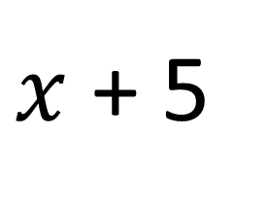
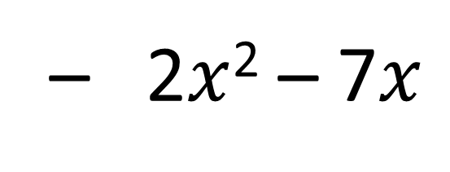
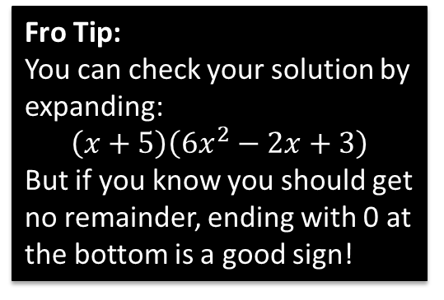
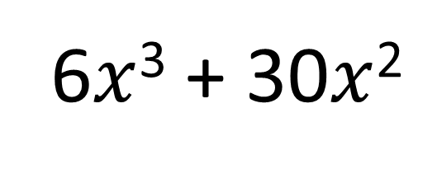
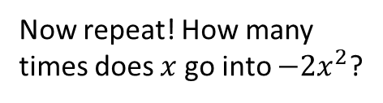
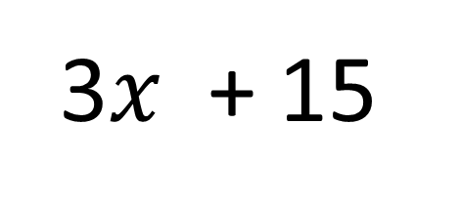
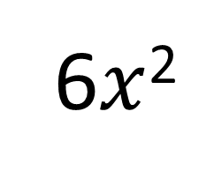
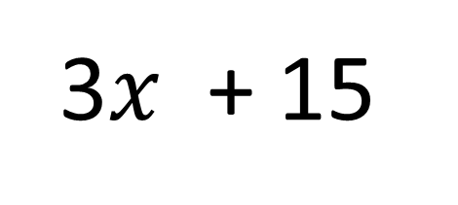
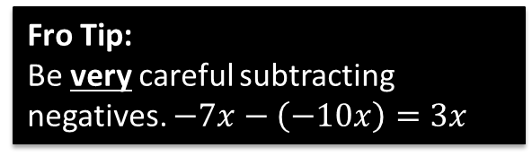
How many times does $x$ go into $6x^{3}$?
Now repeat! How many times does $x$ go into $−2x^{2}$?
6$x$²
- 2$x$
+ 3
$x$ + 5
6$x$³ + 28$x$² – 7$x$ + 15
6$x$³ + 30$x$²
Subtract and carry down next term.
Multiply $6x^{2}$ by $(x+5)$. The first term should match with above.
– 2$x$² – 7$x$
Fro Tip:
You can check your solution by expanding:
$$\left(x+5\right)\left(6x^{2}−2x+3\right)$$
But if you know you should get no remainder, ending with 0 at the bottom is a good sign!
– 2$x$² – 10$x$
3$x$ + 15
3$x$ + 15
Fro Tip:
Be very careful subtracting negatives. $−7x−\left(−10x\right)=3x$
This is the remainder.
0

Slide 9
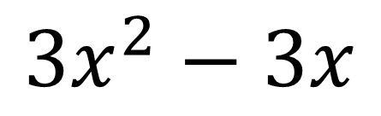

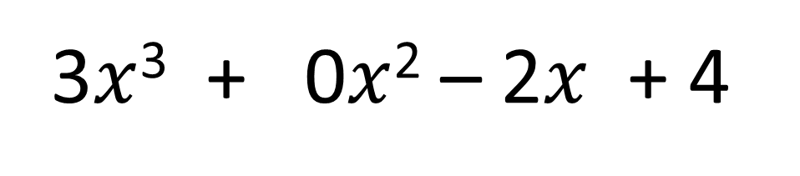
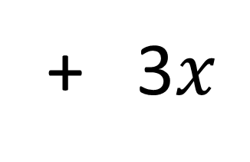
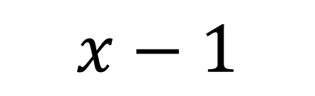
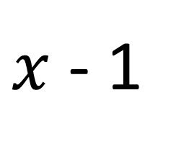
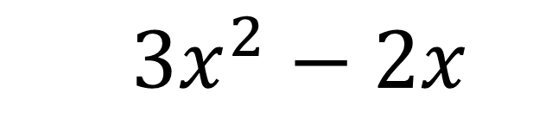
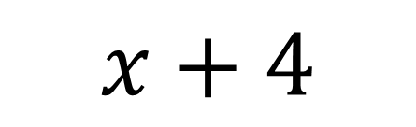
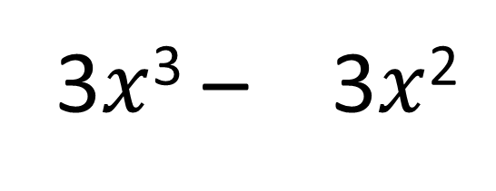
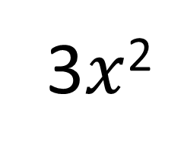
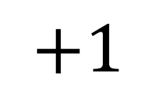
Further Example
Find the remainder when $3x^{3}−2x+4$ is divided by $x−1$.
3$x$²
+ 3$x$
$$+1$$
$x$ - 1
3$x$³ + 0$x$² – 2$x$ + 4
3$x$³ – 3$x$²
$3x^{2}−2x$
$$3x^{2}−3x$$
$$x+4$$
Fro Note: Ensure that any missing terms in the polynomial are filled in, so that the powers decrease by 1 each time.
$$x−1$$
$$5$$
The remainder is 5.

Slide 10


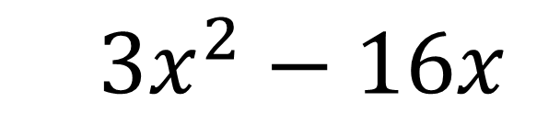

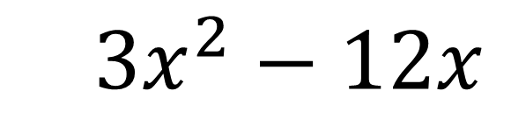
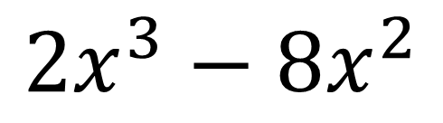
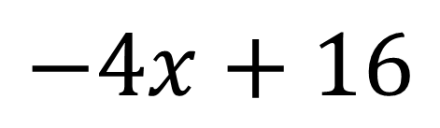


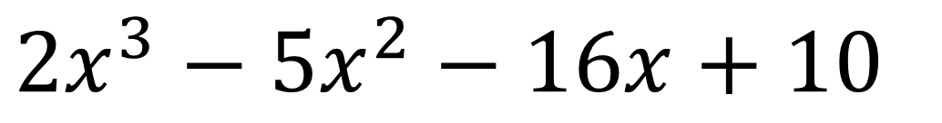
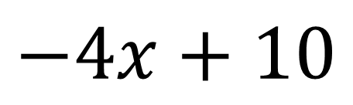
Test Your Understanding
Find the remainder when $2x^{3}−5x^{2}−16x+10$ is divided by $x−4$.
?
$$2x^{2}$$
$$+3x$$
$$−4$$
$$x−4$$
$$2x^{3}−5x^{2}−16x+10$$
$$2x^{3}−8x^{2}$$
$3x^{2}−16x$
$3x^{2}−12x$
$$−4x+10$$
$$−4x+16$$
$$−6$$
The remainder is -6.

Slide 11
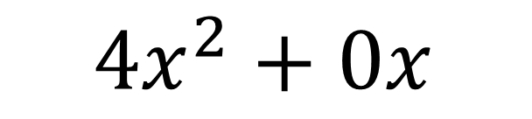
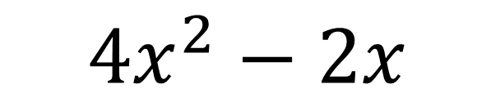
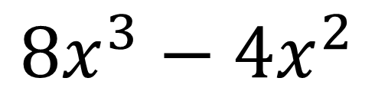
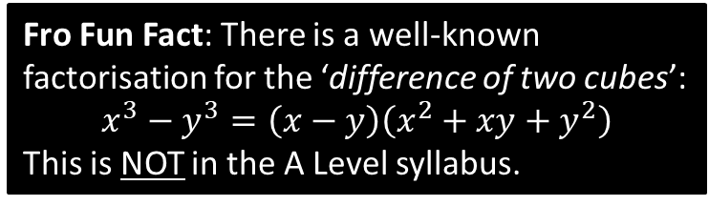
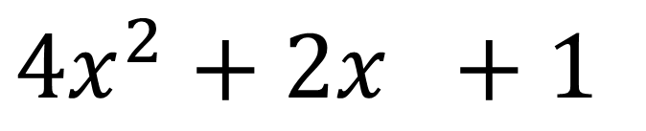

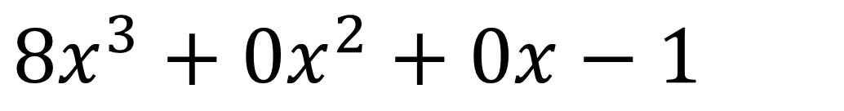
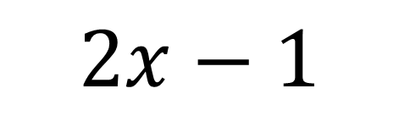

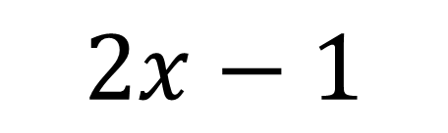
Further Test Your Understanding
Divide $8x^{3}−1$ by $2x−1$.
?
$$4x^{2}+2x +1$$
$$2x−1$$
$$8x^{3}+0x^{2}+0x−1$$
$$8x^{3}−4x^{2}$$
$4x^{2}+0x$
$4x^{2}−2x$
$$2x−1$$
Fro Fun Fact: There is a well-known factorisation for the ‘difference of two cubes’:
$$x^{3}−y^{3}=\left(x−y\right)\left(x^{2}+xy+y^{2}\right)$$
This is NOT in the A Level syllabus.
$$2x−1$$
$$0$$

Slide 12
Exercise 7B
Pearson Pure Mathematics Year 1/AS
Pages 141-142
Complete before the lesson Q1-3 a-d only
Green Q7-10
Amber Q11-14
Red Q15-19

Slide 13


3 :: The Factor Theorem
$$x^{3}+x^{2}−4x−4=\left(x−2\right)\left(x^{2}+3x+2\right)$$
We can see that $(x−2)$ is a factor of $x^{3}+x^{2}−4x−4$.
What would happen if $x$ is 2?
$2−2=0$ so the RHS, and hence LHS would be 0.
The converse is also true: if we could find a value $a$ such that the LHS is 0 when we substitute in $a$ for $x$, then $(x−a)$ would be a factor.
?
! The Factor Theorem states that if $f(x)$ is a polynomial then:
If $f\left(p\right)=0$, then $(x−p)$ is a factor of $f(x)$.
Conversely, if $(x−p)$ is a factor of $f(x)$, then $f\left(p\right)=0$.

Slide 14





Examples (in textbook)
Show that $(x−2)$ is a factor of $x^{3}+x^{2}−4x−4$.
?
Let $f\left(x\right)=x^{3}+x^{2}−4x−4$
$$f\left(2\right)=2^{3}+2^{2}−4\left(2\right)−4=0$$
$∴\left(x−2\right)$ is a factor of $x^{3}+x^{2}−4x−4$.
Writing $f\left(x\right)=…$ gives us appropriate notation, i.e. $f(2)$, to show we’re substituting 2 into the polynomial on the next line.
Fully factorise $2x^{3}+x^{2}−18x−9$.
?
Keep on trying values until you find one where $f\left(p\right)=0$. Recommended order: $p=1,−1,2,−2,…$
You can use the ‘Table’ mode on your calculator to try lots of values in a range – see my interactive Classwiz powerpoint.
Let $f\left(x\right)=2x^{3}+x^{2}−18x−9$
$$f\left(1\right)=2{\left(1\right)}^{3}+1^{2}−18\left(1\right)−9=−24 \\ f\left(−1\right)=2{\left(−1\right)}^{3}+{\left(−1\right)}^{2}+18\left(−1\right)−9=24 \\ …$$
$f\left(3\right)=0 ∴ (x−3)$ is a factor.
Using algebraic division we find that:
$$2x^{3}+x^{2}−18x−9=\left(x−3\right)\left(2x^{2}+7x+3\right) \\ =(x−3)(2x+1)(x+3)$$
Fro Tip: If you consider that:
$$2x^{3}+x^{2}−18x−9=\left(x−3\right)\left(ax^{2}+bx+c\right)$$
it’s clear, by considering the expansion of the RHS, that $a=2$ and $c=3$. We can determine $b$ by considering for example the $x$ terms in the expansion. This is much faster than algebraic division.

Slide 15



Using Factor Theorem to find unknown coefficients
Given that $2x+1$ is a factor of $6x^{3}+ax^{2}+1$, determine the value of $a$.
?
Fro Side Notes:
Choose the value of $x$ to substitute that makes the divisor/factor 0.
So if $2x+1=0$, then $x=−\frac{1}{2}$, thus find $f\left(−\frac{1}{2}\right)$.
This even works when you’re dividing by non-linear factors, e.g. $\frac{1}{x}+1$, but at A Level they will always be of the form $ax+b$.
$$f\left(x\right)=6x^{3}+ax^{2}+1 \\ f\left(−\frac{1}{2}\right)=6{\left(−\frac{1}{2}\right)}^{3}+a{\left(−\frac{1}{2}\right)}^{2}+1 \\ =−\frac{3}{4}+\frac{1}{4}a+1=0 \\ \frac{1}{4}a=−\frac{1}{4} \\ a=−1$$

Slide 16




Test Your Understanding
Edexcel C2 May 2016 Q2
No long in spec.
?
Given that $3x−1$ is a factor of $3x^{3}+11x^{2}+ax+1$, determine the value of $a$.
$$f\left(\frac{1}{3}\right)=3{\left(\frac{1}{3}\right)}^{3}+11{\left(\frac{1}{3}\right)}^{2}+\frac{1}{3}a+1=0 \\ \frac{7}{3}+\frac{1}{3}a=0 → a=−7$$
?

Slide 17



Exercise 7C
Complete before the lesson Q2-5
Green Q6-12
Amber Q13-15
Red Ext & Challenge
Pearson Pure Mathematics Year 1/AS Pages 145-146
Extension
The remainder theorem states that if $f(x)$ is divided by $(x−a)$, the remainder is $f(a)$. This similarly works whenever $a$ makes the divisor 0.
1
[MAT 2006 1E] The cubic
$$x^{3}+ax+b$$
Has both $\left(x−1\right)$ and $\left(x−2\right)$ as factors. Determine the values of $a$ and $b$.
$$a=−7, b=6$$
[MAT 2009 1I] The polynomial
$$n^{2}x^{2n+3}−25nx^{n+1}+150x^{7}$$
Has $x^{2}−1$ as a factor
for no values of $n$;
for $n=10$ only;
for $n=15$ only;
for $n=10$ and $n=15$ only.
$x^{2}−1=(x+1)(x−1)$ so both factors.
$$f\left(1\right)=n^{2}−25n+150=0$$
If $n$ is odd: $f\left(−1\right)=−n^{2}−25n−150=0$
If $n$ is even: $f\left(−1\right)=−n^{2}+25n−150=0$
Putting this all together, we get option B.
3
[MAT 2013 1G] Let $n≥2$ be an integer and $p_{n}\left(x\right)$ be the polynomial
$$p_{n}\left(x\right)=\left(x−1\right)+\left(x−2\right)+…+(x−n)$$
What is the remainder, in terms of $n$, when $p_{n}\left(x\right)$ is divided by $p_{n−1}\left(x\right)$?
$$p_{n}\left(x\right)=nx−\frac{1}{2}n\left(n+1\right) \\ p_{n−1}\left(x\right)=\left(n−1\right)x+\frac{1}{2}n\left(n−1\right)$$
We need to make the divisor 0:
$$\left(n−1\right)\left(x+\frac{1}{2}n\right)=0 → x=−\frac{n}{2}$$
Remainder:
$$p_{n}\left(−\frac{n}{2}\right)=n\left(−\frac{n}{2}\right)−\frac{1}{2}n\left(n+1\right)=−\frac{1}{2}n$$
?
2
?
?

Slide 18


4 :: Proof
Terminology
A conjecture is a mathematical statement that has yet to be proven.
One famous conjecture is Goldbach’s Conjecture.
It states “Every even integer greater than 2 can be expressed as the sum of two primes.”
It has been verified up to $4×{10}^{18}$ (that’s big!); this provides evidence that it is true, but does not prove it is true!
A theorem is a mathematical statement that has been proven.
One famous misnomer was Fermat’s Last Theorem, which states “If $n$ is an integer where $n>2$, then $a^{n}+b^{n}=c^{n}$ has no non-zero integer solutions for $a,b,c$.” It was 300 years until this was proven in 1995. Only then was the ‘Theorem’ in the name then correct!

Slide 19



Types of Proof
A proof must show all assumptions you are using, have a clear sequential list of steps that logically follow, and must cover all possible cases.
You should usually make a concluding statement, e.g. restating the original conjecture that you have proven.
a. Proof by Deduction
An identity is an equation that is true for all values of the variables. e.g. $x^{2}=4$ is true only for $x=±2$, but $x\left(x−1\right)≡x^{2}−x$ is true for all $x$.
This is the simplest type, where you start from known facts and reach the desired conclusion via deductive steps.
“Prove that $\left(3x+2\right)\left(x−5\right)\left(x+7\right)≡3x^{3}+8x^{2}−101x−70$”
$$\left(3x+2\right)\left(x−5\right)\left(x+7\right) \\ =\left(3x+2\right)\left(x^{2}+2x−35\right) \\ =3x^{3}+6x^{2}−105x+2x^{2}+4x−70 \\ =3x^{2}+8x^{2}−101x−70$$
$$∴\left(3x+2\right)\left(x−5\right)\left(x+7\right)≡3x^{3}+8x^{2}−101x−70$$
“Prove that the product of two odd numbers is odd.”
Let $p,q$ be integers, then $2p+1$ and $2q+1$ are odd numbers.
$$\left(2p+1\right)\left(2q+1\right)=4pq+2p+2q+1 \\ =2\left(2pq+p+q\right)+1$$
This is one more than a multiple of 2, and is therefore odd.
?
?

Slide 20


Be Warned…
Proof by Deduction requires you to start from known facts and end up at the conclusion. It is not acceptable to start with to the conclusion, and verify it works, because you are assuming the thing you are trying to prove.
Example: Prove that if three consecutive integers are the sides of a right-angled triangle, they must be 3, 4 and 5.
Incorrect Proof:
Let the lengths be 3,4,5.
Therefore:
$$3^{2}+4^{2}=5^{2} \\ 25=25$$
This satisfies Pythagoras’ Theorem, and the numbers are consecutive.
Correct Proof:
If the sides are consecutive, then let the sides be:
$$x,x+1,x+2$$
Then by Pythagoras’ Theorem:
$$x^{2}+{\left(x+1\right)}^{2}={\left(x+2\right)}^{2} \\ … \\ x^{2}−2x−3=0 \\ \left(x+1\right)\left(x−3\right)=0$$
$x=3$ (as $x$ can’t be negative)
Thus the sides are 3, 4, 5.
?
We are assuming the thing we are trying to prove!
?
We are only assuming things in the ‘if’ bit. This is fine!
The underlying problem is that this technique doesn’t prove there can’t be other consecutive integers that work – we have only verified 3,4,5 is one such solution.

Slide 21


Types of Proof
a. Proof by Deduction
Fro Exam Tip: This is quite a common last parter.
Prove that $x^{2}+4x+5$ is positive for all values of $x$.
$$x^{2}+4x+5={\left(x+2\right)}^{2}+1$$
${\left(x+2\right)}^{2}≥0$ for all $x$
$$∴{\left(x+2\right)}^{2}+1≥1>0$$
?
Anything squared is at least 0. This is formally known as the ‘trivial inequality’.
Test Your Understanding
Prove that the sum of the squares of two consecutive odd numbers is 2 more than a multiple of 8.
Let $2n−1$ and $2n+1$ be any two consecutive odd numbers, where $n$ is an integer.
$${\left(2n−1\right)}^{2}+{\left(2n+1\right)}^{2}=4n^{2}−4n+1+4n^{2}+4n+1$$
$=8n^{2}+2$ which is 2 more than a multiple of 8.
?

Slide 22


Exercise 7D
Pearson Pure Mathematics Year 1/AS Pages 149-150
Complete before the lesson Ex7D
You should attempt all. During this lesson we will discuss all problems encountered.
Extension
[STEP I 2005 Q1] 47231 is a five-digit number whose digits sum to
$4+7+2+3+1=17$.
Prove that there are 15 five-digit numbers whose digits sum to 43. You should explain your reasoning clearly.
How many five-digit numbers are there whose digits sum to 39?
i) Since $5×9=45$ then the digits drop by 2 in total from the maximum of 9, 9, 9, 9, 9. This can either be on one number (9,9,9,9,7) or spread across two numbers (9,9,9,8,8).
If 9, 9, 9, 9, 7 are used, the 7 can go in 5 positions, giving 5 numbers.
If 9, 9, 9, 8, 8 is used, the two 8s can go in $\frac{5×4}{2}=10$ positions (as there are 5 choices for the first 8 and 4 for the second, but they can go either way round). Thus there are $5+10=15$ possibilities.
ii) This time we must drop the digit sum by 6 from the maximum of 9,9,9,9,9. This gives the possibilities: (9,9,9,9,3), (9,9,9,8,4), (9,9,9,7,5), (9,9,8,8,5), (9,9,9,6,6), (9,9,8,7,6), (9,8,8,8,6), (9,9,7,7,7), (9,8,8,7,7), (8,8,8,8,7). This give 5, 20, 20, 30, 10, 60, 20, 10, 30, 5 possibilities respectively, giving 210 possibilities in total. (I have omitted the calculation for each for brevity)
? i
? ii

Slide 23


Other Types of Proof
b. Proof by Exhaustion
c. Disproof by Counter-Example
This means breaking down the statement into all possible smaller cases, where we prove each individual case.
(This technique is sometimes known as ‘case analysis’)
While to prove a statement is true, we need to prove every possible case (potentially infinitely many!), we only need one example to disprove a statement.
This is known as a counterexample.
Prove that $n^{2}+n$ is even for all integers $n$.
$n$ is either even or odd.
If $n$ is even:
$n^{2}+n=even×even+even$
$$=even+even \\ =even$$
If $n$ is odd:
$$n^{2}+n=odd×odd+odd \\ =odd+odd \\ =even$$
$∴$ $n^{2}+n$ is even for all integers $n$.
?
Disprove the statement:
“$n^{2}−n+41$ is prime for all integers $n$.”
If $n=41$, then we have ${41}^{2}−41+41$
$$={41}^{2}$$
Which is not prime as it has a factor of 41.
Thus the statement is not true.
?

Slide 24


Another Type not in the A Level Specification
c. Proof by Contradiction
This is another technique of proving a statement, which is not in the A Level specification (but is in the STEP specification!).
We assume the original statement is false, and show this results in a contradiction.
Prove that $\sqrt{2}$ is irrational.
Assume by contradiction that the statement is false, i.e. that $\sqrt{2}$ is rational.
Then:
$$\sqrt{2}=\frac{a}{b}$$
where $a,b,$ are integers, and $\frac{a}{b}$ is a fraction in its simplest form.
$$b\sqrt{2}=a \\ 2b^{2}=a^{2}$$
The prime factorisation of any square number has even powers. Thus the power of 2 of the prime factorisation of the RHS is even (and possibly 0).
The power of 2 in $b^{2}$ is also even, thus $2b^{2}$ must have an odd power of 2.
This is a contradiction, thus the original assumption that $\sqrt{2}$ is rational is false, and thus $\sqrt{2}$ is irrational.
?
There are other methods from this point, e.g. recognising $2b^{2}$ is even, therefore $a$ is even and replacing $a=2k$ before eventually discovering that $a$ and $b$ must both be even, thus violating assumption that $\frac{a}{b}$ was in its simplest form. The method used is faster and doesn’t require this ‘simplest form’ assumption!

Slide 25


Exercise 7E
Complete before the lesson Ex7E
You should attempt ALL. During this lesson we will discuss all problems encountered.
Pearson Pure Mathematics Year 1/AS
Pages 152-154
Extension
[STEP I 2008 Q1] What does it mean to say that a number $x$ is rational?
Prove by contradiction statements $A$ and $B$ below, where $p$ and $q$ are real numbers.
A: If $pq$ is irrational, then at least one of $p$ and $q$ is irrational.
B: If $p+q$ is irrational, then at least one of $p$ and $q$ is irrational.
Disprove by means of a counterexample statement $C$ below, where $p$ and $q$ are real numbers.
C: If $p$ and $q$ are irrational, then $p+q$ is irrational.
If the numbers $e,π,π^{2}, e^{2}$ and $eπ$ are irrational, prove that at most one of the numbers $π+e, π−e, π^{2}−e^{2}, π^{2}+e^{2}$ is rational.
Solutions on next slide.
Note: $e$ is Euler’s Number and you will encounter it later at A Level. But for the moment, you only need to know it is an irrational number, like $π$.

Slide 26

Solution to Extension Problem
?
?
?

Slide 27


Solution to Extension Problem
?
Fro Fun Fact: No mathematician has yet managed to prove that $π+e$ or $π−e$ is irrational.

