Slide 1
Hyperbolic
Functions
Twitter: @Owen134866
www.mathsfreeresourcelibrary.com

Slide 2

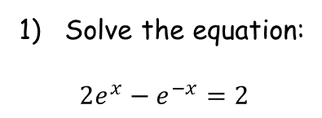


Prior Knowledge Check
Solve the equation:
$$2e^{x}−e^{−x}=2$$
3) Show that:
$$\int_{0}^{π}{e^{x}sinx dx}=\frac{1}{2}\left(1+e^{π}\right)$$
$$ln\frac{1+\sqrt{3}}{2}$$
Correctly shown!
2) Show that:
$$\frac{1}{\cos^{2}x}−\tan^{2}x≡1$$
Correctly shown!

Slide 3
Teachings for
Exercise 6A

Slide 4
Hyperbolic Functions
You can define hyperbolic functions using trigonometry and exponential functions
Hyperbolic functions are part of the ‘conic sections’
Unfortunately, this chapter does not give a wide picture of this area
If you would like to learn more about these and fill in some of the gaps, I suggest the Further Pure 1 textbook, Chapter 3!
6A

Slide 5
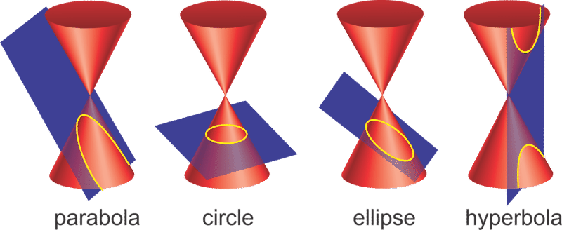




Hyperbolic Functions
https://www.ck12.org/book/ck-12-algebra-ii-with-trigonometry-concepts/section/10.0/
You can define hyperbolic functions using trigonometry and exponential functions
Hyperbolic functions are part of the ‘conic sections’
The ‘conic sections’ arise from the idea of a plane intersecting one or two ‘nappes’ of a cone (each ‘side’ is called a ‘nappe’)
You will be familiar with some of the shapes formed (in each case, the cone is vertical)
Ellipse (FP1 CH3)
→ If the plane is tilted but still intersects the cone on both sides
Circle
→ If the plane is horizontal
→ eg) $x^{2}+y^{2}=1$
→ eg) $\frac{x^{2}}{9}+\frac{y^{2}}{20}=2$
Parabola
→ If the plane is parallel to the slope of the cone
Hyperbola
→ If the plane is vertical or tilted so it intersects both sides
→ eg) $y=x^{2}$
→ eg) $y=\frac{1}{x}$
6A

Slide 6




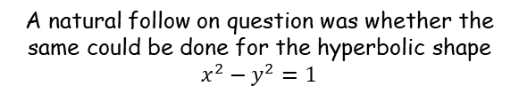

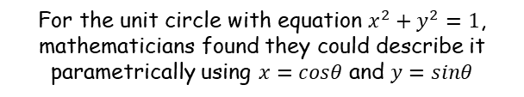




Hyperbolic Functions
You can define hyperbolic functions using trigonometry and exponential functions
$$y$$
$$x^{2}−y^{2}=1$$
$$y$$
$$x^{2}+y^{2}=1$$
$$?$$
$$?$$
$$1$$
$$sinθ$$
$$θ$$
$$x$$
$$x$$
$$cosθ$$
For the unit circle with equation $x^{2}+y^{2}=1$, mathematicians found they could describe it parametrically using $x=cosθ$ and $y=sinθ$
So we are going to try and describe points on this curve parametrically…
A natural follow on question was whether the same could be done for the hyperbolic shape $x^{2}−y^{2}=1$
6A

Slide 7






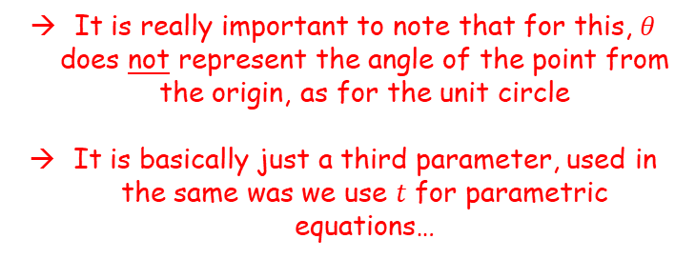




Hyperbolic Functions
You can define hyperbolic functions using trigonometry and exponential functions
$$\cos^{2}θ+\sin^{2}θ≡1$$
Divide all by $\cos^{2}θ$
$$1+\tan^{2}θ≡\sec^{2}θ$$
Subtract $\tan^{2}θ$
$$x^{2}−y^{2}=1$$
$$y$$
$$1≡\sec^{2}θ−\tan^{2}θ$$
Let $x=secθ$ and $y=tanθ$
$$1=x^{2}−y^{2}$$
$$?$$
So the curve $x^{2}−y^{2}=1$ can be described with parametric equations $x=secθ$ and $y=tanθ$
$$x$$
It is really important to note that for this, $θ$ does not represent the angle of the point from the origin, as for the unit circle
It is basically just a third parameter, used in the same was we use $t$ for parametric equations…
So we are going to try and describe points on this curve parametrically…
This way is the simplest to derive, but is not the way that is used in this chapter though!
(this method is used in FP1 Chapter 3)
6A

Slide 8





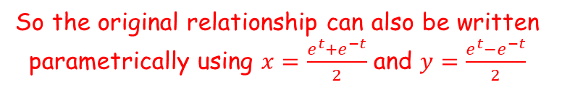



Hyperbolic Functions
$$x^{2}−y^{2}=1$$
Let $x=\frac{e^{t}+e^{−t}}{2}$ and $y=\frac{e^{t}−e^{−t}}{2}$
You can define hyperbolic functions using trigonometry and exponential functions
$${\left(\frac{e^{t}+e^{−t}}{2}\right)}^{2}−{\left(\frac{e^{t}−e^{−t}}{2}\right)}^{2}=1$$
Expand brackets
$$x^{2}−y^{2}=1$$
$$y$$
$$\frac{e^{2t}+2e^{0}+e^{−2t}}{4}−\frac{e^{2t}−{2e}^{0}+e^{−2t}}{4}=1$$
$$?$$
$$2e^{0}=1$$
$$\frac{e^{2t}+2+e^{−2t}}{4}−\frac{e^{2t}−2+e^{−2t}}{4}=1$$
Write as a single fraction (careful with the signs)
$$x$$
$$\frac{e^{2t}+2+e^{−tx}−e^{2t}+2−e^{−2t}}{4}=1$$
Simplify left side
$$\frac{4}{4}=1$$
So we are going to try and describe points on this curve parametrically…
So the original relationship can also be written parametrically using $x=\frac{e^{t}+e^{−t}}{2}$ and $y=\frac{e^{t}−e^{−t}}{2}$
6A

Slide 9











Hyperbolic Functions
$$y$$
You can define hyperbolic functions using trigonometry and exponential functions
$$x^{2}+y^{2}=1$$
$$?$$
$$1$$
$$sinθ$$
$$θ$$
$$x$$
Similar to the unit circle, the horizontal distances are described using sine and cosine, but in this case sinh and cosh (sinh means ‘hyperbolic sine’)
We also just saw that the horizontal and vertical distances can be described using $x=\frac{e^{θ}+e^{−θ}}{2}$ and $y=\frac{e^{θ}−e^{−θ}}{2}$
It therefore follows that:
$$cosθ$$
$$x^{2}−y^{2}=1$$
$$y$$
$$?$$
$$sinhθ$$
$$sinhθ=\frac{e^{θ}−e^{−θ}}{2}$$
$$coshθ=\frac{e^{θ}+e^{−θ}}{2}$$
$$coshθ$$
$$x$$
and
(Remember that $θ$ is just being used as a third parameter now, not an angle)
6A

Slide 10








Hyperbolic Functions
$$sinhx=\frac{e^{x}−e^{−x}}{2}$$
$$coshx=\frac{e^{x}+e^{−x}}{2}$$
$$tanhx=\frac{e^{2x}−1}{e^{2x}+1}$$
You can define hyperbolic functions using trigonometry and exponential functions
You can then use the above to describe hyperbolic tan…
$$tanhx=\frac{sinhx}{coshx}$$
Replace using the relationships above
$$=\frac{\frac{e^{x}−e^{−x}}{2}}{\frac{e^{x}+e^{−x}}{2}}$$
Multiply numerator and denominator by 2
$$=\frac{e^{x}−e^{−x}}{e^{x}+e^{−x}}$$
Multiply all terms by $e^{x}$
$$=\frac{e^{2x}−1}{e^{2x}+1}$$
6A

Slide 11






Hyperbolic Functions
$$sinhx=\frac{e^{x}−e^{−x}}{2}$$
$$coshx=\frac{e^{x}+e^{−x}}{2}$$
$$tanhx=\frac{e^{2x}−1}{e^{2x}+1}$$
You can define hyperbolic functions using trigonometry and exponential functions
Make sure you know how to say them!
(although if you check online you will find a variety of different ways that are used…)
You will not need these directly in this chapter or for your exam, but if you are confident you can use them!
(Shine or sinch)
$$sinhx=\frac{e^{x}−e^{−x}}{2}$$
(cosetch)
$$cosechx=\frac{2}{e^{x}−e^{−x}}$$
(cosh)
$$coshx=\frac{e^{x}+e^{−x}}{2}$$
(setch)
$$sechx=\frac{2}{e^{x}+e^{−x}}$$
(tanch)
$$tanhx=\frac{e^{2x}−1}{e^{2x}+1}$$
(coth)
$$cothx=\frac{e^{2x}+1}{e^{2x}−1}$$
You do not get given these in the formula booklet…
6A

Slide 12




Hyperbolic Functions
$$sinhx=\frac{e^{x}−e^{−x}}{2}$$
$$coshx=\frac{e^{x}+e^{−x}}{2}$$
$$tanhx=\frac{e^{2x}−1}{e^{2x}+1}$$
You can define hyperbolic functions using trigonometry and exponential functions
Find, to 2 decimal places, the value of:
$$\sinh{3}$$
$$sinhx=\frac{e^{x}−e^{−x}}{2}$$
Sub in $x=3$
$$\sinh{3}=\frac{e^{3}−e^{−3}}{2}$$
Calculate
$$=10.02$$
6A

Slide 13





Hyperbolic Functions
$$sinhx=\frac{e^{x}−e^{−x}}{2}$$
$$coshx=\frac{e^{x}+e^{−x}}{2}$$
$$tanhx=\frac{e^{2x}−1}{e^{2x}+1}$$
You can define hyperbolic functions using trigonometry and exponential functions
Find, to 2 decimal places, the value of:
$$\cosh{1}$$
$$coshx=\frac{e^{x}+e^{−x}}{2}$$
Sub in $x=1$
$$\cosh{3}=\frac{e^{1}+e^{−1}}{2}$$
Calculate
$$=1.54$$
6A

Slide 14





Hyperbolic Functions
$$sinhx=\frac{e^{x}−e^{−x}}{2}$$
$$coshx=\frac{e^{x}+e^{−x}}{2}$$
$$tanhx=\frac{e^{2x}−1}{e^{2x}+1}$$
You can define hyperbolic functions using trigonometry and exponential functions
Find, to 2 decimal places, the value of:
$$\tanh{0.8}$$
$$tanhx=\frac{e^{2x}−1}{e^{2x}+1}$$
Sub in $x=0.8$
$$\tanh{0.8}=\frac{e^{2(0.8)}−1}{e^{2(0.8)}+1}$$
Calculate
$$=0.66$$
6A

Slide 15






Hyperbolic Functions
$$sinhx=\frac{e^{x}−e^{−x}}{2}$$
$$coshx=\frac{e^{x}+e^{−x}}{2}$$
$$tanhx=\frac{e^{2x}−1}{e^{2x}+1}$$
You can define hyperbolic functions using trigonometry and exponential functions
Find the exact value of:
$$\tanh\left(ln4\right)$$
$$tanhx=\frac{e^{2x}−1}{e^{2x}+1}$$
Sub in $x=ln4$
$$\tanh\left(ln4\right)=\frac{e^{2ln4}−1}{e^{2ln4}+1}$$
Use the power law
$$=\frac{e^{ln4^{2}}−1}{e^{ln4^{2}}+1}$$
Simplify
$$=\frac{4^{2}−1}{4^{2}+1}$$
Calculate
$$=\frac{15}{17}$$
6A

Slide 16















Hyperbolic Functions
$$sinhx=\frac{e^{x}−e^{−x}}{2}$$
$$coshx=\frac{e^{x}+e^{−x}}{2}$$
$$tanhx=\frac{e^{2x}−1}{e^{2x}+1}$$
$$sinhx=\frac{e^{x}−e^{−x}}{2}$$
You can define hyperbolic functions using trigonometry and exponential functions
Find the value of $x$ for which $\sinh{x}=5$. Give your answer to 2 decimal places.
Sub in $\sinh{x}=5$
$$5=\frac{e^{x}−e^{−x}}{2}$$
Multiply both sides by 2
$$10=e^{x}−e^{−x}$$
Multiply both sides by $e^{x}$
$$10e^{x}=e^{2x}−1$$
Subtract ${10e}^{x}$
$$0=e^{2x}−10e^{x}−1$$
Let $y=e^{x}$
$$0=y^{2}−10y−1$$
Solve using your preferred method (or one which you do not prefer…)
$$y=5±\sqrt{26}$$
Remember there is only a solution if $e^{x}$ is positive
$$e^{x}=5+\sqrt{26}$$
Take natural logarithms
$$x=ln\left(5+\sqrt{26}\right)$$
Calculate
$$x=2.31$$
6A

Slide 17


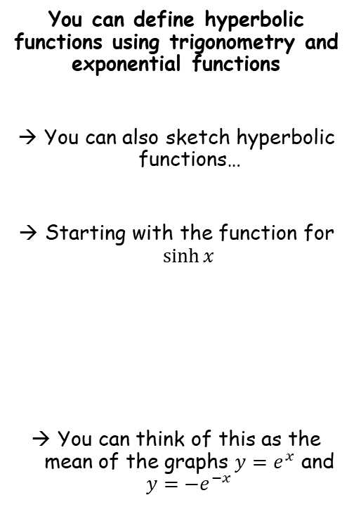





Hyperbolic Functions
$$sinhx=\frac{e^{x}−e^{−x}}{2}$$
$$coshx=\frac{e^{x}+e^{−x}}{2}$$
$$tanhx=\frac{e^{2x}−1}{e^{2x}+1}$$
$$y$$
$$y=e^{x}$$
You can define hyperbolic functions using trigonometry and exponential functions
You can also sketch hyperbolic functions…
Starting with the function for $\sinh{x}$
You can think of this as the mean of the graphs $y=e^{x}$ and $y={−e}^{−x}$
$$y=\frac{e^{x}−e^{−x}}{2}=\sinh{x}$$
$$1$$
$$x$$
$$−1$$
$$y=\frac{e^{x}−e^{−x}}{2}$$
$$y={−e}^{−x}$$
Write differently
$$y=\frac{\left(e^{x}\right)+\left(−e^{−x}\right)}{2}$$
6A

Slide 18
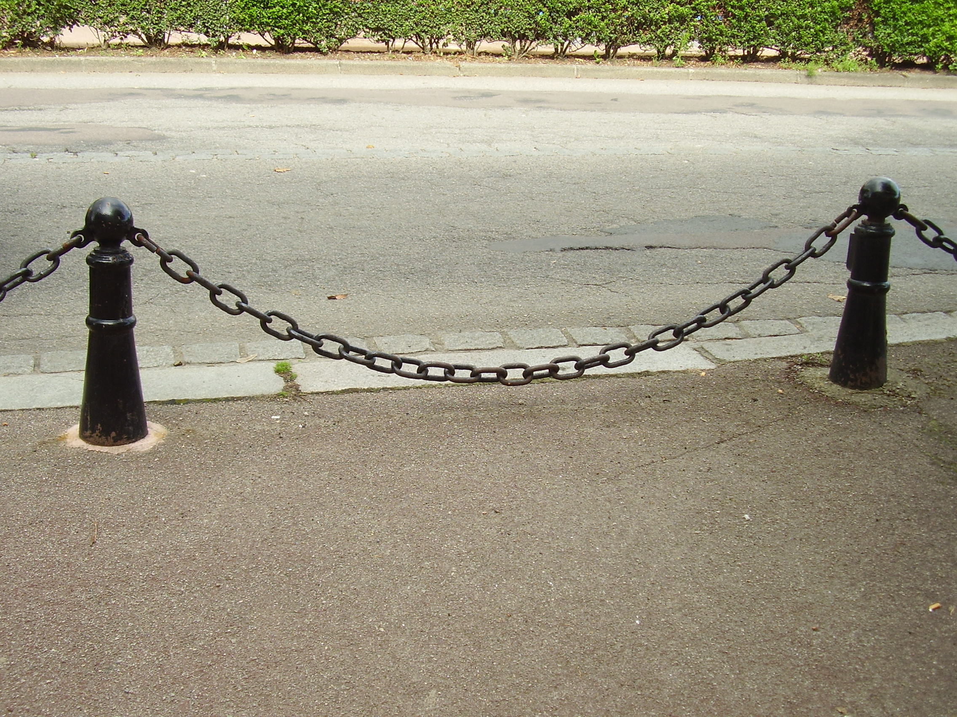


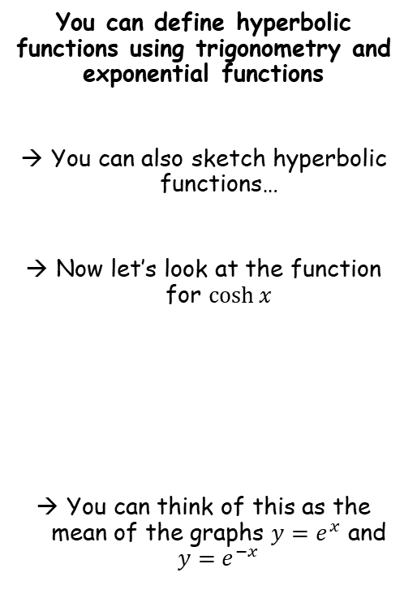



Hyperbolic Functions
$$sinhx=\frac{e^{x}−e^{−x}}{2}$$
$$coshx=\frac{e^{x}+e^{−x}}{2}$$
$$tanhx=\frac{e^{2x}−1}{e^{2x}+1}$$
$$y={−e}^{−x}$$
$$y$$
$$y=e^{x}$$
You can define hyperbolic functions using trigonometry and exponential functions
You can also sketch hyperbolic functions…
Now let’s look at the function for $\cosh{x}$
You can think of this as the mean of the graphs $y=e^{x}$ and $y=e^{−x}$
$$y=\frac{e^{x}+e^{−x}}{2}=\cosh{x}$$
$$1$$
$$x$$
$$y=\frac{e^{x}+e^{−x}}{2}$$
Write differently
The shape of $y=\cosh{x}$ is a catenary!
$$y=\frac{\left(e^{x}\right)+\left(e^{−x}\right)}{2}$$
(Catenary comes from the latin word catēna, meaning ‘chain’)
6A

Slide 19
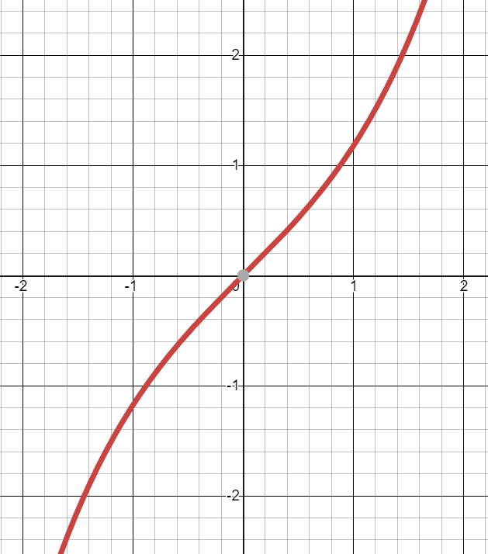


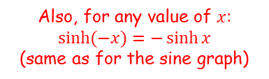










Hyperbolic Functions
$$sinhx=\frac{e^{x}−e^{−x}}{2}$$
$$coshx=\frac{e^{x}+e^{−x}}{2}$$
$$tanhx=\frac{e^{2x}−1}{e^{2x}+1}$$
$$sinhx=\frac{e^{x}−e^{−x}}{2}$$
You can define hyperbolic functions using trigonometry and exponential functions
Separate
$$=\frac{e^{x}}{2}−\frac{e^{−x}}{2}$$
$$y$$
$$y=\sinh{x}$$
Rewrite
$$=\frac{e^{x}}{2}−\frac{1}{2e^{x}}$$
As $x→∞$, $e^{x}→∞$
As $x→−∞$, $e^{x}→0$
$$≈\frac{e^{x}}{2}$$
$$≈−\frac{1}{2e^{x}}$$
$$≈−\frac{e^{−x}}{2}$$
$$x$$
So as $x→±∞$, the sides of the graph tend towards the graphs of $y=−\frac{e^{−x}}{2}$ (left) and $y=\frac{e^{x}}{2}$ (right)
Also, for any value of $x$:
$$\sinh{(−x)}=−\sinh{x}$$
(same as for the sine graph)
→ This means that $y=\sinh{x}$ is an odd function (has rotational symmetry about the origin)
(Drawn using Desmos)
6A

Slide 20
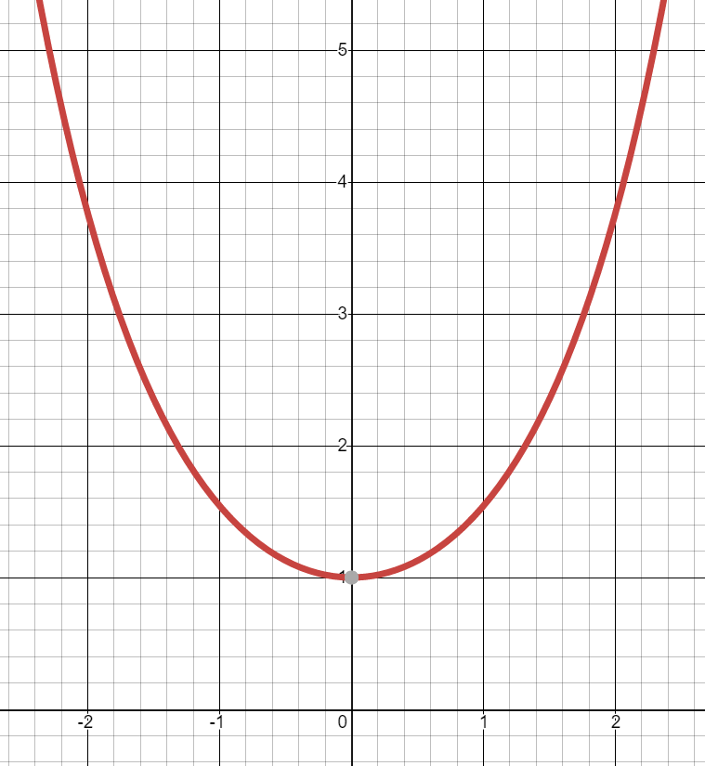






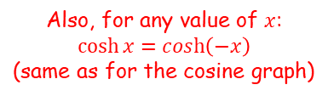


Hyperbolic Functions
$$sinhx=\frac{e^{x}−e^{−x}}{2}$$
$$coshx=\frac{e^{x}+e^{−x}}{2}$$
$$tanhx=\frac{e^{2x}−1}{e^{2x}+1}$$
$$coshx=\frac{e^{x}+e^{−x}}{2}$$
You can define hyperbolic functions using trigonometry and exponential functions
Separate
$$=\frac{e^{x}}{2}+\frac{e^{−x}}{2}$$
$$y$$
$$y=\cosh{x}$$
Rewrite
$$=\frac{e^{x}}{2}+\frac{1}{2e^{x}}$$
As $x→∞$, $e^{x}→∞$
As $x→−∞$, $e^{x}→0$
$$≈\frac{e^{x}}{2}$$
$$≈\frac{1}{2e^{x}}$$
$$≈\frac{e^{−x}}{2}$$
So as $x→±∞$, the sides of the graph tend towards the graphs of $y=\frac{e^{−x}}{2}$ (left) and $y=\frac{e^{x}}{2}$ (right)
Also, for any value of $x$:
$$\cosh{x}=\cosh\left(−x\right)$$
(same as for the cosine graph)
$$x$$
→ This means that $y=\cosh{x}$ is an even function (has reflection symmetry in the y-axis)
(Drawn using Desmos)
6A

Slide 21
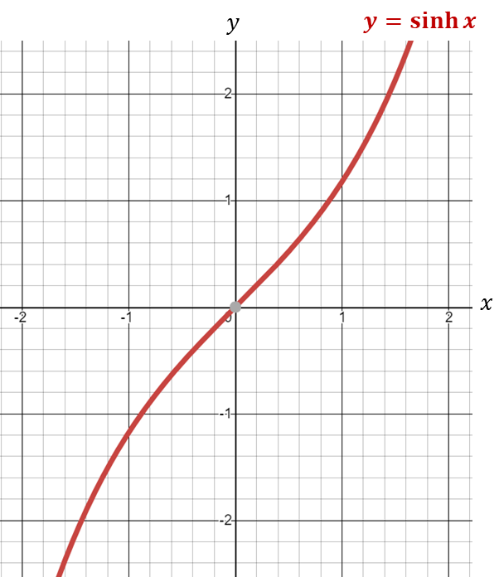
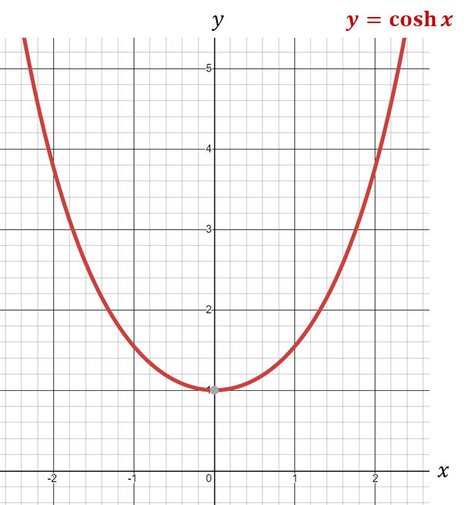





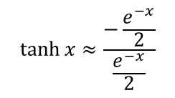

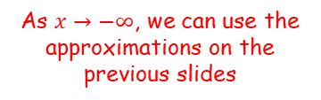

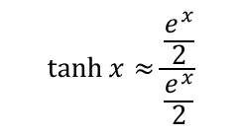

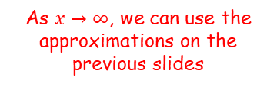

Hyperbolic Functions
$$sinhx=\frac{e^{x}−e^{−x}}{2}$$
$$coshx=\frac{e^{x}+e^{−x}}{2}$$
$$tanhx=\frac{e^{2x}−1}{e^{2x}+1}$$
You can define hyperbolic functions using trigonometry and exponential functions
Sketch the graph of $y=\tanh{x}$
$$\tanh{x}=\frac{\sinh{x}}{\cosh{x}}$$
When $x=0$
$$\tanh{0}=\frac{\sinh{0}}{\cosh{0}}$$
$$\tanh{x}=\frac{\sinh{x}}{\cosh{x}}$$
Calculate
$$=\frac{0}{1}$$
As $x→∞$, we can use the approximations on the previous slides
As $x→−∞$, we can use the approximations on the previous slides
Simplify
$$=0$$
So the curve will pass through (0,0)
$$\tanh{x}≈\frac{\frac{e^{x}}{2}}{\frac{e^{x}}{2}}$$
$$\tanh{x}≈\frac{−\frac{e^{−x}}{2}}{\frac{e^{−x}}{2}}$$
$$≈1$$
$$≈−1$$
So there will be asymptotes at $y=1$ and $y=−1$
6A

Slide 22
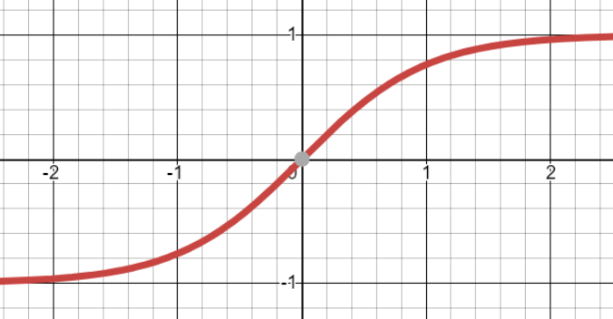



Hyperbolic Functions
$$sinhx=\frac{e^{x}−e^{−x}}{2}$$
$$coshx=\frac{e^{x}+e^{−x}}{2}$$
$$tanhx=\frac{e^{2x}−1}{e^{2x}+1}$$
You can define hyperbolic functions using trigonometry and exponential functions
Sketch the graph of $y=\tanh{x}$
The curve will pass through (0,0)
There will be asymptotes at $y=1$ and $y=−1$
$$y$$
$$y=\tanh{x}$$
$$y=1$$
$$x$$
$$y=−1$$
6A

Slide 23
Exercise 6A
Pearson Core Pure Year 2
Pages 122-123
Complete before the lesson Q1-2
In Class:
Green Q3-6
Amber Q7-9
Red Challenge

