Slide 1
Year 2 Pure Mathematics
Integration
- Trapezium Rule
Chapter 11
(Part 9 of 11)

Slide 2







Trapezium Rule
Sometimes finding the exact under the graph
via integration is difficult.
Therefore you can approximate the area under a graph by dividing it into trapeziums of equal width.
$$y3$$
$$y2$$
$$y0$$
$$y1$$
$$h$$
$$h$$
$$h$$

Slide 3

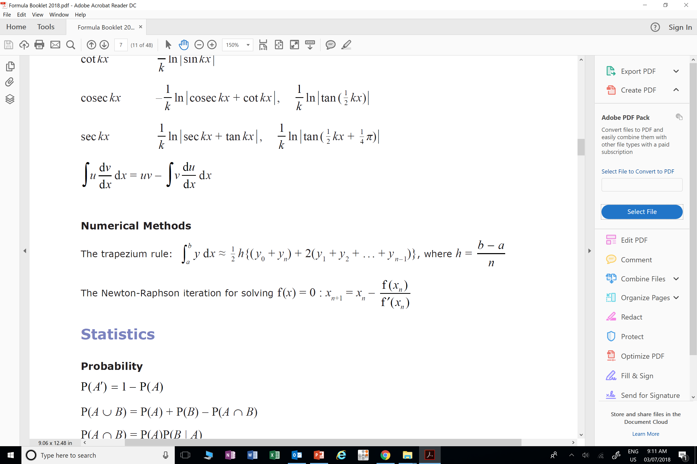


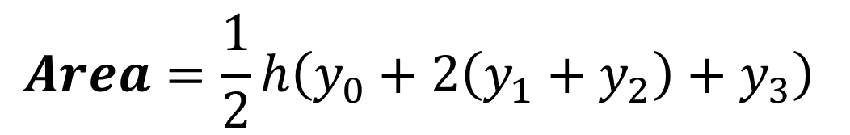


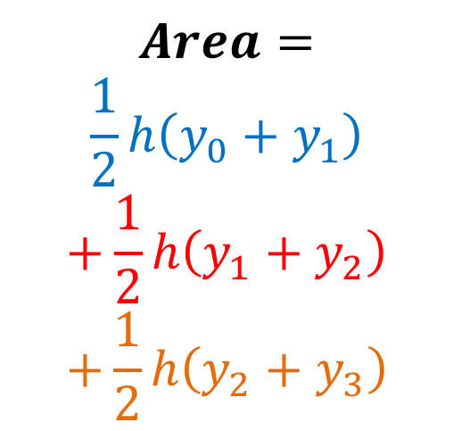




Trapezium Rule
$$Area=$$
$$\frac{1}{2}h\left(y_{0}+y_{1}\right)$$
$$+\frac{1}{2}h\left(y_{1}+y_{2}\right)$$
$$+\frac{1}{2}h\left(y_{2}+y_{3}\right)$$
$$y2$$
$$y3$$
$$y2$$
$$y0$$
$$y1$$
$$h$$
$$h$$
$$h$$
$$Area=\frac{1}{2}h\left(y_{0}+2\left(y_{1}+y_{2}\right)+y_{3}\right)$$

Slide 4
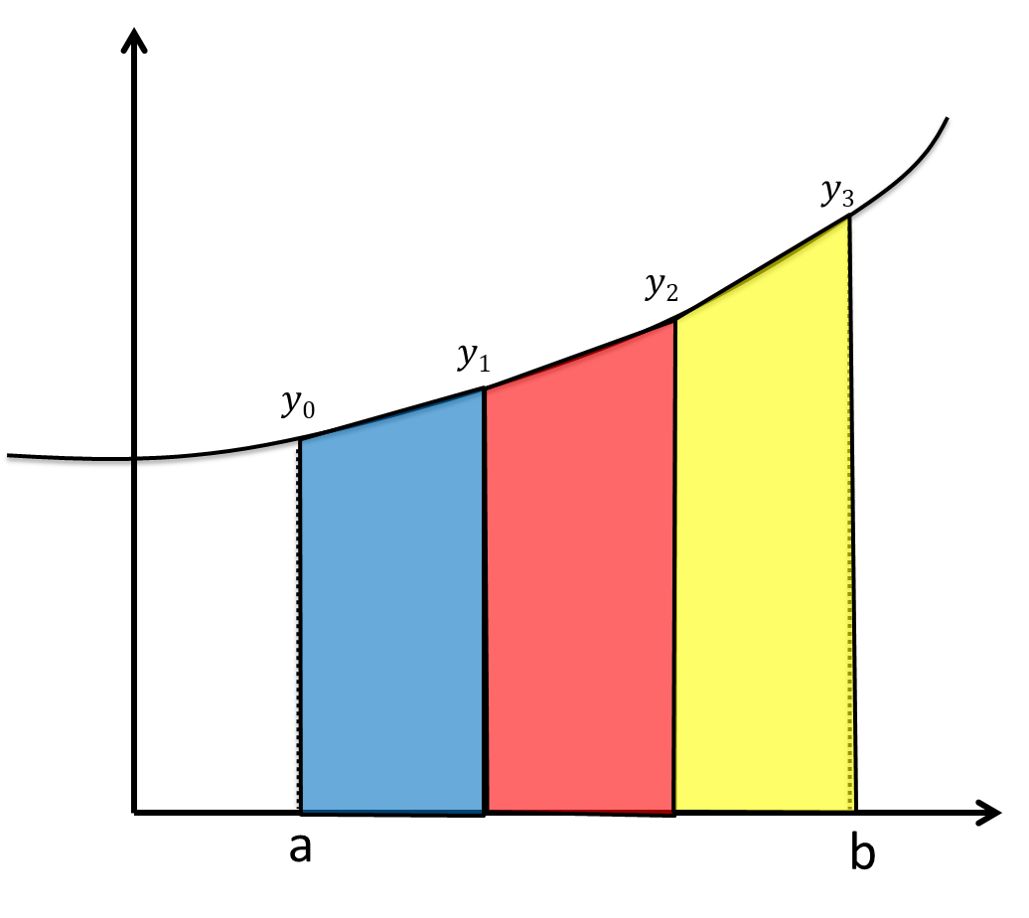
Trapezium Rule
First height
Last height
(All heights in-between) x 2
b – a = TOTAL width
n = number of trapeziums
h = width of EACH trapezium

Slide 5
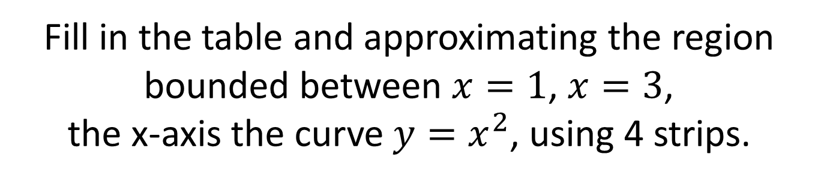
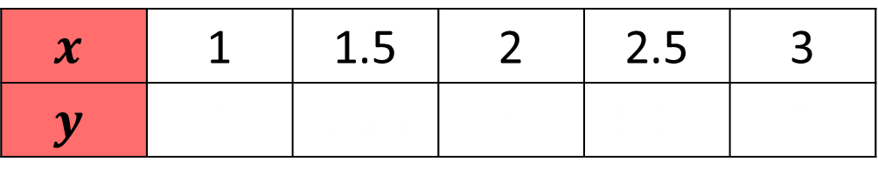
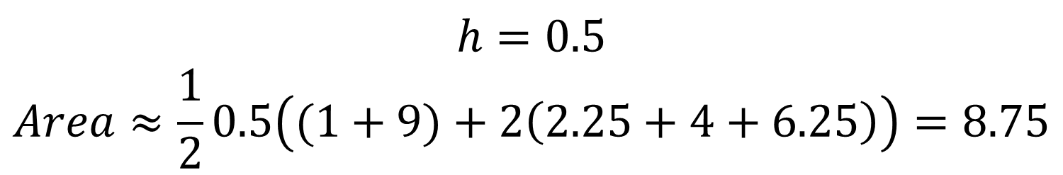
Trapezium Rule
Fill in the table and approximating the region bounded between $x=1$, $x=3$,
the x-axis the curve $y=x^{2}$, using 4 strips.
$$x$$ | 1 | 1.5 | 2 | 2.5 | 3
$$y$$ | 1 | 2.25 | 4 | 6.25 | 9
1 | 2.25 | 4 | 6.25 | 9
$$h=0.5 \\ Area≈\frac{1}{2}0.5\left((1+9)+2\left(2.25+4+6.25\right)\right)=8.75$$

Slide 6
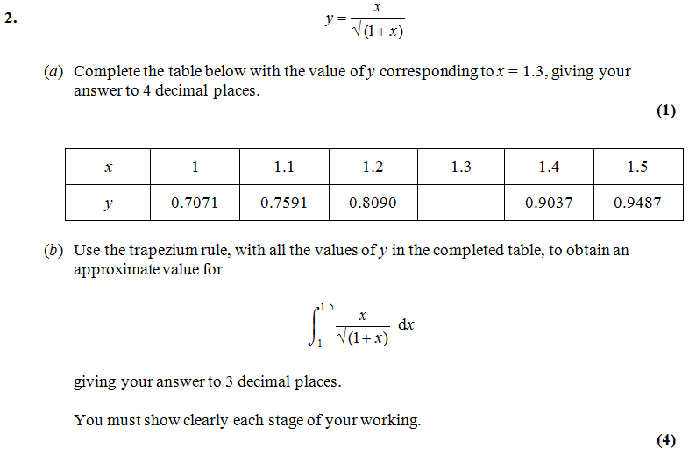
Trapezium Rule – Exam Question A
0.8571
$$Area≈\frac{0.1}{2}\left(0.7071+2\left(0.7591+0.8090+0.8571+0.9037\right)+0.9487\right)=0.416$$

Slide 7
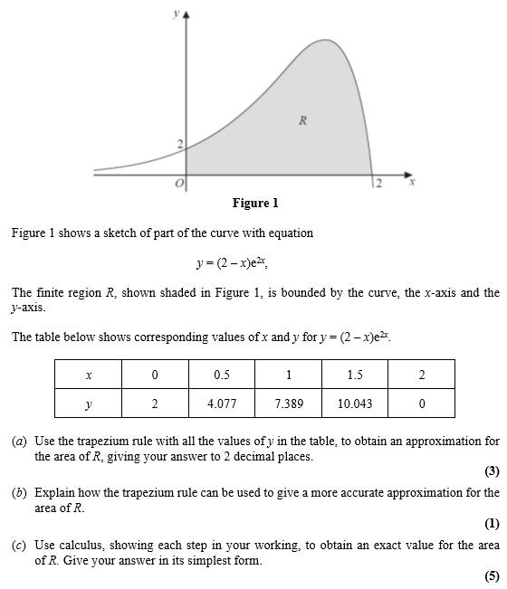
Trapezium Rule – Exam Question B

Slide 8

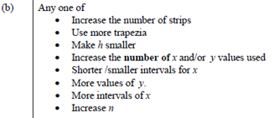
Trapezium Rule – Exam Question B Answers

Slide 9
Exercise 11I
Pearson Pure Mathematics Year 2/AS
Pages 319-322
Complete before the lesson Q1-2
In Class:
Green Q3-4
Amber Q5-6
Red Q7-8

