Slide 1
Complex Numbers
Twitter: @Owen134866
www.mathsfreeresourcelibrary.com

Slide 2
Teachings for
Exercise 1G

Slide 3



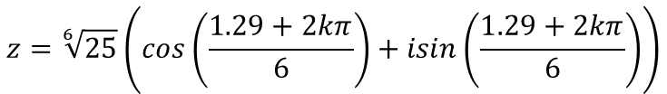


Complex Numbers
In general, the solutions to $z^{n}=1$ are $z=cos\left(\frac{2πk}{n}\right)+isin\left(\frac{2πk}{n}\right)=e^{\frac{2πik}{n}}$ for $k=1,2..n$
Im
Find the modulus and argument
You can use the properties of complex nth roots to solve geometric problems
Find the 6th roots of the complex number $7+24i$
$$r=\sqrt{{\left(7\right)}^{2}+{\left(24\right)}^{2}}$$
$$r=25$$
r
$argz=1.29$ (to 2dp)
24
θ
Re
7
$$z^{6}=7+24i$$
Rewrite in modulus-argument form
$$z^{6}=25\left(cos\left(1.29\right)+isin\left(1.29\right)\right)$$
Use the rule above
$$z^{6}=25\left(cos\left(1.29+2kπ\right)+isin\left(1.29+2kπ\right)\right)$$
Take the sixth root
$$z={\left[25\left(cos\left(1.29+2kπ\right)+isin\left(1.29+2kπ\right)\right)\right]}^{\frac{1}{6}}$$
Rewrite and apply De Moivre’s theorem
$$z=\sqrt[6]{25}\left(cos\left(\frac{1.29+2kπ}{6}\right)+isin\left(\frac{1.29+2kπ}{6}\right)\right)$$
1G

Slide 4



















Complex Numbers
In general, the solutions to $z^{n}=1$ are $z=cos\left(\frac{2πk}{n}\right)+isin\left(\frac{2πk}{n}\right)=e^{\frac{2πik}{n}}$ for $k=1,2..n$
Im
You can use the properties of complex nth roots to solve geometric problems
Find the 6th roots of the complex number $7+24i$
$$z_{5}$$
$$z_{6}$$
$$z_{4}$$
Re
$$z_{1}$$
$$z=\sqrt[6]{25}\left(cos\left(\frac{1.29+2kπ}{6}\right)+isin\left(\frac{1.29+2kπ}{6}\right)\right)$$
$$z_{3}$$
$$k=−3$$
$$z_{1}=−1.67−0.36i$$
$$z_{2}$$
$$k=−2$$
$$z_{2}=−0.52−1.63i$$
$$k=−1$$
$$z_{3}=1.15−1.26i$$
The roots will form a regular polygon
(each is the same distance from the origin ie) the same magnitude, and due to sine and cosine being cyclical they appear at consistent intervals)
$$k=0$$
$$z_{4}=1.67+0.36i$$
$$k=1$$
$$z_{5}=0.52+1.63i$$
$$k=2$$
$$z_{6}=−1.15+1.26i$$
1G

Slide 5






















Complex Numbers
In general, the solutions to $z^{n}=1$ are $z=cos\left(\frac{2πk}{n}\right)+isin\left(\frac{2πk}{n}\right)=e^{\frac{2πik}{n}}$ for $k=1,2..n$
You can use the properties of complex nth roots to solve geometric problems
Find the 6th roots of unity
Since we are finding the 6th roots, $n=6$ in all cases here
In general, the solutions to $z^{n}=1$ are $z=cos\left(\frac{2πk}{n}\right)+isin\left(\frac{2πk}{n}\right)=e^{\frac{2πik}{n}}$ for $k=1,2..n$
$$k=1$$
$$k=6$$
$$k=2$$
$$k=3$$
$$k=4$$
$$k=5$$
$$z=cos\left(\frac{2π}{6}\right)+isin\left(\frac{2π}{6}\right)$$
$$z=cos\left(\frac{4π}{6}\right)+isin\left(\frac{4π}{6}\right)$$
$$z=cos\left(\frac{6π}{6}\right)+isin\left(\frac{6π}{6}\right)$$
$$z=cos\left(\frac{8π}{6}\right)+isin\left(\frac{8π}{6}\right)$$
$$z=cos\left(\frac{10π}{6}\right)+isin\left(\frac{10π}{6}\right)$$
$$z=cos\left(\frac{12π}{6}\right)+isin\left(\frac{12π}{6}\right)$$
$$z=\frac{1}{2}+i\frac{\sqrt{3}}{2}$$
$$z=−\frac{1}{2}+i\frac{\sqrt{3}}{2}$$
$$z=−\frac{1}{2}−i\frac{\sqrt{3}}{2}$$
$$z=\frac{1}{2}−i\frac{\sqrt{3}}{2}$$
$$z=1$$
$$z=−1$$
x $\frac{1}{2}+i\frac{\sqrt{3}}{2}$
x $\frac{1}{2}+i\frac{\sqrt{3}}{2}$
x $\frac{1}{2}+i\frac{\sqrt{3}}{2}$
x $\frac{1}{2}+i\frac{\sqrt{3}}{2}$
x $\frac{1}{2}+i\frac{\sqrt{3}}{2}$
The 6th roots of unity actually follow a cyclical sequence with common ratio $\frac{1}{2}+i\frac{\sqrt{3}}{2}$
→ Notice that this common ratio is the value we get when $k=1$
1G

Slide 6
















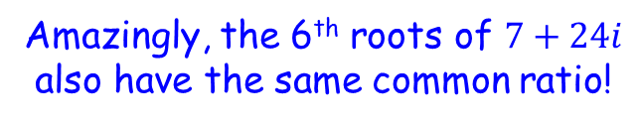






Complex Numbers
In general, the solutions to $z^{n}=1$ are $z=cos\left(\frac{2πk}{n}\right)+isin\left(\frac{2πk}{n}\right)=e^{\frac{2πik}{n}}$ for $k=1,2..n$
You can use the properties of complex nth roots to solve geometric problems
Bringing things together…
Amazingly, the 6th roots of $7+24i$ also have the same common ratio!
The 6th roots of unity
$$z_{1}=\frac{1}{2}+i\frac{\sqrt{3}}{2}$$
$$z_{2}=−\frac{1}{2}+i\frac{\sqrt{3}}{2}$$
$$z_{4}=−\frac{1}{2}−i\frac{\sqrt{3}}{2}$$
$$z_{5}=\frac{1}{2}−i\frac{\sqrt{3}}{2}$$
$$z_{3}=−1$$
$$z_{6}=1$$
x $\frac{1}{2}+i\frac{\sqrt{3}}{2}$
x $\frac{1}{2}+i\frac{\sqrt{3}}{2}$
x $\frac{1}{2}+i\frac{\sqrt{3}}{2}$
x $\frac{1}{2}+i\frac{\sqrt{3}}{2}$
x $\frac{1}{2}+i\frac{\sqrt{3}}{2}$
The 6th roots of $7+24i$
(the first example we did)
$$z_{1}=−1.67−0.36i$$
$$z_{2}=−0.52−1.63i$$
$$z_{3}=1.15−1.26i$$
$$z_{4}=1.67+0.36i$$
$$z_{5}=0.52+1.63i$$
$$z_{6}=−1.15+1.26i$$
x $\frac{1}{2}+i\frac{\sqrt{3}}{2}$
x $\frac{1}{2}+i\frac{\sqrt{3}}{2}$
x $\frac{1}{2}+i\frac{\sqrt{3}}{2}$
x $\frac{1}{2}+i\frac{\sqrt{3}}{2}$
x $\frac{1}{2}+i\frac{\sqrt{3}}{2}$
x ??
x ??
x ??
x ??
x ??
1G

Slide 7

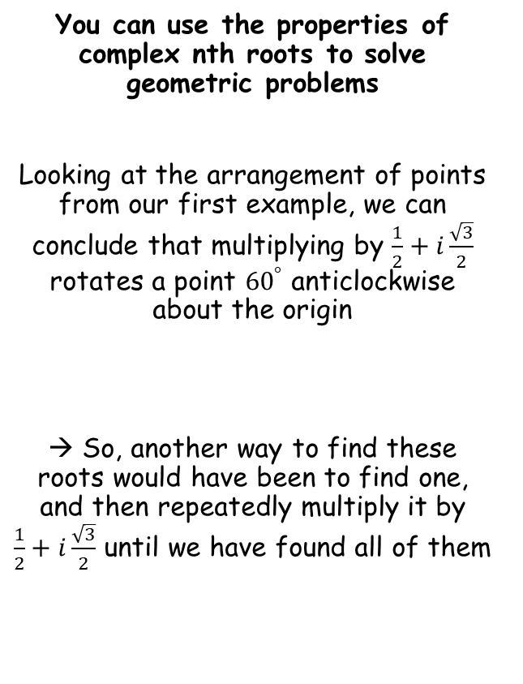

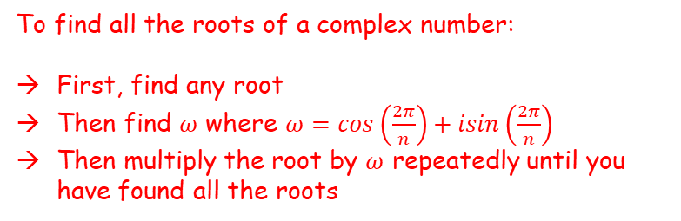
Complex Numbers
In general, the solutions to $z^{n}=1$ are $z=cos\left(\frac{2πk}{n}\right)+isin\left(\frac{2πk}{n}\right)=e^{\frac{2πik}{n}}$ for $k=1,2..n$
This is the result when $k=1$
Im
You can use the properties of complex nth roots to solve geometric problems
Looking at the arrangement of points from our first example, we can conclude that multiplying by $\frac{1}{2}+i\frac{\sqrt{3}}{2}$ rotates a point ${60}^{°}$ anticlockwise about the origin
→ So, another way to find these roots would have been to find one, and then repeatedly multiply it by $\frac{1}{2}+i\frac{\sqrt{3}}{2}$ until we have found all of them
$$z_{5}$$
$$z_{6}$$
$$z_{4}$$
Re
$$z_{1}$$
$${60}^{°}$$
$$z_{3}$$
$$z_{2}$$
To find all the roots of a complex number:
First, find any root
Then find $ω$ where $ω=cos\left(\frac{2π}{n}\right)+isin\left(\frac{2π}{n}\right)$
Then multiply the root by $ω$ repeatedly until you have found all the roots
1G

Slide 8
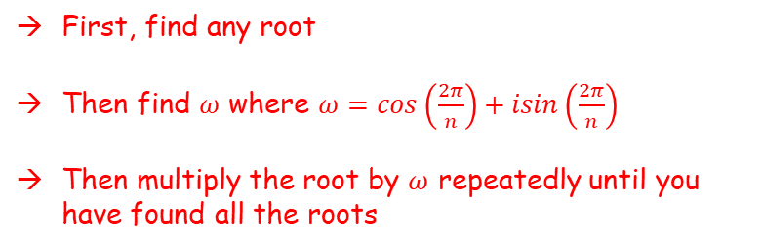
Complex Numbers
In general, the solutions to $z^{n}=1$ are $z=cos\left(\frac{2πk}{n}\right)+isin\left(\frac{2πk}{n}\right)=e^{\frac{2πik}{n}}$ for $k=1,2..n$
You can use the properties of complex nth roots to solve geometric problems
More formally:
If $z_{1}$ is one root of the equation $z^{n}=s$, and $1,ω,ω^{2}..ω^{n−1}$ are the roots of unity, then the roots of $z^{n}=s$ are given by $z_{1},{ z}_{1}ω,{{ z}_{1}ω}^{2 }..{{ z}_{1}ω}^{n−1}$
First, find any root
Then find $ω$ where $ω=cos\left(\frac{2π}{n}\right)+isin\left(\frac{2π}{n}\right)$
Then multiply the root by $ω$ repeatedly until you have found all the roots
1G

Slide 9

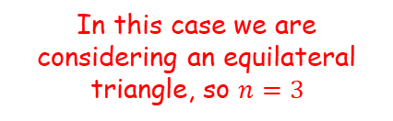
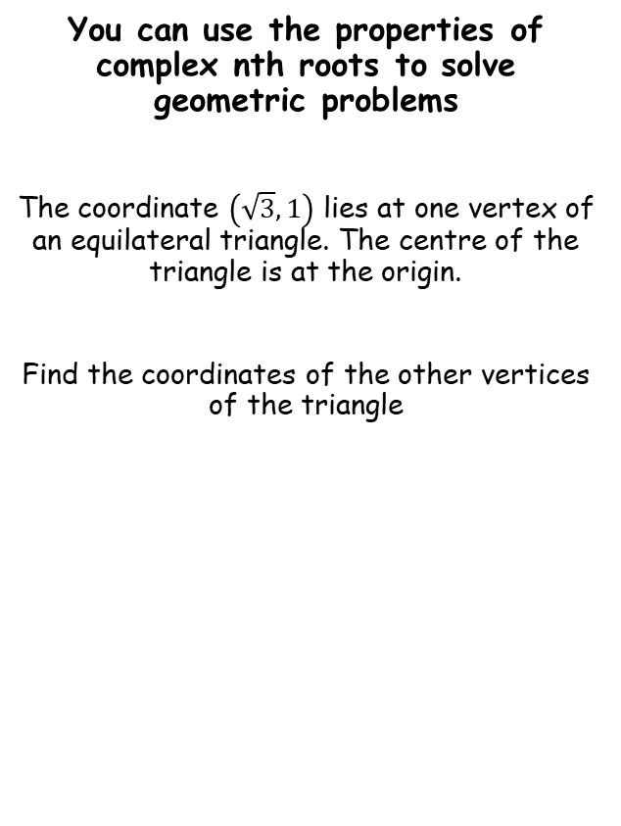







Complex Numbers
In general, the solutions to $z^{n}=1$ are $z=cos\left(\frac{2πk}{n}\right)+isin\left(\frac{2πk}{n}\right)=e^{\frac{2πik}{n}}$ for $k=1,2..n$
First, find any root
Then find $ω$ where $ω=cos\left(\frac{2π}{n}\right)+isin\left(\frac{2π}{n}\right)$
Then multiply the root by $ω$ repeatedly until you have found all the roots
y
You can use the properties of complex nth roots to solve geometric problems
The coordinate $\left(\sqrt{3},1\right)$ lies at one vertex of an equilateral triangle. The centre of the triangle is at the origin.
Find the coordinates of the other vertices of the triangle
$$\left(\sqrt{3},1\right)$$
This will be our first root, $z_{1}$
x
$$ω=cos\left(\frac{2π}{n}\right)+isin\left(\frac{2π}{n}\right)$$
In this case we are considering an equilateral triangle, so $n=3$
Although this problem involves regular coordinates, you can model it using complex numbers in order to solve it!
$$ω=cos\left(\frac{2π}{3}\right)+isin\left(\frac{2π}{3}\right)$$
Work out
$$ω=−\frac{1}{2}+i\frac{\sqrt{3}}{2}$$
$$ω=−\frac{1}{2}+i\frac{\sqrt{3}}{2}$$
$$z_{1}=\sqrt{3}+i$$
1G

Slide 10







Complex Numbers
In general, the solutions to $z^{n}=1$ are $z=cos\left(\frac{2πk}{n}\right)+isin\left(\frac{2πk}{n}\right)=e^{\frac{2πik}{n}}$ for $k=1,2..n$
First, find any root
Then find $ω$ where $ω=cos\left(\frac{2π}{n}\right)+isin\left(\frac{2π}{n}\right)$
Then multiply the root by $ω$ repeatedly until you have found all the roots
y
You can use the properties of complex nth roots to solve geometric problems
The coordinate $\left(\sqrt{3},1\right)$ lies at one vertex of an equilateral triangle. The centre of the triangle is at the origin.
Find the coordinates of the other vertices of the triangle
$$\left(\sqrt{3},1\right)$$
x
Multiplying $z_{1}$ by $ω$
$$\left(\sqrt{3}+i \right)\left(−\frac{1}{2}+i\frac{\sqrt{3}}{2}\right)$$
Although this problem involves regular coordinates, you can model it using complex numbers in order to solve it!
Expand brackets
$$=−\frac{\sqrt{3}}{2}−i\frac{1}{2}+i\frac{3}{2}+i^{2}\frac{\sqrt{3}}{2}$$
$$ω=−\frac{1}{2}+i\frac{\sqrt{3}}{2}$$
$$i^{2}=−1$$
$$z_{1}=\sqrt{3}+i$$
$$=−\frac{\sqrt{3}}{2}−i\frac{1}{2}+i\frac{3}{2}−\frac{\sqrt{3}}{2}$$
$$z_{2}=−\sqrt{3}+i$$
Group like terms
$$=−\sqrt{3}+i$$
1G

Slide 11






Complex Numbers
In general, the solutions to $z^{n}=1$ are $z=cos\left(\frac{2πk}{n}\right)+isin\left(\frac{2πk}{n}\right)=e^{\frac{2πik}{n}}$ for $k=1,2..n$
First, find any root
Then find $ω$ where $ω=cos\left(\frac{2π}{n}\right)+isin\left(\frac{2π}{n}\right)$
Then multiply the root by $ω$ repeatedly until you have found all the roots
y
You can use the properties of complex nth roots to solve geometric problems
The coordinate $\left(\sqrt{3},1\right)$ lies at one vertex of an equilateral triangle. The centre of the triangle is at the origin.
Find the coordinates of the other vertices of the triangle
$$\left(\sqrt{3},1\right)$$
x
Multiplying $z_{2}$ by $ω$
$$\left(−\sqrt{3}+i \right)\left(−\frac{1}{2}+i\frac{\sqrt{3}}{2}\right)$$
Although this problem involves regular coordinates, you can model it using complex numbers in order to solve it!
Expand brackets
$$=\frac{\sqrt{3}}{2}−i\frac{1}{2}−i\frac{3}{2}+i^{2}\frac{\sqrt{3}}{2}$$
$$ω=−\frac{1}{2}+i\frac{\sqrt{3}}{2}$$
$$i^{2}=−1$$
$$z_{1}=\sqrt{3}+i$$
$$=\frac{\sqrt{3}}{2}−i\frac{1}{2}−i\frac{3}{2}−\frac{\sqrt{3}}{2}$$
$$z_{2}=−\sqrt{3}+i$$
Group like terms
$$z_{3}=−2i$$
$$=−2i$$
1G

Slide 12


Complex Numbers
In general, the solutions to $z^{n}=1$ are $z=cos\left(\frac{2πk}{n}\right)+isin\left(\frac{2πk}{n}\right)=e^{\frac{2πik}{n}}$ for $k=1,2..n$
First, find any root
Then find $ω$ where $ω=cos\left(\frac{2π}{n}\right)+isin\left(\frac{2π}{n}\right)$
Then multiply the root by $ω$ repeatedly until you have found all the roots
y
You can use the properties of complex nth roots to solve geometric problems
The coordinate $\left(\sqrt{3},1\right)$ lies at one vertex of an equilateral triangle. The centre of the triangle is at the origin.
Find the coordinates of the other vertices of the triangle
$$\left(−\sqrt{3},1\right)$$
$$\left(\sqrt{3},1\right)$$
x
$$\left(0,−2\right)$$
Although this problem involves regular coordinates, you can model it using complex numbers in order to solve it!
$$ω=−\frac{1}{2}+i\frac{\sqrt{3}}{2}$$
$$z_{1}=\sqrt{3}+i$$
$$z_{2}=−\sqrt{3}+i$$
This will correspond to the coordinate $\left(−\sqrt{3},1\right)$
$$z_{3}=−2i$$
This will correspond to the coordinate $\left(0,−2\right)$
1G

Slide 13
Exercise 1G
Pearson Core Pure Year 2
Pages 26-27
Complete before the lesson Q1
In Class:
Amber Q2
Red Q3-6

