Slide 1

Further Mechanics 1 :
Elastic Collisions in one Dimension
Mr Ingall
(the boss of www.DrFrostMaths.com)
Last modified: 18th March 2019

Slide 2


The need for the ‘coefficient of restitution’
The chapter builds on Chapter 1.
It again considers only direct impacts (also known as one-dimensional or head-on impacts).
In ‘direct impacts’ particles are moving along the same straight line when they collide
(and the plane containing the surfaces in contact is perpendicular to this line).
Here is a question from Chapter 1:
Calculate the value of the unknown in the following isolated systems (all velocities marked are in m/s and all masses in kg.)
3
1
?
2
1
$$v_{2}=5{ms}^{−1}$$
1
$$v_{2}$$
Despite all the information about the movement of the particles before the collision,
We still needed information about the particles after the collision to proceed.
The information from before the collision was insufficient to predict movement afterwards.
We need more information: the coefficient of restitution gives us this information.
Once it is known for two particles we can determine the outcome of any direct impact given only the velocity of both particles before the collision.

Slide 3

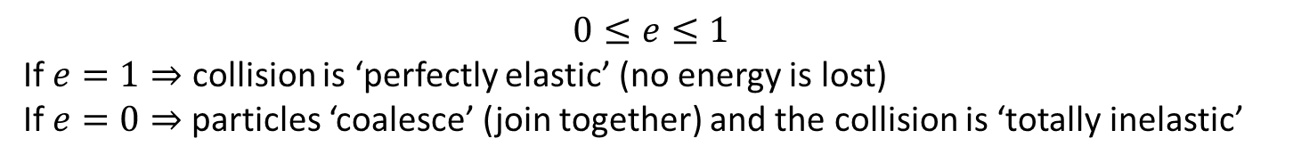


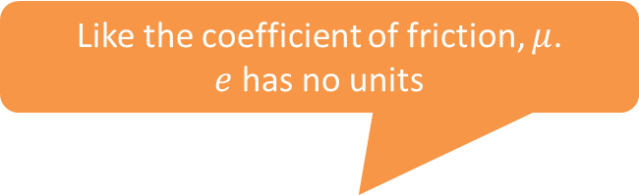

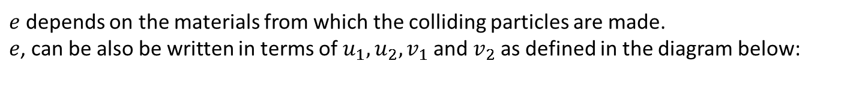

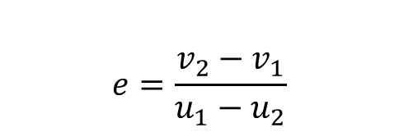

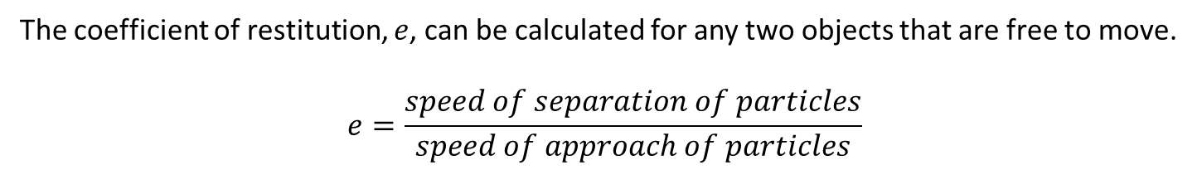
The Coefficient of Restitution
The coefficient of restitution, $e$, can be calculated for any two objects that are free to move.
$$e=\frac{speed of separation of particles}{speed of approach of particles}$$
Known as ‘Newton’s law of restitution’
or ‘Newton’s experimental law’
Like the coefficient of friction, $μ$.
$e$ has no units
$e$ depends on the materials from which the colliding particles are made.
$e$, can be also be written in terms of $u_{1},u_{2},v_{1}$ and $v_{2}$ as defined in the diagram below:
$$u_{1}$$
$$u_{2}$$
$$e=\frac{v_{2}−v_{1}}{u_{1}−u_{2}}$$
$$m_{1}$$
$$m_{2}$$
$$v_{1}$$
$$v_{2}$$
$$0≤e≤1$$
If $e=1⇒$ collision is ‘perfectly elastic’ (no energy is lost)
If $e=0⇒$particles ‘coalesce’ (join together) and the collision is ‘totally inelastic’

Slide 4





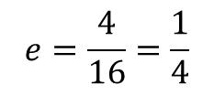



Quickfire $e$
Calculated the value of the coefficient of restitution, $e$, in the following isolated systems.
3
1
$$e=\frac{1}{2}$$
?
1
$$2$$
4
1
Tip: If the colliding particles are moving in opposite directions then the speed of separation/approach will generally be higher (based on the sum of speeds) than if they were moving in the same direction (based on the difference of speeds).
$$e=\frac{2}{3}$$
?
1
$$1$$
6
10
?
$$e=\frac{4}{16}=\frac{1}{4}$$
1
$$3$$
3
1
?
$$e=\frac{4}{4}=1$$
$$2$$
$$6$$

Slide 5

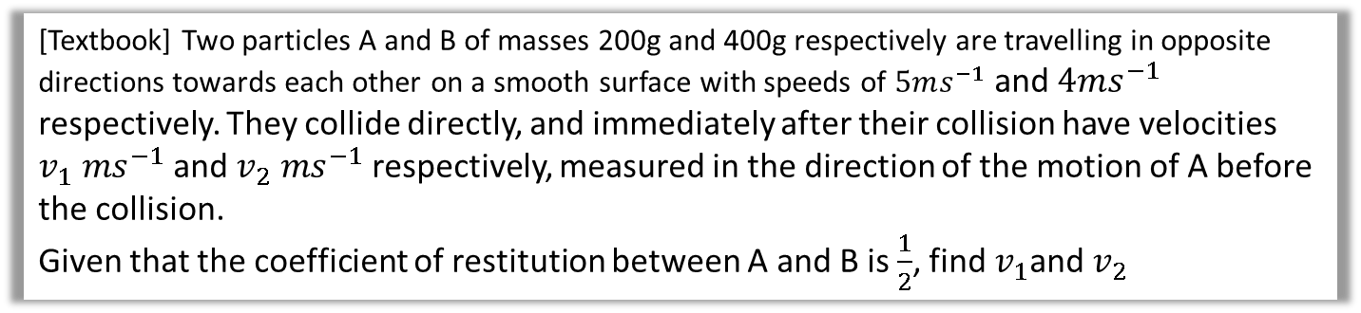



An Example
[Textbook] Two particles A and B of masses 200g and 400g respectively are travelling in opposite directions towards each other on a smooth surface with speeds of $5ms^{−1}$ and $4ms^{−1}$ respectively. They collide directly, and immediately after their collision have velocities $v_{1} ms^{−1}$ and $v_{2} ms^{−1}$respectively, measured in the direction of the motion of A before the collision.
Given that the coefficient of restitution between A and B is $\frac{1}{2}$, find $v_{1}$and $v_{2}$
Strategy
Use Newton’s law of restitution and the conservation of momentum to get two equations in $v_{1}$ and $v_{2}.$Solve these two equations simultaneously.
C.O.M. -> 0.2 $×$ 5 + 0.4 $×\left(−4\right)=0.2v_{1}+0.4v_{2}$
=> -0.6 = $0.2v_{1}+0.4v_{2}$ *
$$e=\frac{v_{2}−v_{1}}{5−−4}=\frac{1}{2}$$
=> $\frac{9}{2}=v_{2}−v_{1}$ *
Solve the two * equations simultaneously to get $v_{1}$and $v_{2}$.
$v_{2}=0.5$and $v_{1}=−4.$
?
5
4
Diagram
$$e=\frac{1}{2}$$
0.2
0.4
$$v_{1}$$
$$v_{2}$$

Slide 6
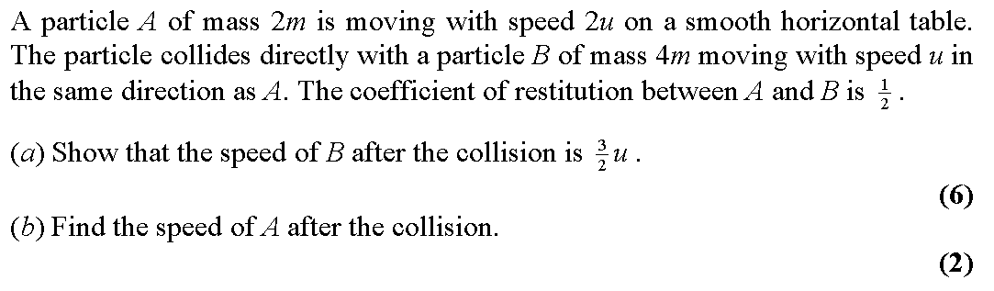
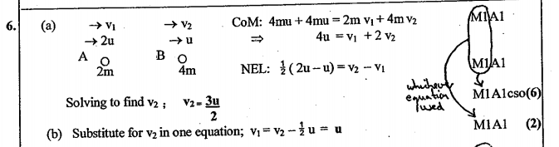
Test Your Understanding
Edexcel M2 Jun 2001 Q6 a & b
?

Slide 7
Exercise 4A
Pearson Further Mechanics 1
Pages 73-75 questions 1 - 6
Complete before the lesson Q1-2
In Class:
Green Q3-4
Amber Q5-7
Red Q8-10 & challenge

Slide 8














Sources of Inequalities
Harder questions often ask for an inequality.
It is sometimes tricky to know where to start.
There are 4 common starting points:
  ‘Direction of a particle is unchanged’
  0 < e < 1
  collision logic
  ‘the particles collide again’
  (considered later)
B.
Find the range of possible values of $k$.
$$0≤e≤1$$
5$u$
4$u$
2
$$e=?$$
3
$$ku$$
$$v_{2}$$
Limiting Inequality?
A.
Given that the direction of the 3kg particle is unchanged find the range of possible values of e.
$$v_{2}>0$$
5
4
C.
Find the maximum value of $v_{2}$
$$v_{2}≤4$$
collision logic => particles moving in a straight line can’t overtake!
(This gives the same result as $e≥0$)
2
$$e=?$$
3
2
$$u_{2}$$
$$v_{1}$$
$$v_{2}$$
2
$$e=?$$
3
4
$$v_{2}$$
Limiting Inequality?
Limiting Inequality?

Slide 9





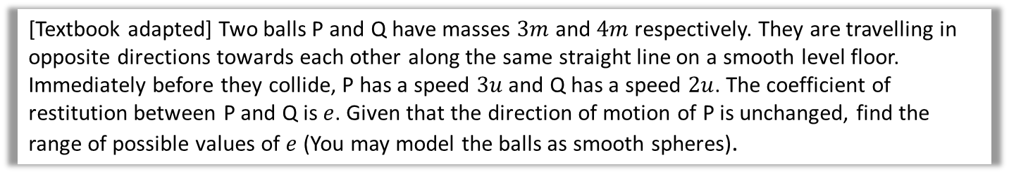








An Example
[Textbook adapted] Two balls P and Q have masses $3m$ and $4m$ respectively. They are travelling in opposite directions towards each other along the same straight line on a smooth level floor. Immediately before they collide, P has a speed $3u$ and Q has a speed $2u$. The coefficient of restitution between P and Q is $e$. Given that the direction of motion of P is unchanged, find the range of possible values of $e$ (You may model the balls as smooth spheres).
Diagram
Starting points
$$3u$$
$$2u$$
Conservation of momentum
Newton’s law of restitution
$$v_{1}>0$$
$$0≤e≤1$$
$$P$$
$$3m$$
$$e=?$$
$$4m$$
$$Q$$
$$v_{1}$$
$$v_{2}$$
Sub for $v_{2}$ in (ii)
$$5eu=\frac{u}{4}−\frac{3v_{1}}{4}−\frac{4v_{1}}{4}$$
$20eu=u−7v_{1}$
$v_{1}=\frac{u−20eu}{7}$
But $v_{1}≥$0 so $\frac{u−20eu}{7}≥0$
$1−20e>0$
$e≤\frac{1}{20}$
However $0≤e≤1$
So $0≤e<\frac{1}{20}$
Tip: Initial momentum of P > Initial momentum of Q.
=> At least $v_{2}$ will be in the direction PQ.
C.O.M. -> $9mu−8mu=3mv_{1}+{4mv}_{2}$
=> $u=3v_{1}+{4v}_{2}$ (i)
$$e=\frac{v_{2}−v_{1}}{3u−−2u}$$
=>$5eu=v_{2}−v_{1}$ (ii)
Rearranging (i) gives:
$$v_{2}=\frac{ u−3v_{1}}{4}$$
?

Slide 10
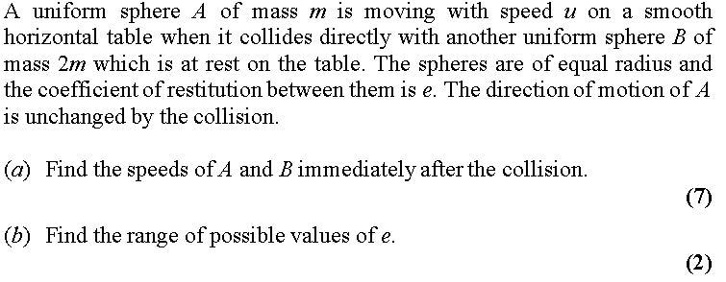
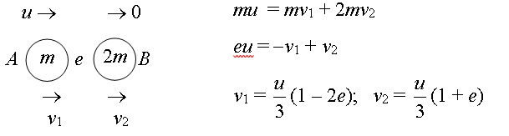
Test Your Understanding
Edexcel M2 June 2003 Q7
Solution to part a?

Slide 11

Test Your Understanding
Edexcel M2 June 2003 Q7
Solution to part b?

Slide 12
Exercise 4A
Pearson Further Mechanics 1
Pages 73-75 questions 7- 10 & challenge
Complete before the lesson Q1-2
In Class:
Green Q3-4
Amber Q5-7
Red Q8-10 & challenge

Slide 13
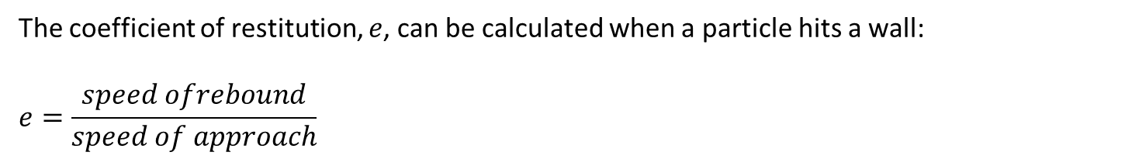
Hitting the Wall
The coefficient of restitution, $e$, can be calculated when a particle hits a wall:
$$e=\frac{speed ofrebound}{speed of approach}$$
Tip: If you think about it this is really the same formula as before
Small print: The above is true for a direct collision of a particle with a smooth plane surface perpendicular to the direction of motion of the particle.

Slide 14



A Simple Example
A Particle collides normally with a fixed vertical plane. The diagram shows the speeds of the particles before and after collision. Find the value of the coefficient of restitution, e.
$$8ms^{−1}$$
$$2ms^{−1}$$
?
$$e=\frac{2}{8}=\frac{1}{4}$$
You might also have to use suvat equations to find the speed immediately before impact – particularly with particles moving in a vertical line.

Slide 15

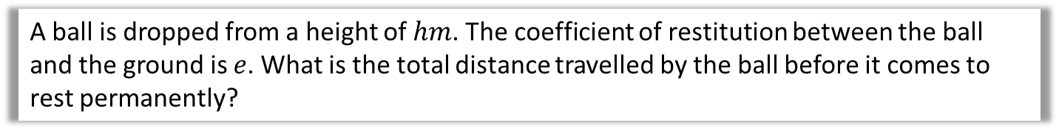
A Tricky Example
A ball is dropped from a height of $hm$. The coefficient of restitution between the ball and the ground is $e$. What is the total distance travelled by the ball before it comes to rest permanently?
?
Speed just before first impact with the ground, v:
$$v^{2}=u^{2}+2as$$
$$⇒v^{2}=2gh$$
$v=\sqrt{2gh}$
Distance travelled = h
-------------------------------------------------------------
Speed just after first impact = $e\sqrt{2gh}$
Distance travelled to highest point after first bounce, w:
$$v^{2}=u^{2}+2as$$
$$⇒0=e^{2}2gh −2gs$$
s $=e^{2}h$
-------------------------------------------------------------
Similarly distance travelled on the rise after second bounce $=e^{4}h$
Total distance = $h+{2e}^{2}h+2e^{4}h+2e^{6}h+ …$
This is $h$ + the sum of an infinite geometric series with $a=2e^{2}h$ and $r=e^{2}$
So Total distance = $h+\frac{a}{1−r}=h+\frac{2e^{2}h}{1−e^{2}}=\frac{h(1+e^{2})}{1−e^{2}}$

Slide 16
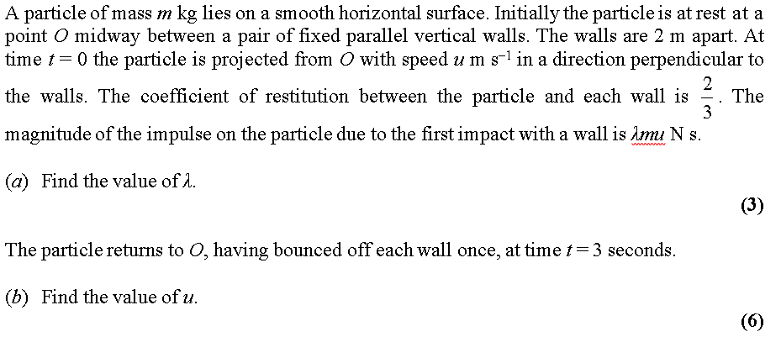
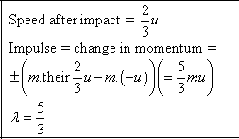


Test Your Understanding
Edexcel M2 June 2014 Q5
a?
b?

Slide 17
Exercise 4B
Pearson Further Mechanics 1
Pages 78-79
Complete before the lesson Q1-3
In Class:
Green Q4&5
Amber Q6&7
Red Q8-9 & challenge

Slide 18
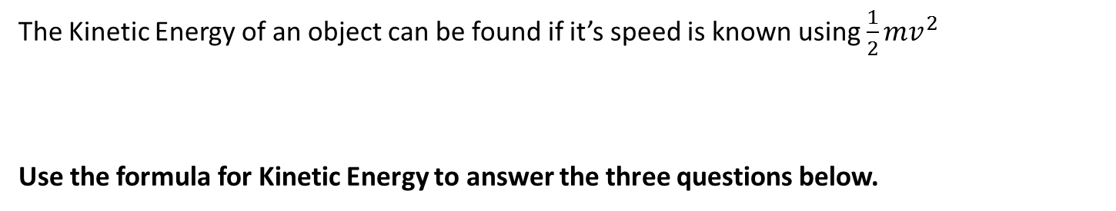






Loss of Kinetic Energy
The Kinetic Energy of an object can be found if it’s speed is known using $\frac{1}{2}mv^{2}$
Use the formula for Kinetic Energy to answer the three questions below.
$$8ms^{−1}$$
2kg
?
Loss in KE $=60J$
$$2ms^{−1}$$
2
2
2kg
2kg
?
?
Loss in KE $=3J$
% of KE lost in collision $=75\%$
1
$$1$$
$$8ms^{−1}$$
2kg
?
$$e=e$$
Loss in KE (in terms of $e$) = $64{\left(1−e\right)}^{2}$

Slide 19
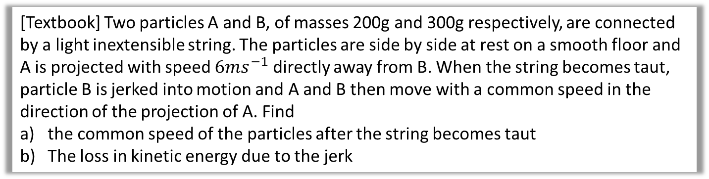
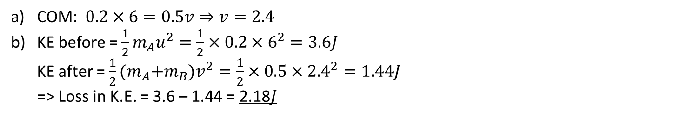
Loss of Kinetic Energy – An Example
[Textbook] Two particles A and B, of masses 200g and 300g respectively, are connected by a light inextensible string. The particles are side by side at rest on a smooth floor and A is projected with speed $6ms^{−1}$ directly away from B. When the string becomes taut, particle B is jerked into motion and A and B then move with a common speed in the direction of the projection of A. Find
the common speed of the particles after the string becomes taut
The loss in kinetic energy due to the jerk
?
COM: $0.2×6=0.5v⇒v=2.4$
KE before = $\frac{1}{2}m_{A}u^{2}=\frac{1}{2}×0.2×6^{2}=3.6J$
KE after = $\frac{1}{2}{(m}_{A}+m_{B})v^{2}=\frac{1}{2}×0.5×{2.4}^{2}=1.44J$
=> Loss in K.E. = 3.6 – 1.44 = 2.18$J$

Slide 20
Exercise 4C
Pearson Further Mechanics 1
Pages 82-84
Complete before the lesson Q1-3
In Class:
Green Q4-6
Amber Q7-9
Red Q10-14 & challenge

Slide 21
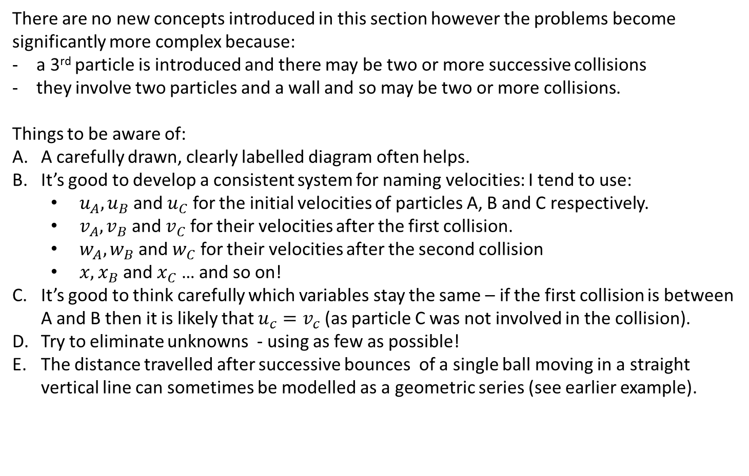
Successive Direct Impacts
There are no new concepts introduced in this section however the problems become significantly more complex because:
a 3rd particle is introduced and there may be two or more successive collisions
they involve two particles and a wall and so may be two or more collisions.
Things to be aware of:
A carefully drawn, clearly labelled diagram often helps.
It’s good to develop a consistent system for naming velocities: I tend to use:
  $u_{A},u_{B}$ and $u_{C}$ for the initial velocities of particles A, B and C respectively.
  $v_{A},v_{B}$ and $v_{C}$ for their velocities after the first collision.
  $w_{A},w_{B}$ and $w_{C}$ for their velocities after the second collision
  $x,x_{B}$ and $x_{C}$ … and so on!
It’s good to think carefully which variables stay the same – if the first collision is between A and B then it is likely that $u_{c}=v_{c}$ (as particle C was not involved in the collision).
Try to eliminate unknowns - using as few as possible!
The distance travelled after successive bounces of a single ball moving in a straight vertical line can sometimes be modelled as a geometric series (see earlier example).

Slide 22


Sources of Inequalities - revisited
Harder questions often ask for an inequality.
It is sometimes tricky to know where to start.
There are 4 common starting points:
  ‘Direction of a particle is unchanged’
  0 < e < 1
  collision logic
  (A-C were considered earlier)
  ‘the particles collide again’
D.
Given that the particles collide after P has hit the wall find the range of values of e.
$$v_{1}>2$$
5
2
m
m
$$e=?$$
$$v_{1}$$
2
Starting Point?

Slide 23



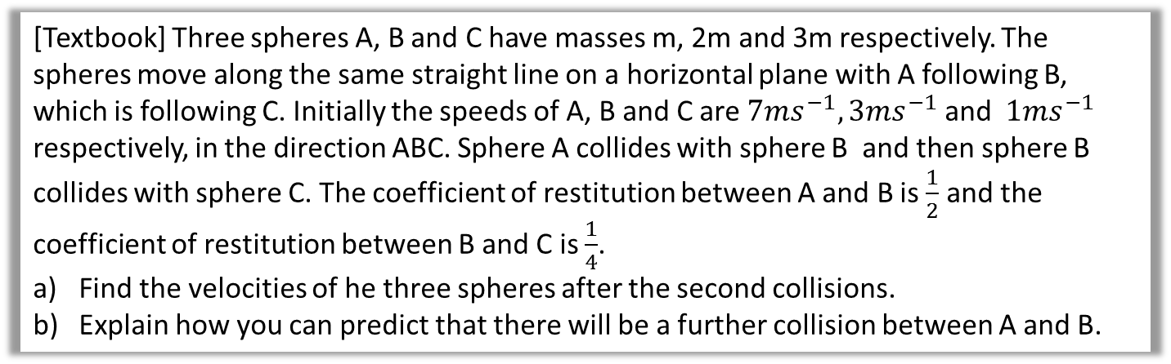


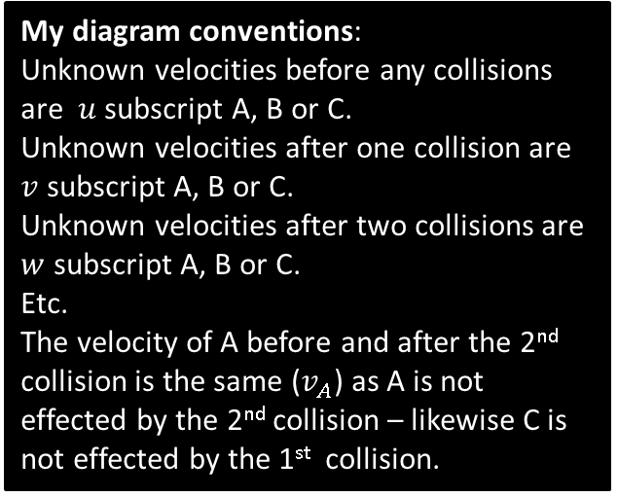


An Example
[Textbook] Three spheres A, B and C have masses m, 2m and 3m respectively. The spheres move along the same straight line on a horizontal plane with A following B, which is following C. Initially the speeds of A, B and C are $7ms^{−1}, 3ms^{−1}$ and $1ms^{−1}$ respectively, in the direction ABC. Sphere A collides with sphere B and then sphere B collides with sphere C. The coefficient of restitution between A and B is $\frac{1}{2}$ and the coefficient of restitution between B and C is $\frac{1}{4}$.
Find the velocities of he three spheres after the second collisions.
Explain how you can predict that there will be a further collision between A and B.
Diagram?
7
3
1
My diagram conventions:
Unknown velocities before any collisions are $u$ subscript A, B or C.
Unknown velocities after one collision are $v$ subscript A, B or C.
Unknown velocities after two collisions are $w$ subscript A, B or C.
Etc.
The velocity of A before and after the 2nd collision is the same ($v_{A}$) as A is not effected by the 2nd collision – likewise C is not effected by the 1st collision.
m
$$e=\frac{1}{2}$$
2m
$$e=\frac{1}{4}$$
3m
$$v_{A}$$
$$v_{B}$$
1
$$v_{A}$$
$$w_{B}$$
$$w_{c}$$

Slide 24

An Example
[Textbook] Three spheres A, B and C have masses m, 2m and 3m respectively. The spheres move along the same straight line on a horizontal plane with A following B, which is following C. Initially the speeds of A, B and C are $7ms^{−1}, 3ms^{−1}$ and $1ms^{−1}$ respectively, in the direction ABC. Sphere A collides with sphere B and then sphere B collides with sphere C. The coefficient of restitution between A and B is $\frac{1}{2}$ and the coefficient of restitution between B and C is $\frac{1}{4}$.
Find the velocities of he three spheres after the second collisions.
Explain how you can predict that there will be a further collision between A and B.
COM for A and B:
7m + 6m = m$v_{A}$+2m$v_{B}$
$e=\frac{1}{2}=\frac{v_{B}−v_{A}}{7−3}$
$v_{B}=v_{A}+2$ …
$v_{A}=3ms^{−1},v_{B}=5ms^{−1}$
COM for B and C:
10m+3m=2m$w_{B}$+3m$w_{C}$
$e=\frac{1}{4}=\frac{w_{c}−w_{B}}{5−1}$
$w_{c}=1+w_{B} …$
$w_{B}=2ms^{−1},w_{C}=3ms^{−1}$
b) $v_{A}>w_{B}$
7
3
1
?
m
$$e=\frac{1}{2}$$
2m
$$e=\frac{1}{4}$$
3m
$$v_{A}$$
$$v_{B}$$
1
$$v_{A}$$
$$w_{B}$$
$$w_{c}$$

Slide 25
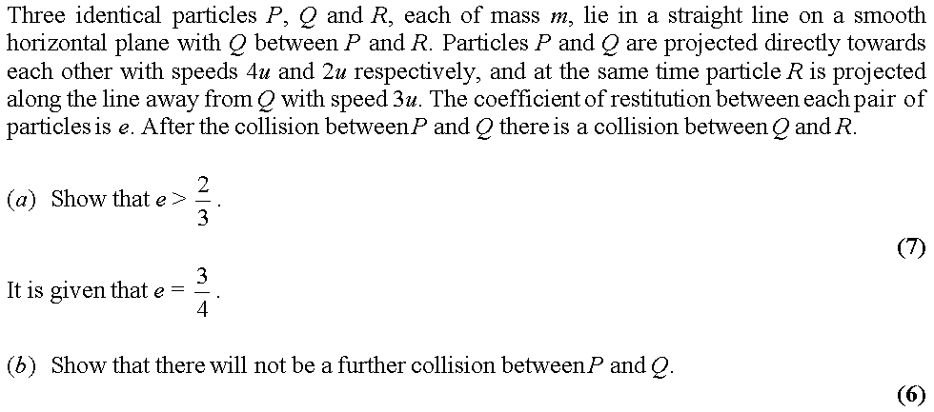
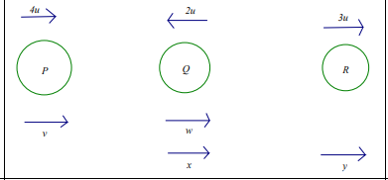
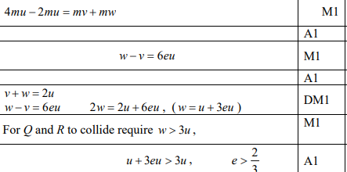
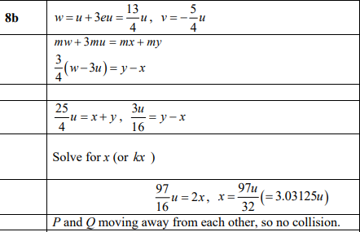
Test Your Understanding
Edexcel M2 June 2015 Q8
?

Slide 26
Exercise 4D
Pearson Further Mechanics 1
Pages 89-91 and Challenge
Complete before the lesson Q1
In Class:
Green Q2-3
Amber Q4-6
Red Q7-9 & challenge

Slide 27
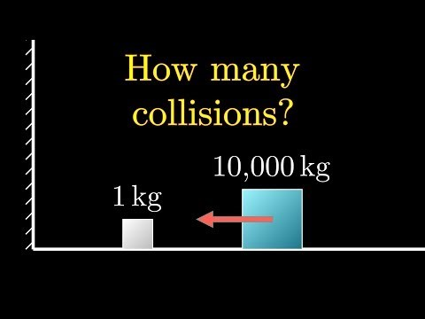
A rather wonderful challenge
Definitely beyond the scope of the syllabus! If video doesn’t play use link: https://www.youtube.com/watch?v=HEfHFsfGXjs

