Slide 1
Year 2 Applied Mathematics
Application of Forces
- Connected Particles and Friction
Chapter 7
(Part 5 of 5)

Slide 2
Connected particles
Look at both particles individually
using the F = ma equation.
Then solve simultaneously.
5
2
ϴ

Slide 3
Connected particles
Tension (T)
Tension (T)
2
5
Friction
2g sin ϴ
5g

Slide 4
Connected particles – Force exerted on the pulley
What is the force exerted on the pulley?
2
5
ϴ
It is the resultant of the two tensions.

Slide 5
Connected particles – Force exerted on the pulley
Resultant Force of the Tension
ϴ
2T cos ϴ

Slide 6
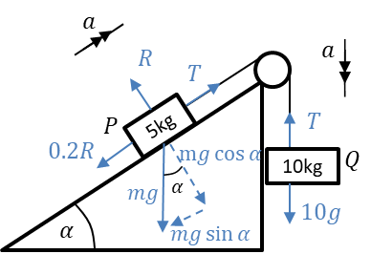
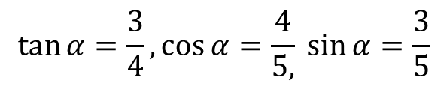
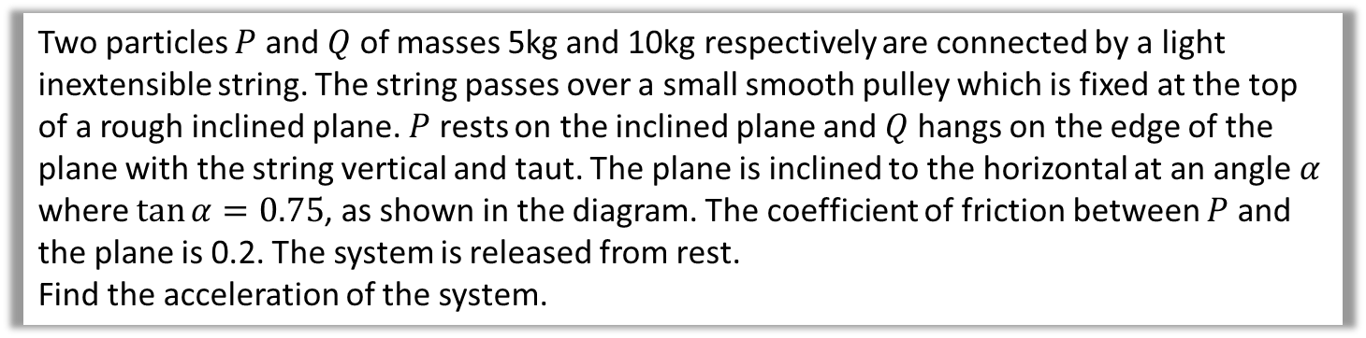
Connected particles – Example A
Two particles $P$ and $Q$ of masses 5kg and 10kg respectively are connected by a light inextensible string. The string passes over a small smooth pulley which is fixed at the top of a rough inclined plane. $P$ rests on the inclined plane and $Q$ hangs on the edge of the plane with the string vertical and taut. The plane is inclined to the horizontal at an angle $α$ where $\tan{α}=0.75$, as shown in the diagram. The coefficient of friction between $P$ and the plane is 0.2. The system is released from rest.
Find the acceleration of the system.
$$\tan{α}=\frac{3}{4}, \cos{α}=\frac{4}{5,}\sin{α}=\frac{3}{5}$$

Slide 7
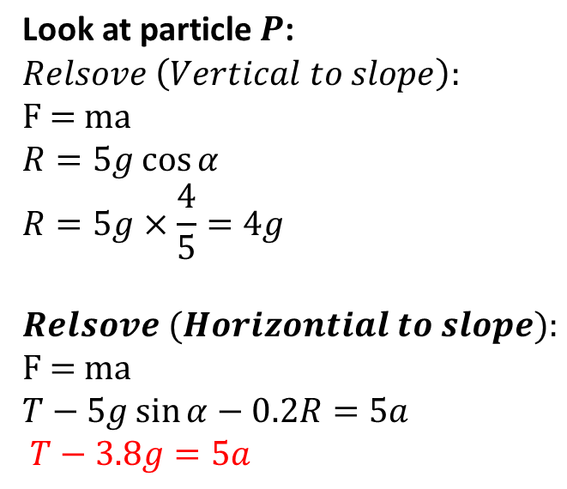
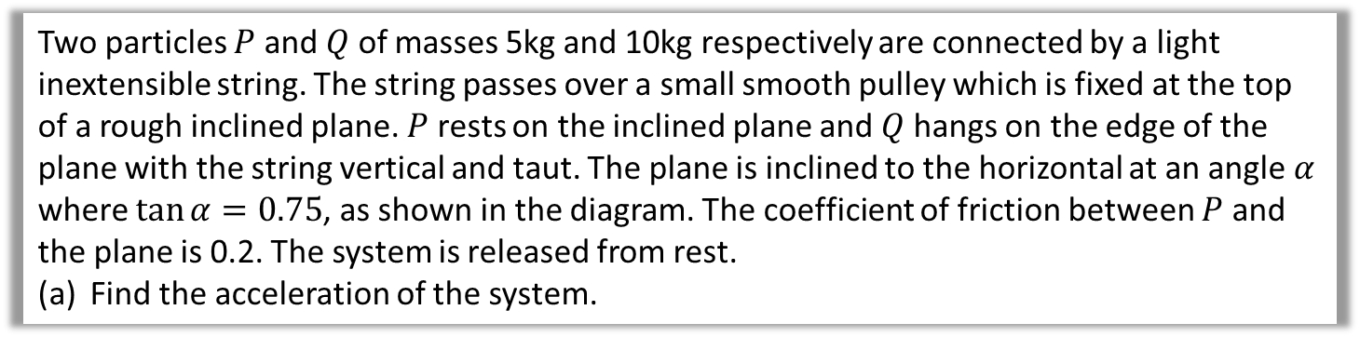
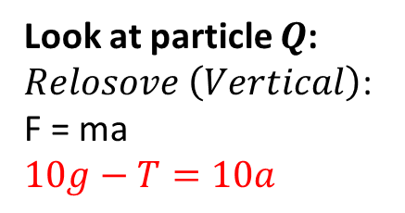
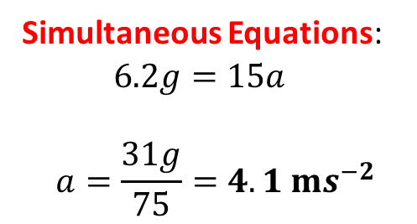
Connected particles – Example A
Two particles $P$ and $Q$ of masses 5kg and 10kg respectively are connected by a light inextensible string. The string passes over a small smooth pulley which is fixed at the top of a rough inclined plane. $P$ rests on the inclined plane and $Q$ hangs on the edge of the plane with the string vertical and taut. The plane is inclined to the horizontal at an angle $α$ where $\tan{α}=0.75$, as shown in the diagram. The coefficient of friction between $P$ and the plane is 0.2. The system is released from rest.
Find the acceleration of the system.
$$\text{Look} \text{at} \text{particle} P\text{:}$$
$$Relsove \left(Vertical to slope\right):$$
F = ma
$$R=5g\cos{α} \\ R=5g×\frac{4}{5}=4g$$
$$Relsove (Horizontial to slope):$$
F = ma
$$T−5g\sin{α}−0.2R=5a \\ T−3.8g=5a$$
Look at particle $Q$:
$Relosove \left(Vertical\right)$:
F = ma
$$10g−T=10a$$
Simultaneous Equations:
$$6.2g=15a$$
$$a=\frac{31g}{75}=4.1 ms^{−2}$$

Slide 8
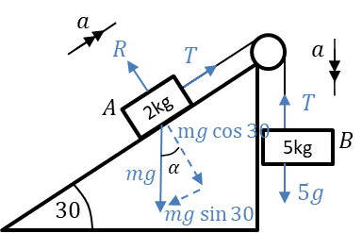
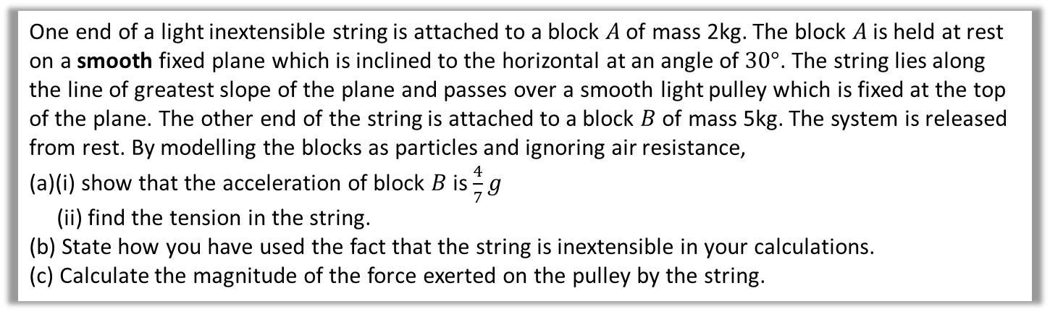
Connected particles – Example B
One end of a light inextensible string is attached to a block $A$ of mass 2kg. The block $A$ is held at rest on a smooth fixed plane which is inclined to the horizontal at an angle of $30°$. The string lies along the line of greatest slope of the plane and passes over a smooth light pulley which is fixed at the top of the plane. The other end of the string is attached to a block $B$ of mass 5kg. The system is released from rest. By modelling the blocks as particles and ignoring air resistance,
(a)(i) show that the acceleration of block $B$ is $\frac{4}{7}g$
(ii) find the tension in the string.
(b) State how you have used the fact that the string is inextensible in your calculations.
(c) Calculate the magnitude of the force exerted on the pulley by the string.

Slide 9
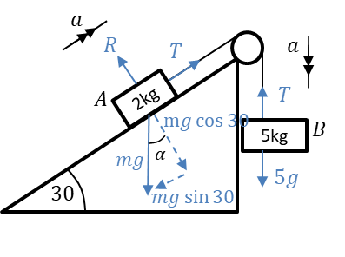
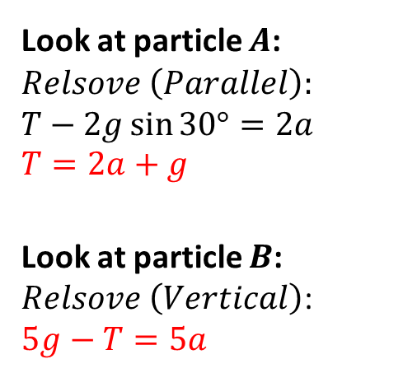
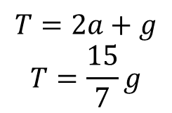
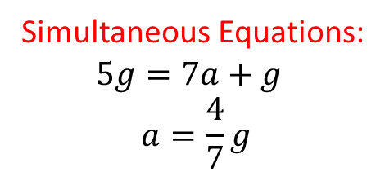
Connected particles – Example B
One end of a light inextensible string is attached to a block $A$ of mass 2kg. The block $A$ is held at rest on a smooth fixed plane which is inclined to the horizontal at an angle of $30°$. The string lies along the line of greatest slope of the plane and passes over a smooth light pulley which is fixed at the top of the plane. The other end of the string is attached to a block $B$ of mass 5kg. The system is released from rest. By modelling the blocks as particles and ignoring air resistance,
(a)(i) show that the acceleration of block $B$ is $\frac{4}{7}g$
(ii) find the tension in the string.
(b) State how you have used the fact that the string is inextensible in your calculations.
(c) Calculate the magnitude of the force exerted on the pulley by the string.
Look at particle $A$:
$$Relsove \left(Parallel\right):$$
$$T−2g\sin{30°}=2a$$
$$T=2a+g$$
Look at particle $B$:
$Relsove \left(Vertical\right)$:
$$5g−T=5a$$
Simultaneous Equations:
$$5g=7a+g$$
$$a=\frac{4}{7}g$$
a
$$T=2a+g$$
$$T=\frac{15}{7}g$$
b
String is inextensible so acceleration at $A$ and $B$ the same.

Slide 10
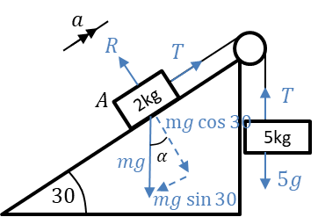
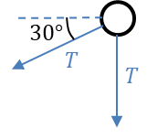
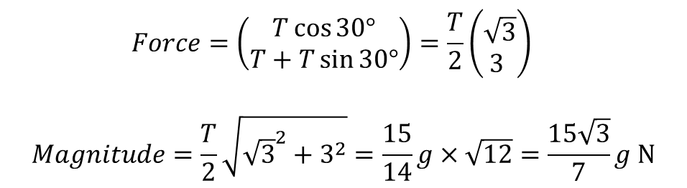
Connected particles – Example B
One end of a light inextensible string is attached to a block $A$ of mass 2kg. The block $A$ is held at rest on a smooth fixed plane which is inclined to the horizontal at an angle of $30°$. The string lies along the line of greatest slope of the plane and passes over a smooth light pulley which is fixed at the top of the plane. The other end of the string is attached to a block $B$ of mass 5kg. The system is released from rest. By modelling the blocks as particles and ignoring air resistance,
(a)(i) show that the acceleration of block $B$ is $\frac{4}{7}g$
(ii) find the tension in the string.
(b) State how you have used the fact that the string is inextensible in your calculations.
(c) Calculate the magnitude of the force exerted on the pulley by the string.
c
$$Force=\left(\begin{matrix}T\cos{30°} \\ T+T\sin{30°}\end{matrix}\right)=\frac{T}{2}\left(\begin{matrix}\sqrt{3} \\ 3 \end{matrix}\right)$$
$$Magnitude=\frac{T}{2}\sqrt{{\sqrt{3}}^{2}+3^{2}}=\frac{15}{14}g×\sqrt{12}=\frac{15\sqrt{3}}{7}g N$$

Slide 11
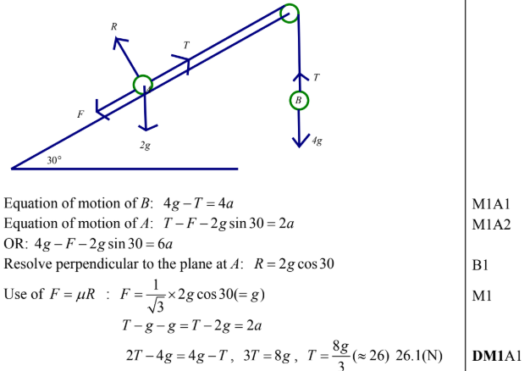
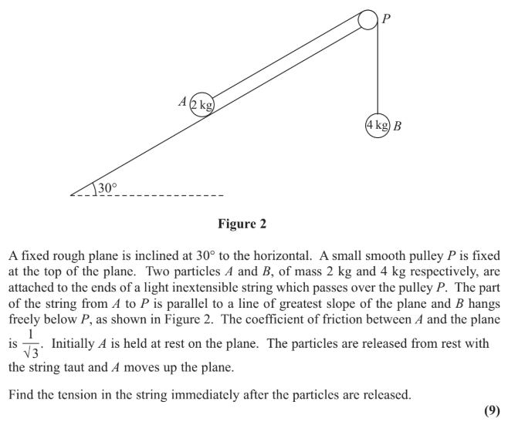
Test Your Understanding
?
Edexcel M1(Old) May 2013(R) Q3

Slide 12
Exercise 7F
Pearson Stats/Mechanics Year 2
Pages 152-154
Complete before the lesson Q1-2
In Class:
Green Q3
Amber Q4
Red Q5-6 & Challenge

