Slide 1
Year 1 Pure Mathematics
Vectors
- Introduction
Chapter 11
(Part 2 of 2)

Slide 2




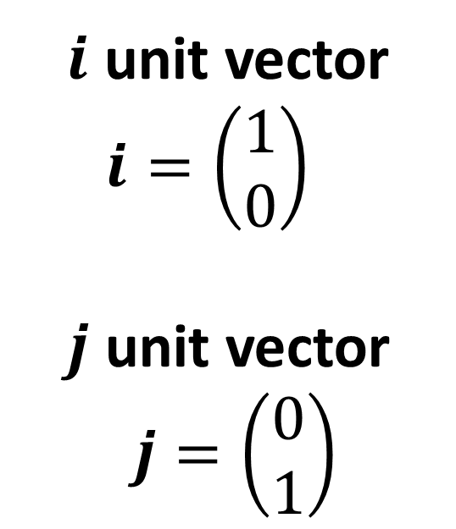
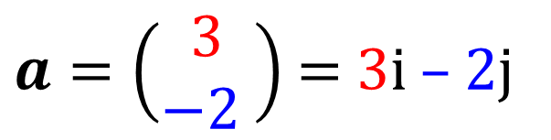
Vectors – i and j compoents
$a=\left(\begin{matrix}3 \\ −2 \end{matrix}\right)$ $=$ 3i – 2j
$$\left(\begin{matrix}3 \\ −2 \end{matrix}\right)$$
$i$ unit vector
$$i=\left(\begin{matrix}1 \\ 0\end{matrix}\right)$$
$j$ unit vector
$$j=\left(\begin{matrix}0 \\ 1\end{matrix}\right)$$
$$j$$
$$i$$

Slide 3


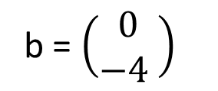
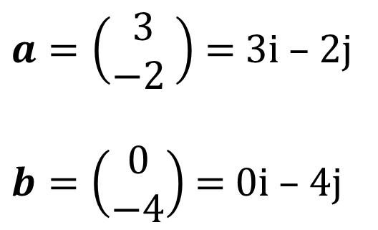

Vectors – adding vectors
$a=\left(\begin{matrix}3 \\ −2 \end{matrix}\right)$ $=$ 3i – 2j
$b=\left(\begin{matrix}0 \\ −4\end{matrix}\right)$ $=$ 0i – 4j
a = $\left(\begin{matrix}3 \\ −2 \end{matrix}\right)$
$$a+b$$
$$=\left(\begin{matrix}3+0 \\ −2+ −4\end{matrix}\right)$$
$$=\left(\begin{matrix}3 \\ −6\end{matrix}\right)$$
b = $\left(\begin{matrix}3 \\ −6 \end{matrix}\right)$
b = $\left(\begin{matrix}0 \\ −4 \end{matrix}\right)$

Slide 4
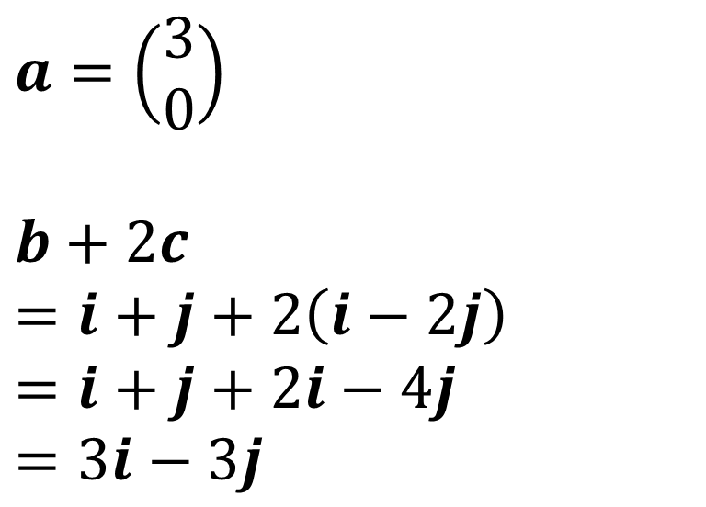
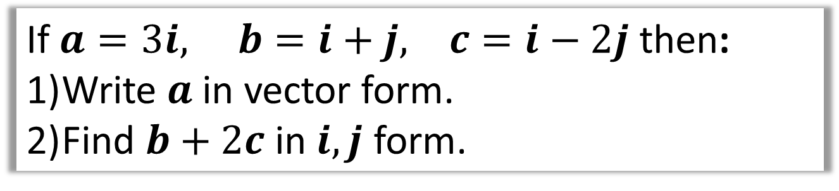
Vectors – calculating with vectors
If $a=3i, b=i+j, c=i−2j$ then:
Write $a$ in vector form.
Find $b+2c$ in $i,j$ form.
$$a=\left(\begin{matrix}3 \\ 0\end{matrix}\right)$$
$$b+2c=i+j+2\left(i−2j\right) \\ =i+j+2i−4j \\ =3i−3j$$
1
2

Slide 5
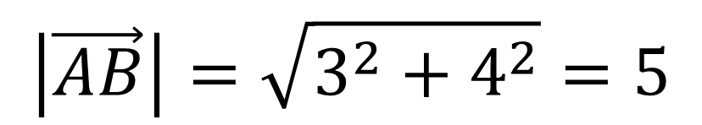
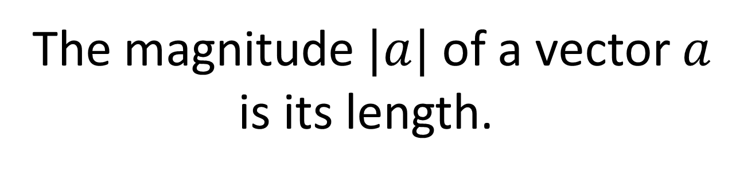


Vectors - Magnitude
The magnitude $|a|$ of a vector $a$
is its length.
$$B$$
AB = 3i + 4j
4
$$A$$
3
$$\left|\vec{AB}\right|=\sqrt{3^{2}+4^{2}}=5$$

Slide 6
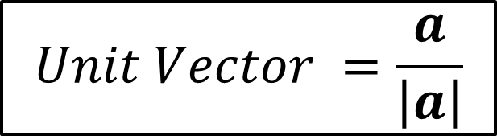
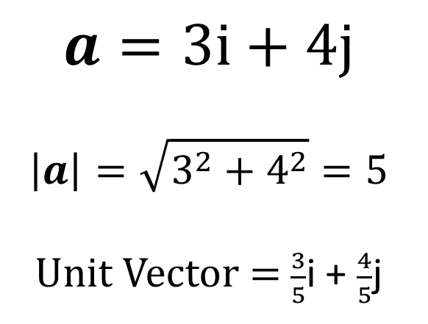
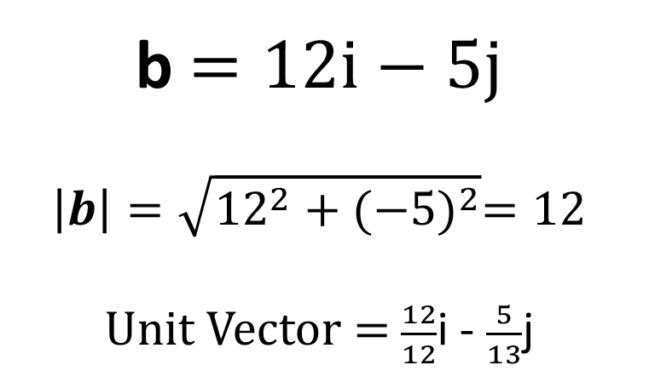
Vectors - Unit Vectors
A unit vector is a vector whose magnitude is 1
$$Unit Vector =\frac{a}{\left|a\right|}$$
$$a=3i+4j$$
$$\left|a\right|=\sqrt{3^{2}+4^{2}}=5$$
Unit Vector $=$ $\frac{3}{5}$i + $\frac{4}{5}$j
b$=12i−5j$
$$\left|b\right|=\sqrt{{12}^{2}+{(−5)}^{2}}=12$$
Unit Vector $=$ $\frac{12}{12}$i - $\frac{5}{13}$j

Slide 7




Vectors - Position Vectors
A vector used to represent a position
is known as a position vector.
The position is with reference from the origin
$$y$$
Position Vector of A
= OA
= 3i + 2j
$$A\left(3,2\right)$$
$$O$$
$$x$$

Slide 8

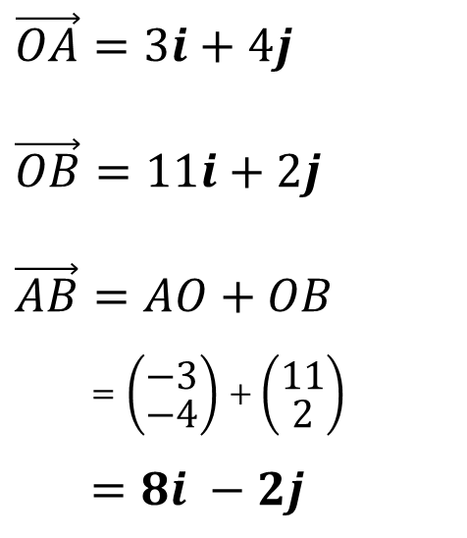

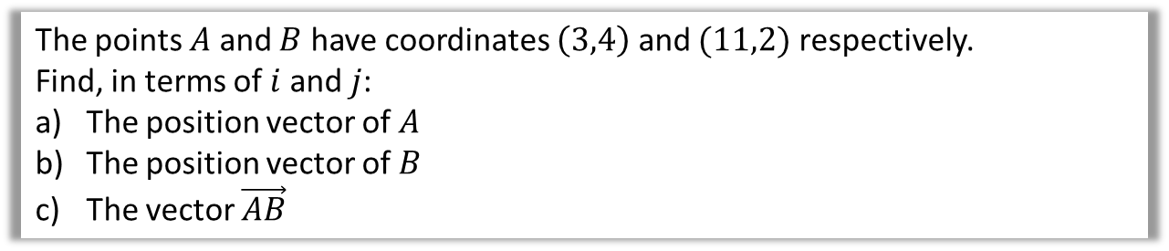



Vectors - Position Vectors
The points $A$ and $B$ have coordinates $\left(3,4\right)$ and $(11,2)$ respectively.
Find, in terms of $i$ and $j$:
The position vector of $A$
The position vector of $B$
The vector $\vec{AB}$
$$y$$
$$\vec{OA}=3i+4j$$
$$\vec{OB}=11i+2j$$
$$\vec{AB}=AO+OB$$
$=\left(\begin{matrix}−3 \\ −4\end{matrix}\right)+\left(\begin{matrix}11 \\ 2\end{matrix}\right)$
$$=8i −2j$$
a
$$A\left(3,4\right)$$
b
B$\left(11,2\right)$
c
$$O$$
$$x$$

Slide 9
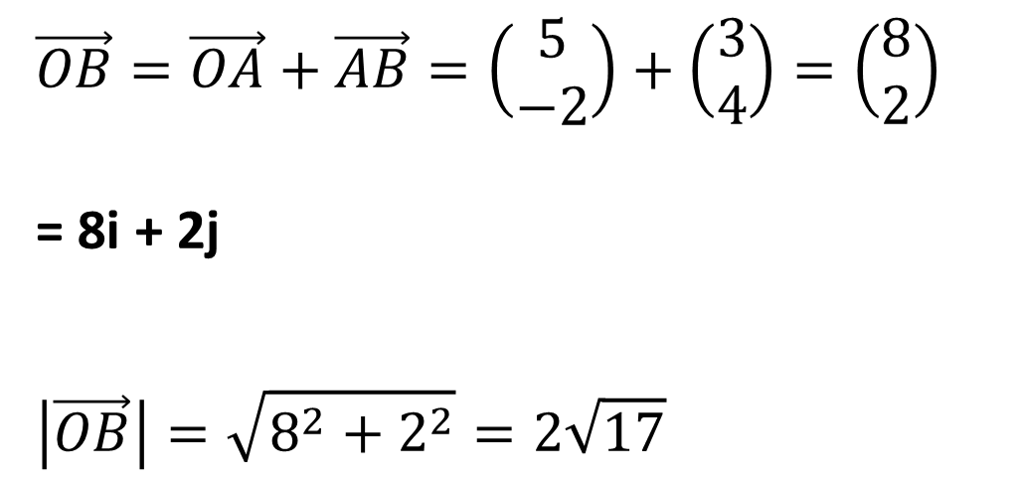
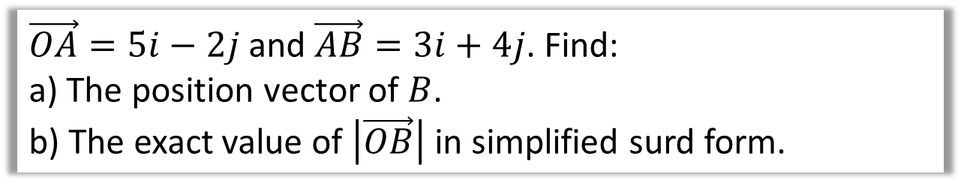
Vectors - Position Vectors
$\vec{OA}=5i−2j$ and $\vec{AB}=3i+4j$. Find:
a) The position vector of $B$.
b) The exact value of $\left|\vec{OB}\right|$ in simplified surd form.
$$\vec{OB}=\vec{OA}+\vec{AB}=\left(\begin{matrix}5 \\ −2\end{matrix}\right)+\left(\begin{matrix}3 \\ 4\end{matrix}\right)=\left(\begin{matrix}8 \\ 2\end{matrix}\right)$$
= 8i + 2j
$$\left|\vec{OB}\right|=\sqrt{8^{2}+2^{2}}=2\sqrt{17}$$
a
b

Slide 10





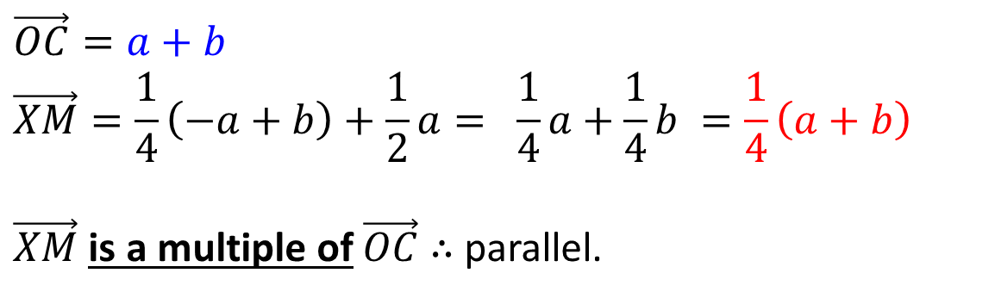

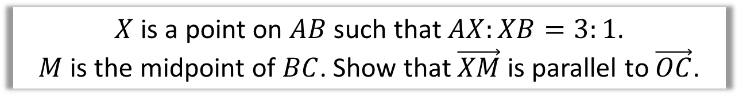


Vectors - Geometric Problems
$$A$$
$$C$$
$$a$$
$$X$$
$$M$$
$$O$$
$$b$$
$$B$$
$X$ is a point on $AB$ such that $AX:XB=3:1$.
$M$ is the midpoint of $BC$. Show that $\vec{XM}$ is parallel to $\vec{OC}$.
$$\vec{OC}=a+b \\ \vec{XM}=\frac{1}{4}\left(−a+b\right)+\frac{1}{2}a= \frac{1}{4}a+\frac{1}{4}b =\frac{1}{4}\left(a+b\right)$$
$\vec{XM}$ is a multiple of $\vec{OC}$ $∴$ parallel.

Slide 11



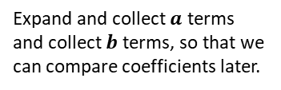


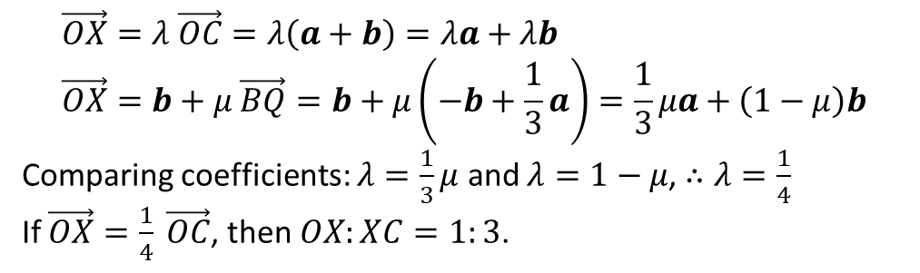

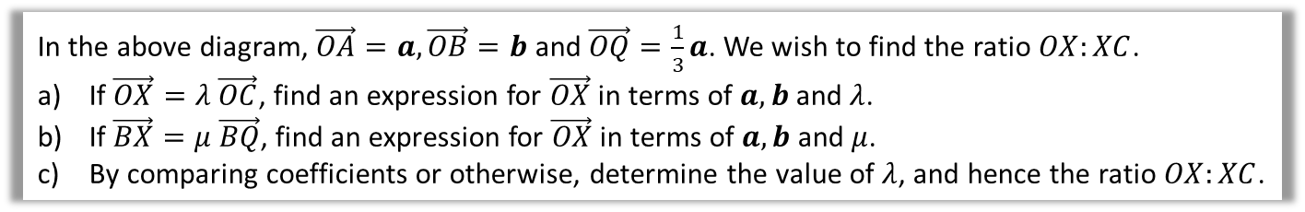


Vectors - Geometric Problems
$$a$$
$$O$$
$$Q$$
$$A$$
$$X$$
$$b$$
$$B$$
$$C$$
In the above diagram, $\vec{OA}=a, \vec{OB}=b$ and $\vec{OQ}=\frac{1}{3}a$. We wish to find the ratio $OX:XC$.
If $\vec{OX}=λ \vec{OC}$, find an expression for $\vec{OX}$ in terms of $a,b$ and $λ$.
If $\vec{BX}=μ \vec{BQ}$, find an expression for $\vec{OX}$ in terms of $a,b$ and $μ$.
By comparing coefficients or otherwise, determine the value of $λ$, and hence the ratio $OX:XC$.
a
$$\vec{OX}=λ \vec{OC}=λ\left(a+b\right)=λa+λb \\ \vec{OX}=b+μ \vec{BQ}=b+μ\left(−b+\frac{1}{3}a\right)=\frac{1}{3}μa+\left(1−μ\right)b$$
Comparing coefficients: $λ=\frac{1}{3}μ$ and $λ=1−μ$, $∴λ=\frac{1}{4}$
If $\vec{OX}=\frac{1}{4} \vec{OC}$, then $OX:XC=1:3$.
b
Expand and collect $a$ terms and collect $b$ terms, so that we can compare coefficients later.
c

Slide 12



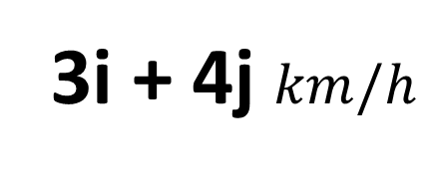

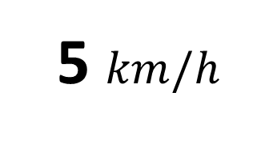


Vectors - Modelling
What is the difference between
velocity and speed?
Velocity
Speed
3i + 4j $km/h$
5 $km/h$
$$5$$
$$5$$
$$4$$
$$4$$
$$3$$
$$3$$

Slide 13



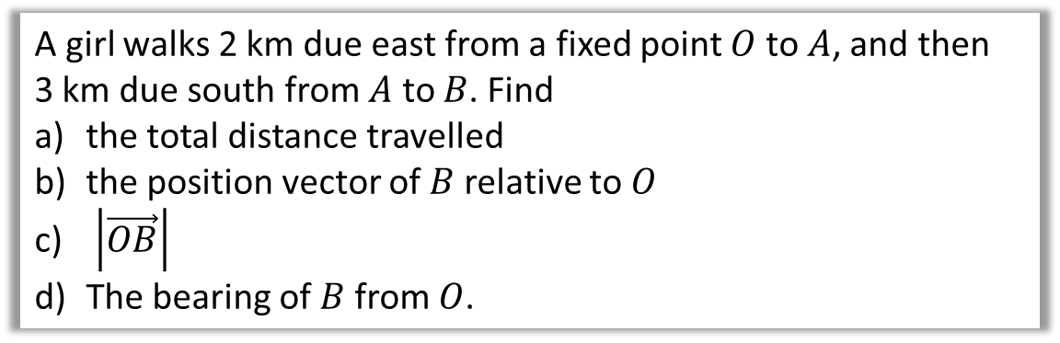



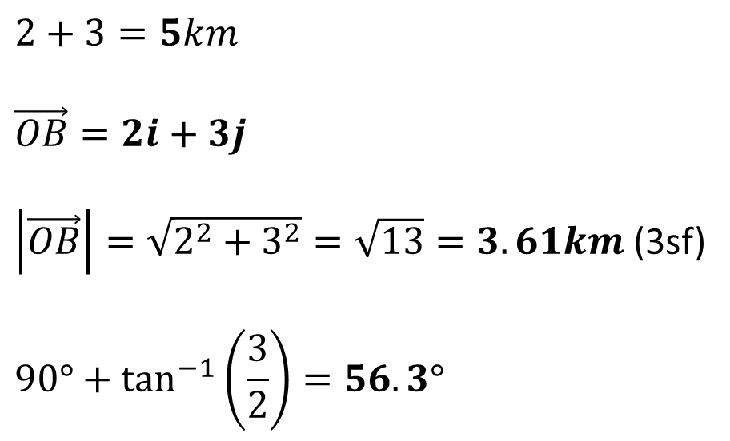
Vectors - Modelling
A girl walks 2 km due east from a fixed point $O$ to $A$, and then
3 km due south from $A$ to $B$. Find
the total distance travelled
the position vector of $B$ relative to $O$
$\left|\vec{OB}\right|$
The bearing of $B$ from $O$.
N
a
$$2+3=5km$$
$$\vec{OB}=2i+3j$$
$\left|\vec{OB}\right|=\sqrt{2^{2}+3^{2}}=\sqrt{13}=3.61km$ (3sf)
$$90°+\tan^{−1}\left(\frac{3}{2}\right)=56.3°$$
$$2$$
$$A$$
$$O$$
$$θ$$
b
$$3$$
c
$$B$$
d

Slide 14
Exercise 11C
Pearson Pure Mathematics Year 1/AS
Pages 240-242
Complete before the lesson Q1-4
Green Q5-7
Amber Q8-11 & Challenge
Red

Slide 15
Exercise 11D
Pearson Pure Mathematics Year 1/AS
Pages 243-244
Complete before the lesson Q1-2
Green Q4
Amber Q5-6
Red Q7 & Challenge

Slide 16
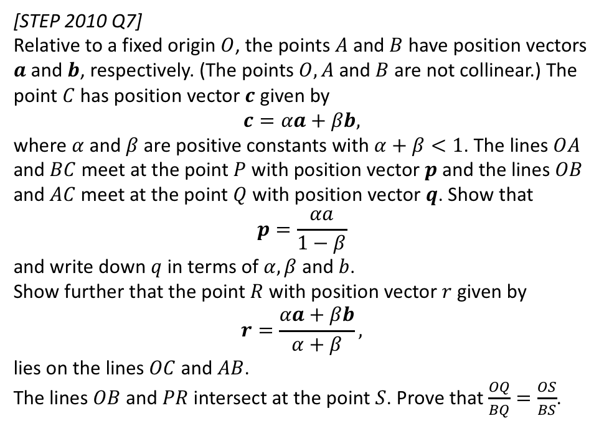
Exercise 11E
Complete before the lesson Q1-2
Amber Q3-4
Red Q5-6 & Challenge
Pearson Pure Mathematics
Pages 246-247
Extension
1
[STEP 2010 Q7]
Relative to a fixed origin $O$, the points $A$ and $B$ have position vectors $a$ and $b$, respectively. (The points $O, A$ and $B$ are not collinear.) The point $C$ has position vector $c$ given by
$$c=αa+βb,$$
where $α$ and $β$ are positive constants with $α+β<1$. The lines $OA$ and $BC$ meet at the point $P$ with position vector $p$ and the lines $OB$ and $AC$ meet at the point $Q$ with position vector $q$. Show that
$$p=\frac{αa}{1−β}$$
and write down $q$ in terms of $α, β$ and $b$.
Show further that the point $R$ with position vector $r$ given by
$$r=\frac{αa+βb}{α+β},$$
lies on the lines $OC$ and $AB$.
The lines $OB$ and $PR$ intersect at the point $S$. Prove that $\frac{OQ}{BQ}=\frac{OS}{BS}$.
Click here for the solution:
http://www.mathshelper.co.uk/STEP%202010%20Solutions.pdf
(go to Q7)

Slide 17
Exercise 11F
Pearson Pure Mathematics Year 1/AS
Pages 250-251
Complete before the lesson Q1-3
Green Q4-5
Amber Q6-8

