Slide 1
Year 1 Pure Mathematics
Algebraic Expressions
- Expanding and Factorising
Chapter 1
(Part 2 of 3)

Slide 2
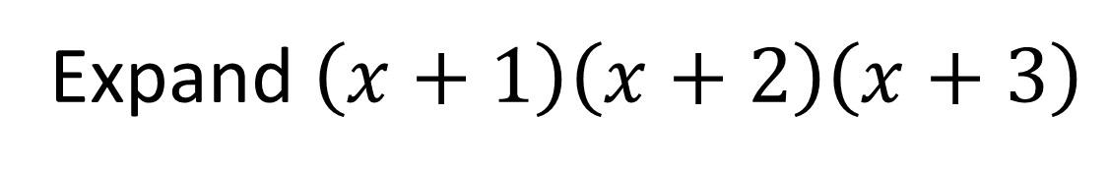
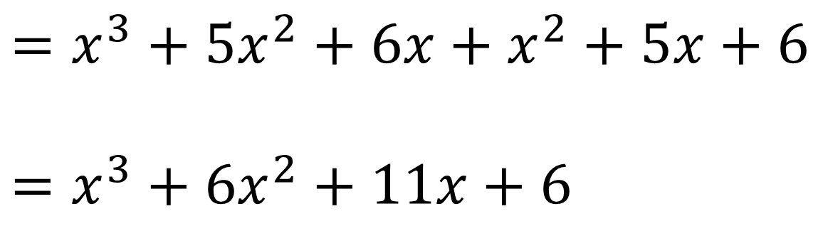
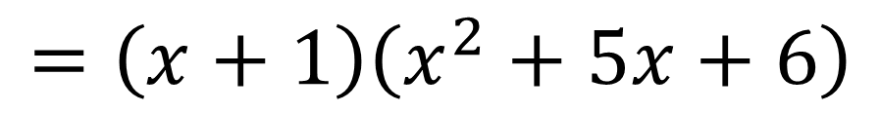
Expanding Brackets
Expand $\left(x+1\right)\left(x+2\right)\left(x+3\right)$
$$=\left(x+1\right)\left(x^{2}+5x+6\right)$$
Multiply each term in the first bracket by each term in the second.
$$=x^{3}+5x^{2}+6x+x^{2}+5x+6$$
$$=x^{3}+6x^{2}+11x+6$$

Slide 3
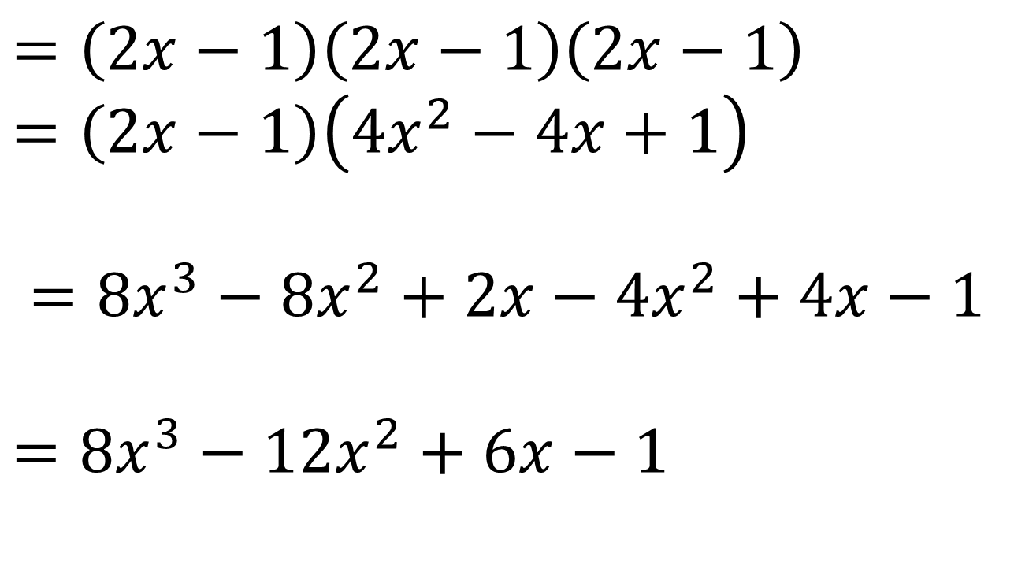
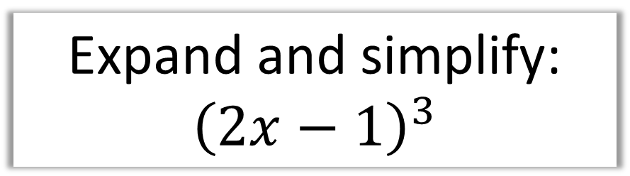
Expanding Brackets
Expand and simplify:
$${\left(2x−1\right)}^{3}$$
$$=\left(2x−1\right)\left(2x−1\right)\left(2x−1\right) \\ =\left(2x−1\right)\left(4x^{2}−4x+1\right)$$
$$=8x^{3}−8x^{2}+2x−4x^{2}+4x−1$$
$$=8x^{3}−12x^{2}+6x−1$$

Slide 4
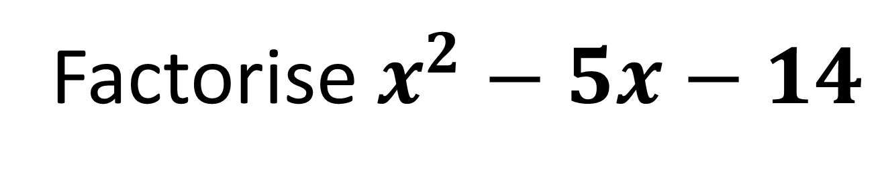
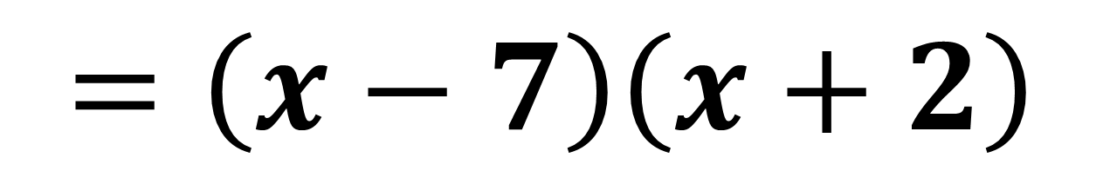
Factorising Quadratics
Factorise $x^{2}−5x−14$
Sum -5
Product -14
$$=\left(x−7\right)\left(x+2\right)$$

Slide 5
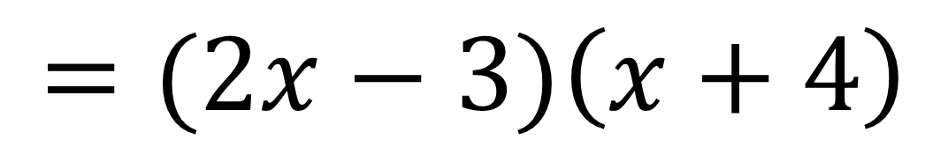


Factorising Quadratics - coefficient of $x^{2}$ is not 1
$${2x}^{2}+5x−12$$
Because the coefficient is a prime number
the easiest way is to use your common sense.
$$=(2x + ?)\left(x + ?\right)$$
$$=(2x−3)\left(x+4\right)$$

Slide 6
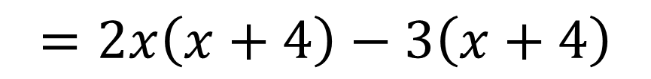
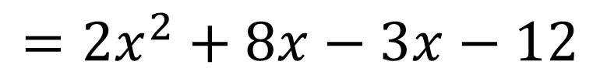
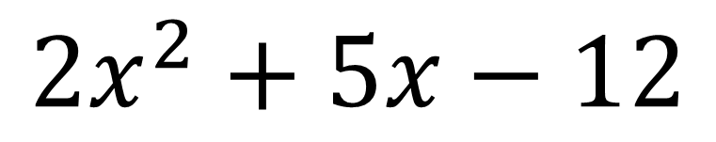
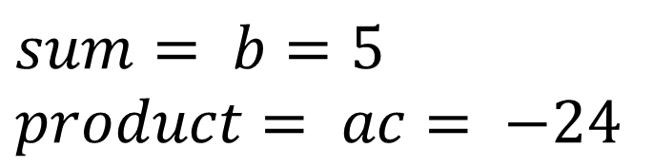

Factorising Quadratics - coefficient of $x^{2}$ is not 1
$${2x}^{2}+5x−12$$
Formal way
$$sum= b=5 \\ product= ac= −24$$
8 and - 3
STEP 1
$$=2x^{2}+8x−3x−12$$
STEP 2: Split the middle term.
STEP 3: Factorise in pairs
$$=2x\left(x+4\right)−3\left(x+4\right)$$
$$=(x+4)(2x−3)$$
STEP 4: Factorise out bracket.

Slide 7

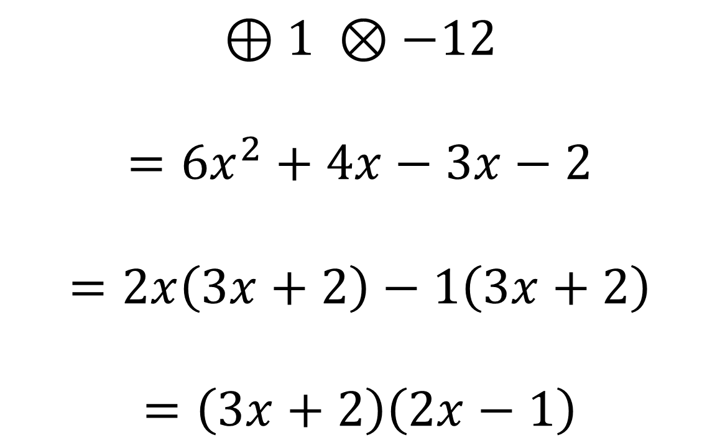
Factorising Quadratics - coefficient of $x^{2}$ is not 1
Factorise completely:
$$6x^{2}+x−2$$
$$⊕1 ⊗−12$$
$$=6x^{2}+4x−3x−2$$
$$=2x\left(3x+2\right)−1\left(3x+2\right)$$
$$=\left(3x+2\right)\left(2x−1\right)$$

Slide 8
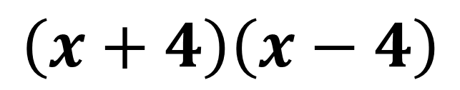
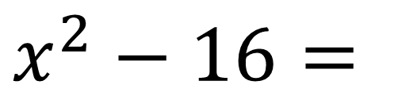
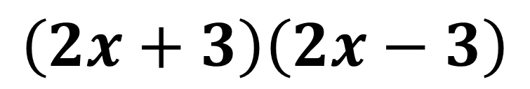
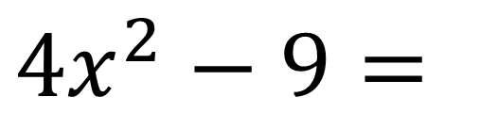
Factorising Quadratics – Difference of two squares
Difference of two squares:
Look out of squared numbers
$$x^{2}−16=$$
$$\left(x+4\right)\left(x−4\right)$$
$$4x^{2}−9=$$
$$\left(2x+3\right)\left(2x−3\right)$$

Slide 9
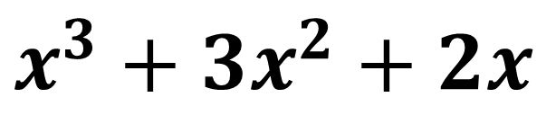
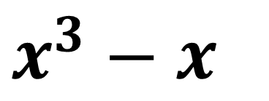
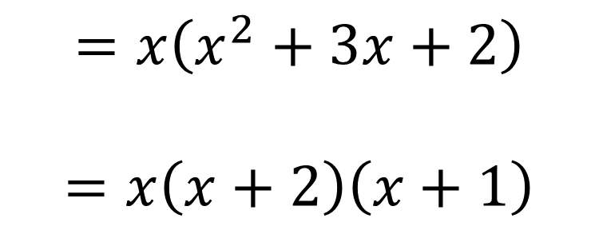
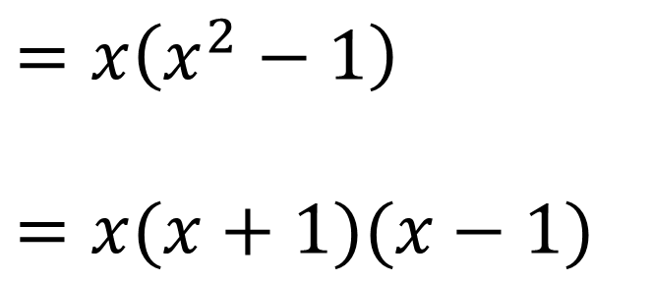
Factorising Quadratics – multiple factorisations
Using multiple factorisations:
$$x^{3}−x$$
$$x^{3}+3x^{2}+2x$$
$$=x\left(x^{2}−1\right)$$
$$=x(x+1)(x−1)$$
$$=x\left(x^{2}+3x+2\right)$$
$$=x\left(x+2\right)\left(x+1\right)$$

Slide 10

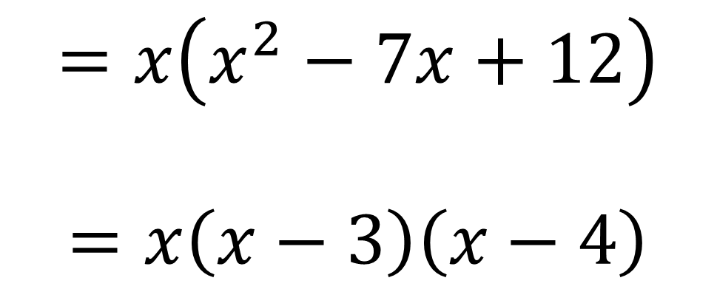
Factorising Quadratics – multiple factorisations
Factorise completely:
$$x^{3}−7x^{2}+12x$$
$$=x\left(x^{2}−7x+12\right)$$
$$=x\left(x−3\right)\left(x−4\right)$$

Slide 11
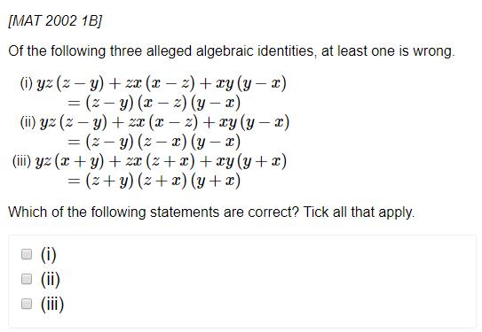
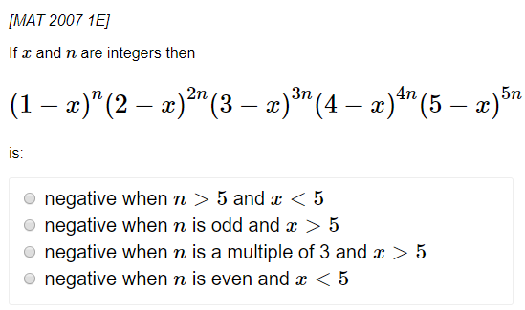

Exercise 1B&C
Complete before the lesson Ex1B
In Class Ex1C:
Green Q1-2
Amber Q3-5
Red Challenge &Extension
Pearson Pure Mathematics Year 1/AS Page 5
Extension (Full Database: http://www.drfrostmaths.com/resources/resource.php?rid=268 )
1
2
?
?
Solution: (ii) only
Solution: $n$ is odd and $x>5$

