Slide 1

P2 Chapter 10 :: Numerical Methods
jfrost@tiffin.kingston.sch.uk
www.drfrostmaths.com
@DrFrostMaths
Last modified: 6th September 2018

Slide 2








www.drfrostmaths.com
Everything is completely free.
Why not register?
Register now to interactively practise questions on this topic, including past paper questions and extension questions (including MAT + UKMT).
Teachers: you can create student accounts (or students can register themselves), to set work, monitor progress and even create worksheets.
With questions by:
Dashboard with points, trophies, notifications and student progress.
Questions organised by topic, difficulty and past paper.
Teaching videos with topic tests to check understanding.

Slide 3
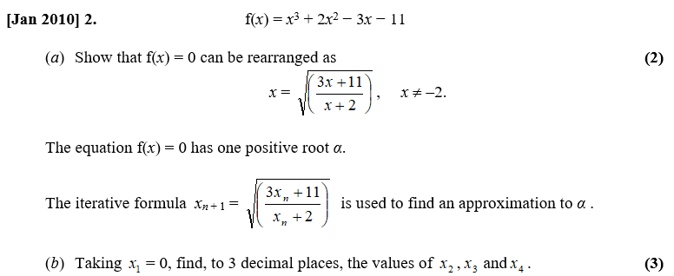
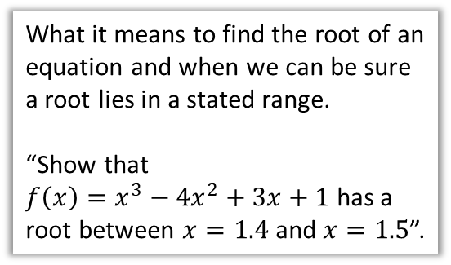
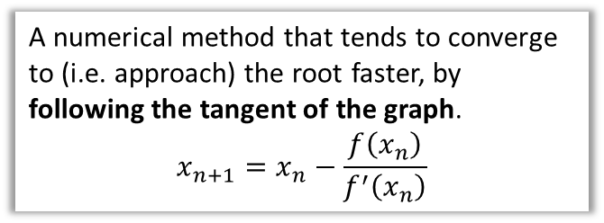
Chapter Overview
In the GCSE9-1 syllabus you covered ‘iteration’, which allowed you to find successfully better approximations to the solutions of an equation. We’ll revisit this, but also see a more powerful method for approximating solutions.
1:: Locating Roots
2:: Using iteration to approximate roots to $f\left(x\right)=0$
What it means to find the root of an equation and when we can be sure a root lies in a stated range.
“Show that
$f\left(x\right)=x^{3}−4x^{2}+3x+1$ has a root between $x=1.4$ and $x=1.5$”.
3:: The Newton-Raphson Method
Notes for teachers: Most of the chapter is covered in GCSE9-1 syllabus (and was in old C3). In addition to this:
Newton-Raphson method (in old FP1)
Staircase and cobweb diagrams (in the very old P modules!)
How to prove a root is correct to a given accuracy (old C3).
A numerical method that tends to converge to (i.e. approach) the root faster, by following the tangent of the graph.
$$x_{n+1}=x_{n}−\frac{f\left(x_{n}\right)}{f^{′}\left(x_{n}\right)}$$

Slide 4
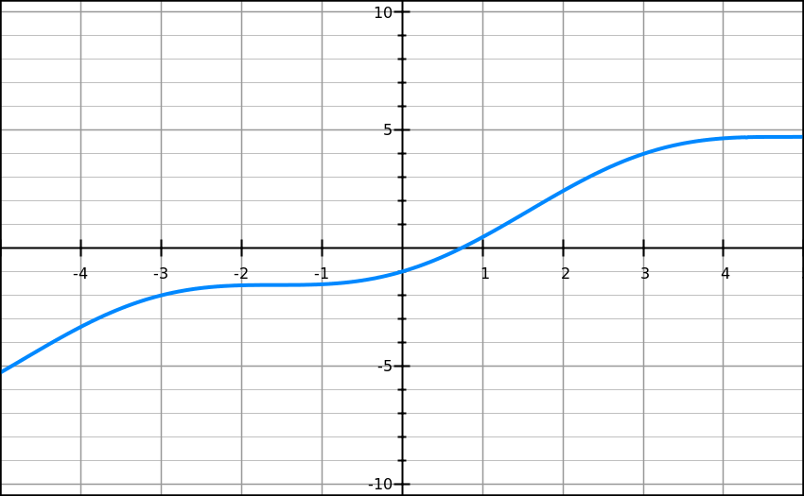
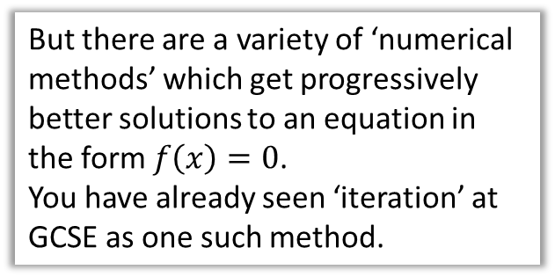

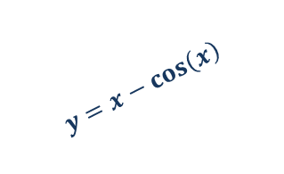
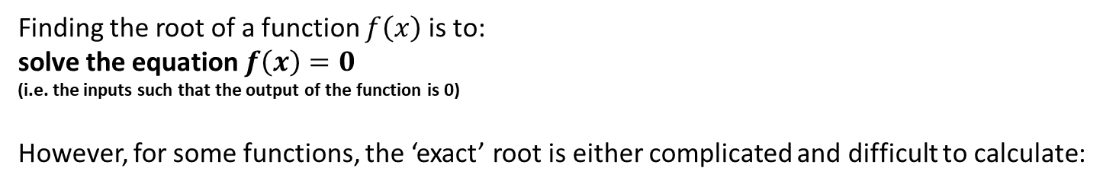

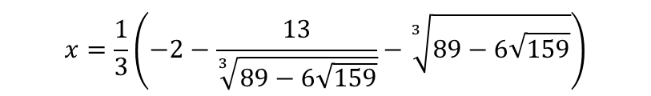
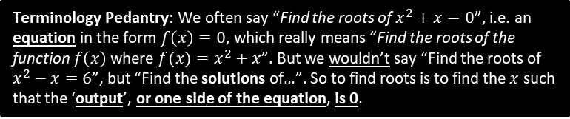
Why do we need numerical methods?
Terminology Pedantry: We often say “Find the roots of $x^{2}+x=0$”, i.e. an equation in the form $f\left(x\right)=0$, which really means “Find the roots of the function $f\left(x\right)$ where $f(x)=x^{2}+x$”. But we wouldn’t say “Find the roots of $x^{2}−x=6$”, but “Find the solutions of…”. So to find roots is to find the $x$ such that the ‘output’, or one side of the equation, is 0.
Finding the root of a function $f\left(x\right)$ is to:
solve the equation $f\left(x\right)=0$
(i.e. the inputs such that the output of the function is 0)
However, for some functions, the ‘exact’ root is either complicated and difficult to calculate:
?
$$x=\frac{1}{3}\left(−2−\frac{13}{\sqrt[3]{89−6\sqrt{159}}}−\sqrt[3]{89−6\sqrt{159}}\right)$$
$$x^{3}+2x^{2}−3x+4=0$$
?
or there’s no ‘algebraic’ expression at all! (involving roots, logs, sin, cos, etc.)
?
$$x−\cos\left(x\right)=0$$
Exact solution not expressible ☹
But there are a variety of ‘numerical methods’ which get progressively better solutions to an equation in the form $f\left(x\right)=0$.
You have already seen ‘iteration’ at GCSE as one such method.
$$y=x−\cos\left(x\right)$$
Root

Slide 5
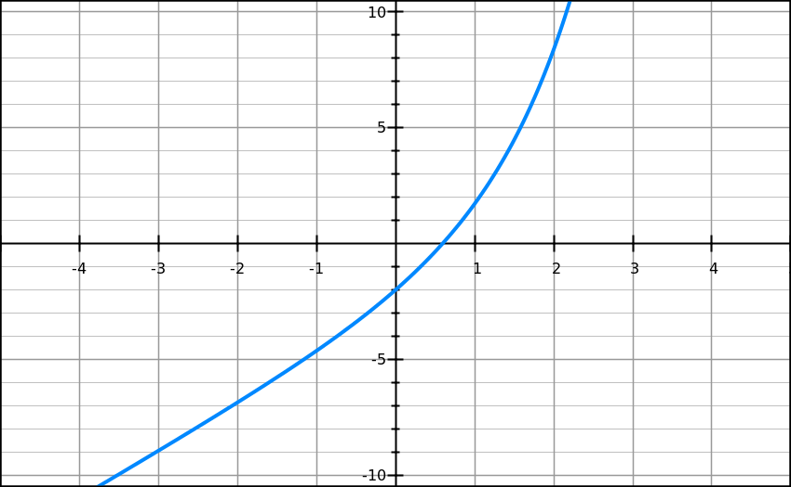
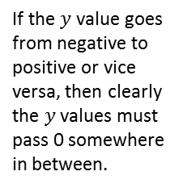


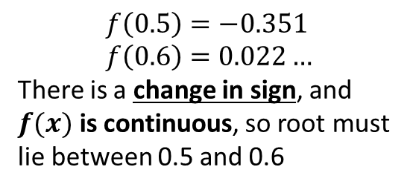
Proving a solution lies in a range
Show that ${f\left(x\right)=e}^{x}+2x−3$ has a root between $x=0.5$ and $x=0.6$
?
$$f\left(0.5\right)=−0.351 \\ f\left(0.6\right)=0.022…$$
There is a change in sign, and $f(x)$ is continuous, so root must lie between 0.5 and 0.6
Bro Exam Tip: In the mark scheme they’re looking for:
Finding the function output for the two values.
Referring to a ‘change in sign’.
$$\left(0.6, 0.022\right)$$
If the $y$ value goes from negative to positive or vice versa, then clearly the $y$ values must pass 0 somewhere in between.
$$\left(0.5,−0.351\right)$$

Slide 6


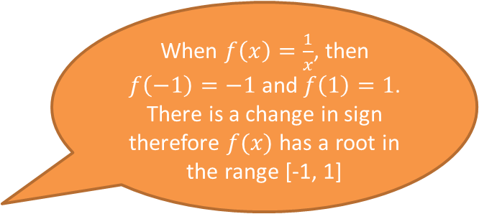



…but only if the function is continuous
Stupid Steve says:
When $f\left(x\right)=\frac{1}{x}$, then $f\left(−1\right)=−1$ and $f\left(1\right)=1$. There is a change in sign therefore $f(x)$ has a root in the range [-1, 1]
Why is Steve wrong?
$$y$$
A function is continuous if the line does not ‘jump’. A root is only guaranteed with a sign change if the function is continuous, as otherwise the line can skip past 0 (in this case due to a vertical asymptote.
$$(1,1)$$
$$x$$
$$(−1,−1)$$

Slide 7


…and no sign change doesn’t mean there isn’t a root
$$y$$
Beware! Just because there isn’t a sign change, doesn’t mean there’s no root in that interval.
root
root
$$x$$
The sign change method fails to detect a root if there were an even number of roots in that interval.

Slide 8
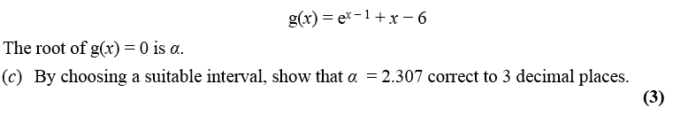

Proving a solution to a given accuracy
Edexcel C3 Jan 2013
Thinking back to lower school, if the root $2.307$ is correct to 3dp, what’s the smallest and greatest value it could be?
Smallest: $2.3065$
Greatest: $2.3075$
If there was a sign change between $x=2.3065$ and $x=2.3075$, then we know $2.3065<α<2.3075$. But if the value is in this range, then we know it is 2.307 to 3 decimal places!
$$f\left(2.3065\right)=−0.000275 \\ f\left(2.3075\right)=0.00442$$
There is a change in sign in the interval $(2.3065, 2.3075)$
$$∴2.3065<α<2.3075 \\ ∴α=2.307 to 3dp$$
?
?
? What do we write in exam…

Slide 9


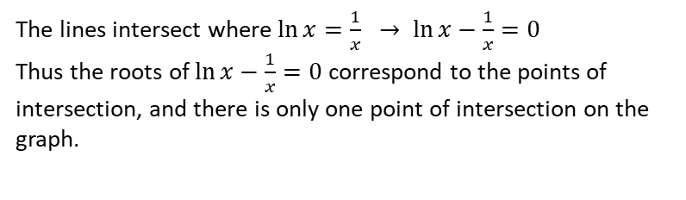
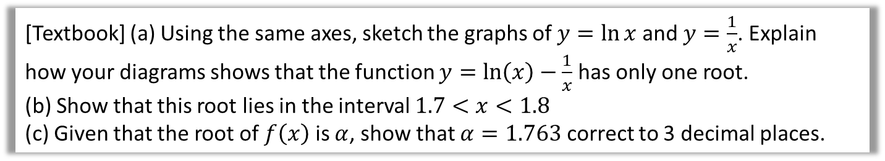



Example
[Textbook] (a) Using the same axes, sketch the graphs of $y=\ln{x}$ and $y=\frac{1}{x}$. Explain how your diagrams shows that the function $y=\ln\left(x\right)−\frac{1}{x}$ has only one root.
(b) Show that this root lies in the interval $1.7<x<1.8$
(c) Given that the root of $f\left(x\right)$ is $α$, show that $α=1.763$ correct to 3 decimal places.
a
$$y$$
?
b
$$f\left(x\right)=\ln{x}−\frac{1}{x} \\ f\left(1.7\right)=−0.0576… \\ f\left(1.8\right)=0.0322…$$
There is a change of sign between 1.7 and 1.8, so there is a root in the interval $1.7<x<1.8$
$$f\left(1.17625\right)=−0.00064<0 \\ f\left(1.7635\right)=0.00024>0$$
There is a change of sign in the interval $(1.7625, 1.7635)$ so $1.7625<α<1.7635$, so $α=1.763$ correct to 3dp.
$$y=\frac{1}{x}$$
?
$$y=\ln{x}$$
$$x$$
c
?
The lines intersect where $\ln{x}=\frac{1}{x} → \ln{x}−\frac{1}{x}=0$
Thus the roots of $\ln{x}−\frac{1}{x}=0$ correspond to the points of intersection, and there is only one point of intersection on the graph.

Slide 10
Exercise 10A
Pearson Pure Mathematics Year 2/AS
Pages 276-277
(Classes pressed for time may wish to skip this exercise)
Complete before the lesson Q1-2
In Class:
Green Q7-9
Amber Q10-12

Slide 11
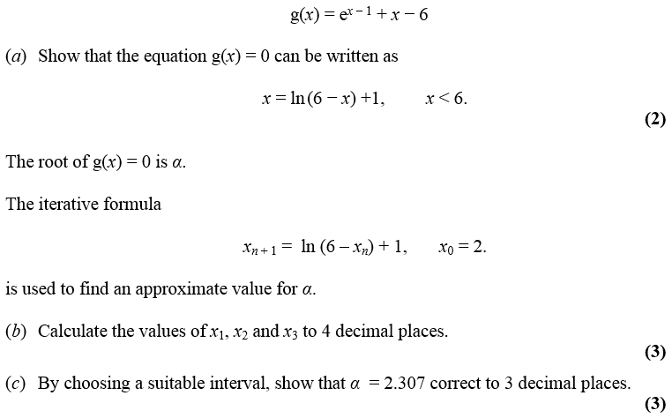

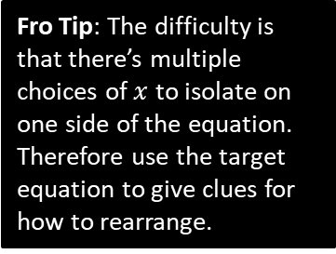
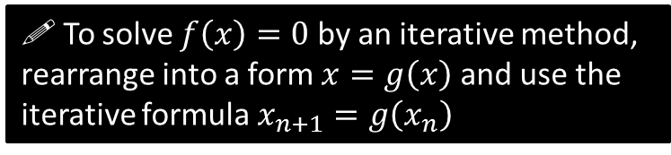
Using iteration to approximate a root
Edexcel C3 Jan 2013
a
?
$$0=e^{x−1}+x−6 \\ 6−x=e^{x−1} \\ \ln\left(6−x\right)=x−1 \\ \ln\left(6−x\right)+1=x$$
Fro Tip: The difficulty is that there’s multiple choices of $x$ to isolate on one side of the equation. Therefore use the target equation to give clues for how to rearrange.
! To solve $f\left(x\right)=0$ by an iterative method, rearrange into a form $x=g\left(x\right)$ and use the iterative formula $x_{n+1}=g\left(x_{n}\right)$
We’ll see why it works later.

Slide 12
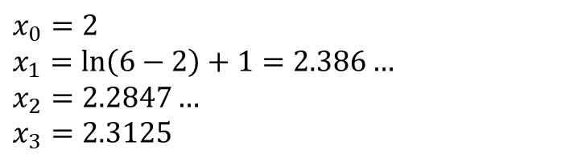
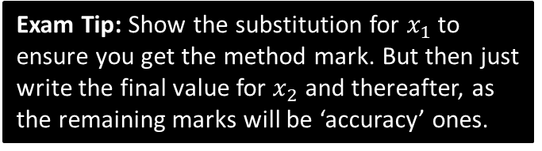
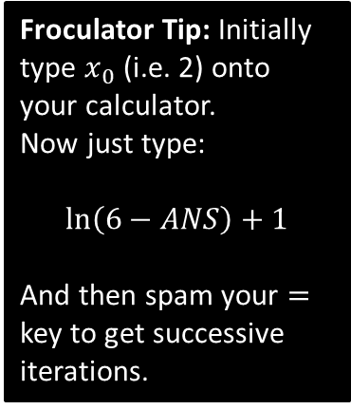
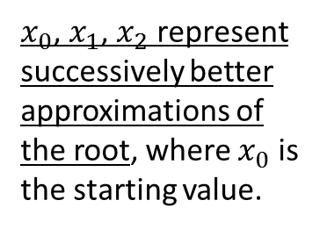
Using iteration to approximate a root
Edexcel C3 Jan 2013
$x_{0}$, $x_{1}$, $x_{2}$ represent successively better approximations of the root, where $x_{0}$ is the starting value.
Froculator Tip: Initially type $x_{0}$ (i.e. 2) onto your calculator.
Now just type:
$$\ln\left(6−ANS\right)+1$$
And then spam your $=$ key to get successive iterations.
b
$$x_{0}=2 \\ x_{1}=\ln\left(6−2\right)+1=2.386… \\ x_{2}=2.2847… \\ x_{3}=2.3125$$
?
Exam Tip: Show the substitution for $x_{1}$ to ensure you get the method mark. But then just write the final value for $x_{2}$ and thereafter, as the remaining marks will be ‘accuracy’ ones.

Slide 13
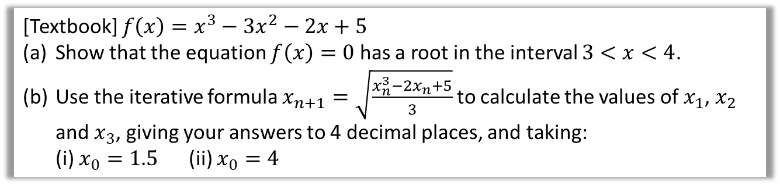
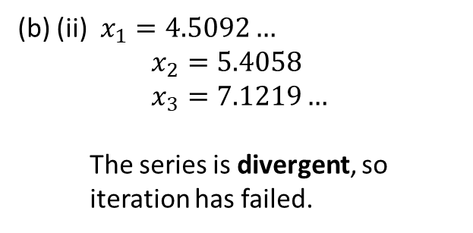

Does the starting value $x_{0}$ matter?
Yes! We’ll see why in a bit when we look at staircase and cobweb diagrams.
If there are a multiple roots, iteration might converge to (i.e. approach) a different root.
Or we may not converge to a root at all, and diverge (i.e. approach infinity).
[Textbook] $f\left(x\right)=x^{3}−3x^{2}−2x+5$
Show that the equation $f\left(x\right)=0$ has a root in the interval $3<x<4$.
Use the iterative formula $x_{n+1}=\sqrt{\frac{x_{n}^{3}−2x_{n}+5}{3}}$ to calculate the values of $x_{1}$, $x_{2}$ and $x_{3}$, giving your answers to 4 decimal places, and taking:
(i) $x_{0}=1.5$ (ii) $x_{0}=4$
$f\left(3\right)=−1 f\left(4\right)=13$
There is a change in sign in the interval $3<x<4$ and $f$ is continuous, so there is a root of $f(x)$ in this interval.
i) $x_{1}=\sqrt{\frac{{1.5}^{3}−2\left(1.5\right)+5}{3}}=1.3385…$
$x_{2}=1.2544… , x_{3}=1.2200…$
This appears to be convergent as the
change in the root on each iteration is
becoming smaller.
(b) (ii) $x_{1}=4.5092…$
$$x_{2}=5.4058 \\ x_{3}=7.1219…$$
The series is divergent, so
iteration has failed.
?
?
?

Slide 14
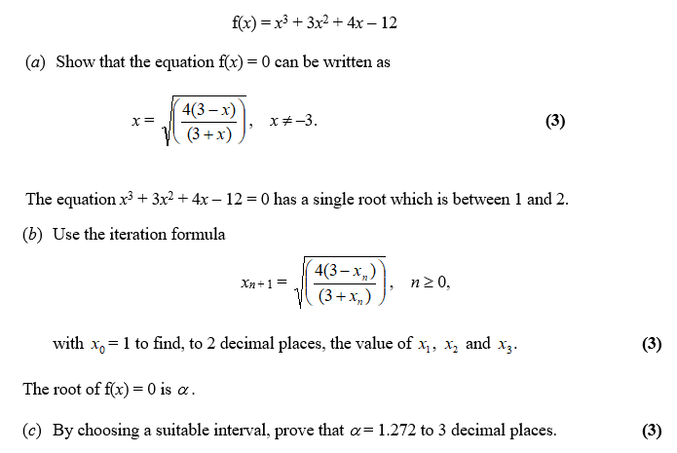
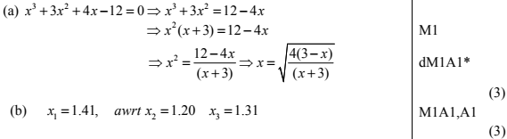
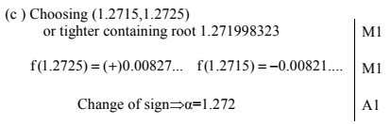
Test Your Understanding
Edexcel C3 June 2012 Q2
Warning: Any particular mark scheme gives what is minimally acceptable. So you should use the full wording earlier to avoid the risk of mark loss.
?
?
?

Slide 15
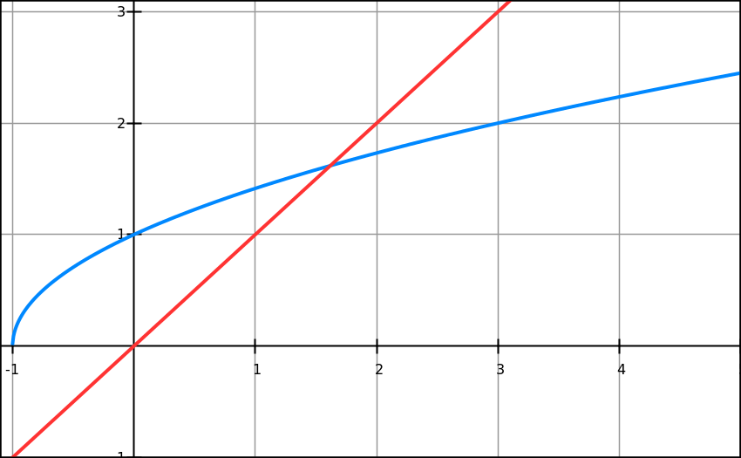
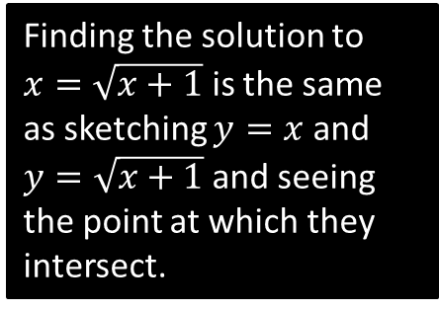
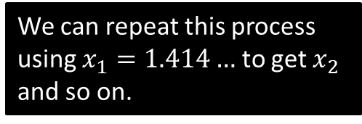





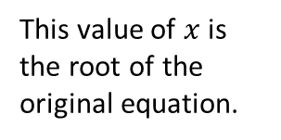

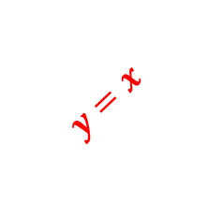
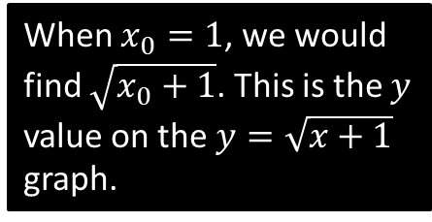

Why does this method work?
Solve $x^{2}−x−1=0$
Recall we put in the form $x=g\left(x\right)$: in this case $x=\sqrt{x+1}$ is one possible rearrangement.
We can then use the recurrence $x_{n+1}=\sqrt{x_{n}+1}$ . Why does this recurrence work?
This is called a staircase diagram due to its shape. We can see that we’re converging towards the root $α$.
$$y=x$$
$$y=\sqrt{x+1}$$
Finding the solution to $x=\sqrt{x+1}$ is the same as sketching $y=x$ and $y=\sqrt{x+1}$ and seeing the point at which they intersect.
This value of $x$ is the root of the original equation.
This gives $x_{1}=1.414…$ This is then fed back into $\sqrt{x_{n}+1}$ for the next iteration, i.e. the $y$ value becomes the new $x$ value! This is equivalent to moving to the line $y=x$.
$$x_{1}$$
$$α$$
$$x_{0}$$
When $x_{0}=1$, we would find $\sqrt{x_{0}+1}$. This is the $y$ value on the $y=\sqrt{x+1}$ graph.
We can repeat this process using $x_{1}=1.414…$ to get $x_{2}$ and so on.

Slide 16
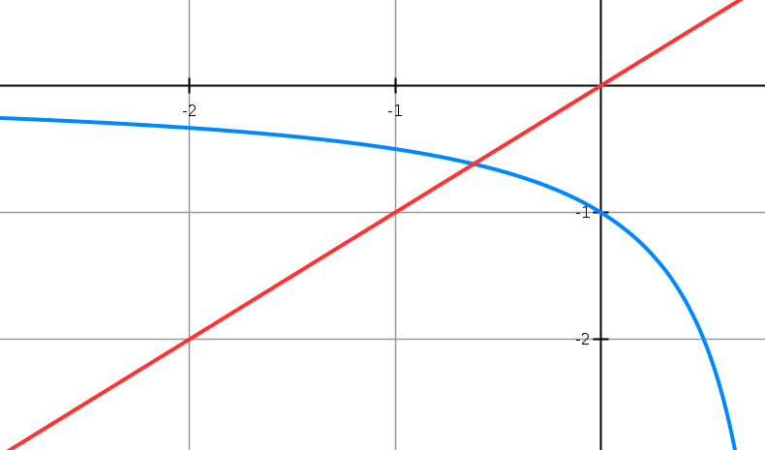






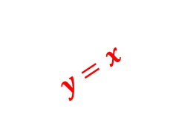

Cobweb Diagrams
Solve $x^{2}−x−1=0$
We could also have rearranged differently to $x=\frac{1}{x−1}$
Therefore we use the recurrence $x_{n+1}=\frac{1}{x_{n}−1}$ . What happens this time?
$$y=x$$
$$x_{2}$$
$$x_{0}$$
$$α$$
$$x_{1}$$
$$x_{3}$$
$$y=\frac{1}{x−1}$$
This is unsurprisingly called a cobweb diagram. Again we can see that we’re successfully converging towards the root $α$.

Slide 17
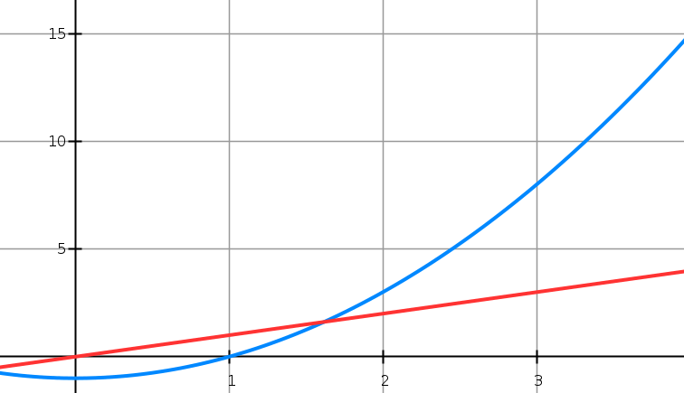
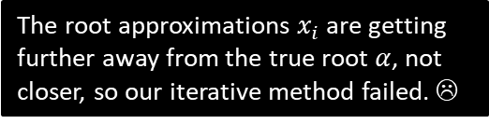


And when iteration fails…
Solve $x^{2}−x−1=0$
But again, we could have rearranged differently! $x=x^{2}−1$
Therefore we use the recurrence $x_{n+1}=x_{n}^{2}−1$ . What happens this time?
The root approximations $x_{i}$ are getting further away from the true root $α$, not closer, so our iterative method failed. ☹
$$α$$
$$x_{0}$$
$$x_{1}$$

Slide 18
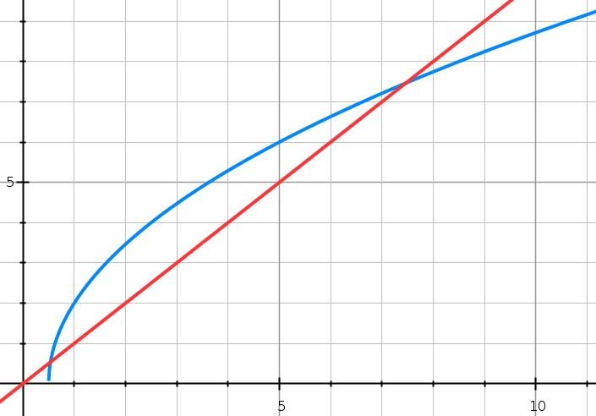


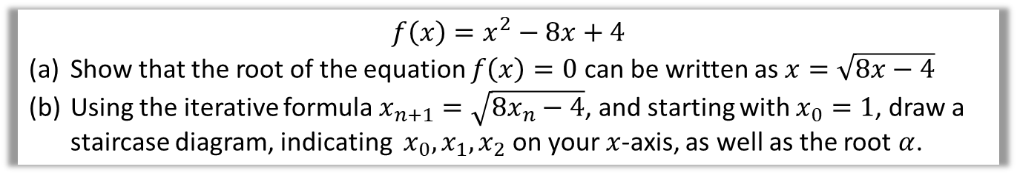


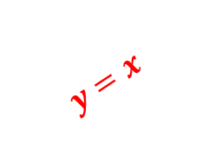

Test Your Understanding
$$f\left(x\right)=x^{2}−8x+4$$
Show that the root of the equation $f\left(x\right)=0$ can be written as $x=\sqrt{8x−4}$
Using the iterative formula $x_{n+1}=\sqrt{8x_{n}−4}$, and starting with $x_{0}=1$, draw a staircase diagram, indicating $x_{0},x_{1}, x_{2}$ on your $x$-axis, as well as the root $α$.
?
$$y=x$$
$$y=\sqrt{8x−4}$$
$$x_{0}$$
$$x_{1}$$
$$x_{2}$$
$$α$$

Slide 19
Exercise 10B
Pearson Pure Mathematics Year 2/AS
Pages 280-282
Complete before the lesson Q1-2
In Class:
Green Q3-5
Amber Q6-8
Red Q9-10

Slide 20


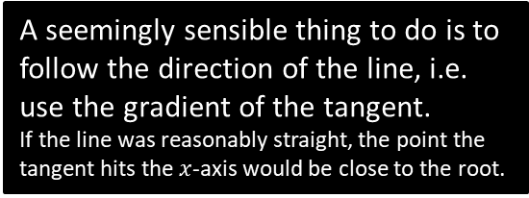







The Newton-Raphson Process
(also known as Newton’s method)
We wish to find the root $α$.
Suppose we start with the indicated approximation of the root, $x0$. Clearly this is well off the mark!
$$y$$
A seemingly sensible thing to do is to follow the direction of the line, i.e. use the gradient of the tangent.
If the line was reasonably straight, the point the tangent hits the $x$-axis would be close to the root.
$$y=f\left(x\right)$$
We can keep repeating this process to (hopefully) get increasingly accurate approximations.
Can you come up with a formula for $x_{n+1}$ in terms of $xn$?
$$α$$
$$x$$
$$x2$$
$$x1$$
$$x0$$

Slide 21






The Newton-Raphson Process
y
Formula:
?
Using Year 1 coordinate geometry:
$$y−f\left(x_{n}\right)=f^{′}\left(x_{n}\right)\left(x−x_{n}\right)$$
But we’re interested when
$x=x_{n+1}$ and $y=0$
$$−f\left(x_{n}\right)=f^{′}\left(x_{n}\right)\left(x_{n+1}−x_{n}\right)$$
which rearranges to give:
$$y=f\left(x\right)$$
! Newton-Raphson Process:
$$x_{n+1}=x_{n}−\frac{f\left(x_{n}\right)}{f^{′}\left(x_{n}\right)}$$
$$x$$
$$x_{n+1}$$
$$xn$$
Exam Note: Pearson didn’t include the above proof in their own textbook, so I can only presume you won’t be tested on the proof.

Slide 22

A nice animation…
Demo (Courtesy of Wikipedia)
This is German, but I’ll presume you’re not an idiot.

Slide 23

Example
Returning to our original example: $x=\cos\left(x\right)$, say letting $x_{0}=0.5$
(Note: Recall that differentiation assumes radians)
?
Let $f\left(x\right)=x−cos\left(x\right)$
$f^{′}\left(x\right)=1+sin x$
$$∴x_{n+1}=x_{n}−\frac{x_{n}−cos\left(x_{n}\right)}{1+sin\left(x_{n}\right)}$$
$$x_{1}=0.5−\frac{0.5−cos\left(0.5\right)}{1+sin\left(0.5\right)}=0.7552224171 \\ x_{2}=0.7391412 \\ x_{3}=0.7390851$$
After merely three iterations, our approximation is accurate to 7 decimal places. Holy smokes Batman!
This ensures we have an equation of the form $f\left(x\right)=0$
Fro Tip: To perform iterations quickly, do the following on your calculator:
[0.5] [=]
[ANS] – (ANS – cos(ANS))/(1 + sin(ANS))
Then spam [=].

Slide 24






Quickfire Questions
Using the Newton-Raphson process, state the recurrence relation for the following functions:
$$x_{n+1}=x_{n}−\frac{{\left(x_{n}\right)}^{3}−2}{3{\left(x_{n}\right)}^{2}}$$
?
$$f\left(x\right)=x^{3}−2$$
$$x_{n+1}=x_{n}−\frac{\tan{x_{n}}}{\sec^{2}{x_{n}}}=x_{n}−\frac{1}{2}\sin\left(2x_{n}\right)$$
?
$$f\left(x\right)=\tan{x}$$
?
$$x_{n+1}=x_{n}−\frac{{\left(x_{n}\right)}^{2}−x_{n}−1}{2x_{n}−1}$$
$$f\left(x\right)=x^{2}−x−1$$

Slide 25



Example Exam Question
Edexcel FP1 June 2013(R) Q3c
?
$$x_{n+1}=x_{n}−\frac{\frac{1}{2}{\left(x_{n}\right)}^{4}−{\left(x_{n}\right)}^{3}+x_{n}−3}{2{\left(x_{n}\right)}^{3}−3{\left(x_{n}\right)}^{2}+1}$$
$$β_{1}=−1.5 −\frac{1.40625}{−12.5}=−1.3875$$

Slide 26


Test Your Understanding
Edexcel FP1 Jan 2010 Q2c
?

Slide 27











When does Newton-Raphson fail?
$$y$$
If the starting value $x_{0}$ was the stationary point, then $f^{′}\left(x_{0}\right)=0$, resulting in a division by 0 in the above formula.
Graphically, it is because the tangent will never reach the $x$-axis.
tangent
$$x_{0}$$
$$x$$
$$y=\frac{x}{\sqrt{1+x^{2}}}$$
$$y$$
Newton-Raphson also suffers from the same drawbacks as solving by iteration, in that it’s possible for the values of $x_{i}$ to diverge.
In this example, the $x_{i}$ oscillate either side of 0, but gradually getting further away from $α=0$.
$$x_{1}$$
$$x_{0}$$
$$x$$
$$x_{2}$$

Slide 28
Exercise 10C
Pearson Pure Mathematics Year 2/AS
Pages 284-285
Complete before the lesson Q1-2
In Class:
Green Q3-4
Amber Q5
Red Q6-7 & Challenge

Slide 29


Application to Modelling
[Textbook] The price of a car in £s, $x$ years after purchase, is modelled by the function
$$f\left(x\right)=15 000 {\left(0.85\right)}^{x}−1000\sin{x}, x>0$$
Use the model to find the value, to the nearest hundred £s, of the car 10 years after purchase.
Show that $f\left(x\right)$ has a root between 19 and 20.
Find $f^{′}\left(x\right)$
Taking 19.5 as a first approximation, apply the Newton-Raphson method once to $f(x)$ to obtain a second approximation for the time when the value of the car is zero. Give your answer to 3 decimal places.
Criticise this model with respect to the value of the car as it gets older.
a
$$f\left(10\right)=3497.13$$
$$→£3500$$
$$f\left(19\right)=543.11>0 \\ f\left(20\right)=−331.55<0$$
There is a change of sign between 19 and 20, so that is a root in the interval $19<x<20$
$$f^{′}\left(x\right)=\left(15 000\right){\left(0.85\right)}^{x}\left(\ln{0.85}\right)−1000\cos{x} \\ f\left(19.5\right)=25.0693… \\ f^{′}\left(19.5\right)=−898.3009… \\ x_{1}=x_{0}−\frac{f\left(x_{0}\right)}{f^{′}\left(x_{0}\right)}=19.528$$
?
In reality, the car can never have a negative value so this model is not reasonable for cars that are approximately 20 or more years old.
d
?
b
?
c
?

Slide 30
Exercise 10D
Pearson Pure Mathematics Year 2/AS
Pages 287-289
Complete before the lesson Q1-2
In Class:
Green Q3
Amber Q4
Red Q5

