Slide 1

Further Stats 1 Chapter 6 ::
Chi-Squared Tests
jfrost@tiffin.kingston.sch.uk
www.drfrostmaths.com
@DrFrostMaths
Last modified: 23rd July 2018

Slide 2








www.drfrostmaths.com
Everything is completely free.
Why not register?
Register now to interactively practise questions on this topic, including past paper questions and extension questions (including MAT + UKMT).
Teachers: you can create student accounts (or students can register themselves), to set work, monitor progress and even create worksheets.
With questions by:
Dashboard with points, trophies, notifications and student progress.
Questions organised by topic, difficulty and past paper.
Teaching videos with topic tests to check understanding.

Slide 3
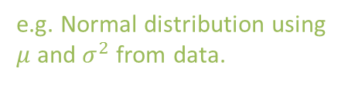
Testing a Model
A model is a way of representing a problem, in the hope that we can subsequently use common mathematical techniques to make deductions about the data.
Data
Simplifying assumptions
Model
e.g. Collected heights of people in the population
e.g. Normal distribution using $μ$ and $σ^{2}$ from data.
Why might we want to use a model for a data?
It often makes calculations from the data easier, e.g. for heights in the population, if we assume a Normal Distribution, we could then calculate probabilities of someone having a given height range. This might be difficult if we used the raw data.
This chapter mostly concerns how well a chosen model fits the observed data.
If our simplifying assumptions were justified, we should find the model is a good fit.
?

Slide 4
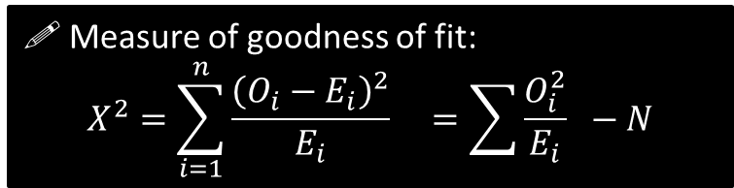
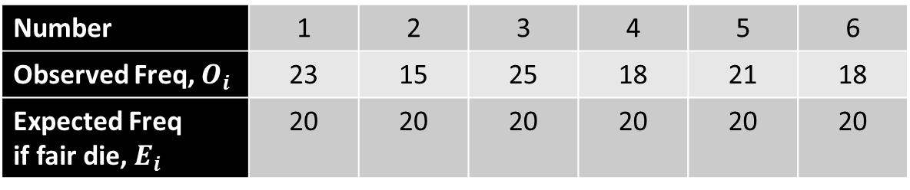

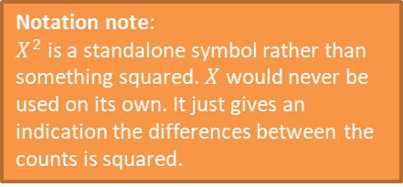
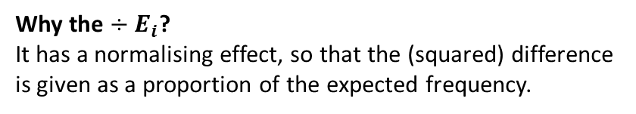
Expected Frequency vs Observed Frequencies
I throw a die (which may be fair) 120 times and observe the counts of each possible number.
Number | 1 | 2 | 3 | 4 | 5 | 6
Observed Freq, $O_{i}$ | 23 | 15 | 25 | 18 | 21 | 18
Expected Freq if fair die, $E_{i}$ | 20 | 20 | 20 | 20 | 20 | 20
?
An obvious thing we might want to do is hypothesise whether or not the die is fair based on the counts seen.
We need some sensible way to measure the difference between the observed and expected frequencies.
Alternative form where $N$ is total frequency.
Notation note:
$X^{2}$ is a standalone symbol rather than something squared. $X$ would never be used on its own. It just gives an indication the differences between the counts is squared.
! Measure of goodness of fit:
$$X^{2}=\sum_{i=1}^{n}{\frac{{\left(O_{i}−E_{i}\right)}^{2}}{E_{i}}} =\sum{\frac{O_{i}^{2}}{E_{i}}} −N$$
?
?
Why the squared?
It ensures difference is positive.
Why the $÷E_{i}$?
It has a normalising effect, so that the (squared) difference is given as a proportion of the expected frequency.
?
?

Slide 5

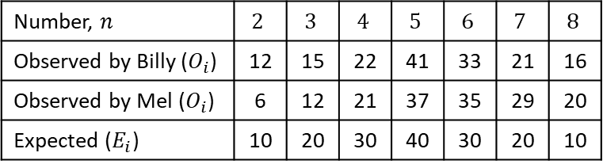
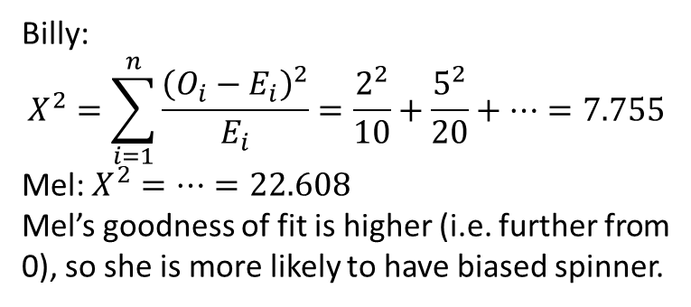
Example
[Textbook] Billy and Mel each have two 4-sided spinners numbered 1-4. They each carry out experiments, where they spin their spinners at the same time, and add the scores together. After each student has carried out 160 experiments, the frequency distributions are as follows:
Both Billy and Mel believe that their spinners are fair.
State the null and alternative hypotheses for the experiment.
One of the students has a biased spinner.
(b) Calculate the goodness of fit for both students, and determine which of them is most likely to have the biased spinner.
Number, $n$ | $$2$$ | $$3$$ | $$4$$ | $$5$$ | $$6$$ | $$7$$ | $$8$$
Observed by Billy ($O_{i}$) | 12 | 15 | 22 | 41 | 33 | 21 | 16
Observed by Mel ($O_{i}$) | 6 | 12 | 21 | 37 | 35 | 29 | 20
Expected ($E_{i}$) | 10 | 20 | 30 | 40 | 30 | 20 | 10
? a
Billy:
$$X^{2}=\sum_{i=1}^{n}{\frac{{\left(O_{i}−E_{i}\right)}^{2}}{E_{i}}}=\frac{2^{2}}{10}+\frac{5^{2}}{20}+…=7.755$$
Mel: $X^{2}=…=22.608$
Mel’s goodness of fit is higher (i.e. further from 0), so she is more likely to have biased spinner.
$H_{0}$: Observed distribution same as theoretical distribution (i.e. spinner is fair)
$H_{1}$: Observed distribution is different to theoretical distribution (i.e. spinner is biased)
? b

Slide 6
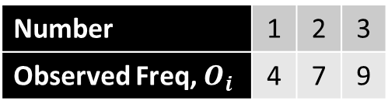
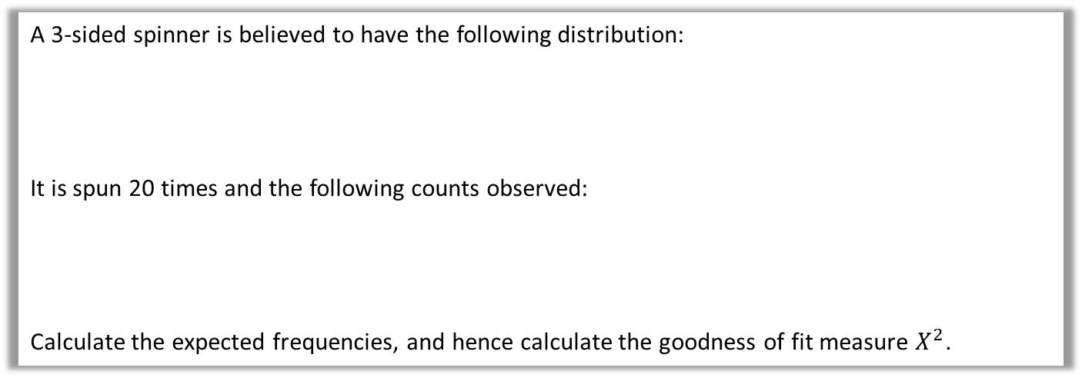
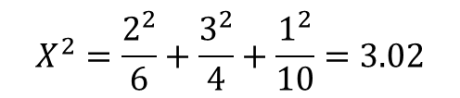
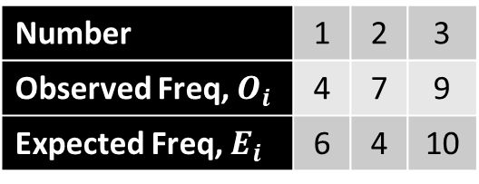
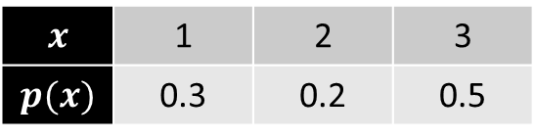
Test Your Understanding
A 3-sided spinner is believed to have the following distribution:
It is spun 20 times and the following counts observed:
Calculate the expected frequencies, and hence calculate the goodness of fit measure $X^{2}$.
$$x$$ | 1 | 2 | 3
$$p(x)$$ | 0.3 | 0.2 | 0.5
Number | 1 | 2 | 3
Observed Freq, $O_{i}$ | 4 | 7 | 9
? a
Number | 1 | 2 | 3
Observed Freq, $O_{i}$ | 4 | 7 | 9
Expected Freq, $E_{i}$ | 6 | 4 | 10
$$X^{2}=\frac{2^{2}}{6}+\frac{3^{2}}{4}+\frac{1^{2}}{10}=3.02$$

Slide 7
Exercise 6A
Pearson Further Statistics 1
Pages 95-96
Complete before the lesson Q1-2
In Class:
Green Q3-4
Amber Q5-6

Slide 8
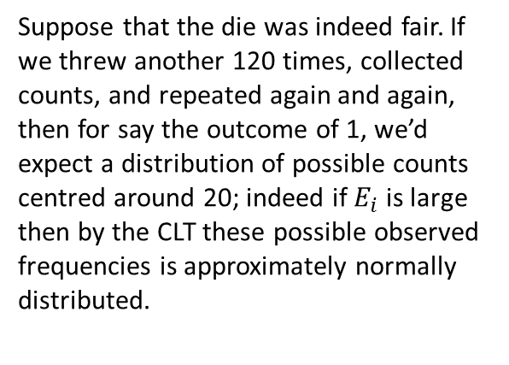

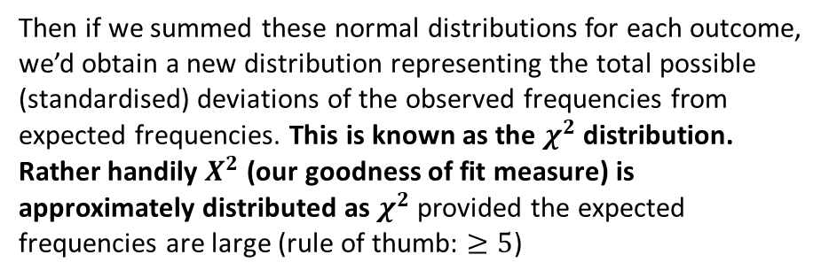
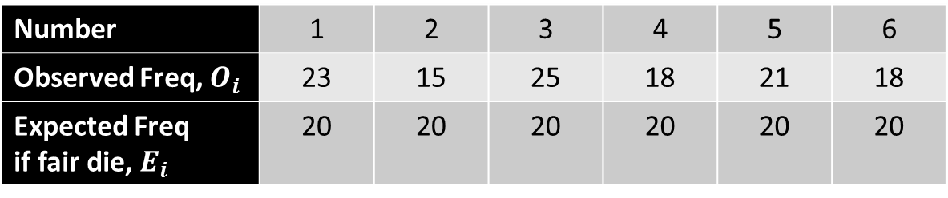
$χ^{2}$ (“Kye squared”) distribution
!
Number | 1 | 2 | 3 | 4 | 5 | 6
Observed Freq, $O_{i}$ | 23 | 15 | 25 | 18 | 21 | 18
Expected Freq if fair die, $E_{i}$ | 20 | 20 | 20 | 20 | 20 | 20
Suppose we standardised this normal distribution (representing the possible observed frequencies for one particular outcome), so that 0 means the observed frequency is equal to the expected frequency, and that we square this random variable to ensure the difference is positive.
Suppose that the die was indeed fair. If we threw another 120 times, collected counts, and repeated again and again, then for say the outcome of 1, we’d expect a distribution of possible counts centred around 20; indeed if $E_{i}$ is large then by the CLT these possible observed frequencies is approximately normally distributed.
Possible observed counts (now standardised and squared)
i.e. possible deviation of the observed frequency from the expected frequency
Then if we summed these normal distributions for each outcome, we’d obtain a new distribution representing the total possible (standardised) deviations of the observed frequencies from expected frequencies. This is known as the $χ^{2}$ distribution.
Rather handily $X^{2}$ (our goodness of fit measure) is approximately distributed as $χ^{2}$ provided the expected frequencies are large (rule of thumb: $≥5$)
$$20$$
Possible observed counts given that expected count is 20.

Slide 9
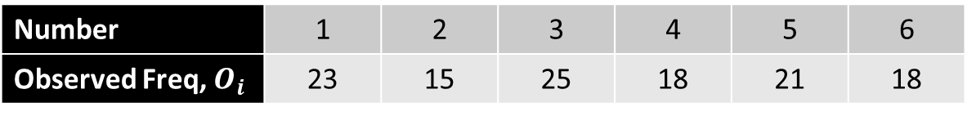
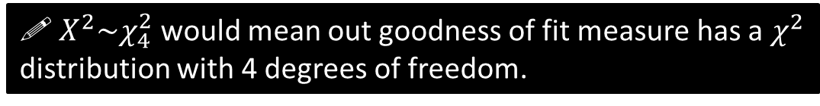
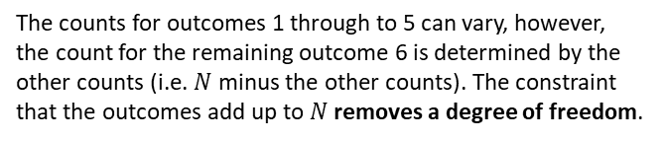

Degrees of Freedom
The $χ^{2}$ distribution has one parameter: degrees of freedom ($ν$ – Greek Letter “nu”), which is how many values we have that can vary.
Number | 1 | 2 | 3 | 4 | 5 | 6
Observed Freq, $O_{i}$ | 23 | 15 | 25 | 18 | 21 | 18
?
Degrees of freedom in this example $=5$
(given that $N$ is fixed)
The counts for outcomes 1 through to 5 can vary, however, the count for the remaining outcome 6 is determined by the other counts (i.e. $N$ minus the other counts). The constraint that the outcomes add up to $N$ removes a degree of freedom.
! The number of degrees of freedom $ν$ = number of cells $−$ number of constraints
So when in combining the normal distributions for each outcome to give some kind of total measure of possible deviation of observed frequencies from expected frequencies, it doesn’t make sense to have another normal distribution representing the possible observed counts for the last outcome, because the observed frequency can’t actually vary!
! $X^{2}\sim χ_{4}^{2}$ would mean out goodness of fit measure has a $χ^{2}$ distribution with 4 degrees of freedom.

Slide 10
Exercise 6B
Pearson Further Statistics 1
Pages 99
Complete before the lesson Q1
In Class:
Green Q2-3
Amber Q4-5

Slide 11

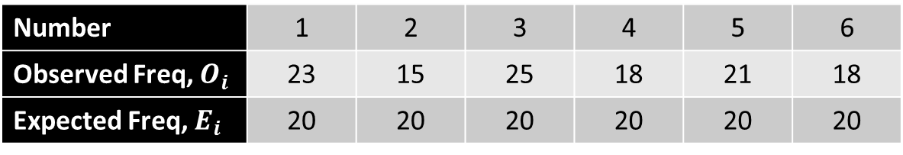
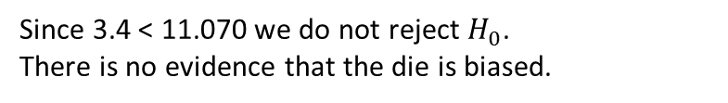
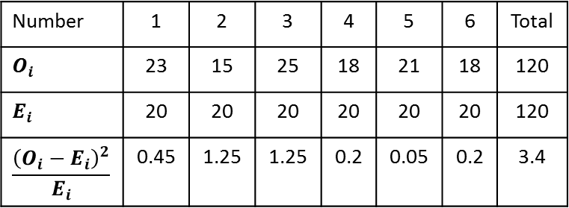
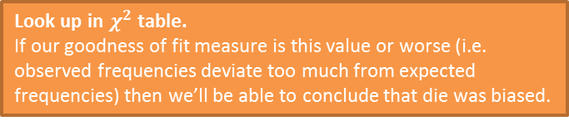
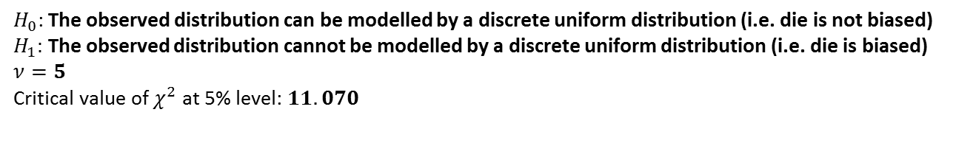
Example: Hypothesis Testing
Number | 1 | 2 | 3 | 4 | 5 | 6
Observed Freq, $O_{i}$ | 23 | 15 | 25 | 18 | 21 | 18
Expected Freq, $E_{i}$ | 20 | 20 | 20 | 20 | 20 | 20
Test, at the 5% significance level, whether or not the observed frequencies could be modelled by a discrete uniform distribution.
?
$H_{0}$: The observed distribution can be modelled by a discrete uniform distribution (i.e. die is not biased)
$H_{1}:$ The observed distribution cannot be modelled by a discrete uniform distribution (i.e. die is biased)
$ν=5$
Critical value of $χ^{2}$ at 5% level: $11.070$
?
?
Look up in $χ^{2}$ table.
If our goodness of fit measure is this value or worse (i.e. observed frequencies deviate too much from expected frequencies) then we’ll be able to conclude that die was biased.
Number | 1 | 2 | 3 | 4 | 5 | 6 | Total
$$O_{i}$$ | 23 | 15 | 25 | 18 | 21 | 18 | 120
$$E_{i}$$ | 20 | 20 | 20 | 20 | 20 | 20 | 120
$$\frac{{\left(O_{i}−E_{i}\right)}^{2}}{E_{i}}$$ | 0.45 | 1.25 | 1.25 | 0.2 | 0.05 | 0.2 | 3.4
Important Note: A goodness of fit test is always one-tailed.
?
Since 3.4 < 11.070 we do not reject $H_{0}$.
There is no evidence that the die is biased.
Critical region
?
?
5%
$$χ^{2}\left(5\right)$$
3.4
11.070

Slide 12
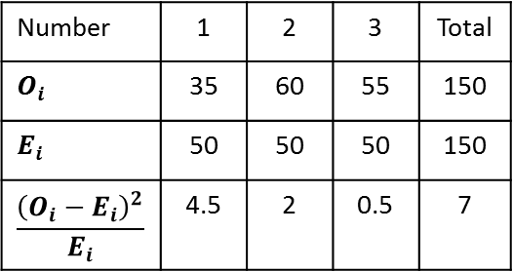

Test Your Understanding
A 3-sided spinner is spun 150 times, and counts of the three outcomes are shown. Test, at the 1% significance level, whether or not spinner is fair.
Number | 1 | 2 | 3 | Total
Observed | 35 | 60 | 55 | 150
?
$H_{0}$: The observed distribution can be modelled by a discrete uniform distribution (i.e. die is not biased)
$H_{1}:$ The observed distribution cannot be modelled by a discrete uniform distribution (i.e. die is biased)
$ν=2$
Critical value of $χ_{2}^{2}(1\%)$ is $9.210$
7 < 9.210 so we do not reject $H_{0}$. Cannot conclude that the spinner is biased.
Number | 1 | 2 | 3 | Total
$$O_{i}$$ | 35 | 60 | 55 | 150
$$E_{i}$$ | 50 | 50 | 50 | 150
$$\frac{{\left(O_{i}−E_{i}\right)}^{2}}{E_{i}}$$ | 4.5 | 2 | 0.5 | 7

Slide 13
Exercise 6C
Pearson Further Statistics 1
Pages 102-103
Complete before the lesson Q1
In Class:
Green Q2-3
Amber Q4-5

Slide 14
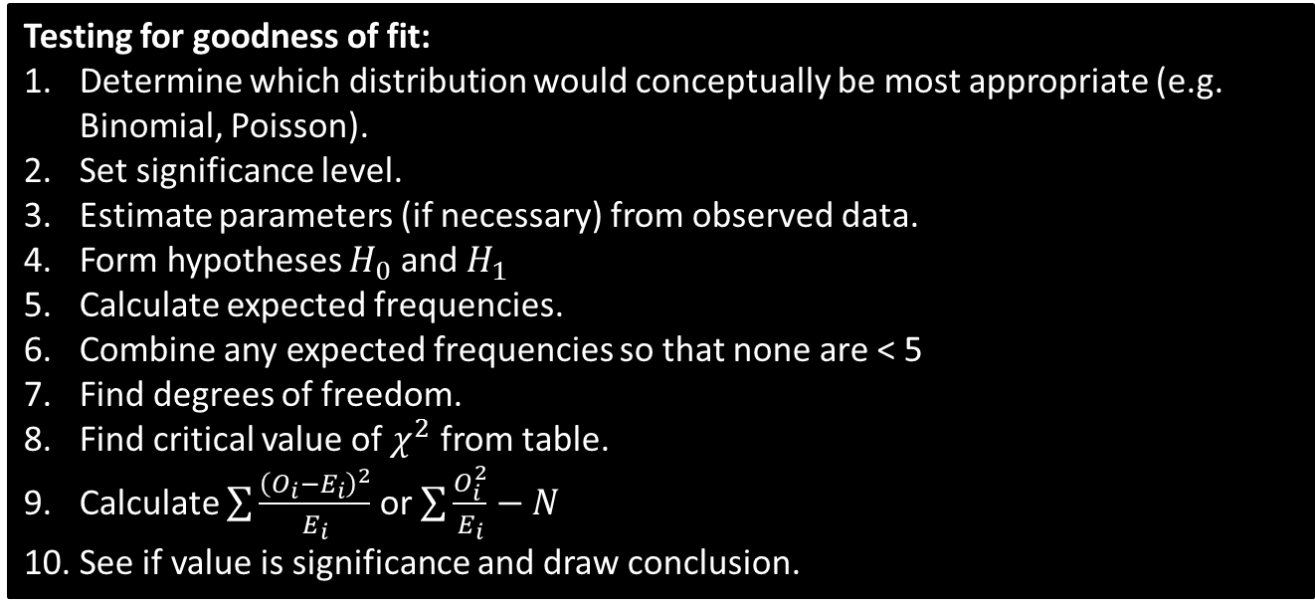
General Method for Goodness of Fit
We have so far tested against a discrete uniform distribution or arbitrarily specified distribution, but we can obviously test against any other distribution in exactly the same way.
Testing for goodness of fit:
Determine which distribution would conceptually be most appropriate (e.g. Binomial, Poisson).
Set significance level.
Estimate parameters (if necessary) from observed data.
Form hypotheses $H_{0}$ and $H_{1}$
Calculate expected frequencies.
Combine any expected frequencies so that none are < 5
Find degrees of freedom.
Find critical value of $χ^{2}$ from table.
Calculate $\sum{\frac{{\left(O_{i}−E_{i}\right)}^{2}}{E_{i}}}$ or $\sum{\frac{O_{i}^{2}}{E_{i}}−N}$
See if value is significance and draw conclusion.

Slide 15
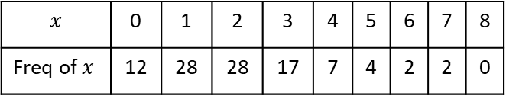
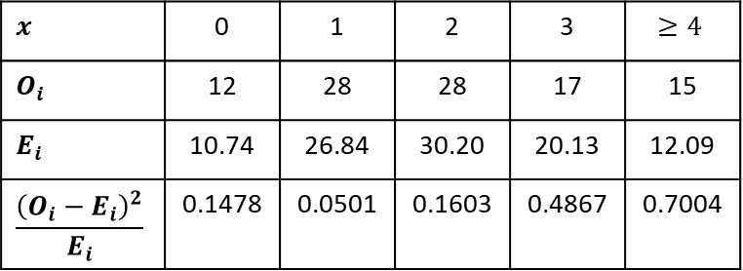
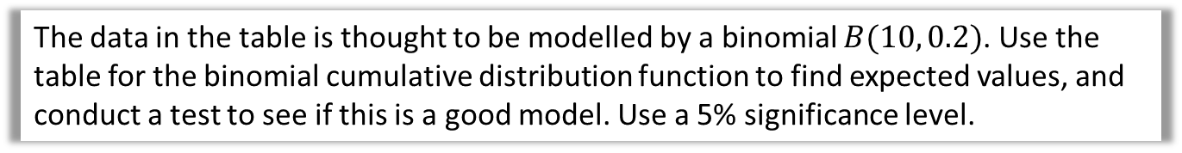
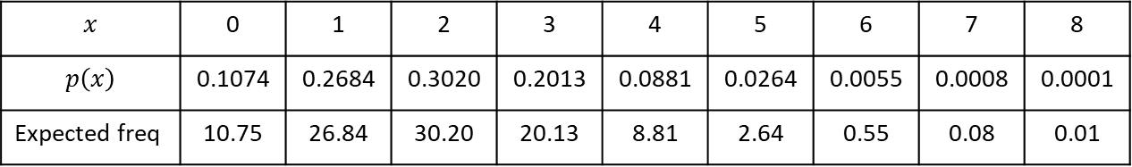
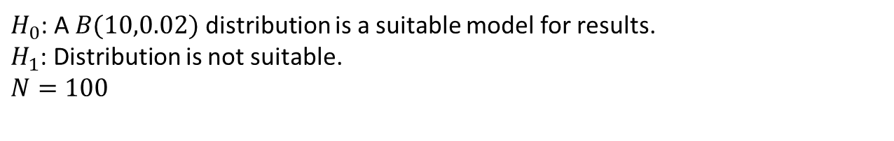
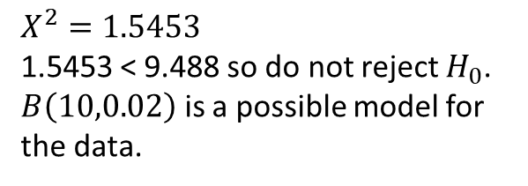
Testing a Binomial Distribution as Model
The data in the table is thought to be modelled by a binomial $B(10, 0.2)$. Use the table for the binomial cumulative distribution function to find expected values, and conduct a test to see if this is a good model. Use a 5% significance level.
$$x$$ | 0 | 1 | 2 | 3 | 4 | 5 | 6 | 7 | 8
Freq of $x$ | 12 | 28 | 28 | 17 | 7 | 4 | 2 | 2 | 0
$H_{0}$: A $B(10,0.02)$ distribution is a suitable model for results.
$H_{1}$: Distribution is not suitable.
$$N=100$$
?
Fro Tip: You can use tables and find differences to retrieve probabilities.
?
$$x$$ | 0 | 1 | 2 | 3 | 4 | 5 | 6 | 7 | 8
$$p\left(x\right)$$ | 0.1074 | 0.2684 | 0.3020 | 0.2013 | 0.0881 | 0.0264 | 0.0055 | 0.0008 | 0.0001
Expected freq | 10.75 | 26.84 | 30.20 | 20.13 | 8.81 | 2.64 | 0.55 | 0.08 | 0.01
?
?
?
?
?
?
?
?
?
?
?
?
?
?
?
?
?
?
Recall that our expected frequencies need to be $≥5$. This typically happens at the tail of the distribution: Combine outcomes until the expected frequency is $≥5$.
$$x$$ | 0 | 1 | 2 | 3 | $$≥4$$
$$O_{i}$$ | 12 | 28 | 28 | 17 | 15
$$E_{i}$$ | 10.74 | 26.84 | 30.20 | 20.13 | 12.09
$$\frac{{\left(O_{i}−E_{i}\right)}^{2}}{E_{i}}$$ | 0.1478 | 0.0501 | 0.1603 | 0.4867 | 0.7004
$ν=5−1=4$
?
?
$X^{2}=1.5453$
1.5453 < 9.488 so do not reject $H_{0}$. $B\left(10,0.02\right)$ is a possible model for the data.
?
?
?
?

Slide 16
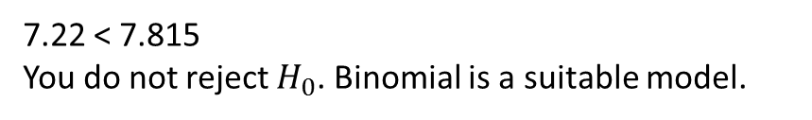
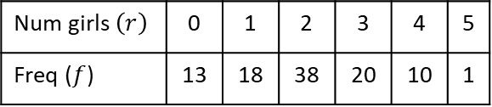

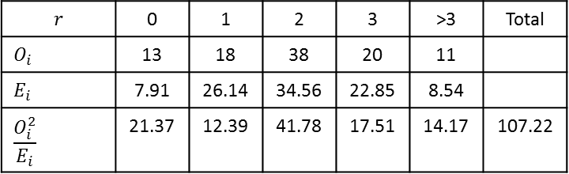
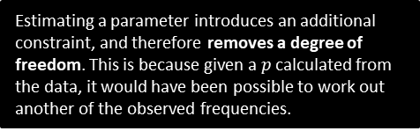
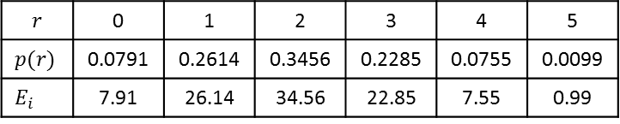
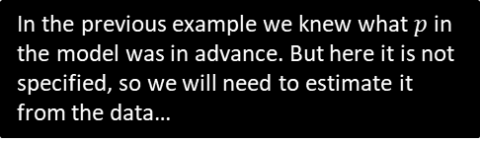
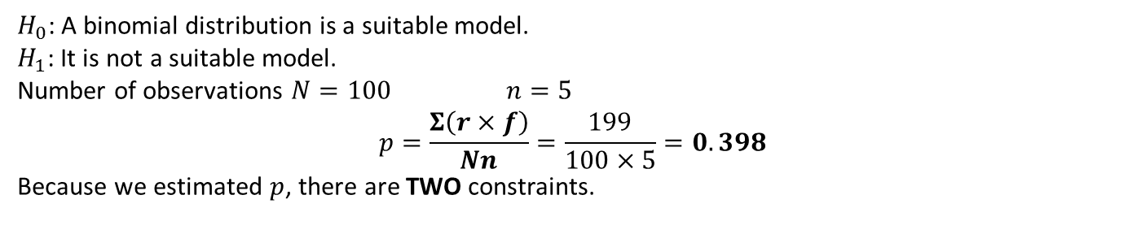
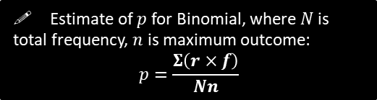
When $p$ is not given
A study of the number of girls in families with five children was done on 100 such families. The results are summarised in the following table.
Test, at the 5% significance level, whether or not a binomial distribution is a good model.
In the previous example we knew what $p$ in the model was in advance. But here it is not specified, so we will need to estimate it from the data…
Num girls $\left(r\right)$ | 0 | 1 | 2 | 3 | 4 | 5
Freq ($f$) | 13 | 18 | 38 | 20 | 10 | 1
! Estimate of $p$ for Binomial, where $N$ is total frequency, $n$ is maximum outcome:
$$p=\frac{Σ\left(r×f\right)}{Nn}$$
$H_{0}$: A binomial distribution is a suitable model.
$H_{1}$: It is not a suitable model.
Number of observations $N=100$ $n=5$
$$p=\frac{Σ\left(r×f\right)}{Nn}=\frac{199}{100×5}=0.398$$
Because we estimated $p$, there are TWO constraints.
?
Estimating a parameter introduces an additional constraint, and therefore removes a degree of freedom. This is because given a $p$ calculated from the data, it would have been possible to work out another of the observed frequencies.
?
$$r$$ | 0 | 1 | 2 | 3 | 4 | 5
$$p(r)$$ | 0.0791 | 0.2614 | 0.3456 | 0.2285 | 0.0755 | 0.0099
$$E_{i}$$ | 7.91 | 26.14 | 34.56 | 22.85 | 7.55 | 0.99
$$r$$ | 0 | 1 | 2 | 3 | >3 | Total
$$O_{i}$$ | 13 | 18 | 38 | 20 | 11
$$E_{i}$$ | 7.91 | 26.14 | 34.56 | 22.85 | 8.54
$$\frac{O_{i}^{2}}{E_{i}}$$ | 21.37 | 12.39 | 41.78 | 17.51 | 14.17 | 107.22
?
?
$$ν=5−2=3$$
Critical value is $χ_{3}^{2}=7.815$
$$X=\sum{\frac{{\left(O_{i}\right)}^{2}}{E_{i}}}−N=107.22−100=7.22$$
?
?
?
?
7.22 < 7.815
You do not reject $H_{0}$. Binomial is a suitable model.
?
?

Slide 17
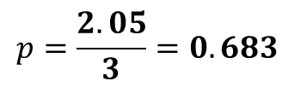

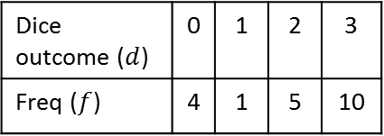

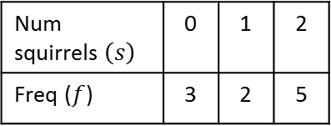

Quickfire $p$ and $ν$
The easiest way to remember how to calculate $p$ is to find the mean of the table and then divide by the $n$ of the Binomial.
Num squirrels $\left(s\right)$ | 0 | 1 | 2
Freq ($f$) | 3 | 2 | 5
?
?
$$p=\frac{1.2}{2}=0.6$$
$$ν=3−2=1$$
Dice outcome ($d$) | 0 | 1 | 2 | 3
Freq ($f$) | 4 | 1 | 5 | 10
?
?
$$p=\frac{2.05}{3}=0.683$$
$$ν=4−2=2$$

Slide 18
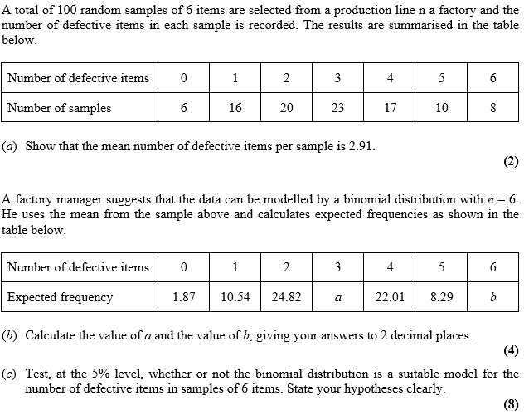
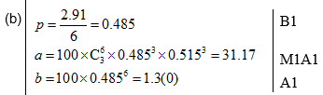

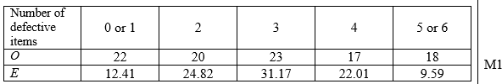
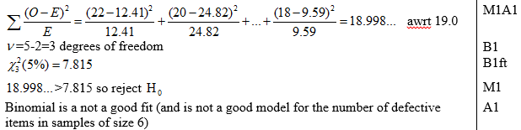
Test Ye Understanding
S3(Old) May 2012 Q6
?
?

Slide 19








Testing a Poisson Distribution as Model
The numbers of telephone calls arriving at an exchange in six-minute periods were recorded over a period of 8 hours, with the following results.
Can these results be modelled by a Poisson distribution? Test at the 5% significance level.
Num calls $\left(r\right)$ | 0 | 1 | 2 | 3 | 4 | 5 | 6 | 7 | 8
Freq ($f$) | 8 | 19 | 26 | 13 | 7 | 5 | 1 | 1 | 0
$H_{0}$: A Poisson distribution is a suitable model for number of calls.
$H_{1}$: It is not a suitable model.
Number of observations $N=\frac{8×60}{6}=80$
$$λ=\frac{167}{80}=2.2$$
$λ$ means the the mean number of calls. So to estimate it, find the mean of the frequency table!
?
?
If we estimate $λ$, we lose a degree of freedom.
$$r$$ | $$P(r)$$ | Expected freq of $r$
0 | 0.1108 | $$0.1108×80=8.864$$
1 | 0.2438 | 19.504
2 | 0.2681 | 21.448
3 | 0.1966 | 15.728
4 | 0.1082 | 8.656
5 | 0.0476 | 3.808
6 | 0.0174 | 1.392
$$≥7$$ | 0.0075 | 0.6
$$r$$ | $$O_{i}$$ | $$E_{i}$$ | $$\frac{{\left(O_{i}−E_{i}\right)}^{2}}{E_{i}}$$
0 | 8 | $$8.864$$ | 0.0842
1 | 19 | 19.504 | 0.0130
2 | 26 | 21.448 | 0.9661
3 | 13 | 15.728 | 0.4732
4 | 7 | 8.656 | 0.3168
$$≥5$$ | 7 | 3.808 | 0.2483
?
?
?
$$ν=6−2=4$$
$$χ_{4}^{2} \left(5\%\right)=9.488$$
2.1016 > 9.488
So insufficient evidence to reject $H_{0}$
Calls may be modelled by Poisson distribution.
?
?
?
?
?
Notice we didn’t say “modelled using $Po\left(2.2\right)$”, because $λ$ wasn’t specified in the original hypothesis.
?
?
Just 1- the rest.

Slide 20
Exercise 6D
Pearson Further Statistics 1
Pages 110-113
Complete before the lesson Q1
In Class:
Green Q2-4
Amber Q5-7
Red Q8-11

Slide 21


Contingency Tables
 |  | Grade |  |  | Totals
 |  | $$A$$ | $$B$$ | $$C$$
School | $$X$$ | 18 | 12 | 20 | 50
 | $$Y$$ | 26 | 12 | 32 | 70
Totals |  | 44 | 24 | 52 | 120
So far, we have repeated a single event to get counts, e.g. throwing a single die multiple times, or in this case sampling grades from a single school and taking counts of each grade.
We then determined how well this fit a particular distribution (uniform, binomial, etc.)
But we might have multiple sets of results, and want to instead see how independent school and grade are – did say pupils in school A receive better teaching, or was the difference just due to chance? (i.e. natural variability)
This table is known as a $2×3$ contingency table (rows first, then columns, just like matrices).

Slide 22




Contingency Tables
Determine to the 5% significance level whether school and grade are dependent.
 |  | Grade |  |  | Totals
 |  | $$A$$ | $$B$$ | $$C$$
School | $$X$$ | 18 | 12 | 20 | 50
 | $$Y$$ | 26 | 12 | 32 | 70
Totals |  | 44 | 24 | 52 | 120
?
i.e. there is not any association between the two criterion
$H_{0}:$School and grade are independent.
$H_{1}:$ School and grade are not independent
Using the totals, what is the probability that a student is from school $X$ and has a grade $A$?
$$P\left(A∩X\right)=\frac{44}{120}×\frac{50}{120}$$
Hence what is the expected number of students from school $X$ getting grade $A$?
$$\frac{44}{120}×\frac{50}{120}×120=\frac{44×50}{120}$$
?
?
! Expected frequency $=\frac{row total×column total}{grand total}$

Slide 23


Contingency Tables
 |  | Grade |  |  | Totals
 |  | $$A$$ | $$B$$ | $$C$$
School | $$X$$ | 18 | 12 | 20 | 50
 | $$Y$$ | 26 | 12 | 32 | 70
Totals |  | 44 | 24 | 52 | 120
Expected Frequencies
 |  | Grade |  |  | Totals
 |  | $$A$$ | $$B$$ | $$C$$
School | $$X$$ | $$\frac{50×44}{120}=18.33$$ | $$\frac{50×24}{120}=10$$ | $$\frac{50×52}{120}=21.67$$ | 50
 | $$Y$$ | $$\frac{70×44}{120}=25.67$$ | $$\frac{70×24}{120}=14$$ | $$\frac{70×52}{120}=30.33$$ | 70
Totals |  | 44 | 24 | 52 | 120
?
?
?
?
?
?

Slide 24



Contingency Tables
 |  | Grade |  |  | Totals
 |  | $$A$$ | $$B$$ | $$C$$
School | $$X$$ | 18 | 12 | 20 | 50
 | $$Y$$ | 26 | 12 | 32 | 70
Totals |  | 44 | 24 | 52 | 120
Degrees of Freedom for $h×k$ table?
i.e. Given the fixed totals, how many cells could you fill in before all other values could be determined?
?
! $ν=(h−1)(k−1)$
?
In this example $ν=\left(2−1\right)\left(3−1\right)=2$

Slide 25


Contingency Tables
$$O_{i}$$ | $$E_{i}$$ | $$\frac{O_{i}^{2}}{E_{i}}$$
18 | 18.33 | 17.676
12 | 10.00 | 14.4
20 | 21.67 | 18.46
26 | 25.67 | 26.334
12 | 14.00 | 10.286
32 | 30.33 | 33.76
?
$$X^{2}=120.916−120=0.916 \\ χ_{2}^{2}=5.991$$
0.916 < 5.991 so do not reject $H_{0}$.
Insufficient evidence to suggest an association between school and grade of pass – the two are independent.
?
?

Slide 26



Test Your Understanding
June 2010 Q5
?

Slide 27
Exercise 6E
Pearson Further Statistics 1
Pages 116-119
Complete before the lesson Q1-2
In Class:
Green Q3-4
Amber Q5-8
Red Q9-12

Slide 28


Goodness of Fit for Geometric Distributions
Recall that a geometric distribution is appropriate when we conduct trials repeatedly until the first ‘success’ is seen.
As before:
We need to deal with expected frequencies $<5$. As we do more trials the probability of getting that far tails off, so expected frequencies also tail off.
We may need to estimate the probability of success $p$.
! For Geometric distribution:
$$p=\frac{Total successes}{Total trials}=\frac{N}{Σr×f_{r}}$$

Slide 29





Example
[Textbook] Sarah has a large DVD collection. Every week she picks DVDs off the shelf at random until she finds one that she would like to watch. Sarah thinks that there is about a 50% chance she will be in the mood to watch any particular DVD. Over the course of a year she records the number of DVDs she picks off the shelf before finding one she would like to watch. The results are recorded in the frequency table below.
(a) Calculate the expected frequencies if the number of DVDs considered is modelled as a $Geo\left(0.5\right)$ random variable.
Sarah wants to check if her guess that there is a 50% chance she’ll watch any particular DVD is supported by the data.
(b) Formulate the null and alternative hypotheses.
(c) Is Sarah right in her assumption? Test at the 5% significance level.
Num DVDs | 1 | 2 | 3 | 4 | Total
Observed frequency $O_{i}$ | 33 | 12 | 5 | 2 | 52
a
?
Num DVDs ($r$) | 1 | 2 | 3 | $≥4$ | Total
$$O_{i}$$ | 33 | 12 | 5 | 2 | 52
$$p(r)$$ | 0.5 | 0.25 | 0.125 | 0.125
$$E_{i}$$ | 26 | 13 | 6.5 | 6.5 | 52
The highest observed outcome was 4. Since the geometric distribution has infinite outcomes, we treat 4 as “4 or more”.
The last expected frequency will therefore be 52 minus the others.
$H_{0}:X\sim Geo(0.5)$ a suitable model.
$H_{1}$: $X\sim Geo\left(0.5\right)$ not a suitable model.
b
?
$X^{2}=\frac{7^{2}}{26}+\frac{1^{2}}{13}+\frac{{1.5}^{2}}{6.5}+\frac{{4.5}^{2}}{6.5}=5.4231$
$$ν=3$$
Critical value $χ_{3}^{2}\left(5\%\right)=7.815$. Since 5.4231<7.815, insufficient evidence to reject null hypothesis. We can model number of DVDs by a geometric random variable with $p=0.5$.
c
?
We didn’t estimate $p$ so the fixed number of observations was the only constraint.

Slide 30
Exercise 6F
Pearson Further Statistics 1
Pages 121-122
Complete before the lesson Q1
In Class:
Green Q2
Amber Q3-4
Red Q5 & Challenge

