Slide 1
Year 2 Pure Mathematics
Vectors
- Column Vectors
Chapter 12
(Part 1 of 6)

Slide 2
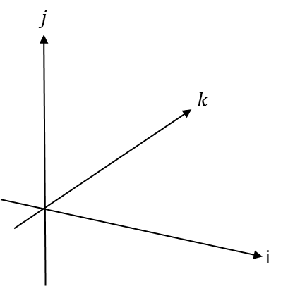

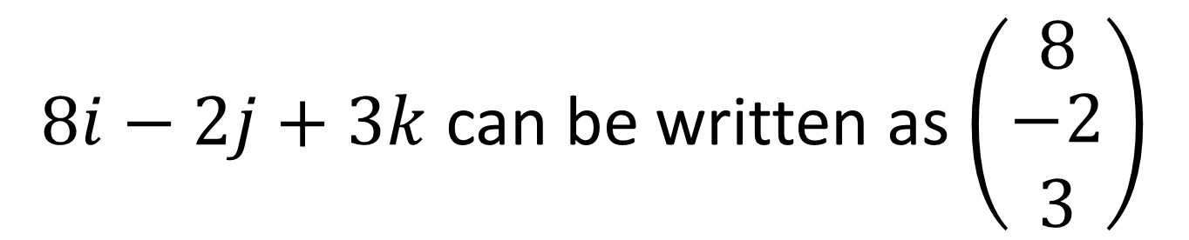
Vectors – Vectors in 3D
3D uses $i, j and k compents.$
$8i−2j+3k$ can be written as $\left(\begin{matrix}8 \\ \begin{aligned}−2 \\ 3\end{aligned}\end{matrix}\right)$

Slide 3

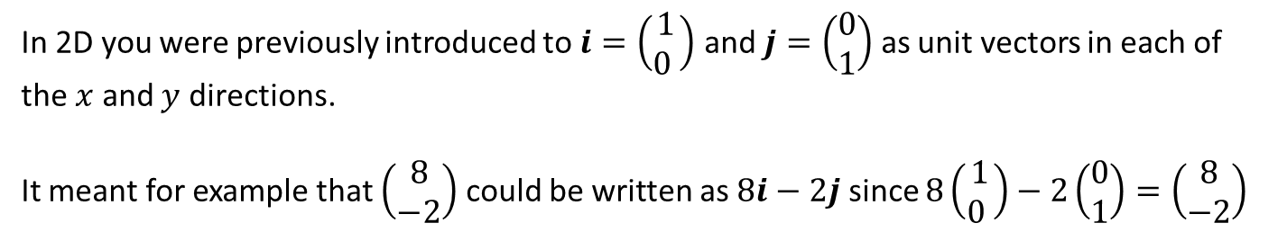

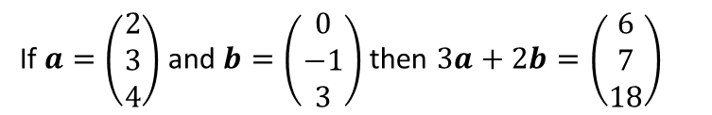

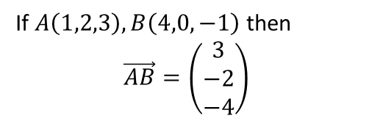




$i$, $j$ and $k$ notation
In 2D you were previously introduced to $i=\left(\begin{matrix}1 \\ 0 \end{matrix}\right)$ and $j=\left(\begin{matrix}0 \\ 1\end{matrix}\right)$ as unit vectors in each of the $x$ and $y$ directions.
It meant for example that $\left(\begin{matrix}8 \\ −2\end{matrix}\right)$ could be written as $8i−2j$ since $8\left(\begin{matrix}1 \\ 0 \end{matrix}\right)−2\left(\begin{matrix}0 \\ 1\end{matrix}\right)=\left(\begin{matrix}8 \\ −2\end{matrix}\right)$
Unsurprisingly, in 3D:
$$i=\left(\begin{matrix}1 \\ 0 \\ 0\end{matrix}\right), j=\left(\begin{matrix}0 \\ 1 \\ 0\end{matrix}\right), k=\left(\begin{matrix}0 \\ 0 \\ 1\end{matrix}\right)$$
Quickfire Questions
2
Write as a column vector:
?
$$i−j=\left(\begin{matrix}1 \\ −1 \\ 0\end{matrix}\right)$$
$$4j+k=\left(\begin{matrix}0 \\ 4 \\ 1\end{matrix}\right)$$
?
1
Put in $i,j,k$ notation:
$$\left(\begin{matrix}1 \\ 2 \\ 3\end{matrix}\right)=i+2j+3k$$
?
3
If $A\left(1,2,3\right), B\left(4,0,−1\right)$ then
$$\vec{AB}=\left(\begin{matrix}3 \\ −2 \\ −4\end{matrix}\right)$$
$$\left(\begin{matrix}−7 \\ 3 \\ 0\end{matrix}\right)=−7i+3j$$
?
?
$$\left(\begin{matrix}3 \\ 0 \\ −1\end{matrix}\right)=3i−k$$
?
If $a=\left(\begin{matrix}2 \\ 3 \\ 4\end{matrix}\right)$ and $b=\left(\begin{matrix}0 \\ −1 \\ 3\end{matrix}\right)$ then $3a+2b=\left(\begin{matrix}6 \\ 7 \\ 18\end{matrix}\right)$
?
4

Slide 4
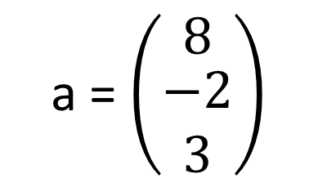
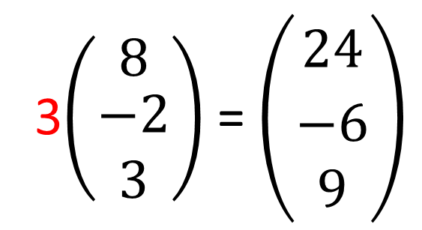
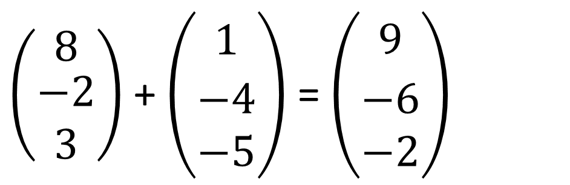
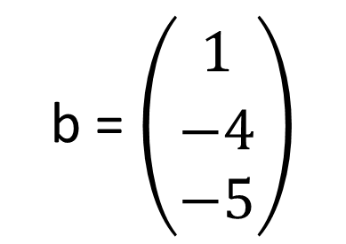
Vectors - $Calculations with vectors$
b = $\left(\begin{aligned}1 \\ \begin{matrix} \\ \begin{aligned}−4 \\ −5\end{aligned}\end{matrix}\end{aligned}\right)$
a = $\left(\begin{matrix}8 \\ \begin{aligned}−2 \\ 3\end{aligned}\end{matrix}\right)$
3$\left(\begin{matrix}8 \\ \begin{aligned}−2 \\ 3\end{aligned}\end{matrix}\right)$ = $\left(\begin{aligned}24 \\ \begin{matrix} \\ \begin{aligned}−6 \\ 9\end{aligned}\end{matrix}\end{aligned}\right)$
3a =
$\left(\begin{matrix}8 \\ \begin{aligned}−2 \\ 3\end{aligned}\end{matrix}\right)$ + $\left(\begin{aligned}1 \\ \begin{matrix} \\ \begin{aligned}−4 \\ −5\end{aligned}\end{matrix}\end{aligned}\right)$ = $\left(\begin{aligned}9 \\ \begin{matrix} \\ \begin{aligned}−6 \\ −2\end{aligned}\end{matrix}\end{aligned}\right)$
a + b =

Slide 5
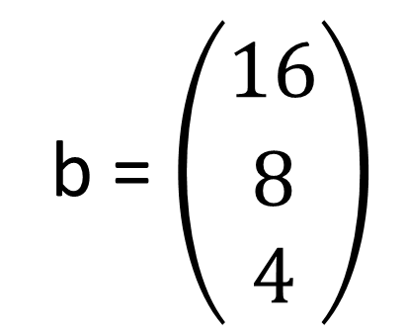
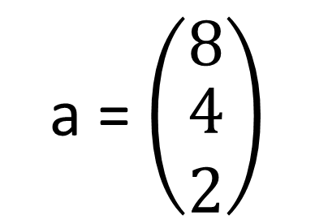
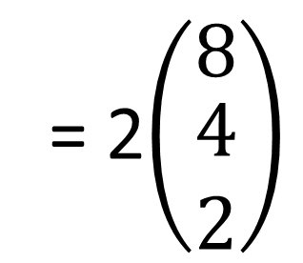
Vectors – Parallel
Two vectors are parallel if
one is a multiple of the other.
b = $\left(\begin{aligned}16 \\ \begin{matrix} \\ \begin{aligned}8 \\ 4\end{aligned}\end{matrix}\end{aligned}\right)$
a = $\left(\begin{matrix}8 \\ \begin{aligned}4 \\ 2\end{aligned}\end{matrix}\right)$
= 2$\left(\begin{matrix}8 \\ \begin{aligned}4 \\ 2\end{aligned}\end{matrix}\right)$
2a = b
therefore they are parallel

Slide 6
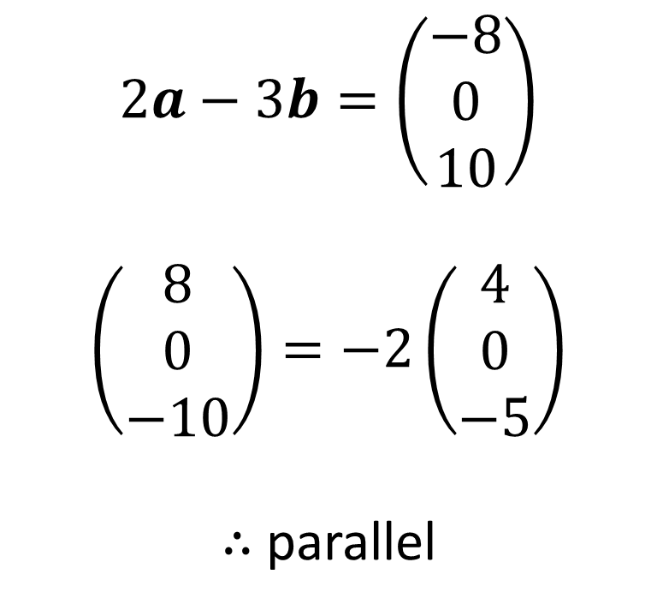
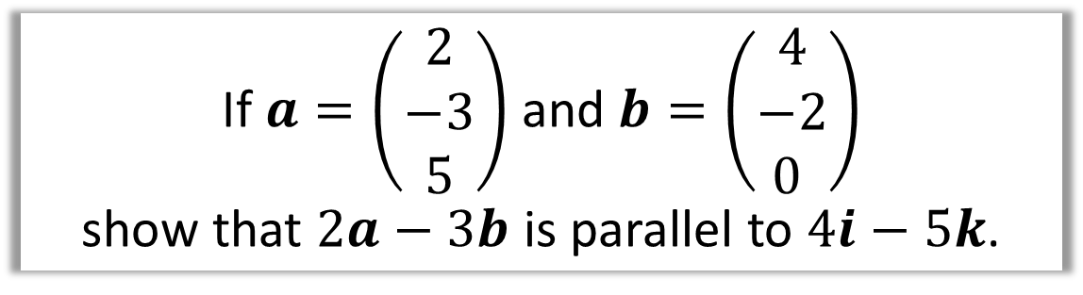
Vectors – Parallel
If $a=\left(\begin{matrix}2 \\ −3 \\ 5\end{matrix}\right)$ and $b=\left(\begin{matrix}4 \\ −2 \\ 0 \end{matrix}\right)$
show that $2a−3b$ is parallel to $4i−5k$.
$$2a−3b=\left(\begin{matrix}−8 \\ 0 \\ 10\end{matrix}\right)$$
$$\left(\begin{matrix}8 \\ 0 \\ −10\end{matrix}\right)=−2\left(\begin{matrix}4 \\ 0 \\ −5\end{matrix}\right)$$
$∴$ parallel

