Slide 1
Volumes of
Revolution
Twitter: @Owen134866
www.mathsfreeresourcelibrary.com

Slide 2
Teachings for
Exercise 4C

Slide 3







Volumes of Revolution
$$V=π\int_{a}^{b}{y^{2}} dx$$
$$V=π\int_{a}^{b}{x^{2}} dy$$
You can find the volumes of even more solids when the curves are defined parametrically
You can adjust the formula for volume of revolution so it can be used for equations given parametrically such that $x=f(t)$ and $y=g(t)$
$$V=π\int_{x=a}^{x=b}{y^{2}} dx$$
The limits given are the lines $x=a$ and $x=b$
This is equivalent
$$V=π\int_{t=q}^{t=p}{y^{2}} \frac{dx}{dt}dt$$
With parametric equations, the limits need to be adjusted for $t$ instead…
4C

Slide 4






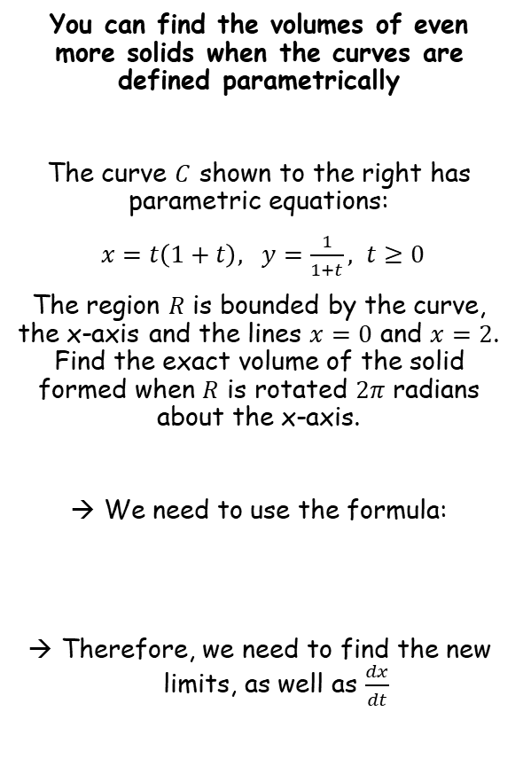











Volumes of Revolution
$$V=π\int_{a}^{b}{y^{2}} dx$$
$$V=π\int_{t=q}^{t=p}{y^{2}} \frac{dx}{dt}dt$$
$$V=π\int_{a}^{b}{x^{2}} dy$$
$$V=π\int_{t=q}^{t=p}{x^{2}} \frac{dy}{dt}dt$$
You can find the volumes of even more solids when the curves are defined parametrically
The curve $C$ shown to the right has parametric equations:
$x=t\left(1+t\right), y=\frac{1}{1+t}, t≥0$
The region $R$ is bounded by the curve, the x-axis and the lines $x=0$ and $x=2$. Find the exact volume of the solid formed when $R$ is rotated $2π$ radians about the x-axis.
We need to use the formula:
Therefore, we need to find the new limits, as well as $\frac{dx}{dt}$
Finding the limits
$$y$$
$$x=t\left(1+t\right)$$
$$x=0$$
$$x=2$$
$$0=t\left(1+t\right)$$
$$2=t\left(1+t\right)$$
$$R$$
$$C$$
$$t=0 or −1$$
$$t^{2}+t−2=0$$
$$t=−2 or 1$$
$$O$$
$$2$$
$$x$$
Finding $\frac{dx}{dt}$
$$x=t\left(1+t\right)$$
Expand bracket
$$V=π\int_{t=q}^{t=p}{y^{2}} \frac{dx}{dt}dt$$
$$x=t+t^{2}$$
$$\frac{dx}{dt}=1+2t$$
Differentiate
4C

Slide 5







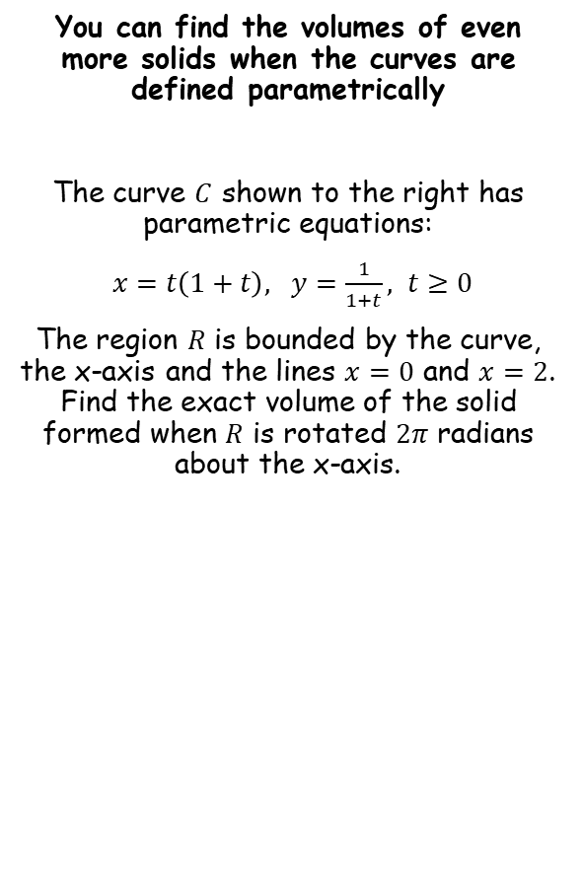








Volumes of Revolution
$$V=π\int_{a}^{b}{y^{2}} dx$$
$$V=π\int_{t=q}^{t=p}{y^{2}} \frac{dx}{dt}dt$$
$$V=π\int_{a}^{b}{x^{2}} dy$$
$$V=π\int_{t=q}^{t=p}{x^{2}} \frac{dy}{dt}dt$$
You can find the volumes of even more solids when the curves are defined parametrically
The curve $C$ shown to the right has parametric equations:
$x=t\left(1+t\right), y=\frac{1}{1+t}, t≥0$
The region $R$ is bounded by the curve, the x-axis and the lines $x=0$ and $x=2$. Find the exact volume of the solid formed when $R$ is rotated $2π$ radians about the x-axis.
$$V=π\int_{t=q}^{t=p}{y^{2}} \frac{dx}{dt}dt$$
Replace terms and limits
$$=π\int_{0}^{1}{{\left(\frac{1}{1+t}\right)}^{2}\left(1+2t\right)}dt$$
Group up
$$=π\int_{0}^{1}{\frac{1+2t}{{\left(1+t\right)}^{2}}}dt$$
We need to use partial fractions…
$$\frac{1+2t}{{\left(1+t\right)}^{2}}=\frac{A}{1+t}+\frac{B}{{\left(1+t\right)}^{2}}$$
Multiply all by ${\left(1+t\right)}^{2}$
Interval is $t=\left[0,1\right]$
$$1+2t=A(1+t)+B$$
$$\frac{dx}{dt}=1+2t$$
$$t=−1$$
$$t=0$$
$$−1=B$$
$$1=A+B$$
We know $B=−1$
$$2=A$$
So the partial fractions will be:
$$\frac{1+2t}{{\left(1+t\right)}^{2}}=\frac{2}{1+t}−\frac{1}{{\left(1+t\right)}^{2}}$$
4C

Slide 6










Volumes of Revolution
$$V=π\int_{a}^{b}{y^{2}} dx$$
$$V=π\int_{t=q}^{t=p}{y^{2}} \frac{dx}{dt}dt$$
$$V=π\int_{a}^{b}{x^{2}} dy$$
$$V=π\int_{t=q}^{t=p}{x^{2}} \frac{dy}{dt}dt$$
You can find the volumes of even more solids when the curves are defined parametrically
The curve $C$ shown to the right has parametric equations:
$x=t\left(1+t\right), y=\frac{1}{1+t}, t≥0$
The region $R$ is bounded by the curve, the x-axis and the lines $x=0$ and $x=2$. Find the exact volume of the solid formed when $R$ is rotated $2π$ radians about the x-axis.
$$V=π\int_{t=q}^{t=p}{y^{2}} \frac{dx}{dt}dt$$
Replace terms and limits
$$=π\int_{0}^{1}{{\left(\frac{1}{1+t}\right)}^{2}\left(1+2t\right)}dt$$
Group up
$$=π\int_{0}^{1}{\frac{1+2t}{{\left(1+t\right)}^{2}}}dt$$
Write using partial fractions
$$=π\int_{0}^{1}{\left(\frac{2}{1+t}−\frac{1}{{\left(1+t\right)}^{2}}\right)}dt$$
Integrate each term
$$=π{\left[2ln\left|1+t\right|+\frac{1}{1+t}\right]}_{0}^{1}$$
$$y={\left(1+t\right)}^{−1}$$
Sub in limits and subtract
$$y=ln\left|1+t\right|$$
Differentiate
$$\frac{dy}{dt}={−1\left(1+t\right)}^{−2}(1)$$
Differentiate
$$=π\left(\left(2ln\left|1+1\right|+\frac{1}{1+1}\right)−\left(2ln\left|1+0\right|+\frac{1}{1+0}\right)\right)$$
$$\frac{dy}{dt}=\frac{1}{1+t}$$
Rewrite
Simplify
$$\frac{dy}{dt}=−\frac{1}{{\left(1+t\right)}^{2}}$$
$$=π\left(\left(2ln2+\frac{1}{2}\right)−\left(0+1\right)\right)$$
This is half of what we want, so double the original ‘guess’
Simplify more
This is the exactly what we want!
(be careful with the negatives)
$$=π\left(2ln2−\frac{1}{2}\right)$$
4C

Slide 7
Exercise 4C
Pearson Core Pure Year 2
Pages 84-87
Complete before the lesson Q1
In Class:
Green Q2-4
Amber Q5-9
Red Q10-11

