Slide 1

Further Stats 1 Chapter 4 ::
Hypothesis Testing
jfrost@tiffin.kingston.sch.uk
www.drfrostmaths.com
@DrFrostMaths
Last modified: 21st July 2018

Slide 2




Register at: www.drfrostmaths.com
Everything is completely free.
Practise questions by chapter, including past paper questions and extension questions (e.g. MAT).
Teachers: you can create student accounts (or students can register themselves).
Teaching videos with topic tests to check understanding.

Slide 3

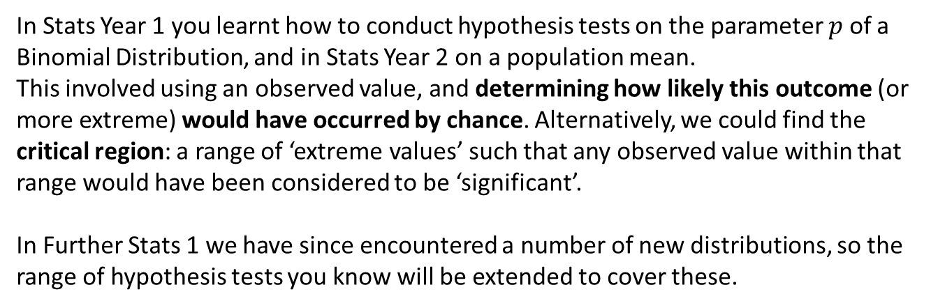

Chapter Overview
In Stats Year 1 you learnt how to conduct hypothesis tests on the parameter $p$ of a Binomial Distribution, and in Stats Year 2 on a population mean.
This involved using an observed value, and determining how likely this outcome (or more extreme) would have occurred by chance. Alternatively, we could find the critical region: a range of ‘extreme values’ such that any observed value within that range would have been considered to be ‘significant’.
In Further Stats 1 we have since encountered a number of new distributions, so the range of hypothesis tests you know will be extended to cover these.
Poisson Distribution
Hypothesis test on $λ$
Geometric Distribution
Hypothesis test on $p$

Slide 4
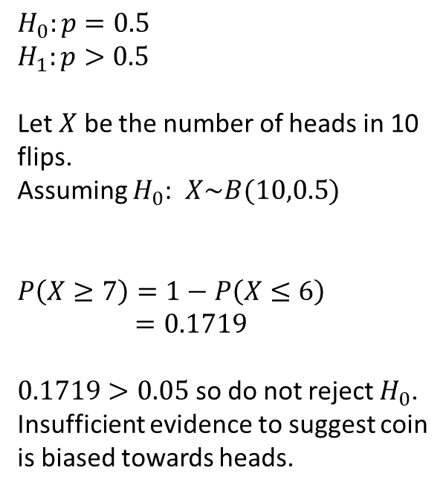

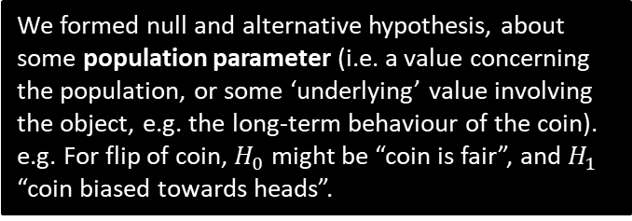
Recap of test on $p$ for binomial distribution
Recap of Binomial test:
We formed null and alternative hypothesis, about some population parameter (i.e. a value concerning the population, or some ‘underlying’ value involving the object, e.g. the long-term behaviour of the coin). e.g. For flip of coin, $H_{0}$ might be “coin is fair”, and $H_{1}$ “coin biased towards heads”.
$$H_{0}:p=0.5 \\ H_{1}:p>0.5$$
Let $X$ be the number of heads in 10 flips.
Assuming $H_{0}$: $X\sim B(10,0.5)$
$$P\left(X≥7\right)=1−P\left(X≤6\right)$$
$=0.1719$
$0.1719>0.05$ so do not reject $H_{0}$.
Insufficient evidence to suggest coin is biased towards heads.
The test statistic was a distribution over what we might observe. We state what this distribution would be if we assumed the null hypothesis was true.
Suppose we saw 7 heads in 10 flips. We calculate the probability of seeing this outcome or more extreme.
This was not sufficiently unlikely (using threshold of 5%), so there is insufficient evidence to suggest coin was biased towards heads, i.e. coin could have been fair, i.e. $p$ could have been $0.5$.

Slide 5




Test on $λ$ for Poisson distribution
[Textbook] Accidents used to occur at a certain road junction at a rate of 6 per month. The residents petitioned for traffic lights. In the month after the lights were installed there was only 1 accident. Does this give sufficient evidence that the lights have reduced the number of accidents? Use a 5% level of significance.
?
Let $X$ be number of accidents this month
$$H_{0}:λ=6, H_{1}:λ<6$$
Assuming $X_{0}, X\sim Po\left(6\right)$
$$P(X≤1)=0.0174 \\ 0.0174<0.05$$
There is sufficient evidence to reject $H_{0}$. Lights may have reduced number of accidents.
This time hypotheses regard underlying rate of accidents, $λ$. It is a one-tailed test.
For Poisson tests, the direction of the inequality is consistent with that of $H_{1}$. This is because as we decrease $λ$, the observed events that occur also decreases, so “1 or more extreme” would be 1 or less events occurring.
Two-point conclusion:
Do we accept or reject $H_{0}$?
Put conclusion in context of original (worded) hypothesis.

Slide 6


Further Example
[Old S2 Textbook] Over a long period of time, Jessie found that the bus taking her to school was late at the rate of 6.7 times per month. In the month following the start of the new summer bus schedules, Jessie finds that her bus is late twice. Assuming that the number of times the bus is late has a Poisson distribution, test at the 1% level of significance, whether or not the new schedules have in fact decreased the number of times the bus is late.
?
Let $X$ be the num times late.
$$H_{0}:λ=6.7 H_{1}:λ<6.7$$
Under $H_{0}$, $X\sim Po\left(6.7\right)$
$$P(X≤2)=P\left(X=0\right)+P\left(X=1\right)+P\left(X=2\right) \\ =0.0371 \left(3sf\right)$$
$0.0371>0.01$ so insufficient evidence to reject $H_{0}$. New schedule has not decreased number of times bus is late.
Because $λ=6.7$ is not a round value, you can’t use tables. But you can use the Poisson CD on your calculator.

Slide 7


Using Binomial $→$ Poisson approximation
We have learnt how to approximate a Binomial distribution using a Poisson one.
[Textbook] During an influenza epidemic, 4% of a population of a large city were affected on a given day. The manager of a factory that employs 250 people found that 17 of the employees at his factory were absent, claiming to be suffering from influenza. Using a Poisson approximation to the binomial distribution and a 5% level of significance, test whether or not the proportion of employees suffering from influenza at his factory was larger than that of the whole city.
[Textbook] During an influenza epidemic, 4% of a population of a large city were affected on a given day. The manager of a factory that employs 250 people found that 17 of the employees at his factory were absent, claiming to be suffering from influenza. Using a Poisson approximation to the binomial distribution and a 5% level of significance, test whether or not the proportion of employees suffering from influenza at his factory was larger than that of the whole city.
?
$H_{0}:p=0.04, H_{1}:p>0.04$
$X=$ number of employees out of 250 suffering from influenza.
Assuming $H_{0}, X\sim B(250,0.04)$
Using Poisson approximation,
$$X\sim Po\left(250×0.04\right) → X\sim Po(10)$$
$$P\left(X≥17\right)=1−P\left(X≤16\right) \\ =0.0270$$
$0.0270<0.05$ so reject $H_{0}$.
Sufficient evidence to conclude that proportion of employees at his factory having influenza is greater than that of the whole city.

Slide 8
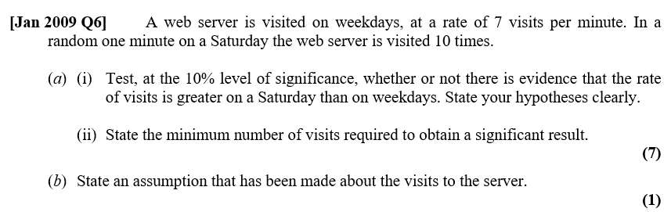
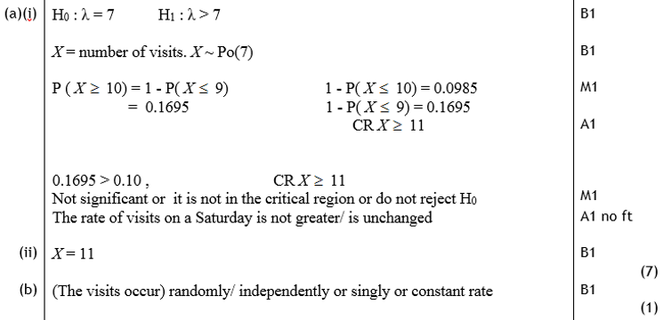
Test Your Understanding
We’ll do critical regions in a bit…
?
?

Slide 9
Exercise 4A
Pearson Further Statistics 1
Pages 61-62
Complete before the lesson Q1-4
In Class:
Green Q5-6
Amber Q7-10
Red Q11-14

Slide 10

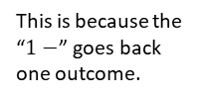
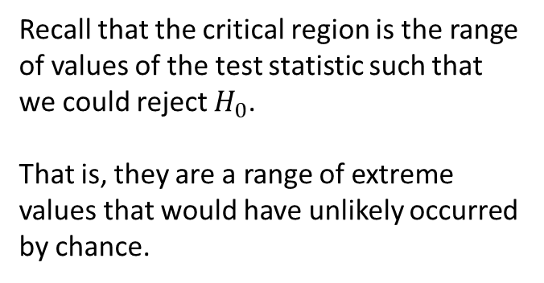
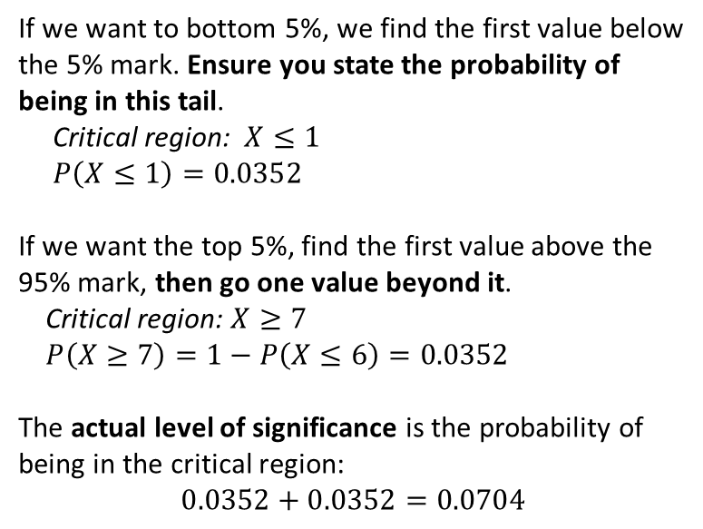
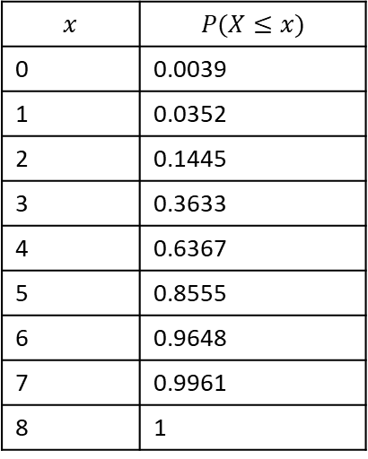

Recap of Critical regions
Recall that the critical region is the range of values of the test statistic such that we could reject $H_{0}$.
That is, they are a range of extreme values that would have unlikely occurred by chance.
Prob under $H_{0}$
0 1 2 3 4 5 6 7 8
Num heads
C.D.F. Binomial table:
$$p=0.5, n=8$$
If we want to bottom 5%, we find the first value below the 5% mark. Ensure you state the probability of being in this tail.
Critical region: $X≤1$
$P\left(X≤1\right)=0.0352$
If we want the top 5%, find the first value above the 95% mark, then go one value beyond it.
Critical region: $X≥7$
$P\left(X≥7\right)=1−P\left(X≤6\right)=0.0352$
The actual level of significance is the probability of being in the critical region:
$$0.0352+0.0352=0.0704$$
$$x$$ | $$P(X≤x)$$
0 | 0.0039
1 | 0.0352
2 | 0.1445
3 | 0.3633
4 | 0.6367
5 | 0.8555
6 | 0.9648
7 | 0.9961
8 | 1
?
This is because the “$1−$” goes back one outcome.
?
?

Slide 11


Examples
[Textbook] An estate agent has been selling houses at a rate of 9 per month. He believes that the rate of sales will decrease in the next month.
Using a 5% level of significance, find the critical region for a one-tailed test of the hypothesis that the rate of sales will decrease from 9 per month.
Write down the actual significance level of the test in part a.
?
$H_{0}:λ=9, H_{1}:λ<9$
Assuming $H_{0}, X\sim Po\left(9\right)$
Using tables:
$P\left(X≤3\right)=0.0212$ $∴$ critical region $X≤3$
Actual significance level: $0.0212$
Use tables where possible (rather than your calculator). If using a calculator, make use of the ‘list’ mode for Poisson CD.
[Textbook] An estate agent has been selling houses at a rate of 9 per month. He believes that the rate of sales will decrease in the next month.
Using a 5% level of significance, find the critical region for a one-tailed test of the hypothesis that the rate of sales will decrease from 9 per month.
Write down the actual significance level of the test in part a.
Let $X$ = the number of incoming calls in a 20-minute interval.
0.325 per minute is 6.5 calls per 20-minutes.
$H_{0}:λ=6.5, H_{1}:λ≠6.5$
$P\left(X≤1\right)=0.0113 →$Lower critical region $X≤1$
$P\left(X≥13\right)=1−P\left(X≤12\right)=0.0160$ $→$ Upper critical region $X≥12$
So critical region $X≤1$ or $X≥12$
Actual significance level: $0.0113+0.0339=0.0452$
$X=13$ is in critical region so reject $H_{0}$ and conclude that there is evidence to suggest that the rate of incoming calls has changed.
?
Two-tailed, so 2.5% at each tail.

Slide 12
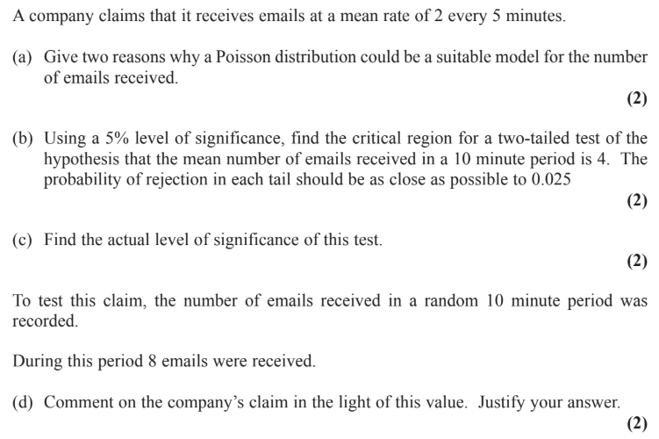
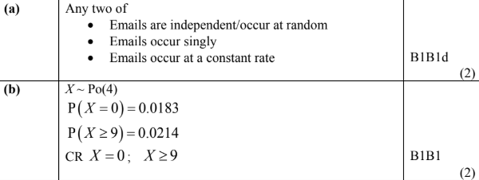
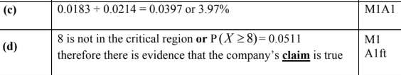
Test Your Understanding
Edexcel S2(Old) June 2014 Q3
?
?
?
?

Slide 13
Exercise 4B
Pearson Further Statistics 1
Pages 65-66
Complete before the lesson Q1
In Class:
Green Q2
Amber Q3-7
Red Q8-11

Slide 14




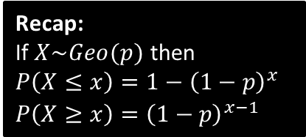
Test on $p$ for geometric distribution
Just as we could test whether the underlying probability of success $p$ had changed for a Binomial distribution, or the underlying rate of events $λ$ for a Poisson distribution, we can also test for a change in the probability of success $p$ for a geometric distribution.
You, Christopher Walken, are captured by the Vietcong and forced to play ‘Russian Roulette’. The Vietcong claim that the probability you will die on each shot is 0.3. You survive a number of shots before dying on the 6th shot. Test, to the 10% level, whether the Vietcong have overstated the probability of dying on each shot.
A scene from one of Dr Frost’s favourite films, The Deer Hunter.
?
We are claiming the probability of dying on each shot is actually lower.
$H_{0}:p=0.3, H_{1}:p<0.3$
Let $X$ be number of shots before dying.
Assuming $H_{0}$, $X\sim Geo(0.3)$
$$P\left(X≥6\right)={\left(1−0.3\right)}^{6−1}=0.16807$$
$0.16807>0.1$ do not reject $H_{0}$.
Insufficient evidence to suggest that the Vietcong have overstated the probability of dying on each shot.
Recap:
If $X\sim Geo(p)$ then
$P\left(X≤x\right)=1−{\left(1−p\right)}^{x}$
$P\left(X≥x\right)={\left(1−p\right)}^{x−1}$
As $p$ decreases, the expected number of shots increases, so “6 or more extreme” is “6 or more”. In general for Geometric tests, the inequality is the opposite direction to $H_{1}$.
* History disclaimer: There is no documented cases of Russian Roulette occurring during the Vietnam War.

Slide 15
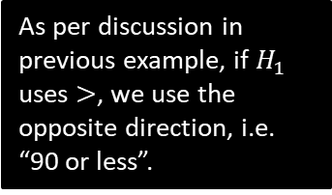

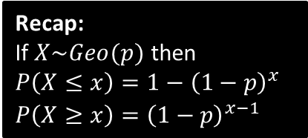
Test Your Understanding
[Textbook] An electronics company makes small components for use in computers. It claims that the percentage of defective components coming off the production line is 0.05%. The electronics company sells the components to a retailer. The retailer suspects that the percentage defective stated by the electronics company should be higher. From a very large consignment recently purchased, the retailer tests the components until he finds a defective component. He finds a defective component on the 90th component that he tests. Is there any evidence to suggest that the retailer’s suspicions are correct? Test at the 5% level of significance.
?
Let the random variable $X$ = number of components tested until finding a defective one.
$H_{0}:p=0.0005, H_{1}:p>0.0005$
Assuming $H_{0}, X\sim Geo(0.0005)$
$P\left(X≤90\right)=1−{\left(1−0.0005\right)}^{30}$
$=0.0440 (4dp)$
$0.0440<0.05$ therefore reject $H_{0}$. Sufficient evidence to conclude that the retailer’s suspicions are correct, i.e. the percentage defective is greater than 0.05%.
As per discussion in previous example, if $H_{1}$ uses $>$, we use the opposite direction, i.e. “90 or less”.
Recap:
If $X\sim Geo(p)$ then
$P\left(X≤x\right)=1−{\left(1−p\right)}^{x}$
$P\left(X≥x\right)={\left(1−p\right)}^{x−1}$

Slide 16
Exercise 4C
Pearson Further Statistics 1
Pages 68-69
Complete before the lesson Q1-3
In Class:
Green Q4-7
Red Q8-12

Slide 17

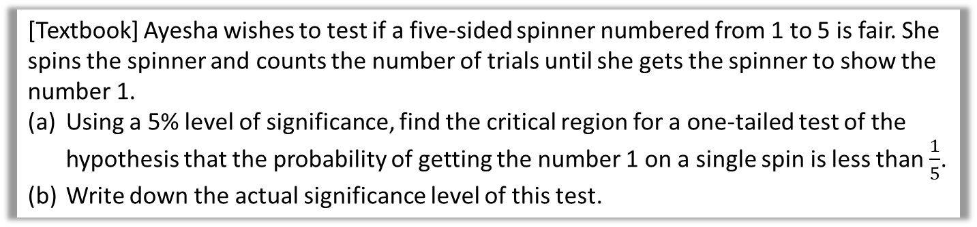

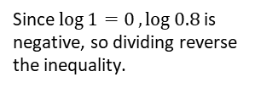

Critical Regions for Geometric Tests
[Textbook] Ayesha wishes to test if a five-sided spinner numbered from 1 to 5 is fair. She spins the spinner and counts the number of trials until she gets the spinner to show the number 1.
Using a 5% level of significance, find the critical region for a one-tailed test of the hypothesis that the probability of getting the number 1 on a single spin is less than $\frac{1}{5}$.
Write down the actual significance level of this test.
We don’t have any tables to work with here, and using trial and error would take far too long. We can work out the critical value algebraically!
Suppose that the critical value is $k$.
$$P\left(X≥k\right)<0.05 \\ {\left(1−\frac{1}{5}\right)}^{k−1}<0.05 \\ {0.8}^{k−1}<0.05 \\ \left(k−1\right)\log{0.8}<\log{0.05} \\ k−1>\frac{\log{0.05}}{\log{0.8}} \\ k>14.43 → k=15$$
Critical region is $X≥15$
Actual significance level $=P\left(X≥15\right)={0.8}^{14}=0.04398 (5dp)$
Recap:
If $X\sim Geo(p)$ then
$P\left(X≤x\right)=1−{\left(1−p\right)}^{x}$
$P\left(X≥x\right)={\left(1−p\right)}^{x−1}$
a
Because $H_{1}:p<0.2$, we therefore find $P(X≥k)$.
?
Since $\log{1=0},\log{0.8}$ is negative, so dividing reverse the inequality.
b
?

Slide 18


Test Your Understanding
[Textbook] In a particular city, a Lobster Card is used as a method of payment on trains. The company that administers the card claims that only 1 in 1000 cards will be rejected by the card reader at the train station. A station manager feels that the company is understating the proportion of cards rejected by the card reader, and decides to carry out a test. When he comes on shift at 5:00 am he counts the number of passengers who pass through until he notes a passenger who has a Lobster Card rejected.
Using a 5% level of significance, find the critical region for a one-tailed test of the hypothesis that the proportion of Lobsters Cards rejected by the card reader is greater than 1 in 1000.
Write down the actual significance level of the test in part a.
a
Let $k$ be the critical value.
$$P\left(X≤k\right)<0.05 \\ 1−{\left(1−0.0001\right)}^{k}<0.05 \\ … \\ k<51.267 → k=51$$
So critical region is $X≤51$.
Actual significance level $=P\left(X≤51\right)$
$=1−{0.999}^{51}=0.0497 (4dp)$
?
Recap:
If $X\sim Geo(p)$ then
$P\left(X≤x\right)=1−{\left(1−p\right)}^{x}$
$P\left(X≥x\right)={\left(1−p\right)}^{x−1}$
b
?

Slide 19
Exercise 4D
Pearson Further Statistics 1
Pages 71-72
Complete before the lesson Q1-3
In Class:
Amber Q4-6
Red Challenge

