Slide 1
Year 1 Pure Mathematics
Differentiation
- Modelling
Chapter 12
(Part 6 of 6)

Slide 2



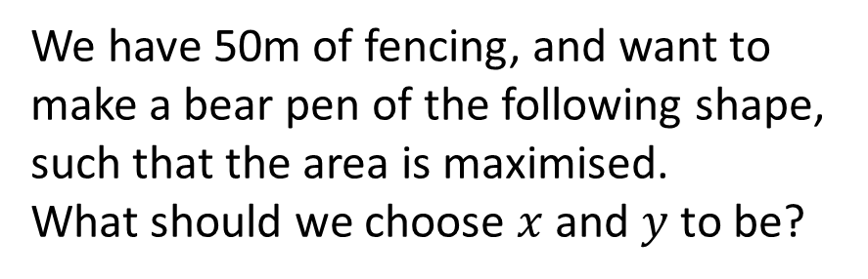
Modelling
We have a sheet of A4 paper, which we want to fold into a cuboid. What height should we choose for the cuboid in order to maximise the volume?
$$h$$
We have 50m of fencing, and want to make a bear pen of the following shape, such that the area is maximised.
What should we choose $x$ and $y$ to be?
$$x$$
$$y$$

Slide 3
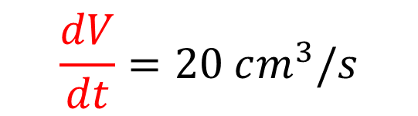
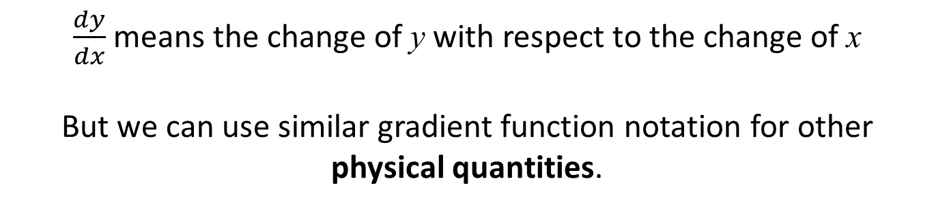
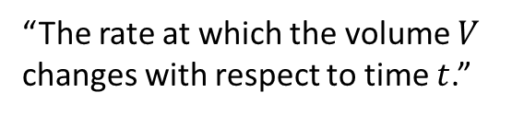
Modelling - Rate of change
$\frac{dy}{dx}$ means the change of y with respect to the change of x
But we can use similar gradient function notation for other physical quantities.
A sewage container fills at a rate of
20 cm³ per second.
How could we use appropriate notation to represent this?
$$\frac{dV}{dt}=20 cm^{3}/s$$
“The rate at which the volume $V$ changes with respect to time $t$.”

Slide 4

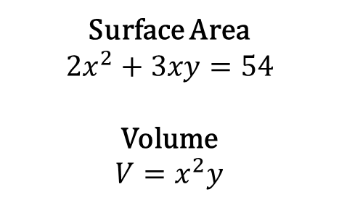

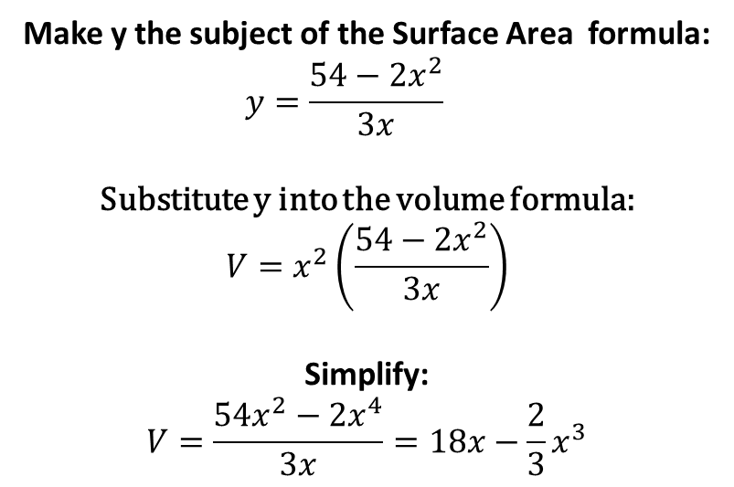
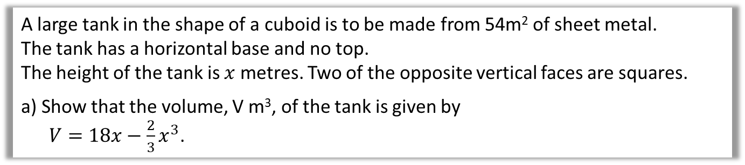

Modelling - Optimisation Problem
A large tank in the shape of a cuboid is to be made from 54m² of sheet metal.
The tank has a horizontal base and no top.
The height of the tank is $x$ metres. Two of the opposite vertical faces are squares.
a) Show that the volume, V m³, of the tank is given by
$V=18x−\frac{2}{3}x^{3}$.
Make y the subject of the Surface Area formula:
$$y=\frac{54−2x^{2}}{3x}$$
Substitute y into the volume formula:
$$V=x^{2}\left(\frac{54−2x^{2}}{3x}\right)$$
Simplify:
$$V=\frac{54x^{2}−2x^{4}}{3x}=18x−\frac{2}{3}x^{3}$$
$$x$$
$$x$$
$$y$$
Surface Area
$$2x^{2}+3xy=54$$
Volume
$$V=x^{2}y$$

Slide 5
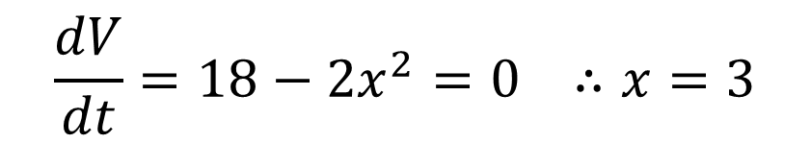

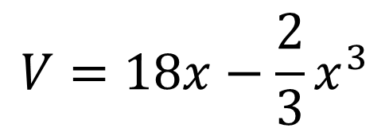

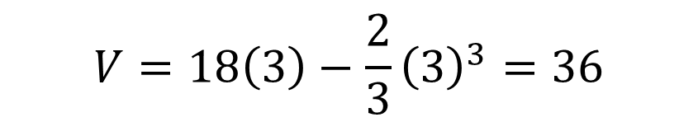
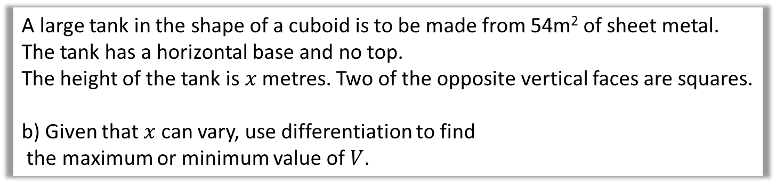

Modelling - Optimisation Problem
A large tank in the shape of a cuboid is to be made from 54m² of sheet metal.
The tank has a horizontal base and no top.
The height of the tank is $x$ metres. Two of the opposite vertical faces are squares.
b) Given that $x$ can vary, use differentiation to find
the maximum or minimum value of $V$.
$$V=18x−\frac{2}{3}x^{3}$$
$$x$$
$$\frac{dV}{dt}=18−2x^{2}=0 ∴x=3$$
$$x$$
$$y$$
$$V=18\left(3\right)−\frac{2}{3}{\left(3\right)}^{3}=36$$

Slide 6
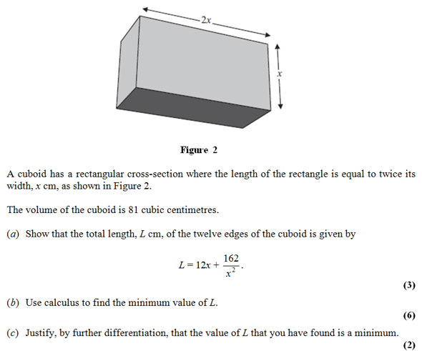
Modelling – Exam Question

Slide 7
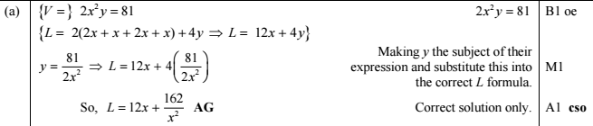
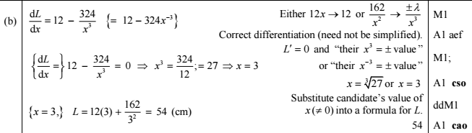

Modelling – Exam Question Answers

Slide 8

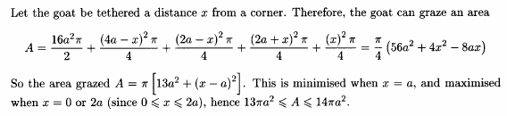
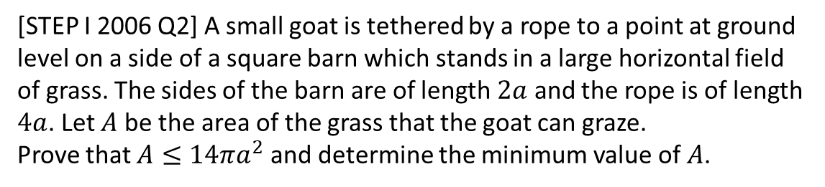
Exercise 12K
Complete before the lesson Q1
Green Q2
Amber Q3
Red
Pearson Pure Mathematics
Page 281
Extension
1
[STEP I 2006 Q2] A small goat is tethered by a rope to a point at ground level on a side of a square barn which stands in a large horizontal field of grass. The sides of the barn are of length $2a$ and the rope is of length $4a$. Let $A$ be the area of the grass that the goat can graze.
Prove that $A≤14πa^{2}$ and determine the minimum value of $A$.
?

