Slide 1
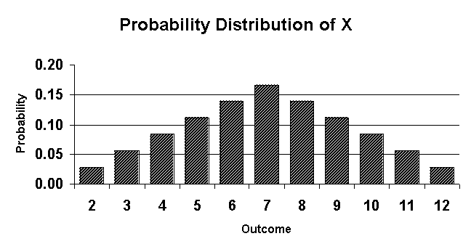
Discrete Random Variables
Explanation of Discrete Random Variables
Discrete Random Variables are linked to Probability.
A Discrete Random Variable can be obtained by real-world measurement. For example, rolling a dice.
They must always be numerical values. For example, you could toss a coin and say ‘how many heads?’, the answer being 1 or 0.
However you could not say ‘heads or tails’ as these are not numerical.
The possibilities can only be whole numbers (discrete). There can be others but these are not the focus of the chapter.
Summary → Discrete random variables allow us to calculate the expected outcomes of events with given probabilities.
8A

Slide 2
Discrete Random Variables
Notation of Discrete Random Variables
A Capital letter, such as X, will be used for the random variable, and a lower case x for a particular value of that variable.
P(X = x) means the Probability that the Random variable is equal to a particular value.
Rolling a Dice → ‘X’
P(X = 5) = ¹/₆
P(X > 4) = ²/₆ = ¹/₃
Tossing a coin once → Number of heads → ‘X’
P(X = 0) = ¹/₂
P(X = 1) = ¹/₂
8A

Slide 3
Discrete Random Variables
Discrete Random Variables
A coin is tossed 6 times and the number of heads (X) is noted. What are the possible values of X?
→ 0, 1, 2, 3, 4, 5, 6
Which of the following are Discrete Random Variables?
→ The average height of a group of boys
→ No as height is on a continuous scale
→ The number of times a dice is rolled before a 2 appears
→ Yes, it is numerical and comes from an experiment
→ The number of months in a year
→ No as it is fixed and therefore not random
8A

Slide 4
Discrete Random Variables
Discrete Random Variables
You can draw up a table to show the Probability Distribution of a discrete Random Variable. This should be something you always do first if you are not given it in the question.
A fair dice is rolled. Show the Probability of getting any number as a Probability Distribution.
x
1
2
3
4
5
6
P(X = x)
¹/₆
¹/₆
¹/₆
¹/₆
¹/₆
¹/₆
This is the Probability Function. It summarises the data in the table.
→ P(X = x) = ¹/₆ for x = 1, 2, 3, 4, 5, 6
8A

Slide 5
Discrete Random Variables
Discrete Random Variables
Three fair coins are tossed. The number of heads is counted.
a) Draw the sample space for this experiment.
→ This shows all possibilities
b) Show this as a Probability Distribution
→ The table summarises the Probabilities
c) Show this as a Probability Function
→ This summarises the table. It is common practice to include a ‘0’ probability at the bottom.
a)
H
H
H
H
H
T
These Probabilities will always add up to 1
H
T
H
H
T
T
T
H
H
T
H
T
T
T
H
T
T
T
b)
No. Heads, x
0
1
2
3
P(X = x)
¹/₈
³/₈
³/₈
¹/₈
c)
8A

Slide 6
Discrete Random Variables
Discrete Random Variables
You will need to be able to calculate missing values, based on the Probabilities adding up to 1.
a) Find the value of k in the table opposite
b) Complete the missing values in the table, based on the value of k.
x
1
2
3
4
5
P(X = x)
0.2
k
0.1
0.2
3k
Group together like terms
0.2 + k + 0.1 + 0.2 + 3k = 1
4k + 0.5 = 1
- 0.5
4k = 0.5
÷ 4
k = 0.125
x
1
2
3
4
5
P(X = x)
0.2
0.125
0.1
0.2
0.375
8A

Slide 7
Discrete Random Variables
Discrete Random Variables
You will need to be able to calculate missing values, based on the Probabilities adding up to 1.
A tetrahedral (4 sided) dice is numbered 1, 2, 3 and 4.
The probability of it landing on a given side is ^{k}/_{x}, where k is constant.
a) Draw the Probability Distribution of P(X = x), in terms of k.
b) Calculate the value of k
x
1
2
3
4
P(X = x)
^{k}/₁
^{k}/₂
^{k}/₃
^{k}/₄
Make the denominators equal
Now you can group them
x 12
÷ 25
8A

Slide 8
Discrete Random Variables
Discrete Random Variables
You will need to be able to calculate missing values, based on the Probabilities adding up to 1.
A tetrahedral (4 sided) dice is numbered 1, 2, 3 and 4.
The probability of it landing on a given side is ^{k}/_{x}, where k is constant.
a) Draw the Probability Distribution of P(X = x), in terms of k.
b) Calculate the value of k
c) Draw the finished Probability Distribution
x
1
2
3
4
P(X = x)
^{k}/₁
^{k}/₂
^{k}/₃
^{k}/₄
x
1
2
3
4
P(X = x)
¹²/₂₅
⁶/₂₅
⁴/₂₅
³/₂₅
Half of ¹²/₂₅
¹²/₂₅ ÷ 3
¹²/₂₅ ÷ 4
8A

Slide 9
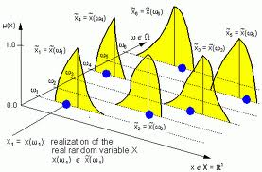
Discrete Random Variables
Calculating the Expected value
If we know the probability distribution for a variable X, we can calculate the expected value of X
The expected value is not necessarily a value which is possible
It is effectively the mean of the distribution (this will become clearer as we do some questions)
Notation
‘The expected value of x’
‘The sum of (x multiplied by the probability of x)’
8C

Slide 10
Discrete Random Variables
Calculating the Expected value
The table shows the number of television sets per household, in a survey of 100.
a) Calculate the mean for this data
No. sets | 0 | 1 | 2 | 3
Frequency | 10 | 75 | 10 | 5
8C

Slide 11
Discrete Random Variables
Calculating the Expected value
The table shows the number of television sets per household, in a survey of 100.
a) Calculate the mean for this data
b) Draw the probability distribution for X where X is the number of TV sets for a house picked at random.
c) Calculate E(X), the expected value of X.
No. sets | 0 | 1 | 2 | 3
Frequency | 10 | 75 | 10 | 5
Mean = 1.1 sets
x
0
1
2
3
p(x)
0.1
0.75
0.1
0.05
xp(x)
0
0.75
0.2
0.15
E(X) is sometimes called ‘the mean of X’
8C

Slide 12
Discrete Random Variables
The random variable X has the following probability distribution.
a) Given that E(X) = 3, write down 2 equations involving p and q.
x | 1 | 2 | 3 | 4 | 5
p(x) | 0.1 | p | 0.3 | q | 0.2
All the probabilities add up to 1
Group together the numbers
Subtract 0.6
8C

Slide 13
Discrete Random Variables
The random variable X has the following probability distribution.
a) Given that E(X) = 3, write down 2 equations involving p and q.
x | 1 | 2 | 3 | 4 | 5
p(x) | 0.1 | p | 0.3 | q | 0.2
Work out each bracket
Group numbers
Subtract 2
8C

Slide 14
Discrete Random Variables
The random variable X has the following probability distribution.
a) Given that E(X) = 3, write down 2 equations involving p and q.
b) Use your equations to find the values of p and q.
x
1
2
3
4
5
p(x)
0.1
p
0.3
q
0.2
0.3
0.1
1
2
x 2
3
4
4
-
3
8C

Slide 15
Discrete Random Variables
x | 1 | 2 | 3 | 4
P(X = x) | ¹²/₂₅ | ⁶/₂₅ | ⁴/₂₅ | ³/₂₅
Finding the expected value of x²
In order to calculate Standard Deviation in these types of question, we need to see how to work out E(X²).
a) Find the value of E(X)
8C

Slide 16
Discrete Random Variables
x | 1 | 2 | 3 | 4
P(X = x) | ¹²/₂₅ | ⁶/₂₅ | ⁴/₂₅ | ³/₂₅
x | 1 | 2 | 3 | 4
x² | 1 | 4 | 9 | 16
P(X = x) | ¹²/₂₅ | ⁶/₂₅ | ⁴/₂₅ | ³/₂₅
Finding the expected value of x²
In order to calculate Standard Deviation in these types of question, we need to see how to work out E(X²).
a) Find the value of E(X)
b) Calculate E(X²)
Note that E(X²) IS NOT E(X) squared!
8C

Slide 17
Exercise 1A
Pearson Pure Mathematics Year 1/AS
Pages 4-5
Complete before the lesson Q2
In Class:
Green Q3-4
Amber Q5-6
Red Q7-9 & Challenge

