Slide 1
Year 1 Pure Mathematics
Algebraic Methods
- Factor Theorem
Chapter 7
(Part 3 of 4)

Slide 2


The Factor Theorem
You can use the Factor Theorem to easily find
the value of any remainder.
Show that $(x−2)$ is a factor of
$$x^{3}+x^{2}−4x−4$$
Step 1: Identify your $x$ value
$(x−2)$ = 0
So let $x$= 2
Step 2: Substitute the x value into the polynomial
The answer to the substitution is your remainder.

Slide 3

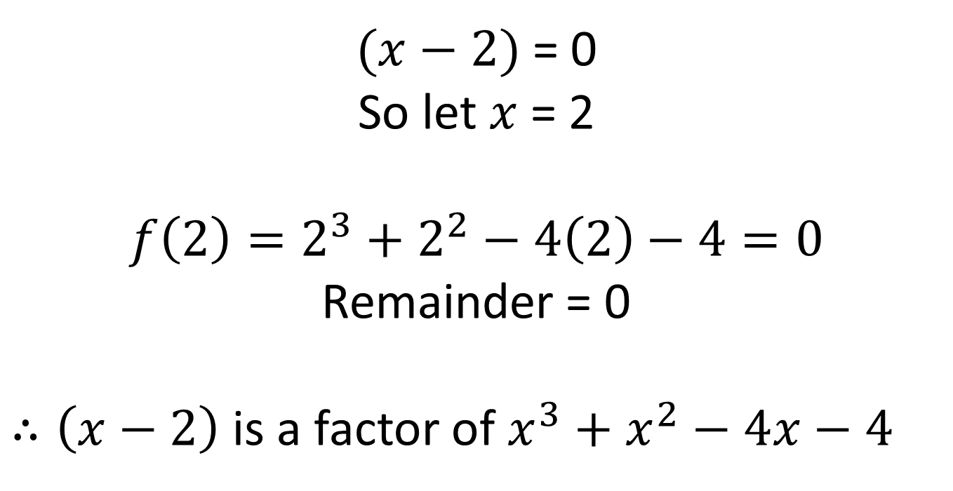
The Factor Theorem
Show that $(x−2)$ is a factor of
$$x^{3}+x^{2}−4x−4$$
$(x−2)$ = 0
So let $x$= 2
$$f\left(2\right)=2^{3}+2^{2}−4\left(2\right)−4=0$$
Remainder = 0
$∴\left(x−2\right)$ is a factor of $x^{3}+x^{2}−4x−4$

Slide 4


Factor Theorem – Finding unknown coefficients
Given that $2x+1$ is a factor of $6x^{3}+ax^{2}+1$, determine the value of $a$.
$2x+1$ = 0
So let $x$ = -½
$$f\left(−\frac{1}{2}\right)=6{\left(−\frac{1}{2}\right)}^{3}+a{\left(−\frac{1}{2}\right)}^{2}+1$$
$$−\frac{3}{4}+\frac{1}{4}a+1=0$$
$$\frac{1}{4}a=−\frac{1}{4} \\ a=−1$$

Slide 5

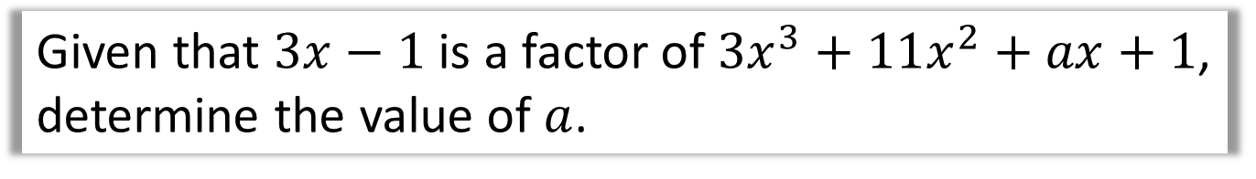
Test Your Understanding
Given that $3x−1$ is a factor of $3x^{3}+11x^{2}+ax+1$, determine the value of $a$.
$$f\left(\frac{1}{3}\right)=3{\left(\frac{1}{3}\right)}^{3}+11{\left(\frac{1}{3}\right)}^{2}+\frac{1}{3}a+1=0$$
$$\frac{7}{3}+\frac{1}{3}a=0$$
$$a=−7$$

Slide 6
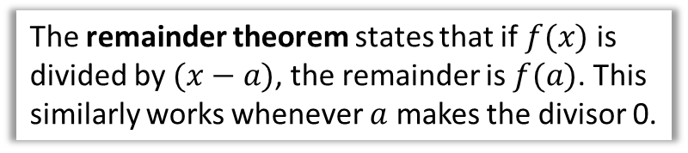
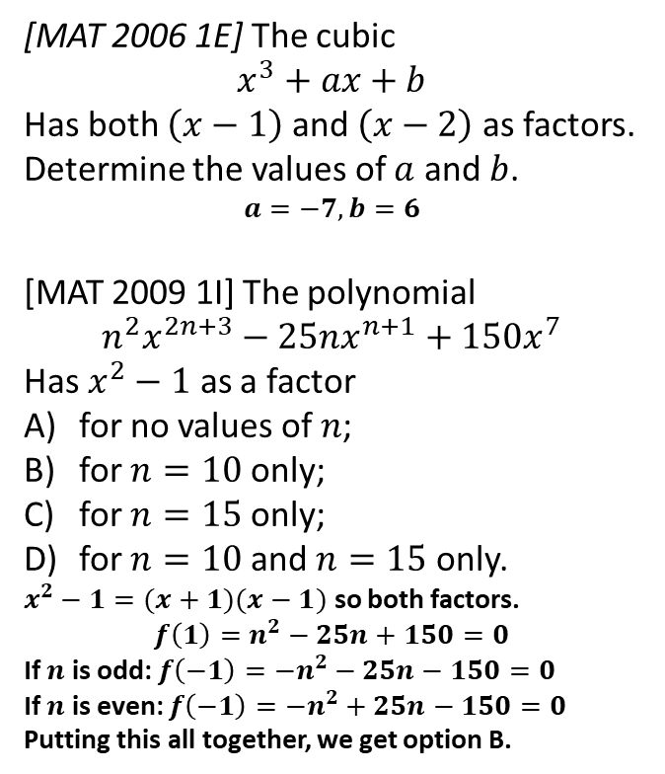

Exercise 7C
Complete before the lesson Q2-5
Green Q6-12
Amber Q13-15
Red Ext & Challenge
Pearson Pure Mathematics Year 1/AS Pages 145-146
Extension
The remainder theorem states that if $f(x)$ is divided by $(x−a)$, the remainder is $f(a)$. This similarly works whenever $a$ makes the divisor 0.
1
[MAT 2006 1E] The cubic
$$x^{3}+ax+b$$
Has both $\left(x−1\right)$ and $\left(x−2\right)$ as factors. Determine the values of $a$ and $b$.
$$a=−7, b=6$$
[MAT 2009 1I] The polynomial
$$n^{2}x^{2n+3}−25nx^{n+1}+150x^{7}$$
Has $x^{2}−1$ as a factor
for no values of $n$;
for $n=10$ only;
for $n=15$ only;
for $n=10$ and $n=15$ only.
$x^{2}−1=(x+1)(x−1)$ so both factors.
$$f\left(1\right)=n^{2}−25n+150=0$$
If $n$ is odd: $f\left(−1\right)=−n^{2}−25n−150=0$
If $n$ is even: $f\left(−1\right)=−n^{2}+25n−150=0$
Putting this all together, we get option B.
3
[MAT 2013 1G] Let $n≥2$ be an integer and $p_{n}\left(x\right)$ be the polynomial
$$p_{n}\left(x\right)=\left(x−1\right)+\left(x−2\right)+…+(x−n)$$
What is the remainder, in terms of $n$, when $p_{n}\left(x\right)$ is divided by $p_{n−1}\left(x\right)$?
$$p_{n}\left(x\right)=nx−\frac{1}{2}n\left(n+1\right) \\ p_{n−1}\left(x\right)=\left(n−1\right)x+\frac{1}{2}n\left(n−1\right)$$
We need to make the divisor 0:
$$\left(n−1\right)\left(x+\frac{1}{2}n\right)=0 → x=−\frac{n}{2}$$
Remainder:
$$p_{n}\left(−\frac{n}{2}\right)=n\left(−\frac{n}{2}\right)−\frac{1}{2}n\left(n+1\right)=−\frac{1}{2}n$$
?
2
?
?

