Slide 1
Year 1 Pure Mathematics
Sketching Graphs
- Reciprocal
Chapter 4
(Part 1 of 5)

Slide 2
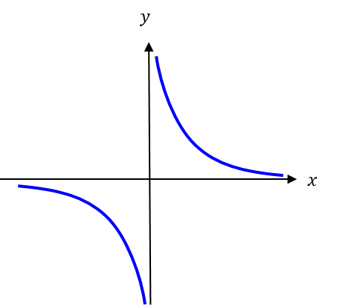
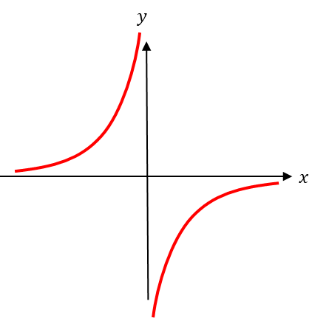
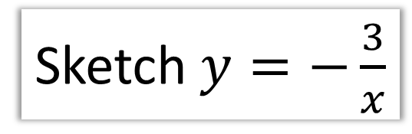
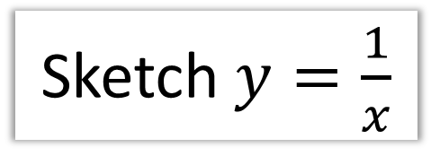
Reciprocal Graphs
Sketch $y=\frac{1}{x}$
Sketch $y=−\frac{3}{x}$

Slide 3

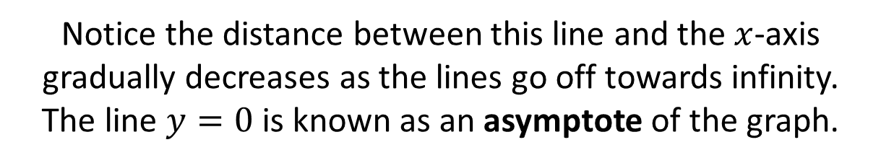

Reciprocal Graphs - Asymptotes
An asymptote is a line which the graph approaches
but never reaches.
$$y$$
$$x$$
Notice the distance between this line and the $x$-axis gradually decreases as the lines go off towards infinity. The line $y=0$ is known as an asymptote of the graph.

Slide 4
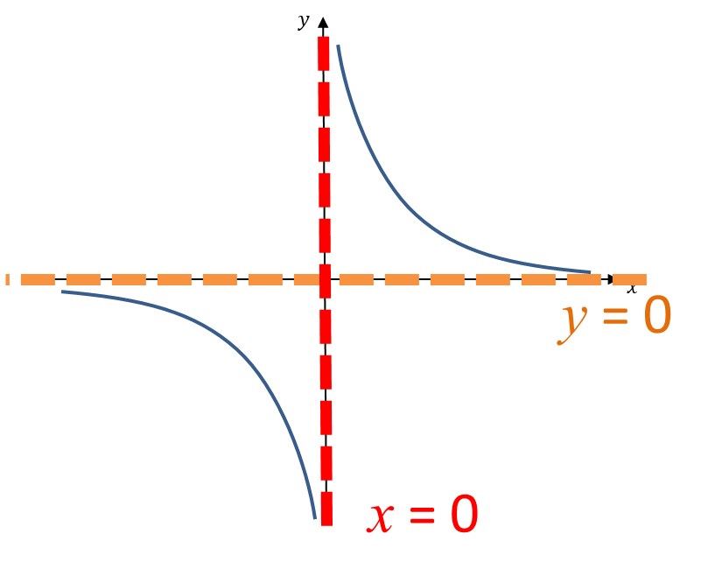
Reciprocal Graphs - Asymptotes
An asymptote is a line which the graph approaches
but never reaches.

Slide 5
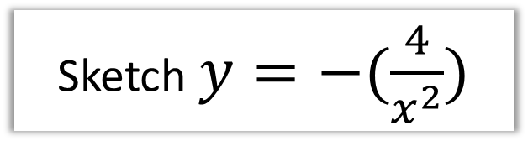
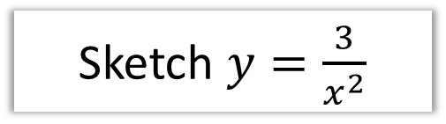



Reciprocal Graphs
Sketch $y=\frac{3}{x^{2}}$
Sketch $y=−(\frac{4}{x^{2}})$
$$y$$
$$y$$
$$x$$
$$x$$
Hint: Note that anything squared will always be at least 0.

Slide 6

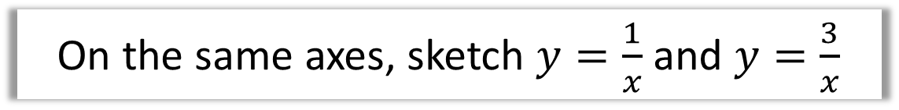
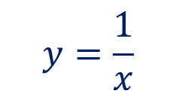
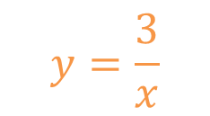

Reciprocal Graphs
On the same axes, sketch $y=\frac{1}{x}$ and $y=\frac{3}{x}$
$$y$$
$$y=\frac{3}{x}$$
$$y=\frac{1}{x}$$
$$x$$

Slide 7
Exercise 4C
Pearson Pure Mathematics Year 1/AS
Page 67
Complete before the lesson Q1
Green Q2

