Slide 1
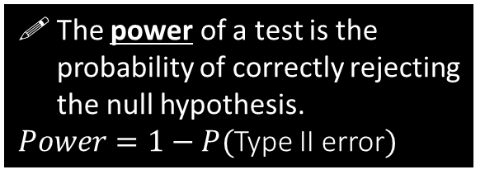
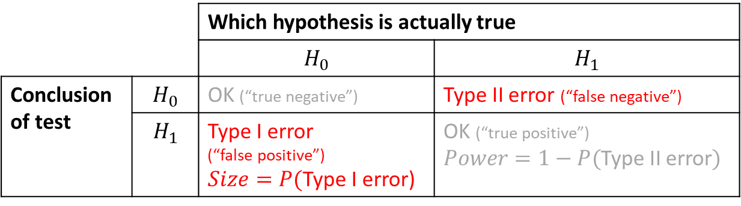
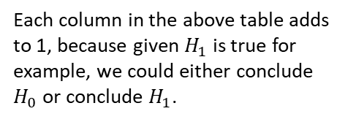
Calculate the Size and Power of a Test
 |  | Which hypothesis is actually true
 |  | $$H_{0}$$ | $$H_{1}$$
Conclusion of test | $$H_{0}$$ | OK (“true negative”) | Type II error (“false negative”)
 | $$H_{1}$$ | Type I error (“false positive”) $Size=P($Type I error) | OK (“true positive”) $Power=1−P($Type II error$)$
The power of a test is the probability of correctly rejecting the null hypothesis.
$Power=1−P($Type II error$)$
! The probability of a Type I error is known as the size of a test.
Memory Tip: Both of these terms relate to when we conclude the alternative hypothesis.
Each column in the above table adds to 1, because given $H_{1}$ is true for example, we could either conclude $H_{0}$ or conclude $H_{1}$.

Slide 2

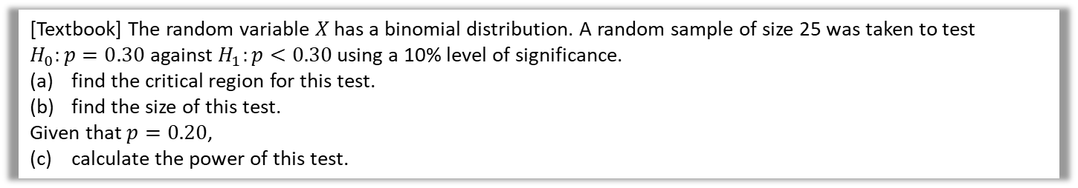


Example
[Textbook] The random variable $X$ has a binomial distribution. A random sample of size 25 was taken to test $H_{0}:p=0.30$ against $H_{1}:p<0.30$ using a 10% level of significance.
find the critical region for this test.
find the size of this test.
Given that $p=0.20$,
(c) calculate the power of this test.
a
$X\sim B\left(25,p\right)$
$H_{0}:p=0.30 H_{1}:p<0.30$
Assuming $H_{0}, X\sim B(25,0.30)$
Using tables, critical region $X≤4$ where $P\left(X≤4\right)=0.0905$
Size $=P($Type I error$)=0.0905$
Power $=P($accepting $H_{1} | H_{1}$ is true$)$
$$=P\left(X≤4 \right| p=0.20) \\ =0.4207$$
?
b
?
$P($Type I error$)$ is actual significance level.
c
?
Calculate directly. No need to do $1−P($Type II error$)$

Slide 3

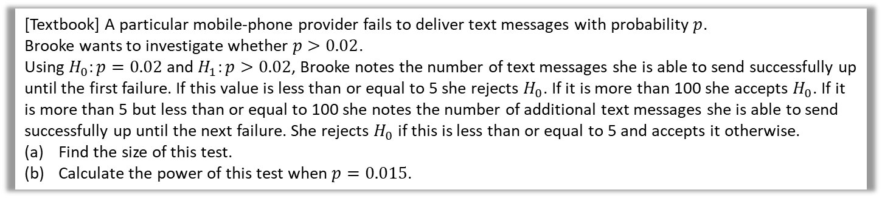
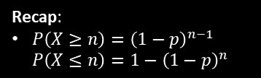
Geometric Example
[Textbook] A particular mobile-phone provider fails to deliver text messages with probability $p$.
Brooke wants to investigate whether $p>0.02$.
Using $H_{0}:p=0.02$ and $H_{1}:p>0.02$, Brooke notes the number of text messages she is able to send successfully up until the first failure. If this value is less than or equal to 5 she rejects $H_{0}$. If it is more than 100 she accepts $H_{0}$. If it is more than 5 but less than or equal to 100 she notes the number of additional text messages she is able to send successfully up until the next failure. She rejects $H_{0}$ if this is less than or equal to 5 and accepts it otherwise.
Find the size of this test.
Calculate the power of this test when $p=0.015$.
a
?
Let $X$ be number of messages up to an including first failure. $X\sim Geo(p)$
Assuming $H_{0}, X\sim Geo(0.02)$
$P\left(X≤5\right)=1−{0.98}^{5}=0.09607$
$$P\left(5<X≤100\right)=P\left(X≤100\right)−P\left(X≤5\right)=0.77130…$$
$P(H_{1}$ concluded | $H_{0}$ true)
$=P\left(X≤5\right)+\left[P\left(5<X≤100\right)×P\left(X≤5\right)\right]$
$=0.09607+\left(0.77130×0.09607\right)=0.1702$
$Y\sim Geo\left(0.015\right)$
$P\left(Y≤5\right)=…=0.07278 P\left(5<Y≤100\right)=0.70660$
$P(H_{1}$ concluded | $H_{1}$ true)
$=P\left(X≤5\right)+\left[P\left(5<X≤100\right)×P\left(X≤5\right)\right]$
$=0.1242$
Recap:
$P\left(X≥n\right)={\left(1−p\right)}^{n−1}$
$P\left(X≤n\right)=1−{\left(1−p\right)}^{n}$
b
?

Slide 4
Exercise 8C
Pearson Further Statistics 1
Pages 160-162
Complete before the lesson Q1-3
In Class:
Green Q4
Amber Q5-7
Red Q8-10 & Challenge

