Slide 1
Year 1 Pure Mathematics
Exponentials and Logs
- Modelling
Chapter 14
(Part 7 of 7)

Slide 2


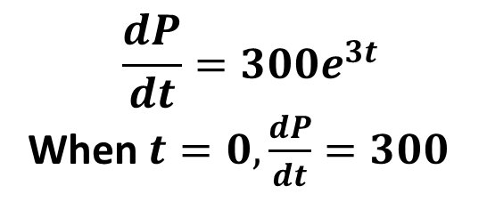
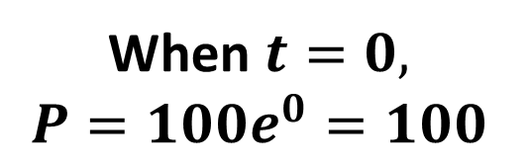
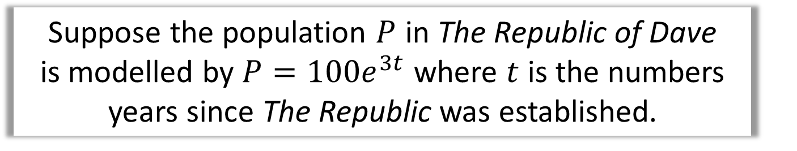
Modelling – Exam Questions
Suppose the population $P$ in The Republic of Dave is modelled by $P=100e^{3t}$ where $t$ is the numbers years since The Republic was established.
$$P$$
$$t$$
What is the initial population?
What is the initial rate of
population growth?
$$\frac{dP}{dt}=300e^{3t}$$
When $t=0,\frac{dP}{dt}=300$
When $t=0,$
$$P=100e^{0}=100$$

Slide 3
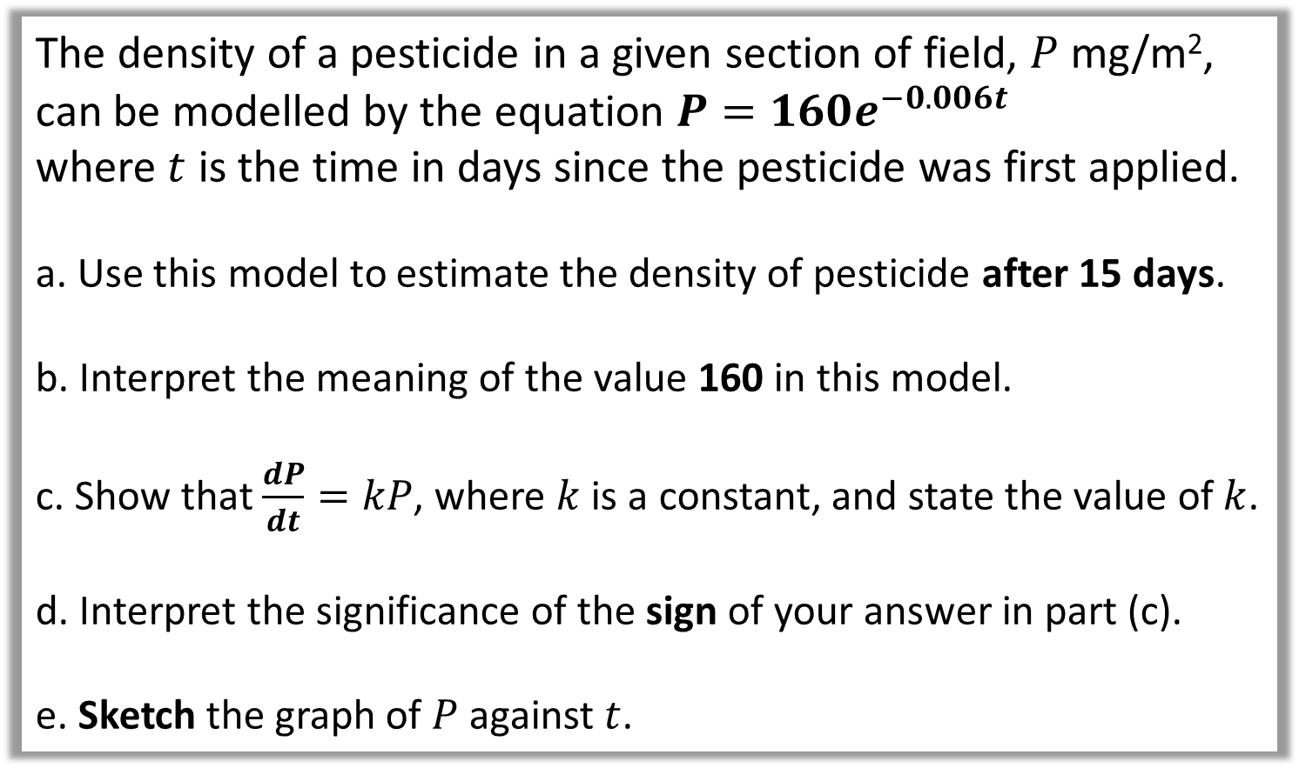
Modelling – Exam Questions
The density of a pesticide in a given section of field, $P$ mg/m²,
can be modelled by the equation $P=160e^{−0.006t}$
where $t$ is the time in days since the pesticide was first applied.
a. Use this model to estimate the density of pesticide after 15 days.
b. Interpret the meaning of the value 160 in this model.
c. Show that $\frac{dP}{dt}=kP$, where $k$ is a constant, and state the value of $k$.
d. Interpret the significance of the sign of your answer in part (c).
e. Sketch the graph of $P$ against $t$.

Slide 4
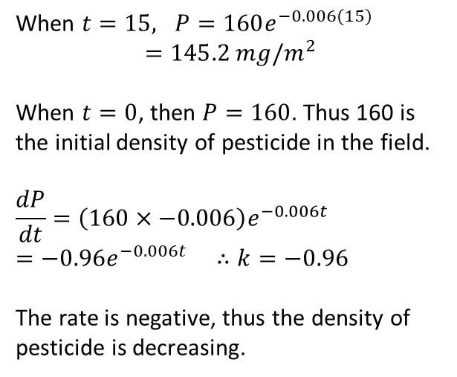
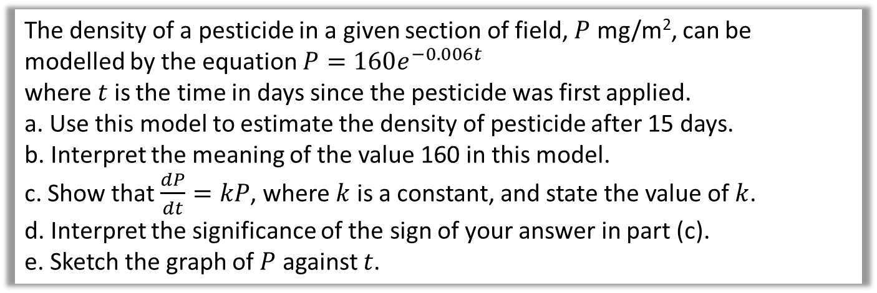


Modelling – Exam Questions
The density of a pesticide in a given section of field, $P$ mg/m², can be modelled by the equation $P=160e^{−0.006t}$
where $t$ is the time in days since the pesticide was first applied.
a. Use this model to estimate the density of pesticide after 15 days.
b. Interpret the meaning of the value 160 in this model.
c. Show that $\frac{dP}{dt}=kP$, where $k$ is a constant, and state the value of $k$.
d. Interpret the significance of the sign of your answer in part (c).
e. Sketch the graph of $P$ against $t$.
a
When $t=15, P=160e^{−0.006(15)}$
$$=145.2 mg/m^{2}$$
When $t=0$, then $P=160$. Thus 160 is the initial density of pesticide in the field.
$$\frac{dP}{dt}=\left(160×−0.006\right)e^{−0.006t} \\ =−0.96e^{−0.006t} ∴k=−0.96$$
The rate is negative, thus the density of pesticide is decreasing.
e
$$P$$
b
160
c
$$t$$
d

Slide 5
Exercise 14C
Pearson Pure Mathematics Year 1/AS
Pages 318-319
Complete before the lesson Ex3B Q2-4
Green Complete Ex3B
Amber Ex3C Q1-6
Red Ex3C Q7-9

Slide 6
Exercise 14H
Pearson Pure Mathematics Year 1/AS
Page 331-333
Complete before the lesson Ex3B Q2-4
Green Complete Ex3B
Amber Ex3C Q1-6
Red Ex3C Q7-9

