Slide 1
Year 2 Applied Mathematics
Regression Correlation and Hypothesis Testing
- Exponential Models
Chapter 1
(Part 1 of 3)

Slide 2
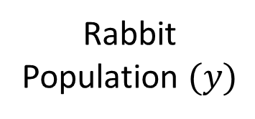
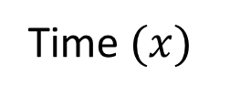
Exponential Regression
Rabbit
Population $(y)$
Time$(x)$
This is not a good regression line for the data. Why not?

Slide 3
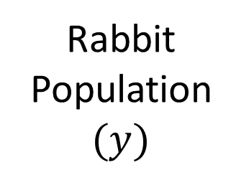
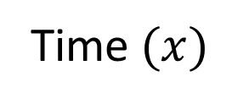

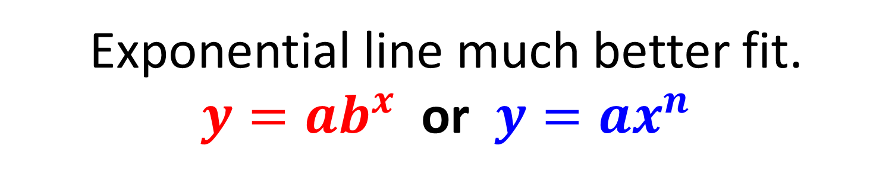
Exponential Regression
Rabbit
Population $(y)$
Time$(x)$
Exponential line much better fit.
$y=ab^{x}$ or $y=ax^{n}$
where $a$, b and $n$ are constants

Slide 4



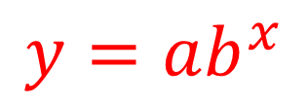


Exponential Regression
$$y=ab^{x}$$
$$\log{y}=\log{a}+x\log{b}$$
$$\log{y}$$
Rabbit population $(y)$
Coding
Time ($x$)
Time ($x$)
You can use logarithms and coding
to examine trends in non-linear data.

Slide 5




Exponential Regression
$$y=ab^{x}$$
Log both sides
$$\log{y}=\log\left(ab^{x}\right)$$
Separate the log(ab^{x})
$$\log{y}=\log{a}+\log{b^{x}}$$
Apply the power law
$$\log{y}=\log{a}+x\log{b}$$

Slide 6
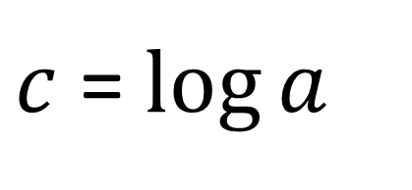
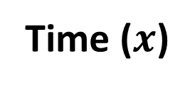
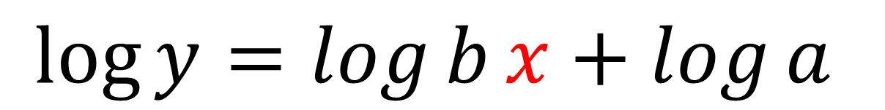

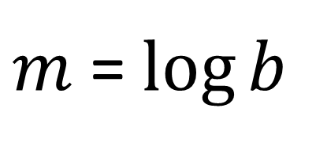

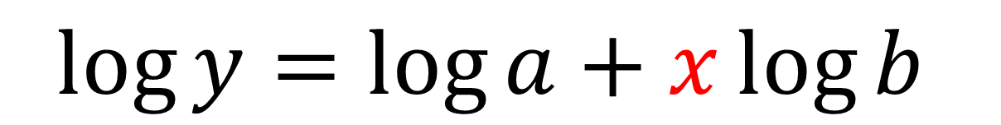
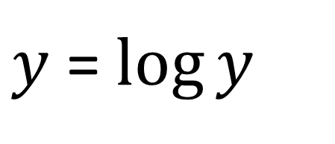
Exponential Regression
$$\log{y}=\log{a}+x\log{b}$$
$$y=mx+c$$
$$\log{y}=\log{b}x+\log{a}$$
$m$ = $\log{b}$
$$\log{y}$$
$c$ = $\log{a}$
$y$ = $\log{y}$
Time ($x$)

Slide 7

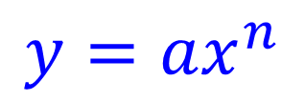
Exponential Regression
$$y=ax^{n}$$
$$\log{y}=\log{a}+n\log{x}$$
$$\log{y}$$
Rabbit population $(y)$
Coding
Time ($x$)
Log x
You can use logarithms and coding
to examine trends in non-linear data.

Slide 8




Exponential Regression
$$y=ax^{n}$$
Log both sides
$$\log{y}=\log\left(ax^{n}\right)$$
Separate the log(ab^{x})
$$\log{y}=\log{a}+\log{x^{n}}$$
Apply the power law
$$\log{y}=\log{a}+n\log{x}$$

Slide 9

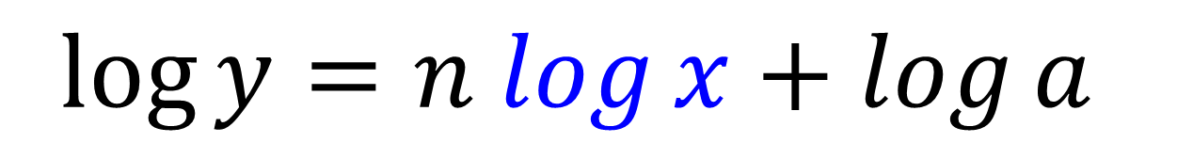

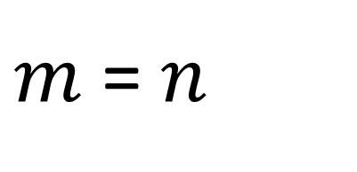
Exponential Regression
$$\log{y}=\log{a}+n\log{x}$$
$$y=mx+c$$
$$\log{y}=n log{x}+\log{a}$$
$m$ = $n$
$$\log{y}$$
$c$ = $\log{a}$
$y$ = $\log{y}$
Log x

Slide 10
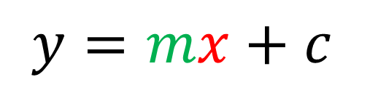
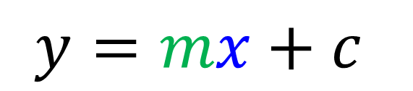

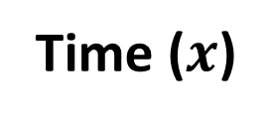



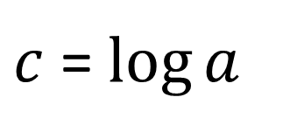
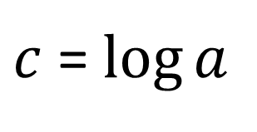
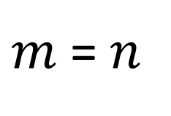
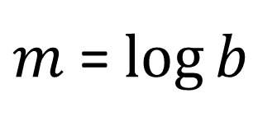
Exponential Regression – Key Concepts
$$\log{y}=\log{a}+n\log{x}$$
$$\log{y}=\log{a}+x\log{b}$$
$$y=mx+c$$
$$y=mx+c$$
$m$ = $n$
$m$ = $\log{b}$
$c$ = $\log{a}$
$c$ = $\log{a}$
$$\log{y}$$
$$\log{y}$$
Log x
Time ($x$)

Slide 11
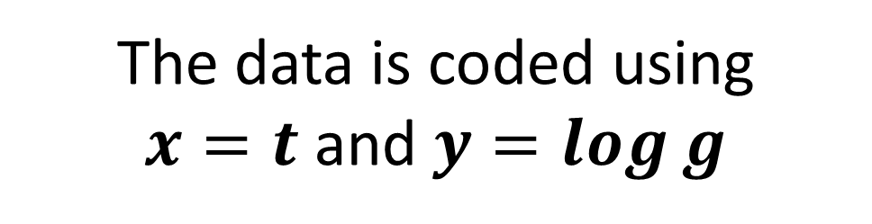
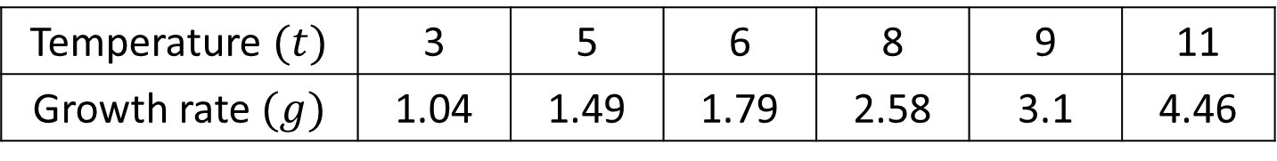
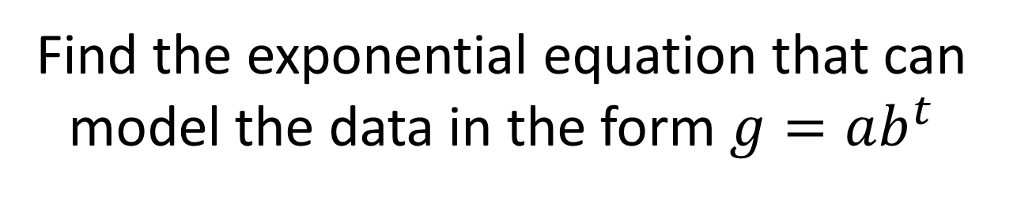
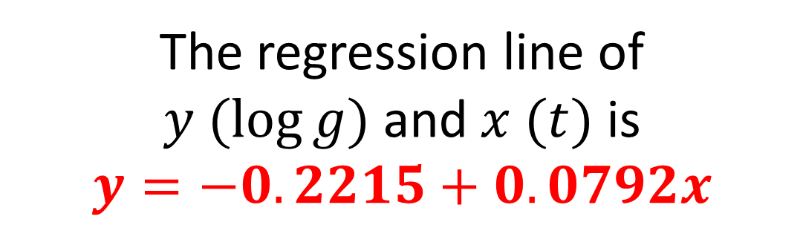
Exponential Regression - Example
Temperature $(t)$ | 3 | 5 | 6 | 8 | 9 | 11
Growth rate $(g)$ | 1.04 | 1.49 | 1.79 | 2.58 | 3.1 | 4.46
The data is coded using
$x=t$ and $y=\log{g}$
The regression line of
$y (log{g)}$ and $x (t)$ is
$$y=−0.2215+0.0792x$$
Find the exponential equation that can model the data in the form $g=ab^{t}$

Slide 12
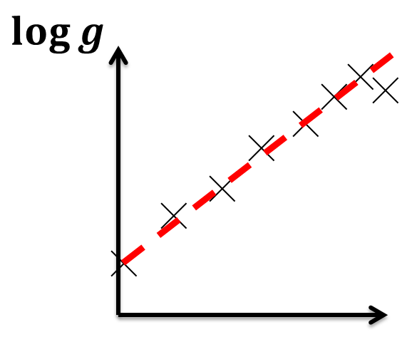

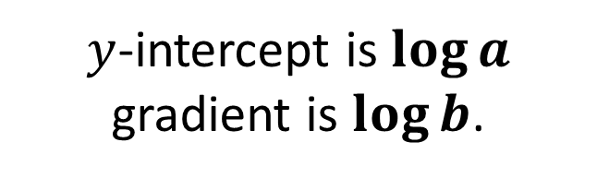

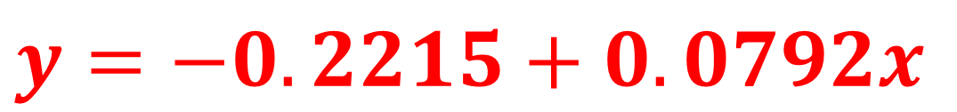
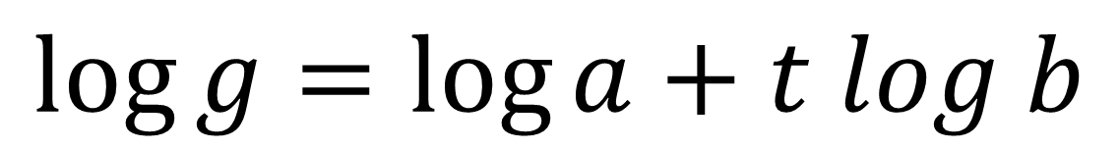
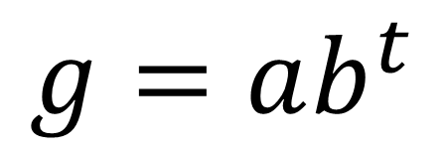
Exponential Regression - Example
$$g=ab^{t}$$
$$\log{g}=\log{a}+t log b$$
$$y=−0.2215+0.0792x$$
$y$-intercept is $\log{a}$
gradient is $\log{b}$.
$$\log{a}=−0.2215$$
$$\log{b}=0.0792$$

Slide 13
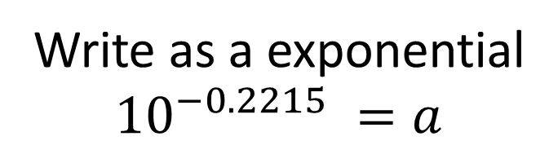





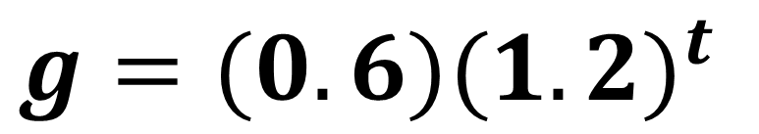

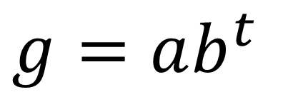
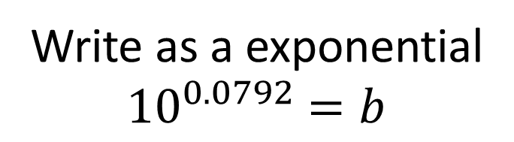
Exponential Regression - Example
$$\log{a}=−0.2215$$
$$\log{b}=0.0792$$
$$\log_{10}{a}=−0.2215$$
$$\log_{10}{b}=0.0792$$
Write as a exponential
$${10}^{−0.2215} =a$$
Write as a exponential
${10}^{0.0792}$ $=b$
$$a=0.600$$
$$b=1.20$$
$g=ab^{t}$
$g=(0.6){(1.2)}^{t}$

Slide 14
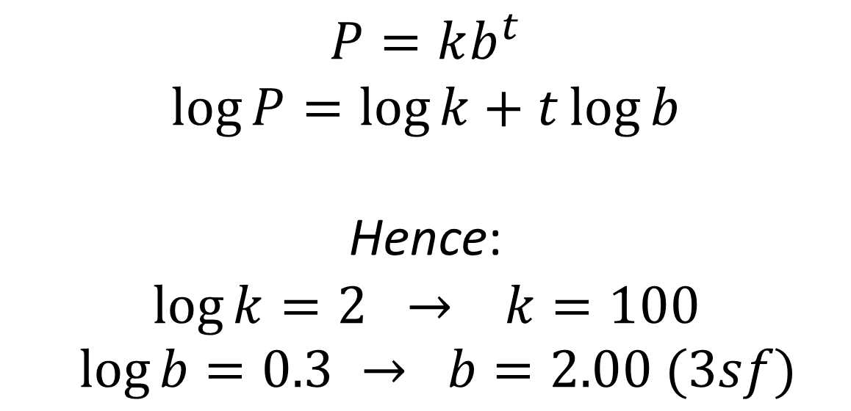
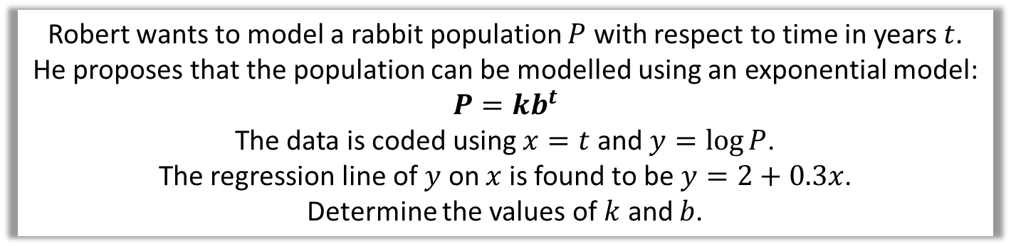
Exponential Regression – Test your understanding
Robert wants to model a rabbit population $P$ with respect to time in years $t$.
He proposes that the population can be modelled using an exponential model:
$$P=kb^{t}$$
The data is coded using $x=t$ and $y=\log{P}$.
The regression line of $y$ on $x$ is found to be $y=2+0.3x$.
Determine the values of $k$ and $b$.
$$P=kb^{t} \\ \log{P}=\log{k}+t\log{b}$$
Hence:
$$\log{k}=2 → k=100 \\ \log{b}=0.3 → b=2.00 (3sf)$$

Slide 15
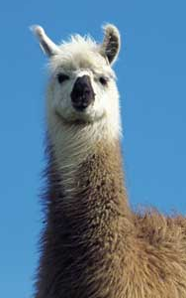
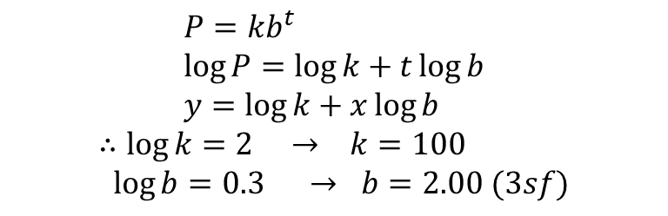
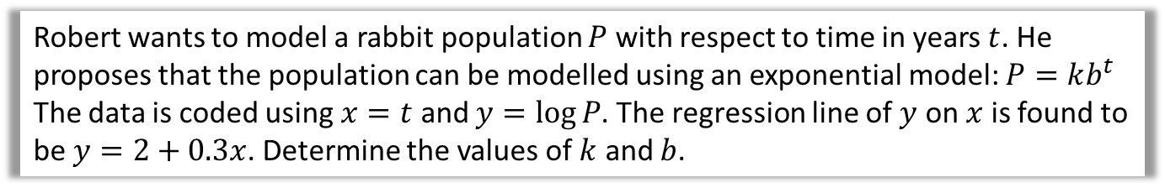
Test Your Understanding
Robert wants to model a rabbit population $P$ with respect to time in years $t$. He proposes that the population can be modelled using an exponential model: $P=kb^{t}$
The data is coded using $x=t$ and $y=\log{P}$. The regression line of $y$ on $x$ is found to be $y=2+0.3x$. Determine the values of $k$ and $b$.
?
$$P=kb^{t} \\ \log{P}=\log{k}+t\log{b} \\ y=\log{k}+x\log{b}$$
$$∴\log{k}=2 → k=100 \\ \log{b}=0.3 → b=2.00 (3sf)$$
Rabbit

Slide 16
Exercise 1A
Pearson Pure Mathematics Year 1/AS
Pages 3-5
Complete before the lesson Q1-3
In Class:
Green Q4&5
Amber Q6&7
Red Q8 & challenge

