Slide 1
Year 1 Pure Mathematics
Quadratics
- Solving Quadratics
Chapter 2
(Part 1 of 4)

Slide 2
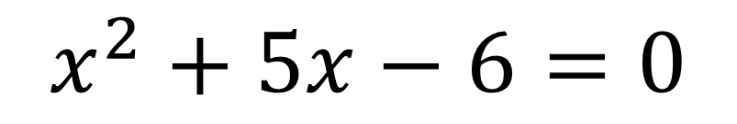
Solving Quadratic Equations
$$x^{2}+5x−6=0$$
There are three ways of solving a quadratic equation:
- Factorising
- Quadratic Formula
- Completing the square

Slide 3
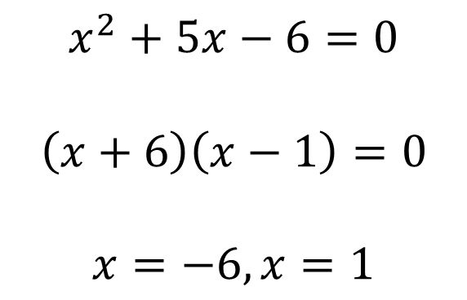
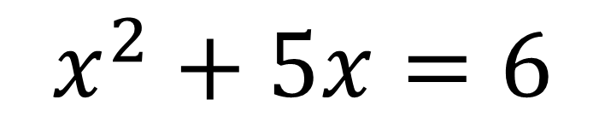
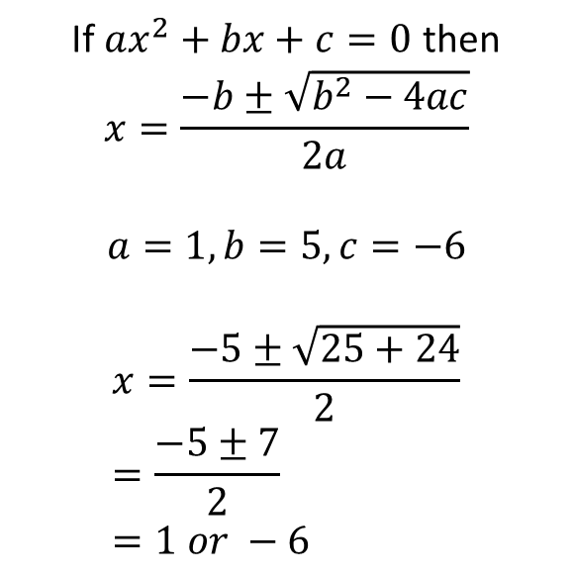
Solving Quadratic Equations
$$x^{2}+5x=6$$
By factorisation
Using the quadratic formula.
If $ax^{2}+bx+c=0$ then
$$x=\frac{−b±\sqrt{b^{2}−4ac}}{2a}$$
$$a=1, b=5, c=−6$$
$$x=\frac{−5±\sqrt{25+24}}{2} \\ =\frac{−5±7}{2} \\ =1 or −6$$
$$x^{2}+5x−6=0$$
$$\left(x+6\right)\left(x−1\right)=0$$
$$x=−6, x=1$$

Slide 4
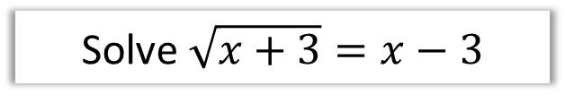
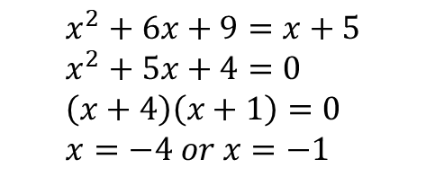
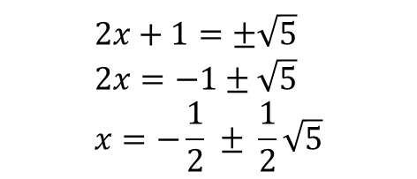
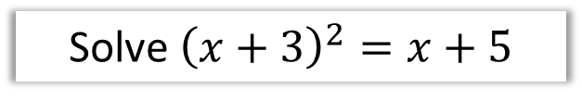
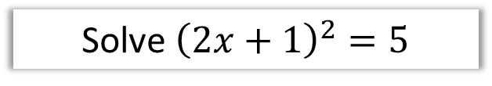
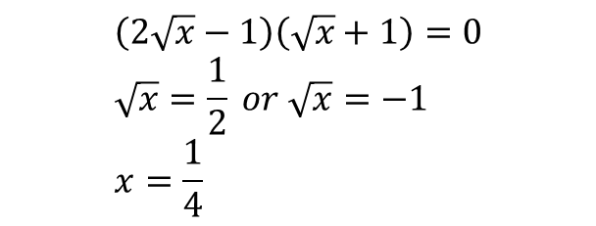
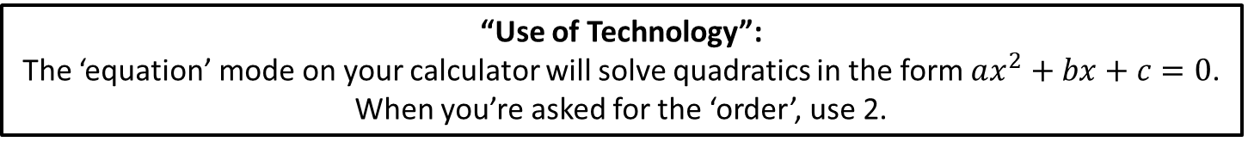
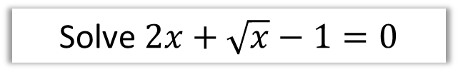
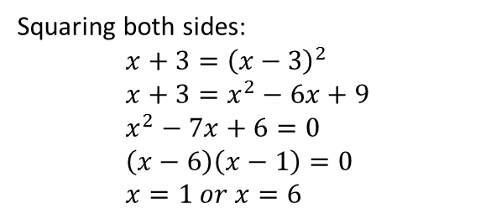
Solving Quadratic Equations
Solve ${\left(x+3\right)}^{2}=x+5$
Solve ${\left(2x+1\right)}^{2}=5$
$$x^{2}+6x+9=x+5 \\ x^{2}+5x+4=0 \\ \left(x+4\right)\left(x+1\right)=0 \\ x=−4 or x=−1$$
$$2x+1=±\sqrt{5} \\ 2x=−1±\sqrt{5} \\ x=−\frac{1}{2} ± \frac{1}{2}\sqrt{5}$$
Solve $\sqrt{x+3}=x−3$
Solve $2x+\sqrt{x}−1=0$
Squaring both sides:
$$x+3={\left(x−3\right)}^{2} \\ x+3=x^{2}−6x+9 \\ x^{2}−7x+6=0 \\ \left(x−6\right)\left(x−1\right)=0 \\ x=1 or x=6$$
$$\left(2\sqrt{x}−1\right)\left(\sqrt{x}+1\right)=0 \\ \sqrt{x}=\frac{1}{2} or \sqrt{x}=−1 \\ x=\frac{1}{4}$$
“Use of Technology”:
The ‘equation’ mode on your calculator will solve quadratics in the form $ax^{2}+bx+c=0$.
When you’re asked for the ‘order’, use 2.

Slide 5
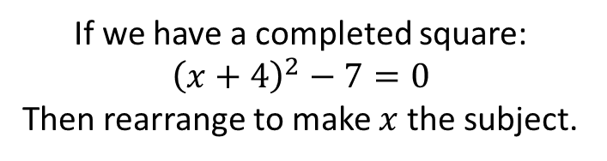
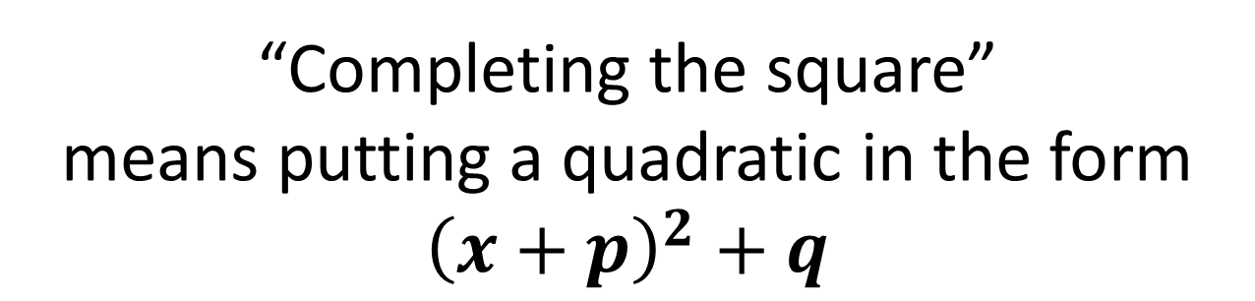
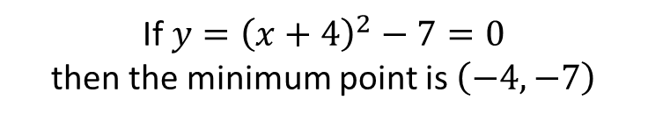
Completing the Square
“Completing the square”
means putting a quadratic in the form
$${\left(x+p\right)}^{2}+q$$
Why use completing the square?
a. Solving Quadratics
b. Sketching Quadratics
If we have a completed square:
$${\left(x+4\right)}^{2}−7=0$$
Then rearrange to make $x$ the subject.
If $y={\left(x+4\right)}^{2}−7=0$
then the minimum point is $\left(−4,−7\right)$

Slide 6
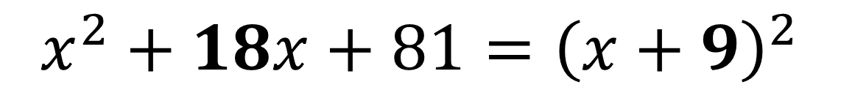
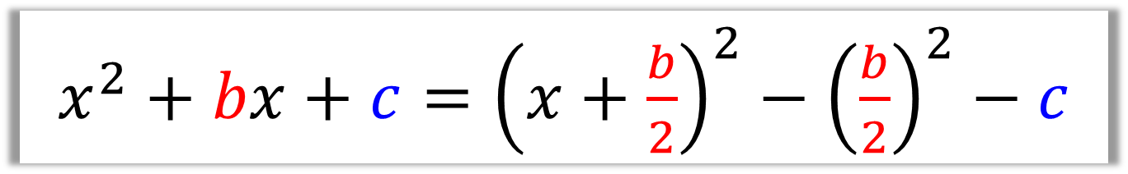
Completing the Square
$x^{2}+bx+c={\left(x+\frac{b}{2}\right)}^{2}−{\left(\frac{b}{2}\right)}^{2}$ $−$ $c$
$$x^{2}+18x+81={\left(x+9\right)}^{2}$$
$x^{2}+18x+81={\left(x+9\right)}^{2}$ $− 81$

Slide 7
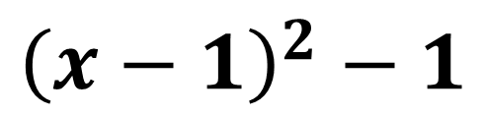
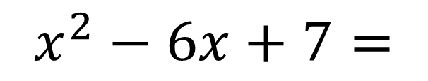
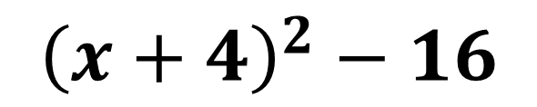
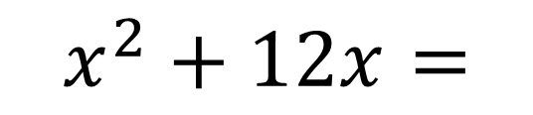
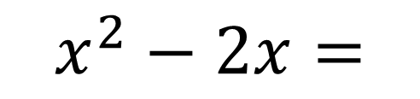
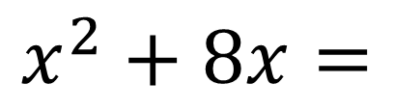
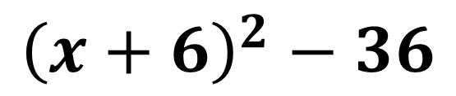
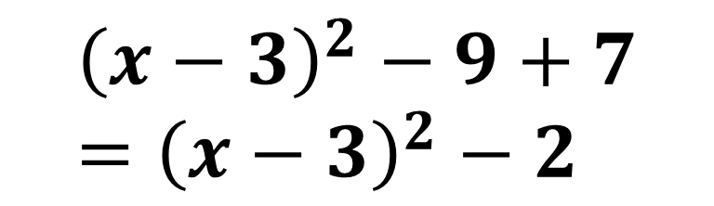
Completing the Square
$$x^{2}+12x=$$
$${\left(x+6\right)}^{2}−36$$
$$x^{2}+8x=$$
$${\left(x+4\right)}^{2}−16$$
$$x^{2}−2x=$$
$${\left(x−1\right)}^{2}−1$$
$$x^{2}−6x+7=$$
$${\left(x−3\right)}^{2}−9+7 \\ ={\left(x−3\right)}^{2}−2$$

Slide 8
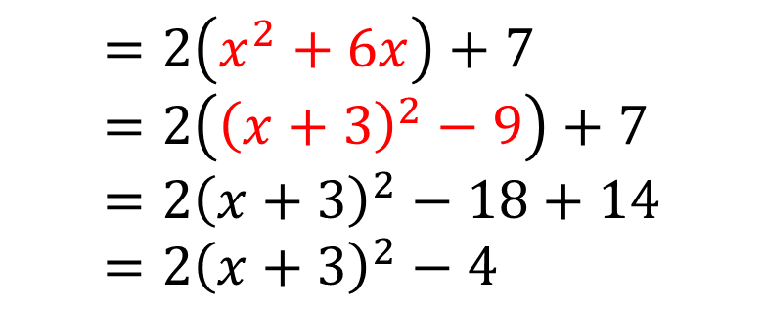
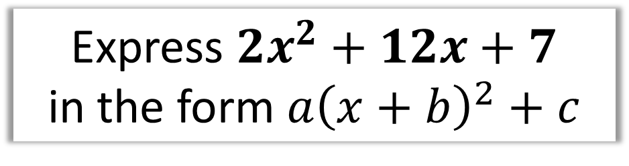
Completing the Square
Express $2x^{2}+12x+7$
in the form $a{\left(x+b\right)}^{2}+c$
$$=2\left(x^{2}+6x\right)+7 \\ =2\left({\left(x+3\right)}^{2}−9\right)+7 \\ =2{\left(x+3\right)}^{2}−18+14 \\ =2{\left(x+3\right)}^{2}−4$$
Factorise
Complete the square inside the bracket
Expand out outer bracket.

Slide 9
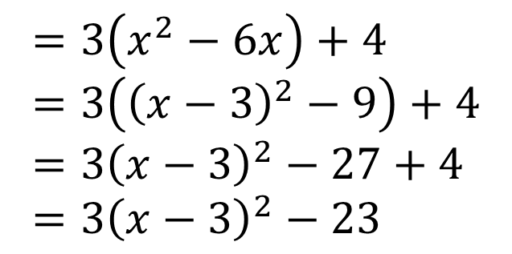
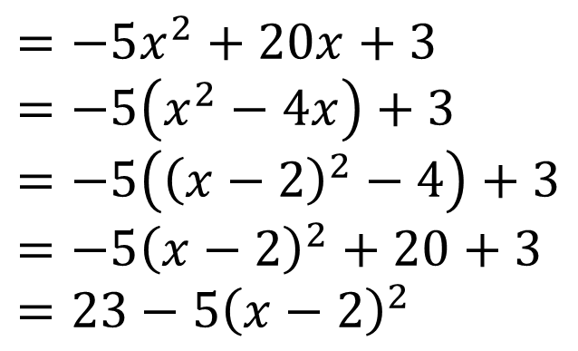
Completing the Square
Express $3x^{2}−18x+4$ in the form $a{\left(x+b\right)}^{2}+c$
$$=3\left(x^{2}−6x\right)+4 \\ =3\left({\left(x−3\right)}^{2}−9\right)+4 \\ =3{\left(x−3\right)}^{2}−27+4 \\ =3{\left(x−3\right)}^{2}−23$$
Express $20x−5x^{2}+3$ in the form $a−b{\left(x+c\right)}^{2}$
$$=−5x^{2}+20x+3 \\ =−5\left(x^{2}−4x\right)+3 \\ =−5\left({\left(x−2\right)}^{2}−4\right)+3 \\ =−5{\left(x−2\right)}^{2}+20+3 \\ =23−5{\left(x−2\right)}^{2}$$

Slide 10
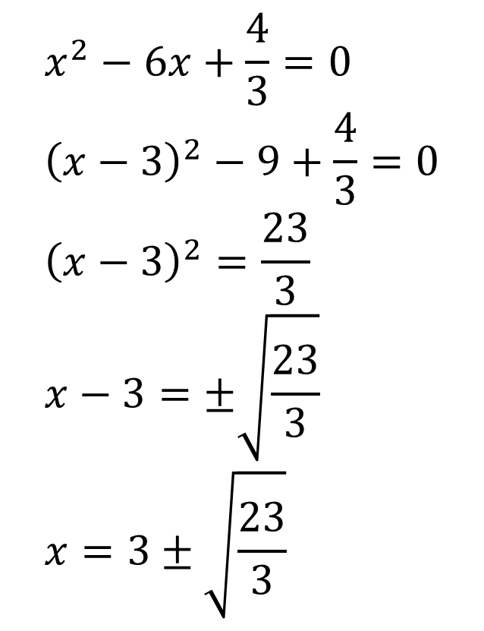
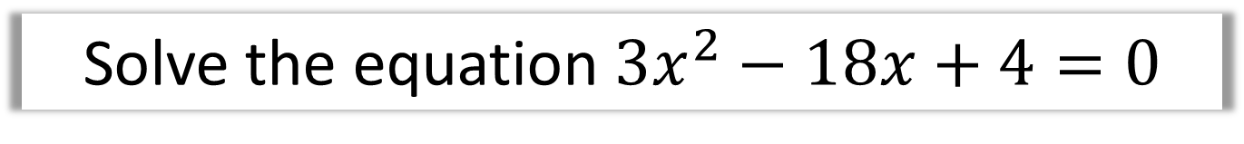
Solving by Completing the Square
Solve the equation$3x^{2}−18x+4=0$
$$x^{2}−6x+\frac{4}{3}=0 \\ {\left(x−3\right)}^{2}−9+\frac{4}{3}=0 \\ {\left(x−3\right)}^{2}=\frac{23}{3} \\ x−3=±\sqrt{\frac{23}{3}} \\ x=3±\sqrt{\frac{23}{3}}$$

Slide 11
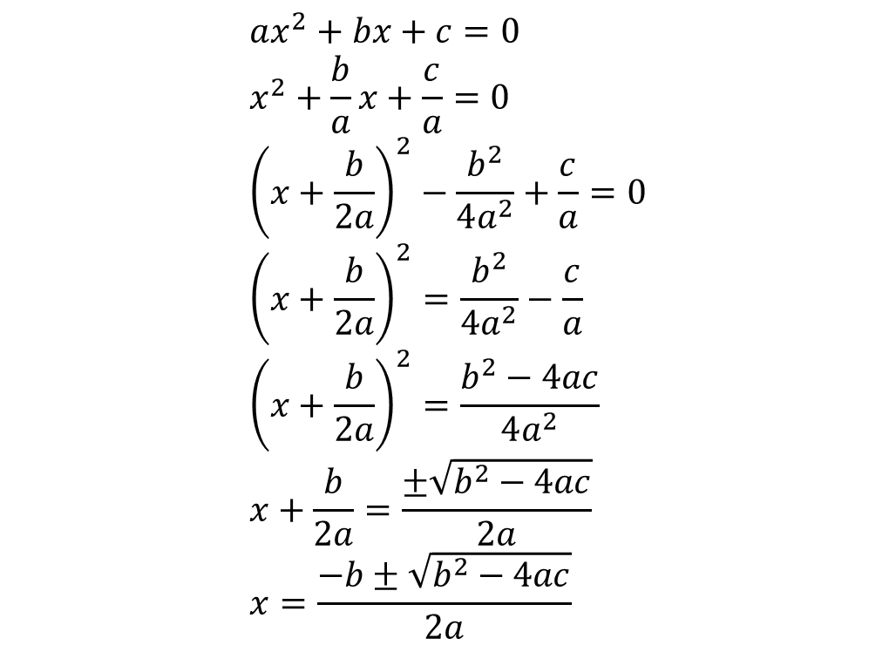
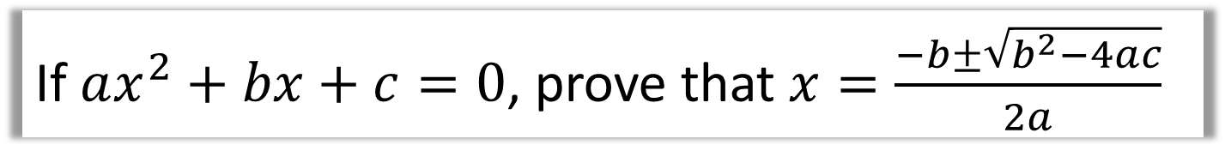
Proving the Quadratic Formula
If $ax^{2}+bx+c=0$, prove that $x=\frac{−b±\sqrt{b^{2}−4ac}}{2a}$
$$ax^{2}+bx+c=0 \\ x^{2}+\frac{b}{a}x+\frac{c}{a}=0 \\ {\left(x+\frac{b}{2a}\right)}^{2}−\frac{b^{2}}{4a^{2}}+\frac{c}{a}=0 \\ {\left(x+\frac{b}{2a}\right)}^{2}=\frac{b^{2}}{4a^{2}}−\frac{c}{a} \\ {\left(x+\frac{b}{2a}\right)}^{2}=\frac{b^{2}−4ac}{4a^{2}} \\ x+\frac{b}{2a}=\frac{±\sqrt{b^{2}−4ac}}{2a} \\ x=\frac{−b±\sqrt{b^{2}−4ac}}{2a}$$
Hint: Complete the square.

Slide 12
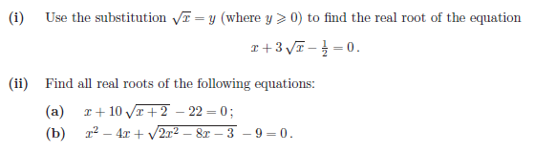
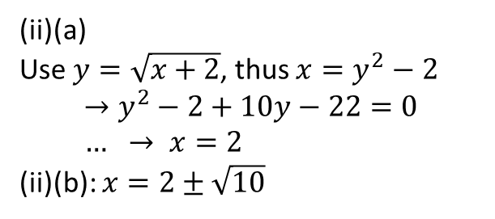

Exercise 2A/2B
Complete before the lesson Ex1A
In Class:
Green Q1-2
Amber Q3-5
Red Extension
Pearson Pure Mathematics Year 1/AS Pages 20-22
Extension: (Full Database: http://www.drfrostmaths.com/resources/resource.php?rid=268 )
1
$$y^{2}+3y−\frac{1}{2}=0 \\ 2y^{2}+6y−1=0 \\ y=\frac{−6±\sqrt{36+8}}{4} \\ \sqrt{x}=−\frac{3}{2}±\frac{\sqrt{11}}{2}$$
Since $\sqrt{x}>0$:
$$\sqrt{x}=−\frac{3}{2}+\frac{\sqrt{11}}{2} \\ x=5−\frac{3}{2}\sqrt{11}$$
? i
? ii(a)
(ii)(a)
Use $y=\sqrt{x+2}$, thus $x=y^{2}−2$
$$→y^{2}−2+10y−22=0 \\ … → x=2$$
(ii)(b): $x=2±\sqrt{10}$
? ii(b)

Slide 13
Exercise 2C/2D
Pearson Pure Mathematics Year 1/AS
Page 23-24
Complete before the lesson Ex2A Q3-5 & Ex2B Q3-4 & Challenge
In Class:
Green Ex2C Q3-5
Amber Ex2D Q1-2
Red Ex2D Q3-4 & Challenge & Ext from previous Dr Frost Slide (duplicated next)

Slide 14
Exercise 2A/2B
Pearson Pure Mathematics Year 1/AS
Pages 20-22
Extension: (Full Database: http://www.drfrostmaths.com/resources/resource.php?rid=268 )
1
$$y^{2}+3y−\frac{1}{2}=0 \\ 2y^{2}+6y−1=0 \\ y=\frac{−6±\sqrt{36+8}}{4} \\ \sqrt{x}=−\frac{3}{2}±\frac{\sqrt{11}}{2}$$
Since $\sqrt{x}>0$:
$$\sqrt{x}=−\frac{3}{2}+\frac{\sqrt{11}}{2} \\ x=5−\frac{3}{2}\sqrt{11}$$
? i
? ii(a)
(ii)(a)
Use $y=\sqrt{x+2}$, thus $x=y^{2}−2$
$$→y^{2}−2+10y−22=0 \\ … → x=2$$
(ii)(b): $x=2±\sqrt{10}$
? ii(b)

