Slide 1
Year 2 Applied Mathematics
Application of Forces
- Statics on Slopes
Chapter 7
(Part 2 of 5)

Slide 2
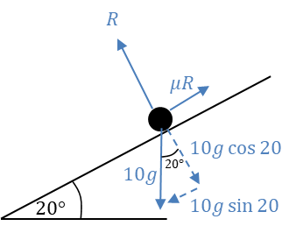
Statics on Slopes
When solving statics on a slope,
set up one perpendicular to the slope equation and
set up one parallel to the slope equation.
If too many unknowns then
solve the equations simultaneously.

Slide 3



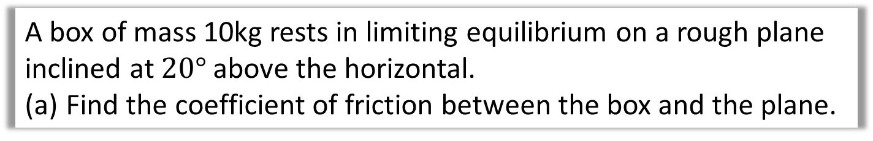
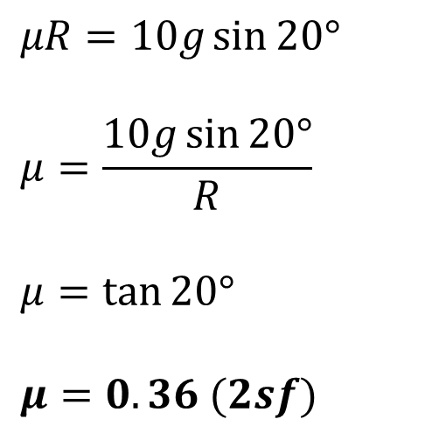

Statics on Slopes
A box of mass 10kg rests in limiting equilibrium on a rough plane inclined at $20°$ above the horizontal.
Find the coefficient of friction between the box and the plane.
$R\left(Parallel to slope\right):$
$$μR=10g\sin{20°}$$
$$μ=\frac{10g\sin{20°}}{R}$$
$$μ=\tan{20°}$$
$$μ=0.36 (2sf)$$
$$=\frac{10g\sin{20°}}{10g\cos{20°}}$$
$$R\left(Veritcal to slope\right):$$
$$R=10g\cos{20°}$$

Slide 4
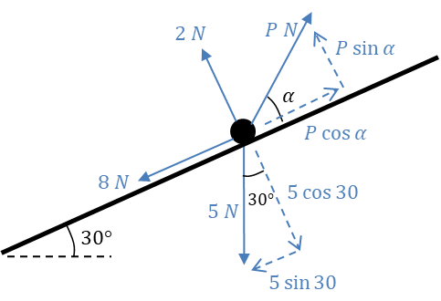
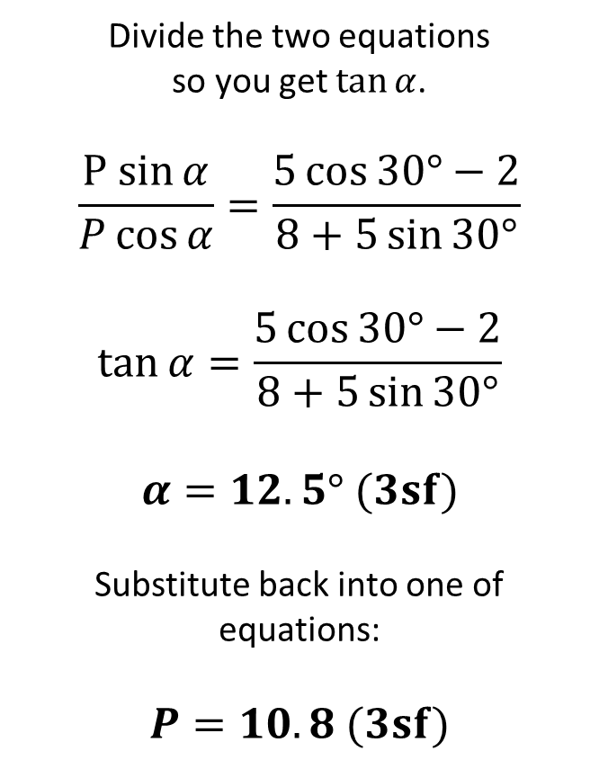
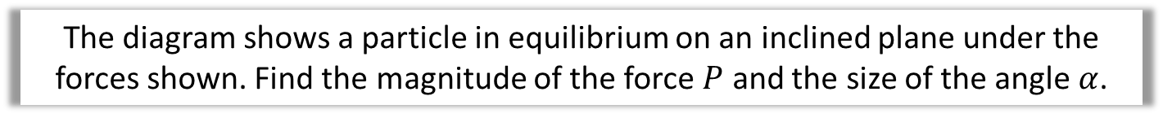

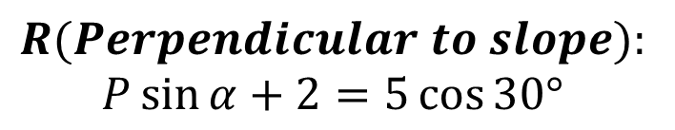
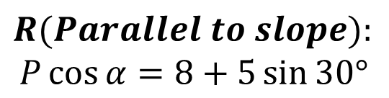
Statics on a Slope – Find a missing angle
The diagram shows a particle in equilibrium on an inclined plane under the forces shown. Find the magnitude of the force $P$ and the size of the angle $α$.
Divide the two equations
so you get $\tan{α}$.
$$\frac{P sin{α}}{P\cos{α}}=\frac{5\cos{30°}−2}{8+5\sin{30°}}$$
$$\tan{α}=\frac{5\cos{30°}−2}{8+5\sin{30°}}$$
$$α=12.5° (3sf)$$
Substitute back into one of equations:
$$P=10.8 (3sf)$$
$$R(Parallel to slope):$$
$$P\cos{α}=8+5\sin{30°}$$
$$R(Perpendicular to slope):$$
$$P\sin{α}+2=5\cos{30°}$$
$P\sin{α}=5\cos{30° −20°}$

Slide 5
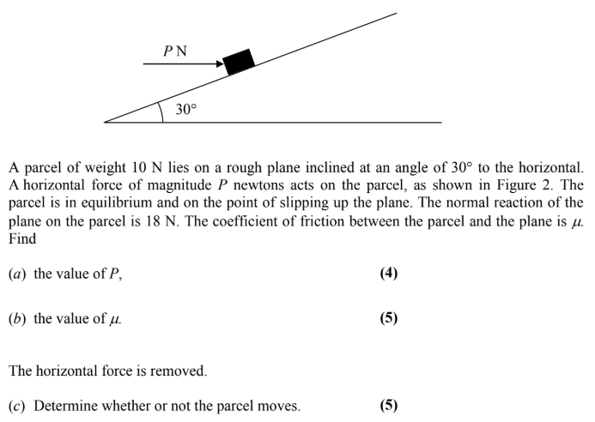
Statics on Slopes – Exam Questions

Slide 6
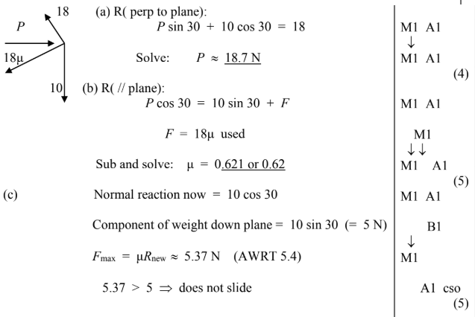
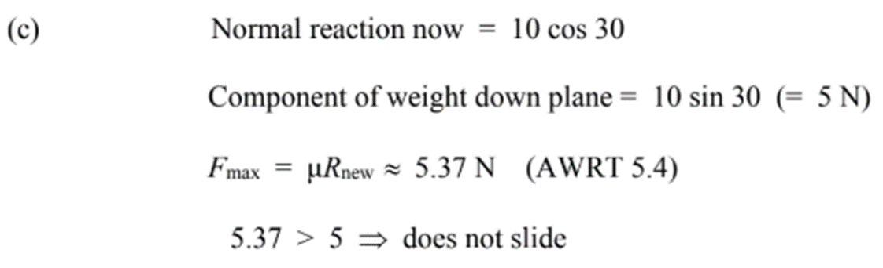
Statics on Slopes – Exam Questions Answers

Slide 7
Exercise 7C
Pearson Stats/Mechanics Year 2
Pages 139-142
Complete before the lesson Q1-2
In Class:
Green Q3-5
Amber Q6-8
Red Q9-13

