Slide 1
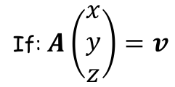
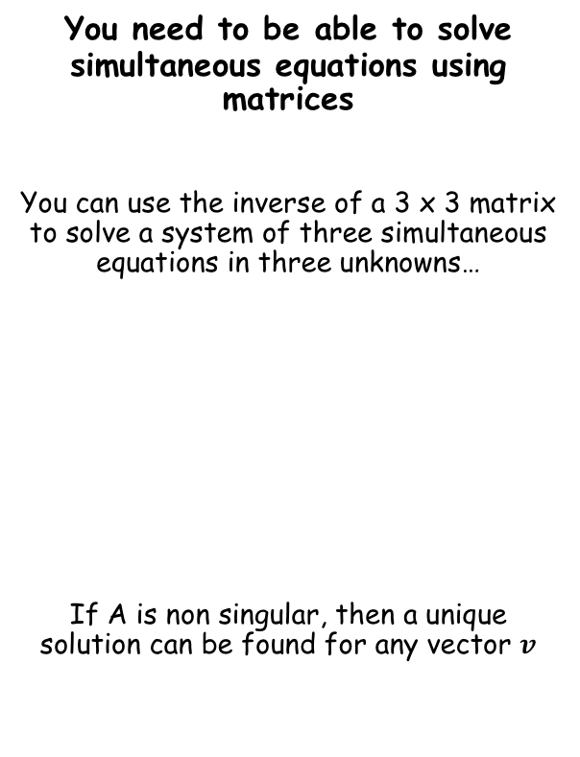

Matrices
You need to be able to solve simultaneous equations using matrices
You can use the inverse of a 3 x 3 matrix to solve a system of three simultaneous equations in three unknowns…
If A is non singular, then a unique solution can be found for any vector $v$
If: $A\left(\begin{matrix}x \\ y \\ z\end{matrix}\right)=v$
Then: $\left(\begin{matrix}x \\ y \\ z\end{matrix}\right)=A^{−1}v$
6F

Slide 2

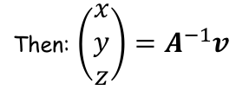
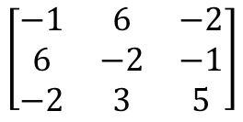
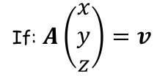



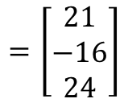
Matrices
If: $A\left(\begin{matrix}x \\ y \\ z\end{matrix}\right)=v$
Then: $\left(\begin{matrix}x \\ y \\ z\end{matrix}\right)=A^{−1}v$
Note that multiplying the first row by the column will give the first equation…
You need to be able to solve simultaneous equations using matrices
Use an inverse matrix to solve the simultaneous equations:
You need to start by writing this information as a matrix calculation…
$$\left[\begin{matrix}−1 & 6 & −2 \\ 6 & −2 & −1 \\ −2 & 3 & 5\end{matrix}\right]$$
$$\left[\begin{matrix}x \\ y \\ z\end{matrix}\right]$$
$$=\left[\begin{matrix}21 \\ −16 \\ 24\end{matrix}\right]$$
Write the coefficients as a grid (ensure the unknowns are in the same order on each equation first!)
Write the 3 unknowns as a column matrix (following the same order they are in the equations)
Write the 3 answers as a column matrix as well
$$−x+6y−2z=21$$
$$6x−2y−z=−16$$
$$−2x+3y+5z=24$$
6F

Slide 3

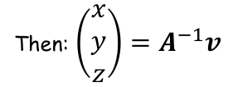
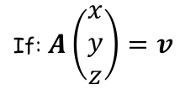
Matrices
If: $A\left(\begin{matrix}x \\ y \\ z\end{matrix}\right)=v$
Then: $\left(\begin{matrix}x \\ y \\ z\end{matrix}\right)=A^{−1}v$
You need to be able to solve simultaneous equations using matrices
Use an inverse matrix to solve the simultaneous equations:
$$\left[\begin{matrix}−1 & 6 & −2 \\ 6 & −2 & −1 \\ −2 & 3 & 5\end{matrix}\right]$$
$$\left[\begin{matrix}x \\ y \\ z\end{matrix}\right]$$
$$=\left[\begin{matrix}21 \\ −16 \\ 24\end{matrix}\right]$$
If: $A\left(\begin{matrix}x \\ y \\ z\end{matrix}\right)=v$
$$−x+6y−2z=21$$
$$6x−2y−z=−16$$
Then: $\left(\begin{matrix}x \\ y \\ z\end{matrix}\right)=A^{−1}v$
$$−2x+3y+5z=24$$
So we need to find the inverse of $A$, and then multiply that by the answer matrix $v$
6F

Slide 4
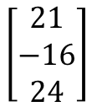
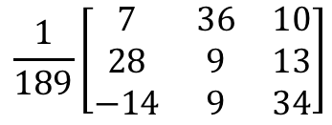
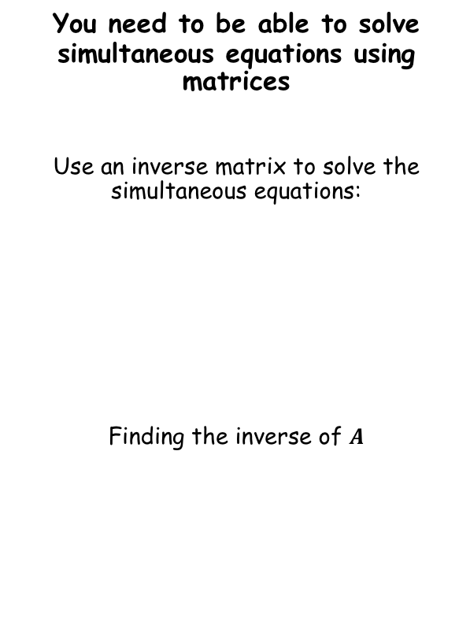


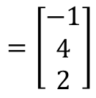
Matrices
If: $A\left(\begin{matrix}x \\ y \\ z\end{matrix}\right)=v$
Then: $\left(\begin{matrix}x \\ y \\ z\end{matrix}\right)=A^{−1}v$
You need to be able to solve simultaneous equations using matrices
Use an inverse matrix to solve the simultaneous equations:
Finding the inverse of $A$
$$\left[\begin{matrix}−1 & 6 & −2 \\ 6 & −2 & −1 \\ −2 & 3 & 5\end{matrix}\right]$$
$$\left[\begin{matrix}x \\ y \\ z\end{matrix}\right]$$
$$=\left[\begin{matrix}21 \\ −16 \\ 24\end{matrix}\right]$$
Using your calculator will give…
$$\frac{1}{189}\left[\begin{matrix}7 & 36 & 10 \\ 28 & 9 & 13 \\ −14 & 9 & 34\end{matrix}\right]$$
$$−x+6y−2z=21$$
We need to multiply this by the answer matrix
$$6x−2y−z=−16$$
$$\frac{1}{189}\left[\begin{matrix}7 & 36 & 10 \\ 28 & 9 & 13 \\ −14 & 9 & 34\end{matrix}\right]$$
$$\left[\begin{matrix}21 \\ −16 \\ 24\end{matrix}\right]$$
$$−2x+3y+5z=24$$
You can use your calculator again (just make it clear what steps you are taking…)
$$=\left[\begin{matrix}−1 \\ 4 \\ 2\end{matrix}\right]$$
So $x=−1$, $y=4$ and $z=2$
6F

Slide 5


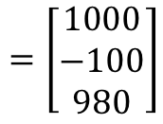






Matrices
If: $A\left(\begin{matrix}x \\ y \\ z\end{matrix}\right)=v$
Then: $\left(\begin{matrix}x \\ y \\ z\end{matrix}\right)=A^{−1}v$
You need to be able to solve simultaneous equations using matrices
A colony of 1000 mole rats is made up of adult males, adult females, and youngsters. Originally there were 100 more adult females than adult males.
After one year, the number of adult males had increased by 2%, the number of adult females had increased by 3%, the number of youngsters had decreased by 4%, and the total number of mole rats had decreased by 20.
Find out how many of each type of mole rat were originally in the colony.
Start by setting up simultaneous equations…
$x=$ original adult males
$y=$ original adult females
$z=$ original youngsters
$$x+y+z=1000$$
$$x−y=−100$$
$$1.02x+1.03y+0.96z=980$$
Now convert these to matrices…
$$\left[\begin{matrix}1 & 1 & 1 \\ 1 & −1 & 0 \\ 1.02 & 1.03 & 0.96\end{matrix}\right]$$
$$\left[\begin{matrix}x \\ y \\ z\end{matrix}\right]$$
$$=\left[\begin{matrix}1000 \\ −100 \\ 980\end{matrix}\right]$$
As before, we now need to find the inverse of the original matrix, and multiply it by the answers…
6F

Slide 6
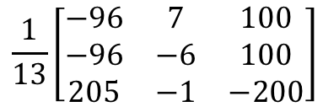
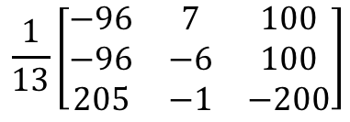
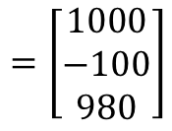

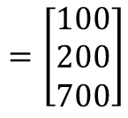

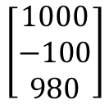
Matrices
If: $A\left(\begin{matrix}x \\ y \\ z\end{matrix}\right)=v$
Then: $\left(\begin{matrix}x \\ y \\ z\end{matrix}\right)=A^{−1}v$
You need to be able to solve simultaneous equations using matrices
A colony of 1000 mole rats is made up of adult males, adult females, and youngsters. Originally there were 100 more adult females than adult males.
After one year, the number of adult males had increased by 2%, the number of adult females had increased by 3%, the number of youngsters had decreased by 4%, and the total number of mole rats had decreased by 20.
Find out how many of each type of mole rat were originally in the colony.
$$\left[\begin{matrix}1 & 1 & 1 \\ 1 & −1 & 0 \\ 1.02 & 1.03 & 0.96\end{matrix}\right]$$
$$\left[\begin{matrix}x \\ y \\ z\end{matrix}\right]$$
$$=\left[\begin{matrix}1000 \\ −100 \\ 980\end{matrix}\right]$$
The inverse of the original matrix can be found using your calculator
$$\frac{1}{13}\left[\begin{matrix}−96 & 7 & 100 \\ −96 & −6 & 100 \\ 205 & −1 & −200\end{matrix}\right]$$
We need to multiply this by the answer matrix
$$\frac{1}{13}\left[\begin{matrix}−96 & 7 & 100 \\ −96 & −6 & 100 \\ 205 & −1 & −200\end{matrix}\right]$$
$$\left[\begin{matrix}1000 \\ −100 \\ 980\end{matrix}\right]$$
You can use your calculator again (just make it clear what steps you are taking…)
$$=\left[\begin{matrix}100 \\ 200 \\ 700\end{matrix}\right]$$
So originally there were 100 adult males, 200 adult females, and 700 youngsters
6F

Slide 7
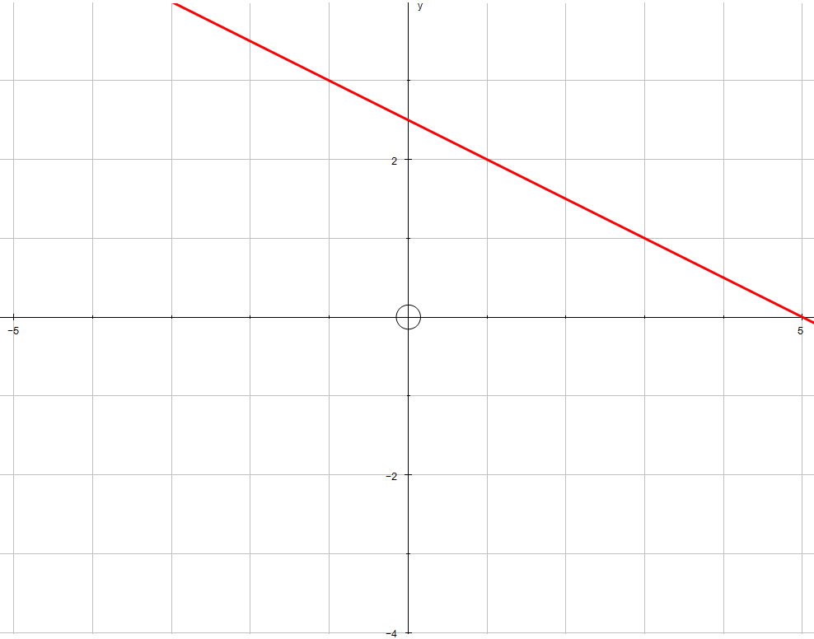
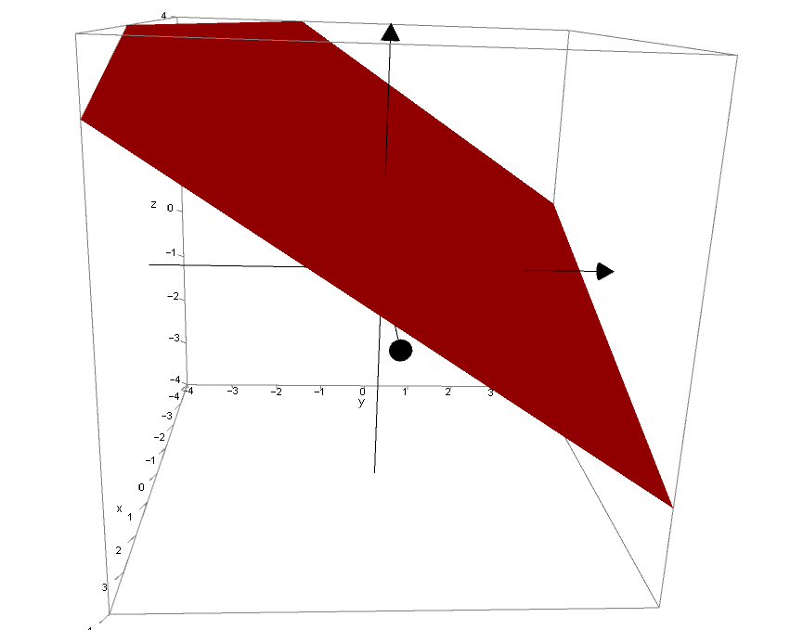













Matrices
If: $A\left(\begin{matrix}x \\ y \\ z\end{matrix}\right)=v$
Then: $\left(\begin{matrix}x \\ y \\ z\end{matrix}\right)=A^{−1}v$
$$y$$
$$4$$
You need to be able to solve simultaneous equations using matrices
When you have 2 simultaneous equations, you will have seen that the solutions can be modelled as the location on a set of axes where the graphs of each equation intersect.
With 3 equations and 3 unknowns, the situation can be more complicated, and will be modelled in 3D.
When an equation in 3 unknowns is plotted, it forms a plane, rather than just a line.
For example…
$$2$$
$$2x+4y=10$$
$$−5$$
$$5$$
$$x$$
$$−2$$
$$−4$$
$$y$$
$$x$$
$$z$$
LINK to Autograph file
$$2x+4y+6z=10$$
6F

Slide 8
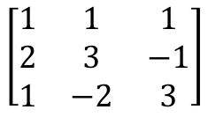

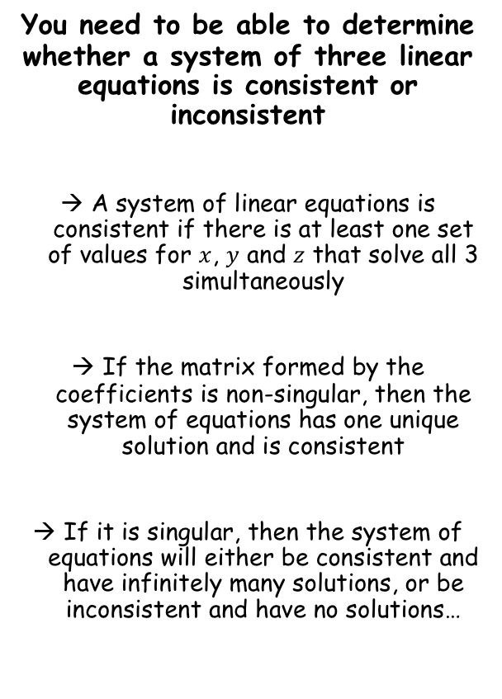



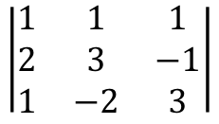
Matrices
If: $A\left(\begin{matrix}x \\ y \\ z\end{matrix}\right)=v$
Then: $\left(\begin{matrix}x \\ y \\ z\end{matrix}\right)=A^{−1}v$
$$x+y+z=2$$
You need to be able to determine whether a system of three linear equations is consistent or inconsistent
A system of linear equations is consistent if there is at least one set of values for $x$, $y$ and $z$ that solve all 3 simultaneously
If the matrix formed by the coefficients is non-singular, then the system of equations has one unique solution and is consistent
If it is singular, then the system of equations will either be consistent and have infinitely many solutions, or be inconsistent and have no solutions…
$$2x+3y−z=13$$
$$x−2y+3z=−11$$
Write as a matrix
$$\left[\begin{matrix}1 & 1 & 1 \\ 2 & 3 & −1 \\ 1 & −2 & 3\end{matrix}\right]$$
We need to find the determinant of this (use your calculator)
$$\left|\begin{matrix}1 & 1 & 1 \\ 2 & 3 & −1 \\ 1 & −2 & 3\end{matrix}\right|$$
Calculate
$$=−7$$
So this matrix is non-singular
→ This means that there will be one unique solution
6F

Slide 9
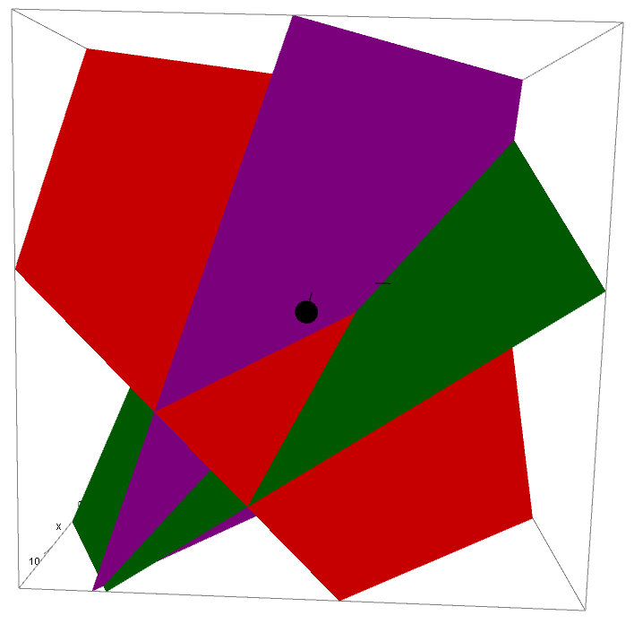
Matrices
If: $A\left(\begin{matrix}x \\ y \\ z\end{matrix}\right)=v$
Then: $\left(\begin{matrix}x \\ y \\ z\end{matrix}\right)=A^{−1}v$
Non-singular - One solution for x, y and z
$$x+y+z=2$$
You need to be able to determine whether a system of three linear equations is consistent or inconsistent
A system of linear equations is consistent if there is at least one set of values for $x$, $y$ and $z$ that solve all 3 simultaneously
If the matrix formed by the coefficients is non-singular, then the system of equations has one unique solution and is consistent
If it is singular, then the system of equations will either be consistent and have infinitely many solutions, or be inconsistent and have no solutions…
LINK to Autograph file
$$2x+3y−z=13$$
$$x−2y+3z=−11$$
6F

Slide 10
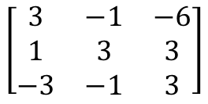




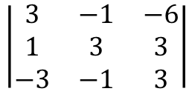
Matrices
If: $A\left(\begin{matrix}x \\ y \\ z\end{matrix}\right)=v$
Then: $\left(\begin{matrix}x \\ y \\ z\end{matrix}\right)=A^{−1}v$
You need to be able to determine whether a system of three linear equations is consistent or inconsistent
A system of linear equations is consistent if there is at least one set of values for $x$, $y$ and $z$ that solve all 3 simultaneously
If the matrix formed by the coefficients is non-singular, then the system of equations has one unique solution and is consistent
If it is singular, then the system of equations will either be consistent and have infinitely many solutions, or be inconsistent and have no solutions…
$$3x−y−6z=1$$
$$x+3y+3z=2$$
$$−3x−y+3z=−2$$
Write as a matrix
$$\left[\begin{matrix}3 & −1 & −6 \\ 1 & 3 & 3 \\ −3 & −1 & 3\end{matrix}\right]$$
We need to find the determinant of this (use your calculator)
$$\left|\begin{matrix}3 & −1 & −6 \\ 1 & 3 & 3 \\ −3 & −1 & 3\end{matrix}\right|$$
Calculate
$$=0$$
So this matrix is singular
→ This means that there will either be an infinite number of solutions, or no solutions
6F

Slide 11

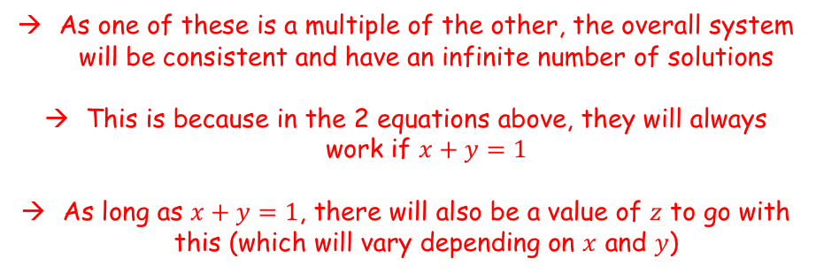

Matrices
If: $A\left(\begin{matrix}x \\ y \\ z\end{matrix}\right)=v$
Then: $\left(\begin{matrix}x \\ y \\ z\end{matrix}\right)=A^{−1}v$
(1)
$$3x−y−6z=1$$
You need to be able to determine whether a system of three linear equations is consistent or inconsistent
A system of linear equations is consistent if there is at least one set of values for $x$, $y$ and $z$ that solve all 3 simultaneously
If the matrix formed by the coefficients is non-singular, then the system of equations has one unique solution and is consistent
If it is singular, then the system of equations will either be consistent and have infinitely many solutions, or be inconsistent and have no solutions…
(2)
$$x+3y+3z=2$$
(3)
$$−3x−y+3z=−2$$
Determining whether there are an infinite number of solutions, or no solutions…
→ Eliminate one of the variables. If the resulting equations are consistent, then the overall system is consistent
(1) + 2(2)
$$5x+5y=5$$
(2) - (3)
$$4x+4y=4$$
As one of these is a multiple of the other, the overall system will be consistent and have an infinite number of solutions
This is because in the 2 equations above, they will always work if $x+y=1$
As long as $x+y=1$, there will also be a value of $z$ to go with this (which will vary depending on $x$ and $y$)
6F

Slide 12






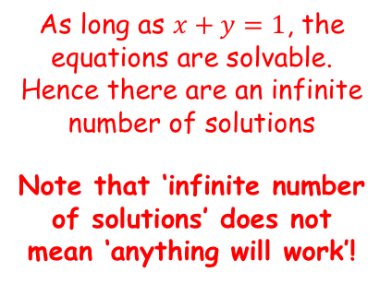






Matrices
If: $A\left(\begin{matrix}x \\ y \\ z\end{matrix}\right)=v$
Then: $\left(\begin{matrix}x \\ y \\ z\end{matrix}\right)=A^{−1}v$
(1)
$$3x−y−6z=1$$
You need to be able to determine whether a system of three linear equations is consistent or inconsistent
A system of linear equations is consistent if there is at least one set of values for $x$, $y$ and $z$ that solve all 3 simultaneously
If the matrix formed by the coefficients is non-singular, then the system of equations has one unique solution and is consistent
If it is singular, then the system of equations will either be consistent and have infinitely many solutions, or be inconsistent and have no solutions…
(1) + 2(2)
$$5x+5y=5$$
(2)
$$x+3y+3z=2$$
(2) - (3)
$$4x+4y=4$$
(3)
$$−3x−y+3z=−2$$
For example, let $x=2$ and $y=−1$ (as this means they add up to 1)
→ Let us see what $z$ will be if this is the case…
$$3x−y−6z=1$$
$$x+3y+3z=2$$
$$3(2)−(−1)−6z=1$$
$$(2)+3(−1)+3z=2$$
$$z=1$$
$$z=1$$
As long as $x+y=1$, the equations are solvable. Hence there are an infinite number of solutions
Note that ‘infinite number of solutions’ does not mean ‘anything will work’!
$$−3x−y+3z=−2$$
$$−3(2)−(−1)+3z=−2$$
$$z=1$$
6F

Slide 13
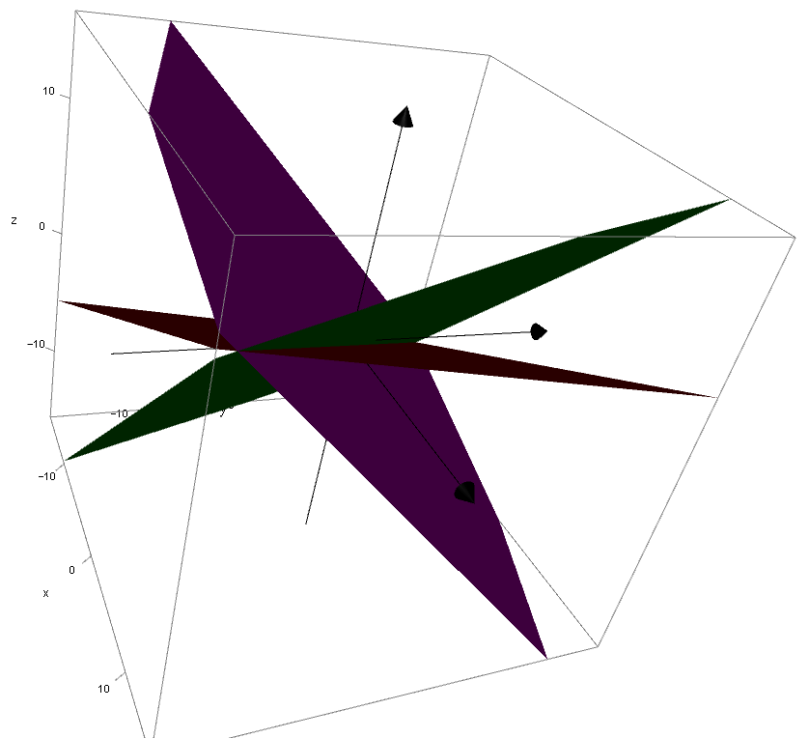
Matrices
If: $A\left(\begin{matrix}x \\ y \\ z\end{matrix}\right)=v$
Then: $\left(\begin{matrix}x \\ y \\ z\end{matrix}\right)=A^{−1}v$
Singular – infinitely many solutions
You need to be able to determine whether a system of three linear equations is consistent or inconsistent
A system of linear equations is consistent if there is at least one set of values for $x$, $y$ and $z$ that solve all 3 simultaneously
If the matrix formed by the coefficients is non-singular, then the system of equations has one unique solution and is consistent
If it is singular, then the system of equations will either be consistent and have infinitely many solutions, or be inconsistent and have no solutions…
$$3x−y−6z=1$$
LINK to Autograph file
$$x+3y+3z=2$$
$$−3x−y+3z=−2$$
This pattern is called a ‘sheaf’
6F

Slide 14
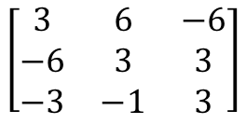



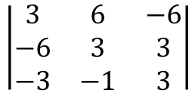
Matrices
If: $A\left(\begin{matrix}x \\ y \\ z\end{matrix}\right)=v$
Then: $\left(\begin{matrix}x \\ y \\ z\end{matrix}\right)=A^{−1}v$
You need to be able to determine whether a system of three linear equations is consistent or inconsistent
A system of linear equations is consistent if there is at least one set of values for $x$, $y$ and $z$ that solve all 3 simultaneously
If the matrix formed by the coefficients is non-singular, then the system of equations has one unique solution and is consistent
If it is singular, then the system of equations will either be consistent and have infinitely many solutions, or be inconsistent and have no solutions…
$$3x+6y−6z=−6$$
$$−6x+3y+3z=2$$
$$−3x−y+3z=−2$$
Write as a matrix
$$\left[\begin{matrix}3 & 6 & −6 \\ −6 & 3 & 3 \\ −3 & −1 & 3\end{matrix}\right]$$
We need to find the determinant of this (use your calculator)
$$\left|\begin{matrix}3 & 6 & −6 \\ −6 & 3 & 3 \\ −3 & −1 & 3\end{matrix}\right|$$
Calculate
$$=0$$
So this matrix is singular
→ This means that there will either be an infinite number of solutions, or no solutions
6F

Slide 15


Matrices
If: $A\left(\begin{matrix}x \\ y \\ z\end{matrix}\right)=v$
Then: $\left(\begin{matrix}x \\ y \\ z\end{matrix}\right)=A^{−1}v$
(1)
$$3x+6y−6z=−6$$
You need to be able to determine whether a system of three linear equations is consistent or inconsistent
A system of linear equations is consistent if there is at least one set of values for $x$, $y$ and $z$ that solve all 3 simultaneously
If the matrix formed by the coefficients is non-singular, then the system of equations has one unique solution and is consistent
If it is singular, then the system of equations will either be consistent and have infinitely many solutions, or be inconsistent and have no solutions…
(2)
$$−6x+3y+3z=2$$
(3)
$$−3x−y+3z=−2$$
Determining whether there are an infinite number of solutions, or no solutions…
→ Eliminate one of the variables. If the resulting equations are consistent, then the overall system is consistent
(1) + (3)
$$5y−3z=−8$$
2(1) + (2)
$$15y−9z=−10$$
As this pair of equations cannot be solved, this means that the overall system cannot be solved
Hence there are no solutions
6F

Slide 16
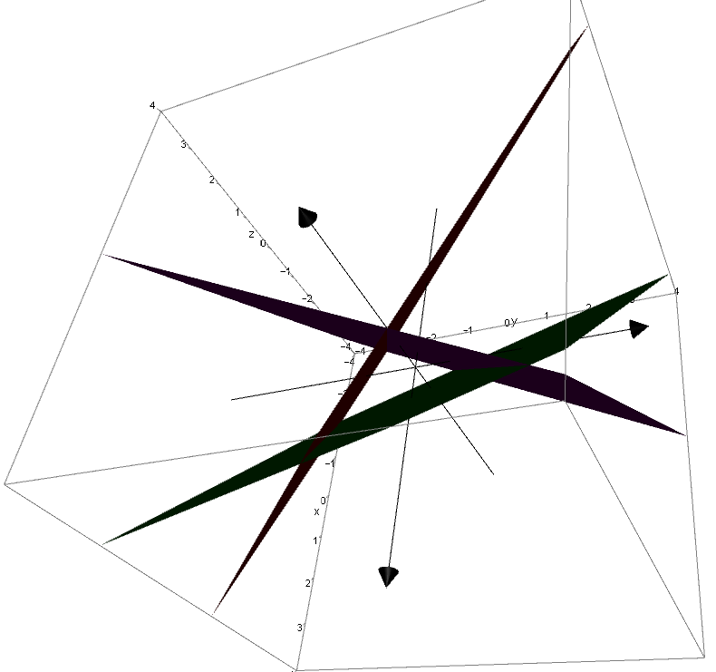
Matrices
If: $A\left(\begin{matrix}x \\ y \\ z\end{matrix}\right)=v$
Then: $\left(\begin{matrix}x \\ y \\ z\end{matrix}\right)=A^{−1}v$
Singular – no solutions
You need to be able to determine whether a system of three linear equations is consistent or inconsistent
A system of linear equations is consistent if there is at least one set of values for $x$, $y$ and $z$ that solve all 3 simultaneously
If the matrix formed by the coefficients is non-singular, then the system of equations has one unique solution and is consistent
If it is singular, then the system of equations will either be consistent and have infinitely many solutions, or be inconsistent and have no solutions…
$$3x+6y−6z=−6$$
LINK to Autograph file
$$−6x+3y+3z=2$$
$$−3x−y+3z=−2$$
In this case the planes form a prism!
6F

Slide 17
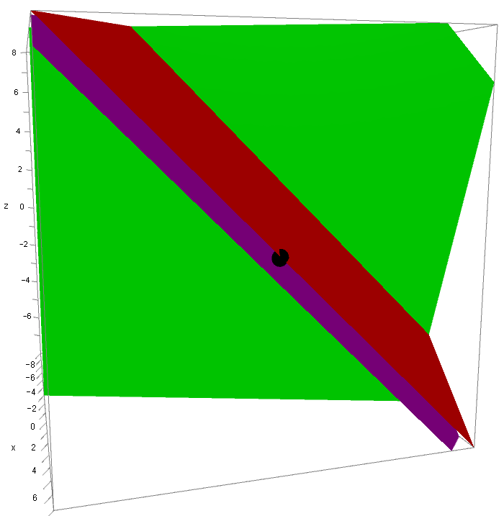



Matrices
If: $A\left(\begin{matrix}x \\ y \\ z\end{matrix}\right)=v$
Then: $\left(\begin{matrix}x \\ y \\ z\end{matrix}\right)=A^{−1}v$
If one is a linear multiple of the other (with a different answer), the planes will be parallel, and hence there will be no solutions
$$x+y+z=8$$
You need to be able to determine whether a system of three linear equations is consistent or inconsistent
A system of linear equations is consistent if there is at least one set of values for $x$, $y$ and $z$ that solve all 3 simultaneously
If the matrix formed by the coefficients is non-singular, then the system of equations has one unique solution and is consistent
If it is singular, then the system of equations will either be consistent and have infinitely many solutions, or be inconsistent and have no solutions…
LINK to Autograph file
$$2x+2y+2z=14$$
$$3x−y−z=10$$
6F

Slide 18
Exercise 6F
Pearson Further Core Mathematics Year 1/AS
Complete before the lesson Q1
In Class:
Green Q2
Amber Q3&4
Red Q5&6

