Slide 1
Complex Numbers
Twitter: @Owen134866
www.mathsfreeresourcelibrary.com

Slide 2


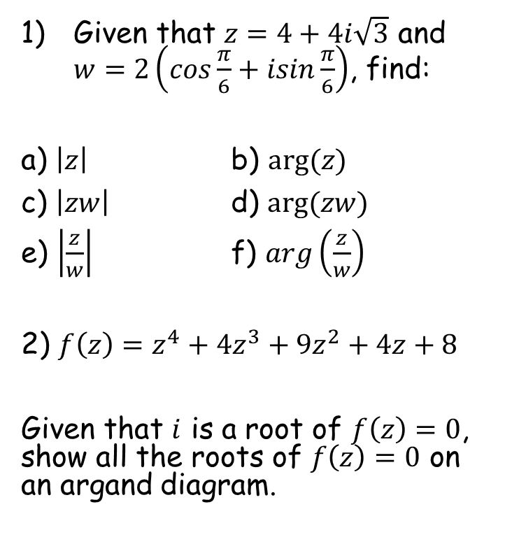



Prior Knowledge Check
Given that $z=4+4i\sqrt{3}$ and $w=2\left(cos\frac{π}{6}+isin\frac{π}{6}\right)$, find:
a) $\left|z\right|$ b) $arg⁡(z)$
c) $\left|zw\right|$ d) $arg⁡(zw)$
e) $\left|\frac{z}{w}\right|$ f) $arg\left(\frac{z}{w}\right)$
2) $f\left(z\right)=z^{4}+4z^{3}+9z^{2}+4z+8$
Given that $i$ is a root of $f\left(z\right)=0$, show all the roots of $f\left(z\right)=0$ on an argand diagram.
3) Use the binomial expansion to find the $n^{4}$ term in the expansion of ${\left(2+n\right)}^{9}$
$$4032n^{4}$$
$$\frac{π}{3}$$
8
$$\frac{π}{2}$$
16
Im
4
$$\frac{π}{6}$$
2
1
-2
-1
1
2
Re
-1
-2

Slide 3
Teachings for
Exercise 1A

Slide 4









Complex Numbers
Im
A reminder of the modulus-argument form…
Express the numbers following numbers in the modulus argument form:
z₁
3
√3
$$z_{1}=1+i\sqrt{3}$$
θ
Re
θ
1
$$z_{2}=−3−3i$$
3
$$z_{1}=2\left(cos\frac{π}{3}+isin\frac{π}{3}\right)$$
z₂
Modulus for z₁
Argument for z₁
$$\sqrt{1^{2}+{\sqrt{3}}^{2}}$$
$$Tan^{−1}\left(\frac{\sqrt{3}}{1}\right)$$
$$=2$$
$$=\frac{π}{3}$$
$$z_{1}=r(cosθ+isinθ)$$
$$z_{1}=2\left(cos\frac{π}{3}+isin\frac{π}{3}\right)$$
1A

Slide 5


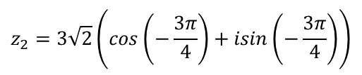


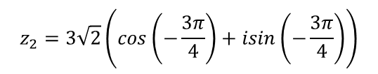



Complex Numbers
Im
A reminder of the modulus-argument form…
Express the numbers following numbers in the modulus argument form:
z₁
3
√3
$$z_{1}=1+i\sqrt{3}$$
θ
Re
θ
1
$$z_{2}=−3−3i$$
3
$$z_{1}=2\left(cos\frac{π}{3}+isin\frac{π}{3}\right)$$
z₂
$$z_{2}=3\sqrt{2}\left(cos\left(−\frac{3π}{4}\right)+isin\left(−\frac{3π}{4}\right)\right)$$
Modulus for z₂
Argument for z₂
$$\sqrt{3^{2}+3^{2}}$$
$$Tan^{−1}\left(\frac{3}{3}\right)$$
Remember the angle you actually want!
$$=\sqrt{18}$$
$$=\frac{π}{4}$$
$$=−\frac{3π}{4}$$
$$=3\sqrt{2}$$
$$z_{2}=r(cosθ+isinθ)$$
$$z_{2}=3\sqrt{2}\left(cos\left(−\frac{3π}{4}\right)+isin\left(−\frac{3π}{4}\right)\right)$$
1A

Slide 6

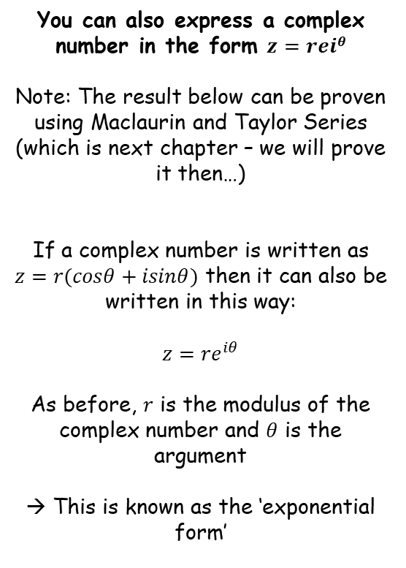

Complex Numbers
$$z=r(cosθ+isinθ)$$
$$z={re}^{iθ}$$
You can also express a complex number in the form $z=reiθ$
Note: The result below can be proven using Maclaurin and Taylor Series (which is next chapter – we will prove it then…)
If a complex number is written as $z=r(cosθ+isinθ)$ then it can also be written in this way:
$$z={re}^{iθ}$$
As before, $r$ is the modulus of the complex number and $θ$ is the argument
→ This is known as the ‘exponential form’
1A

Slide 7


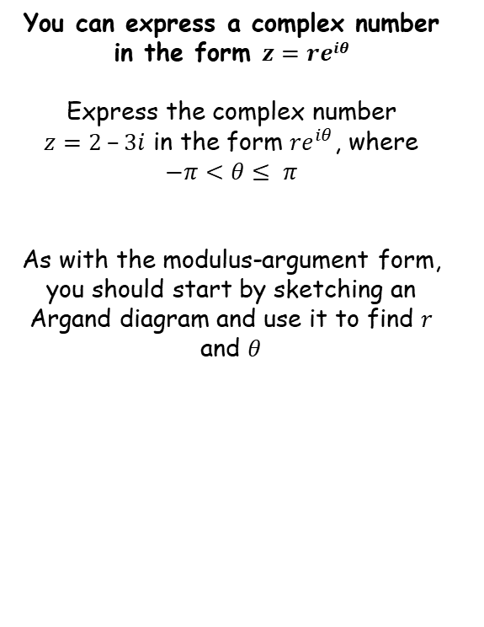





Complex Numbers
$$z=r(cosθ+isinθ)$$
$$z={re}^{iθ}$$
y
You can express a complex number in the form $z=reiθ$
Express the complex number $z=2 –3i$ in the form ${re}^{iθ}$, where
$$−π<θ≤ π$$
As with the modulus-argument form, you should start by sketching an Argand diagram and use it to find $r$ and $θ$
Pay attention to the directions
The ‘x’ part is positive so will go in the positive direction horizontally
The ‘y’ part is negative so will go downwards
2
x
θ
r
3
→ Once sketched you can then find the modulus and argument using GCSE Pythagoras and Trigonometry
$$z={re}^{iθ}$$
$$r=\sqrt{{\left(2\right)}^{2}+{(3)}^{2}}$$
$$Tanθ=\frac{3}{2}$$
Replace r and θ
Calculate
$$z={\sqrt{13}e}^{−0.98i}$$
Inverse Tan
$$r=\sqrt{13}$$
$$θ=0.98$$
Negative as below the x-axis
$$\arg{z=−0.98}$$
1A

Slide 8





Complex Numbers
$$z=r(cosθ+isinθ)$$
$$cos\left(−θ\right)=cosθ$$
$$sin\left(−θ\right)=−sinθ$$
$$z={re}^{iθ}$$
y
$$y=cosθ$$
You can express a complex number in the form $z=reiθ$
In the regular Maths course, you will have encountered the following:
$$cos⁡(−θ)=cosθ$$
$$sin⁡(−θ)=−sinθ$$
1
-θ
0
θ
θ
-360º
-270º
-180º
-90º
-θ
θ
90º
180º
270º
-1
You can see that $\cos\left(−θ\right)=cosθ$ anywhere on the graph
y
1
$$y=sinθ$$
-θ
0
θ
-360º
-270º
-180º
-90º
θ
90º
180º
270º
-1
You can see that $\sin\left(−θ\right)=−sinθ$ anywhere on the graph
1A

Slide 9







Complex Numbers
$$z=r(cosθ+isinθ)$$
$$cos\left(−θ\right)=cosθ$$
$$sin\left(−θ\right)=−sinθ$$
$$z={re}^{iθ}$$
You can express a complex number in the form $z=reiθ$
Express the following in the form
$z={re}^{iθ}$ where $–π<θ≤π$
$$z=\sqrt{2}\left(cos\left(\frac{π}{10}\right)+isin\left(\frac{π}{10}\right)\right)$$
You can see from the form that r = √2
You can see from the form that θ = ^{π}/₁₀
$$z=\sqrt{2}\left(cos\left(\frac{π}{10}\right)+isin\left(\frac{π}{10}\right)\right)$$
$$r=\sqrt{2}$$
$$θ=\frac{π}{10}$$
$$z={re}^{iθ}$$
Replace r and θ
$$z={\sqrt{2}e}^{\frac{π}{10}i}$$
1A

Slide 10



Complex Numbers
$$z=r(cosθ+isinθ)$$
$$cos\left(−θ\right)=cosθ$$
$$sin\left(−θ\right)=−sinθ$$
$$z={re}^{iθ}$$
You can express a complex number in the form $z=reiθ$
Express the following in the form
$z={re}^{iθ}$where $–π<θ≤π$
$$z=5\left(cos\left(\frac{π}{8}\right)−isin\left(\frac{π}{8}\right)\right)$$
$$z=5\left(cos\left(\frac{π}{8}\right)−isin\left(\frac{π}{8}\right)\right)$$
We need to adjust this first
The sign in the centre is negative, we need it to be positive for the ‘rules’ to work
We also need both angles to be identical. In this case we can apply the rules we saw a moment ago…
1A

Slide 11



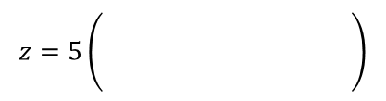





Complex Numbers
$$z=r(cosθ+isinθ)$$
$$cos\left(−θ\right)=cosθ$$
$$sin\left(−θ\right)=−sinθ$$
$$z={re}^{iθ}$$
You can express a complex number in the form $z=reiθ$
Express the following in the form
$z={re}^{iθ}$where $–π<θ≤π$
$$z=5\left(cos\left(\frac{π}{8}\right)−isin\left(\frac{π}{8}\right)\right)$$
Apply cosθ = cos(-θ)
Apply sin(-θ) = -sin(θ)
$$z=5\left(\begin{matrix} \\ \begin{matrix} \\ \end{matrix}\end{matrix} \right)$$
$$cos\left(−\frac{π}{8}\right)$$
$$+ isin\left(−\frac{π}{8}\right)$$
$$z=5\left(cos\left(\frac{π}{8}\right)−isin\left(\frac{π}{8}\right)\right)$$
You can see from the form that r = 5
You can see from the form that θ = -^{π}/₈
$$r=5$$
$$θ=−\frac{π}{8}$$
$$z={re}^{iθ}$$
Replace r and θ
$$z={5e}^{−\frac{π}{8}i}$$
1A

Slide 12





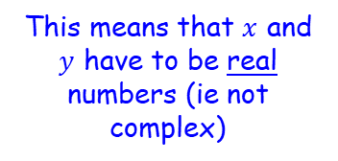


Complex Numbers
$$z=r(cosθ+isinθ)$$
$$cos\left(−θ\right)=cosθ$$
$$sin\left(−θ\right)=−sinθ$$
$$z={re}^{iθ}$$
$$z=\sqrt{2}e^{\frac{3π}{4}i}$$
You can express a complex number in the form $z=reiθ$
Express the following in the form
$z=x+iy$ where $x∈ℝ$ and $y∈ℝ$
You can see from the form that r = √2
You can see from the form that θ = ^{3π}/₄
$$z=\sqrt{2}e^{\frac{3π}{4}i}$$
$$r=\sqrt{2}$$
$$θ=\frac{3π}{4}$$
$$z=r(cosθ+isinθ)$$
This means that $x$ and $y$ have to be real numbers (ie not complex)
Replace r and θ
$$z=\sqrt{2}\left(cos\frac{3π}{4}+isin\frac{3π}{4}\right)$$
You can calculate all of this! Leave the second part in terms of i
$$z=−1+i$$
1A

Slide 13









Complex Numbers
$$z=r(cosθ+isinθ)$$
$$cos\left(−θ\right)=cosθ$$
$$sin\left(−θ\right)=−sinθ$$
$$z={re}^{iθ}$$
$$z=2e^{\frac{23π}{5}i}$$
You can express a complex number in the form $z=reiθ$
Express the following in the form
$r(cosθ+isinθ)$, where $–π<θ≤π$
The value of θ is not in the range we want. We can keep subtracting 2π until it is!
You can see from the form that r = 2
You can see from the form that θ = ^{23π}/₅
$$z=2e^{\frac{23π}{5}i}$$
$$r=2$$
$$θ=\frac{23π}{5}$$
Subtract 2π
$$θ=\frac{13π}{5}$$
Subtract 2π
$$θ=\frac{3π}{5}$$
$$z=r(cosθ+isinθ)$$
Replace r and θ
$$z=2\left(cos\frac{3π}{5}+isin\frac{3π}{5}\right)$$
1A

Slide 14











Complex Numbers
$$z=r(cosθ+isinθ)$$
$$cos\left(−θ\right)=cosθ$$
$$sin\left(−θ\right)=−sinθ$$
$$z={re}^{iθ}$$
You can express a complex number in the form $z=reiθ$
Use:
To show that:
$$e^{iθ}=cosθ+isinθ$$
Let $θ$ = $−θ$
$$e^{i(−θ)}=cos\left(−θ\right)+isin\left(−θ\right)$$
Use the relationships above to rewrite
$$e^{iθ}=cosθ+isinθ$$
$$e^{−iθ}=cosθ−isinθ$$
$$cosθ=\frac{1}{2}\left(e^{iθ}+e^{−iθ}\right)$$
1)
$$e^{iθ}=cosθ+isinθ$$
2)
$$e^{−iθ}=cosθ−isinθ$$
Add 1 and 2
$$e^{−iθ}+e^{iθ}=2cosθ$$
Divide by 2
$$\frac{1}{2}\left(e^{−iθ}+e^{iθ}\right)=cosθ$$
1A

Slide 15
Exercise 1A
Pearson Core Pure Year 2
Page 5
In Class:
Green Q1-3
Amber Q4

