Slide 1

Stats1 Chapter 2 :: Measures of Location & Spread
jfrost@tiffin.kingston.sch.uk
www.drfrostmaths.com
@DrFrostMaths
Last modified: 7th June 2018

Slide 2
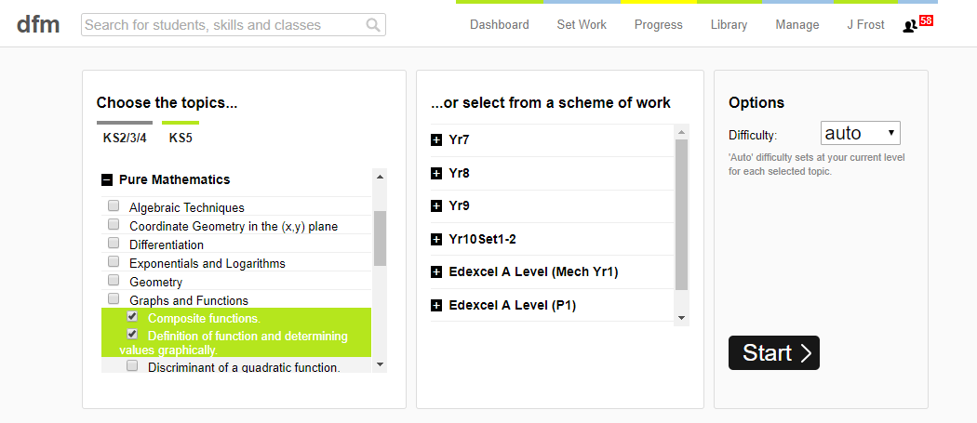
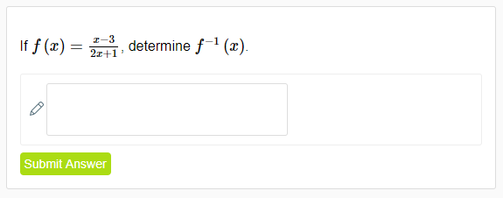
Use of DrFrostMaths for practice
Register for free at:
www.drfrostmaths.com/homework
Practise questions by chapter, including past paper Edexcel questions and extension questions (e.g. MAT).
Teachers: you can create student accounts (or students can register themselves).

Slide 3
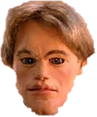
Experimental
i.e. Dealing with collected data.
Chp2: Measures of Location/Spread
Chp3: Representation of Data
Chp1: Data Collection
Statistics used to summarise data, including mean, standard deviation, quartiles, percentiles. Use of linear interpolation for estimating medians/quartiles.
Producing and interpreting visual representations of data, including box plots and histograms.
Methods of sampling, types of data, and populations vs samples.
Chp4: Correlation
Measuring how related two variables are, and using linear regression to predict values.
Theoretical
Deal with probabilities and modelling to make inferences about what we ‘expect’ to see or make predictions, often using this to reason about/contrast with experimentally collected data.
Chp5: Probability
Chp6: Statistical Distributions
Chp7: Hypothesis Testing
Venn Diagrams, mutually exclusive + independent events, tree diagrams.
Common distributions used to easily find probabilities under certain modelling conditions, e.g. binomial distribution.
Determining how likely observed data would have happened ‘by chance’, and making subsequent deductions.

Slide 4
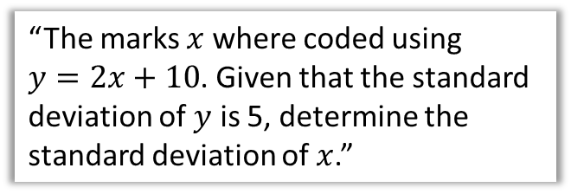
This Chapter Overview
This is identical to the equivalent chapter in the old S1 module. Some content will be familiar from GCSE (mean of grouped/ungrouped data), but many concepts new (e.g. standard deviation) along with possibly unfamiliar notation.
1:: Mean, Median, Mode
2:: Quartiles, Percentiles, Deciles
“Calculate the mean of this grouped frequency table.”
“Use linear interpolation to estimate the interquartile range.”
4:: Coding
3:: Variance & Standard Deviation
“The marks $x$ where coded using
$y=2x+10$. Given that the standard deviation of $y$ is 5, determine the standard deviation of $x$.”
“Calculate the standard deviation of the maths marks.”

Slide 5
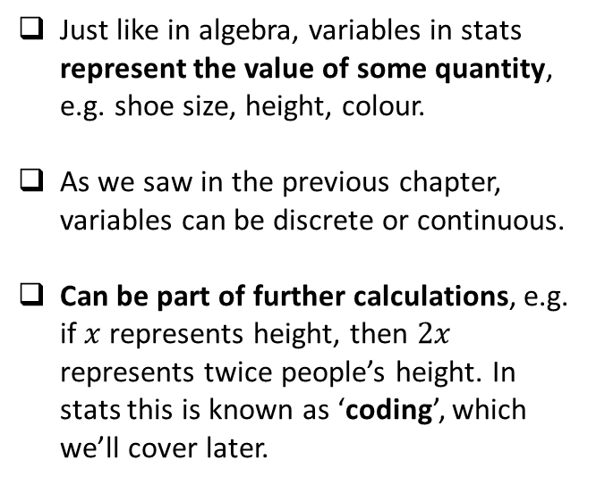
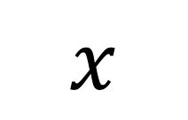
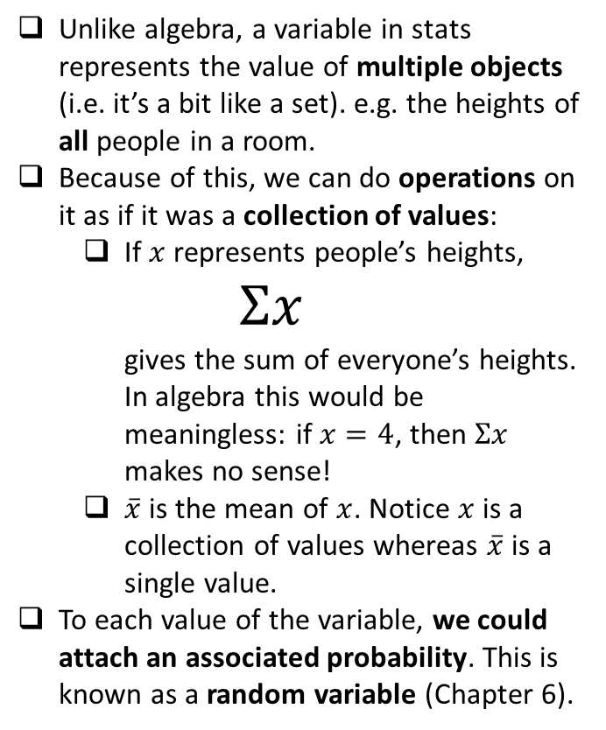
Variables in algebra vs stats
$$x$$
Similarities
Differences
Just like in algebra, variables in stats represent the value of some quantity, e.g. shoe size, height, colour.
As we saw in the previous chapter, variables can be discrete or continuous.
Can be part of further calculations, e.g. if $x$ represents height, then $2x$ represents twice people’s height. In stats this is known as ‘coding’, which we’ll cover later.
Unlike algebra, a variable in stats represents the value of multiple objects (i.e. it’s a bit like a set). e.g. the heights of all people in a room.
Because of this, we can do operations on it as if it was a collection of values:
  If $x$ represents people’s heights,
  $Σx$
  gives the sum of everyone’s heights.
  In algebra this would be meaningless: if $x=4$, then $Σx$ makes no sense!
  $\overline{x}$ is the mean of $x$. Notice $x$ is a collection of values whereas $\overline{x}$ is a single value.
To each value of the variable, we could attach an associated probability. This is known as a random variable (Chapter 6).

Slide 6
Measures of …
Measures of Location
Measures of Spread
Range
Standard Deviation
Measures of Central Tendency
Maximum
Median
Minimum
Mode
Quartiles
Interquartile Range
Mean
Percentiles
Variance
Deciles
Measures of location are single values which describe a position in a data set.
Of these, measures of central tendency are to do with the centre of the data, i.e. a notion of ‘average’.
Measures of spread are to do with how data is spread out.

Slide 7
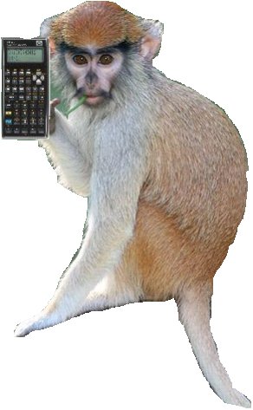
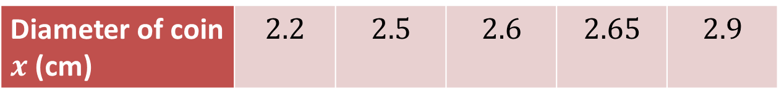
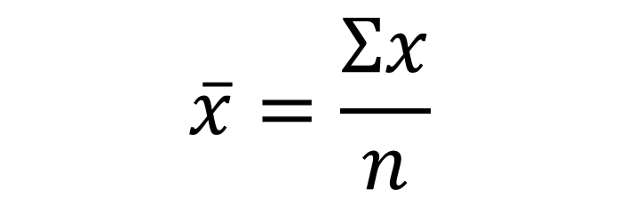
Mean of ungrouped data
Diameter of coin $x$ (cm) | $$2.2$$ | $$2.5$$ | $$2.6$$ | $$2.65$$ | $$2.9$$
You all know how to find the mean of a list of values. But lets consider the notation, and see how theoretically we could calculate each of the individual components on a calculator.
$$\overline{x}=\frac{Σx}{n}$$
?
?
The ‘overbar’ in stats specifically means ‘the sample mean of’, but don’t worry about the ‘sample’ bit for now.
“Use of Technology” Monkey says:
Time to whip out yer Casios…

Slide 8







Inputting Data
Diameter of coin $x$ (cm) | $$2.2$$ | $$2.5$$ | $$2.6$$ | $$2.65$$ | $$2.9$$
Use the MENU button to access STATS mode.
On older black/silver Casios:
Select 1-VAR meaning “1 variable”.
Enter each value above, pressing = after each entry.
Press AC to start a statistical calculation.
Use SHIFT $→$ 1 to access statistical symbols, e.g. $\overline{x}$, to insert into your calculation. Press = to evaluate when done.
On a Classwiz:
Select 1-Variable.
Enter each value above, pressing = after each entry.
Press AC to start a statistical calculation.
Press the OPTN button. “1-Variable Calc” will calculate all common statistics (including all on the left). Alternatively you can construct a statistical expression yourself – in the OPTN menu press Down. “Variable” for example contains $\overline{x}$. This will insert it into your calculation; press = when done.
?
$$n =5$$
$$Σx /n =2.57$$
?
?
$$3\overline{x}+1 =8.71$$
?
$$Σx =12.85$$
?
$$\overline{x} =2.57$$

Slide 9

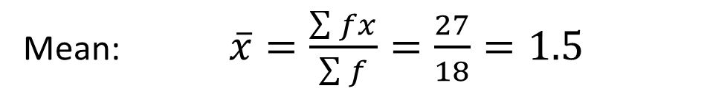
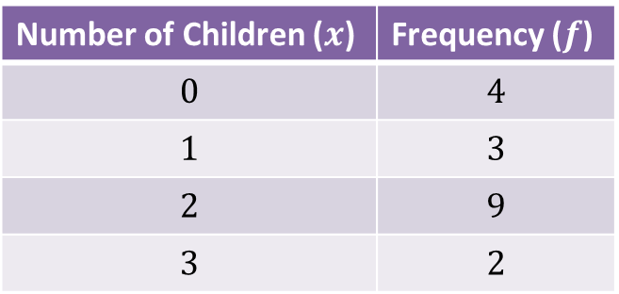
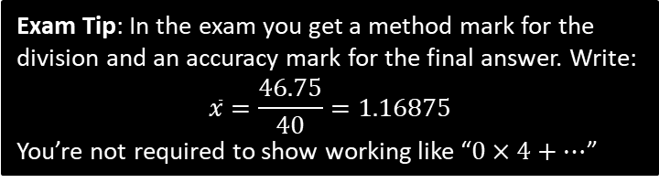
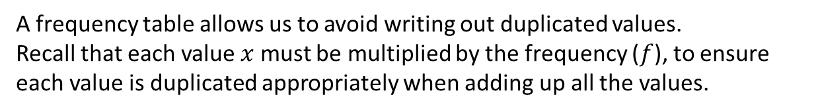
Frequency Tables (ungrouped data)
Number of Children ($x$) | Frequency ($f$)
$$0$$ | $$4$$
$$1$$ | $$3$$
$$2$$ | $$9$$
$$3$$ | $$2$$
A frequency table allows us to avoid writing out duplicated values.
Recall that each value $x$ must be multiplied by the frequency ($f$), to ensure each value is duplicated appropriately when adding up all the values.
Mean: $\overline{x}=\frac{\sum{fx}}{\sum{f}}=\frac{27}{18}=1.5$
?
?
?
Exam Tip: In the exam you get a method mark for the division and an accuracy mark for the final answer. Write:
$$\overline{x}=\frac{46.75}{40}=1.16875$$
You’re not required to show working like “$0×4+…$”

Slide 10
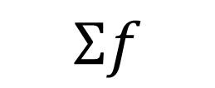
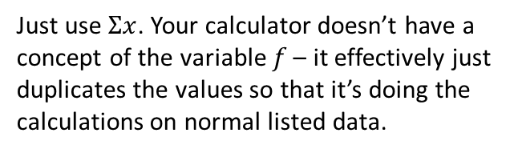
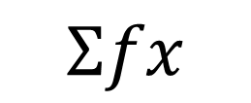
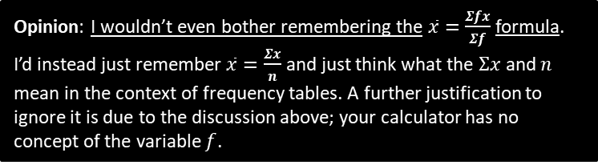
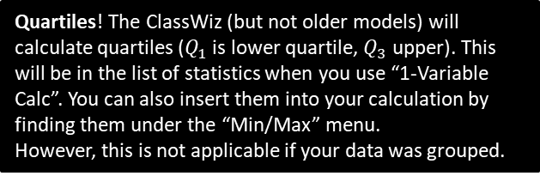
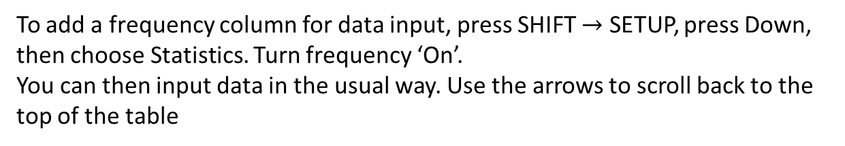

Doing it in STATS mode
Number of Children ($x$) | Frequency ($f$)
$$0$$ | $$4$$
$$1$$ | $$3$$
$$2$$ | $$9$$
$$3$$ | $$2$$
To add a frequency column for data input, press SHIFT $→$ SETUP, press Down, then choose Statistics. Turn frequency ‘On’.
You can then input data in the usual way. Use the arrows to scroll back to the top of the table
?
Just use $Σx$. Your calculator doesn’t have a concept of the variable $f$ – it effectively just duplicates the values so that it’s doing the calculations on normal listed data.
$$Σfx$$
How on the calculator would we get…
$$Σf$$
?
This is $n$. (Since $n=Σf$)
Opinion: I wouldn’t even bother remembering the $\overline{x}=\frac{Σfx}{Σf}$ formula.
I’d instead just remember $\overline{x}=\frac{Σx}{n}$ and just think what the $Σx$ and $n$ mean in the context of frequency tables. A further justification to ignore it is due to the discussion above; your calculator has no concept of the variable $f$.
Quartiles! The ClassWiz (but not older models) will calculate quartiles ($Q_{1}$ is lower quartile, $Q_{3}$ upper). This will be in the list of statistics when you use “1-Variable Calc”. You can also insert them into your calculation by finding them under the “Min/Max” menu.
However, this is not applicable if your data was grouped.

Slide 11
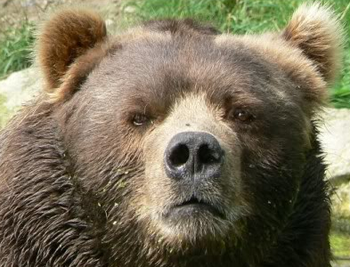
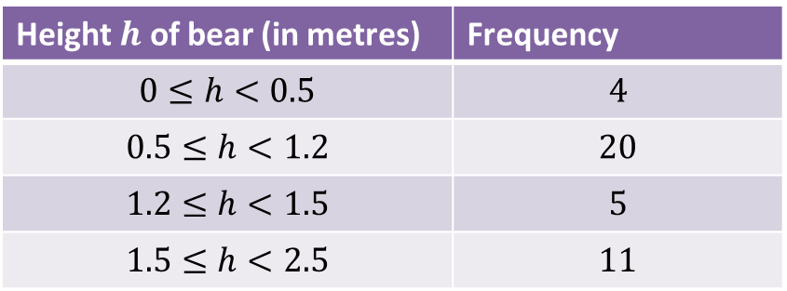
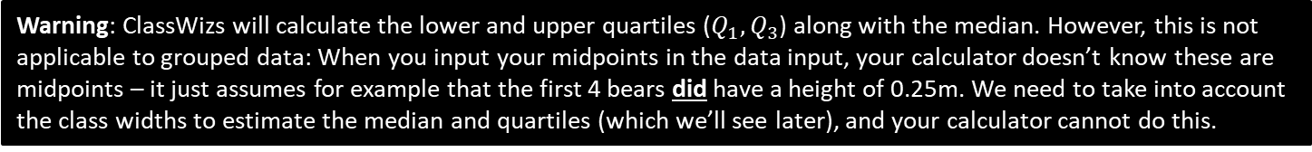
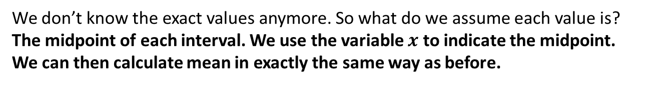
Grouped Data
Height $h$ of bear (in metres) | Frequency
$$0≤h<0.5$$ | $$4$$
$$0.5≤h<1.2$$ | $$20$$
$$1.2≤h<1.5$$ | $$5$$
$$1.5≤h<2.5$$ | $$11$$
We don’t know the exact values anymore. So what do we assume each value is?
The midpoint of each interval. We use the variable $x$ to indicate the midpoint.
We can then calculate mean in exactly the same way as before.
?
Estimate of Mean: $\overline{x}=\frac{\sum{fx}}{\sum{f}}=\frac{46.75}{40}=1.17m$
?
?
?
?
Why is our mean just an estimate?
Because we don’t know the exact heights within each group. Grouping data loses information.
Warning: ClassWizs will calculate the lower and upper quartiles ($Q_{1}, Q_{3}$) along with the median. However, this is not applicable to grouped data: When you input your midpoints in the data input, your calculator doesn’t know these are midpoints – it just assumes for example that the first 4 bears did have a height of 0.25m. We need to take into account the class widths to estimate the median and quartiles (which we’ll see later), and your calculator cannot do this.

Slide 12
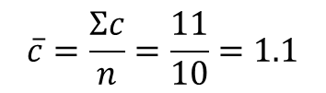

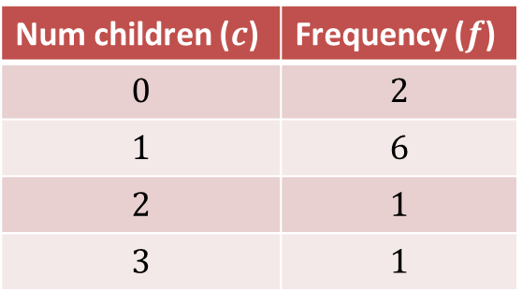
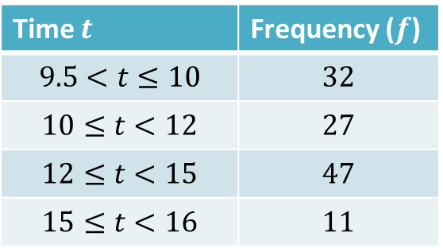
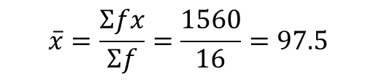
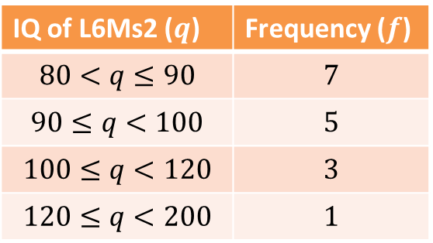
Mini-Exercise
Use your calculator’s STATS mode to determine the mean (or estimate of the mean).
Ensure that you show the division in your working.
1
Num children ($c$) | Frequency ($f$)
$$0$$ | $$2$$
$$1$$ | $$6$$
$$2$$ | $$1$$
$$3$$ | $$1$$
2
IQ of L6Ms2 ($q$) | Frequency ($f$)
$$80<q≤90$$ | $$7$$
$$90≤q<100$$ | $$5$$
$$100≤q<120$$ | $$3$$
$$120≤q<200$$ | $$1$$
?
?
$$\overline{c}=\frac{Σc}{n}=\frac{11}{10}=1.1$$
$$\overline{x}=\frac{Σfx}{Σf}=\frac{1560}{16}=97.5$$
Time $t$ | Frequency ($f$)
$$9.5<t≤10$$ | $$32$$
$$10≤t<12$$ | $$27$$
$$12≤t<15$$ | $$47$$
$$15≤t<16$$ | $$11$$
3
?
$\overline{x}=\frac{Σfx}{Σf}=\frac{1414}{117}=12.1$ to 3sf.

Slide 13
Exercises 2A/2B
Pearson Statistics & Mechanics Year 1/AS
Pages 22-23, 24-25
Complete before the lesson Ex2A Q3-4 & Ex2B Q1-2
In Class:
Green Ex2A Q5-7
Amber Ex2B Q3-4

Slide 14
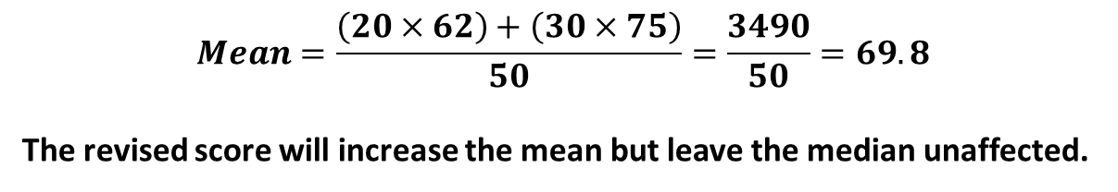
GCSE RECAP :: Combined Mean
This subtopic doesn’t appear in your textbook but has cropped up in exams.
The mean maths score of 20 pupils in class A is 62.
The mean maths score of 30 pupils in class B is 75.
What is the overall mean of all the pupils’ marks.
The teacher realises they mismarked one student’s paper; he should have received 100 instead of 95. Explain the effect on the mean and median.
?
$$Mean=\frac{\left(20×62\right)+\left(30×75\right)}{50}=\frac{3490}{50}=69.8$$
The revised score will increase the mean but leave the median unaffected.
Test Your Understanding
Archie the Archer competes in a competition with 50 rounds. He scored an average of 35 points in the first 10 rounds and an average of 25 in the remaining rounds. What was his average score per round?
$$Mean=\frac{\left(35×10\right)+\left(25×40\right)}{50}=27$$
?

Slide 15
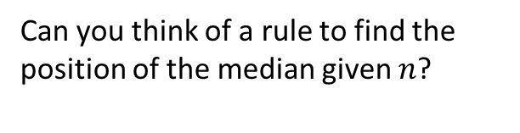

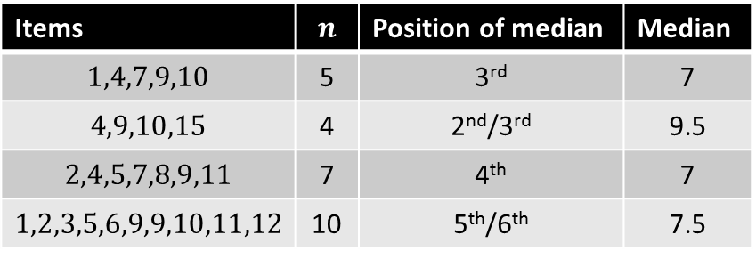
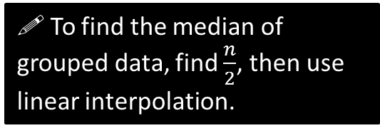
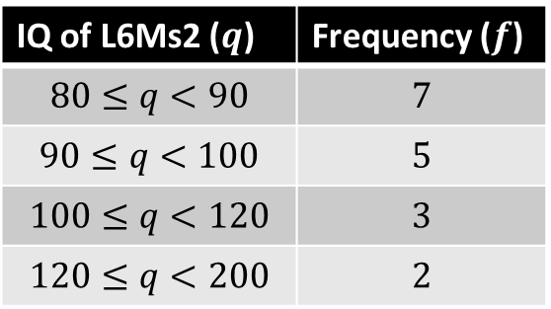
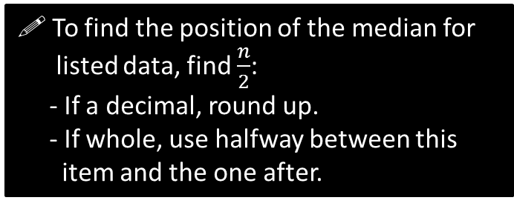
Median – which item?
You need to be able to find the median of both listed data and of grouped data.
Listed data
Grouped data
Items | $$n$$ | Position of median | Median
$$1,4,7,9,10$$ | 5 | 3rd | 7
$$4,9,10,15$$ | 4 | 2nd/3rd | 9.5
$$2,4,5,7,8,9,11$$ | 7 | 4th | 7
$$1,2,3,5,6,9,9,10,11,12$$ | 10 | 5th/6th | 7.5
IQ of L6Ms2 ($q$) | Frequency ($f$)
$$80≤q<90$$ | $$7$$
$$90≤q<100$$ | $$5$$
$$100≤q<120$$ | $$3$$
$$120≤q<200$$ | $$2$$
?
?
?
?
?
?
?
?
Can you think of a rule to find the position of the median given $n$?
Position to use for median:
8.5
?
! To find the position of the median for
listed data, find $\frac{n}{2}$:
- If a decimal, round up.
- If whole, use halfway between this
item and the one after.
?
! To find the median of grouped data, find $\frac{n}{2}$, then use linear interpolation.
DO NOT round $\frac{n}{2}$ or adjust it in any way. This is just like at GCSE where, if you had a cumulative frequency graph with 60 items, you’d look across the 30th. We’ll cover linear interpolation in a sec…

Slide 16
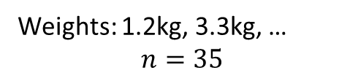
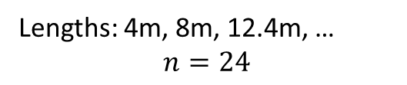
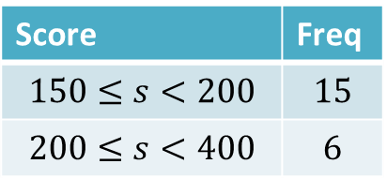
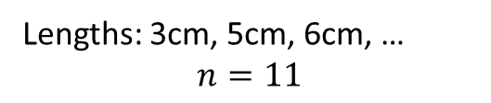
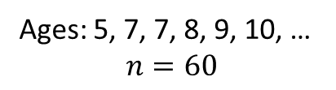
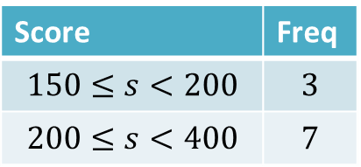
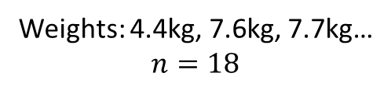
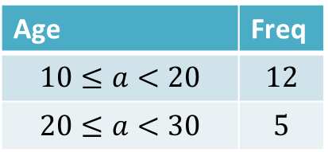
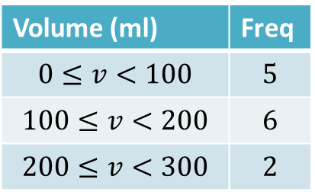
Quickfire Questions…
What position do we use for the median?
Lengths: 3cm, 5cm, 6cm, …
$$n=11$$
Score | Freq
$$150≤s<200$$ | $$3$$
$$200≤s<400$$ | $$7$$
Weights: 1.2kg, 3.3kg, …
$$n=35$$
?
Median position: 18th
?
Median position: 6th
Volume (ml) | Freq
$$0≤v<100$$ | $$5$$
$$100≤v<200$$ | $$6$$
$$200≤v<300$$ | $$2$$
?
Lengths: 4m, 8m, 12.4m, …
$$n=24$$
Median position: 5
Ages: 5, 7, 7, 8, 9, 10, …
$$n=60$$
?
Median position: 12th/13th
?
Age | Freq
$$10≤a<20$$ | $$12$$
$$20≤a<30$$ | $$5$$
Median position: 30th/31st
?
Median position: 6.5
Score | Freq
$$150≤s<200$$ | $$15$$
$$200≤s<400$$ | $$6$$
Weights: 4.4kg, 7.6kg, 7.7kg…
$$n=18$$
Median position: 9th/10th
?
?
Median position: 8.5
Median position: 10.5
?

Slide 17
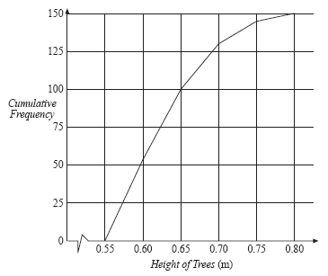
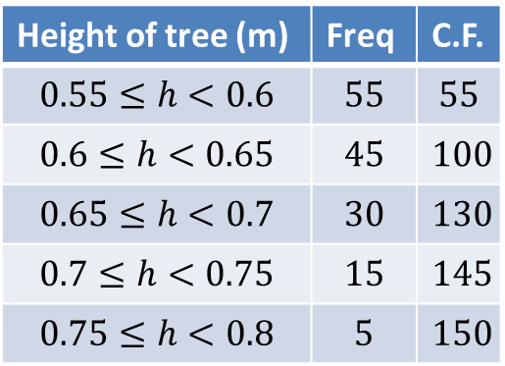
Linear Interpolation
Height of tree (m) | Freq | C.F.
$$0.55≤h<0.6$$ | $$55$$ | $$55$$
$$0.6≤h<0.65$$ | $$45$$ | $$100$$
$$0.65≤h<0.7$$ | $$30$$ | $$130$$
$$0.7≤h<0.75$$ | $$15$$ | $$145$$
$$0.75≤h<0.8$$ | $$5$$ | $$150$$
At GCSE we could find the median by drawing a suitable line on a cumulative frequency graph. How could we read off this value exactly using a suitable calculation?
We could find the fraction of the way along the line segment using the frequencies, then go this same fraction along the class interval.
?

Slide 18
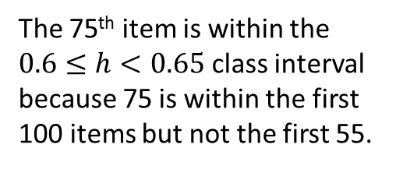
Linear Interpolation
Height of tree (m) | Freq | C.F.
$$0.55≤h<0.6$$ | $$55$$ | $$55$$
$$0.6≤h<0.65$$ | $$45$$ | $$100$$
$$0.65≤h<0.7$$ | $$30$$ | $$130$$
$$0.7≤h<0.75$$ | $$15$$ | $$145$$
$$0.75≤h<0.8$$ | $$5$$ | $$150$$
The 75th item is within the $0.6≤h<0.65$ class interval because 75 is within the first 100 items but not the first 55.
Frequency up until this interval
Item number we’re interested in.
Frequency by end of this interval
?
?
?
55
75
100
0.6m
Med
0.65m
?
?
Height at start of interval.
Height by end of interval.

Slide 19



Linear Interpolation
Height of tree (m) | Freq | C.F.
$$0.55≤h<0.6$$ | $$55$$ | $$55$$
$$0.6≤h<0.65$$ | $$45$$ | $$100$$
$$0.65≤h<0.7$$ | $$30$$ | $$130$$
$$0.7≤h<0.75$$ | $$15$$ | $$145$$
$$0.75≤h<0.8$$ | $$5$$ | $$150$$
What fraction of the way across the interval are we?
$$\frac{20}{45}$$
Hence:
?
$$Median=0.6+\left(\frac{20}{45}×0.05\right)$$
?
Frequency up until this interval
Item number we’re interested in.
Frequency by end of this interval
55
75
100
0.6m
Med
0.65m
Height at start of interval.
Height by end of interval.
Fro Tip: To quickly get frequency before and after, just look for the two cumulative frequencies that surround the item number.
Fro Tip: I like to put the units to avoid getting frequencies confused with values of the variable.

Slide 20






More Examples
Weight of cat (kg) | Freq | C.F.
$$1.5≤w<3$$ | $$10$$ | $$10$$
$$3≤w<4$$ | $$8$$ | $$18$$
$$4≤w<6$$ | $$14$$ | $$32$$
Time (s) | Freq | C.F.
$$8≤t<10$$ | $$4$$ | $$4$$
$$10≤t<12$$ | $$3$$ | $$7$$
$$12≤t<14$$ | $$13$$ | $$20$$
Median class interval:
$$3≤w<4$$
?
?
10
20
7
?
?
?
?
?
12s
14s
10
16
18
?
Med
?
3kg
Med
4kg
?
?
Median:
$12+\left(\frac{3}{13}×2\right)=12.5$ (to 3sf)
Fraction along interval:
$$\frac{6}{8}$$
Median:
$$3+\left(\frac{6}{8}×1\right)=3.75kg$$
?
?
?

Slide 21



What’s different about the intervals here?
Weight of cat to nearest kg | Frequency
$$10−12$$ | $$7$$
$$13−15$$ | $$2$$
$$16−18$$ | $$9$$
$$19−20$$ | $$4$$
There are GAPS between intervals!
What interval does this actually represent?
$$10−12$$
?
$$9.5−12.5$$
Lower class boundary
Upper class boundary
Class width = 3
?

Slide 22




Identify the class width
Distance $d$ travelled (in m) | …
$$0≤d<150$$
$$150≤d<200$$
$$200≤d<210$$
Time $t$ taken (in seconds) | …
$$0−3$$
$$4−6$$
$$7−11$$
?
?
Lower class boundary = 200
Lower class boundary = 3.5
Class width = 3
Class width = 10
?
?
Weight $w$ in kg | …
$$10−20$$
$$21−30$$
$$31−40$$
Speed $s$ (in mph) | …
$$10≤s<20$$
$$20≤s<29$$
$$29≤s<31$$
?
?
Lower class boundary = 30.5
Lower class boundary = 29
?
Class width = 10
Class width = 2
?

Slide 23


Linear Interpolation with gaps
Edexcel S1 Jan 2007 Q4
10
29
72
97
105
111
116
119
120
?
?
?
$$Median=19.5+\left(\frac{31}{43}×10\right)=26.7kg$$
29
60
72
?
19.5 miles
29.5 miles
?
Med
?

Slide 24



Test Your Understanding
Questions should be on a printed sheet…
Age of relic (years) | Frequency
0-1000 | 24
1001-1500 | 29
1501-1700 | 12
1701-2000 | 35
Shark length (cm) | Frequency
$$40≤x<100$$ | 17
$$100≤x<300$$ | 5
$$300≤x<600$$ | 8
$$600≤x<1000$$ | 10
$$Median=1000.5+\left(\frac{26}{29}×500\right)$$
$=1448.7$ years
$$Median=100+\left(\frac{3}{5}×200\right) \\ =220cm$$
?
?
Notes:
There’s a slip to print out here.

Slide 25
Exercises 2C
Pearson Statistics & Mechanics Year 1/AS
Pages 27-28
Q1a, 3, 4a, 5a
There is also a supplementary worksheet consisting of S1 exam questions (see next slides).
Complete before the lesson Q1-2
In Class:
Green Q3
Amber Q4
Red Q5-6

Slide 26






Supplementary Exercise 1
1
Questions should be on a printed sheet…
$$Median=34.5+\left(\frac{16}{30}×5\right)=37.2$$
?
2
3
$$Median=40+\left(\frac{22}{74}×20\right)=45.9$$
?
$$Median=60+\left(\frac{14}{32}×30\right)=73.125$$
?

Slide 27


Supplementary Exercise 1
4
?
$$Mean=\frac{4837.5}{200}=24.1875$$
$$Median=20.5+\left(\frac{38}{88}×5\right)=22.7$$
?

Slide 28




Quartiles – which item?
You need to be able to find the quartiles of both listed data and of grouped data. The rule is exactly the same as for the median.
Grouped data
Listed data
IQ of L6Ms2 ($q$) | Frequency ($f$)
$$80≤q<90$$ | $$7$$
$$90≤q<100$$ | $$5$$
$$100≤q<120$$ | $$3$$
$$120≤q<200$$ | $$2$$
Items | $$n$$ | Position of LQ & UQ | LQ & UQ
$$1,4,7,9,10$$ | 5 | 2nd & 4th | 4 & 9
$$4,9,10,15$$ | 4 | 1st/2nd & 3rd/4th | 6.5 & 12.5
$$2,4,5,7,8,9,11$$ | 7 | 2nd & 6th | 4 & 9
$$1,2,3,5,6,9,9,10,11,12$$ | 10 | 3rd and 8th | 3 & 10
?
?
?
?
?
?
?
?
Can you think of a rule to find the position of the LQ/UQ given $n$?
Position to use for LQ:
4.25
?
! To find the position of the LQ/UQ for
listed data, find $\frac{1}{4}n$ or $\frac{3}{4}n$ then as before:
- If a decimal, round up.
- If whole, use halfway between this
item and the one after.
! To find the LQ and UQ of grouped data, find $\frac{1}{4}n$ and $\frac{3}{4}n$, then use linear interpolation.
?
Again, DO NOT round this value.

Slide 29






Percentiles
The LQ, median and UQ give you 25%, 50% and 75% along the data respectively.
But we can have any percentage you like!
$$n=43$$
Item to use for 57th percentile?
?
$$43×0.57=24.51$$
You will always find these for grouped data in an exam, so never round this position.
Notation:
$$Q_{2}$$
$$Q_{1}$$
?
Lower Quartile:
?
Median:
$$Q_{3}$$
$$P_{57}$$
Upper Quartile:
?
57th Percentile:
?

Slide 30



Measures of Spread
The interquartile range and interpercentile range are examples of measures of spread.
Range
Interquartile Range
Min
$$Q_{1}$$
$$Q_{3}$$
Max
Bottom 25% of data
Middle 50% of data
Top 25% of data
Interquartile Range = Upper Quartile $−$ Lower Quartile
Why might we favour the interquartile range over the range?
Because it gives us the spread of the data excluding the extreme values at either end.
We can control this further by having for example the “10th to 90th interpercentile range”, which would be $P_{90}−P_{10}$. This would typically be symmetrical about the median, so that we could interpret this as “the range of the data with the most extreme 10% of values at either end excluded”.
The 10th percentile is also known as the 1st decile ($D_{1}$), and similarly $P_{90}=D_{9}$.
?

Slide 31




Test Your Understanding
These are the same as the ‘Test Your Understanding’ questions on your supplementary sheet from before.
Age of relic (years) | Frequency
0-1000 | 24
1001-1500 | 29
1501-1700 | 12
1701-2000 | 35
Shark length (cm) | Frequency
$$40≤x<100$$ | 17
$$100≤x<300$$ | 5
$$300≤x<600$$ | 8
$$600≤x<1000$$ | 11
Item for $Q_{1}$:
25th
$$Q_{1}=1000.5+\left(\frac{1}{29}×500\right)$$
$=1017.74$ years
$$Q_{3}=1700.5+\left(\frac{10}{35}×300\right)$$
$=1786.21$ years
$IQR=768.47$
?
Item to use for $P_{10}$: $41×0.1=4.1$
$$P_{10}=40+\left(\frac{4.1}{17}×60\right)=54.47$$
$$P_{90}=600+\left(\frac{6.9}{11}×400\right)=850.91$$
?
?
?
?
?
10th to 90th interpercentile range:
$850.91 −54.47=796.44$
?
?
Notes:
There’s a slip to print out here.

Slide 32
Exercises 2C/2D
Pearson Statistics & Mechanics Year 1/AS
Pages 27-28
Ex 2C: Q1b, 2, 4b-d, 5b-c, 6
Ex 2D
Again, there is also a supplementary worksheet consisting of S1 exam questions (see next slides).
Complete before the lesson Q1
In Class:
Green Q2
Amber Q3-4

Slide 33




Supplementary Exercise 2
?
?

Slide 34






Supplementary Exercise 2
$$Q_{1}=19.5+\left(\frac{1}{43}×10\right)=19.7 \\ Q_{3}=29.5+\left(\frac{18}{25}×10\right)=36.7 \\ IQR=17.0$$
?
?
$$Q_{1}=20+\left(\frac{39}{92}×20\right)=28.5 \\ Q_{3}=60+\left(\frac{23}{39}×40\right)=83.6$$
$$IQR=55.1$$
$$Q_{1}=30+\left(\frac{15}{31}×30\right)=44.5 \\ Q_{3}=90+\left(\frac{12}{23}×30\right)=105.7 \\ P_{90}=120+\left(\frac{7}{17}×120\right)=169.4$$
?

Slide 35




What is variance?
Distribution of IQs in L6Ms4
Distribution of IQs in L6Ms5
$$Frequency$$
$$Frequency$$
$$IQ$$
$$IQ$$
$$90 100 110 120 130 140$$
$$90 100 110 120 130 140$$
?
Here are the distribution of IQs in two classes of the same size. What’s the same, and what’s different?
The (estimated) mean IQ is the same for the two classes, as is the (estimated) range, but the overall spread of values is greater for the second class.
The interquartile range would convey this, but do we have a method of measuring spread that takes into account all the values?

Slide 36






Variance
Variance is a measure of spread that takes all values into account.
Variance, by definition, is the average squared distance from the mean.
Notation: While $Σ$ is ‘uppercase sigma’ and means ‘sum of’, $σ$ is ‘lowercase sigma’ (we’ll see why we have the squared in a sec)
$${\left( \right)}^{2}$$
$$Σ$$
$$x−\overline{x}$$
$$σ^{2}=$$
$$n$$
Distance from mean…
Squared distance from mean…
Average squared distance from mean…

Slide 37



Simpler formula for variance
But in practice you will never use this form, and it’s possible to simplify the formula to the following*:
Variance
“The mean of the squares minus the square of the mean (‘msmsm’)”
?
* Proof: (certainly not in syllabus!)
Note that $\overline{x}$ is constant for a fixed variable, and that in general, $Σkf\left(x\right)=kΣf\left(x\right)$ for a constant $k$, i.e. we can factor out constants out of a summation.
$$σ^{2}=\frac{Σ{\left(x−\overline{x}\right)}^{2}}{n}=\frac{Σ\left(x^{2}−2x\overline{x}+{\overline{x}}^{2}\right)}{n} \\ =\frac{Σx^{2}}{n}−\frac{Σ\left(2x\overline{x}\right)}{n}+\frac{Σ{\overline{x}}^{2}}{n} \\ =\frac{Σx^{2}}{n}−2\overline{x}\left(\frac{Σx}{n}\right)+\frac{{\overline{x}}^{2}}{n}Σ1 \\ =\frac{Σx^{2}}{n}−2{\overline{x}}^{2}+\frac{{\overline{x}}^{2}}{n}⋅n \\ =\frac{Σx^{2}}{n}−2{\overline{x}}^{2}+{\overline{x}}^{2} \\ =\frac{Σx^{2}}{n}−{\overline{x}}^{2}$$
?
$$σ^{2}=\frac{Σx^{2}}{n}−{\overline{x}}^{2}$$
?
Standard Deviation
$$σ=\sqrt{Variance}$$
The standard deviation can ‘roughly’ be thought of as the average distance from the mean.

Slide 38



Examples
3, 11
2cm 3cm 3cm 5cm 7cm
Variance
$$σ^{2}=65−7^{2}=16$$
Standard Deviation
$$σ=\sqrt{16}=4$$
Variance
$σ^{2}=19.2−4^{2}=3.2$cm
?
?
Standard Deviation
$σ=\sqrt{3.2}=1.79$cm
?
?
So note that that in the case of two items, the standard deviation is indeed the average distance of the values from the mean.

Slide 39




Practice
Find the variance and standard deviation of the following sets of data.
$$2 4 6$$
?
?
Variance = $2.67$
Standard Deviation = $1.63$
$$1 2 3 4 5$$
?
Variance = $2$
Standard Deviation = $1.41$
?

Slide 40

Extending to frequency/grouped frequency tables
We can just mull over our mnemonic again:
Variance: “The mean of the squares minus the square of the mean (‘msmsm’)”
?
?
$$Variance=\frac{Σfx^{2}}{Σf}−{\overline{x}}^{2}$$
Fro Tip: It’s better to try and memorise the mnemonic than the formula itself – you’ll understand what’s going on better.
Fro Exam Note: In an exam, you will pretty much certainly be asked to find the standard deviation for grouped data, and not listed data.

Slide 41




Example
May 2013 Q4
We can use our STATS mode to work out the various summations needed (and “1-Variable Calc” will contain this amongst its list). Just input the table as normal.
Note that, as per the discussion before, $Σx^{2}$ on a calculator actually gives you $Σfx^{2}$ because it’s already taking the frequencies into account.
?
$$\overline{x}=\frac{4837.5}{200}=24.1875 \\ σ^{2}=\frac{134281.25}{200}−{24.1875}^{2}=86.37 \\ σ=\sqrt{86.37}=9.29$$
?
You ABSOLUTELY must check this with the $σx$ you can get on the calculator directly.
?

Slide 42


Test Your Understanding
May 2013 (R) Q3
?

Slide 43

Most common exam errors
Thinking $Σfx^{2}$ means ${\left(Σfx\right)}^{2}$. It means the sum of each value squared!
When asked to calculate the mean followed by standard deviation, using a rounded version of the mean in calculating the standard deviation, and hence introducing rounding errors.
Forgetting to square root the variance to get the standard deviation.
ALL these mistakes can be easily spotted if you check your value against “$σx$” in STATS mode.

Slide 44
Exercise 2E
Pearson Statistics & Mechanics Year 1/AS
Pages 32-33
Complete before the lesson Q1-3
In Class:
Green Q4-5
Amber Q6-8

Slide 45
Coding
What do you reckon is the mean height of people in this room?
Now, stand on your chair, as per the instructions below.
INSTRUCTIONAL VIDEO
Is there an easy way to recalculate the mean based on your new heights? And the variance of your heights?
The mean would increase by the height of the chairs. The spread however is unaffected thus the variance would remain the same.
?

Slide 46

Starter
Suppose now after a bout of ‘stretching you to your limits’, you’re now all 3 times your original height.
What do you think happens to the standard deviation of your heights?
It becomes 3 times larger (i.e. your heights are 3 times as spread out!)
?
What do you think happens to the variance of your heights?
?
It becomes 9 times larger. We use the scale factor of the standard deviation, squared.
Extension Question: Can you prove the latter using the formula for variance?
$$σ^{2}=\frac{Σ{\left(3x\right)}^{2}}{n}−{\left(\frac{Σ\left(3x\right)}{n}\right)}^{2} \\ =\frac{Σ9x^{2}}{n}−{\left(\frac{3Σx}{n}\right)}^{2}=\frac{9⋅Σx^{2}}{n}−9{\left(\frac{Σx}{n}\right)}^{2} \\ =9\left(\frac{Σx^{2}}{n}−{\left(\frac{Σx}{n}\right)}^{2}\right)$$
?

Slide 47










Rules of coding
Suppose our original variable (e.g. heights in cm) was $x$.
Then $y$ would represent the heights with 10cm added on to each value.
Coding
Effect on $\overline{x}$
Effect on $σ$
?
?
$$y=x+10$$
$\overline{x}$ will similarly increase by 10 (to get $\overline{y}$)
As discussed, adding (and subtracting) has no effect on standard deviation or any measure of spread.
$$y=3x$$
?
?
$\overline{x}$ will get 3 times bigger.
Standard deviation will get 3 times larger.
?
?
$$y=2x−5$$
$\overline{y}=2\overline{x}−5$, i.e. effect on values is same effect on mean.
-5 has no effect but standard deviation will get 2 times larger.
You might get any linear coding (i.e. using $×+÷−$). We might think that any operation on the values has the same effect on the mean. But note for example that squaring the values would not square the mean; we already know that $Σx^{2}≠{\left(Σx\right)}^{2}$ in general.

Slide 48




The point of coding
Cost $x$ of diamond ring (£)
£1010 £1020 £1030 £1040 £1050
We ‘code’ our variable using the following:
$$y=\frac{x−1000}{10}$$
New values $y$:
?
£1 £2 £3 £4 £5
Standard deviation of $y$ ($σ_{y}$): $\sqrt{2}$
therefore…
Standard deviation of $x$ ($σ_{x}$): $10\sqrt{2}$
?
?
The jist of coding: We want to find the mean/standard deviation of a variable. We transform the values, using some rule, to make them simpler. We can then more easily calculate the mean/standard deviation of the ‘coded’ data, and from this we can then determine what the mean/standard deviation would have been for the original uncoded data.

Slide 49


































Quickfire Questions
Old mean $\overline{x}$
Old $σ_{x}$
Coding
New mean $\overline{y}$
New $σ_{y}$
$$36$$
$$4$$
$$y=x−20$$
$$16$$
$$4$$
?
?
?
?
$$72$$
$$16$$
$$36$$
$$8$$
$$y=2x$$
?
?
$$35$$
$$4$$
$$y=3x−20$$
$$85$$
$$12$$
$$40$$
$$3$$
$$y=\frac{x}{2}$$
$$20$$
$$\frac{3}{2}$$
?
?
$$11$$
$$27$$
$$y=\frac{x+10}{3}$$
$$7$$
$$9$$
?
?
$$300$$
$$25$$
$$y=\frac{x−100}{5}$$
$$40$$
$$5$$
?
?

Slide 50


Example Exam Question
Suppose we’ve worked all these out already.
f)
Coding is
$$t_{2}=t_{1}−5$$
Mean decreases by 5.
$σ$ unaffected.
Median decreases by 5.
Lower quartile decreases by 5.
Interquartile range unaffected.
?

Slide 51
Exercise 2F
Pearson Statistics & Mechanics Year 1/AS
Pages 34-36
Complete before the lesson Q1-2
In Class:
Green Q3-4
Amber Q5-6
Red Q7-9

Slide 52





Chapter 2 Summary
I have a list of 30 heights in the class. What item do I use for:
$Q_{1}$? 8th
$Q_{2}$? Between 15th and 16th
$Q_{3}$? 23rd
?
?
?
For the following grouped frequency table, calculate:
Height $h$ of bear (in metres) | Frequency
$$0≤h<0.5$$ | $$4$$
$$0.5≤h<1.2$$ | $$20$$
$$1.2≤h<1.5$$ | $$5$$
$$1.5≤h<2.5$$ | $$11$$
$$\overline{h}=\frac{\left(0.25×4\right)+\left(0.85×20\right)+…}{40}=\frac{46.75}{40}=1.17m to 3sf$$
?
a) The estimate mean:
?
b) The estimate median:
$$0.5+\left(\frac{16}{20}×0.7\right)=1.06m$$
?
c) The estimate variance:
(you’re given $Σfh^{2}=67.8125$)
$$σ^{2}=\frac{67.8125}{40}−{\left(\frac{46.75}{40}\right)}^{2}=0.329 to 3sf$$

Slide 53


Chapter 2 Summary
What is the standard deviation of the following lengths: 1cm, 2cm, 3cm
$$σ^{2}=\frac{14}{3}−2^{2}=\frac{2}{3} σ=\sqrt{\frac{2}{3}}$$
?
The mean of a variable $x$ is 11 and the variance $4$.
The variable is coded using $y=\frac{x+10}{3}$. What is:
The mean of $y$? $\overline{y}=7$
The variance of $y$? $σ_{y}^{2}=\frac{4}{9}$
A variable $x$ is coded using $y=4x−5$.
For this new variable $y$, the mean is 15 and the standard deviation 8.
What is:
The mean of the original data? $\overline{x}=5$
The standard deviation of the original data? $σ_{x}^{}=2$
?
?
?
?

