Slide 1
Year 1 Pure Mathematics
Representation of Data
– Histograms
Chapter 3
(Part 3 of 3)

Slide 2
Bar Charts vs Histograms
Bar Charts
For discrete data.
Frequency given by height of bars.
Histograms
For continuous data.
Bars can be uneven intervals.
Frequency given by area of bars.
No gaps between bars.
Frequency
Frequency Density
6 7 8 9
1.0m 1.2m 1.4m 1.6m 1.8m
Shoe Size
Height

Slide 3
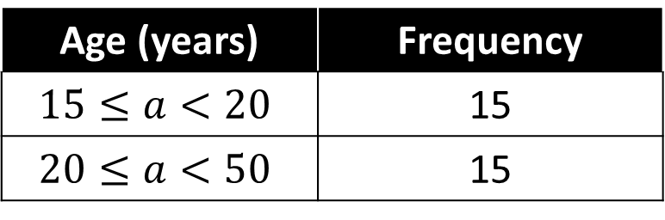
Histograms
Age (years) | Frequency
$$15≤a<20$$ | 15
$$20≤a<50$$ | 15
Freq
F.D.
Width
3
2
1
Frequency is represented by the area
Frequency Density
10 20 30 40 50
Age

Slide 4
Histograms
Weight (w kg) | Frequency | Frequency Density
10 < w ≤ 15 | 15
15 < w ≤ 30 | 30
30 < w ≤ 40 |  | 4
 | 20 | 5
3
2
Freq
40
40 < w ≤ 44
F.D.
Width
5
4
3
2
1
Frequency Density
10 20 30 40 50
Height (m)

Slide 5
Histograms
Watch out for when the data has been rounded to
the nearest whole number.
Height (to the nearest cm) | Frequency | Frequency Density
10 - 15 |  | 3
16 - 30 |  | 2
31 - 40 |  | 4
6 x 3 = 18
15 x 2 = 30
10 x 4 = 12
5
4
3
2
1
Frequency Density
10 15 20 30 40
Height (m)

Slide 6
Histograms - Scalers
Unlike at GCSE,
the area of a bar is not necessarily equal to the frequency;
there are just proportional.
So when you are given predawn histogram you need to check to see if the TOTAL AREA is equal to the TOTAL FREQUENCY.
5
4
3
2
1
Frequency Density
10 20 30 40 50
Height (m)

Slide 7
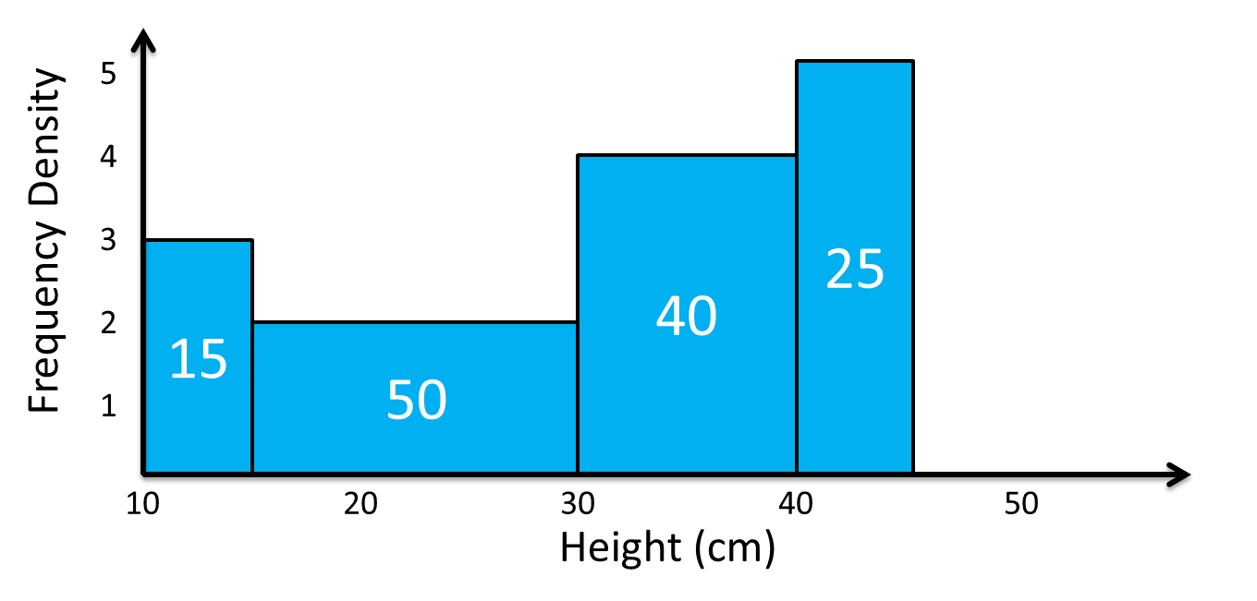
Histograms - Scalers
65 plants heights were measured.
The following histogram represents their heights.
Total Area =
130
65
Total Frequency =
Total Area does not equal the total frequency.
Therefore a scaler has been used.
Scaler
= 130 ÷ 65
= 2

Slide 8
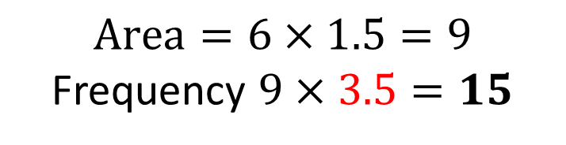
Histograms - Scalers
There were 84 runners in a 100m race.
The following histogram represents their times.
Determine the number of runners with times above 12s.
Step 1:
Find the Scaler
5
4
3
2
1
0
Total Area = 24
Total Frequency = 84
Scaler = 84/24 = 3.5
Frequency Density
Step 2:
Find the Area.
9
12
18
$$Area=6×1.5=9$$
Frequency $9×3.5=15$
Time (s)

Slide 9
Histograms - Scalers
Weight (to nearest kg) | Area | Frequency
1-2
3-6
7-9
The histograms show the weight of 39 babies.
2 x 2 = 4
4 x 1.5 = 6
3 x 1 = 3
4 x 3 = 12
6 x 3 = 18
3 x 3 = 9
2
1
0
Scaler = 39/13 = 3
Frequency Density
1 2 3 4 5 6 7 8 9 10
Weight

Slide 10
Frequency Polygon
Frequency polygon can be drawn from a histogram
by using the midpoint of each interval
and joining them with a straight line.
Note that the frequency in this interval is 0.

Slide 11
Exercise 3D
Pearson Pure Mathematics Year 1/AS
Pages 47-48
There is a supplementary exercise (available as a separate file for printing) with solutions on the next slides…
Complete before the lesson Q1-2
In Class:
Green Q3-4
Amber Q5
Red Q6-7

