Slide 1
Year 1 Pure Mathematics
Trigonometric Ratios
- Trigonometric Ratios
Chapter 9
(Part 1 of 2)

Slide 2




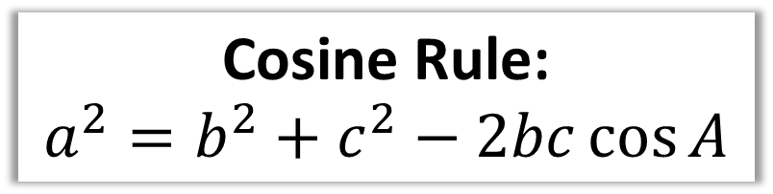



Cosine Rule - Side
Cosine Rule:
$$a^{2}=b^{2}+c^{2}−2bc\cos{A}$$
You need two sides either side of an angle.
$$b$$
$$15$$
$$A$$
$$a$$
$$c$$
$$x$$
$$12$$

Slide 3



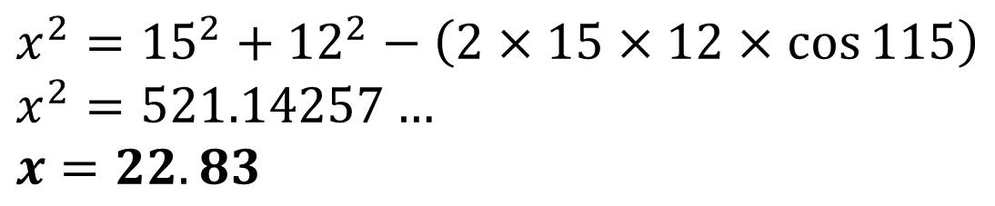


Cosine Rule - Side
Cosine Rule:
$$a^{2}=b^{2}+c^{2}−2bc\cos{A}$$
$$b$$
$$15$$
$$A$$
$$115°$$
$$a$$
$$c$$
$$x$$
$$12$$
$$x^{2}={15}^{2}+{12}^{2}−\left(2×15×12×\cos{115}\right) \\ x^{2}=521.14257… \\ x=22.83$$

Slide 4

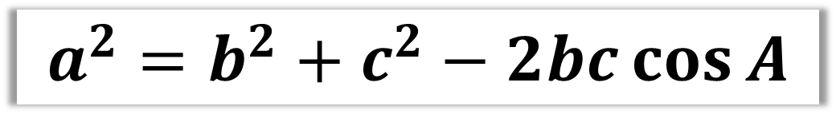

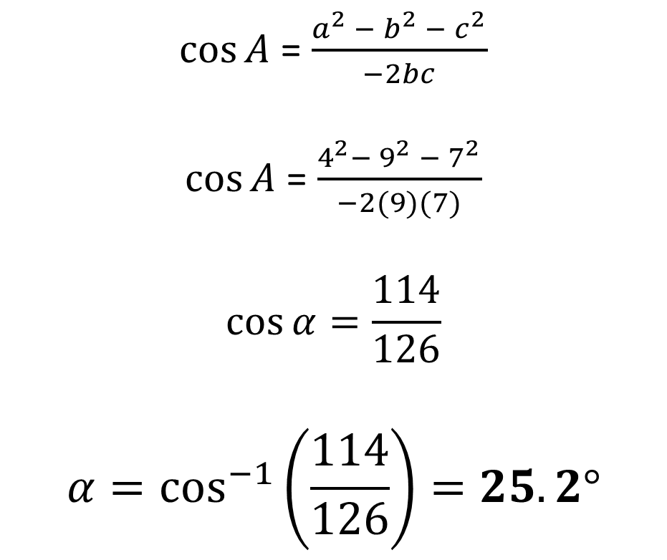


Cosine Rule - Angle
$$a^{2}=b^{2}+c^{2}−2bc\cos{A}$$
$$7$$
$\cos{A}$ = $\frac{a^{2} − b^{2} − c^{2}}{−2bc}$
$\cos{A}$ = $\frac{4^{2}−{ 9}^{2} − 7^{2}}{−2(9)(7)}$
$$\cos{α}=\frac{114}{126}$$
$$α=\cos^{−1}\left(\frac{114}{126}\right)=25.2°$$
$$α$$
$$4$$
$$9$$

Slide 5



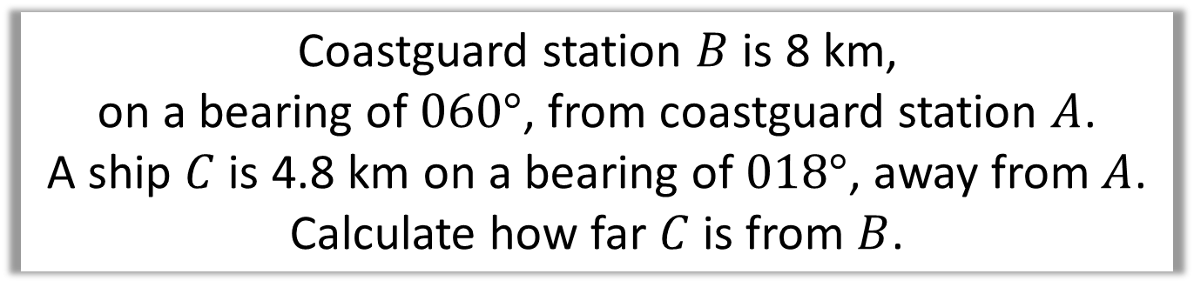


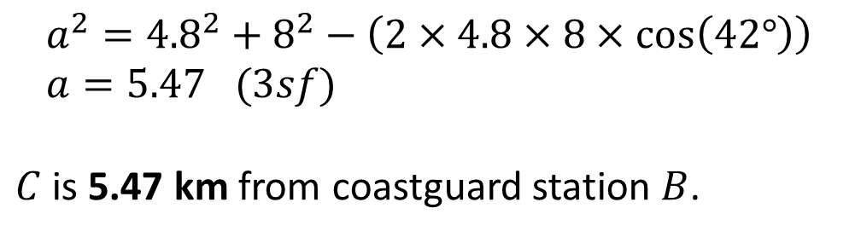




Cosine Rule – Angle (Bearing)
Coastguard station $B$ is 8 km,
on a bearing of $060°$, from coastguard station $A$.
A ship $C$ is 4.8 km on a bearing of $018°$, away from $A$.
Calculate how far $C$ is from $B$.
$$N$$
$$C$$
$$a km$$
$$4.8km$$
$$B$$
$$18°$$
$$60°$$
$$8 km$$
$$a^{2}={4.8}^{2}+8^{2}−\left(2×4.8×8×\cos\left(42°\right)\right) \\ a=5.47 (3sf)$$
$C$ is 5.47 km from coastguard station $B$.
$$A$$

Slide 6

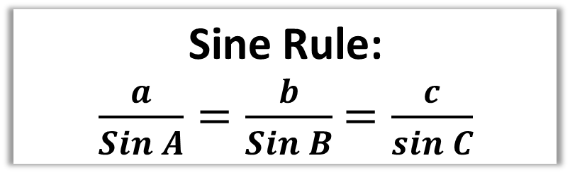



Sine Rule - Side
Sine Rule:
$\frac{a}{Sin A}=\frac{b}{Sin B}$ $=\frac{c}{sin C}$
You need two pairs sides and angles.
$$A$$
$$b$$
8
85°
45°
x
$$a$$
$$B$$

Slide 7

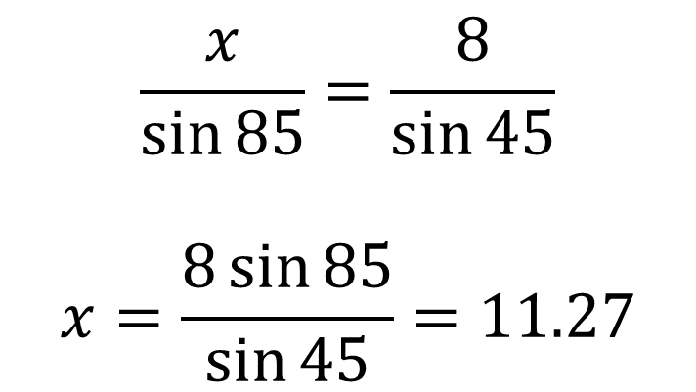
Sine Rule - Side
Sine Rule:
$\frac{a}{Sin A}=\frac{b}{Sin B}$ $=\frac{c}{sin C}$
8
85°
$$\frac{x}{\sin{85}}=\frac{8}{\sin{45}}$$
$$x=\frac{8\sin{85}}{\sin{45}}=11.27$$
45°
x

Slide 8

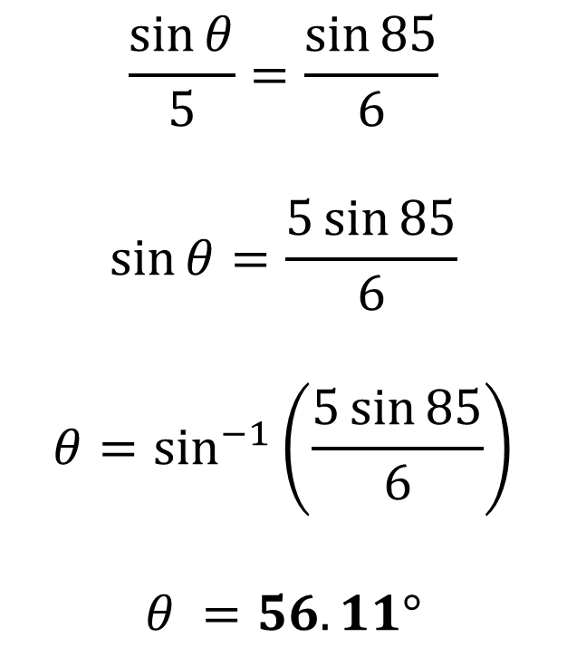
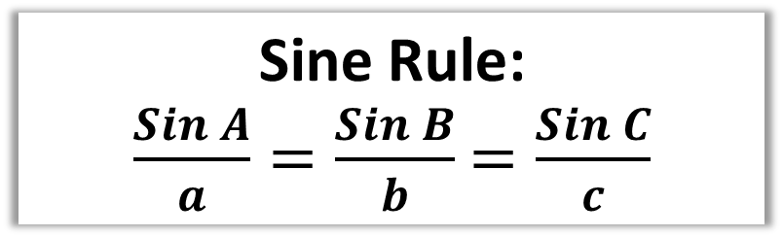
Sine Rule - Angle
Sine Rule:
$\frac{Sin A}{a}=\frac{Sin B}{b}$ $=\frac{Sin C}{c}$
$$\frac{\sin{θ}}{5}=\frac{\sin{85}}{6}$$
$$\sin{θ}=\frac{5\sin{85}}{6}$$
$$θ=\sin^{−1}\left(\frac{5\sin{85}}{6}\right)$$
$$θ =56.11°$$
5
85°
6
$$θ$$

Slide 9




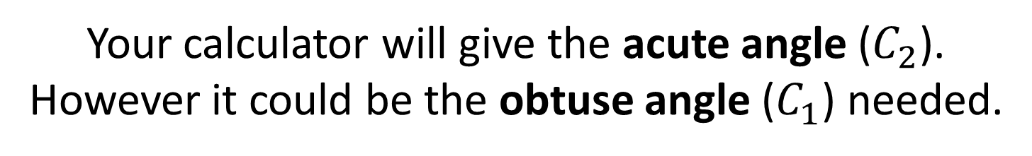




The ‘Special Case’
$$A$$
Watch out for a special case where the calculator will only give one of two answers.
$$4$$
$$3$$
$$3$$
The clue in the question will be that they are asking for the acute or obtuse angle.
$$44°$$
$$B$$
$$C_{1}$$
$$C_{2}$$
Your calculator will give the acute angle ($C_{2}$).
However it could be the obtuse angle ($C_{1}$) needed.

Slide 10
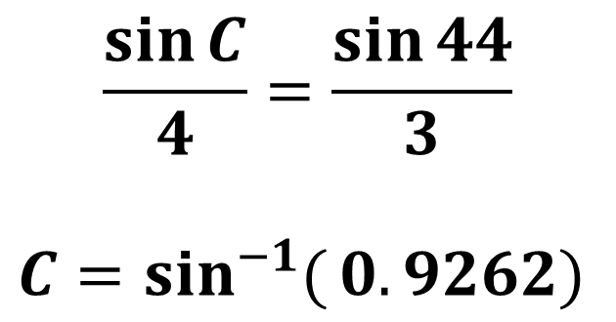
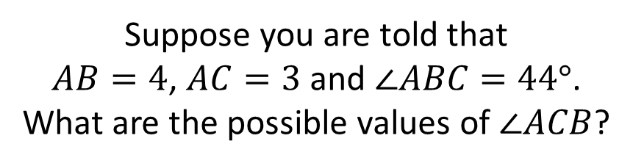
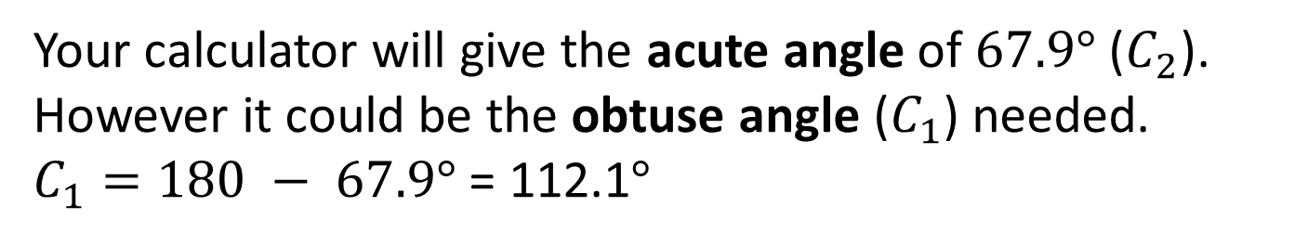
The ‘Special Case’
$$A$$
Suppose you are told that
$AB=4$, $AC=3$ and $∠ABC=44°$.
What are the possible values of $∠ACB$?
$$4$$
$$\frac{\sin{C}}{4}=\frac{\sin{44}}{3}$$
$$C=\sin^{−1}{(}0.9262)$$
$$3$$
$$3$$
$$44°$$
$$B$$
$$C_{1}$$
$$C_{2}$$
Your calculator will give the acute angle of $67.9°$ ($C_{2}$). However it could be the obtuse angle ($C_{1}$) needed.
$C_{1}=180 − 67.9°$ = 112.1$°$

Slide 11
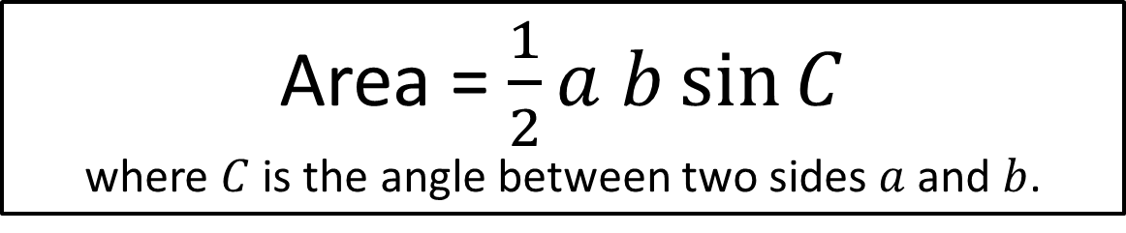
Area of Non Right-Angled Triangles
Area = $\frac{1}{2}a b\sin{C}$
where $C$ is the angle between two sides $a$ and $b$.
3cm
Area = 0.5 x 3 x 7 x sin(59)
= 9.00cm²
59°
7cm

Slide 12
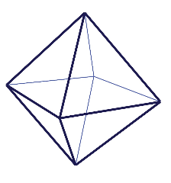
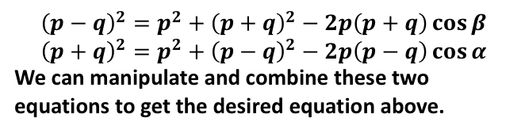


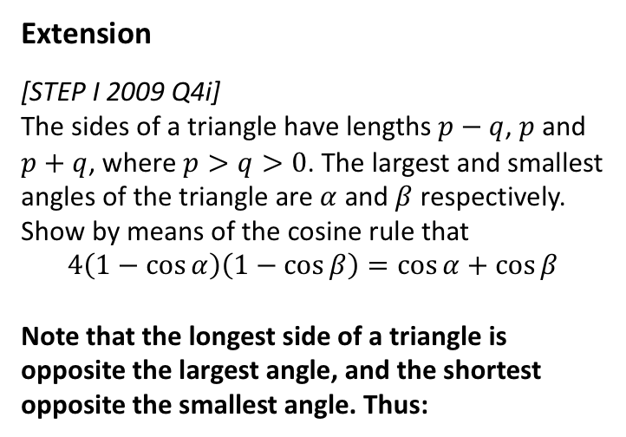



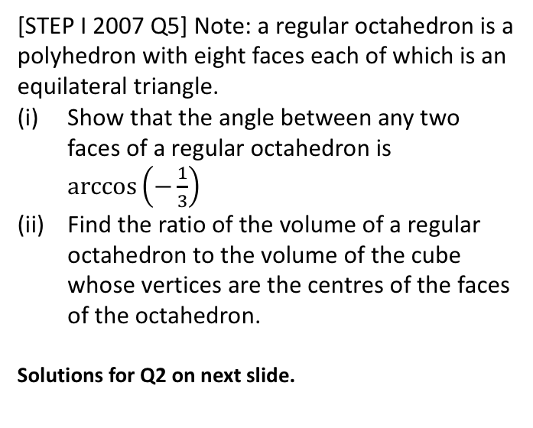
Exercise 9A
Complete before the lesson Q1-2
Green Q3-6
Amber Q7-13
Red Q14-17
Pearson Pure Mathematics
Pages 177-179
Extension
[STEP I 2009 Q4i]
The sides of a triangle have lengths $p−q$, $p$ and $p+q$, where $p>q>0$. The largest and smallest angles of the triangle are $α$ and $β$ respectively. Show by means of the cosine rule that
$$4\left(1−\cos{α}\right)\left(1−\cos{β}\right)=\cos{α+\cos{β}}$$
Note that the longest side of a triangle is opposite the largest angle, and the shortest opposite the smallest angle. Thus:
2
[STEP I 2007 Q5] Note: a regular octahedron is a polyhedron with eight faces each of which is an equilateral triangle.
Show that the angle between any two faces of a regular octahedron is $\arccos\left(−\frac{1}{3}\right)$
Find the ratio of the volume of a regular octahedron to the volume of the cube whose vertices are the centres of the faces of the octahedron.
Solutions for Q2 on next slide.
1
?
$$p$$
$$p−q$$
$$α$$
$$β$$
$$p+q$$
$${\left(p−q\right)}^{2}=p^{2}+{\left(p+q\right)}^{2}−2p\left(p+q\right)\cos{β} \\ {\left(p+q\right)}^{2}=p^{2}+{\left(p−q\right)}^{2}−2p\left(p−q\right)\cos{α}$$
We can manipulate and combine these two equations to get the desired equation above.

Slide 13
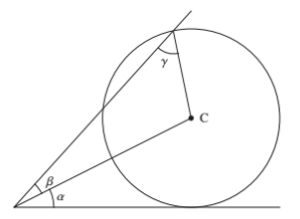
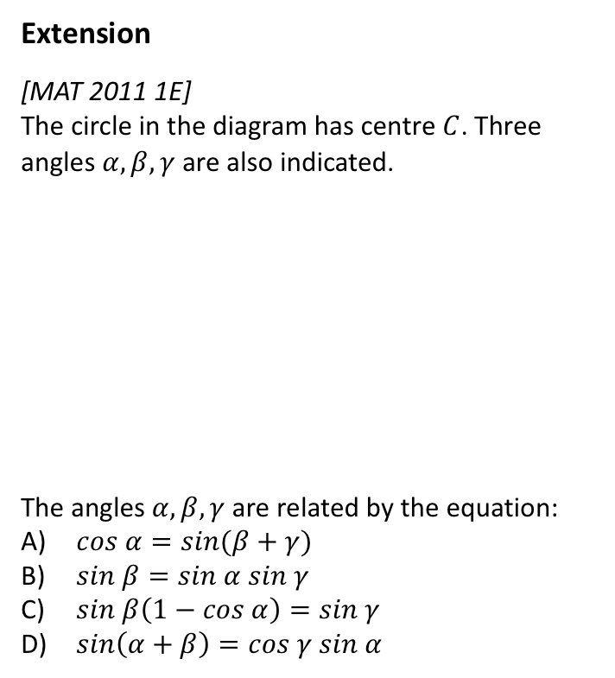


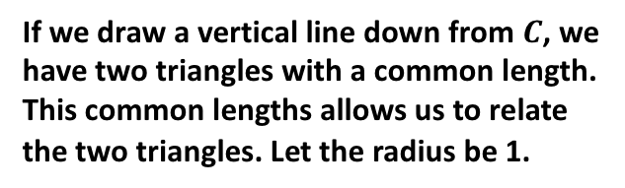
Exercise 9B
Complete before the lesson Q3-4
Green Q5-7
Amber Q8-9
Red Q10-12
Pearson Pure Mathematics
Pages 181-183
Extension
[MAT 2011 1E]
The circle in the diagram has centre $C$. Three angles $α, β, γ$ are also indicated.
The angles $α, β, γ$ are related by the equation:
$cos α=sin(β+γ)$
$sin β=sin α sin γ$
$sin β\left(1−cos α\right)=sin γ$
$sin\left(α+β\right)=cos γ sin α$
?
If we draw a vertical line down from $C$, we have two triangles with a common length. This common lengths allows us to relate the two triangles. Let the radius be 1.
1
1
$$x$$
1
Using bottom triangle:
$$1=x\sin{α → x=\frac{1}{\sin{α}}}$$
Using sine rule on top:
$$\frac{x}{\sin{γ}}=\frac{1}{\sin{β}}$$
Substituting in $x$ from the first equation, and rearranging, we obtain (B).

Slide 14
Exercise 9C
Pearson Pure Mathematics Year 1/AS
Pages 184-185
Complete before the lesson Q1-2
Green Q3-4
Amber Q5-6

Slide 15
Exercise 9D
Pearson Pure Mathematics Year 1/AS
Pages 186-187
Complete before the lesson Q1-2
Green Q3-4
Amber Q5-6

Slide 16
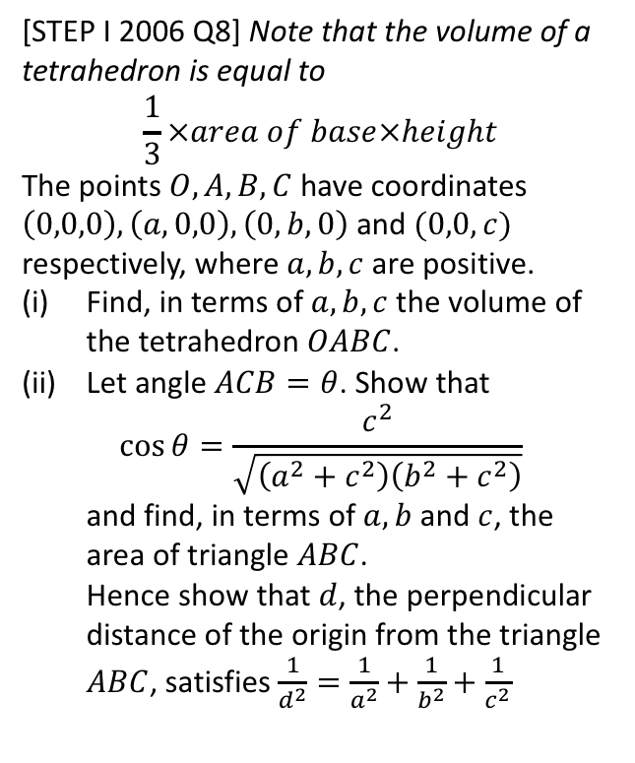
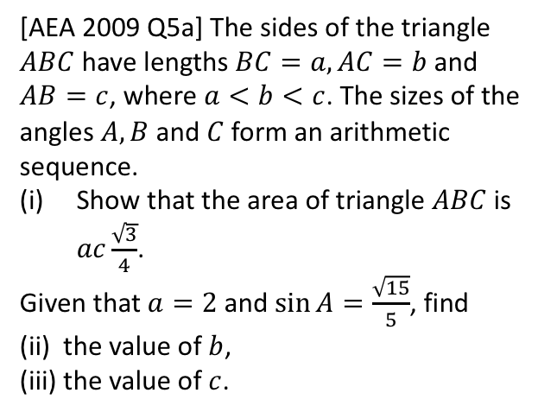
Exercise 9E
Pearson Pure Mathematics Year 1/AS
Pages 189-191
1
[AEA 2009 Q5a] The sides of the triangle $ABC$ have lengths $BC=a, AC=b$ and $AB=c$, where $a<b<c$. The sizes of the angles $A, B$ and $C$ form an arithmetic sequence.
Show that the area of triangle $ABC$ is $ac\frac{\sqrt{3}}{4}$.
Given that $a=2$ and $\sin{A}=\frac{\sqrt{15}}{5}$, find
(ii) the value of $b$,
(iii) the value of $c$.
2
[STEP I 2006 Q8] Note that the volume of a tetrahedron is equal to
$$\frac{1}{3}×area of base×height$$
The points $O, A, B, C$ have coordinates $\left(0,0,0\right),\left(a,0,0\right), \left(0,b,0\right)$ and $(0,0,c)$ respectively, where $a,b,c$ are positive.
Find, in terms of $a,b,c$ the volume of the tetrahedron $OABC$.
Let angle $ACB=θ$. Show that
$\cos{θ=\frac{c^{2}}{\sqrt{\left(a^{2}+c^{2}\right)\left(b^{2}+c^{2}\right)}}}$
and find, in terms of $a,b$ and $c$, the area of triangle $ABC$.
Hence show that $d$, the perpendicular distance of the origin from the triangle $ABC$, satisfies $\frac{1}{d^{2}}=\frac{1}{a^{2}}+\frac{1}{b^{2}}+\frac{1}{c^{2}}$
Complete before the lesson Q1
Green Q3-5
Amber Q6-9
Red Q10-15
Solutions to extension problems on next slides.

