Slide 1
Year 2 Applied Mathematics
Normal Distribution
– Hypothesis Testing
on Sample Mean
Chapter 3 (Part 7)

Slide 2
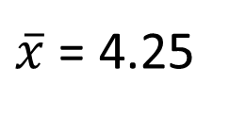
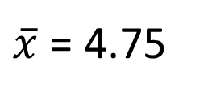
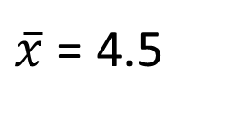
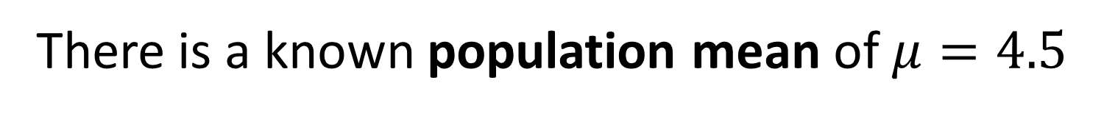
Hypothesis Testing on the Sample Mean
You have a population of children, with the below ages.
0
1
2
3
4
5
6
7
8
9
There is a known population mean of $μ=4.5$
Different samples of 4 ages are taken
Sample 1:
1
3
7
8
$\overline{x}$ = 4.75
Sample 2:
6
2
0
9
$\overline{x}$ = 4.25
Sample 3:
5
3
6
4
$\overline{x}$ = 4.5
How would these means be distributed?

Slide 3
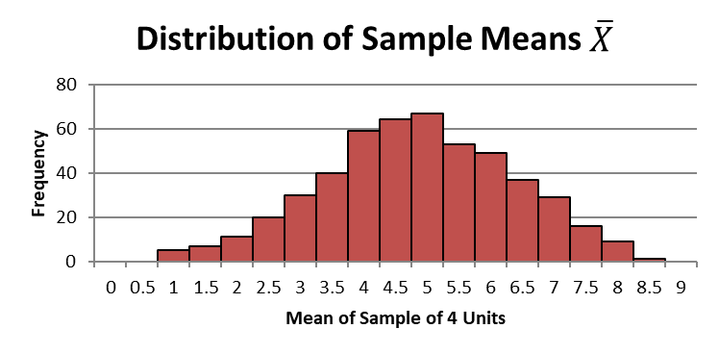
Hypothesis Testing on the Sample Mean
1000 samples are taken.
Below is the distribution of the sample.
What type of distribution appears?
Approximately normally distributed.

Slide 4
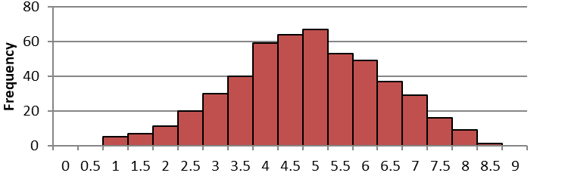
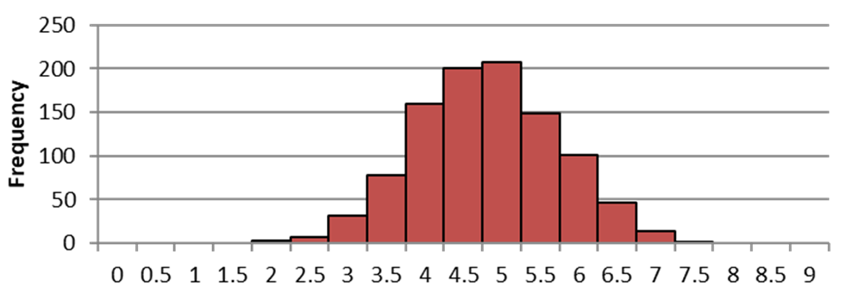
Hypothesis Testing on the Sample Mean
1000 samples.
Each sample
4 children.
1000 samples.
Each sample
10 children.
How does the sample mean
compare to the population mean?
Sample mean is on average
equal to the population mean.

Slide 5
Hypothesis Testing on the Sample Mean
1000 samples.
Each sample
4 children.
1000 samples.
Each sample
10 children.
What is the difference between
each sample distribution?
The variance/standard deviation is different.

Slide 6
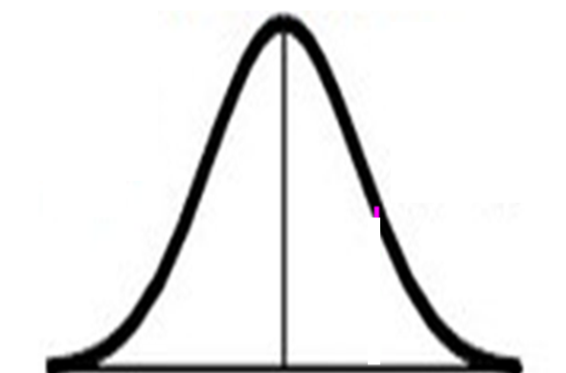
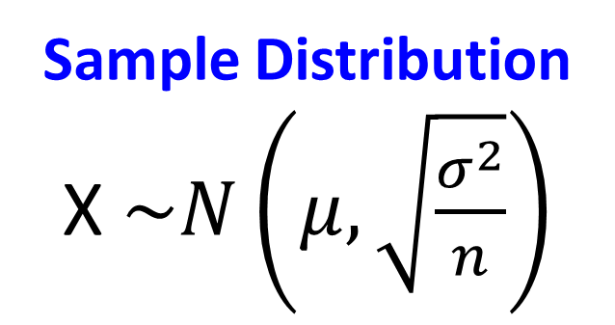
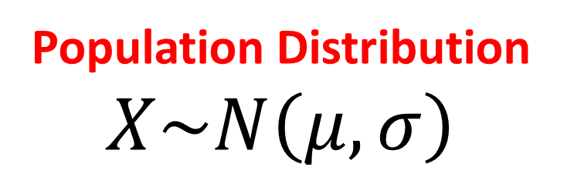

Hypothesis Testing on the Sample Mean
Population Distribution
$$X\sim N\left(μ, σ\right)$$
Sample Distribution
X $\sim N\left(μ,\sqrt{\frac{σ^{2}}{n}}\right)$
Sample size = n
Standard deviation = $\sqrt{\frac{σ^{2}}{n}}$

Slide 7
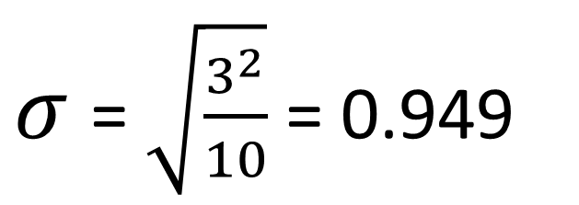

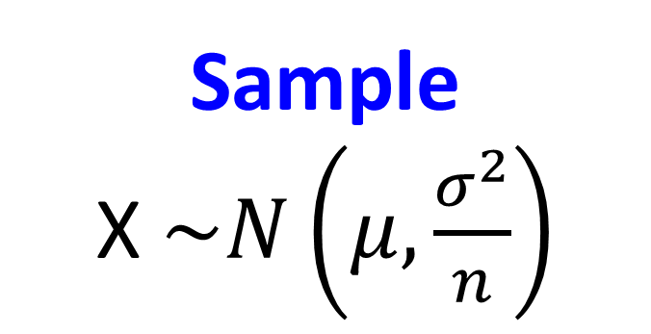

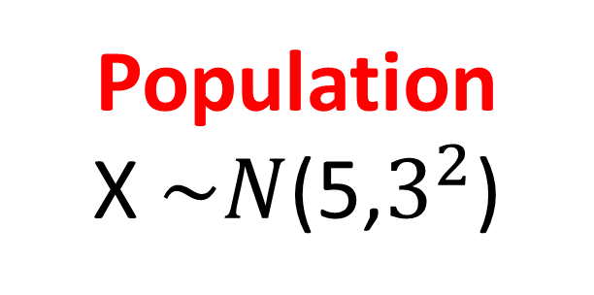
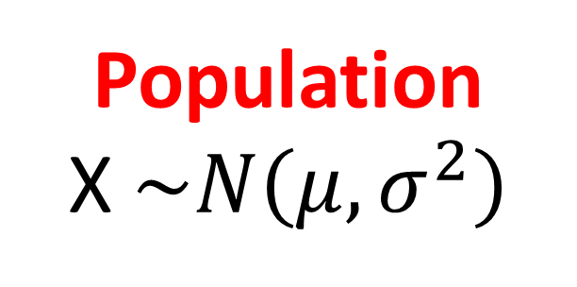
Hypothesis Testing on the Sample Mean
Population
X $\sim N\left(μ,σ^{2}\right)$
Sample
X $\sim N\left(μ,\frac{σ^{2}}{n}\right)$
Population
X $\sim N$(5,$3^{2}$)
Sample (size 10)
X $\sim N$( 5,${0.949 }^{2}$)
5
${ 0.949}^{2}$
$σ$= $\sqrt{\frac{3^{2}}{10}}$ = 0.949

Slide 8
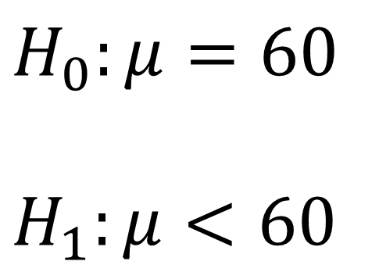
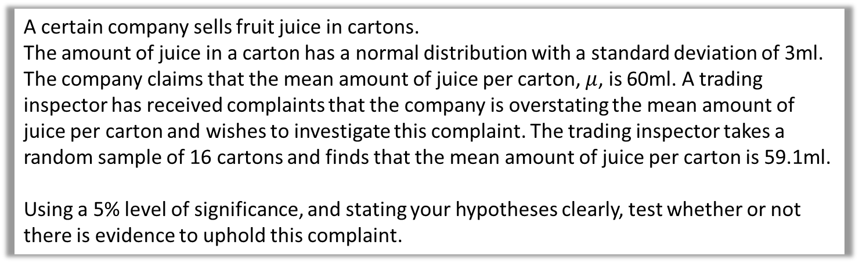
Hypothesis Testing on Sample Mean
A certain company sells fruit juice in cartons.
The amount of juice in a carton has a normal distribution with a standard deviation of 3ml.
The company claims that the mean amount of juice per carton, $μ$, is 60ml. A trading inspector has received complaints that the company is overstating the mean amount of juice per carton and wishes to investigate this complaint. The trading inspector takes a random sample of 16 cartons and finds that the mean amount of juice per carton is 59.1ml.
Using a 5% level of significance, and stating your hypotheses clearly, test whether or not there is evidence to uphold this complaint.
State you hypotheses:
$$H_{0}:μ=60$$
$$H_{1}:μ<60$$

Slide 9
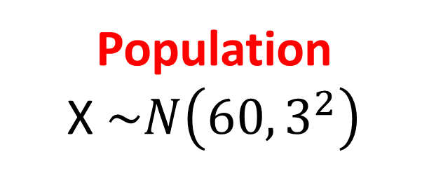

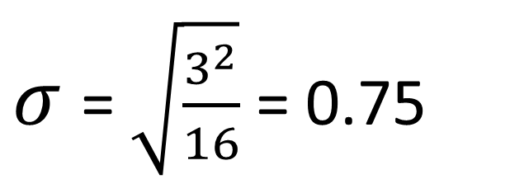
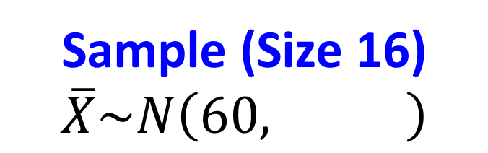
Hypothesis Testing on Sample Mean
A certain company sells fruit juice in cartons.
The amount of juice in a carton has a normal distribution with a standard deviation of 3ml.
The company claims that the mean amount of juice per carton, $μ$, is 60ml. A trading inspector has received complaints that the company is overstating the mean amount of juice per carton and wishes to investigate this complaint. The trading inspector takes a random sample of 16 cartons and finds that the mean amount of juice per carton is 59.1ml.
Using a 5% level of significance, and stating your hypotheses clearly, test whether or not there is evidence to uphold this complaint.
State your distribution for the sample:
Population
X $\sim N\left(60,3^{2}\right)$
Sample (Size 16)
$$\overline{X}\sim N\left({60, 0.75}^{2}\right)$$
$${0.75}^{2}$$
$σ$= $\sqrt{\frac{3^{2}}{16}}$ = 0.75

Slide 10
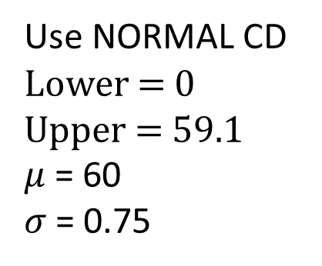
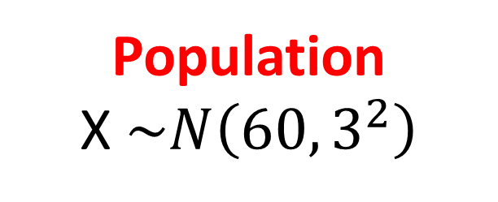
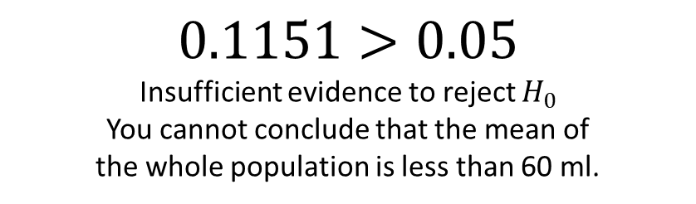


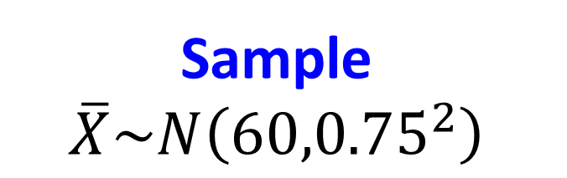
Hypothesis Testing on Sample Mean
Population
X $\sim N\left(60,3^{2}\right)$
Sample
$$\overline{X}\sim N\left({60,0.75}^{2}\right)$$
60
59.1
60
$$P\left(\overline{X}≤59.1\right)=$$
$$0.1151$$
Use NORMAL CD
Lower = 0
Upper = 59.1
$μ$ = 60
$σ$= 0.75
$0.1151>0.05$
Insufficient evidence to reject $H_{0}$
You cannot conclude that the mean of
the whole population is less than 60 ml.

Slide 11
Hypothesis Testing on Sample Mean – Step by Step
Step 1. State you hypotheses
Step 2. State you distribution for the sample
Step 3. Calculate the probability
of your sample result happening
Step 4. Compare this probability
with the significant level
Step 5. Accept or reject your hypotheses H_{o}

Slide 12
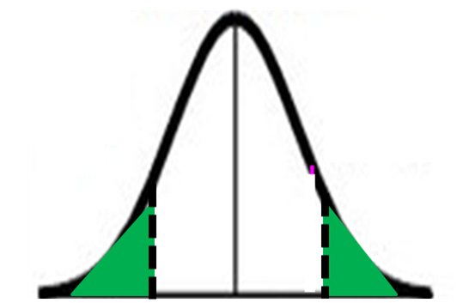
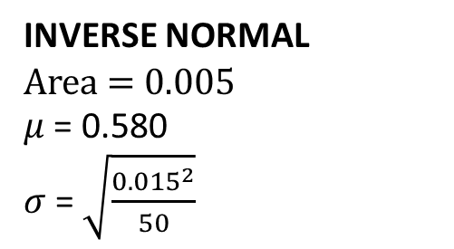

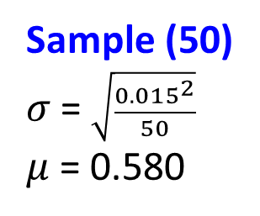
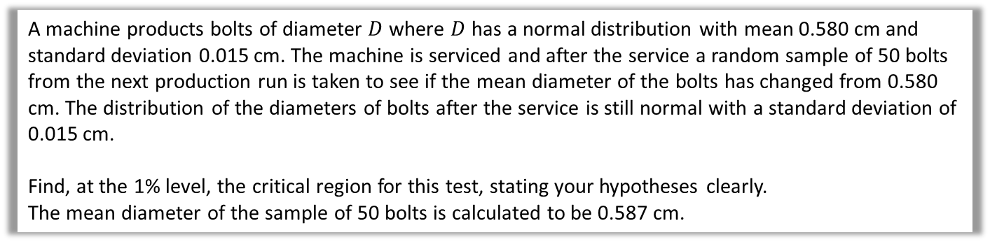

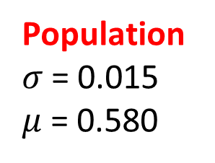

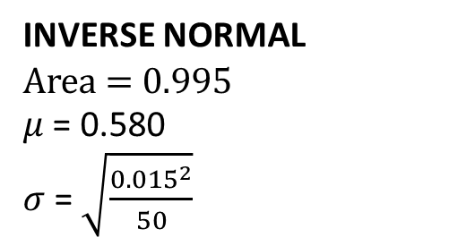
Hypothesis Testing – Given Probability Area
A machine products bolts of diameter $D$ where $D$ has a normal distribution with mean 0.580 cm and standard deviation 0.015 cm. The machine is serviced and after the service a random sample of 50 bolts from the next production run is taken to see if the mean diameter of the bolts has changed from 0.580 cm. The distribution of the diameters of bolts after the service is still normal with a standard deviation of 0.015 cm.
Find, at the 1% level, the critical region for this test, stating your hypotheses clearly.
The mean diameter of the sample of 50 bolts is calculated to be 0.587 cm.
$$H_{0}:μ=0.580$$
$$H_{1}:μ≠0.580$$
Population
$σ$= 0.015
$μ$ = 0.580
Sample (50)
$σ$= $\sqrt{\frac{{0.015}^{2}}{50}}$
$μ$ = 0.580
0.580
0.580
0.5%
0.5%
INVERSE NORMAL
Area = 0.005
$μ$ = 0.580
$σ$= $\sqrt{\frac{{0.015}^{2}}{50}}$
INVERSE NORMAL
Area = 0.995
$μ$ = 0.580
$σ$= $\sqrt{\frac{{0.015}^{2}}{50}}$
Lower Critical region
d $≤0.575$
Upper Critical region
d $≥0.585$

Slide 13
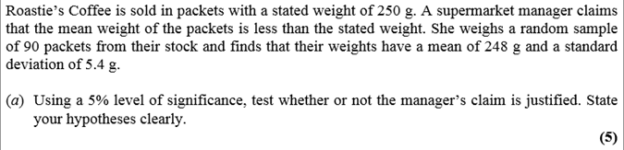
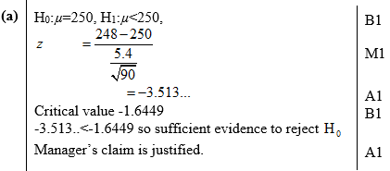
Test Your Understanding
Edexcel S3 June 2011 Q7a
?

Slide 14
Exercise 3G
Pearson Stats/Mechanics Year 2
Pages 58-60
Complete before the lesson Q1-2
In Class:
Green Q3-5
Amber Q6-7
Red Q7-8

