Slide 1
Year 2 Pure Mathematics
Trigonometry and Modelling
- Solving Equations
Chapter 7
(Part 3 of 5)

Slide 2
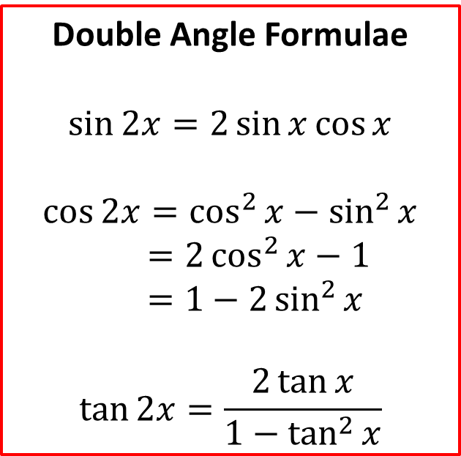
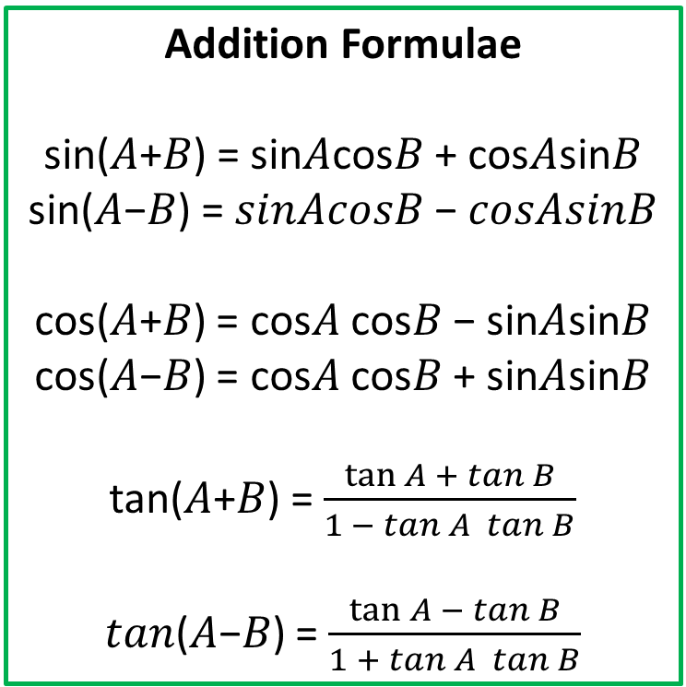
Solving Trigonometric Equations
Use the addition formulae and double angle formulae
to help solve trigonometric equations
Addition Formulae
sin⁡(𝐴+𝐵) = sin⁡𝐴cos⁡𝐵 + cos⁡𝐴sin⁡𝐵
sin⁡(𝐴−𝐵) = 𝑠𝑖𝑛⁡𝐴𝑐𝑜𝑠⁡𝐵 − 𝑐𝑜𝑠⁡𝐴𝑠𝑖𝑛⁡𝐵
cos⁡(𝐴+𝐵) = cos⁡𝐴 cos⁡𝐵 − sin⁡𝐴sin⁡𝐵
cos⁡(𝐴−𝐵) = cos⁡𝐴 cos⁡𝐵 + sin⁡𝐴sin⁡𝐵
tan⁡(𝐴+𝐵) = $\frac{\tan{A} + tan⁡B}{1 − tan⁡A tan⁡B}$
𝑡𝑎𝑛⁡(𝐴−𝐵) = $\frac{\tan{A }− tan⁡B}{1 + tan⁡A tan⁡B}$
Double Angle Formulae
$$\sin{2x}=2\sin{x}\cos{x}$$
$$\cos{2x}=\cos^{2}{x}−\sin^{2}{x} \\ =2\cos^{2}{x}−1 \\ =1−2\sin^{2}{x}$$
$$\tan{2x}=\frac{2\tan{x}}{1−\tan^{2}{x}}$$

Slide 3
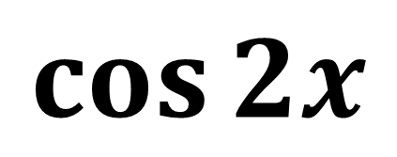
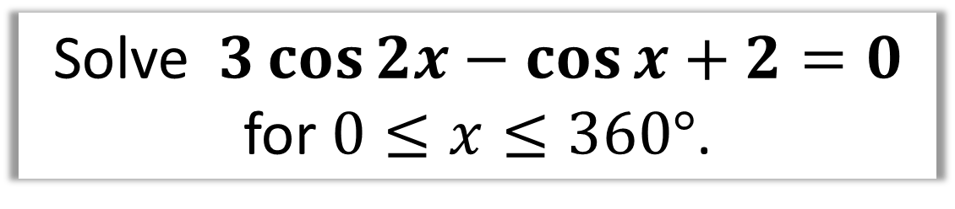
Solving Trigonometric Equations
Solve $3\cos{2x}−\cos{x}+2=0$
for $0≤x≤360°$.
Double Angle Formulae or Additional Formulae?
$$\cos{2x}$$
Double Angle of course!!!!

Slide 4
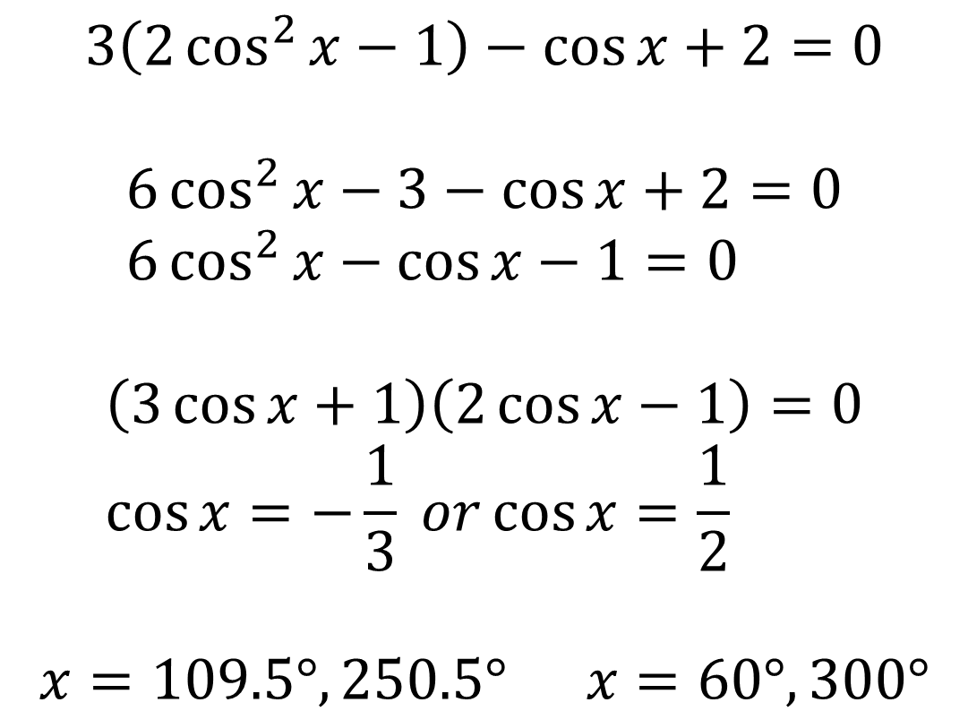

Solving Trigonometric Equations – Exam Questions
Solve $3\cos{2x}−\cos{x}+2=0$
for $0≤x≤360°$.
$$3\left(2\cos^{2}{x}−1\right)−\cos{x}+2=0$$
$$6\cos^{2}{x}−3−\cos{x}+2=0 \\ 6\cos^{2}{x}−\cos{x}−1=0$$
$$\left(3\cos{x}+1\right)\left(2\cos{x}−1\right)=0 \\ \cos{x}=−\frac{1}{3} or\cos{x}=\frac{1}{2}$$
$$x=109.5°, 250.5° x=60°,300°$$

Slide 5
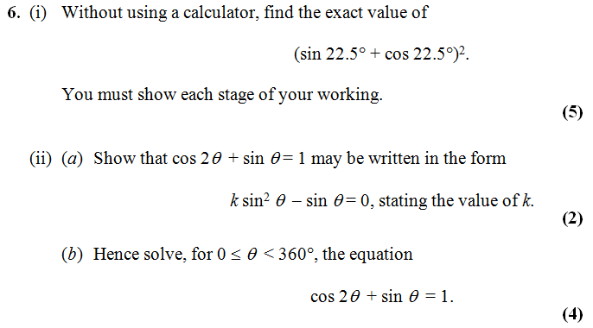
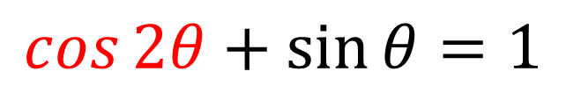
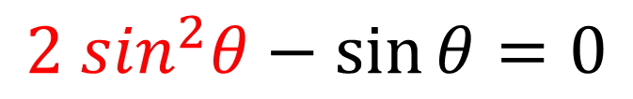
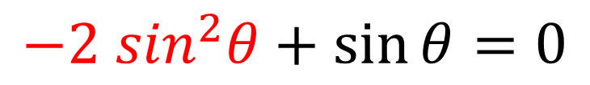
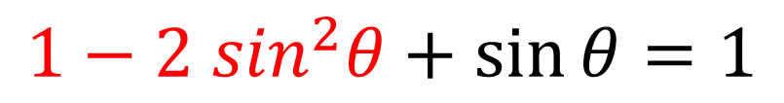
Solving Trigonometric Equations – Exam Question
ii) (a)
$$\cos{2θ}+\sin{θ}=1$$
$$1−2 \sin^{2}θ+\sin{θ}=1$$
$$−2 \sin^{2}θ+\sin{θ}=0$$
$$2 \sin^{2}θ−\sin{θ}=0$$
k = 2

Slide 6
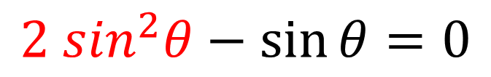
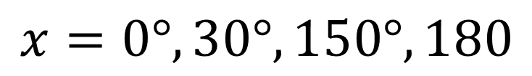
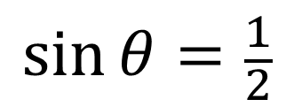
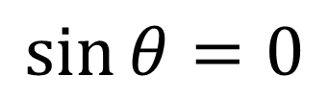
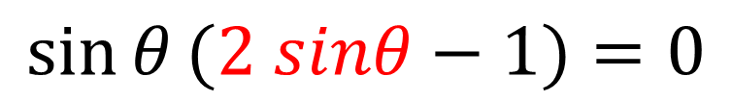
Solving Trigonometric Equations – Exam Question
ii) (b)
$$2 \sin^{2}θ−\sin{θ}=0$$
$$\sin{θ}(2 sinθ−1)=0$$
$$\sin{θ}=0$$
$$\sin{θ}=\frac{1}{2}$$
$$x=0°, 30°, 150°, 180$$

Slide 7
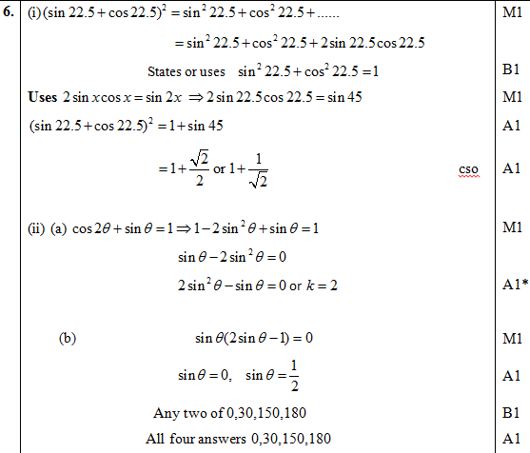


Test Your Understanding
Edexcel C3 Jan 2013 Q6
?
If you finish that quickly…
[Textbook] Solve $2\tan{2y}\tan{y}=3$ for $0≤y<2π$, giving your answer to 2dp.
?
$$2\tan{2y}\tan{y}=3 \\ 2\left(\frac{2\tan{y}}{1−\tan^{2}{y}}\right)\tan{y}=3 \\ … \\ 7\tan^{2}{y}=3 \\ \tan{y}=±\sqrt{\frac{3}{7}} \\ y=0.58, 2.56, 3.72, 5.70$$
Forgetting the $±$ is an incredibly common source of lost marks.

Slide 8
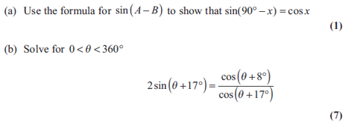
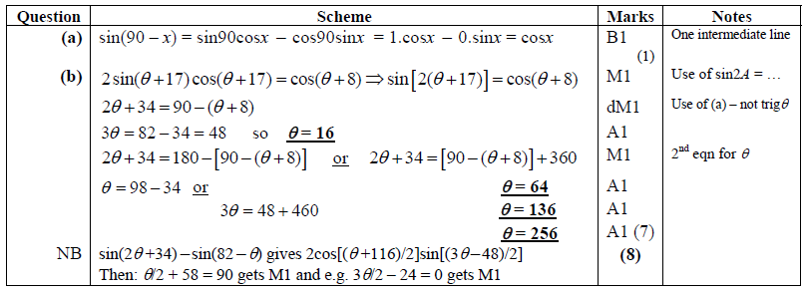
Exercise 7D
Pearson Pure Mathematics Year 2/AS
Pages 180-181
Extension
[AEA 2013 Q2]
Complete before the lesson Q1-3
In Class:
Green Q4-5
Amber Q6-9
Red Q10-14
1
?

