Slide 1
Year 1 Pure Mathematics
Forces and Friction
– Resolving Forces
Chapter 1
(Part 1 of 3)

Slide 2



Resolving Forces
$$10N$$
8 kg
$$30°$$
the above gives the horizontal force below:
8 kg
$$10\cos{30° }$$

Slide 3

Resolving Forces
$$10N$$
8 kg
$$30°$$
the above gives the vertical force below:
8 kg
$$10\sin{30° }$$

Slide 4








Resolving Forces
$$R$$
$$10N$$
8 kg
$$30°$$
$$8g$$
The diagram used be resolved using horizontal and vertical forces only.
$$R$$
$$10\sin{30}$$
8 kg
$$10\sin{30}$$
$$8g$$

Slide 5



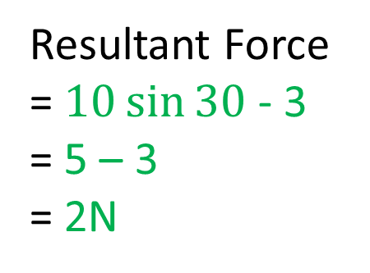







Resolving Forces
$$R$$
$$10N$$
$$3N$$
8 kg
$$30°$$
$$8g$$
What is the resultant horizontal force?
$$R$$
$$10\sin{30}$$
Resultant Force
= $10\sin{30}$ - 3
= 5 – 3
= 2N
$$3N$$
8 kg
$$10\sin{30}$$
$$8g$$

Slide 6
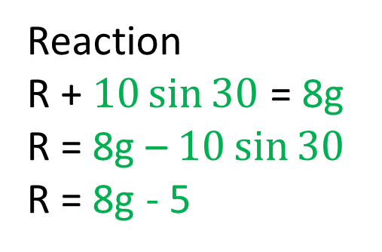
Resolving Forces
$$R$$
$$10N$$
$$3N$$
8 kg
$$30°$$
$$8g$$
What is the reaction (R) to the surface?
$$R$$
$$10\sin{30}$$
Reaction
R + $10\sin{30}$ = 8g
R = 8g – $10\sin{30}$
R = 8g - 5
$$3N$$
8 kg
$$10\sin{30}$$
$$8g$$

Slide 7

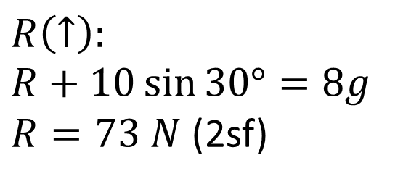

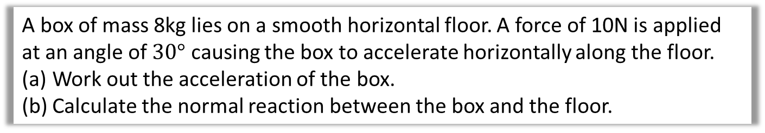


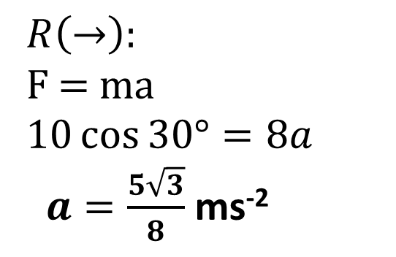


Resolving Forces
A box of mass 8kg lies on a smooth horizontal floor. A force of 10N is applied at an angle of $30°$ causing the box to accelerate horizontally along the floor.
Work out the acceleration of the box.
Calculate the normal reaction between the box and the floor.
$$R$$
a
$$R\left(→\right):$$
F = ma
$10\cos{30°}=8a$
$a=\frac{5\sqrt{3}}{8}$ ms⁻²
$$10N$$
8 kg
$$10\sin{30}$$
$$30°$$
$$10\cos{30}$$
$$8g$$
b
$$R\left(↑\right):$$
$$R+10\sin{30°}=8g$$
$R=73 N$ (2sf)

Slide 8
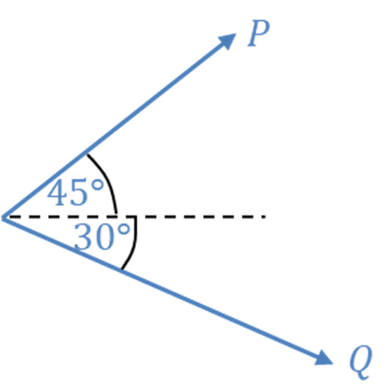
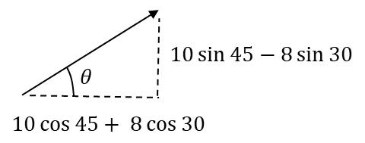
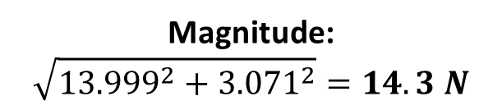
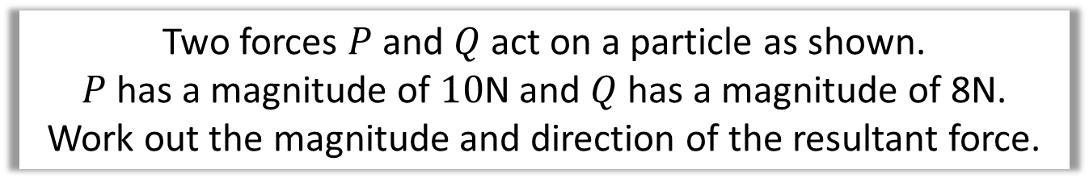
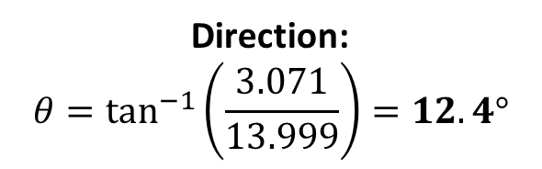
Combining Forces
Two forces $P$ and $Q$ act on a particle as shown.
$P$ has a magnitude of $10$N and $Q$ has a magnitude of 8N.
Work out the magnitude and direction of the resultant force.
Resultant Vertical Force
10 sin 45 – 8 sin 30
Resultant Horizontal Force
10 cos 45 + 8 cos 30
Magnitude:
$$\sqrt{{13.999}^{2}+{3.071}^{2}}=14.3 N$$
Direction:
$$θ=\tan^{−1}\left(\frac{3.071}{13.999}\right)=12.4°$$

Slide 9
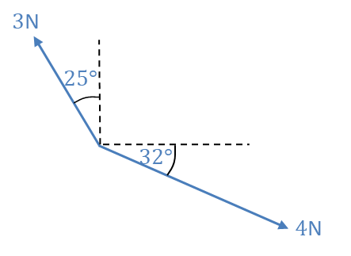
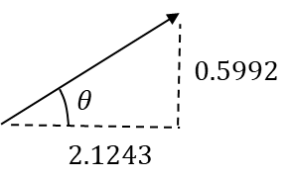
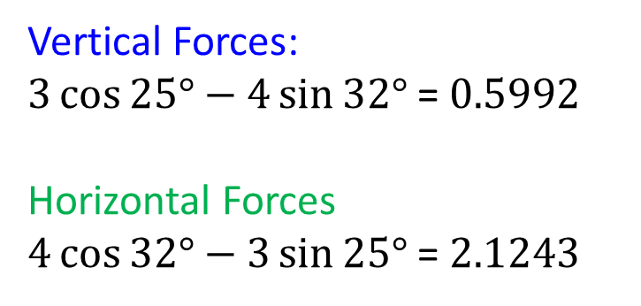

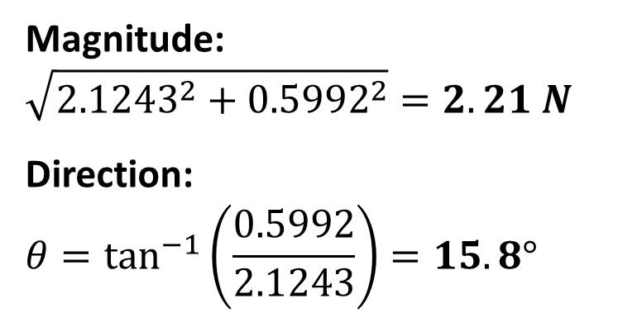
Combining Forces
A particle has forces acting on it as indicated in the diagram. Determine the magnitude and direction (anticlockwise from the positive $x$ direction) of the resultant force.
Vertical Forces:
$3\cos{25°}−4\sin{32°}$ = $0.5992$
Horizontal Forces
$4\cos{32°}−3\sin{25°}$ = $2.1243$
Magnitude:
$$\sqrt{{2.1243}^{2}+{0.5992}^{2}}=2.21 N$$
Direction:
$$θ=\tan^{−1}\left(\frac{0.5992}{2.1243}\right)=15.8°$$

Slide 10
Exercise 5A
Pearson Stats/Mechanics Year 2
Pages 94-96
Complete before the lesson Q1-3*
In Class:
Green Q4-5
Amber Q6-7
Red Q8-9 & Challenge

