Slide 1
Year 1 Pure Mathematics
Data Collection
– Large Data Set
Chapter 1
(Part 4 of 4)

Slide 2
Large Data Set
All A Level exam boards are obligated to provide a
‘large data set’.
Data in exam questions will often be from this set,
and you are encouraged to explore this data.
It is important to note that you are expected
to be familiar with this data set
before you go into your exam,
including some basic geographic knowledge!

Slide 3
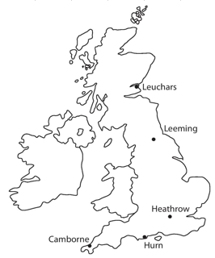
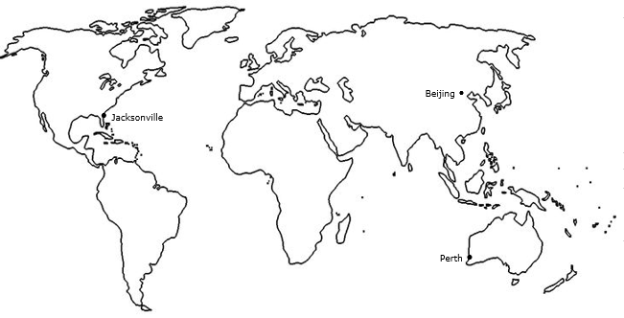
What You Need To Be Familiar With…
Northern Hemisphere
Southern Hemisphere
1
You should know the names and rough locations
of the 5 UK weather stations,
as well as the 3 international weather stations.
The data was recorded for:
May-Oct 1987
May-Oct 2015

Slide 4
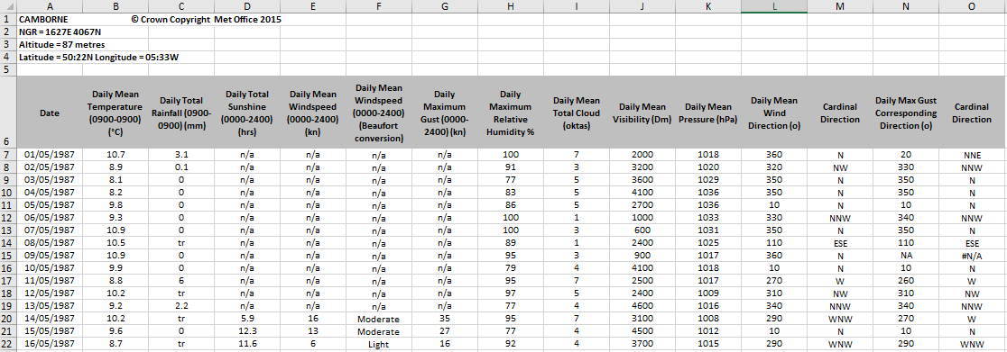
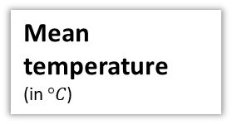
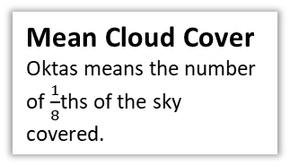
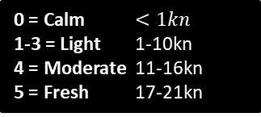
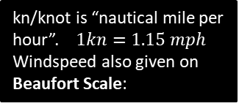
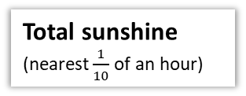
All the following are daily…
2
You should be familiar with the variables involved
and their respective units.
Total rainfall
(in mm)
Mean Windspeed
Mean Visibility
How far (in metres) can be seen into the horizon during daylight hours.
kn/knot is “nautical mile per hour”. $1kn=1.15 mph$
Windspeed also given on Beaufort Scale:
0 = Calm $<1kn$
1-3 = Light 1-10kn
4 = Moderate 11-16kn
5 = Fresh 17-21kn
tr/trace means less than 0.05mm
Wind Direction
Mean Pressure
In hectopascals (hPa)
Mean temperature
(in $°C$)
Maximum Gust (in kn) is highest instantaneous wind speed.
Humidity
is the % of air saturation with water vapour. 100% is the maximum % water content air can contain.
Mean Cloud Cover
Oktas means the number of $\frac{1}{8}$ths of the sky covered.
Total sunshine
(nearest $\frac{1}{10}$ of an hour)

Slide 5
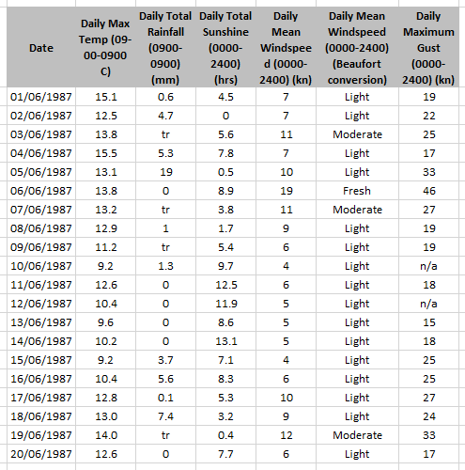
Example Questions
(a) Describe the type of data represented by daily total rainfall.
Alison is investigating daily maximum gust. She wants to select a sample of size 5 from the first 20 days in Hurn in June 1987. She uses the first two digits of the date as a sampling frame and generates five random numbers between 1 and 20.
b) State the type of sample selected by Alison.
c) Explain why Alison’s process might not generate a sample of size 5.
a
Continuous qualitative data.
Simple random sample.
Some of the data values are not available (n/a).
b
the actual data set has mean temperature for all locations.
c

Slide 6
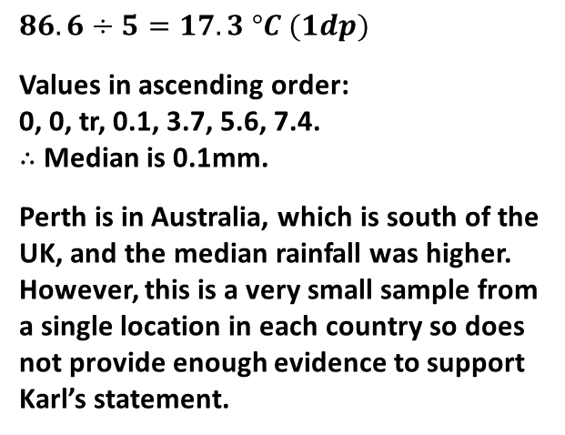
Example Questions
Calculate:
The mean daily maximum temperature for the first five days of June in Hurn in 1987.
The median daily total rainfall for the week of 14th June to 20th June inclusive.
The median daily total rainfall for the same week in Perth was 19.00mm. Karl states that more southerly countries experience higher rainfall during June. State with a reason whether your answer to part (b) supports this statement.
a
$$86.6÷5=17.3 °C (1dp)$$
Values in ascending order:
0, 0, tr, 0.1, 3.7, 5.6, 7.4.
$∴$ Median is 0.1mm.
Perth is in Australia, which is south of the UK, and the median rainfall was higher. However, this is a very small sample from a single location in each country so does not provide enough evidence to support Karl’s statement.
b
c

Slide 7
Exercise 1E
Pearson Statistics & Mechanics Year 1/AS
Pages 13-15
Complete before the lesson Q1-2
In Class:
Green Q3-5
Amber Q6-8

