Slide 1
Year 2 Pure Mathematics
Parametric Equations
- Graphing and Intersection
Chapter 8
(Part 3 of 3)

Slide 2
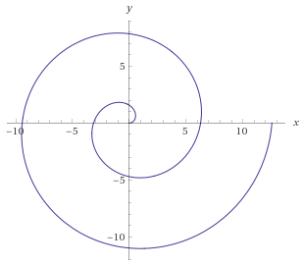
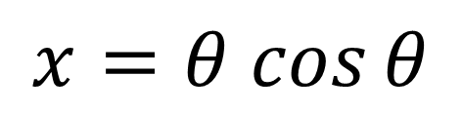
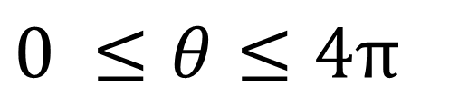
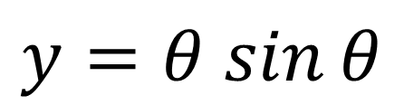
Parametric Curves - Sketching
We saw that one strategy for sketching parametric curves is to convert into a Cartesian equation, and hope this is a form we recognise
(e.g. quadratic or equation of circle) to appropriately sketch.
However, some parametric equations can’t easily be turned into Cartesian form:
$$x=θ cos{θ}$$
$$y=θ sin{θ}$$
$0 ≤θ≤4π$

Slide 3

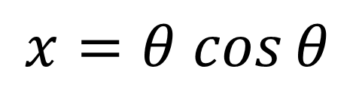





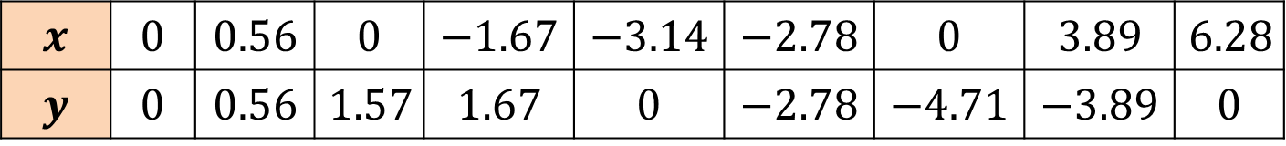



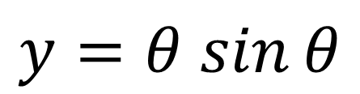
Parametric Curves - Sketching
$$x=θ cos{θ}$$
$$y=θ sin{θ}$$
$$θ$$ | $$0$$ | $$\frac{π}{4}$$ | $$\frac{π}{2}$$ | $$\frac{3}{4}π$$ | $$π$$ | $$\frac{5}{4}π$$ | $$\frac{3}{2}π$$ | $$\frac{7}{4}π$$ | $$2π$$
$$x$$ | $$0$$ | $$0.56$$ | $$0$$ | $$−1.67$$ | $$−3.14$$ | $$−2.78$$ | $$0$$ | $$3.89$$ | $$6.28$$
$$y$$ | $$0$$ | $$0.56$$ | $$1.57$$ | $$1.67$$ | $$0$$ | $$−2.78$$ | $$−4.71$$ | $$−3.89$$ | $$0$$
$$y$$
$$\left(−1.67,1.57\right)$$
$$\left(0,1.57\right)$$
$$\left(0.56,0.56\right)$$
$$x$$
$$\left(−3.14,0\right)$$
$$\left(0,0\right)$$
$$\left(−2.78,−2.78\right)$$
$$\left(0, −4.71\right)$$

Slide 4
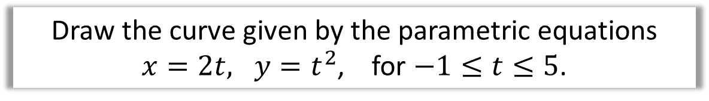
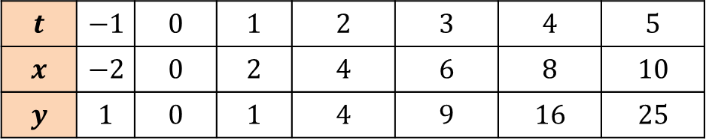


Parametric Curves - Sketching
Draw the curve given by the parametric equations
$x=2t, y=t^{2}$, for $−1≤t≤5$.
$$t$$ | $$−1$$ | $$0$$ | $$1$$ | $$2$$ | $$3$$ | $$4$$ | $$5$$
$$x$$ | $$−2$$ | $$0$$ | $$2$$ | $$4$$ | $$6$$ | $$8$$ | $$10$$
$$y$$ | $$1$$ | $$0$$ | $$1$$ | $$4$$ | $$9$$ | $$16$$ | $$25$$
$$y$$
25
20
15
10
5
$$x$$
-2 2 4 6 8 10

Slide 5
Exercise 8C
Pearson Pure Mathematics Year 2/AS
Pages 207-208
(This exercise could probably be skipped for classes in a rush)

Slide 6
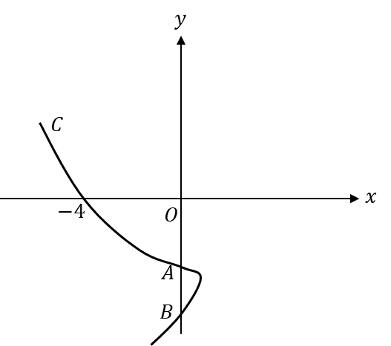
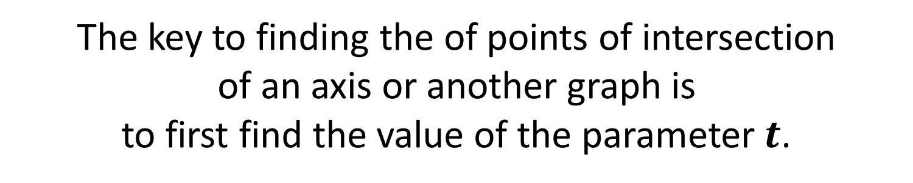
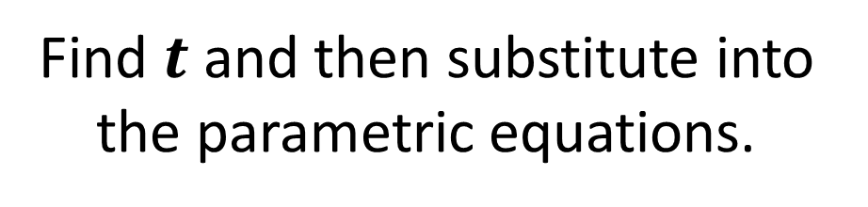
Parametric Curves - Points of Intersection
The key to finding the of points of intersection
of an axis or another graph is
to first find the value of the parameter $t$.
Find $t$ and then substitute into the parametric equations.

Slide 7

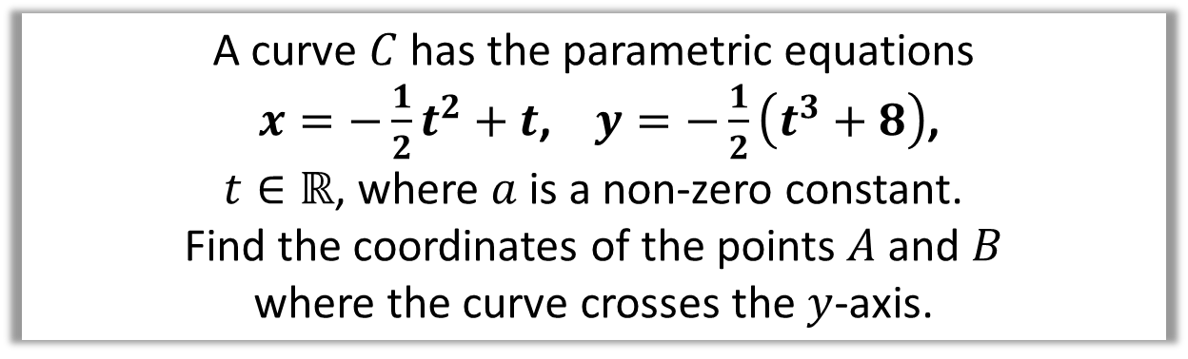
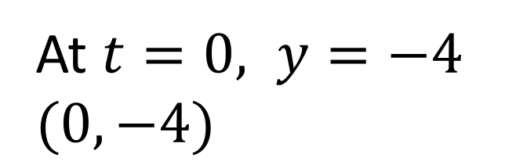
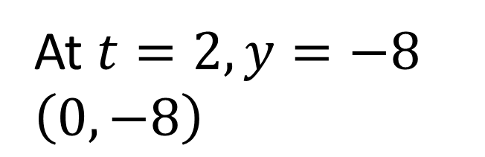
Parametric Curves - Points of Intersection
A curve $C$ has the parametric equations
$x=−\frac{1}{2}t^{2}+t$, $y=−\frac{1}{2}\left(t^{3}+8\right)$,
$t∈ℝ$, where $a$ is a non-zero constant.
Find the coordinates of the points $A$ and $B$
where the curve crosses the $y$-axis.
$$x=0$$
0 $=−\frac{1}{2}t^{2}+t$
a = $−\frac{1}{2}$ b = 1 c =0
$$t=0 or t=2$$
At $t=2, y=−8$
$$\left(0,−8\right)$$
At $t=0, y=−4$
$$(0,−4)$$

Slide 8
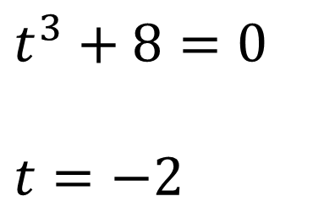

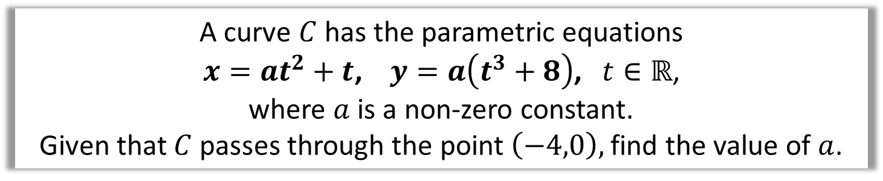
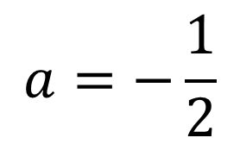
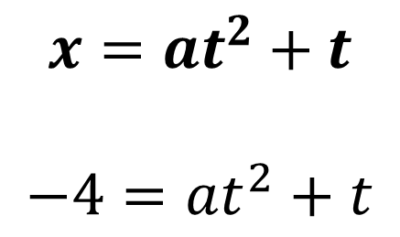
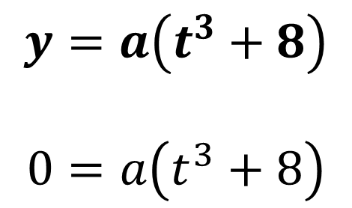
Parametric Curves - Points of Intersection
A curve $C$ has the parametric equations
$x=at^{2}+t$, $y=a\left(t^{3}+8\right)$, $t∈ℝ$,
where $a$ is a non-zero constant.
Given that $C$ passes through the point $\left(−4,0\right),$ find the value of $a$.
$$y=a\left(t^{3}+8\right)$$
$$0=a\left(t^{3}+8\right)$$
$$x=at^{2}+t$$
$$−4=at^{2}+t$$
$$−4=4a−2$$
$$t^{3}+8=0$$
$$t=−2$$
$$a=−\frac{1}{2}$$

Slide 9
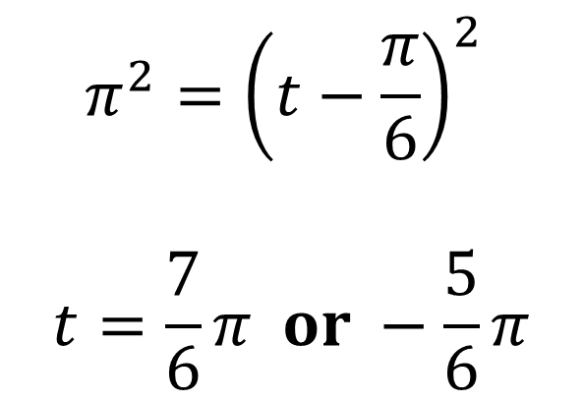
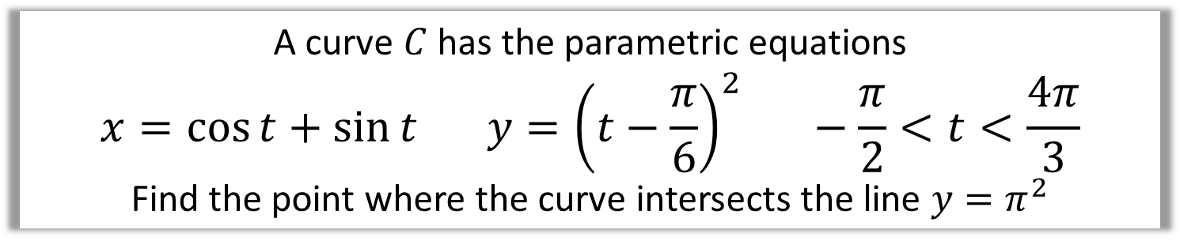
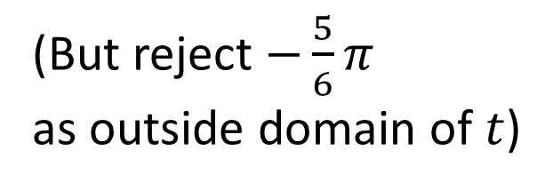
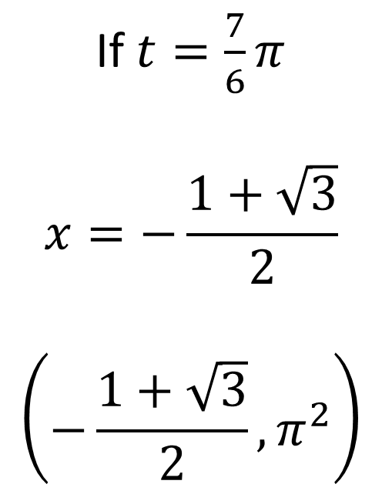
Parametric Curves - Points of Intersection
A curve $C$ has the parametric equations
$$x=\cos{t}+\sin{t} y={\left(t−\frac{π}{6}\right)}^{2} −\frac{π}{2}<t<\frac{4π}{3}$$
Find the point where the curve intersects the line $y=π^{2}$
$$π^{2}={\left(t−\frac{π}{6}\right)}^{2}$$
$$t=\frac{7}{6}π or −\frac{5}{6}π$$
If $t=\frac{7}{6}π$
$$x=−\frac{1+\sqrt{3}}{2}$$
$$\left(−\frac{1+\sqrt{3}}{2},π^{2}\right)$$
(But reject $−\frac{5}{6}π$
as outside domain of $t$)

Slide 10
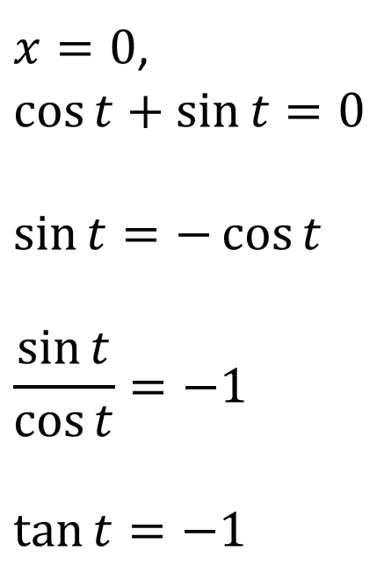
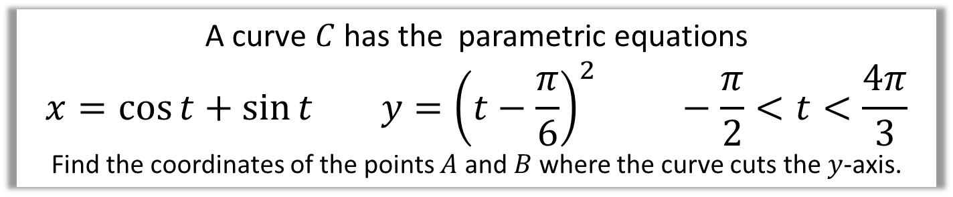
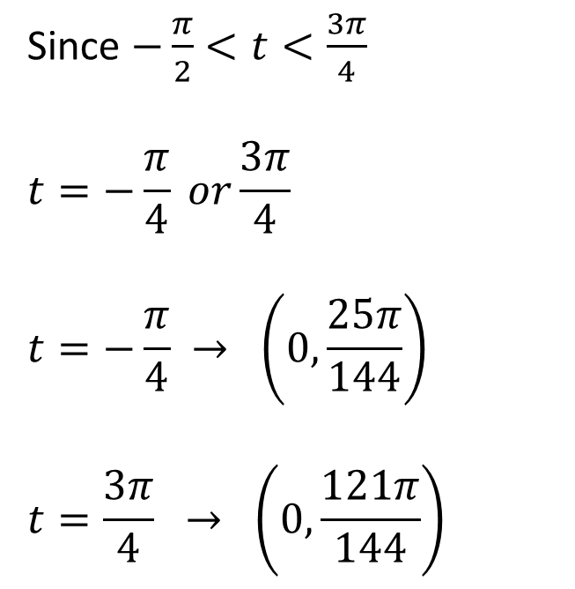
Parametric Curves - Points of Intersection
A curve $C$ has the parametric equations
$$x=\cos{t}+\sin{t} y={\left(t−\frac{π}{6}\right)}^{2} −\frac{π}{2}<t<\frac{4π}{3}$$
Find the coordinates of the points $A$ and $B$ where the curve cuts the $y$-axis.
$x=0$,
$$\cos{t}+\sin{t}=0$$
$$\sin{t}=−\cos{t}$$
$$\frac{\sin{t}}{\cos{t}}=−1$$
$$\tan{t}=−1$$
Since $−\frac{π}{2}<t<\frac{3π}{4}$
$$t=−\frac{π}{4} or\frac{3π}{4}$$
$$t=−\frac{π}{4} → \left(0,\frac{25π}{144}\right)$$
$$t=\frac{3π}{4} → \left(0,\frac{121π}{144}\right)$$

Slide 11
Exercise 8D
Pearson Pure Mathematics Year 2/AS
Pages 211-213
Complete before the lesson Ex8C Q1-3 & Ex8D Q1-2
In Class:
Green Q3-10
Amber Q11-14
Red Q15-17 & Challenge

