Slide 1
Series
Twitter: @Owen134866
www.mathsfreeresourcelibrary.com

Slide 2
Teachings for
Exercise 2C

Slide 3


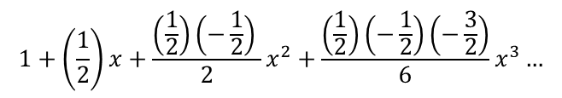
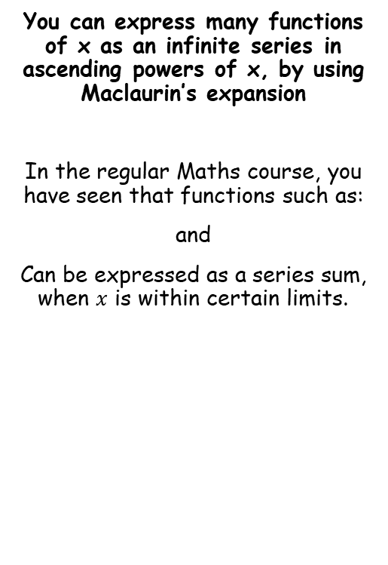



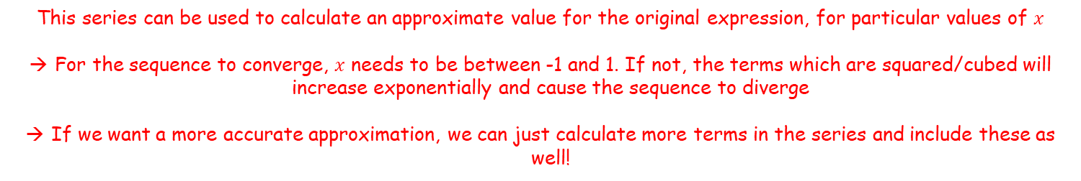
Series
$$\sqrt{1+x}={\left(1+x\right)}^{\frac{1}{2}}$$
n = ¹/₂
You can express many functions of x as an infinite series in ascending powers of x, by using Maclaurin’s expansion
In the regular Maths course, you have seen that functions such as:
and
Can be expressed as a series sum, when $x$ is within certain limits.
x = x
Start by considering the general form of the binomial expansion
$$1+nx+\frac{n(n−1) }{2!}x^{2}+\frac{n(n−1)(n−2)}{3!}x^{3}…$$
$$\sqrt{1+x}$$
$${\left(1−2x\right)}^{−1}$$
Sub in n = ¹/₂ and x = x
$$1+\left(\frac{1}{2}\right)x+\frac{\left(\frac{1}{2}\right)\left(−\frac{1}{2}\right) }{2}x^{2}+\frac{\left(\frac{1}{2}\right)\left(−\frac{1}{2}\right)\left(−\frac{3}{2}\right)}{6}x^{3}…$$
Simplify
$$=1+\frac{1}{2}x−\frac{1}{8}x^{2}+\frac{1}{16}x^{3}…$$
This series can be used to calculate an approximate value for the original expression, for particular values of $x$
For the sequence to converge, $x$ needs to be between -1 and 1. If not, the terms which are squared/cubed will increase exponentially and cause the sequence to diverge
If we want a more accurate approximation, we can just calculate more terms in the series and include these as well!
2C

Slide 4







Series
n = -1
You can express many functions of x as an infinite series in ascending powers of x, by using Maclaurin’s expansion
In the regular Maths course, you have seen that functions such as:
and
Can be expressed as a series sum, when $x$ is within certain limits.
$${\left(1−2x\right)}^{−1}$$
x = -2x
Start by considering the general form of the binomial expansion
$$1+nx+\frac{n(n−1) }{2!}x^{2}+\frac{n(n−1)(n−2)}{3!}x^{3}…$$
Sub in
n = -1 and
x = -2x
$$\sqrt{1+x}$$
$${\left(1−2x\right)}^{−1}$$
$$1+\left(−1\right)(−2x)+\frac{\left(−1\right)\left(−2\right) }{2}{(−2x)}^{2}+\frac{\left(−1\right)\left(−2\right)\left(−3\right)}{6}{(−2x)}^{3}…$$
Simplify
$$=1+2x+4x^{2}+8x^{3}…$$
For this series to converge, we need to look at the term which is raised to a power
→ Again, the value of this expression must be between -1 and 1 for it to converge. As the term itself is ‘-2x’…
$$−1<−2x<1$$
$$−1<2x<1$$
$$−\frac{1}{2}<x<\frac{1}{2}$$
2C

Slide 5
Series
You can express many functions of x as an infinite series in ascending powers of x, by using Maclaurin’s expansion
More functions can be expressed this way, as series sums
This is an extremely valuable tool as it allows us to calculate functions to any degree of accuracy
It is also essentially the process a calculator goes through when calculating such values!
2C

Slide 6




























Series
You can express many functions of x as an infinite series in ascending powers of x, by using Maclaurin’s expansion
Given that f(x) = e^{x} can be written in the form:
And that it is valid to differentiate an infinite series term by term, show that:
→ Effectively, we need to find the values of the ‘a’ terms
$$f(x)$$
$$e^{x}=a_{0}+a_{1}x+a_{2}x^{2}+a_{3}x^{3}+a_{4}x^{4}+a_{5}x^{5}+.. . + a_{r}x^{r}$$
Differentiate (non-x terms will disappear)
$$f′(x)$$
$$e^{x}=$$
$$a_{1}$$
$$+ {2a}_{2}x$$
$$+ {3a}_{3}x^{2}$$
$$+ {4a}_{4}x^{3}$$
$$+ {5a}_{5}x^{4}$$
$$+ …+{ra}_{r}x^{r−1}$$
And again
$$f′′(x)$$
$$e^{x}=$$
$${2a}_{2}$$
$$+ {6a}_{3}x$$
$$+ {12a}_{4}x^{2}$$
$$+ {20a}_{5}x^{3}$$
$$+ …+{r(r−1)a}_{r}x^{r−2}$$
And again
$$e^{x}=a_{0}+a_{1}x+a_{2}x^{2}+a_{3}x^{3}+ .. . + a_{r}x^{r}$$
$$f′′′(x)$$
$$e^{x}=$$
$${6a}_{3}$$
$$+ {24a}_{4}x$$
$$+ {60a}_{5}x^{3}$$
$$+ …+{r(r−1)(r−2)a}_{r}x^{r−3}$$
Now we can start finding some of the ‘a’ terms by substituting x = 0 into each differential
$$e^{x}=1+x+\frac{x^{2}}{2!}+\frac{x^{3}}{3!}+ … +\frac{x^{r}}{r!}$$
$$f(x)$$
$$e^{x}=a_{0}+a_{1}x+a_{2}x^{2}+a_{3}x^{3}+a_{4}x^{4}+a_{5}x^{5}+.. . + a_{r}x^{r}$$
Sub in x = 0
$$f(0)$$
$$e^{0}=a_{0}$$
$$a_{0}=1$$
e⁰ = 1
→ All the terms with x in will be cancelled out!
$$1=a_{0}$$
2C

Slide 7




Series
You can express many functions of x as an infinite series in ascending powers of x, by using Maclaurin’s expansion
Given that f(x) = e^{x} can be written in the form:
And that it is valid to differentiate an infinite series term by term, show that:
→ Effectively, we need to find the values of the ‘a’ terms
$$f(x)$$
$$e^{x}=a_{0}+a_{1}x+a_{2}x^{2}+a_{3}x^{3}+a_{4}x^{4}+a_{5}x^{5}+.. . + a_{r}x^{r}$$
Differentiate (non-x terms will disappear)
$$f′(x)$$
$$e^{x}=$$
$$a_{1}$$
$$+ {2a}_{2}x$$
$$+ {3a}_{3}x^{2}$$
$$+ {4a}_{4}x^{3}$$
$$+ {5a}_{5}x^{4}$$
$$+ …+{ra}_{r}x^{r−1}$$
And again
$$f′′(x)$$
$$e^{x}=$$
$${2a}_{2}$$
$$+ {6a}_{3}x$$
$$+ {12a}_{4}x^{2}$$
$$+ {20a}_{5}x^{3}$$
$$+ …+{r(r−1)a}_{r}x^{r−2}$$
And again
$$e^{x}=a_{0}+a_{1}x+a_{2}x^{2}+a_{3}x^{3}+ .. . + a_{r}x^{r}$$
$$f′′′(x)$$
$$e^{x}=$$
$${6a}_{3}$$
$$+ {24a}_{4}x$$
$$+ {60a}_{5}x^{3}$$
$$+ …+{r(r−1)(r−2)a}_{r}x^{r−3}$$
Now we can start finding some of the ‘a’ terms by substituting x = 0 into each differential
$$e^{x}=1+x+\frac{x^{2}}{2!}+\frac{x^{3}}{3!}+ … +\frac{x^{r}}{r!}$$
$$f′(x)$$
$$e^{x}=$$
$$a_{1}$$
$$+ {2a}_{2}x$$
$$+ {3a}_{3}x^{2}$$
$$+ {4a}_{4}x^{3}$$
$$+ {5a}_{5}x^{4}$$
$$+ …+{ra}_{r}x^{r−1}$$
Sub in x = 0
$$f′(0)$$
$$e^{0}=$$
$$a_{1}$$
$$a_{0}=1$$
$$a_{1}=1$$
e⁰ = 1
→ All the terms with x in will be cancelled out!
$$1=a_{1}$$
2C

Slide 8











Series
You can express many functions of x as an infinite series in ascending powers of x, by using Maclaurin’s expansion
Given that f(x) = e^{x} can be written in the form:
And that it is valid to differentiate an infinite series term by term, show that:
→ Effectively, we need to find the values of the ‘a’ terms
$$f(x)$$
$$e^{x}=a_{0}+a_{1}x+a_{2}x^{2}+a_{3}x^{3}+a_{4}x^{4}+a_{5}x^{5}+.. . + a_{r}x^{r}$$
Differentiate (non-x terms will disappear)
$$f′(x)$$
$$e^{x}=$$
$$a_{1}$$
$$+ {2a}_{2}x$$
$$+ {3a}_{3}x^{2}$$
$$+ {4a}_{4}x^{3}$$
$$+ {5a}_{5}x^{4}$$
$$+ …+{ra}_{r}x^{r−1}$$
And again
$$f′′(x)$$
$$e^{x}=$$
$${2a}_{2}$$
$$+ {6a}_{3}x$$
$$+ {12a}_{4}x^{2}$$
$$+ {20a}_{5}x^{3}$$
$$+ …+{r(r−1)a}_{r}x^{r−2}$$
And again
$$e^{x}=a_{0}+a_{1}x+a_{2}x^{2}+a_{3}x^{3}+ .. . + a_{r}x^{r}$$
$$f′′′(x)$$
$$e^{x}=$$
$${6a}_{3}$$
$$+ {24a}_{4}x$$
$$+ {60a}_{5}x^{3}$$
$$+ …+{r(r−1)(r−2)a}_{r}x^{r−3}$$
Now we can start finding some of the ‘a’ terms by substituting x = 0 into each differential
$$e^{x}=1+x+\frac{x^{2}}{2!}+\frac{x^{3}}{3!}+ … +\frac{x^{r}}{r!}$$
$$f′′(x)$$
$$e^{x}=$$
$${2a}_{2}$$
$$+ {6a}_{3}x$$
$$+ {12a}_{4}x^{2}$$
$$+ {20a}_{5}x^{3}$$
$$+ …+{r(r−1)a}_{r}x^{r−2}$$
Sub in x = 0
$$f′′(0)$$
$$e^{0}=$$
$${2a}_{2}$$
$$a_{0}=1$$
$$a_{1}=1$$
e⁰ = 1
$$a_{2}=\frac{1}{2}$$
$$1={2a}_{2}$$
Divide by 2
$$\frac{1}{2}=a_{2}$$
2C

Slide 9










Series
You can express many functions of x as an infinite series in ascending powers of x, by using Maclaurin’s expansion
Given that f(x) = e^{x} can be written in the form:
And that it is valid to differentiate an infinite series term by term, show that:
→ Effectively, we need to find the values of the ‘a’ terms
$$f(x)$$
$$e^{x}=a_{0}+a_{1}x+a_{2}x^{2}+a_{3}x^{3}+a_{4}x^{4}+a_{5}x^{5}+.. . + a_{r}x^{r}$$
Differentiate (non-x terms will disappear)
$$f′(x)$$
$$e^{x}=$$
$$a_{1}$$
$$+ {2a}_{2}x$$
$$+ {3a}_{3}x^{2}$$
$$+ {4a}_{4}x^{3}$$
$$+ {5a}_{5}x^{4}$$
$$+ …+{ra}_{r}x^{r−1}$$
And again
$$f′′(x)$$
$$e^{x}=$$
$${2a}_{2}$$
$$+ {6a}_{3}x$$
$$+ {12a}_{4}x^{2}$$
$$+ {20a}_{5}x^{3}$$
$$+ …+{r(r−1)a}_{r}x^{r−2}$$
And again
$$e^{x}=a_{0}+a_{1}x+a_{2}x^{2}+a_{3}x^{3}+ .. . + a_{r}x^{r}$$
$$f′′′(x)$$
$$e^{x}=$$
$${6a}_{3}$$
$$+ {24a}_{4}x$$
$$+ {60a}_{5}x^{3}$$
$$+ …+{r(r−1)(r−2)a}_{r}x^{r−3}$$
Now we can start finding some of the ‘a’ terms by substituting x = 0 into each differential
$$e^{x}=1+x+\frac{x^{2}}{2!}+\frac{x^{3}}{3!}+ … +\frac{x^{r}}{r!}$$
$$f′′′(x)$$
$$e^{x}=$$
$${6a}_{3}$$
$$+ {24a}_{4}x$$
$$+ {60a}_{5}x^{3}$$
$$+ …+{r(r−1)(r−2)a}_{r}x^{r−3}$$
Sub in x = 0
$$f′′′(0)$$
$$e^{0}=$$
$${6a}_{3}$$
$$a_{0}=1$$
$$a_{1}=1$$
e⁰ = 1
$$a_{2}=\frac{1}{2}$$
$$a_{3}=\frac{1}{6}$$
$$1={6a}_{3}$$
Divide by 6
$$\frac{1}{6}=a_{3}$$
2C

Slide 10





Series
You can express many functions of x as an infinite series in ascending powers of x, by using Maclaurin’s expansion
Given that f(x) = e^{x} can be written in the form:
And that it is valid to differentiate an infinite series term by term, show that:
$$e^{x}=a_{0}+a_{1}x+a_{2}x^{2}+a_{3}x^{3}+.. .$$
We can now replace the ‘a’ terms with the values we calculated…
$$e^{x}=1+x+\frac{1}{2}x^{2}+\frac{1}{6}x^{3}+.. .$$
However, ¹/₂ = ¹/_{2!}, and ¹/₆ = ¹/_{3!} etc…
$$e^{x}=a_{0}+a_{1}x+a_{2}x^{2}+a_{3}x^{3}+ .. . + a_{r}x^{r}$$
$$e^{x}=1+x+\frac{1}{2!}x^{2}+\frac{1}{3!}x^{3}+.. .+\frac{1}{r!}x^{r}$$
Note that for the first term, r is defined as being ‘0’
$$e^{x}=1+x+\frac{x^{2}}{2!}+\frac{x^{3}}{3!}+ … +\frac{x^{r}}{r!}$$
It is possible to go through similar processes to find series summations of other functions
→ However in the early 18th century a Scottish mathematician called Colin Maclaurin created a generalised solution that can be used in many expansions…
$$a_{0}=1$$
$$a_{1}=1$$
$$a_{2}=\frac{1}{2}$$
$$a_{3}=\frac{1}{6}$$
2C

Slide 11
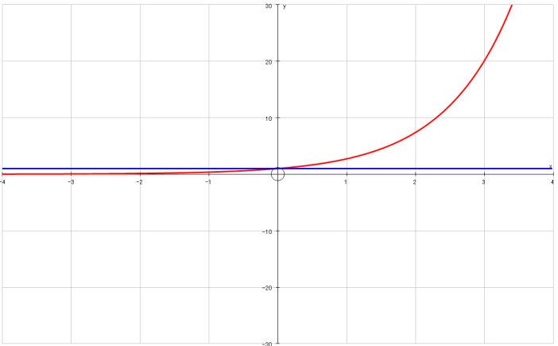
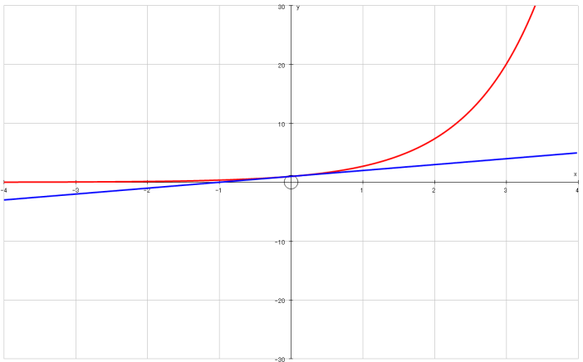
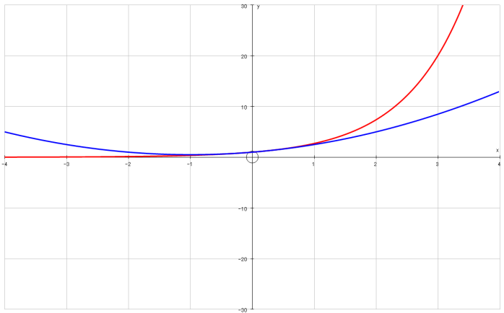
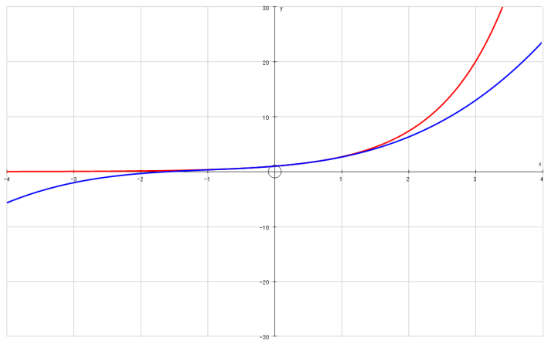
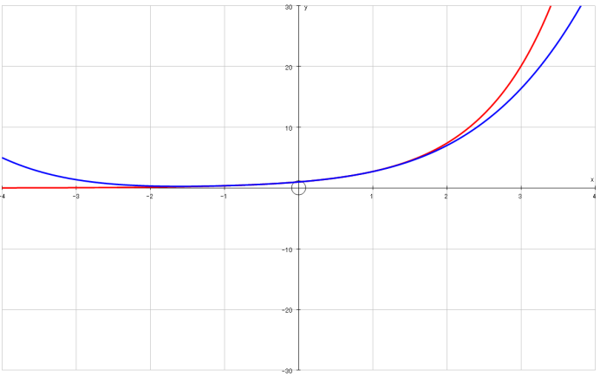
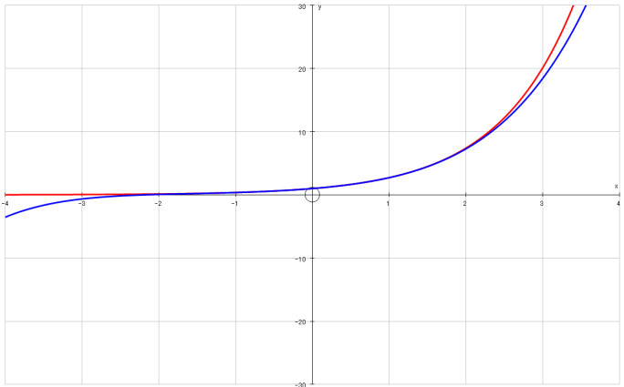








Series
$$e^{x}=1+x+\frac{x^{2}}{2!}+\frac{x^{3}}{3!}+ …$$
A quick graphical comparison of the summation against the exact value of e^{x}
$$y=e^{x}$$
$$y=e^{x}$$
$$y=e^{x}$$
$$y=1$$
$$y=1+x$$
$$y=1+x+\frac{x^{2}}{2!}$$
$$y=e^{x}$$
$$y=e^{x}$$
$$y=e^{x}$$
$$y=1+x+\frac{x^{2}}{2!}+\frac{x^{3}}{3!}$$
$$y=1+x+\frac{x^{2}}{2!}+\frac{x^{3}}{3!}+\frac{x^{4}}{4!}$$
$$y=1+x+\frac{x^{2}}{2!}+\frac{x^{3}}{3!}+\frac{x^{4}}{4!}+\frac{x^{5}}{5!}$$
As you can see from these graphs, the more terms we have in the sum, the closer the values are to the actual value of e^{x}
→ Note that as we move away from x = 0, we need more and more terms to make the summation accurate
2C

Slide 12





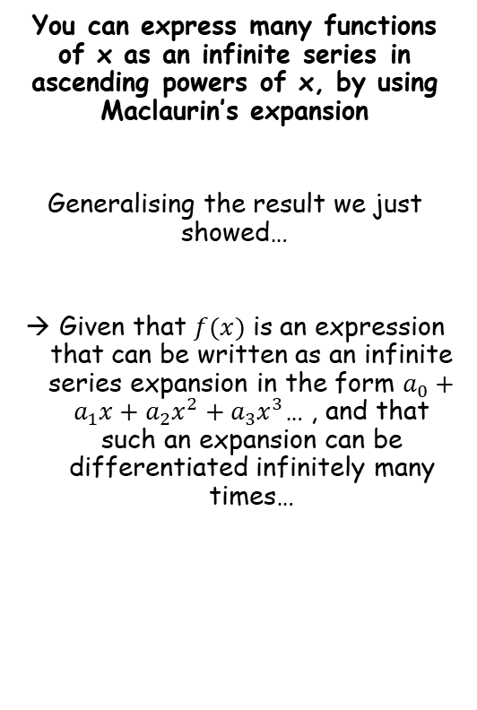








Series
You can express many functions of x as an infinite series in ascending powers of x, by using Maclaurin’s expansion
Generalising the result we just showed…
Given that $f(x)$ is an expression that can be written as an infinite series expansion in the form $a_{0}+a_{1}x+a_{2}x^{2}+a_{3}x^{3}$… , and that such an expansion can be differentiated infinitely many times…
$$f(x)$$
$$f\left(x\right)=a_{0}+a_{1}x+a_{2}x^{2}+a_{3}x^{3}+a_{4}x^{4}+a_{5}x^{5}+.. . + a_{r}x^{r}$$
Differentiate (non-x terms will disappear)
$$f′(x)$$
$$f′\left(x\right)=$$
$$a_{1}$$
$$+ {2a}_{2}x$$
$$+ {3a}_{3}x^{2}$$
$$+ {4a}_{4}x^{3}$$
$$+ {5a}_{5}x^{4}$$
$$+ …+{ra}_{r}x^{r−1}$$
And again
$$f′′(x)$$
$$f′′\left(x\right)=$$
$${2a}_{2}$$
$$+ {6a}_{3}x$$
$$+ {12a}_{4}x^{2}$$
$$+ {20a}_{5}x^{3}$$
$$+ …+{r(r−1)a}_{r}x^{r−2}$$
And again
$$f′′′(x)$$
$$f′′′\left(x\right)=$$
$${6a}_{3}$$
$$+ {24a}_{4}x$$
$$+ {60a}_{5}x^{3}$$
$$+ …+{r(r−1)(r−2)a}_{r}x^{r−3}$$
Now we can start finding expressions for some of the ‘a’ terms by substituting x = 0 into each differential
$$f(x)$$
$$f\left(x\right)=a_{0}+a_{1}x+a_{2}x^{2}+a_{3}x^{3}+a_{4}x^{4}+a_{5}x^{5}+.. . + a_{r}x^{r}$$
Sub in x = 0
$$f\left(0\right)=a_{0}$$
$$f\left(0\right)=a_{0}$$
→ All the terms with x in will be cancelled out!
2C

Slide 13



Series
You can express many functions of x as an infinite series in ascending powers of x, by using Maclaurin’s expansion
Generalising the result we just showed…
Given that $f(x)$ is an expression that can be written as an infinite series expansion in the form $a_{0}+a_{1}x+a_{2}x^{2}+a_{3}x^{3}$… , and that such an expansion can be differentiated infinitely many times…
$$f(x)$$
$$f\left(x\right)=a_{0}+a_{1}x+a_{2}x^{2}+a_{3}x^{3}+a_{4}x^{4}+a_{5}x^{5}+.. . + a_{r}x^{r}$$
Differentiate (non-x terms will disappear)
$$f′(x)$$
$$f′\left(x\right)=$$
$$a_{1}$$
$$+ {2a}_{2}x$$
$$+ {3a}_{3}x^{2}$$
$$+ {4a}_{4}x^{3}$$
$$+ {5a}_{5}x^{4}$$
$$+ …+{ra}_{r}x^{r−1}$$
And again
$$f′′(x)$$
$$f′′\left(x\right)=$$
$${2a}_{2}$$
$$+ {6a}_{3}x$$
$$+ {12a}_{4}x^{2}$$
$$+ {20a}_{5}x^{3}$$
$$+ …+{r(r−1)a}_{r}x^{r−2}$$
And again
$$f′′′(x)$$
$$f′′′\left(x\right)=$$
$${6a}_{3}$$
$$+ {24a}_{4}x$$
$$+ {60a}_{5}x^{3}$$
$$+ …+{r(r−1)(r−2)a}_{r}x^{r−3}$$
Now we can start finding expressions for some of the ‘a’ terms by substituting x = 0 into each differential
$$f\text{′}(x)$$
$$f′\left(x\right)=a_{1}+ {2a}_{2}x+ {3a}_{3}x^{2}+ {4a}_{4}x^{3}+ {5a}_{5}x^{4}+ …+{ra}_{r}x^{r−1}$$
Sub in x = 0
$$f′\left(0\right)=a_{1}$$
$$f\left(0\right)=a_{0}$$
$$f′\left(0\right)=a_{1}$$
→ All the terms with x in will be cancelled out!
2C

Slide 14




Series
You can express many functions of x as an infinite series in ascending powers of x, by using Maclaurin’s expansion
Generalising the result we just showed…
Given that $f(x)$ is an expression that can be written as an infinite series expansion in the form $a_{0}+a_{1}x+a_{2}x^{2}+a_{3}x^{3}$… , and that such an expansion can be differentiated infinitely many times…
$$f(x)$$
$$f\left(x\right)=a_{0}+a_{1}x+a_{2}x^{2}+a_{3}x^{3}+a_{4}x^{4}+a_{5}x^{5}+.. . + a_{r}x^{r}$$
Differentiate (non-x terms will disappear)
$$f′(x)$$
$$f′\left(x\right)=$$
$$a_{1}$$
$$+ {2a}_{2}x$$
$$+ {3a}_{3}x^{2}$$
$$+ {4a}_{4}x^{3}$$
$$+ {5a}_{5}x^{4}$$
$$+ …+{ra}_{r}x^{r−1}$$
And again
$$f′′(x)$$
$$f′′\left(x\right)=$$
$${2a}_{2}$$
$$+ {6a}_{3}x$$
$$+ {12a}_{4}x^{2}$$
$$+ {20a}_{5}x^{3}$$
$$+ …+{r(r−1)a}_{r}x^{r−2}$$
And again
$$f′′′(x)$$
$$f′′′\left(x\right)=$$
$${6a}_{3}$$
$$+ {24a}_{4}x$$
$$+ {60a}_{5}x^{3}$$
$$+ …+{r(r−1)(r−2)a}_{r}x^{r−3}$$
Now we can start finding expressions for some of the ‘a’ terms by substituting x = 0 into each differential
$$\text{f}\text{′′(}\text{x}\text{)}$$
$$f′′\left(x\right)={2a}_{2}+ {6a}_{3}x+ {12a}_{4}x^{2}+ {20a}_{5}x^{3}+ …+{r(r−1)a}_{r}x^{r−2}$$
Sub in x = 0
$$f′′\left(0\right)=2a_{2}$$
Divide by 2 (and write using a factorial)
$$f\left(0\right)=a_{0}$$
$$f′\left(0\right)=a_{1}$$
$$\frac{f′′\left(0\right)}{2!}=a_{2}$$
→ All the terms with x in will be cancelled out!
$$\frac{f′′\left(0\right)}{2!}=a_{2}$$
2C

Slide 15




Series
You can express many functions of x as an infinite series in ascending powers of x, by using Maclaurin’s expansion
Generalising the result we just showed…
Given that $f(x)$ is an expression that can be written as an infinite series expansion in the form $a_{0}+a_{1}x+a_{2}x^{2}+a_{3}x^{3}$… , and that such an expansion can be differentiated infinitely many times…
$$f(x)$$
$$f\left(x\right)=a_{0}+a_{1}x+a_{2}x^{2}+a_{3}x^{3}+a_{4}x^{4}+a_{5}x^{5}+.. . + a_{r}x^{r}$$
Differentiate (non-x terms will disappear)
$$f′(x)$$
$$f′\left(x\right)=$$
$$a_{1}$$
$$+ {2a}_{2}x$$
$$+ {3a}_{3}x^{2}$$
$$+ {4a}_{4}x^{3}$$
$$+ {5a}_{5}x^{4}$$
$$+ …+{ra}_{r}x^{r−1}$$
And again
$$f′′(x)$$
$$f′′\left(x\right)=$$
$${2a}_{2}$$
$$+ {6a}_{3}x$$
$$+ {12a}_{4}x^{2}$$
$$+ {20a}_{5}x^{3}$$
$$+ …+{r(r−1)a}_{r}x^{r−2}$$
And again
$$f′′′(x)$$
$$f′′′\left(x\right)=$$
$${6a}_{3}$$
$$+ {24a}_{4}x$$
$$+ {60a}_{5}x^{3}$$
$$+ …+{r(r−1)(r−2)a}_{r}x^{r−3}$$
Now we can start finding expressions for some of the ‘a’ terms by substituting x = 0 into each differential
$$f′′′(x)$$
$$f′′′\left(x\right)={6a}_{3}+ {24a}_{4}x+ {60a}_{5}x^{3}+ …+{r(r−1)(r−2)a}_{r}x^{r−3}$$
Sub in x = 0
$$f′′′\left(0\right)=6a_{3}$$
Divide by 6 (and write using a factorial)
$$f\left(0\right)=a_{0}$$
$$f′\left(0\right)=a_{1}$$
$$\frac{f′′′\left(0\right)}{3!}=a_{3}$$
→ All the terms with x in will be cancelled out!
$$\frac{f′′\left(0\right)}{2!}=a_{2}$$
$$\frac{f′′′\left(0\right)}{3!}=a_{3}$$
2C

Slide 16






Series
You can express many functions of x as an infinite series in ascending powers of x, by using Maclaurin’s expansion
Generalising the result we just showed…
Given that $f(x)$ is an expression that can be written as an infinite series expansion in the form $a_{0}+a_{1}x+a_{2}x^{2}+a_{3}x^{3}$… , and that such an expansion can be differentiated infinitely many times…
$$f\left(x\right)=a_{0}+a_{1}x+a_{2}x^{2}+a_{3}x^{3}+a_{4}x^{4}+a_{5}x^{5}+.. . + a_{r}x^{r}$$
Rewriting using the results we obtained…
$$+ \frac{f′′\left(0\right)}{2!}x^{2}$$
$$+ \frac{f′′′\left(0\right)}{3!}x^{3}$$
$$+..+ \frac{f^{(r)}\left(0\right)}{r!}x^{r}$$
$$f\left(x\right)=$$
$$f(0)$$
$${+ f}^{′}\left(0\right)x$$
This is the Maclaurin series expansion of a function!
$$f\left(0\right)=a_{0}$$
$$f′\left(0\right)=a_{1}$$
$$\frac{f′′\left(0\right)}{2!}=a_{2}$$
$$\frac{f′′′\left(0\right)}{3!}=a_{3}$$
2C

Slide 17

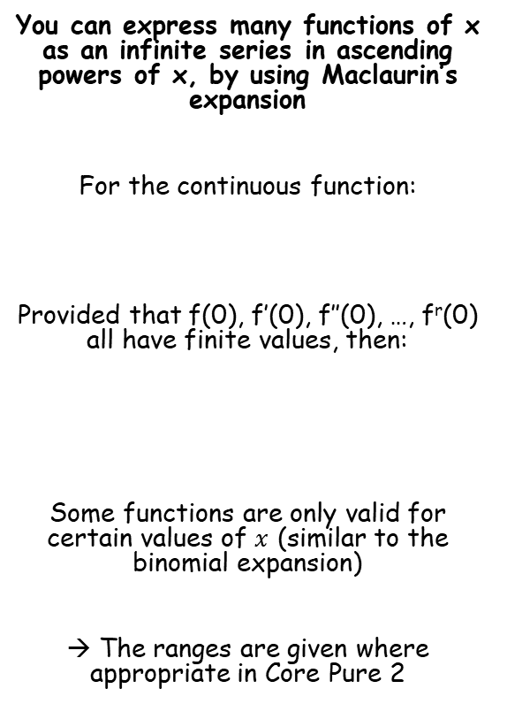


Series
$$f\left(x\right)=f\left(0\right)+f^{′}\left(0\right)x+\frac{f′′(0)}{2!}x^{2}+\frac{f′′′(0)}{3!}x^{3}…$$
You can express many functions of x as an infinite series in ascending powers of x, by using Maclaurin’s expansion
For the continuous function:
Provided that f(0), f’(0), f’’(0), …, f^{r}(0) all have finite values, then:
Some functions are only valid for certain values of $x$ (similar to the binomial expansion)
→ The ranges are given where appropriate in Core Pure 2
$$f\left(x\right), x∈R$$
You get given this result in the formula booklet!
$$f\left(x\right)=f\left(0\right)+f^{′}\left(0\right)x+\frac{f′′(0)}{2!}x^{2}+\frac{f′′′(0)}{3!}x^{3}…$$
2C

Slide 18










Series
$$f\left(x\right)=f\left(0\right)+f^{′}\left(0\right)x+\frac{f′′(0)}{2!}x^{2}+\frac{f′′′(0)}{3!}x^{3}…$$
Differentiate
$$\frac{f′(x)}{f(x)}$$
$$ln⁡f(x)$$
You can express many functions of x as an infinite series in ascending powers of x, by using Maclaurin’s expansion
Express ln(1 + x) as an infinite series in ascending powers of x, up to and including the term in x³
Using the form above, you will need to find f(x) (which you’re given), f’(x), f’’(x) and f’’’(x)
Once you have these, you can substitute x = 0 into all of them to find the values which need to be used in the expansion
$$f\left(x\right)=ln⁡(1+x)$$
Differentiate using the rule for the natural logarithm
$$f′\left(x\right)=\frac{1}{1+x}$$
Differentiate by writing as a power and using the chain rule
$$f^{′′}(x)=−\frac{1}{{\left(1+x\right)}^{2}}$$
Differentiate by writing as a power and using the chain rule again
$$f^{′′′}(x)=\frac{2}{{\left(1+x\right)}^{3}}$$
$$f′\left(x\right)={\left(1+x\right)}^{−1}$$
$$f^{′′\left(x\right)}=−{\left(1+x\right)}^{−2}$$
Use the chain rule
Use the chain rule
$$f′′\left(x\right)={−\left(1+x\right)}^{−2}(1)$$
$$f′′′\left(x\right)=2{\left(1+x\right)}^{−3}(1)$$
2C

Slide 19












Series
$$f\left(x\right)=f\left(0\right)+f^{′}\left(0\right)x+\frac{f′′(0)}{2!}x^{2}+\frac{f′′′(0)}{3!}x^{3}…$$
Differentiate
$$\frac{f′(x)}{f(x)}$$
$$ln⁡f(x)$$
You can express many functions of x as an infinite series in ascending powers of x, by using Maclaurin’s expansion
Express ln(1 + x) as an infinite series in ascending powers of x, up to and including the term in x³
Using the form above, you will need to find f(x) (which you’re given), f’(x), f’’(x) and f’’’(x)
Once you have these, you can substitute x = 0 into all of them to find the values which need to be used in the expansion
$$f\left(x\right)=ln⁡(1+x)$$
Differentiate using the rule for the natural logarithm
$$f′\left(x\right)=\frac{1}{1+x}$$
Differentiate by writing as a power and using the chain rule
$$f^{′′}(x)=−\frac{1}{{\left(1+x\right)}^{2}}$$
Differentiate by writing as a power and using the chain rule again
$$f^{′′′}(x)=\frac{2}{{\left(1+x\right)}^{3}}$$
Substitute x = 0 into each of these to find the coefficients for the form above
$$f\left(0\right)=ln⁡(1+0)$$
$$f\left(0\right)=0$$
$$f′\left(0\right)=\frac{1}{1+0}$$
$$f′\left(0\right)=1$$
$$f^{′′}(0)=−\frac{1}{{\left(1+0\right)}^{2}}$$
$$f^{′′}(0)=−1$$
$$f\left(0\right)=0$$
$$f′\left(0\right)=1$$
$$f^{′′}(0)=−1$$
$$f^{′′′}(0)=2$$
$$f^{′′′}(0)=\frac{2}{{\left(1+0\right)}^{3}}$$
$$f^{′′′}(0)=2$$
2C

Slide 20



Series
$$f\left(x\right)=f\left(0\right)+f^{′}\left(0\right)x+\frac{f′′(0)}{2!}x^{2}+\frac{f′′′(0)}{3!}x^{3}…$$
You can express many functions of x as an infinite series in ascending powers of x, by using Maclaurin’s expansion
Express ln(1 + x) as an infinite series in ascending powers of x, up to and including the term in x³
Using the form above, you will need to find f(x) (which you’re given), f’(x), f’’(x) and f’’’(x)
Once you have these, you can substitute x = 0 into all of them to find the values which need to be used in the expansion
Put these values into Maclaurin’s form above
$$f\left(x\right)=f\left(0\right)+f^{′}\left(0\right)x+\frac{f′′(0)}{2!}x^{2}+\frac{f′′′(0)}{3!}x^{3}$$
Sub in the values we just calculated
$$ln⁡(1+x)=(0)+(1)x+\frac{(−1)}{2!}x^{2}+\frac{(2)}{3!}x^{3}$$
Simplify, calculating the factorials where needed
(ie – ²/_{3!} = ²/₆ = ¹/₃)
$$\ln\left(1+x\right)=x−\frac{1}{2}x^{2}+\frac{1}{3}x^{3}$$
$$f\left(0\right)=0$$
$$f′\left(0\right)=1$$
$$f^{′′}(0)=−1$$
$$f^{′′′}(0)=2$$
2C

Slide 21









Series
$$f\left(x\right)=f\left(0\right)+f^{′}\left(0\right)x+\frac{f′′(0)}{2!}x^{2}+\frac{f′′′(0)}{3!}x^{3}…$$
$$ln⁡(1+x)=x−\frac{1}{2}x^{2}+\frac{1}{3}x^{3}$$
You can express many functions of x as an infinite series in ascending powers of x, by using Maclaurin’s expansion
Express ln(1 + x) as an infinite series in ascending powers of x, up to and including the term in x³
Using this series, find approximate values for:
ln(1.05)
ln(1.25)
ln(1.8)
Sub in x = 0.05
$$ln⁡(1.05)=(0.05)−\frac{1}{2}{(0.05)}^{2}+\frac{1}{3}{(0.05)}^{3}$$
Calculate
$$ln⁡(1.05)=0.0487916$$
This is accurate to 5 dp
$$ln⁡(1+x)=x−\frac{1}{2}x^{2}+\frac{1}{3}x^{3}$$
$$\ln\left(1+x\right)=x−\frac{1}{2}x^{2}+\frac{1}{3}x^{3}$$
Sub in x = 0.25
$$ln⁡(1.25)=(0.25)−\frac{1}{2}{(0.25)}^{2}+\frac{1}{3}{(0.25)}^{3}$$
Calculate
$$ln⁡(1.25)=0.223958$$
This is accurate to 2 dp
$$ln⁡(1+x)=x−\frac{1}{2}x^{2}+\frac{1}{3}x^{3}$$
Sub in x = 0.8
$$ln⁡(1.8)=(0.8)−\frac{1}{2}{(0.8)}^{2}+\frac{1}{3}{(0.8)}^{3}$$
The Maclaurin’s expansion requires more terms to be accurate, as the value of x moves away from 0…
Calculate
$$ln⁡(1.8)=0.6506666$$
This is not even accurate to 1 dp!
2C

Slide 22















Series
$$f\left(x\right)=f\left(0\right)+f^{′}\left(0\right)x+\frac{f′′(0)}{2!}x^{2}+\frac{f′′′(0)}{3!}x^{3}…$$
You can express many functions of x as an infinite series in ascending powers of x, by using Maclaurin’s expansion
Find the Maclaurin expansion for sinx, up to the term in x⁵. Then use your expansion to find an approximation for sin10˚.
As on the previous example, you need to find the differentials of f(x), up to f’’’’’(x).
Then you need to substitute x = 0 into these to find the values to use in the expansion above.
Find successive differentials of f(x), and substitute x = 0 into each
$$f\left(x\right)=sinx$$
$$f\left(0\right)=0$$
$$f′\left(x\right)=cosx$$
$$f′\left(0\right)=1$$
$$f^{′′}(x)=−sinx$$
$$f^{′′}(0)=0$$
$$f^{′′′}(x)=−cosx$$
$$f^{′′′}\left(0\right)=−1$$
$$f^{′′′′}(x)=sinx$$
$$f^{′′′′}(0)=0$$
$$f^{′′′′′}(x)=cosx$$
$$f^{′′′′′}(0)=1$$
Now sub these into Maclaurin’s expansion
$$f\left(x\right)=f\left(0\right)+f^{′}\left(0\right)x+\frac{f′′(0)}{2!}x^{2}+\frac{f′′′(0)}{3!}x^{3}+\frac{f′′′′(0)}{4!}x^{4}+\frac{f′′′′(0)}{5!}x^{5}$$
$$sinx=x−\frac{1}{3!}x^{3}+\frac{1}{5!}x^{5}$$
$$sinx=\left(0\right)+\left(1\right)x+\frac{\left(0\right)}{2!}x^{2}+\frac{\left(−1\right)}{3!}x^{3}+\frac{(0)}{4!}x^{4}+\frac{(1)}{5!}x^{5}$$
$$sinx=x−\frac{1}{3!}x^{3}+\frac{1}{5!}x^{5}$$
2C

Slide 23



Series
$$f\left(x\right)=f\left(0\right)+f^{′}\left(0\right)x+\frac{f′′(0)}{2!}x^{2}+\frac{f′′′(0)}{3!}x^{3}…$$
You can express many functions of x as an infinite series in ascending powers of x, by using Maclaurin’s expansion
Find the Maclaurin expansion for sinx, up to the term in x⁵. Then use your expansion to find an approximation for sin10˚.
As on the previous example, you need to find the differentials of f(x), up to f’’’’’(x).
Then you need to substitute x = 0 into these to find the values to use in the expansion above.
The angle MUST be in radians for this process to work…
10˚ = ^{π}/₁₈ radians
(since 180˚ = π)
$$sin\left(x\right)=x−\frac{1}{3!}x^{3}+\frac{1}{5!}x^{5}$$
Sub in x = ^{π}/₁₈
$$sin\left(\frac{π}{18}\right)=\left(\frac{π}{18}\right)−\frac{1}{3!}{\left(\frac{π}{18}\right)}^{3}+\frac{1}{5!}{\left(\frac{π}{18}\right)}^{5}$$
Calculate
$$=0.173648127864…$$
$$sinx=x−\frac{1}{3!}x^{3}+\frac{1}{5!}x^{5}$$
2C

Slide 24















Series
$$f\left(x\right)=f\left(0\right)+f^{′}\left(0\right)x+\frac{f′′(0)}{2!}x^{2}+\frac{f′′′(0)}{3!}x^{3}…$$
You can express many functions of x as an infinite series in ascending powers of x, by using Maclaurin’s expansion
Find the Maclaurin expansion for cosx, up to the term in x⁴.
As on the previous example, you need to find the differentials of f(x), up to f’’’’’(x).
Then you need to substitute x = 0 into these to find the values to use in the expansion above.
Find successive differentials of f(x), and substitute x = 0 into each
$$f\left(x\right)=cosx$$
$$f\left(0\right)=1$$
$$f^{′\left(x\right)}=−sinx$$
$$f′\left(0\right)=0$$
$$f^{′′}(x)=−cosx$$
$$f^{′′}\left(0\right)=−1$$
$$f^{′′′}(x)=sinx$$
$$f^{′′′}\left(0\right)=0$$
$$f^{′′′′}(x)=cosx$$
$$f^{′′′′}(0)=1$$
$$f^{′′′′′}\left(x\right)=−sinx$$
$$f^{′′′′′}(0)=0$$
Now sub these into Maclaurin’s expansion
$$f\left(x\right)=f\left(0\right)+f^{′}\left(0\right)x+\frac{f′′(0)}{2!}x^{2}+\frac{f′′′(0)}{3!}x^{3}+\frac{f′′′′(0)}{4!}x^{4}+\frac{f′′′′(0)}{5!}x^{5}$$
$$cosx=1−\frac{1}{2!}x^{2}+\frac{1}{4!}x^{4}$$
$$cosx=\left(1\right)+\left(0\right)x+\frac{\left(−1\right)}{2!}x^{2}+\frac{\left(0\right)}{3!}x^{3}+\frac{(1)}{4!}x^{4}+\frac{(0)}{5!}x^{5}$$
$$cosx=1−\frac{1}{2!}x^{2}+\frac{1}{4!}x^{4}$$
2C

Slide 25





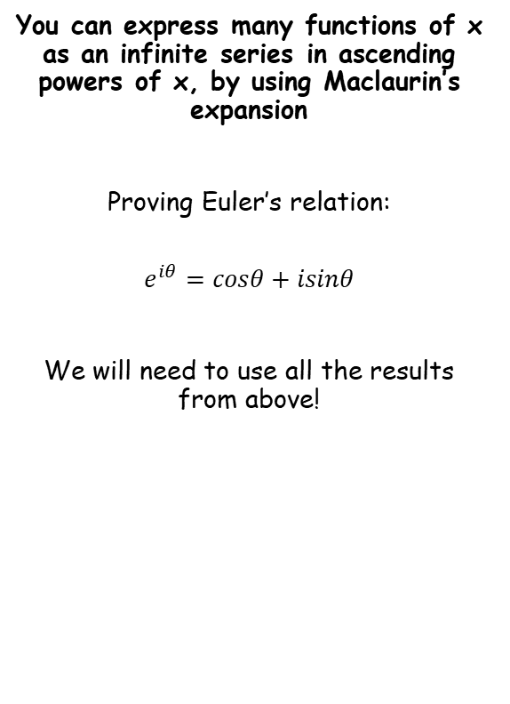






Series
$$e^{x}=1+x+\frac{x^{2}}{2!}+\frac{x^{3}}{3!}+ ..$$
$$sinx=x−\frac{x^{3}}{3!}+\frac{x^{5}}{5!}+..$$
$$cosx=1−\frac{x^{2}}{2!}+\frac{x^{4}}{4!}+..$$
$$e^{x}=1+x+\frac{x^{2}}{2!}+\frac{x^{3}}{3!}+\frac{x^{4}}{4!}+\frac{x^{5}}{5!}..$$
You can express many functions of x as an infinite series in ascending powers of x, by using Maclaurin’s expansion
Proving Euler’s relation:
$$e^{iθ}=cosθ+isinθ$$
We will need to use all the results from above!
$$e^{iθ}=1+\left(iθ\right)+\frac{{\left(iθ\right)}^{2}}{2!}+\frac{{\left(iθ\right)}^{3}}{3!}+\frac{{\left(iθ\right)}^{4}}{4!}+\frac{{\left(iθ\right)}^{5}}{5!}..$$
Let $x=iθ$
Multiply the brackets out
$$e^{iθ}=1+iθ+\frac{i^{2}θ^{2}}{2!}+\frac{i^{3}θ^{3}}{3!}+\frac{i^{4}θ^{4}}{4!}+\frac{i^{5}θ^{5}}{5!}..$$
Simplify the $i$ terms
$$e^{iθ}=1+iθ−\frac{θ^{2}}{2!}−\frac{iθ^{3}}{3!}+\frac{θ^{4}}{4!}+\frac{iθ^{5}}{5!}..$$
Separate into real and imaginary parts
$$e^{iθ}=\left(1−\frac{θ^{2}}{2!}+\frac{θ^{4}}{4!}..\right)+i\left(θ−\frac{θ^{3}}{3!}+\frac{θ^{5}}{5!}..\right)$$
Replace real and imaginary parts using the series we showed earlier!
$$e^{iθ}=cosθ+isinθ$$
2C

Slide 26
Exercise 2C
Pearson Core Pure Year 2
Page 43-44
Complete before the lesson Q1-2
In Class:
Green Q3-5
Amber Q6-7
Red Q8-10 & Challenge

