Slide 1
Methods in
Differential Equations
Twitter: @Owen134866
www.mathsfreeresourcelibrary.com

Slide 2

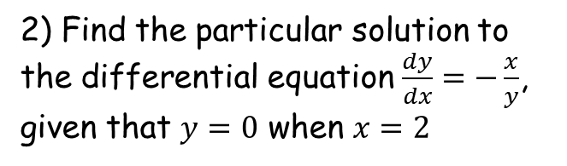

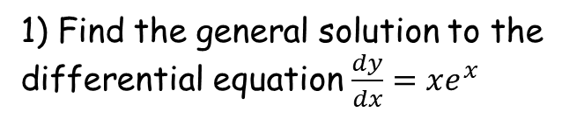

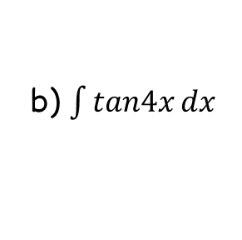
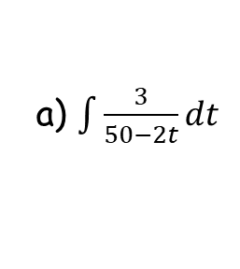

Prior Knowledge Check
1) Find the general solution to the differential equation $\frac{dy}{dx}=xe^{x}$
3) Find:
a) $\int{\frac{3}{50−2t}}dt$
$$=−\frac{3}{2}ln\left|50−2t\right|+c$$
$$y=\left(x−1\right)e^{x}+c$$
b) $\int{tan4x}dx$
2) Find the particular solution to the differential equation $\frac{dy}{dx}=−\frac{x}{y}$, given that $y=0$ when $x=2$
$$=−\frac{1}{4}ln\left|cos4x\right|+c$$
$$y^{2}=4−x^{2}$$

Slide 3
Teachings for
Exercise 7A

Slide 4
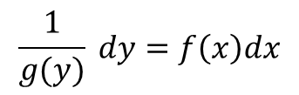
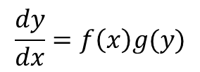
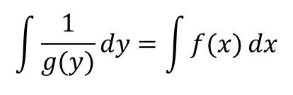
Methods in Differential Equations
You need to be able to solve differential equations by separation of variables, and sketch families of solution curves
→ A first-order differential equation contains only first differentials…
In Pure Maths 2 you have solved these equations using the ‘separation of variables’ technique
Remember what this looks like?
$$\frac{dy}{dx}=f\left(x\right)g(y)$$
Divide by g(y) and multiply by dx
$$\frac{1}{g(y)} dy=f\left(x\right)dx$$
Integrate both sides
$$\int{\frac{1}{g(y)}}dy=\int{f(x)}dx$$
Once integrated, you will be left with an equation that you can rearrange to put in different forms
Remember that the ‘+C’ part could be anything at this stage. The possible functions are known as a ‘family of solution curves’
You can also find ‘particular’ solutions if you are told information linking x and y
7A

Slide 5
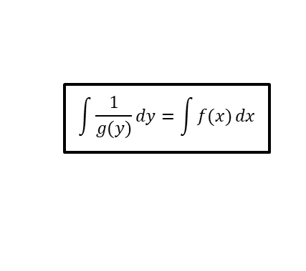




Methods in Differential Equations
$$\frac{dy}{dx}=f\left(x\right)g(y)$$
$$\int{\frac{1}{g(y)}}dy=\int{f(x)}dx$$
$$\frac{dy}{dx}=2$$
You need to be able to solve differential equations by separation of variables, and sketch families of solution curves
Find the general solution of the differential equation:
Then sketch members of the family of solution curves represented by the general solution.
Integrate with respect to x
$$y=2x+C$$
y
2
$$\frac{dy}{dx}=2$$
1
x
This is the family of solution curves for C = -2, -1, 0, 1 and 2
→ Basically a set of possible graphs we could get for certain values of C, the constant
-1
-2
7A

Slide 6

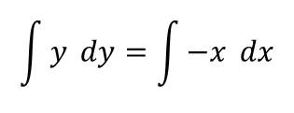






Methods in Differential Equations
$$\frac{dy}{dx}=f\left(x\right)g(y)$$
$$\int{\frac{1}{g(y)}}dy=\int{f(x)}dx$$
You need to be able to solve differential equations by separation of variables, and sketch families of solution curves
Find the general solution of the differential equation:
Then sketch members of the family of solution curves represented by the general solution.
In this case you will need to separate the variables x and y before you can Integrate
As 2C is just a number, we can think of it as being the ‘r²’ part of the circle equation
$$\frac{dy}{dx}=−\frac{x}{y}$$
Multiply by y and multiply by dx
$$y dy=−x dx$$
Integrate both sides
$$\int{y} dy=\int{−x} dx$$
$$\frac{dy}{dx}=−\frac{x}{y}$$
Calculate
$$\frac{1}{2}y^{2}=−\frac{1}{2}x^{2}+C$$
Add ¹/₂x
$$\frac{1}{2}y^{2}+\frac{1}{2}x^{2}=C$$
Multiply by 2
$$y^{2}+x^{2}=2C$$
Hopefully you recognise this as the equation of a circle!
→ r² = 2C
$$x^{2}+y^{2}=2C$$
7A

Slide 7

Methods in Differential Equations
$$\frac{dy}{dx}=f\left(x\right)g(y)$$
$$\int{\frac{1}{g(y)}}dy=\int{f(x)}dx$$
You need to be able to solve differential equations by separation of variables, and sketch families of solution curves
Find the general solution of the differential equation:
Then sketch members of the family of solution curves represented by the general solution.
Now we have the equation we can sketch some examples from this ‘family’
$$\frac{dy}{dx}=−\frac{x}{y}$$
The original equation…
$$x^{2}+y^{2}=2C$$
y
6
$$\frac{dy}{dx}=−\frac{x}{y}$$
3
2
1
x
These curves correspond to C = 0.5, 2, 4.5 and 18 respectively (as the equation has 2C in it!)
7A

Slide 8


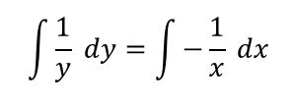







Methods in Differential Equations
$$\frac{dy}{dx}=f\left(x\right)g(y)$$
$$\int{\frac{1}{g(y)}}dy=\int{f(x)}dx$$
$$\frac{dy}{dx}=−\frac{y}{x}$$
You need to be able to solve differential equations by separation of variables, and sketch families of solution curves
Find the general solution of the differential equation:
Then sketch members of the family of solution curves represented by the general solution.
Divide by y, multiply by dx
$$\frac{1}{y} dy=−\frac{1}{x} dx$$
Integrate each side
$$\int{\frac{1}{y} dy}=\int{−\frac{1}{x} dx}$$
$$\frac{dy}{dx}=−\frac{y}{x}$$
Calculate the integrals
$$lny=−lnx+C$$
Add lnx
$$lny+lnx=C$$
Use the multiplication law
$$lnxy=C$$
Take exponentials of each side (cancels the ‘ln’ – we will explain the modulus in a moment!)
This step is common – ie) the replacing of a constant involving several letters with a single, different letter
Make sure it is clear when you do this!
Remember you cannot replace a ‘variable’ term such as ‘x’ in this way!
$$\left|xy\right|=e^{C}$$
Divide by x (remember the modulus gives a positive or negative possibility)
$$y=±\frac{e^{C}}{x}$$
Replace e^{C} with ‘A’ as e^{C} is just a constant
$$y=±\frac{A}{x}$$
7A

Slide 9














Methods in Differential Equations
$$\frac{dy}{dx}=f\left(x\right)g(y)$$
$$\int{\frac{1}{g(y)}}dy=\int{f(x)}dx$$
$$lnxy=C$$
You need to be able to solve differential equations by separation of variables, and sketch families of solution curves
Find the general solution of the differential equation:
Then sketch members of the family of solution curves represented by the general solution.
→ Both possibilities differentiate to give us the original function, so therefore we need to include the modulus or we would lose an answer!
Take exponentials of each side
$$\left|xy\right|=e^{C}$$
Why did we have to include a modulus here?
This is the equation we ended up with when using the modulus
$$y=±\frac{A}{x}$$
$$\frac{dy}{dx}=−\frac{y}{x}$$
If positive
If negative
$$y=\frac{A}{x}$$
$$y=−\frac{A}{x}$$
Rewrite
Rewrite
$$y=Ax^{−1}$$
$$y=−Ax^{−1}$$
Differentiate
Differentiate
$$\frac{dy}{dx}=−Ax^{−2}$$
$$\frac{dy}{dx}=Ax^{−2}$$
If y = ^{A}/_{x},
→A = xy
If y = -^{A}/_{x},
→A = -xy
$$\frac{dy}{dx}=−(xy)x^{−2}$$
$$\frac{dy}{dx}=(−xy)x^{−2}$$
$$\frac{dy}{dx}=−yx^{−1}$$
Group x’s
$$\frac{dy}{dx}=−yx^{−1}$$
Group x’s
$$\frac{dy}{dx}=−\frac{y}{x}$$
Rewrite
$$\frac{dy}{dx}=−\frac{y}{x}$$
Rewrite
7A

Slide 10
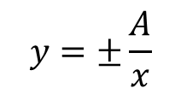
Methods in Differential Equations
$$\frac{dy}{dx}=f\left(x\right)g(y)$$
$$\int{\frac{1}{g(y)}}dy=\int{f(x)}dx$$
You need to be able to solve differential equations by separation of variables, and sketch families of solution curves
Find the general solution of the differential equation:
Then sketch members of the family of solution curves represented by the general solution.
$$y=±\frac{A}{x}$$
Increasing or decreasing the value of A (e^{C}) will move the curves in or out!
y
$$\frac{dy}{dx}=−\frac{y}{x}$$
x
7A

Slide 11
Methods in Differential Equations
$$\frac{dy}{dx}=f\left(x\right)g(y)$$
$$\int{\frac{1}{g(y)}}dy=\int{f(x)}dx$$
You need to be able to solve differential equations by separation of variables, and sketch families of solution curves
However, you will find that some differential equations cannot be solved by separation of variables…
It is possible to solve these by considering the product rule, in reverse…
7A

Slide 12













Methods in Differential Equations
$$\frac{d}{dx}\left(uv\right)=u\frac{dv}{dx}+v\frac{du}{dx}$$
You can solve exact equations where one side is the exact derivative of a product, and the other side can be integrated with respect to x
Find the general solution of the following equation:
In this example you will not be able to separate the variables easily, if at all!
→ You can use a pattern from the product rule however…
The product rule
Imagine we were finding:
$$\frac{d}{dx}x^{3}y$$
(so u = x³ and v = y)
→ We can use the product rule above
$$x^{3}\frac{dy}{dx}+{3x}^{2}y=sinx$$
$$\frac{d}{dx}\left(uv\right)=u\frac{dv}{dx}+v\frac{du}{dx}$$
$$u=x^{3}$$
$$v=y$$
Sub in the values to the right
$$\frac{du}{dx}=3x^{2}$$
$$\frac{dv}{dx}=\frac{dy}{dx}$$
$$\frac{d}{dx}x^{3}y=$$
$$x^{3}\frac{dy}{dx}$$
$$+ 3x^{2}y$$
Notice that ^{d}/_{dx}(x³y) is equivalent to the left side of the original equation
→ This means we can replace it!
$$x^{3}\frac{dy}{dx}+{3x}^{2}y=sinx$$
Replace the left hand side with equivalent expression
$$\frac{d}{dx}x^{3}y=sinx$$
7A

Slide 13




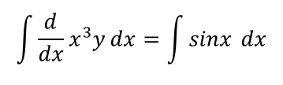



Methods in Differential Equations
You can solve exact equations where one side is the exact derivative of a product, and the other side can be integrated with respect to x
Find the general solution of the following equation:
In this example you will not be able to separate the variables easily, if at all!
→ You can use a pattern from the product rule however…
$$x^{3}\frac{dy}{dx}+{3x}^{2}y=sinx$$
Replace the left hand side with equivalent expression
$$\frac{d}{dx}x^{3}y=sinx$$
Take integrals of each side
$$\int{\frac{d}{dx}x^{3}y}dx=\int{sinx }dx$$
→ On the left side, the integral and differential cancel each other
→ On the right side calculate the integral of sinx
$$x^{3}\frac{dy}{dx}+{3x}^{2}y=sinx$$
$$x^{3}y=$$
$$−cosx+C$$
$$−\frac{1}{x^{3}}cosx+\frac{1}{x^{3}}C$$
Divide by x³
$$y=$$
Other forms of this answer, such as the one below, are also fine!
$$y=\frac{−cosx+C}{x^{3}}$$
7A

Slide 14


Methods in Differential Equations
You can solve exact equations where one side is the exact derivative of a product, and the other side can be integrated with respect to x
You can use a general pattern to see whether this is doable.
It is possible if the conditions to the right are met.
If the conditions are met, you can change the expression on the left side to:
To put this using ‘proper’ mathematical notation…
General pattern
This function of x…
… differentiates to this function of x
$$x^{3}\frac{dy}{dx}+{3x}^{2}y=sinx$$
… differentiates to this function of y (with respect to x)
This function of y…
$$\frac{d}{dx}\left(the function of x\right)(the function of y)$$
7A

Slide 15
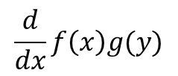
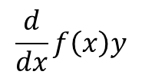

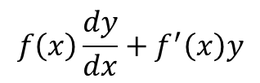


Methods in Differential Equations
$$f\left(x\right)g′(y)+f^{′}\left(x\right)g(y)$$
$$\frac{d}{dx}f\left(x\right)g(y)$$
You can solve exact equations where one side is the exact derivative of a product, and the other side can be integrated with respect to x
Using mathematical notation →
General pattern
$$f\left(x\right)g′(y)+f^{′}\left(x\right)g(y)$$
Can be written as:
$$\frac{d}{dx}f\left(x\right)g(y)$$
The most common one you’ll see is:
$$f\left(x\right)\frac{dy}{dx}+f^{′}\left(x\right)y$$
Can be written as:
$$\frac{d}{dx}f\left(x\right)y$$
7A

Slide 16





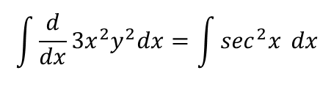

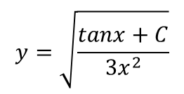




Methods in Differential Equations
$$f\left(x\right)g′(y)+f^{′}\left(x\right)g(y)$$
$$\frac{d}{dx}f\left(x\right)g(y)$$
You can solve exact equations where one side is the exact derivative of a product, and the other side can be integrated with respect to x
Find the general solution of the following differential equation:
At a first glance it might look like the pattern will not work here
6x² does not differentiate to 6x, and y² does not differentiate to y^{dy}/_{dx}
However, if we split up part of the equation, we can see that the pattern does work
$$6x^{2}y\frac{dy}{dx}+6xy^{2}=\sec^{2}x$$
Imagine the first part was split up – we can see the pattern will work!
$$(3x^{2})(2y)\frac{dy}{dx}+6xy^{2}=\sec^{2}x$$
Rewrite the left side using the rule you have seen
$$\frac{d}{dx}$$
$$3x^{2}$$
$$y^{2}$$
$$=\sec^{2}x$$
$$6x^{2}y\frac{dy}{dx}+6xy^{2}=\sec^{2}x$$
Take integrals of each side
$$\int{\frac{d}{dx}}{3x}^{2}y^{2}dx=\int{\sec^{2}x} dx$$
Calculate
$${3x}^{2}y^{2}=$$
$$tanx+C$$
Divide by 3x²
$$y^{2}=\frac{tanx+C}{3x^{2}}$$
Square root (or just leave as it is with y²!)
$$y=\sqrt{\frac{tanx+C}{3x^{2}}}$$
7A

Slide 17





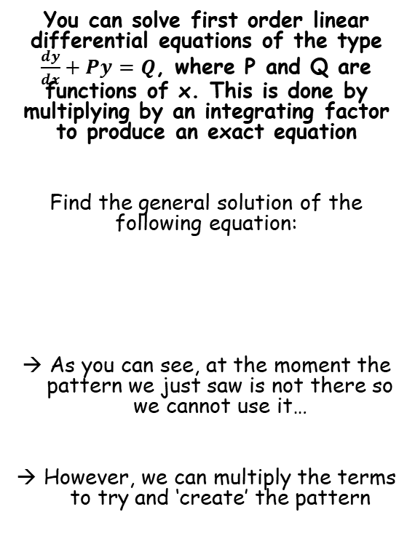



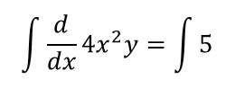



Methods in Differential Equations
$$f\left(x\right)\frac{dy}{dx}+f^{′}\left(x\right)y$$
$$f\left(x\right)g′(y)+f^{′}\left(x\right)g(y)$$
$$\frac{d}{dx}f\left(x\right)g(y)$$
$$\frac{dy}{dx}+\frac{2y}{x}=\frac{5}{{4x}^{2}}$$
You can solve first order linear differential equations of the type $\frac{dy}{dx}+Py=Q$, where P and Q are functions of x. This is done by multiplying by an integrating factor to produce an exact equation
Find the general solution of the following equation:
As you can see, at the moment the pattern we just saw is not there so we cannot use it…
However, we can multiply the terms to try and ‘create’ the pattern
Multiply all terms by 4x²
$$\left({4x}^{2}\right)\frac{dy}{dx}+\frac{2y\left({4x}^{2}\right)}{x}=\frac{5\left({4x}^{2}\right)}{{4x}^{2}}$$
Simplify each one
$${4x}^{2}\frac{dy}{dx}+8xy=5$$
Rewrite now using the pattern from the previous examples
$$\frac{d}{dx}{4x}^{2}y=5$$
$$\frac{dy}{dx}+\frac{2y}{x}=\frac{5}{{4x}^{2}}$$
Take integrals of each side
$$\int{\frac{d}{dx}{4x}^{2}y}=\int{5}$$
Calculate
$${4x}^{2}y=5x+C$$
Divide by 4x²
$$y=\frac{5x+C }{{4x}^{2}}$$
Alternative form (either is fine)
$$y=\frac{5 }{4x}+\frac{C}{{4x}^{2}}$$
7A

Slide 18
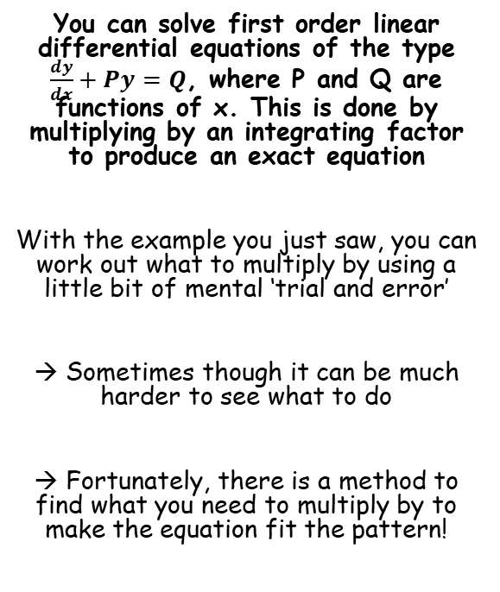
Methods in Differential Equations
$$f\left(x\right)\frac{dy}{dx}+f^{′}\left(x\right)y$$
$$f\left(x\right)g′(y)+f^{′}\left(x\right)g(y)$$
$$\frac{d}{dx}f\left(x\right)g(y)$$
You can solve first order linear differential equations of the type $\frac{dy}{dx}+Py=Q$, where P and Q are functions of x. This is done by multiplying by an integrating factor to produce an exact equation
With the example you just saw, you can work out what to multiply by using a little bit of mental ‘trial and error’
→ Sometimes though it can be much harder to see what to do
→ Fortunately, there is a method to find what you need to multiply by to make the equation fit the pattern!
7A

Slide 19



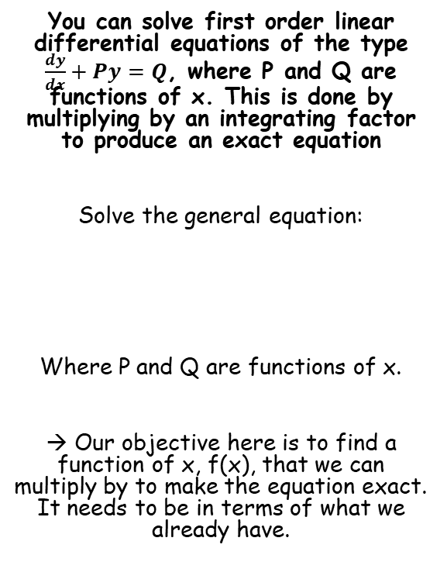





Methods in Differential Equations
$$f\left(x\right)\frac{dy}{dx}+f^{′}\left(x\right)y$$
$$f\left(x\right)g′(y)+f^{′}\left(x\right)g(y)$$
$$\frac{d}{dx}f\left(x\right)g(y)$$
You can solve first order linear differential equations of the type $\frac{dy}{dx}+Py=Q$, where P and Q are functions of x. This is done by multiplying by an integrating factor to produce an exact equation
Solve the general equation:
Where P and Q are functions of x.
→ Our objective here is to find a function of x, f(x), that we can multiply by to make the equation exact. It needs to be in terms of what we already have.
$$\frac{dy}{dx}+Py=Q$$
Multiply by f(x)
→ The idea is to produce an ‘exact’ equation which follows the pattern we know
$$f(x)\frac{dy}{dx}+f(x)Py=f(x)Q$$
Now since we have produced an exact equation, the left side must now equal the general pattern from before
$$\frac{dy}{dx}+Py=Q$$
$$f(x)\frac{dy}{dx}+f(x)Py$$
$$= f\left(x\right)\frac{dy}{dx}+f^{′}\left(x\right)y$$
The second terms must be equal if the sides are equal
$$f\left(x\right)Py=f^{′}\left(x\right)y$$
Divide by y
$$f\left(x\right)P=f^{′}\left(x\right)$$
Divide by f(x)
$$P=\frac{f^{′}\left(x\right)}{f(x)}$$
7A

Slide 20

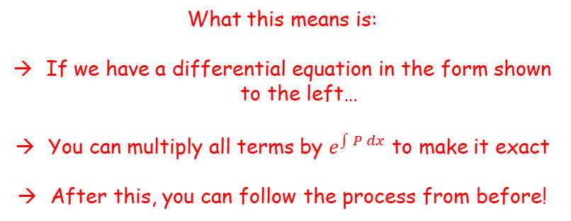
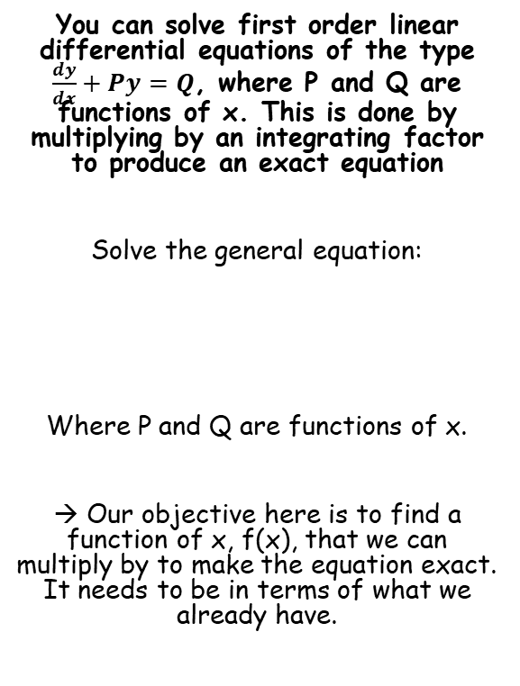
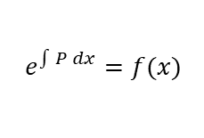
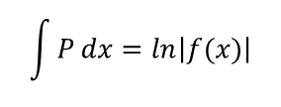
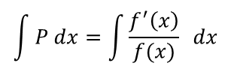
Methods in Differential Equations
$$f\left(x\right)\frac{dy}{dx}+f^{′}\left(x\right)y$$
$$f\left(x\right)g′(y)+f^{′}\left(x\right)g(y)$$
$$\frac{d}{dx}f\left(x\right)g(y)$$
$$P=\frac{f^{′}\left(x\right)}{f(x)}$$
You can solve first order linear differential equations of the type $\frac{dy}{dx}+Py=Q$, where P and Q are functions of x. This is done by multiplying by an integrating factor to produce an exact equation
Solve the general equation:
Where P and Q are functions of x.
→ Our objective here is to find a function of x, f(x), that we can multiply by to make the equation exact. It needs to be in terms of what we already have.
Take integrals of each side
$$\int{P dx}=\int{\frac{f^{′}\left(x\right)}{f(x)}} dx$$
The right side is a ‘standard pattern’
$$\int{P}dx=ln\left|f(x)\right|$$
Take exponentials of each side
$$\frac{dy}{dx}+Py=Q$$
$$e^{\int{P dx}}=f(x)$$
What this means is:
If we have a differential equation in the form shown to the left…
You can multiply all terms by $e^{\int{P dx}}$ to make it exact
After this, you can follow the process from before!
7A

Slide 21
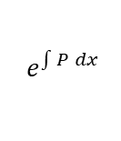


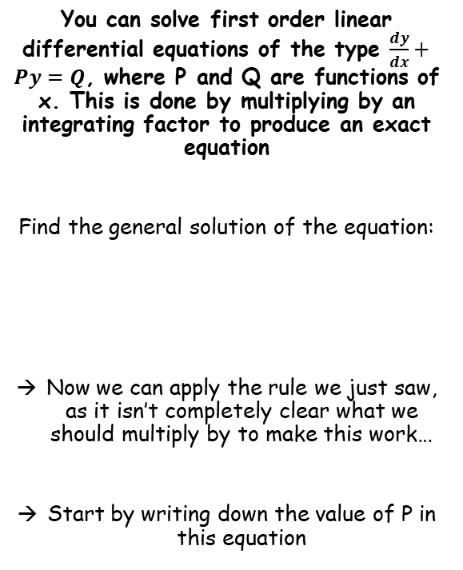




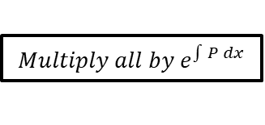
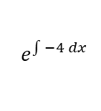
Methods in Differential Equations
$$\frac{dy}{dx}+Py=Q$$
$$Multiply all by e^{\int{P dx}}$$
$$f\left(x\right)\frac{dy}{dx}+f^{′}\left(x\right)y$$
You can solve first order linear differential equations of the type $\frac{dy}{dx}+Py=Q$, where P and Q are functions of x. This is done by multiplying by an integrating factor to produce an exact equation
Find the general solution of the equation:
Now we can apply the rule we just saw, as it isn’t completely clear what we should multiply by to make this work…
Start by writing down the value of P in this equation
$$\frac{dy}{dx}−4y=e^{x}$$
$$So P=−4$$
$$e^{\int{P dx}}$$
Sub in the value of P
$$e^{\int{−4 dx}}$$
Calculate the Integral
$$e^{−4x}$$
$$\frac{dy}{dx}−4y=e^{x}$$
So to make our differential equation exact, we need to multiply all terms by e^{-4x}
7A

Slide 22


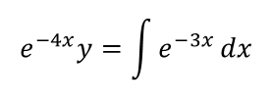
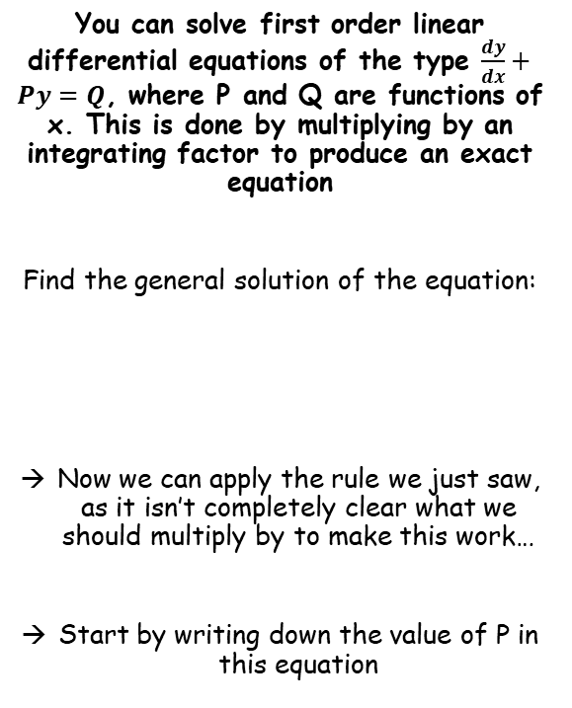




Methods in Differential Equations
$$\frac{dy}{dx}+Py=Q$$
$$Multiply all by e^{\int{P dx}}$$
$$f\left(x\right)\frac{dy}{dx}+f^{′}\left(x\right)y$$
You can solve first order linear differential equations of the type $\frac{dy}{dx}+Py=Q$, where P and Q are functions of x. This is done by multiplying by an integrating factor to produce an exact equation
Find the general solution of the equation:
Now we can apply the rule we just saw, as it isn’t completely clear what we should multiply by to make this work…
Start by writing down the value of P in this equation
So to make our differential equation exact, we need to multiply all terms by e^{-4x}
$$\frac{dy}{dx}−4y=e^{x}$$
Multiply all by e^{-4x}
$$e^{−4x}\frac{dy}{dx}−4e^{−4x}y={e^{−4x}e}^{x}$$
Differentiating e^{-4x} would give -4e^{-4x}, so you can see the left side is now an exact equation
→ Hence, we can rewrite it!
$$\frac{dy}{dx}−4y=e^{x}$$
$$\frac{d}{dx}e^{−4x}y={e^{−4x}e}^{x}$$
We can also simplify the right side
→ We are multiplying so add the powers together
$$\frac{d}{dx}e^{−4x}y=e^{−3x}$$
Integrate each side – cancels ^{d}/_{dx} on the left
$$e^{−4x}y=\int{e^{−3x}}dx$$
Calculate the integral on the right side
$$e^{−4x}y=−\frac{1}{3}e^{−3x}+C$$
Multiply by e^{4x} (same as dividing by e^{-4x})
$$y=−\frac{1}{3}e^{x}+Ce^{4x}$$
7A

Slide 23


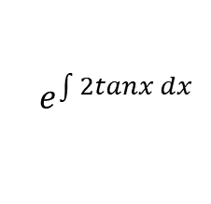
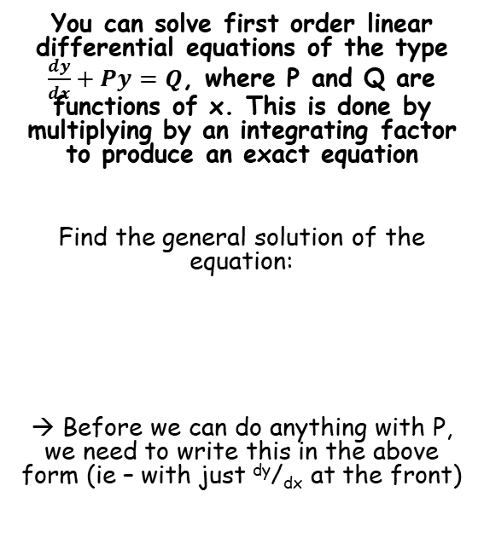
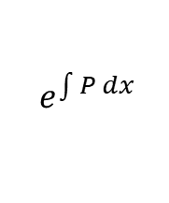




Methods in Differential Equations
$$\frac{dy}{dx}+Py=Q$$
$$Multiply all by e^{\int{P dx}}$$
$$f\left(x\right)\frac{dy}{dx}+f^{′}\left(x\right)y$$
You can solve first order linear differential equations of the type $\frac{dy}{dx}+Py=Q$, where P and Q are functions of x. This is done by multiplying by an integrating factor to produce an exact equation
Find the general solution of the equation:
→ Before we can do anything with P, we need to write this in the above form (ie – with just ^{dy}/_{dx} at the front)
$$cosx\frac{dy}{dx}+2ysinx=\cos^{4}x$$
Divide all terms by cosx
→ Sinx becomes tanx, cos⁴x becomes cos³x
$$\frac{dy}{dx}+2ytanx=\cos^{3}x$$
Now it is in the correct form, we can see the value of P is 2tanx…
$$e^{\int{P dx}}$$
$$cosx\frac{dy}{dx}+2ysinx=\cos^{4}x$$
Sub in the value of P
$$e^{\int{2tanx dx}}$$
Integrate (this one is in the formula booklet!)
$$e^{2lnsecx}$$
Use the power law
$$e^{lnsec^{2}x}$$
The e and ln cancel out (this often happens in these questions!)
$$=sec^{2}x$$
So we need to multiply each part of the equation by sec²x (at the stage where it had only ^{dy}/_{dx} at the front)
7A

Slide 24
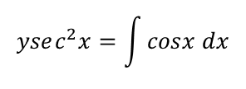


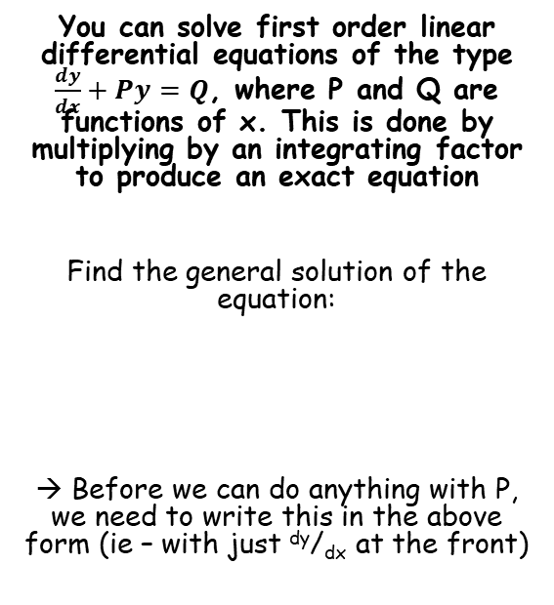




Methods in Differential Equations
$$\frac{dy}{dx}+Py=Q$$
$$Multiply all by e^{\int{P dx}}$$
$$f\left(x\right)\frac{dy}{dx}+f^{′}\left(x\right)y$$
You can solve first order linear differential equations of the type $\frac{dy}{dx}+Py=Q$, where P and Q are functions of x. This is done by multiplying by an integrating factor to produce an exact equation
Find the general solution of the equation:
→ Before we can do anything with P, we need to write this in the above form (ie – with just ^{dy}/_{dx} at the front)
$$cosx\frac{dy}{dx}+2ysinx=\cos^{4}x$$
Divide all terms by cosx
→ Sinx becomes tanx, cos⁴x becomes cos³x
$$\frac{dy}{dx}+2ytanx=\cos^{3}x$$
Multiply by sec²x
$$sec^{2}x\frac{dy}{dx}+2ytanxsec^{2}x=\cos^{3}xsec^{2}x$$
As sec²x = ¹/cos²x, the right hand side can be simplified
$$sec^{2}x\frac{dy}{dx}+2ytanxsec^{2}x=cosx$$
$$cosx\frac{dy}{dx}+2ysinx=\cos^{4}x$$
Combine the left side into a single differential as you have seen
$$\frac{d}{dx}ysec^{2}x=cosx$$
Integrate – cancels out the ^{d}/_{dx}
$$ysec^{2}x=\int{cosx dx}$$
Calculate the right side
$$ysec^{2}x=sinx+C$$
Divide by sec²x (same as multiplying by cos²x)
$$y=cos^{2}x(sinx+C)$$
7A

Slide 25




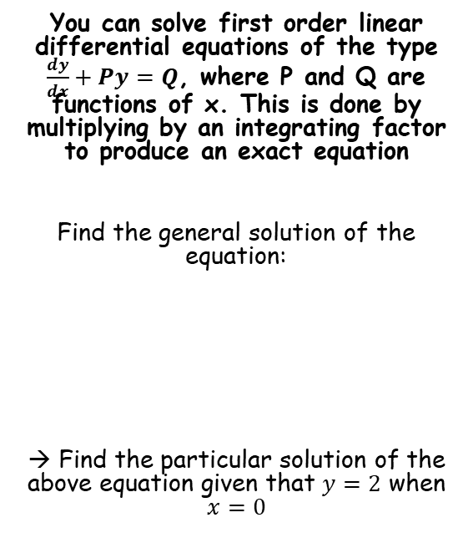



Methods in Differential Equations
$$\frac{dy}{dx}+Py=Q$$
$$Multiply all by e^{\int{P dx}}$$
$$f\left(x\right)\frac{dy}{dx}+f^{′}\left(x\right)y$$
You can solve first order linear differential equations of the type $\frac{dy}{dx}+Py=Q$, where P and Q are functions of x. This is done by multiplying by an integrating factor to produce an exact equation
Find the general solution of the equation:
→ Find the particular solution of the above equation given that $y=2$ when $x=0$
$$y=cos^{2}x(sinx+C)$$
Sub in the values we are given
$$2=cos^{2}(0)(sin⁡(0)+C)$$
Calculate $C$
$$2=C$$
Now we know $C$, we can write the particular solution!
$$y=cos^{2}x(sinx+2)$$
$$cosx\frac{dy}{dx}+2ysinx=\cos^{4}x$$
$$y=cos^{2}x(sinx+C)$$
7A

Slide 26
Exercise 7A
Pearson Core Pure Year 2
Pages 151-153
Complete before the lesson Q1
In Class:
Green Q2-7
Amber Q8-12
Red Q13-16

