Slide 1
Year 1 Pure Mathematics
Measure of Location and Spread
– Mean
Chapter 2
(Part 1 of 5)

Slide 2
Measures of Location and Spread
Measures of Location
Measures of Spread
Maximum
Range
Standard Deviation
Median
Minimum
Mode
Interquartile Range
Mean
Quartiles
Percentiles
Variance
Deciles
Measures of location are single values
which describe a position in a data set.
Measures of spread are to do with
how data is spread out.

Slide 3
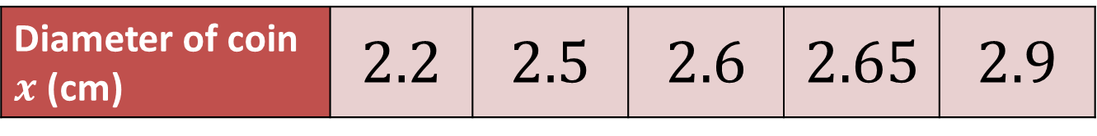
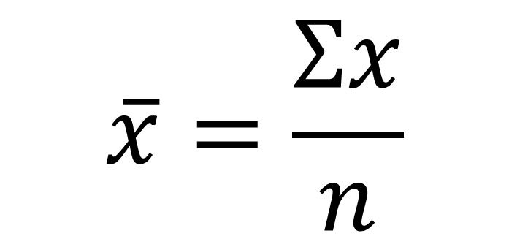
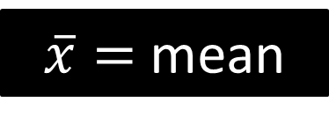

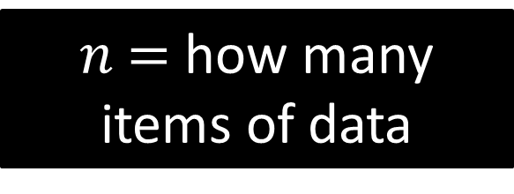
Mean – Raw data
Diameter of coin $x$ (cm) | $$2.2$$ | $$2.5$$ | $$2.6$$ | $$2.65$$ | $$2.9$$
You all know how to find the mean of a list of values.
But lets consider the notation.
$$\overline{x}=\frac{Σx}{n}$$
$\overline{x}=$ mean
$n$ $=$ how many items of data
$Σx$ = the sum of the data

Slide 4
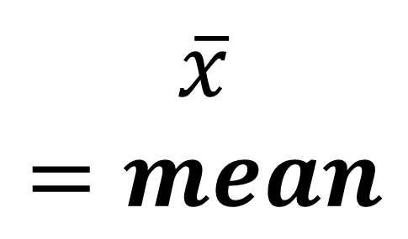
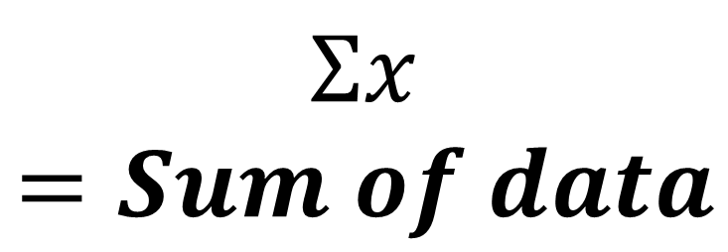
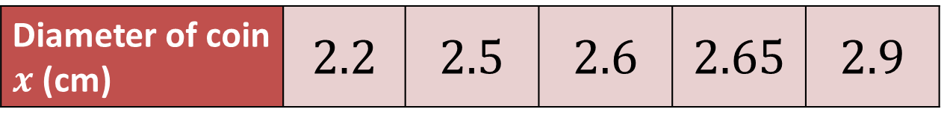
Mean – Raw data (Calculator Use)
Diameter of coin $x$ (cm) | $$2.2$$ | $$2.5$$ | $$2.6$$ | $$2.65$$ | $$2.9$$
$$Σx=Sum of data$$
On a Classwiz:
Menu
Option 6
Option 1
Enter each value
Press AC button
Press OPTN button
Option 2
$$\overline{x}=mean$$

Slide 5

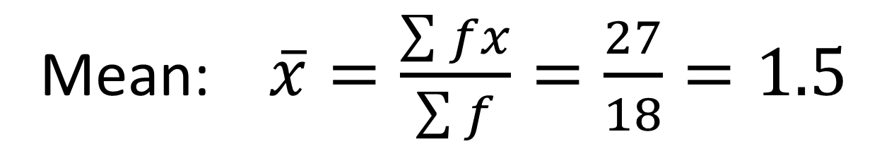
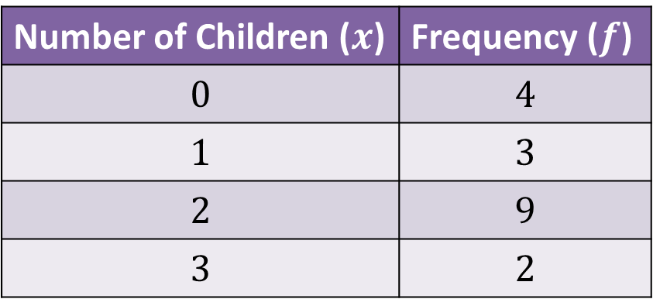
Mean - Frequency Tables
Number of Children ($x$) | Frequency ($f$)
$$0$$ | $$4$$
$$1$$ | $$3$$
$$2$$ | $$9$$
$$3$$ | $$2$$
Calculate the mean number of children in a family.
Mean: $\overline{x}=\frac{\sum{fx}}{\sum{f}}=\frac{27}{18}=1.5$

Slide 6
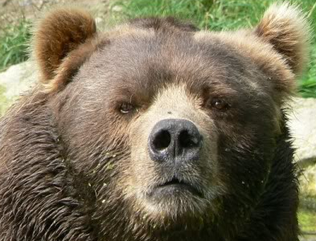
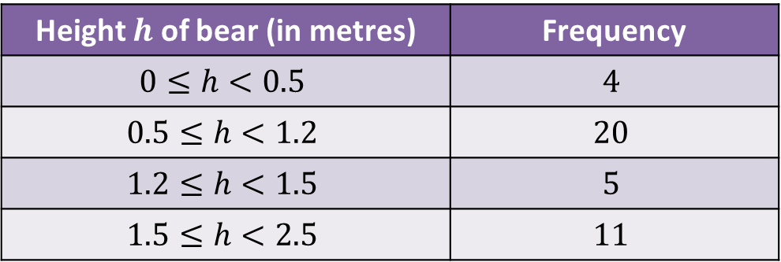
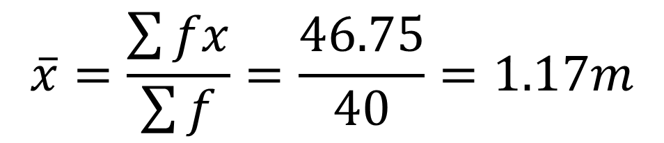
Mean - Grouped Data Tables
Height $h$ of bear (in metres) | Frequency
$$0≤h<0.5$$ | $$4$$
$$0.5≤h<1.2$$ | $$20$$
$$1.2≤h<1.5$$ | $$5$$
$$1.5≤h<2.5$$ | $$11$$
We don’t know the exact values.
What values should you use?
The midpoint of each interval.
Estimate of Mean:
$$\overline{x}=\frac{\sum{fx}}{\sum{f}}=\frac{46.75}{40}=1.17m$$

Slide 7
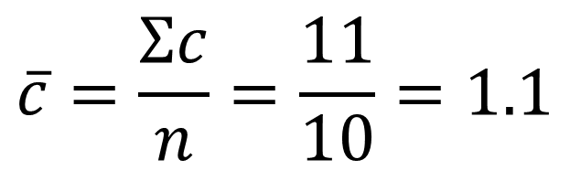
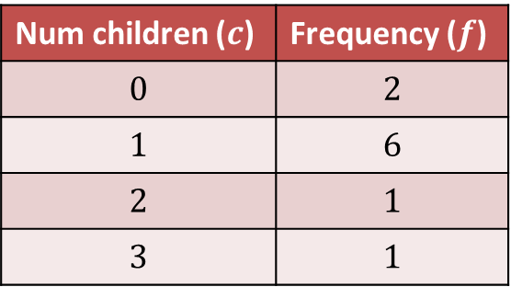
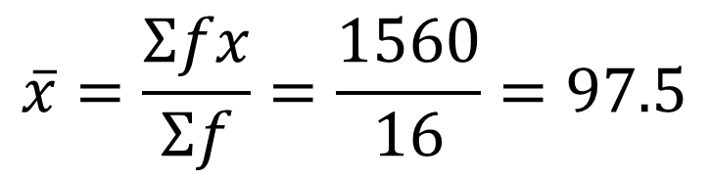
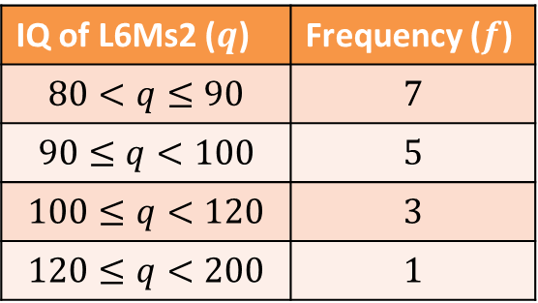
Mean - Tables
Calculate the mean of the following tables:
1
Num children ($c$) | Frequency ($f$)
$$0$$ | $$2$$
$$1$$ | $$6$$
$$2$$ | $$1$$
$$3$$ | $$1$$
2
IQ of L6Ms2 ($q$) | Frequency ($f$)
$$80<q≤90$$ | $$7$$
$$90≤q<100$$ | $$5$$
$$100≤q<120$$ | $$3$$
$$120≤q<200$$ | $$1$$
$$\overline{c}=\frac{Σc}{n}=\frac{11}{10}=1.1$$
$$\overline{x}=\frac{Σfx}{Σf}=\frac{1560}{16}=97.5$$

Slide 8
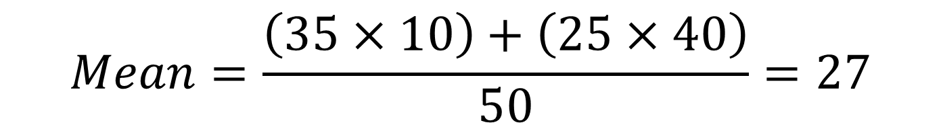
Mean - Combined
Archie the Archer competes in a competition with 50 rounds.
He scored an average of 35 points in the first 10 rounds and
an average of 25 in the remaining rounds.
What was his average score per round?
$$Mean=\frac{\left(35×10\right)+\left(25×40\right)}{50}=27$$

Slide 9
Exercises 2A/2B
Pearson Statistics & Mechanics Year 1/AS
Pages 22-23, 24-25
Complete before the lesson Ex2A Q3-4 & Ex2B Q1-2
In Class:
Green Ex2A Q5-7
Amber Ex2B Q3-4

