Slide 1
Year 1 Pure Mathematics
Differentiation
- First Principles
Chapter 12
(Part 2 of 6)

Slide 2
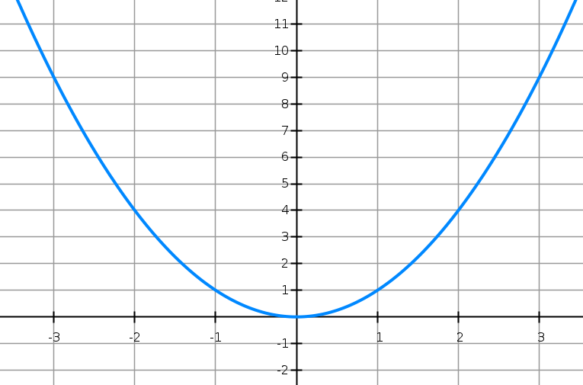


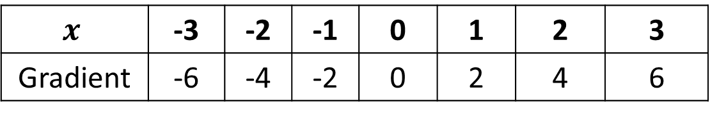







Differentiation by first principles
$$m=6$$
$$m=−6$$
$$y=x^{2}$$
$$m=−4$$
$$m=4$$
$$m=−2$$
$$m=2$$
$$m=0$$
$$x$$ | -3 | -2 | -1 | 0 | 1 | 2 | 3
Gradient | -6 | -4 | -2 | 0 | 2 | 4 | 6
By looking at the relationship between $x$ and the gradient at that point,
can you come up with an expression, in terms of $x$ for calculating the gradient?
$$Gradient Function=2x$$

Slide 3
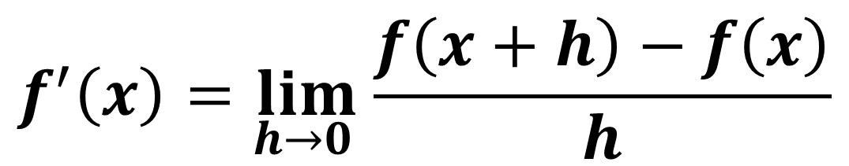
Differentiation by first principles
Is there a method to work out
the gradient function
without having to draw lots of tangents
and hoping that you can spot the rule?
Differentiating by first principles is one way.
$$f^{′}\left(x\right)=\lim_{h→0 }{\frac{f\left(x+h\right)−f\left(x\right)}{h}}$$

Slide 4
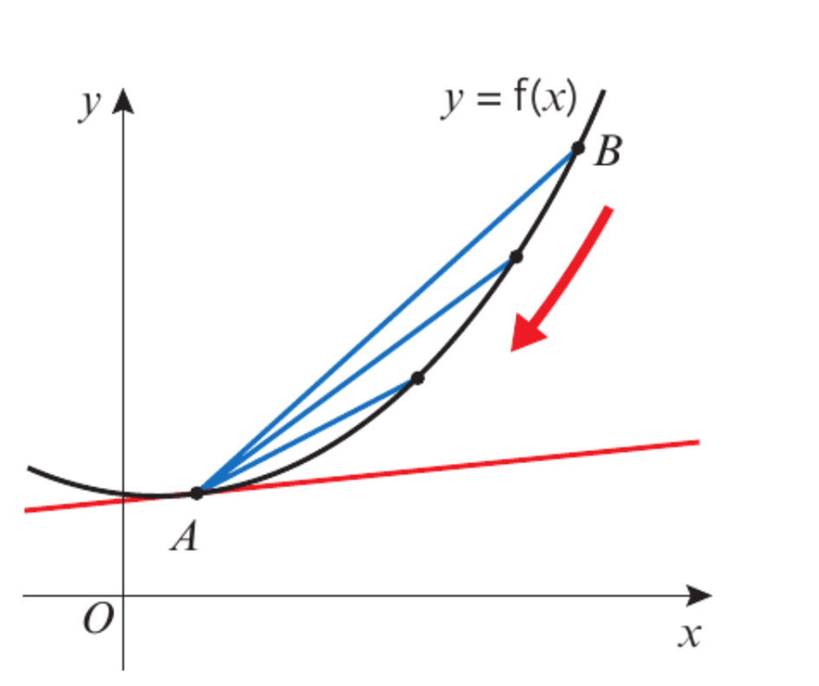
Differentiation by first principles
As B gets closer to A
the gradient of AB
gets closer to the gradient of the tangent.

Slide 5
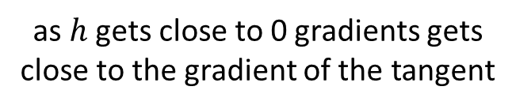
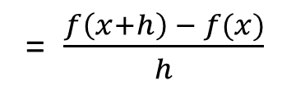
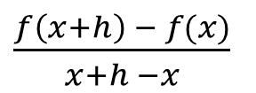
Differentiation by first principles
Gradient of AB =
$\frac{f\left(x+h\right) − f(x)}{x+h −x}$
f(x + h)
= $\frac{f\left(x+h\right) − f(x)}{h}$
f(x)
x
x + h
as $h$ gets close to 0 gradients gets close to the gradient of the tangent
h

Slide 6
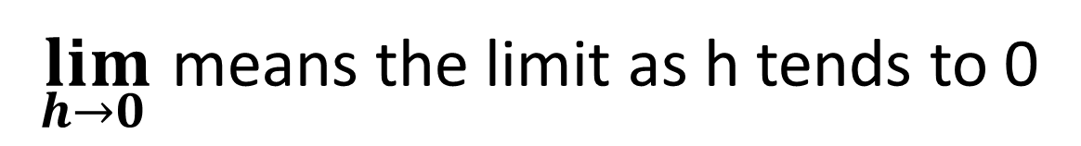
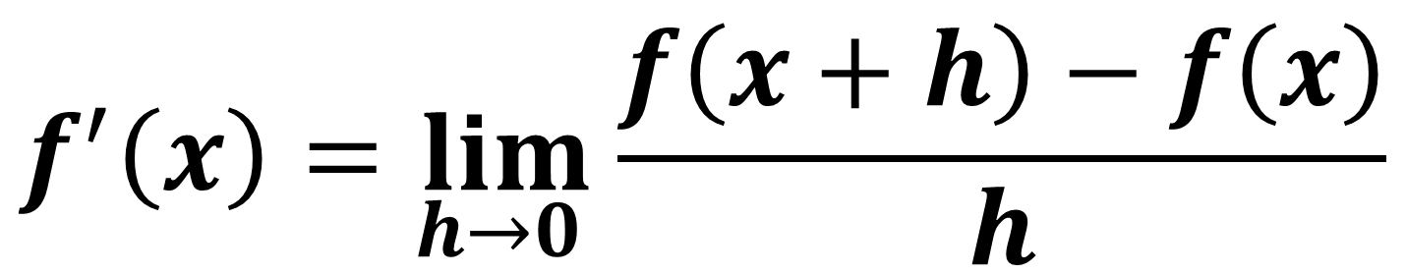
Differentiation by first principles
Differentiation by first principles
$$f^{′}\left(x\right)=\lim_{h→0 }{\frac{f\left(x+h\right)−f\left(x\right)}{h}}$$
$\lim_{h→0 }$ means the limit as h tends to 0

Slide 7
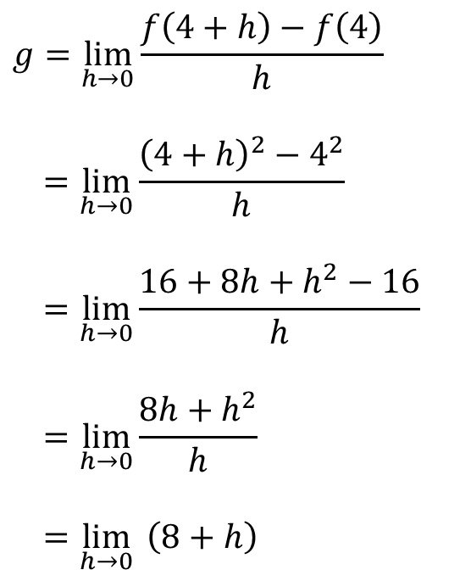
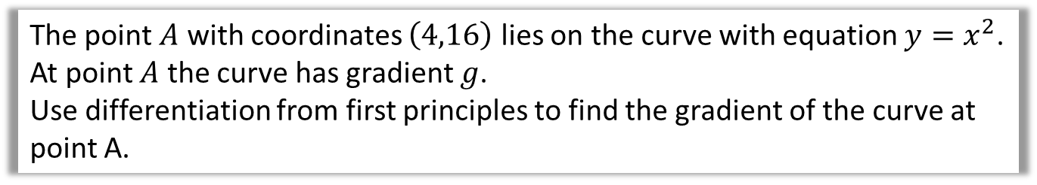


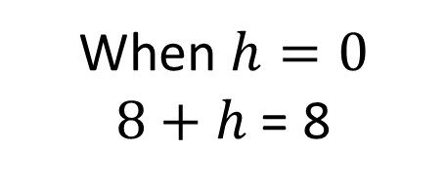
Differentiation by first principles
The point $A$ with coordinates $\left(4,16\right)$ lies on the curve with equation $y=x^{2}$.
At point $A$ the curve has gradient $g$.
Use differentiation from first principles to find the gradient of the curve at point A.
$$g=\lim_{h→0}{\frac{f\left(4+h\right)−f\left(4\right)}{h}}$$
$$=\lim_{h→0}{\frac{{\left(4+h\right)}^{2}−4^{2}}{h}}$$
$$=\lim_{h→0}{\frac{16+8h+h^{2}−16}{h}}$$
$$=\lim_{h→0}{\frac{8h+h^{2}}{h}}$$
$$=\lim_{h→0}{ \left(8+h\right)}$$
Use the “differentiation by first principles” formula.
Function is $f\left(x\right)=x^{2}$
When $h=0$
$8+h$ = 8
$$g=8$$

Slide 8
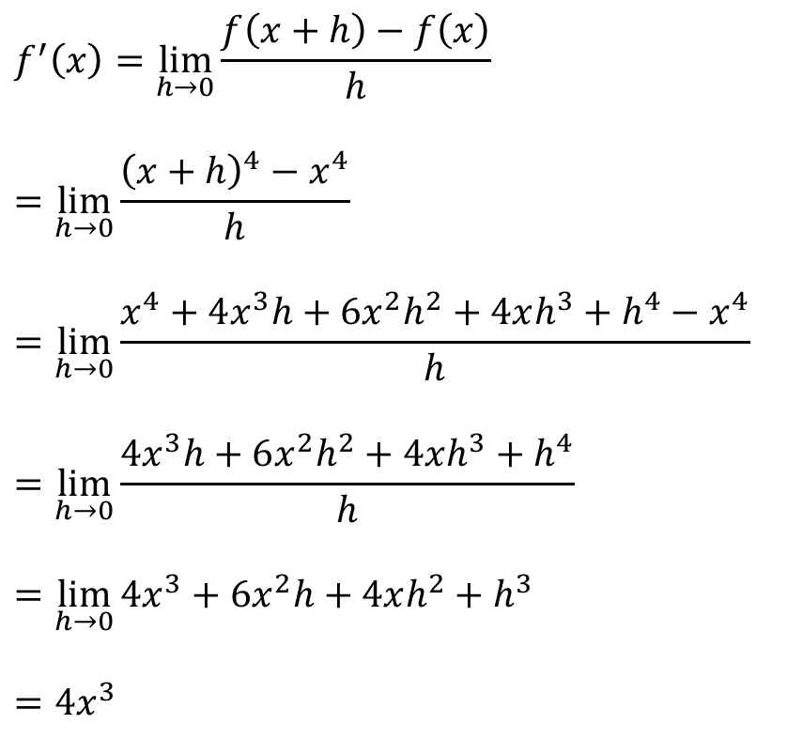
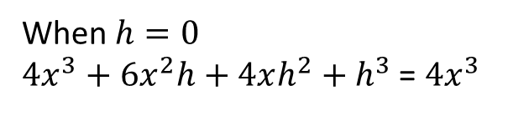
Differentiation by first principles
Prove from first principles that the derivative of $x^{4}$ is $4x^{3}$.
$$f^{′}\left(x\right)=\lim_{h→0}{\frac{f\left(x+h\right)−f\left(x\right)}{h}}$$
$$=\lim_{h→0}{\frac{{\left(x+h\right)}^{4}−x^{4}}{h}}$$
$$=\lim_{h→0}{\frac{x^{4}+4x^{3}h+6x^{2}h^{2}+4xh^{3}+h^{4}−x^{4}}{h}}$$
$$=\lim_{h→0}{\frac{4x^{3}h+6x^{2}h^{2}+4xh^{3}+h^{4}}{h}}$$
$$=\lim_{h→0}{4x^{3}+6x^{2}h+4xh^{2}+h^{3}}$$
$$=4x^{3}$$
When $h=0$
$4x^{3}+6x^{2}h+4xh^{2}+h^{3}$ = $4x^{3}$

Slide 9
Exercise 12B
Pearson Pure Mathematics Year 1/AS
Pages 261-262
(Note that Exercise 12A was skipped in these slides)
Don’t forget the ‘Challenge’ question on Page 262!
Complete before the lesson Q1
Green Q2
Amber Q3
Red

